Slide 1
Overview of Anatomy and Physiology
Anatomy
the study of the structure of body parts and their relationships to one another
Physiology
the study of the function of the body’s structural machinery

Slide 2
Overview of Anatomy and Physiology
Anatomy
Subdivisions:
Gross or macroscopic
regional, surface, and systemic anatomy
Microscopic
cytology and histology
Developmental
Embryology

Slide 3
Levels of Structural Organization
Chemical:
atoms and molecules (Chapter 2)
Cellular:
cells and their organelles (Chapter 3)
Tissue:
groups of similar cells (Chapter 4)
Organ:
contains two or more types of tissues
Organ system:
organs that work closely together
Organismal:
all organ systems

Slide 4
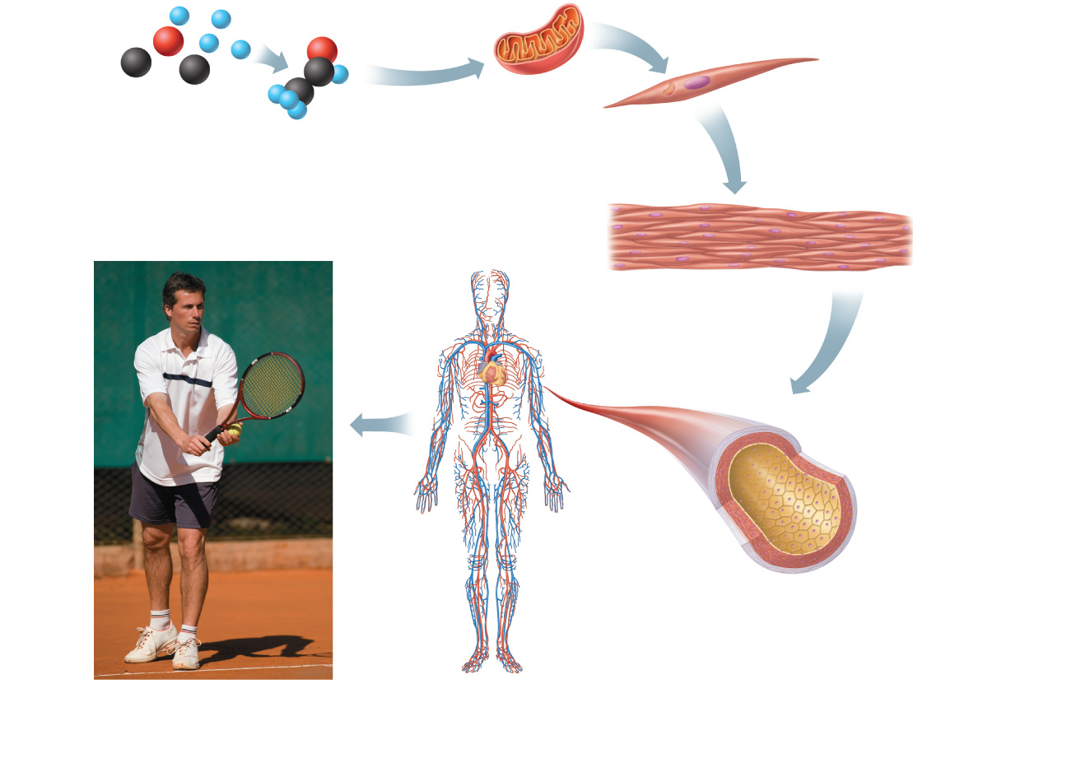
Atoms
Molecule
Organelle
Smooth muscle cell
Cellular level Cells are made up of molecules.
Chemical level Atoms combine to form molecules.
2
1
Smooth muscle tissue
Cardiovascular system
Tissue level Tissues consist of similar types of cells.
3
Heart
Blood vessels
Blood vessel (organ)
Smooth muscle tissue
Connective tissue
Epithelial tissue
Organ level Organs are made up of different types of tissues.
4
Organismal level The human organism is made up of many organ systems.
Organ system level Organ systems consist of different organs that work together closely.
6
5
Figure 1.1, step 6

Slide 5
Necessary Life Functions
Maintaining boundaries between internal and external environments
Plasma membranes
Skin
Movement (contractility)
Of body parts (skeletal muscle)
Of substances (cardiac and smooth muscle)

Slide 6
Necessary Life Functions
Responsiveness: The ability to sense and respond to stimuli
Withdrawal reflex
Control of breathing rate
Digestion
Breakdown of ingested foodstuffs
Absorption of simple molecules into blood

Slide 7
Necessary Life Functions
Metabolism: All chemical reactions that occur in body cells
Catabolism and anabolism
Excretion: The removal of wastes from metabolism and digestion
Urea, carbon dioxide, feces

Slide 8
Necessary Life Functions
Reproduction
Cellular division for growth or repair
Production of offspring
Growth: Increase in size of a body part or of organism

Slide 9
Survival Needs
Nutrients
Chemicals for energy and cell building
Carbohydrates, fats, proteins, minerals, vitamins
Oxygen
Essential for energy release (ATP production)

Slide 10
Survival Needs
Water
Most abundant chemical in the body
Site of chemical reactions
Normal body temperature
Affects rate of chemical reactions
Appropriate atmospheric pressure
For adequate breathing and gas exchange in the lungs

Slide 11
Homeostasis
Maintenance of a relatively stable internal environment despite continuous outside changes
A dynamic state of equilibrium

Slide 12
Components of a Control Mechanism
Receptor (sensor)
Monitors the environment
Responds to stimuli (changes in controlled variables)
Control center
Determines the set point at which the variable is maintained
Receives input from receptor
Determines appropriate response

Slide 13
Components of a Control Mechanism
Effector
Receives output from control center
Provides the means to respond
Response acts to reduce or enhance the stimulus (feedback)

Slide 14
Negative Feedback
The response reduces or shuts off the original stimulus
Examples:
Regulation of body temperature
a nervous mechanism
Regulation of blood volume by ADH
an endocrine mechanism

Slide 15
Positive Feedback
The response enhances or exaggerates the original stimulus
May exhibit a cascade or amplifying effect
Usually controls infrequent events e.g.:
Enhancement of labor contractions by oxytocin (Chapter 28)
Platelet plug formation and blood clotting

Slide 16
Homeostatic Imbalance
Disturbance of homeostasis
Increases risk of disease
Contributes to changes associated with aging
May allow destructive positive feedback mechanisms to take over (e.g., heart failure)

