Slide 1
Tuesday, Sept 8th
Fill out the Opscan with your name and ID

Slide 2
Question One
Which organelle is associated with the endoplasmic reticulum and responsible for creating proteins?
A. Lysosomes
B. Nucleoli
C. Ribosomes
D. Peroxisome
E. Centriole

Slide 3
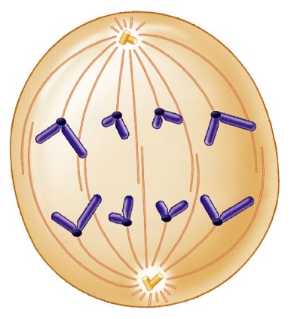
Question Two
Which stage of Mitosis is illustrated here?
A. Prophase
B. Interphase
C. Cytokinesis
D. Anaphase
E. Metaphase

Slide 4
Question Three
Which of the following is TRUE with regards to translation?
A. Translation takes place in the nucleoli
B. Translation takes place in the nucleus
C. Translation uses DNA
D. Translation uses mRNA and tRNA to create proteins

Slide 5
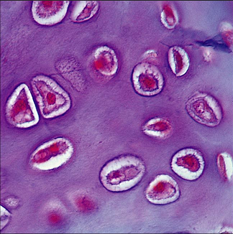
Question Four
This is an image of hyaline cartilage. In addition to the ground substance, you can see the _______ which contain __________
A. Desmosomes, lacunae
B. Lacunae, chondrocytes
C. Osteoblasts, calcium
D. Matrix, fibrocartilage
E. Lamellae, fibroblasts

Slide 6
Make sure your name and ID are on you paper
Please pass your papers to the end of the row and then forward.

