Slide 1
Chapter 5 The Integumentary System
Exam Two Material Covers Chapter 5, 6, & 7

Slide 2
Skin (Integument)
Consists of three major regions
outermost _
middle region
Hypodermis (superficial fascia)

Slide 3
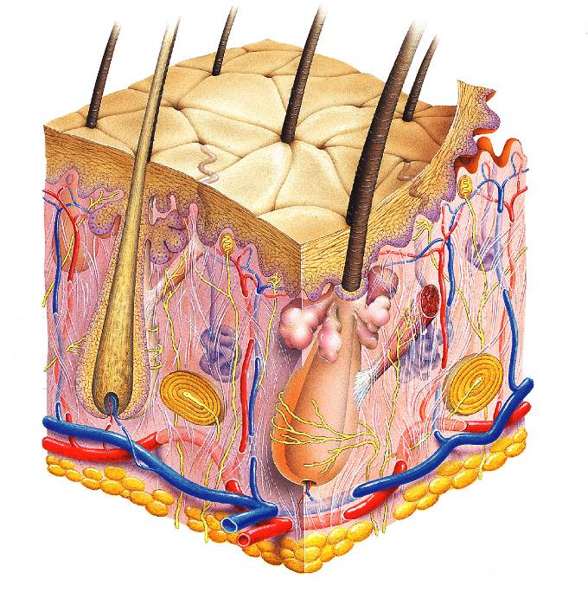
Hair shaft
Pore
Dermal papillae
(papillary layer
of dermis)
Epidermis
Meissner's corpuscle
Free nerve ending
Reticular layer of dermis
Sebaceous (oil) gland
Dermis
Arrector pili muscle
Sensory nerve fiber
Eccrine sweat gland
Pacinian corpuscle
Hypodermis
(superficial
fascia)
Artery
Vein
Hair root
Adipose tissue
Hair follicle
Eccrine sweat
gland
Hair follicle receptor
(root hair plexus)

Slide 4
Epidermis
Composed of keratinized _
consisting of ________________ distinct cell types
produce the _________________________________ protein keratin
Melanocytes
produce the ______________________________________ melanin
Merkel cells
function as _____________________________________________ in association with sensory nerve endings
Langerhans’ cells
epidermal _________________________________________ that help activate the immune system
And four or five layers

Slide 5
Layers of the Epidermis: Stratum Basale (Basal Layer)
firmly attached to the dermis
single row of the _
Cells undergo _
stratum germinativum

Slide 6
Layers of the Epidermis: Stratum Spinosum (Prickly Layer)
Cells contain a weblike system of __________________________________ attached to desmosomes
Melanin _______________________ and Langerhans’ cells are abundant in this layer

Slide 7
Layers of the Epidermis: Stratum Granulosum (Granular Layer)
three to five cell layers

Slide 8
Layers of the Epidermis: Stratum Lucidum (Clear Layer)
superficial to the stratum granulosum
Consists of a few rows of flat, dead keratinocytes
Present only in _

Slide 9
Layers of the Epidermis: Stratum Corneum (Horny Layer)
____________________________________ of keratinized cells
Accounts for three quarters of the epidermal thickness
Functions include:
Protection from _
Rendering the body relatively ______________________________________ to biological, chemical, and physical assaults

Slide 10
Dermis
Second major skin region containing _
Cell types include
White blood cells
Composed of two layers
papillary and reticular

Slide 11
Layers of the Dermis: Papillary Layer
__________________________ layer
Areolar connective tissue
with _
Its superior surface contains _
Dermal papillae contain
capillary loops

Slide 12
Layers of the Dermis: Reticular Layer
Reticular layer
Accounts for approximately 80% of the thickness of the skin
Collagen fibers add _
Elastin fibers provide _

Slide 13
Hypodermis
Subcutaneous layer ________________ to the skin
Composed of _____________________________ connective tissue

Slide 14
Skin Color
Three pigments contribute to skin color
yellow to reddish-brown to black pigment, responsible for dark skin colors
yellow to orange pigment
most obvious in the _
reddish pigment responsible for the pinkish hue of the skin

Slide 15
Sweat Glands
Different types prevent overheating of the body; secrete cerumen and milk
________________________________ sweat glands
found in _
________________________________ sweat glands
found in _
Ceruminous glands
modified apocrine glands in ________________________ that secrete _
Mammary glands
specialized sweat glands that _

Slide 16
Sebaceous Glands
Simple _________________________________ found all over the body
_____________________________ when stimulated by hormones
Secrete an _

Slide 17
Hair
Filamentous strands of dead keratinized cells produced by hair follicles
Contains _
tougher and more durable than soft keratin of the skin
Made up of
Pigmented by melanocytes at the base of the hair

Slide 18
Hair Function and Distribution
Functions of hair include:
Helping to _
_____________________________________ to presence of insects on the skin
_______________________________________ against physical trauma, heat loss, and sunlight

Slide 19
Hair Function and Distribution
Hair is distributed over the entire skin surface except:
Portions of the _

Slide 20
Hair Follicle
Root sheath extending from _
Deep end is expanded forming a hair bulb
A knot of sensory nerve endings (____________________________) wraps around each hair bulb
Bending a hair stimulates these endings, hence our hairs act as _

Slide 21
Types of Hair
pale, ___________________________________ found in children and the adult female
Terminal
_______________________________________ of eyebrows, scalp, axillary, and pubic regions

Slide 22
Hair Thinning and Baldness
Alopecia
hair thinning in both sexes
Alopecia areata:
May be _
True, or frank, baldness
Genetically determined and sex-influenced condition
caused by follicular response to DHT

Slide 23
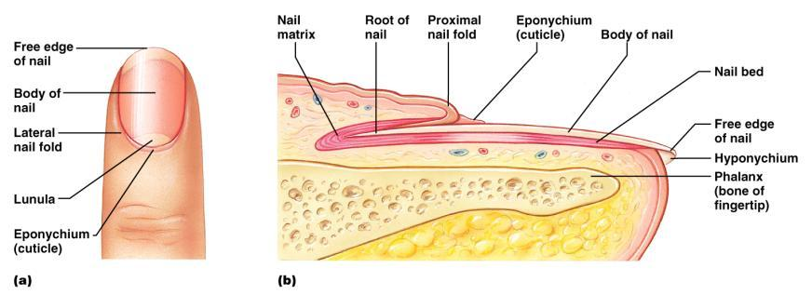
Structure of a Nail
Scalelike ________________________________ on the distal, dorsal surface of fingers and toes

Slide 24
Functions of the Integumentary System
chemical, physical, and mechanical barrier
Body _______________________________ is accomplished by:
_______________________________________ of dermal vessels
Increasing sweat gland secretions to cool the body
Cutaneous sensation
exoreceptors sense touch and pain

Slide 25
Functions of the Integumentary System
Metabolic functions
synthesis of ____________________________ in dermal blood vessels
skin blood vessels store up to 5% of the body’s blood volume
Excretion
limited amounts of ___________________________________ are eliminated from the body in sweat

Slide 26
Skin Cancer
Most skin tumors are _____________________ and do not metastasize
A crucial risk factor for non-melanoma skin cancers is the _
Newly developed skin lotions can fix damaged DNA

Slide 27
Skin Cancer
The three major types of skin cancer are:
Basal cell carcinoma
Squamous cell carcinoma
Melanoma

Slide 28
Basal Cell Carcinoma
________________________________ skin cancer
___________________________________ cells proliferate and invade the dermis and hypodermis
Slow growing
do not often metastasize
Can be cured by _________________________ in 99% of the cases

Slide 29
Squamous Cell Carcinoma
Arises from keratinocytes of _
Arise most often on _
Grows rapidly
metastasizes _
Prognosis is good if treated by radiation therapy or removed surgically

Slide 30
Melanoma
Cancer of ______________________________ is the most dangerous type of skin cancer
Resistant to _

Slide 31
Melanoma
Melanomas have the following characteristics (ABCD rule)
A:
the two sides of the pigmented area do not match
B:
irregular
exhibits indentations
C:
black, brown, tan, and sometimes red or blue
D:
larger than 6 mm (size of a pencil eraser)

Slide 32
Melanoma
Treated by _______________________________ accompanied by immunotherapy
Chance of survival is poor if the lesion is _

Slide 33
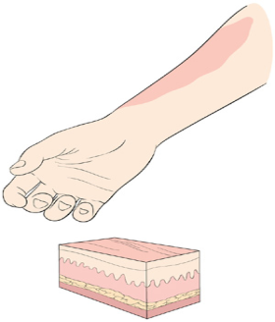
Burns
First-degree
Symptoms
localized _

Slide 34
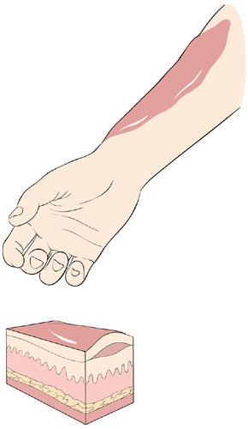
Burns
Second-degree
Symptoms mimic first degree burns
______________________ also appear

Slide 35
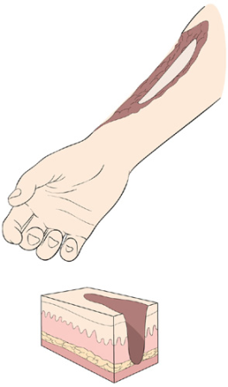
Burns
Third-degree
________________________ of the skin is damaged
Burned area appears gray-white, cherry red, or black
there is no _
nerve endings _

Slide 36
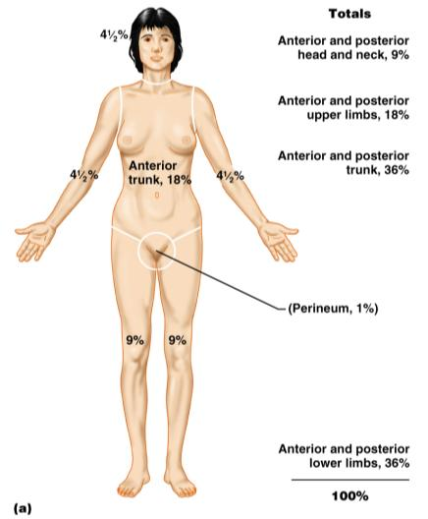
Rule of Nines
Burns considered critical if:
Over 25% of the body has second-degree burns
Over 10% of the body has third-degree burns
There are third-degree burns on face, hands, or feet

Slide 37
Classification of Bones
bones of the skull, vertebral column, and rib cage
bones of the upper and lower limbs, shoulder, and hip

Slide 38
Classification of Bones: By Shape
longer than they are wide

Slide 39
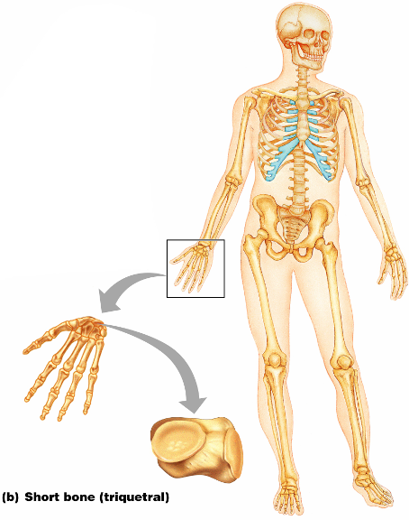
Classification of Bones: By Shape
Cube-shaped bones of the _
Bones that form within tendons _
Figure 6.2b

Slide 40
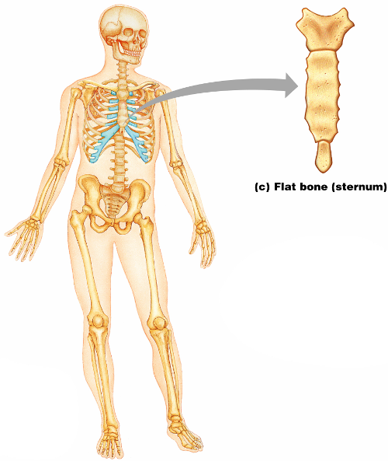
Classification of Bones: By Shape
thin, flattened, and a bit curved
most
Figure 6.2c

Slide 41
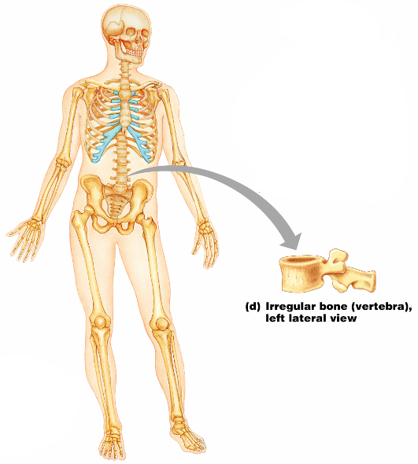
Classification of Bones: By Shape
bones with complicated shapes
Figure 6.2d

Slide 42
Function of Bones
form the framework that supports the body and cradles soft organs
provide a protective case for the brain, spinal cord, and vital organs
provide levers for muscles

Slide 43
Function of Bones
reservoir for minerals, especially calcium and phosphorus
hematopoiesis occurs within the marrow cavities of bones

Slide 44
Bone Markings
Bulges, depressions, and holes that serve as:
Joint surfaces
Conduits for blood vessels and nerves

Slide 45
Bone Markings: Projections – Sites of Muscle and Ligament Attachment
rounded projection
narrow, prominent ridge of bone
large, blunt, irregular surface
narrow ridge of bone
small rounded projection
raised area above a condyle
sharp, slender projection
any bony prominence

Slide 46
Bone Markings: Projections – Projections That Help to Form Joints
bony expansion carried on a narrow neck
smooth, nearly flat articular surface
rounded articular projection
arm-like bar of bone

Slide 47
Bone Markings: Depressions and Openings
canal-like passageway
cavity within a bone
shallow, basin-like depression
furrow
narrow, slit-like opening
round or oval opening through a bone

Slide 48
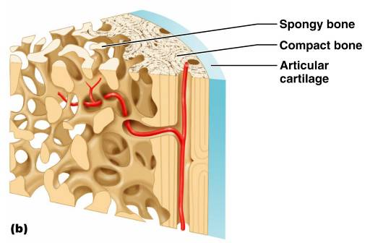
Bone Textures
Compact bone
Spongy bone
honeycomb of trabeculae _

Slide 49
Structure of Long Bone
Long bones consist of a _
Diaphysis
Tubular shaft
Composed of _
surrounds the medullary cavity
Yellow bone marrow in the medullary cavity

Slide 50
Structure of Long Bone
Epiphyses
________________________________ of long bones
Exterior is compact bone, and the _
Joint surface is covered with articular (hyaline) cartilage
Epiphyseal line separates the diaphysis from the epiphyses

Slide 51
Bone Membranes
______________________________ – double-layered protective membrane
Richly supplied with nerve fibers, blood, and lymphatic vessels, which enter the bone via _
Secured to underlying bone by _

Slide 52
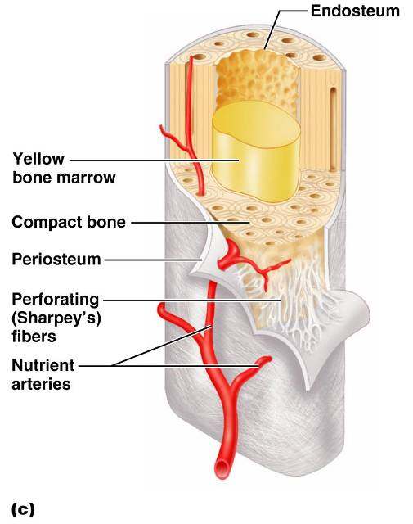
Bone Membranes
delicate membrane covering internal surfaces of bone

Slide 53
Structure of Short, Irregular, and Flat Bones
Thin plates of periosteum-covered compact bone on the outside with endosteum-covered spongy bone on the inside
Have _
Contain bone marrow between the trabeculae

Slide 54
Location of Hematopoietic Tissue (Red Marrow)
In infants
Found in the _
all areas of spongy bone
In adults
Found in the _
the head of the femur
the head of the _

Slide 55
Microscopic Structure of Bone: Compact Bone
_________________________, or osteon – the structural unit of compact bone
weight-bearing, column-like matrix tubes composed mainly of collagen
Haversian, or _
containing blood vessels and nerves
channels lying at right angles to the central canal, connecting blood and nerve supply of the periosteum to that of the Haversian canal

Slide 56
Microscopic Structure of Bone: Compact Bone
Osteocytes
Lacunae
______________________________ in bone that _
Canaliculi
___________________________________ that connect lacunae to each other and the central canal

Slide 57
Chemical Composition of Bone: Organic
Osteoblasts
Osteocytes
mature bone cells
Osteoclasts
large cells that resorb or _

Slide 58
Bone Development
Osteogenesis and ossification – the _________________________________, which leads to:
The formation of the bony skeleton in embryos
Bone growth until early adulthood
Bone thickness, _

Slide 59
Formation of the Bony Skeleton
Begins at ______________________ of embryo development
Intramembranous ossification
bone develops from a _
Endochondral ossification
bone forms by _

Slide 60
Intramembranous Ossification
Formation of most of the _

Slide 61
Stages of Intramembranous Ossification
An _____________________________ appears in the fibrous connective tissue membrane
Bone matrix is secreted within the fibrous membrane
Woven bone and periosteum form
Bone collar of _

Slide 62
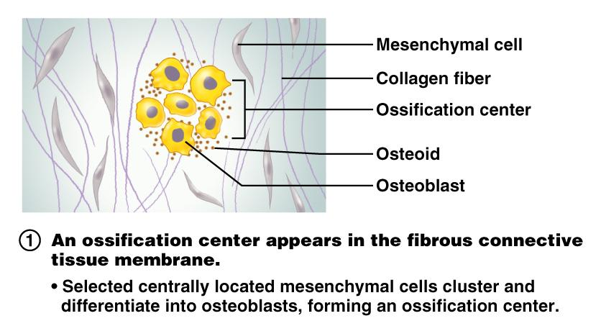
Stages of Intramembranous Ossification
Figure 6.7.1

Slide 63
Stages of Intramembranous Ossification
Figure 6.7.2

Slide 64
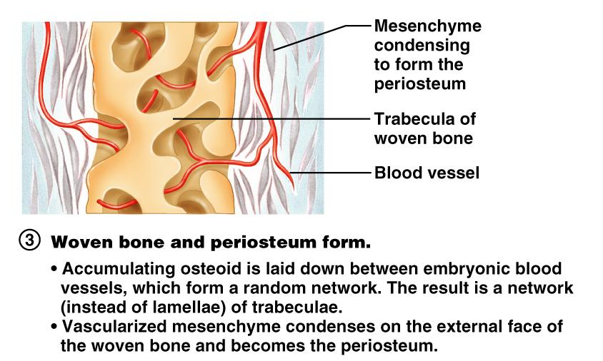
Stages of Intramembranous Ossification
Figure 6.7.3

Slide 65
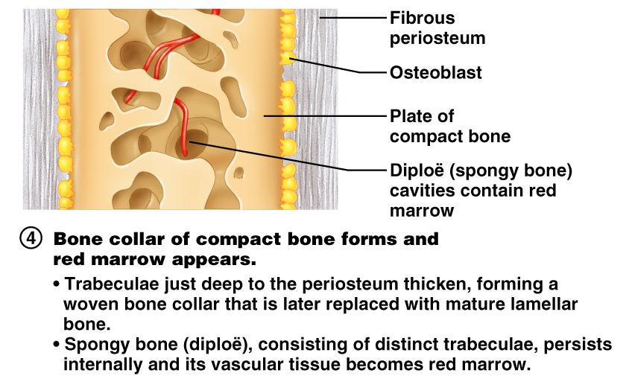
Stages of Intramembranous Ossification
Figure 6.7.4

Slide 66
Endochondral Ossification
Begins in the _
Uses ____________________________” as models for bone construction
Requires breakdown of hyaline cartilage prior to ossification

Slide 67
Stages of Endochondral Ossification
Formation of bone collar
Cavitation of the hyaline cartilage
spongy bone formation
Formation of the medullary cavity; appearance of _
Ossification of the epiphyses, with hyaline cartilage remaining only in the epiphyseal plates

Slide 68
Postnatal Bone Growth
Growth in length of long bones
Cells of the epiphyseal plate proximal to the resting cartilage form three functionally different zones:

Slide 69
Functional Zones in Long Bone Growth
Growth zone
____________________________________, pushing the epiphysis away from the diaphysis
Transformation zone
older cells enlarge, the matrix becomes calcified, cartilage cells die, and the _
Osteogenic zone
new _

Slide 70
Hormonal Regulation of Bone Growth During Youth
During infancy and childhood, epiphyseal plate activity is stimulated by _
During puberty, _
Initially promote adolescent growth spurts
Later induce epiphyseal ___________________________, ending longitudinal bone growth

Slide 71
Response to Mechanical Stress
Wolff’s law
a bone grows or remodels _
Observations supporting Wolff’s law include
Long bones are thickest midway along the shaft (where bending stress is greatest)
Curved bones are thickest where they are most likely to buckle

Slide 72
Bone Fractures (Breaks)
Bone fractures are classified by:
The _____________________________ of the bone ends after fracture
The _______________________________ of the break
The ______________________________ of the bone to the long axis
Whether or not the bones ends penetrate the skin

Slide 73
Types of Bone Fractures
bone ends retain their normal position
bone ends are out of normal alignment

Slide 74
Types of Bone Fractures
bone is broken all the way through
bone is not broken all the way through
the fracture is ___________________________________ of the bone

Slide 75
Types of Bone Fractures
the fracture is __________________________________to the long axis of the bone
Compound (open)
bone ends do not penetrate the skin

Slide 76
Common Types of Fractures
Comminuted
bone fragments into __________________________ common in the elderly
ragged break when bone is _____________________________________ common sports injury
broken bone portion pressed inward; typical skull fracture

Slide 77
Common Types of Fractures
Compression
___________________________________; common in porous bones
epiphysis separates from diaphysis along epiphyseal line; occurs where cartilage cells are dying
incomplete fracture where one side of the bone breaks and the other side bends; _

Slide 78
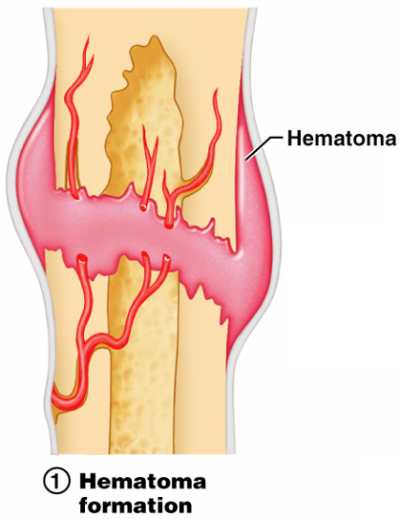
Stages in the Healing of a Bone Fracture
Torn blood vessels hemorrhage
A mass of clotted blood (_______________) forms at the fracture site
Site becomes swollen, painful, and inflamed
Figure 6.13.1

Slide 79
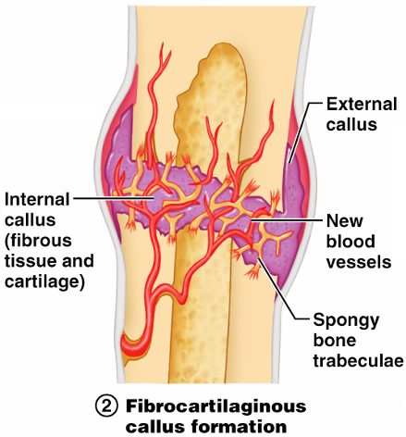
Stages in the Healing of a Bone Fracture
Fibrocartilaginous _
Granulation tissue (soft callus) forms a few days after the fracture
__________________________________ and phagocytic cells begin cleaning debris
Figure 6.13.2

Slide 80
Stages in the Healing of a Bone Fracture
The fibrocartilaginous callus forms when:
___________________________________ migrate to the fracture and begin reconstructing the bone
Fibroblasts secrete __________________________________ that connect broken bone ends
Osteoblasts begin forming spongy bone

Slide 81
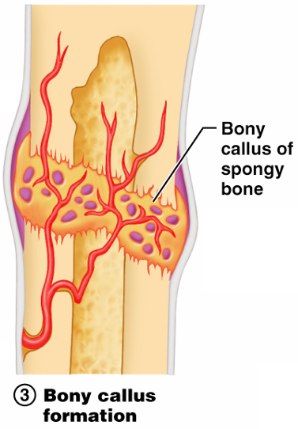
Stages in the Healing of a Bone Fracture
Bony callus formation
New bone trabeculae appear in the fibrocartilaginous callus
Fibrocartilaginous callus _
Bone callus _____________________________________, and continues until firm union is formed 2-3 months later
Figure 6.13.3

Slide 82
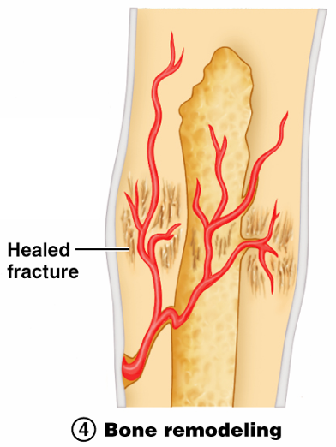
Stages in the Healing of a Bone Fracture
Bone remodeling
Excess material on the bone shaft exterior and in the medullary canal is removed
________________ is laid down to reconstruct shaft walls
Figure 6.13.4

Slide 83
Homeostatic Imbalances
Bones are inadequately mineralized causing softened, weakened bones
Main symptom is pain when weight is put on the affected bone
Caused by insufficient _

Slide 84
Homeostatic Imbalances
Rickets
Bones of children are inadequately mineralized causing softened, weakened bones
________________________________ and deformities of the pelvis, skull, and rib cage are common
Caused by insufficient _

Slide 85
Isolated Cases of Rickets
Rickets has been _
Only isolated cases appear
Example: Infants of breastfeeding mothers deficient in Vitamin D will also be Vitamin D deficient and develop rickets

Slide 86
Homeostatic Imbalances
Osteoporosis
Group of diseases in which _
Occurs most often in postmenopausal women
Bones become so fragile that sneezing or stepping off a curb _

Slide 87
Osteoporosis: Treatment
Increased _
Hormone (estrogen) replacement therapy (HRT) slows bone loss
Natural progesterone cream prompts new bone growth
Statins increase bone mineral density

Slide 88
Chapter Seven

Slide 89
The Axial Skeleton
Eighty bones segregated into three regions

Slide 90
The Skull
______________________________ bony structure
formed by the _
Cranium
protects the brain and is the site of attachment for head and neck muscles
Facial bones
Supply the framework of the _
Provide openings for the passage of air and food
Anchor the facial muscles of expression

Slide 91
Anatomy of the Cranium
The eight cranial bones thin and remarkably strong for their weight
two _
two _
Sphenoid
ethmoid

Slide 92
Wormian Bones
_________________________________ that appear within sutures

Slide 93
Facial Bones
__________________________ of which only the mandible and vomer are unpaired
The paired bones are
Zygomatics
Palatines
inferior conchae

Slide 94
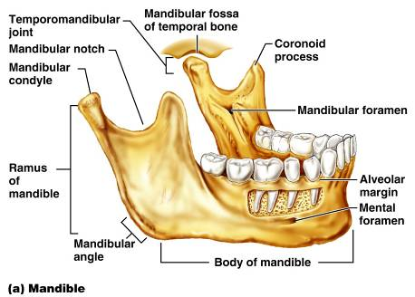
Mandible and Its Markings
The mandible is the _____________________ bone of the face
Its major markings include the
mandibular condyle,
alveolar margin, and
mental foramina

Slide 95
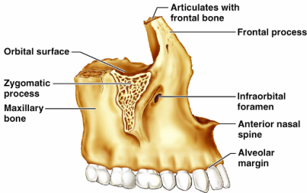
Maxillary Bones
upper jaw and the central portion of the facial skeleton
Their major markings include
palatine,
frontal,
zygomatic processes
the alveolar margins
inferior orbital fissure
the maxillary sinuses

Slide 96
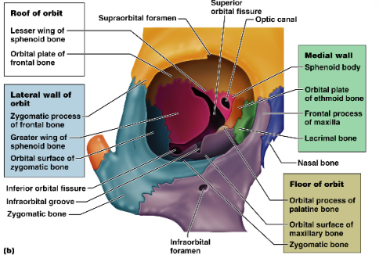
Orbits
Bony cavities in which the eyes are firmly encased and _
Formed by parts of seven bones
Zygomatic
Palatine
Lacrimal
ethmoid

Slide 97
Hyoid Bone
lies just inferior to the mandible in the anterior neck
Only bone of the body that __________________________________ directly with another bone
Attachment point for neck muscles that raise and lower the larynx during swallowing and speech

Slide 98
Vertebral Column
Formed from 26 irregular bones (vertebrae) connected in such a way that a flexible curved structure results
Cervical vertebrae
_____bones of the neck
Thoracic vertebrae
_____ bones of the torso
Lumbar vertebrae
_____ bones of the lower back
Sacrum
bone inferior to the lumbar vertebrae that articulates with the hip bones

Slide 99
Vertebral Column: Curvatures
cervical and lumbar
Secondary curvatures
cervical and lumbar – are convex anteriorly and are _
thoracic and sacral
present at birth
convex posteriorly
causing the infant spine to arch like a four-legged animal

Slide 100
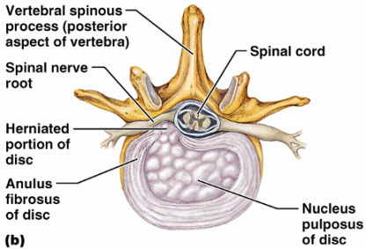
Vertebral Column: Intervertebral Discs
Cushion-like pad composed of two parts
inner gelatinous nucleus that gives the disc its elasticity and compressibility
surrounds the nucleus pulposus with a collar composed of collagen and fibrocartilage

Slide 101
General Structure of Vertebrae
disc-shaped, weight-bearing region
composed of pedicles and laminae that, along with the centrum, enclose the vertebral foramen
make up the vertebral canal through which the spinal cord passes

Slide 102
General Structure of Vertebrae
project posteriorly,
project laterally
Superior and inferior _
protrude superiorly and inferiorly from the pedicle-lamina junctions
Intervertebral foramina
________________________________ formed from notched areas on the _

Slide 103
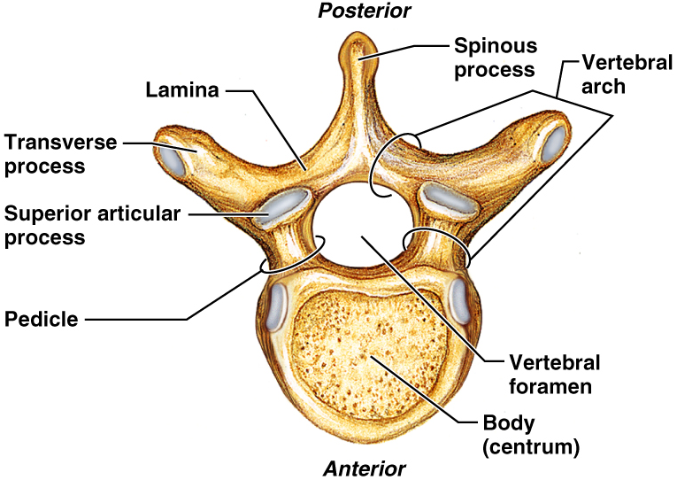
General Structure of Vertebrae

Slide 104
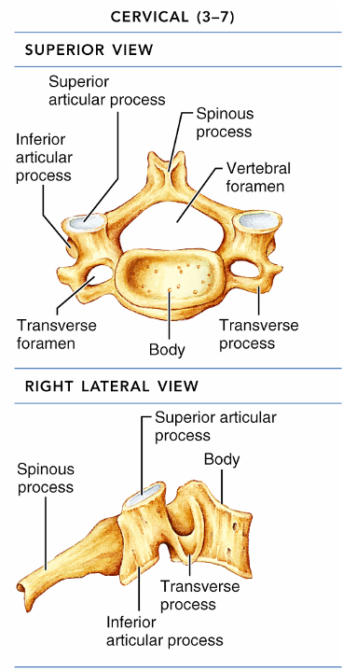
Cervical Vertebrae
Seven vertebrae (C₁-C₇) are the _
C₃-C₇
oval body
short spinous processes,
large, triangular vertebral foramina
Each transverse process contains a _

Slide 105
Cervical Vertebrae: The Atlas (C₁)
The atlas has ___________________ and ______________________
It consists of anterior and posterior arches, and _
The superior surfaces of lateral masses articulate with the _

Slide 106
Cervical Vertebrae: The Axis (C₂)
The axis has a body, spine, and vertebral arches as do other cervical vertebrae
Also has the _______________________
projects superiorly from the body and is cradled in the anterior arch of the atlas
The dens is a ______________ for the rotation of the atlas

Slide 107
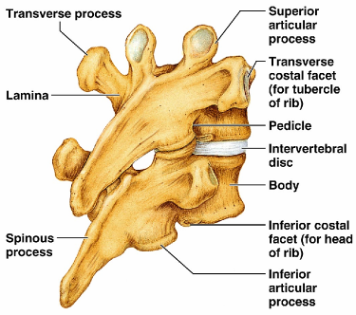
Thoracic Vertebrae
12 Thoracic vertebrae
Major markings include
two _
two demifacets on the heart-shaped body,
_______________ vertebral foramen
transverse processes,
facets prevents flexion and extension
____________________________ of this area of the spine

Slide 108
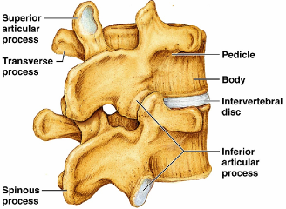
Lumbar Vertebrae
five lumbar vertebrae
have an enhanced _
They have
__________________________ pedicles and laminae
_______________________ hatchet-shaped spinous processes,
triangular-shaped vertebral foramen
Orientation of articular facets locks the lumbar vertebrae together to _

Slide 109
Sacrum
Sacrum
five fused vertebrae (S₁-S₅
shape the _
It articulates with L₅ superiorly, and with the auricular surfaces of the hip bones
Major markings include
transverse lines
dorsal sacral foramina

Slide 110
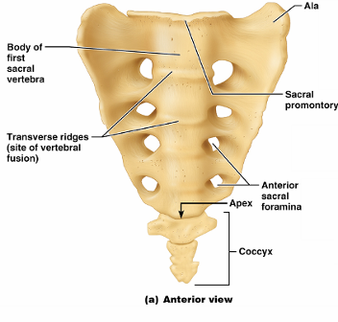
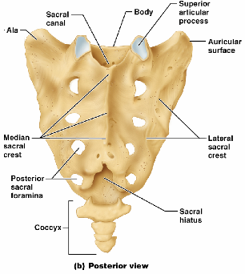
Coccyx
Coccyx (Tailbone)
The coccyx is made up of _____________________ that articulate superiorly with the sacrum

Slide 111
Bony Thorax (Thoracic Cage)
The thoracic cage is composed of
the _
____________________________ laterally
____________________________________ anteriorly

Slide 112
Bony Thorax (Thoracic Cage)
Functions
Forms a ____________________________ around the heart, lungs, and great blood vessels
Supports the _________________________ and upper limbs
Provides attachment for many neck, back, chest, and shoulder muscles
Uses _______________________________ to lift and depress the thorax during breathing

Slide 113
Sternum (Breastbone)
A dagger-shaped, _
lies in the anterior midline of the thorax
Results from the fusion of three bones –
Superior: _
the _
Inferior: _
Anatomical landmarks include the jugular (suprasternal) notch, the sternal angle, and the xiphisternal joint

Slide 114
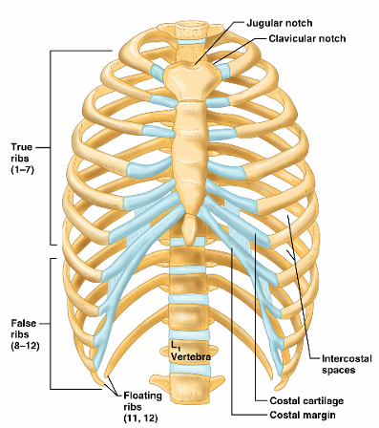
Ribs
There are twelve pair of ribs
All ribs attach _
The superior 7 pair
attach directly to the sternum via costal cartilages
Ribs 8-10 (
attach indirectly to the sternum via costal cartilage
Ribs 11-12
have no anterior attachment

Slide 115
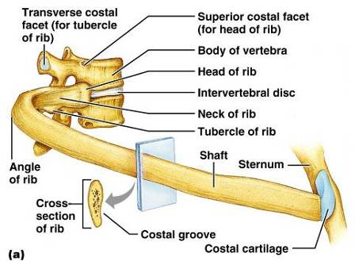
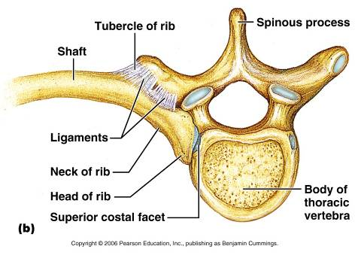
Structure of a Typical True Rib
Bowed, flat bone consisting of a _

Slide 116
Appendicular Skeleton
The _____________________________ skeleton is made up of
the bones of the _
and their _
attach the upper limbs to the body trunk
secures the lower limbs

Slide 117
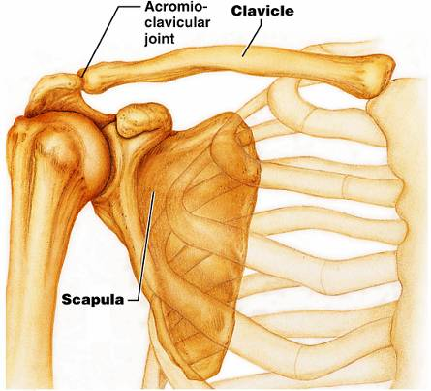
Pectoral Girdles (Shoulder Girdles)
The pectoral girdles consist of the ____________________ and the _
They provide attachment points for muscles that move the upper limbs
Arrangement allows _

Slide 118
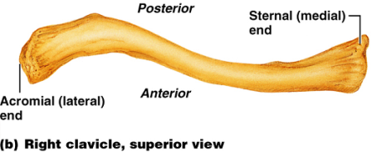
Clavicles (Collarbones)
Slender, doubly curved long bones lying across the _
The ______________________________ end articulates with the scapula
The sternal (medial) end articulates _

Slide 119
Scapulae (Shoulder Blades)
Triangular, flat bones lying on the _
between the _
Scapulae have three borders and three angles

Slide 120
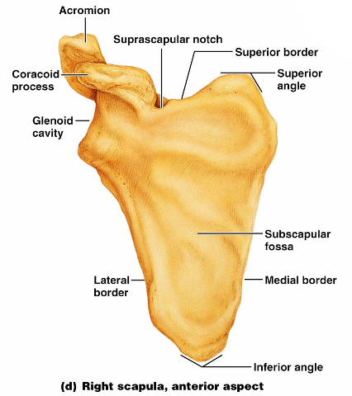
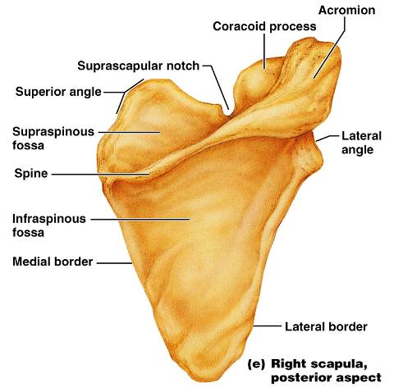
Major markings include the suprascapular notch, the supraspinous and infraspinous fossae, the spine, the acromion, and the coracoid process
Figure 7.22d

Slide 121
The Upper Limb
The upper limb consists of the
forearm
hand
Thirty-seven bones form the skeletal framework of each upper limb

Slide 122
Arm
The ______________________________ is the sole bone of the arm
It articulates with the ________________________________ at the shoulder, and the radius and ulna at the elbow

Slide 123
Arm
Major markings
Proximal humerus includes the head, anatomical and surgical necks, greater and lesser tubercles, and the intertubercular groove

Slide 124
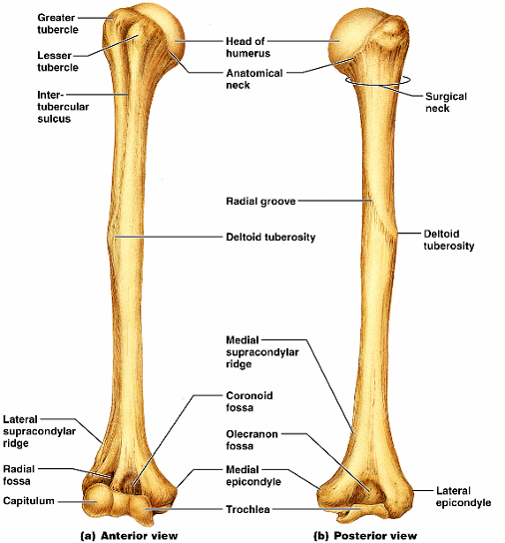
Humerus of the Arm
Distal humerus includes the
medial and lateral epicondyles,
the coronoid
Medial portion includes the
radial groove
deltoid process

Slide 125
Forearm
The bones of the forearm are the _
They articulate proximally with the humerus and _
They also _________________________________ proximally and distally at small radioulnar joints
_______________________________ connects the two bones along their entire length

Slide 126
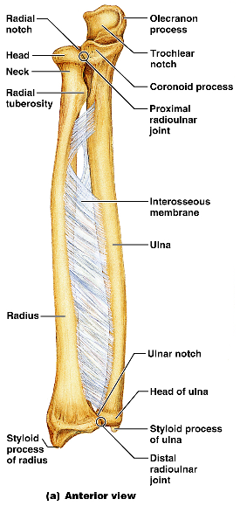
Ulna
The ulna lies _____________ in the forearm and is slightly longer than the radius
Forms the major portion of the _______________________ with the humerus
Its major markings include the olecranon, coronoid process, trochlear notch, radial notch, and the styloid process

Slide 127
Radius
The radius lies opposite ___________________ the ulna and is thin at its proximal end, widened distally
The superior surface of the head articulates with _
Medially, the head articulates with the _
Major markings include the radial tuberosity, ulnar notch, and styloid process

Slide 128
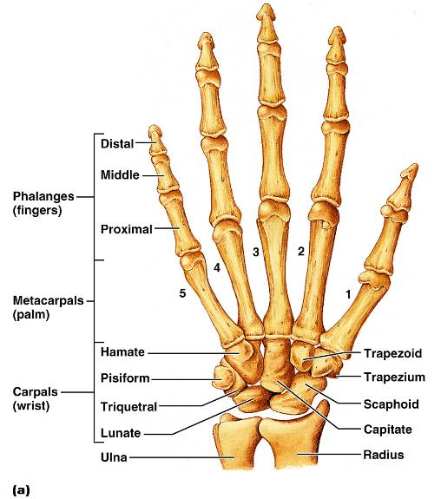
Hand
Skeleton of the hand contains
bones of the palm_
bones of the fingers _

Slide 129
Carpus (Wrist)
Consists of eight bones
____________________, lunate, ___________________, and pisiform proximally
Trapezium, ___________________, capitate, and _________________________ distally

Slide 130
Metacarpus (Palm)
Five numbered (1-5) metacarpal bones radiate from the wrist to form the palm
Their ____________________________________ proximally, and with each other medially and laterally
Heads articulate with _

Slide 131
Phalanges (Fingers)
Each hand contains 14 miniature long bones called phalanges
Fingers (digits) are numbered 1-5, beginning with the _
Each finger (except the thumb) has three phalanges – _
The thumb has _

Slide 132
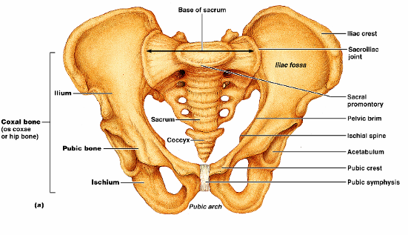
Pelvic Girdle
The hip is formed by a __________________________ (os coxae, or coxal)
Together with the ________________________________ these bones form the bony pelvis

Slide 133
Pelvic Girdle (Hip)
The pelvis
Attaches the lower limbs to the axial skeleton with the strongest ligaments of the body
Supports the visceral organs of the pelvis

Slide 134
Ilium
The ilium is a large flaring bone that forms the superior region of the coxal bone
It consists of
a superior _
The broad posterolateral surface is called the gluteal surface

Slide 135
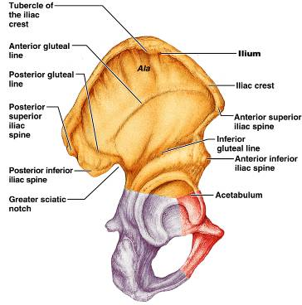
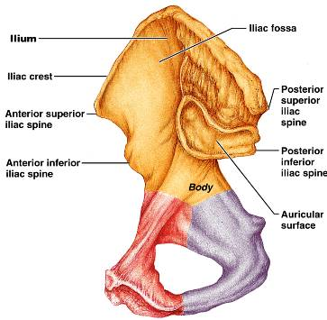
Ilium
The ___________________ articulates with the sacrum (sacroiliac joint)
Major markings include the iliac crests, four spines, greater sciatic notch, iliac fossa, arcuate line, and the pelvic brim

Slide 136
Ischium
The ischium forms the posteroinferior part of the hip bone
The ______________________________, and the thinner ramus articulates with the _
Major markings include the ischial spine, lesser sciatic notch, and the ischial tuberosity

Slide 137
Pubis
The pubic bone forms the anterior portion of the hip bone
It articulates with the _
Major markings include superior and inferior rami, the pubic crest, pubic tubercle, pubic arch, pubic symphysis, and obturator foramen (along with ilium and ischium)

Slide 138
Comparison of Male and Female Pelvic Structure
Female pelvis
Tilted forward, _
True pelvis defines birth canal
Cavity of the true pelvis is broad, shallow, and has greater capacity
Male pelvis
Tilted less forward
Adapted for support of _
Cavity of true pelvis is _

Slide 139
Comparison of Male and Female Pelvic Structure
Characteristic | Female | Male
Bone thickness | Lighter, thinner, and smoother | Heavier, thicker, and more prominent markings
Pubic arch/angle | 80˚–90˚ | 50˚–60˚
Acetabula | Small; farther apart | Large; closer together
Sacrum | Wider, shorter; sacral curvature is accentuated | Narrow, longer; sacral promontory more ventral
Coccyx | More movable; straighter | Less movable; curves ventrally

Slide 140
The Lower Limb
The three segments of the lower limb are the _
They carry the weight of the erect body, and are subjected to exceptional forces when one jumps or runs

Slide 141
Femur
The sole bone of the thigh is the femur, the _____________________________ bone in the body
It articulates _______________________ and _

Slide 142
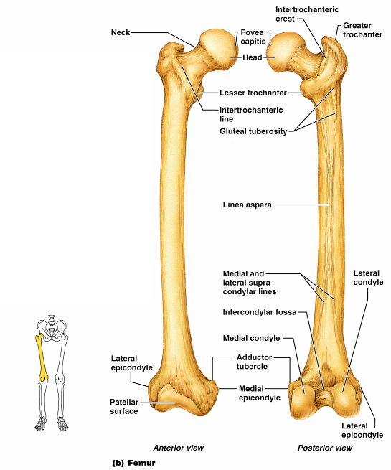
Femur
Major markings include the
head,
fovea capitis
greater and lesser trochanters
gluteal tuberosity
lateral and medial condyles
Epicondyles
linea aspera
patellar surface,
intercondylar notch
Figure 7.28b

Slide 143
Leg
The tibia and fibula form the skeleton of the leg
They are connected to each other by the _
They articulate with the femur proximally and with the _
They also articulate with each other via the _

Slide 144
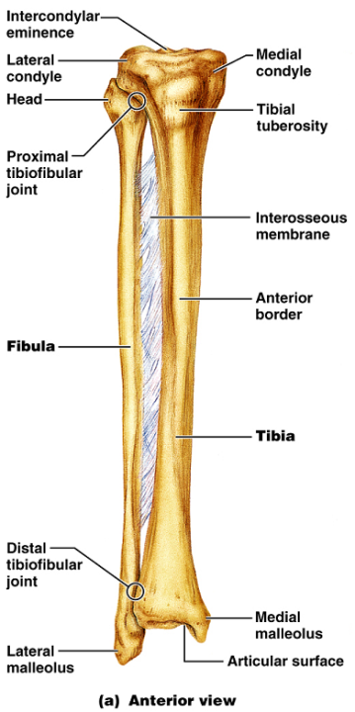
Tibia
____________________ of the body from the femur and _
Major markings include medial and lateral condyles, intercondylar eminence, the tibial tuberosity, anterior crest, medial malleolus, and fibular notch

Slide 145
Fibula
Sticklike bone with slightly expanded ends located _
Major markings include the _

Slide 146
Foot
The skeleton of the foot includes the
The foot supports body weight and acts as a lever to propel the body forward in walking and running

Slide 147
Tarsus
Composed of seven bones that form the posterior half of the foot
Body weight is carried _
Talus articulates with the tibia and fibula superiorly, and the calcaneus inferiorly
Other tarsus bones include the cuboid and navicular, and the medial, intermediate, and lateral cuneiforms

Slide 148
Calcaneus
Forms the _
Carries the _
Point of attachment for the __________________________________ of the calf muscles

Slide 149
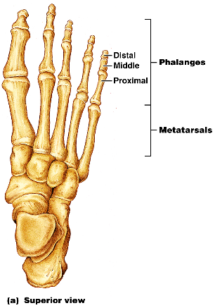
Metatarsus and Phalanges
_
Five (1-5) long bones that articulate with the proximal phalanges
The enlarged head of ________________________ forms the “ball of the foot”
Phalanges
The 14 bones of the toes
Each digit has three phalanges except the _

