Slide 1
Joints (Articulations)
Site where two or more bones meet
Functions of joints
Hold skeleton together
Two classifications

Slide 2
Functional Classification of Joints
Based on
Three functional classifications:
Synarthroses—
Amphiarthroses—slightly movable joints
Diarthroses—

Slide 3
Structural Classification of Joints
Based on
Material binding bones together
Presence/absence of joint cavity
Three structural classifications:

Slide 4
Fibrous Joints
Bones joined by _
No joint cavity
Most synarthrotic (_____________________)
Depends on length of connective tissue fibers
Three types:

Slide 5
Fibrous Joints: Sutures
Rigid, interlocking joints
Immovable joints for _
Contain _
Allow for growth during youth
In middle age, sutures ossify and fuse
Called _

Slide 6
Fibrous Joints: Syndesmoses
Bones connected by _
interosseous membrane connecting radius and ulna

Slide 7
Fibrous Joints: Gomphoses
____________________________________ of teeth in alveolar sockets
Fibrous connection is the _

Slide 8
Cartilaginous Joints
Bones _
Not highly movable
Two types:

Slide 9
Cartilaginous Joints: Synchondroses
Bar/plate of _________________________ unites bones e.g.,
Temporary ___________________________ joints
Become synostoses after plate closure
Cartilage of _

Slide 10
Cartilaginous Joints: Symphyses
_______________________________ unites bone
Hyaline cartilage present as articular cartilage
Strong, flexible
Pubic symphysis

Slide 11
Synovial Joints
Bones separated by _
Include most
joints of body

Slide 12
Synovial Joints: Six Distinguishing Features
1. Articular cartilage: hyaline cartilage
Prevents _
2. Joint (synovial) cavity

Slide 13
Synovial Joints: Six Distinguishing Features
3. Articular (joint) capsule
Two layers
Dense irregular connective tissue
Loose connective tissue
Makes synovial fluid

Slide 14
Synovial Joints: Six Distinguishing Features
4.
Viscous, slippery filtrate of plasma
Contains phagocytic cells to remove microbes and debris

Slide 15
Synovial Joints: Six Distinguishing Features
5. Different types of reinforcing ligaments
Thickened part of fibrous layer
Extracapsular
Outside the capsule
Deep to capsule; covered by synovial membrane

Slide 16
Synovial Joints: Six Distinguishing Features
6. Nerves and blood vessels
Nerve fibers _
Capillary beds supply filtrate for synovial fluid

Slide 17
Other Features of Some Synovial Joints
Articular discs (________________________)
_______________________________ separates articular surfaces to improve "fit" of bone ends, stabilize joint, and reduce wear and tear

Slide 18
Structures Associated with Synovial Joints
Bursae
Sacs lined with _
Contain _
___________________________________ where ligaments, muscles, skin, tendons, or bones rub together
Tendon Sheaths
_____________________________________ wrapped completely around tendon subjected to friction

Slide 19
Three Stabilizing Factors at Synovial Joints
1. ____________________________ of articular surfaces
Minor role
2. ____________________________number and location
Minor role
3. Muscle tendons that cross joint
Muscle tone keeps tendons taut
Extremely important in reinforcing shoulder and knee joints and arches of the foot

Slide 20
Synovial Joints: Movements Allowed
All muscles attach to bone or connective tissue at no fewer than two points
attachment to immovable bone
attachment to movable bone
Muscle contraction causes _

Slide 21
Synovial Joints: Range of Motion
Nonaxial
Ex: Wrists and vertebrae
Uniaxial
movement in _
Hinge joints: _
Biaxial
movement in two planes
Ex: Flex/Extension and abduction/adduction
Multiaxial
movement in or around all three planes
Ex:

Slide 22
Three General Types of Movements at Synovial Joints
1.
2.
Flexion, extension, hyperextension
Abduction, adduction
Circumduction
3.
Medial and lateral rotation

Slide 23
Gliding Movements
One flat bone surface glides or slips over another similar surface
Examples:
Intertarsal joints
Between articular processes of _

Slide 24
Angular Movements
Increase or decrease angle between two bones
Movement along sagittal plane
Flexion
increases the angle of the joint
excessive extension beyond normal range of motion

Slide 25
Angular Movements
Movement along frontal plane
movement away from the midline
movement toward the midline
Involves flexion, abduction, extension, and adduction of limb
Limb describes cone in space

Slide 26
Rotation
Turning of bone around its own long axis
Toward midline or away from it
Medial and lateral rotation
Examples:
Between _
Rotation of _

Slide 27
Special Movements at Synovial Joints
________________________________ of radius and ulna

Slide 28
Special Movements at Synovial Joints

Slide 29
Special Movements at Synovial Joints

Slide 30
Special Movements at Synovial Joints

Slide 31
Types of Synovial Joints
Six types, based on shape of articular surfaces:
Hinge
Condylar
Ball-and-socket

Slide 32
Plane Joint
Plane joints
Articular surfaces are essentially _
Allow only _______________________________ movements
Only examples of nonaxial joints

Slide 33
Types of Synovial Joints
Hinge joints
_________________________________ of one bone fits into a __________________________ surface on another
Motion is along a _
Uniaxial joints permit flexion and extension only
Examples: elbow and _

Slide 34
Pivot Joints
_______________________________ of one bone protrudes into _____________________________________ composed of bone (and possibly ligaments) of another
Only ________________________ movement allowed
Examples: joint between the ________________________________ , and the proximal radio-ulnar joint

Slide 35
Condyloid or Ellipsoidal Joints
______________________________ surface of one bone fits into a _______________________________ in another
Both articular surfaces are oval
Biaxial joints permit _
Examples:
______________________________________ (wrist) joints,
metacarpophalangeal (_________________________) joints

Slide 36
Saddle Joints
Similar to condyloid joints but allow _
Each articular surface has both a concave and a convex surface
Example: carpometacarpal joint of the _

Slide 37
Ball-and-Socket Joints
A spherical or hemispherical head of one bone articulates with a _
Multiaxial joints permit the most freely moving synovial joints
Examples:

Slide 38
Common Joint Injuries
Cartilage tears
Due to _
Fragments may cause joint to lock or bind
Cartilage rarely repairs itself
Repaired with arthroscopic surgery
Ligaments repaired, cartilage fragments removed with minimal tissue damage or scarring
Meniscal transplant in younger patients

Slide 39
Common Joint Injuries
Sprains
Partial tears slowly repair heal
Poor vascularization
Three options if torn completely
Ends sewn together
Replaced with grafts
Time and immobilization

Slide 40
Common Joint Injuries
Dislocations (luxations)
Accompanied by sprains, inflammation, and difficulty moving joint
Caused by _
Must be reduced to treat
Subluxation

Slide 41
Inflammatory and Degenerative Conditions
Bursitis
______________________________________, usually caused by blow or friction
Treated with rest and ice and, if severe, anti-inflammatory drugs
Inflammation of tendon sheaths typically caused by _
Symptoms and treatment similar to bursitis

Slide 42
Arthritis
More than _____________ different types of inflammatory or degenerative diseases that damage the joints
Most widespread crippling disease in the U.S.
Symptoms
Acute forms are caused ___________________________________ and are treated with antibiotics
Chronic forms include osteoarthritis, rheumatoid arthritis, and gouty arthritis

Slide 43
Osteoarthritis (OA)
Most common chronic arthritis; often called “____________________________” arthritis
Affects women more than men
______________ of all Americans develop OA
More prevalent in the aged, and is probably related to the normal aging process

Slide 44
Osteoarthritis: Course
OA reflects the years of abrasion and compression causing enzymes to break down cartilage
As one ages, _
The exposed bone ends thicken, enlarge, form bone spurs, and restrict movement
Joints most affected are the cervical and lumbar spine, fingers, knuckles, knees, and hips

Slide 45
Osteoarthritis: Treatments
OA is slow and _
Treatments include:
Mild pain relievers, along with _
Magnetic therapy
Glucosamine sulfate decreases pain and inflammation

Slide 46
Rheumatoid Arthritis (RA)
Chronic, inflammatory, ___________________________________ of unknown cause, with an insidious onset
Usually arises between the ages of 40 to 50, but may occur at any age
Signs and symptoms include joint tenderness, anemia, osteoporosis, _
The course of RA is marked with exacerbations and remissions

Slide 47
Rheumatoid Arthritis: Course
RA begins with _________________________ of the affected joint
Inflammatory chemicals are inappropriately released
Inflammatory blood cells migrate to the joint_

Slide 48
Rheumatoid Arthritis:
Inflamed synovial membrane ______________________ into a pannus
Pannus erodes cartilage, ________________________________, articulating bone ends connect
The end result, __________________________, produces bent, deformed fingers

Slide 49
Rheumatoid Arthritis: Treatment
Conservative therapy
____________________________, long-term use of antibiotics, and physical therapy
Progressive treatment
anti-inflammatory drugs or _

Slide 50
Gouty Arthritis
Deposition of ________________________________ in joints and soft tissues, followed by _
Typically, gouty arthritis affects the joint at the _
In untreated gouty arthritis, the bone ends fuse and immobilize the joint
Treatment
drugs, plenty of water, avoidance of alcohol

Slide 51
Lyme Disease
Caused by __________________________ transmitted _
Symptoms: skin rash, flu-like symptoms, _
May lead to _
Treatment
Long course of antibiotics

Slide 52
Muscle Tissue
Nearly _________________________ of body's mass
Transforms chemical energy (_____________) to directed mechanical energy → exerts force
Three types
Myo, mys, and sarco - prefixes for muscle

Slide 53
Types of Muscle Tissue
Skeletal muscles
Organs attached _
Elongated cells called muscle fibers
Voluntary (i.e., conscious control)
Require nervous system stimulation

Slide 54
Types of Muscle Tissue
Cardiac muscle
Only in _
bulk of heart walls
Can contract __________________________ nervous system stimulation

Slide 55
Types of Muscle Tissue
Smooth muscle
In walls of _
Stomach
Urinary bladder
Airways
Can contract without nervous system stimulation

Slide 56
Special Characteristics of Muscle Tissue
responsiveness or irritability
ability to receive and respond to stimuli
ability to shorten forcibly when stimulated
ability to be stretched
ability to recoil to resting length

Slide 57
Muscle Functions
Four important functions
Ex: Blood and lymph are moved by muscle contractions
Maintaining posture and body position
Stabilizing joints
especially skeletal muscle
Additional functions
Protects organs
controls pupil size

Slide 58
Skeletal Muscle
__________________________________ sheaths of skeletal muscle
Support cells; reinforce whole muscle
External to internal
dense irregular connective tissue surrounding entire muscle; may blend with fascia
fibrous connective tissue surrounding fascicles (groups of muscle fibers)
fine areolar connective tissue surrounding each muscle fiber

Slide 59
Skeletal Muscle: Attachments
Attach in at least two places
movable bone
immovable (less movable) bone

Slide 60
Microscopic Anatomy of A Skeletal Muscle Fiber
Long, cylindrical cell
10 to 100 µm in diameter; up to 30 cm long
plasma membrane
cytoplasm
Modified structures:
myofibrils, sarcoplasmic reticulum, and T tubules

Slide 61
Myofibrils
Densely packed, rodlike elements
most of cell volume
Contain _
the contractile units
contain _
Exhibit _
repeating series of dark and light bands

Slide 62
Sarcomere
Composed of thick and thin myofilaments made of contractile proteins

Slide 63
Sarcoplasmic Reticulum (SR)
Network of ____________________________________ surrounding each myofibril
Most run longitudinally
Functions in _________________________ of intracellular _______________ levels
Stores and releases Ca²⁺

Slide 64
T Tubules
Lumen continuous with extracellular space
Increase muscle fiber's surface area

Slide 65
Sliding Filament Model of Contraction
_________________________ heads bind to ___________________________; sliding begins
Cross bridges form and break several times, ratcheting thin filaments toward center of sarcomere

Slide 66
Physiology of Skeletal Muscle Fibers
For skeletal muscle to contract
Activation (at neuromuscular junction)
Must be _
Must generate ____________________________________ in sarcolemma
Excitation-contraction coupling
Action potential propagated along sarcolemma
Intracellular Ca²⁺ levels must _______________ briefly

Slide 67
The Nerve Stimulus and Events at the Neuromuscular Junction
Skeletal muscles stimulated by _
Axons of motor neurons travel from central nervous system to skeletal muscle
Each axon forms ____________________________________ as it enters muscle
Each axon ending forms ________________________________________with single muscle fiber
Usually only one per muscle fiber

Slide 68
Neuromuscular Junction (NMJ)
____________________________________and muscle fiber separated by gel-filled ________________________ called synaptic cleft
Synaptic vesicles of axon terminal contain neurotransmitter ______________________________ (ACh)
Muscle side of the NMJ contains _
NMJ includes axon terminals, synaptic cleft, junctional folds

Slide 69
Events at the Neuromuscular Junction
Nerve impulse arrives at axon terminal → _
ACh ___________________________ across cleft and binds with _____________________________________→
Electrical events → generation of _

Slide 70
Destruction of Acetylcholine
ACh effects quickly terminated by _____________________ acetylcholinesterase in synaptic cleft
Breaks down ACh to _
Prevents continued muscle fiber contraction in absence of additional stimulation

Slide 71
Role of Calcium (Ca²⁺) in Contraction
At __________________ intracellular Ca²⁺ concentration
Tropomyosin blocks active sites _
Myosin heads cannot attach to actin
Muscle fiber _

Slide 72
Role of Calcium (Ca²⁺) in Contraction
At _________________________ nintracellular Ca²⁺ concentrations
Ca²⁺ binds _
Troponin changes shape and moves tropomyosin away from myosin-binding sites
_______________________________________________, causing sarcomere shortening and muscle contraction
When nervous stimulation ceases, Ca²⁺ pumped back into SR and contraction ends

Slide 73
Cross Bridge Cycle
Continues as long as Ca²⁺ signal and adequate ATP present
high-energy myosin head attaches to thin filament
myosin head pivots and pulls thin filament toward M line

Slide 74
Cross Bridge Cycle
ATP attaches to myosin head and cross bridge detaches
energy from hydrolysis of ATP cocks myosin head into high-energy state

Slide 75
Homeostatic Imbalance
Cross bridge ____________________________ requires ATP
3–4 hours after death muscles begin to stiffen with weak rigidity at _____________ post mortem
Dying cells take in calcium → cross bridge formation
No ATP generated to break cross bridges

Slide 76
Review Principles of Muscle Mechanics
Same principles apply to contraction of _
Contraction produces ____________________________, force exerted on load or object to be moved

Slide 77
Review Principles of Muscle Mechanics
Contraction may/may not shorten muscle
“same meter”
no shortening;
may actually cause the muscle to be pulled longer (braking movements)
muscle tension ______________________________ but does not exceed load
Isotonic contraction:
muscle _
“same tone”
Force and duration of contraction vary in response to stimuli of different frequencies and intensities

Slide 78
Isotonic Contractions
Muscle changes in _
Thin filaments slide
Isotonic contractions either concentric or eccentric:
muscle shortens and does work
muscle generates force as it lengthens

Slide 79
Isometric Contractions
Load greater than tension muscle can develop
__________________________________to muscle's capacity, but muscle neither shortens nor lengthens
Cross bridges generate force _

Slide 80
Motor Unit: The Nerve-Muscle Functional Unit
Each muscle served by at least _
Axons branch into terminals, each of which create a neuromuscular junction with a single muscle fiber
Motor unit :
fine control, like fingers or eyes
Bulk movement as in low back muscles

Slide 81
Motor Unit
single motor unit causes _
Muscle fibers from motor unit spread throughout muscle
Motor units in muscle usually _____________________________________ to help prevent fatigue of skeletal muscles

Slide 82
Graded Muscle Responses
Varying strength of contraction for different demands
Required for proper control of skeletal movement
Responses graded by
Changing ____________________________ of stimulation
Changing ____________________________ of stimulation

Slide 83
Muscle Tone
_____________________________________ state of all muscles
Due to _
Groups of motor units alternately activated in response to input from stretch receptors in muscles
Keeps muscles firm, healthy, and ready to respond

Slide 84
Muscle Metabolism: Energy for Contraction
________________ only source used directly for contractile activities
Available stores of ATP depleted _

Slide 85
Muscle Fatigue
inability to contract despite continued stimulation
Occurs with
Prolonged exercise
interferes with Ca²⁺
Total lack of ATP occurs rarely, during states of continuous contraction, and causes ________________________________ (continuous contractions)

Slide 86
Excess Postexercise Oxygen Consumption
To return muscle to resting state
Lactic acid converted to pyruvic acid
________________________________ stores replaced
ATP and creatine phosphate reserves replenished
All require ____________________________; occur post exercise

Slide 87
Heat Production During Muscle Activity
~40% of energy released in muscle activity _
Remaining energy (60%) _
Dangerous heat levels prevented
by release of heat from skin
result of muscle contractions to generate heat when cold

Slide 88
Homeostatic Imbalance
Results from _
Muscle strength declines 5% per day
Without neural stimulation muscles atrophy to ¼ initial size
Fibrous connective tissue replaces lost muscle tissue →

Slide 89
Smooth Muscle
Found in walls of most __________________ organs (except heart)
Usually in two layers _

Slide 90
Microscopic Structure
Spindle-shaped fibers
____________________________________________ compared with skeletal muscle fibers
only _
Pouchlike infoldings called caveolae
sequester Ca²⁺
most calcium influx from outside cell; rapid
No sarcomeres, myofibrils, or T tubules

Slide 91
Microscopic Structure of Smooth Muscle Fibers
Fibers parallel to long axis of organ
contraction → _
Fibers in circumference of organ
contraction →
Allows _
Alternating contractions and relaxations of smooth muscle
mix and squeeze substances through lumen of hollow organs

Slide 92
Innervation of Smooth Muscle
No NMJ as in skeletal muscle
___________________________ nerve fibers innervate smooth muscle at diffuse junctions
___________________________ (swellings) of nerve fibers
store and release _

Slide 93
Myofilaments in Smooth Muscle
Thick filaments have heads along entire length
No ______________________________ complex;
protein calmodulin binds Ca²⁺

Slide 94
Myofilaments in Smooth Muscle
Myofilaments are _____________________ arranged, causing smooth muscle to contract in _

Slide 95
Contraction of Smooth Muscle
__________________________________ contractions
Cells electrically coupled by gap junctions
Some cells _
act as ___________________________________ for sheets of muscle
Rate and intensity of contraction may be modified by neural and chemical stimuli

Slide 96
Contraction of Smooth Muscle
Slow to contract and relax
maintained for prolonged periods with _
Slow ATPases

Slide 97
Regulation of Contraction
By _
Neural regulation
Response depends on neurotransmitter released and type of receptor molecules

Slide 98
Regulation of Contraction
Hormones and local chemicals
Some smooth muscle cells have _
Depolarize spontaneously or in response to chemical stimuli
Some respond to both neural and chemical stimuli
Chemical factors include

Slide 99
Special Features of Smooth Muscle Contraction
Stress-relaxation response
Responds to stretch only briefly, _
Retains ability to _
Enables organs such as stomach and bladder to temporarily store contents

Slide 100
Special Features of Smooth Muscle Contraction
Smooth muscle cells can divide and _
Example
Estrogen effects on ___________________________ at puberty and during pregnancy

Slide 101
Types of Smooth Muscle
Smooth muscle varies in different organs
Fiber arrangement and organization
Responsiveness to various stimuli
Categorized as _________________________ (unitary) and __________________________

Slide 102
Types of Smooth Muscle
Unitary (visceral) smooth muscle
In all ____________________________________ except heart
Arranged in opposing sheets
Innervated by _
Often exhibit spontaneous action potentials
Electrically coupled by _
Respond to various chemical stimuli

Slide 103
Types of Smooth Muscle: Multiunit
Multiunit smooth muscle
Located in large airways, _____________________________, arrector pili muscles, and _
spontaneous depolarization rare
Independent muscle fibers
innervated by autonomic NS
Has motor units; responds to hormones

Slide 104
The Muscular System
Muscle tissue
Focus on skeletal muscle
How muscles interact to → movement
Criteria for naming muscles
Principles of leverage

Slide 105
Actions and Interactions of Skeletal Muscles
Muscles can __________________________; never push
What one muscle group "does", another "undoes"

Slide 106
Actions and Interactions of Skeletal Muscles
Functional Groups
Major responsibility for producing specific movement
Opposes or reverses particular movement
Prime mover and antagonist on opposite sides of joint across which they act

Slide 107
Skeletal Muscles: Functional Groups
______________________________ helps prime movers
Adds extra force to same movement
Reduces undesirable or unnecessary movement
_____________________________
Synergist that _____________________________ bone or muscle's origin
Gives prime mover stable base on which to act

Slide 108
Naming Skeletal Muscles
bone or body region with which muscle associated
deltoid muscle
deltoid = triangle
maximus
largest
minimus
smallest
longus
long

Slide 109
Naming Skeletal Muscles
Direction of muscle fibers or fascicles
fibers run straight
transversus
fibers run at right angles
fibers run at angles to imaginary defined axis
Number of origins
Biceps
2 origins
3 origins
Location of _
named according to point of origin and insertion

Slide 110
Naming Skeletal Muscles
named for action they produce
flexor or extensor
Several criteria can be combined, e.g., extensor carpi radialis longus

Slide 111
Major Skeletal Muscles of the Body
grouped by _
Information for each muscle
Location relative to other muscles
Origin and insertion
usually a joint between origin and insertion
insertion moves toward origin
Innervation
name of major nerve that supplies muscle

Slide 112
Muscles of the Head
Two groups
Muscles of _
Muscles of ______________________________ and tongue movement

Slide 113
Muscles of Facial Expression
Insert into _
Important in nonverbal communication
All innervated by cranial nerve _

Slide 114
Muscles of Facial Expression: The Scalp
Epicranius (occipitofrontalis)
Bipartite muscle consisting of
Galea aponeurotica— _________________________________________ connecting the two muscles
Frontal belly; occipital belly
Have alternate actions;

Slide 115
Muscles of Facial Expression: The Face
Corrugator supercilii
Zygomaticus
Risorius
Levator labii superioris
Depressor labii inferioris
Depressor anguli oris
Orbicularis oris
Mentalis
Buccinator
Platysma

Slide 116
Muscles of Mastication
Four pairs involved in mastication
all innervated by _
Prime movers of jaw closure
Grinding movements
Medial and lateral _
Chewing role - holds food between teeth

Slide 117
Muscles of Tongue Movement
Three muscles anchor and move tongue
Styloglossus
All innervated by cranial _

Slide 118
Muscles of the Neck and Vertebral Column
Two functional groups
Muscles that _
Muscles that _____________________________ and maintain posture

Slide 119
Muscles of the Neck and Vertebral Column: Head Movement
major head _
Sternocleidomastoid and scalenes
lateral head movements
Splenius capitis and cervicis portions
head _
Semispinalis capitis
synergist with sternocleidomastoid

Slide 120
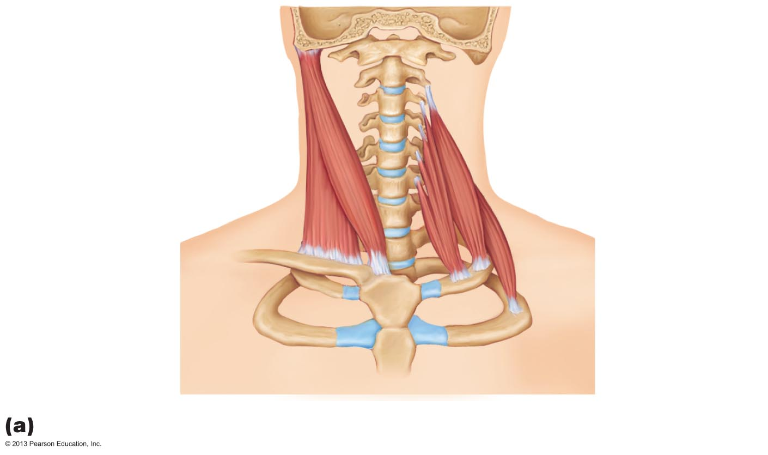
Figure 10.10a Muscles of the neck and vertebral column that move the head and trunk.
Base of
occipital bone
1st cervical
vertebra
Mastoid
process
Middle
scalene
Sternocleido-
mastoid
Anterior
scalene
Posterior
scalene
Anterior

Slide 121
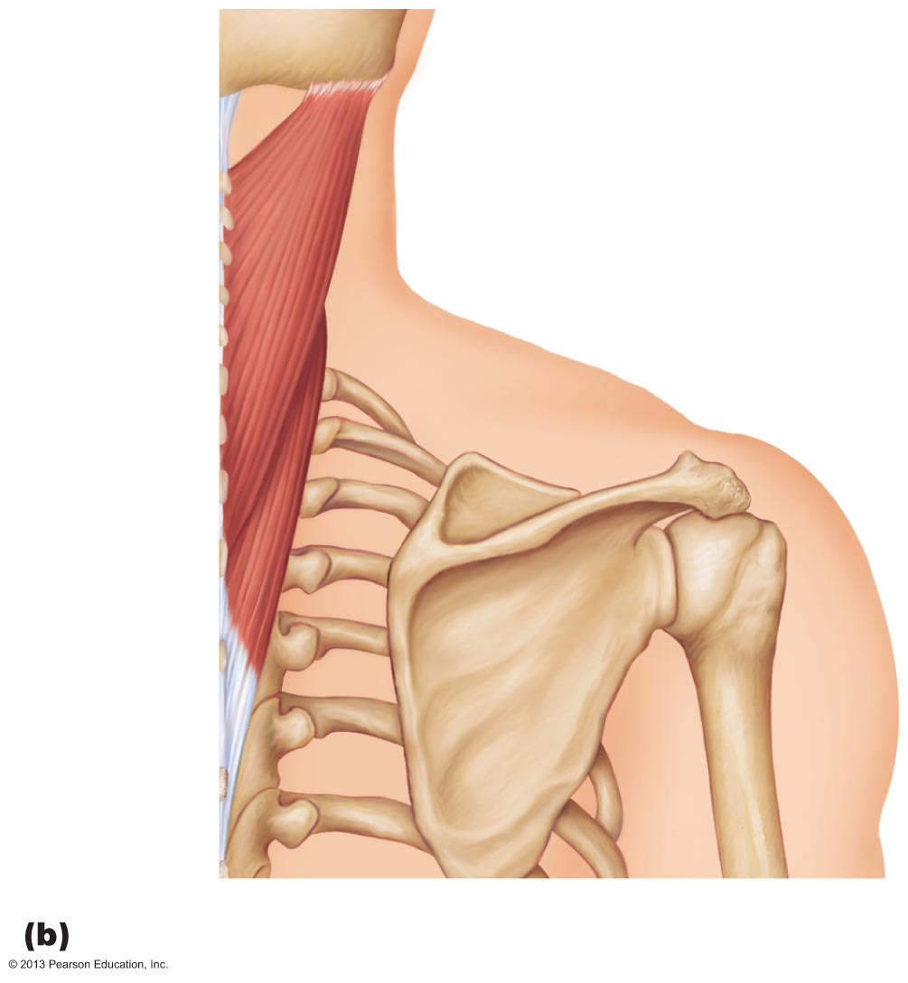
Figure 10.10b Muscles of the neck and vertebral column that move the head and trunk.
Mastoid process
Splenius
capitis
Spinous
processes
of the
vertebrae
Splenius
cervicis
Posterior

Slide 122
Muscles of the Neck and Vertebral Column: Trunk Extension
Deep (_____________________) back muscles
___________________________________ (sacrospinalis) group
prime movers of back extension and lateral bending
Semispinalis and quadratus lumborum—synergists in extension and rotation

Slide 123
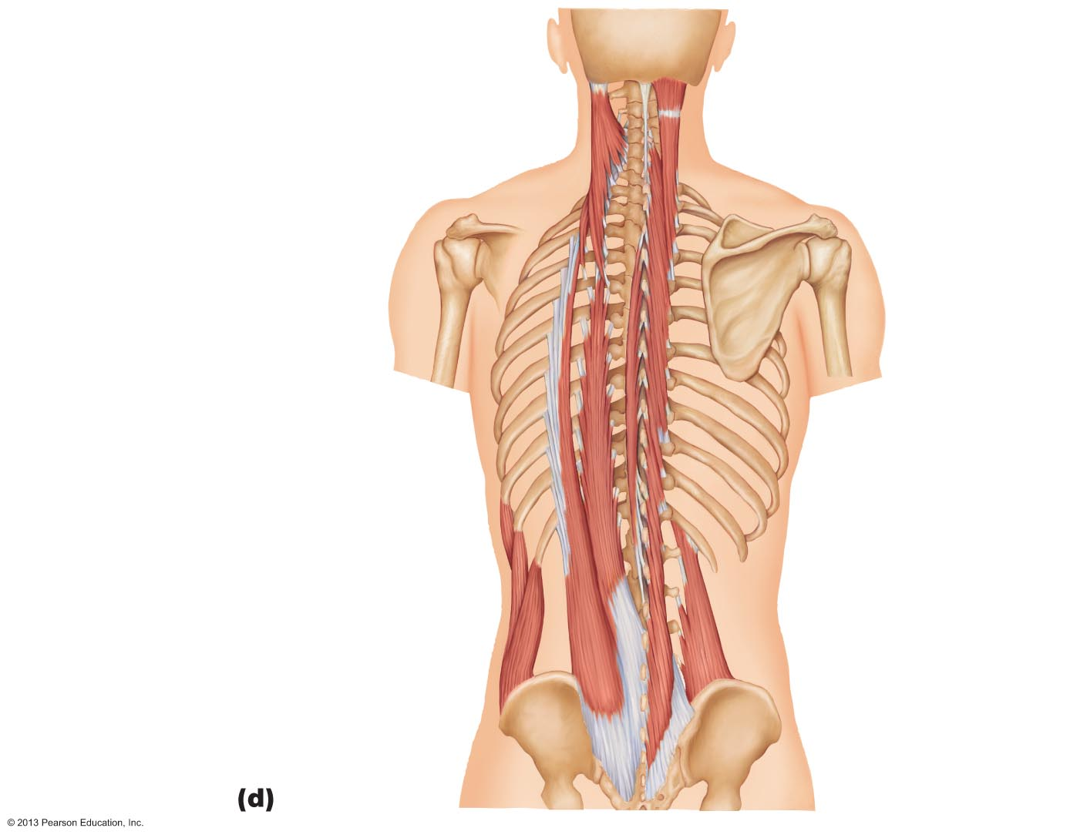
Figure 10.10d Muscles of the neck and vertebral column that move the head and trunk.
Iliocostalis
Erector
spinae
Longissimus
Spinalis
Quadratus
lumborum

Slide 124
Figure 10.10d Muscles of the neck and vertebral column that move the head and trunk.
Ligamentum
nuchae
Mastoid process
of temporal bone
Semispinalis
capitis
Semispinalis
cervicis
Semispinalis
thoracis
Quadratus
lumborum
External oblique

Slide 125
Deep Muscles of the Thorax: Breathing
Muscles of respiration
more superficial muscles
elevate ribs for inspiration
deeper muscles
aid forced _
Diaphragm
Partition between thoracic and abdominal cavities
Most important muscle in inspiration
Innervated by _

Slide 126
Muscles of the Abdominal Wall
_______________________________ muscles, their fasciae and aponeuroses form lateral and anterior abdominal wall
__________________________ abdominis
External obliques
Internal obliques
___________________________abdominis

Slide 127
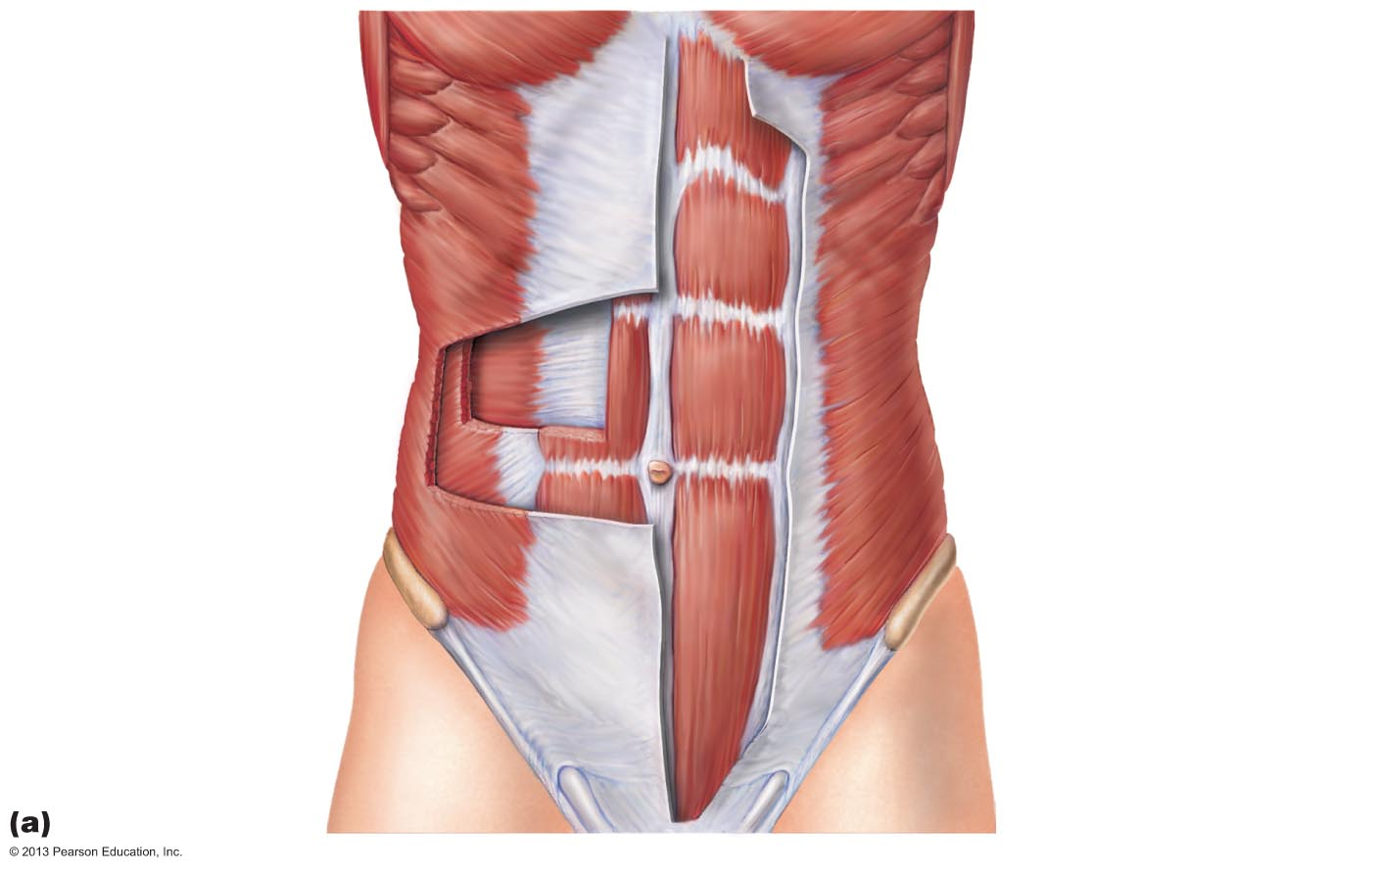
Figure 10.12a Muscles of the abdominal wall.
Linea alba
Tendinous intersection
Transversus abdominis
Rectus abdominis
Internal oblique
External oblique
Aponeurosis of the external oblique

Slide 128
Muscles of the Abdominal Wall
Fascicles run at angles to one another, provide added strength
All innervated by _
Actions of these muscles
Help promote urination, defecation, childbirth, vomiting, coughing, and screaming

Slide 129
Superficial Muscles of the Thorax
Most - __________________________________ shoulder muscles
Act in combination to fix shoulder girdle (mostly scapula); move it to increase range of arm movements
Actions
Depression
lateral and medial movements
protraction and retraction
Two groups of muscles: anterior and posterior

Slide 130
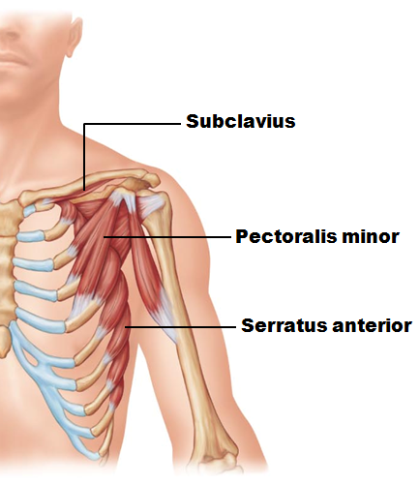
Superficial Muscles of the Thorax
Muscles of anterior thorax

Slide 131
Superficial Muscles of the Posterior Thorax
Posterior extrinsic shoulder muscles
Rhomboids (major and minor)

Slide 132
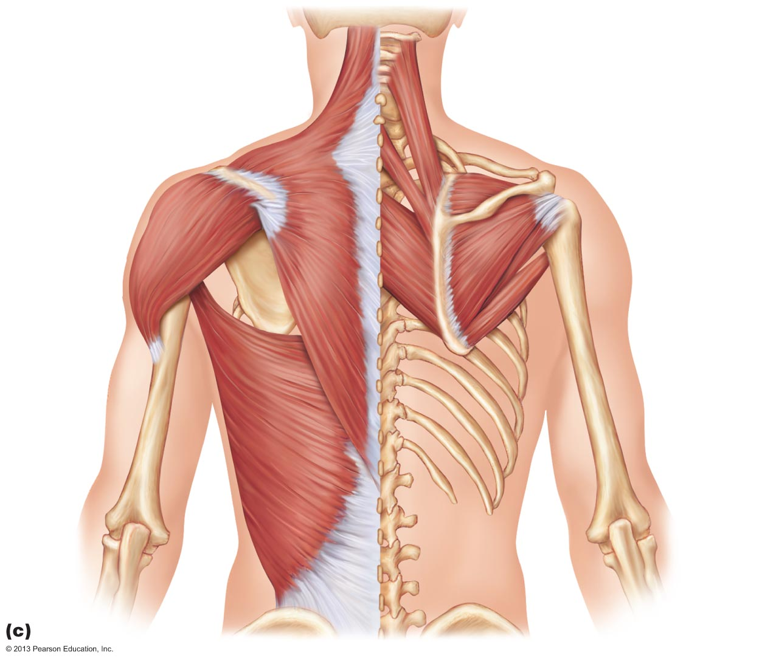
Figure 10.14c Superficial muscles of the thorax and shoulder acting on the scapula and arm.
Levator
scapulae
Trapezius
Rhomboid
minor
Rhomboid
major

Slide 133
Muscles Crossing the Shoulder Joint
Nine muscles cross shoulder joint; insert on and move humerus
Some originate ________________________; others from _
Actions include _

Slide 134
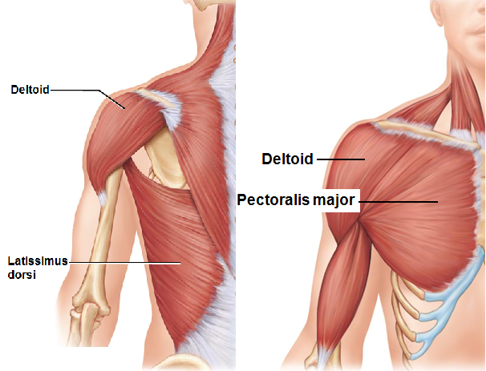
Muscles Crossing the Shoulder Joint
Three prime movers of arm
flexion
extension
abduction

Slide 135
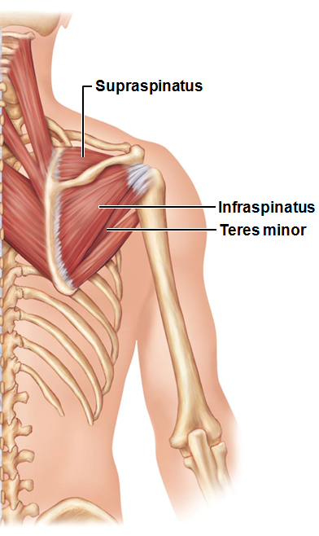
Muscles Crossing the Shoulder Joint
Rotator cuff muscles
synergists and fixators;
originate on scapula;
Supraspinatus
Infraspinatus
Teres minor
Subscapularis
Coracobrachialis and teres major - synergists

Slide 136
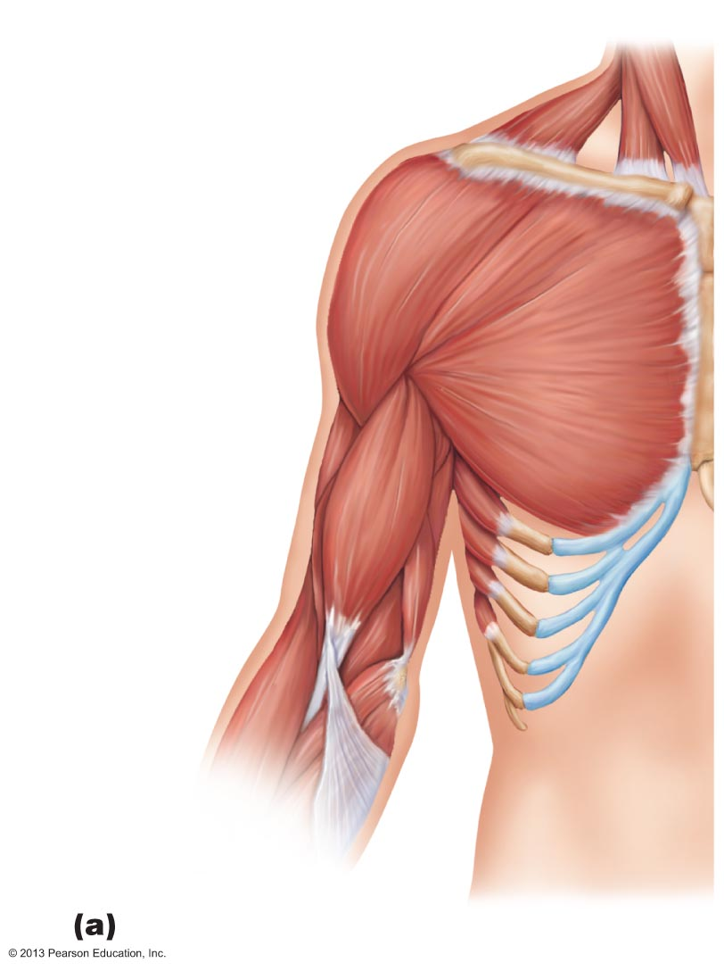
Figure 10.15a Muscles crossing the shoulder and elbow joints, causing movements of the arm and forearm, respectively.
Clavicle
Deltoid
Sternum
Pectoralis
major
Coracobrachialis
Triceps brachii:
Lateral head
Long head
Medial head
Biceps
brachii
Brachialis
Brachio-
radialis
Anterior view

Slide 137
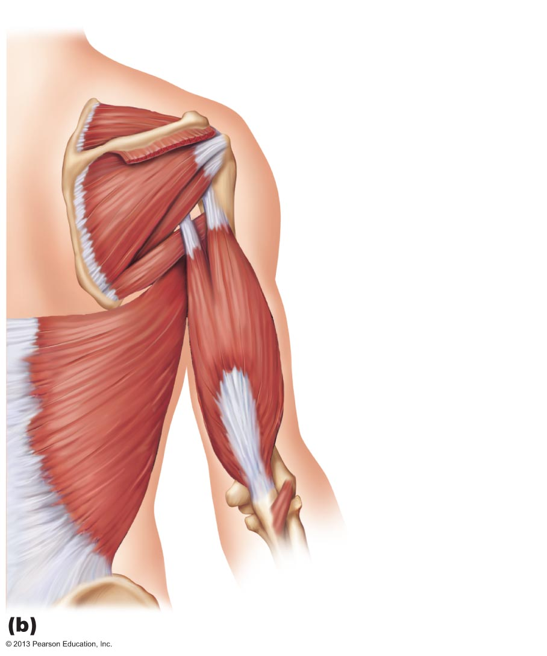
Figure 10.15b Muscles crossing the shoulder and elbow joints, causing movements of the arm and forearm, respectively.
Supraspinatus*
Spine of scapula
Deltoid (cut)
Greater tubercle
of humerus
Infraspinatus*
Teres minor*
Teres major
Triceps brachii:
Lateral head
Long head
Latissimus dorsi
Humerus
Olecranon
of ulna
Anconeus
Posterior view

Slide 138
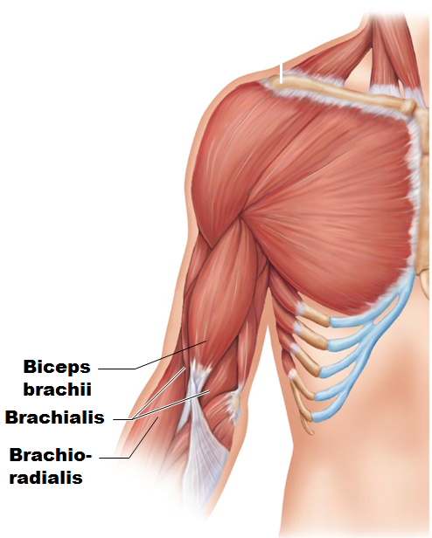
Muscles Crossing the Elbow Joint
Anterior flexor muscles
Brachialis and biceps brachii
synergist and stabilizer

Slide 139
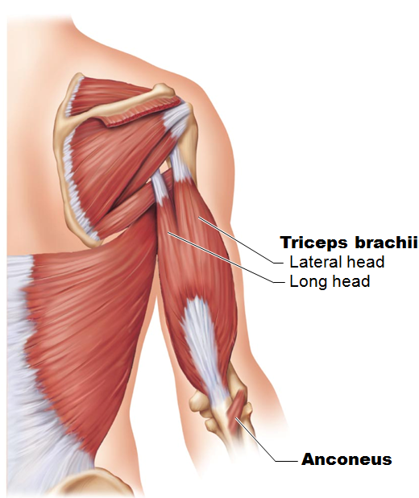
Muscles Crossing the Elbow Joint
________________ extensor muscles
Triceps brachii
weak synergist

Slide 140
Muscles of the Forearm
Actions - movements of wrist, fingers, thumb, pronation, supination
Most ____________________________ muscles
Most ____________________________ muscles

Slide 141
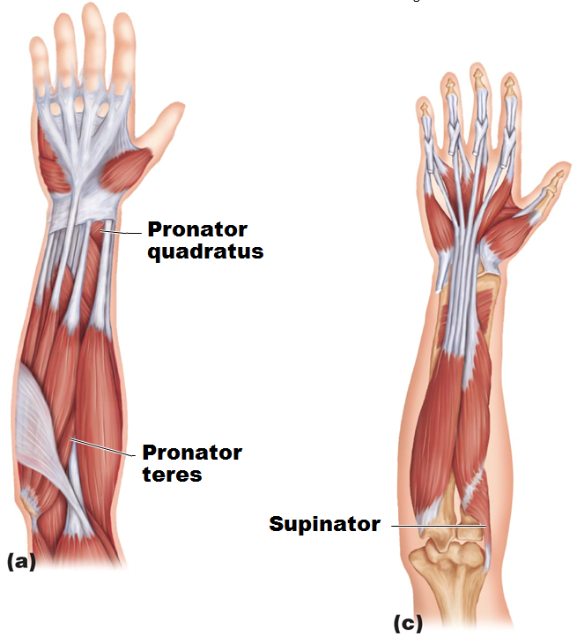
Muscles of the Forearm
Pronator teres and pronator quadratus _
Supinator - synergist with _________________ in forearm supination

Slide 142
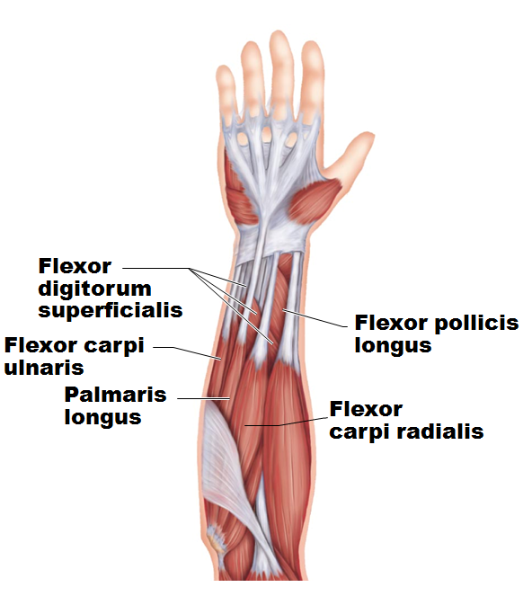
Muscles of the Forearm: Anterior Compartment
Flexors
Flexor carpi radialis
Flexor carpi ulnaris
Flexor digitorum superficialis and flexor digitorum profundus

Slide 143
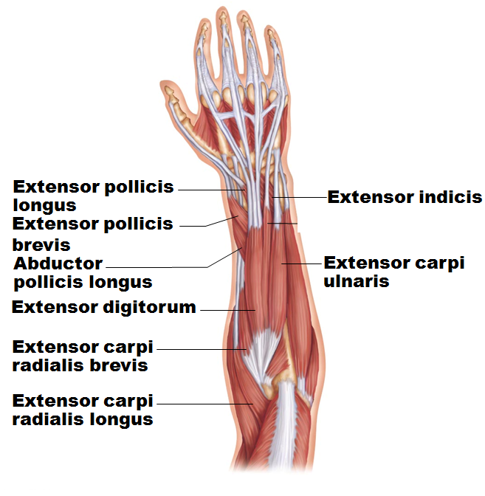
Muscles of the Forearm: Posterior Compartment
Extensors
Extensor carpi radialis longus and brevis
Extensor carpi ulnaris
Extensor pollicis brevis and longus
Abductor pollicis longus

Slide 144
Intrinsic Muscles of the Hand
Small weak muscles
Control ________________________________ movements of metacarpals and fingers (e.g., threading a needle)
Abductors and adductors of fingers
Produce _
move thumb toward little finger

Slide 145
Finger and Thumb Movements
Flexion
Thumb
Fingers
bend anteriorly
Thumb
Fingers
move posteriorly

Slide 146
Intrinsic Muscles of the Palm
Three groups
__________________________________________ (ball of thumb)
Hypothenar eminence (ball of the little finger)
Each of above groups has _
Midpalmar muscles
lumbricals and interossei extend fingers
Interossei muscles also abduct and adduct fingers

Slide 147
Muscles Crossing Hip and Knee Joints
Most anterior muscles
Most posterior muscles
Medial muscles all _

Slide 148
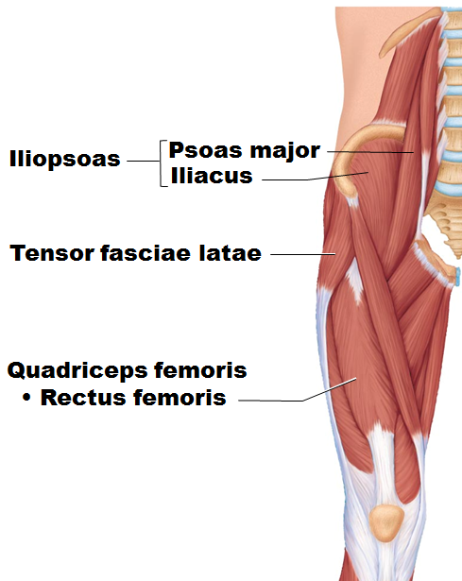
Movements of the Thigh
Include
Flexion
Extension
Abduction
Adduction
Circumduction
Rotation
Thigh flexors pass in front of hip joint
prime mover of flexion
Tensor fasciae latae
Assisted by medial adductors and sartorius

Slide 149
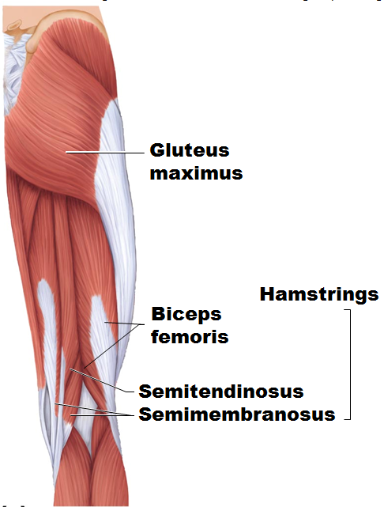
Movements of the Thigh
Thigh extensors
prime movers of extension
Semitendinosus
Semimembranosus
Gluteus maximus
___________________ in forceful thigh extension

Slide 150
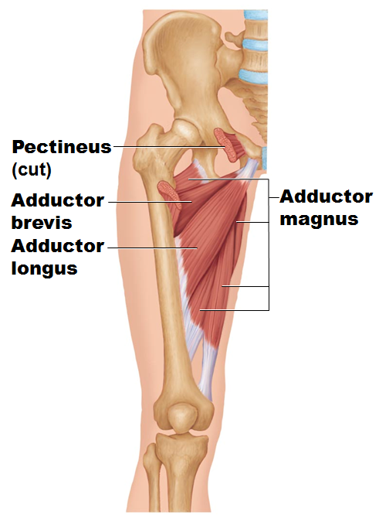
Movements of the Thigh
_________________ (also medially rotate thigh)
Adductor _
Adductor _
Adductor _
Pectineus
Gracilis

Slide 151
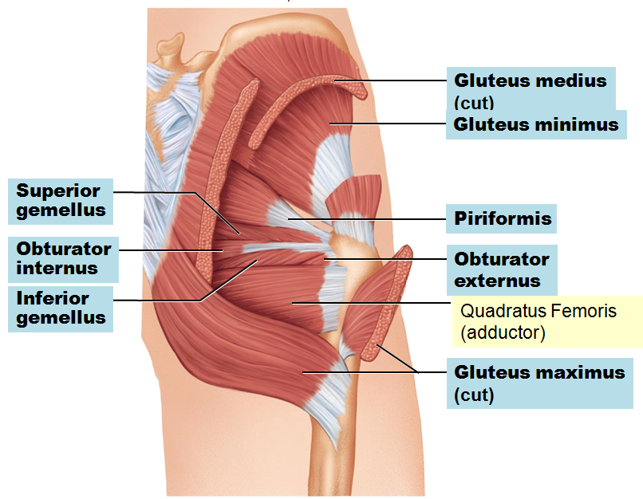
Movements of the Thigh
Abductors
Gluteus _
Gluteus _
Gluteus _
Piriformis
Obturator externus
Obturator internus
Gemellus

Slide 152
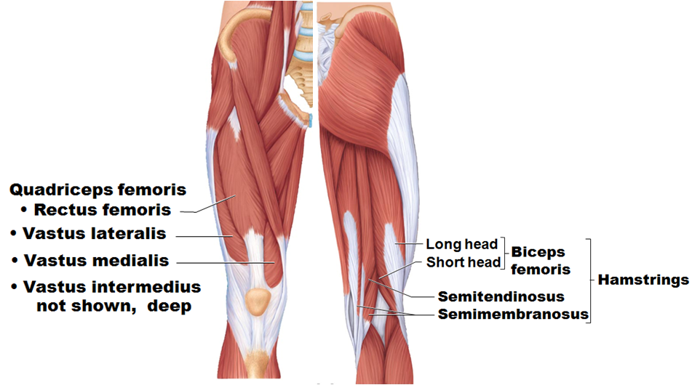
Muscles of the Thigh that Move the Knee Joint
sole extensor of knee
flex knee

Slide 153
Fascia of the Leg
Deep fascia of leg continuous with fascia lata
Segregates leg into three compartments –
Anterior
Lateral
Posterior
Fascia thickens distally; forms flexor, extensor, and fibular retinaculae

Slide 154
Muscles of the Leg: Movements
Various leg muscles produce following movements
Intertarsal joints
inversion and eversion of the foot
flexion and extension

Slide 155
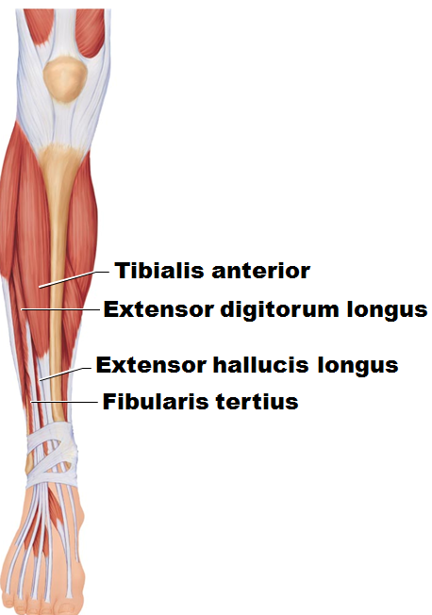
Muscles of the Anterior Compartment, Leg
Primary movers for
ankle _
Extensor digitorum longus
Extensor hallucis longus
Fibularis tertius (not always present)

Slide 156
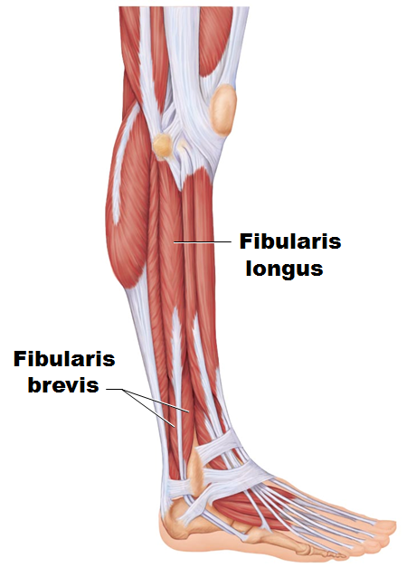
Muscles of the Lateral Compartment, Leg
_________________ of the foot;
stabilize
lateral ankle
arch of foot

Slide 157
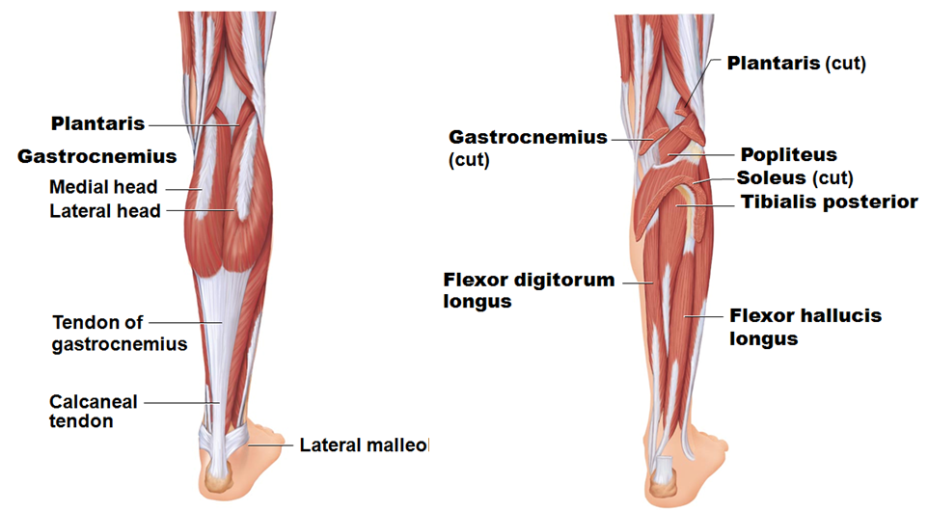
Muscles of the Posterior Compartment of the Leg
Plantar flex ankle
Plantaris
Popliteus
Flexor digitorum longus
Flexor hallucis longus

Slide 158
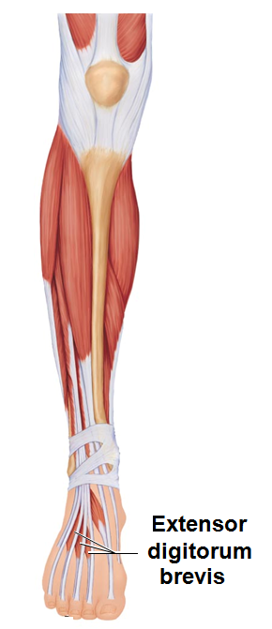
Intrinsic Muscles of the Foot
Help flex, extend, abduct, and adduct toes
dorsal foot muscle
helps extend toes

Slide 159
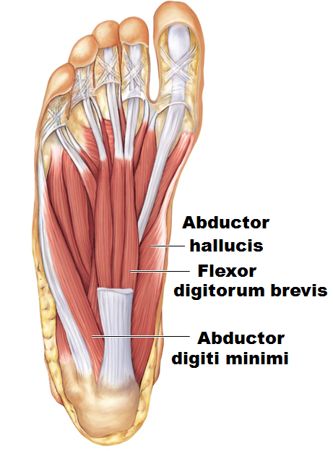
Plantar Muscles
__________ layers of plantar muscles
Superficial layer
Flexor digitorum brevis
Abductor _
Second layer
Flexor accessorius

Slide 160
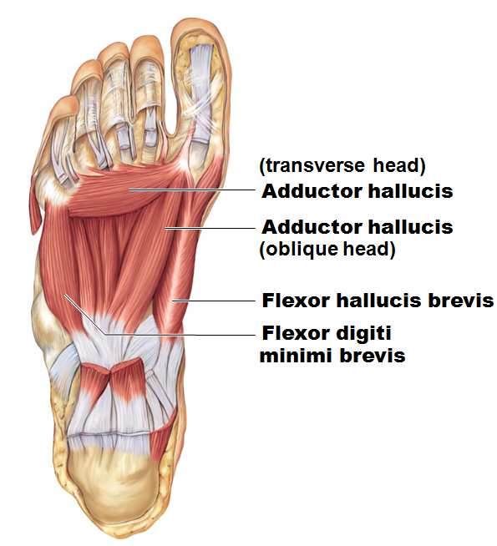
Plantar Muscles
Third layer
Adductor hallucis
Deepest layer
Plantar and dorsal _

