Slide 1
The Nervous System
Master controlling and communicating system of body
Cells communicate via ___________________ and chemical signals
Usually cause almost immediate responses

Slide 2
Functions of the Nervous System
Information gathered by sensory receptors about internal and external changes
Processing and interpretation of sensory input
Activation of _________________________ organs (muscles and glands) produces a response

Slide 3
Divisions of the Nervous System
Central nervous system (CNS)
Integration and control center
Interprets sensory input and dictates motor output
Peripheral nervous system (PNS)
The portion of the nervous system _
__________________________________________ to and from spinal cord
__________________________________________ to and from brain

Slide 4
Peripheral Nervous System (PNS)
Two functional divisions
_________________________________________ division
_______________________________________________ —convey impulses from skin, skeletal muscles, and joints to CNS
Visceral sensory fibers—convey impulses from visceral organs to CNS
________________________________________ division
Transmits impulses from CNS to effector organs
Two divisions

Slide 5
Motor Division of PNS: Somatic Nervous System
Somatic motor nerve fibers
Conducts impulses _
Voluntary nervous system
___________________________________ control of skeletal muscles

Slide 6
Motor Division of PNS: Autonomic Nervous System
Visceral motor nerve fibers
Regulates _
___________________________________ nervous system
Two functional subdivisions
Work in opposition to each other
Sympathetic
Parasympathetic

Slide 7
Histology of Nervous Tissue
Highly cellular; little extracellular space
Tightly packed
Two principal cell types
small cells that surround and wrap delicate neurons
excitable cells that transmit electrical signals

Slide 8
Histology of Nervous Tissue: Neuroglia
Central Nervous System Glial cells
Peripheral Nervous System Glial cells

Slide 9
Astrocytes
Most abundant
Cling to neurons, synaptic endings, and capillaries
Functions include
Support and brace neurons
Play role in exchanges _
Guide migration of young neurons

Slide 10
Microglial Cells
Small, ovoid cells
have ____________________________ that touch and monitor neurons
Migrate toward injured neurons

Slide 11
Ependymal Cells
Can be _
circulates cerebrospinal fluid
Line the central ________________________ of the brain and spinal column

Slide 12
Oligodendrocytes
Branched cells
Processes wrap _______________ nerve fibers
forming _

Slide 13
Satellite Cells and Schwann Cells
Satellite cells
Schwann cells
Surround ________________________________________ fibers
form myelin sheaths in thicker nerve fibers
Vital to regeneration of damaged peripheral nerve fibers

Slide 14
Neurons
Structural units of nervous system
Large, highly specialized cells _
Extreme longevity (→ 100 years or more)
with few exceptions
High metabolic rate
requires continuous supply _
All have cell body and one or more processes

Slide 15
Neuron Cell Body or Soma
Biosynthetic center of neuron
Synthesizes proteins, membranes, and other chemicals
Rough ER (nissl bodies)
Most active and best developed in body
In most, plasma membrane part of receptive region
Most ________________________________________________ are in CNS
Location of cell bodies
Central Nervous system:
In
Peripheral Nervous System
In clusters called _

Slide 16
Neuron Processes
CNS
Both neuron ____________________________________________ and their processes
PNS
Chiefly _
Tracts
Bundles of neuron _
Nerves
Bundles of neuron _
Two types of processes

Slide 17
Dendrites
In motor neurons
hundreds of short, tapering, diffusely branched processes
Convey incoming messages toward cell body
Use _
short distance signals

Slide 18
The Axon: Structure
One axon per cell arising from _
Cone-shaped area of cell body
Some 1 meter long
Occasional branches
Called axon collaterals
Branches profusely at end
Can be 10,000 terminal branches
Distal endings called axon terminals or terminal boutons

Slide 19
The Axon: Functional Characteristics
Conducting region of neuron
Transmits them along neuron cell membrane to axon terminal
Neurotransmitters released into extracellular space
Either excite or inhibit neurons with which axons in close contact
Lacks rough ER and Golgi apparatus
Relies on cell body to renew proteins and membranes
Efficient transport mechanisms
Quickly decay if cut or damaged

Slide 20
Myelin Sheath
Composed of _
Whitish, protein-lipoid substance
Function of myelin
_________________________________________ and electrically insulates axon
Increases speed of nerve impulse transmission
Nonmyelinated fibers conduct impulses _

Slide 21
Myelination in the PNS
Formed by _
Wrap around axon
One cell forms one segment of myelin sheath
Myelin sheath
Concentric layers of Schwann cell _

Slide 22
Myelination in the PNS
Plasma membranes of myelinating have cells less protein
Nodes of Ranvier
Myelin sheath ___________________ between adjacent Schwann cells
Sites where _
Nonmyelinated fibers
Thin fibers not wrapped in myelin
surrounded by Schwann cells but no coiling
one cell may surround 15 different fibers

Slide 23
Myelin Sheaths in the CNS
Formed by multiple, flat processes of _________________________________________ , not whole cells
__________________________________________ are present
No neurilemma
Thinnest fibers are unmyelinated
White matter
Regions of brain and spinal cord with dense collections of _
usually fiber tracts
Gray matter
Mostly neuron cell bodies and nonmyelinated fibers

Slide 24
Structural Classification of Neurons
Grouped by number of processes
Three types
3 or more processes
1 axon, others dendrites
2 processes
1 axon and 1 dendrite
______________________________________: Retina and olfactory mucosa
1 short process
Divides T-like – both branches now considered axons
Distal (peripheral) process – associated with sensory receptor
Proximal (central) process – enters CNS

Slide 25
Functional Classification of Neurons
Grouped by direction in which nerve impulse travels relative to CNS
Three types

Slide 26
Functional Classification of Neurons
Sensory
Transmit impulses from sensory _
Almost all are _
Cell bodies in _
Motor
Carry impulses from _
Most cell bodies in CNS (except some autonomic neurons)
Interneurons (association neurons)
Lie between motor and sensory neurons
Shuttle signals through CNS pathways; most are entirely within CNS
Most confined _

Slide 27
Membrane Potentials
Neurons are highly irritable
Respond to adequate stimulus by generating an ________________________________ (nerve impulse)
Impulse is _____________________________ regardless of stimulus

Slide 28
Role of Membrane Ion Channels
Large proteins serve as selective membrane ion channels
Two main types of ion channels
_______________________________ (nongated) channels
Always open
_______________________________
Part of protein changes shape to open/close channel

Slide 29
Role of Membrane Ion Channels: Gated Channels
Three types
Open with binding of a specific neurotransmitter
Open and close in response to changes in membrane potential
Mechanically gated channels
Open and close in response to physical deformation of receptors, as in sensory receptors

Slide 30
The Resting Membrane Potential
Potential difference across membrane of resting cell
Approximately _
Membrane called _

Slide 31
Resting Membrane Potential: Differences in Ionic Composition
Outside has higher concentration of __________________________ than inside
Inside has higher concentration of ____________ than outside
K⁺ plays most important role in membrane potential

Slide 32
Resting Membrane Potential
More _____________________________ out than sodium diffuses in
Cell more negative inside
Establishes resting membrane potential
Sodium-potassium pump stabilizes resting membrane potential
Maintains __________________________________ for Na⁺ and K⁺

Slide 33
Membrane Potential Changes Used as Communication Signals
Membrane potential changes when
Concentrations of ions across membrane change
Membrane permeability to ions changes
Changes produce two types signals
Incoming signals operating over short distances
Seen in _
Long-distance signals of axons

Slide 34
Changes in Membrane Potential
Terms describing membrane potential changes relative to resting membrane potential
Decrease in membrane potential
inside of membrane _
Increases probability of producing a nerve impulse

Slide 35
Changes in Membrane Potential
Terms describing membrane potential changes relative to resting membrane potential
An increase in membrane potential
Reduces probability of producing a nerve impulse

Slide 36
Graded Potentials
Short-lived, localized changes in membrane potential
Magnitude varies with stimulus strength
Stronger stimulus → farther current flows
Either depolarization _
Current dissipates quickly and decays
Graded potentials are signals only over short distances

Slide 37
Action Potentials (AP)
Principal means of long-distance neural communication
Occur only in _______________________________ and axons of neurons
Brief reversal of membrane potential with a change in voltage of ~100 mV
Do not decay over distance as graded potentials do

Slide 38
Properties of Gated Channels
Each Na⁺ channel has two voltage-sensitive gates
Activation gates
Closed at rest; _____________________________________________ allowing Na⁺ to enter cell
Inactivation gates
Open at rest; block channel once it is open to prevent more Na⁺ from entering cell

Slide 39
Properties of Gated Channels
Each _____________ channel has one voltage-sensitive gate
Opens slowly with depolarization

Slide 40
Generation of an Action Potential: Resting State
All gated Na⁺ and K⁺ channels are closed
Only leakage channels for Na⁺ and K⁺ are open
This maintains the _

Slide 41
Generation of an Action Potential: Depolarizing Phase
Depolarizing local currents _
Na⁺ into cell
More positive charges moving inside the membrane
At ____________________________________ (–55 to –50 mV) positive feedback causes opening of all Na⁺ channels
a reversal of membrane polarity to +30mV
Spike of _

Slide 42
Generation of an Action Potential: Repolarizing Phase
Repolarizing phase
Na⁺ channel slow inactivation gates close
Slow voltage-gated K⁺ channels open
K⁺ exits the cell and _

Slide 43
Generation of an Action Potential: Hyperpolarization
Some K⁺ channels remain open, allowing excessive K⁺ outpouring
Inside of membrane _
This causes hyperpolarization of the membrane

Slide 44
Role of the Sodium-Potassium Pump
Repolarization resets _____________________________ conditions, not _
Charges are correct, but ______________ are not in their original starting positions
_____________________________________ return Na⁺ to the outside and K⁺ to the inside

Slide 45
Threshold
Not all depolarization events produce APs
For axon to "fire", depolarization must reach threshold
At threshold:
Membrane has been _
The ___________________________________ begins

Slide 46
Coding for Stimulus Intensity
All action potentials are alike and are independent of stimulus intensity
________________________________ stimuli cause action potentials to occur more _
CNS determines stimulus intensity by the ________________________________of impulses
Higher frequency means stronger stimulus

Slide 47
Conduction Velocity
Conduction velocities of neurons vary widely
Rate of Action Potential speed depends on
Axon diameter
Degree of myelination
Continuous conduction in unmyelinated axons is slower
_________________________________ conduction in myelinated axons is faster

Slide 48
Conduction Velocity: Effects of Myelination
Myelin sheaths ____________________________ and prevent leakage of charge
Saltatory conduction is about _
Electrical signal appears to jump rapidly from gap to gap

Slide 49
The Synapse
Nervous system works because information flows from neuron to neuron
Neurons functionally connected by _
Junctions that mediate information transfer
From _
Or from one neuron to _

Slide 50
Important Terminology
Neuron conducting impulses toward synapse
Sends the information
Neuron transmitting electrical signal away from synapse
Receives the information

Slide 51
Synaptic Cleft
Prevents nerve impulses from directly passing from one neuron to next
Transmission across synaptic cleft
Not electrical
Depends on release, diffusion, and _
Ensures one-way communication between neurons

Slide 52
Information Transfer Across Chemical Synapses
1. Action Potential arrives at _____________________________________________ of presynaptic neuron
2. Causes voltage-gated _
Ca²⁺ floods into cell
3. Calcium triggers _____________________________________________ into synaptic cleft
Higher impulse frequency → more neutrotransmitter released

Slide 53
Information Transfer Across Chemical Synapses
4. Neurotransmitter _
5. Binds to ____________________________ on postsynaptic neuron
6.
Causes an excitatory or inhibitory event
graded potential
7. Neurotransmitter effects _

Slide 54
Termination of Neurotransmitter Effects
Within a few milliseconds neurotransmitter effect terminated in one of three ways
Taken back into axon by astrocytes or axon terminal
By enzymes
Away from synaptic cleft

Slide 55
Postsynaptic Potentials
Neurotransmitter receptors cause graded potentials that vary in strength with
______________________________________ released and
__________________________ neurotransmitter stays in area

Slide 56
Postsynaptic Potentials
Types of postsynaptic potentials
EPSP
IPSP

Slide 57
Excitatory Synapses and EPSPs
Neurotransmitter binding causes ion movement that results in a _
Na+ enters the cell and makes the _
Slight depolarization is _
EPSP help trigger AP when threshold is reached

Slide 58
Inhibitory Synapses and IPSPs
___________________________ postsynaptic neuron's ability to produce an action potential
K+ moves out or _
Results in the membrane becoming _
Will be _
Therefore neurotransmitter hyperpolarizes cell

Slide 59
Synaptic Integration: Summation
A _______________________EPSP cannot induce an AP
Too weak of a depolarization; won’t reach threshold on its own
EPSPs can ____________________________ to influence postsynaptic neuron
IPSPs can also summate
Most neurons receive ______________________________________________ inputs from thousands of other neurons

Slide 60
Two Types of Summation
One or more presynaptic neurons transmit impulses in rapid-fire order
Postsynaptic neuron stimulated simultaneously by large number of terminals at same time

Slide 61
Regions and Organization of the CNS
Spinal cord
_______________________________ surrounded by gray matter
_________________________________________ composed of myelinated fiber tracts

Slide 62
Regions and Organization of the CNS
Similar pattern
Additional areas of _________________________ in brain
Cerebral hemispheres and cerebellum
Outer gray matter _
Cortex _
Scattered gray matter _________________________ within the white matter

Slide 63
Ventricles of the Brain
Filled with cerebrospinal fluid _
Lined by _
Connected to one another and to central canal of spinal cord
Lateral ventricles connect to the third ventricle by the _
Third ventricle connects to the fourth ventricle via _

Slide 64
Ventricles of the Brain
Paired, C-shaped lateral ventricles in _
Third ventricle in _
Fourth ventricle in hindbrain

Slide 65
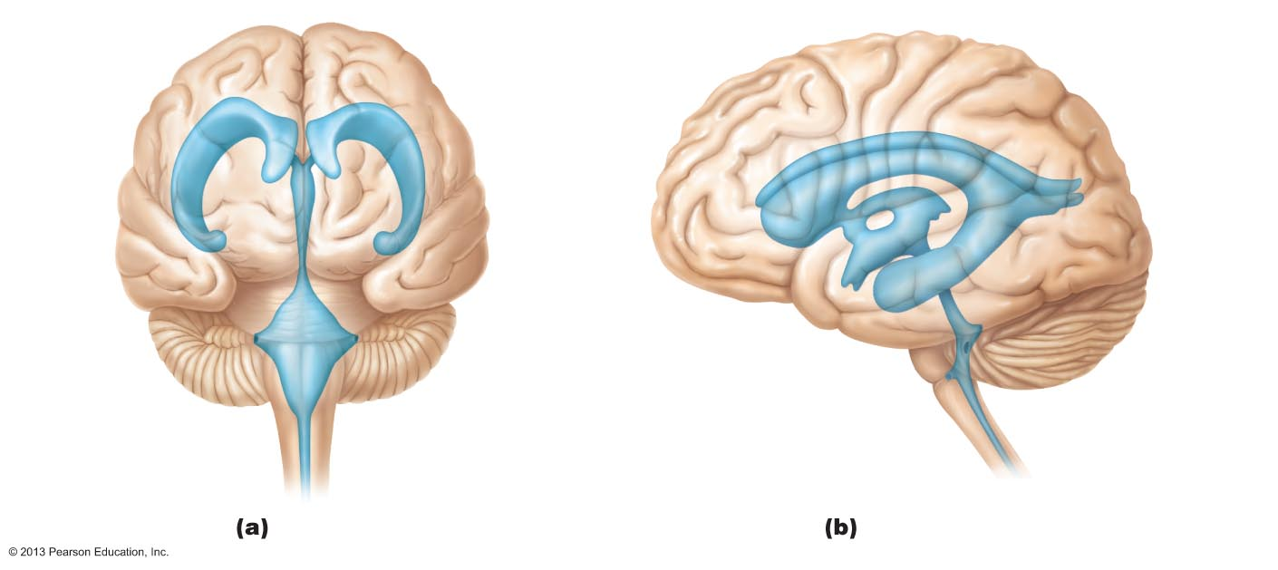
Figure 12.3 Ventricles of the brain.
Lateral
ventricle
Anterior
horn
Posterior
horn
Septum
pellucidum
Interventricular
foramen
Inferior
horn
Third
ventricle
Inferior
horn
Lateral
aperture
Cerebral aqueduct
Median
aperture
Fourth ventricle
Lateral
aperture
Central canal
Anterior view
Left lateral view

Slide 66
Cerebral Hemispheres
Surface markings
Ridges
shallow grooves
deep grooves
Separates two hemispheres
Transverse cerebral fissure
Separates _

Slide 67
Cerebral Hemispheres
Five lobes
Insula

Slide 68
Cerebral Hemispheres
Separates precentral gyrus (__________________) of frontal lobe and postcentral gyrus (____________________________) of parietal lobe
Parieto-occipital sulcus
Separates occipital and parietal lobes
Lateral sulcus outlines _

Slide 69
Cerebral Hemispheres
Three basic regions
Cerebral cortex of _________________________ superficially
____________________________________ internally
____________________________________ deep within white matter

Slide 70
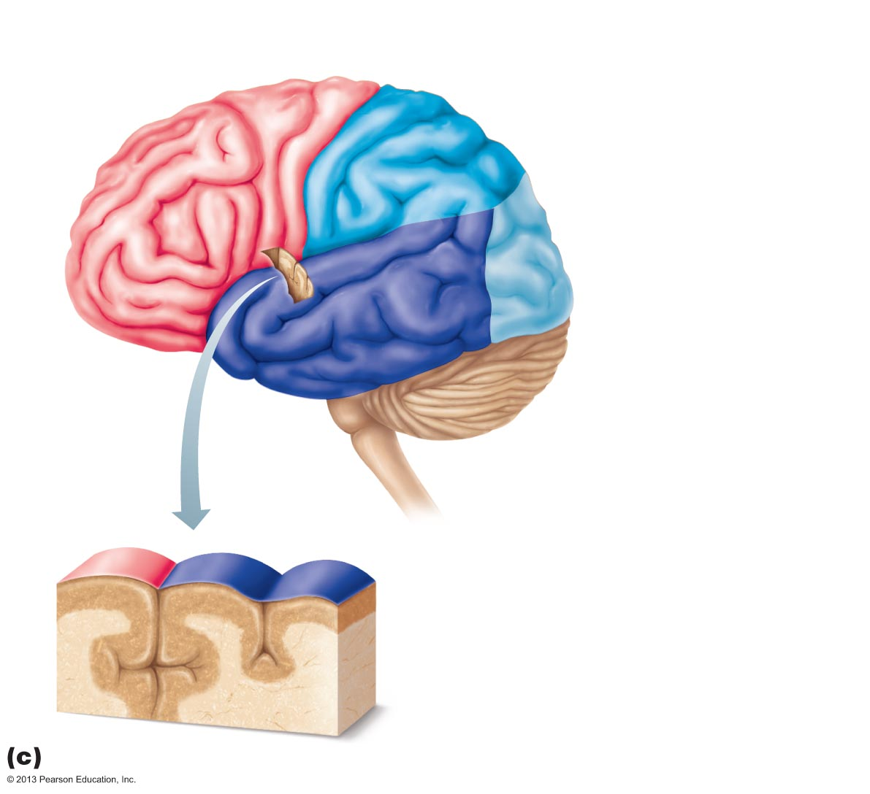
Figure 12.4c Lobes, sulci, and fissures of the cerebral hemispheres.
Precentral
gyrus
Central
sulcus
Postcentral
gyrus
Frontal lobe
Parietal lobe
Parieto-occipital sulcus
(on medial surface
of hemisphere)
Lateral sulcus
Occipital lobe
Temporal lobe
Transverse
cerebral fissure
Cerebellum
Pons
Medulla oblongata
Fissure
(a deep
sulcus)
Spinal cord
Gyrus
Cortex (gray matter)
Sulcus
White matter
Lobes and sulci of the cerebrum

Slide 71
Cerebral Cortex
Thin, _
40% mass of brain
Site of conscious mind: awareness, sensory perception, voluntary motor initiation, communication, memory storage, understanding

Slide 72
4 General Considerations of Cerebral Cortex
Three types of functional areas
control ____________________________________ movement
conscious awareness of sensation
____________________________________ diverse information

Slide 73
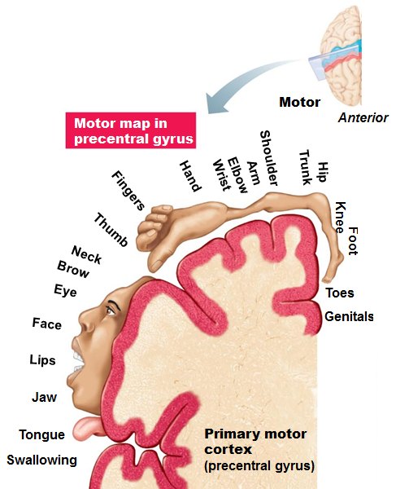
Motor Areas of Cerebral Cortex
In frontal lobe; control voluntary movement
in _
Allows conscious control of precise, skilled, skeletal muscle movements
Motor _
upside-down caricatures represent contralateral motor innervation of body regions

Slide 74
Motor Areas of Cerebral Cortex
____________________________________ anterior to precentral gyrus
Helps _
Controls learned, repetitious, or patterned motor skills
Coordinates simultaneous or sequential actions
Controls voluntary actions that depend on sensory feedback
_________________________________ anterior to inferior premotor area
Present in one hemisphere (____________________________)
directs _
Active in planning speech and voluntary motor activities

Slide 75
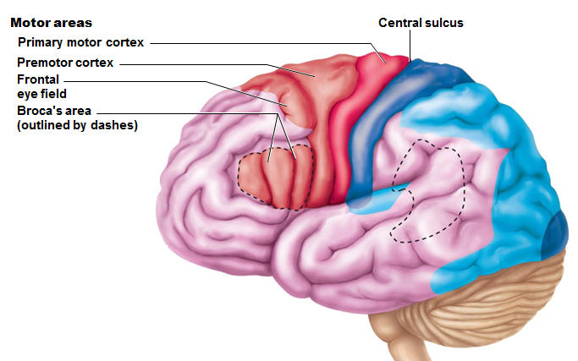
Motor Areas of Cerebral Cortex
___________________________________ within and anterior to premotor cortex; superior to Broca's area
Controls

Slide 76
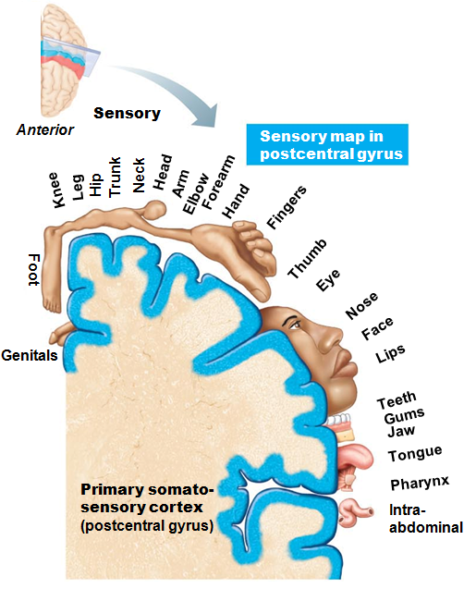
Primary Somatosensory Cortex
In _
general _______________________ from skin, joints, and tendons
Capable of _
identification of body region being stimulated
homunculus
upside-down caricatures represent contralateral sensory input from body regions

Slide 77
Somatosensory Association Cortex
Posterior to primary somatosensory cortex
______________________________ sensory input from primary somatosensory cortex for understanding of object
Determines ___________________________, and relationship of parts of objects being felt

Slide 78
Visual Areas
Primary ________________________(striate) cortex
Extreme posterior tip of _
Receives visual information from _
Visual association area
_________________________________________ primary visual cortex
Uses past visual experiences to interpret visual stimuli
ability to recognize faces

Slide 79
Auditory Areas
Primary ________________________ cortex
Superior margin of _
Interprets information from inner ear as pitch, loudness, and location
Auditory association area
Located posterior to primary auditory cortex
Stores __________________________________ and permits perception of sound stimulus

Slide 80
OIfactory and Gustatory
Primary olfactory (___________________) cortex
Medial aspect of _
Region of conscious awareness of _
Gustatory Cortex
In ____________________________ just deep to temporal lobe
Involved in perception of _

Slide 81
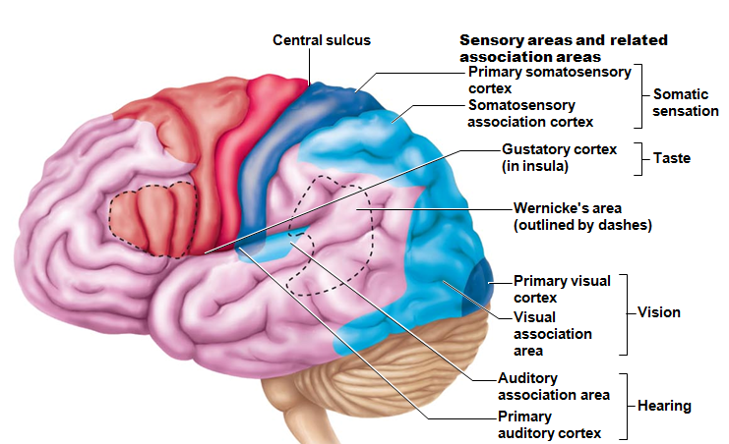
Visceral Sensory Area
Posterior to gustatory cortex
Conscious perception of _
upset

Slide 82
Cerebral White Matter
Myelinated fibers and tracts
Communication between cerebral areas, and between cortex and lower CNS
horizontal; connect different parts of same hemisphere
horizontal; connect gray matter of two hemispheres
vertical; connect hemispheres with lower brain or spinal cord

Slide 83
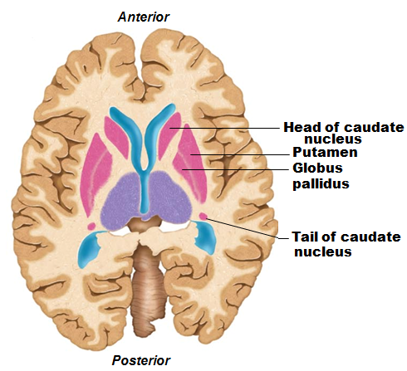
Functions of Basal Nuclei
Functions thought to be
Influence muscle movements
Role in _
Regulate intensity of slow or stereotyped movements
Filter out incorrect/inappropriate responses
Inhibit _

Slide 84
Diencephalon
Three paired structures
Encloses third ventricle

Slide 85
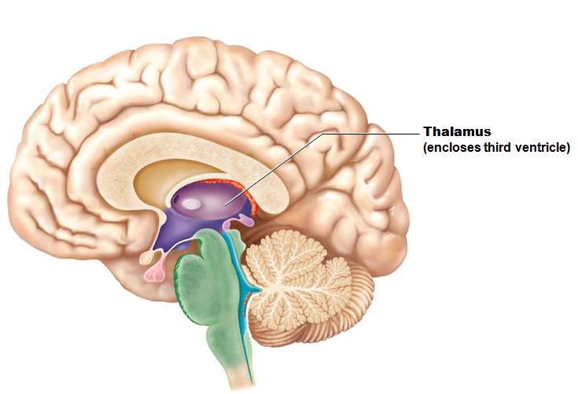
Thalamus
80% of diencephalon
Nuclei __________________________________ fibers from cerebral cortex

Slide 86
Thalamic Function
Gateway to cerebral cortex

Slide 87
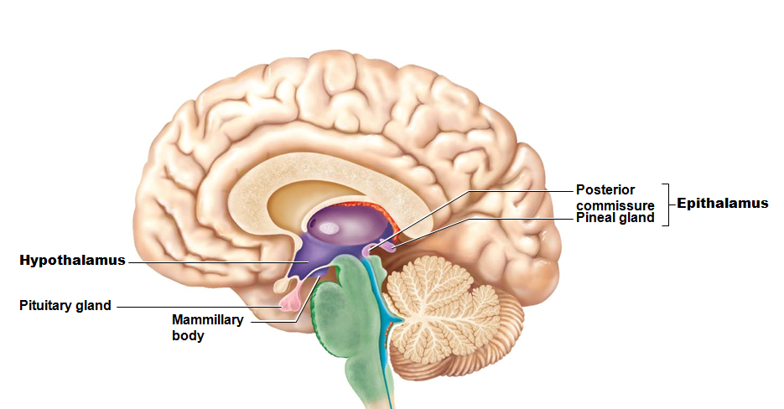
Hypothalamus
Contains many _
Example: _
Infundibulum
____________________________ that connects to pituitary gland

Slide 88
Hypothalamic Function
Controls _
blood pressure
rate and force of heartbeat
digestive tract motility
pupil size
Physical responses to
Perception of pleasure, fear, and rage, and in biological rhythms and drives

Slide 89
Hypothalamic Function
Regulates _
sweating/shivering
Regulates _
in response to nutrient blood levels or hormones
Regulates water balance and thirst
Regulates sleep-wake cycles
Controls _
Controls secretions of anterior pituitary gland
Produces posterior pituitary hormones

Slide 90
Epithalamus
___________________________ gland (body)
extends from posterior border and secretes _
Melatonin
helps regulate _

Slide 91
Brain Stem
Three regions
Medulla oblongata

Slide 92
Brain Stem
Similar structure to spinal cord
contains ______________________________ embedded in white matter
Controls __________________________ behaviors necessary for survival
Contains fiber tracts connecting higher and lower neural centers

Slide 93
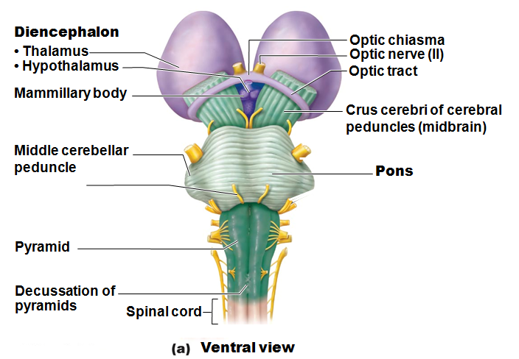

Slide 94
Pons
Fibers of pons
_______________________________________________ and spinal cord
Relay impulses between motor cortex and cerebellum
Nuclei help maintain _

Slide 95
Medulla Oblongata (Medulla)
Joins spinal cord at _
Contains _____________________________ of fourth ventricle
Pyramids
two ventral ____________________________________ formed by pyramidal tracts
Decussation of the pyramids

Slide 96
Medulla Oblongata: Functions
Autonomic reflex center
Functions overlap with hypothalamus
Hypothalamus relays instructions via medulla
Cardiovascular center
__________________________________ adjusts force and rate of heart contraction
__________________________________ adjusts blood vessel diameter for blood pressure regulation

Slide 97
Medulla Oblongata
Respiratory centers
Generate _
Control rate and depth of breathing (with pontine centers)

Slide 98
Medulla Oblongata
Additional centers regulate
Hiccuping
Coughing

Slide 99
Cerebellum
11% of brain mass
Input from cortex, brain stem and sensory receptors
Allows _
treelike pattern of _
Role in thinking, language, and emotion
May compare actual with expected output and adjust accordingly

Slide 100
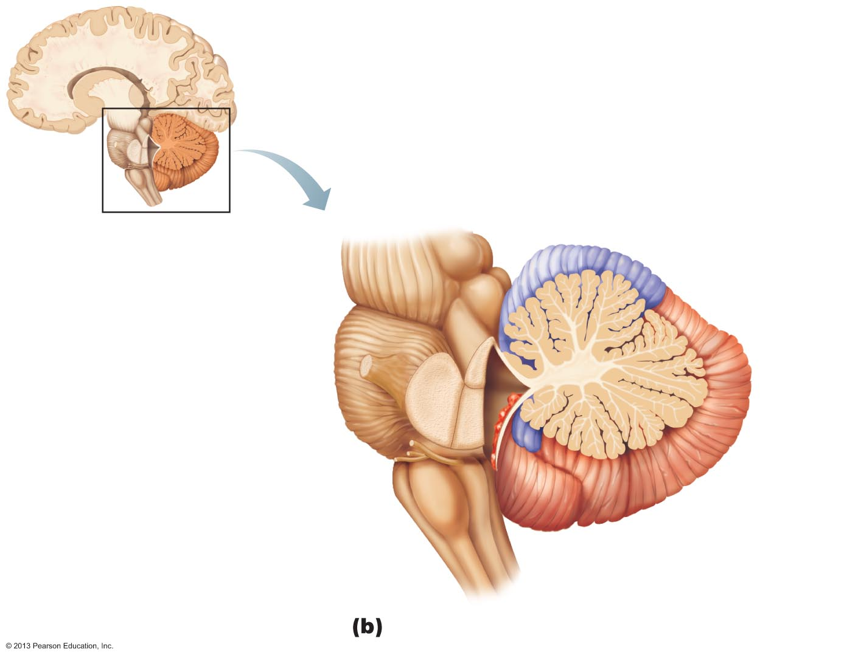
Figure 12.15b Cerebellum.
Anterior lobe
Cerebellar cortex
Arbor
vitae
Cerebellar
peduncles
Posterior
lobe
• Superior
• Middle
Choroid
plexus of
fourth
ventricle
• Inferior
Medulla
oblongata
Flocculonodular
lobe

Slide 101
Protection of the Brain
Bone (_________________________)
Membranes (__________________________)
Watery cushion (________________________ fluid)
Blood brain barrier

Slide 102
Meninges
Cover and __________________________ CNS
Protect blood vessels and enclose venous sinuses
Contain cerebrospinal fluid (CSF)

Slide 103
Meninges
Three layers
Meningitis
Inflammation of meninges

Slide 104
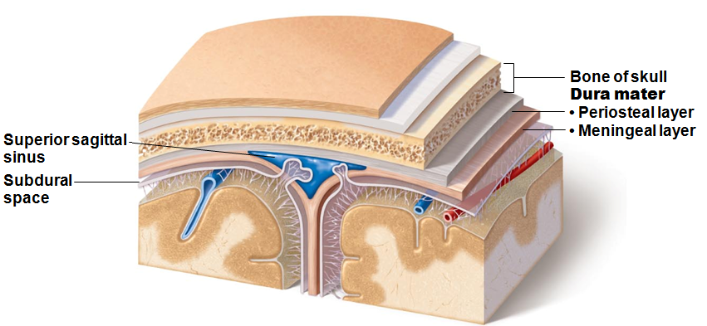
Dura Mater
_______________________ layers of fibrous connective tissue (around brain) ___________________________ to form dural venous sinuses

Slide 105
Dura Mater
Dural septa limit excessive movement of brain
in longitudinal fissure; attached to crista galli
along vermis of cerebellum
horizontal dural fold over cerebellum and in transverse fissure

Slide 106
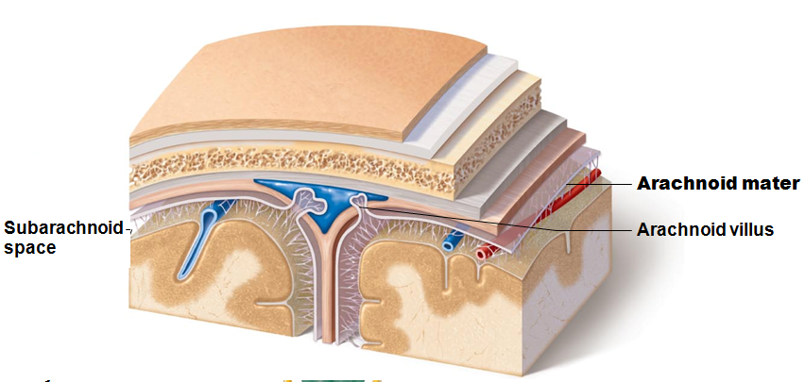
Arachnoid Mater
Middle layer with _____________________ extensions
Separated from dura mater by _
contains CSF and largest blood vessels of brain
permit cerebrospinal fluid reabsorption

Slide 107
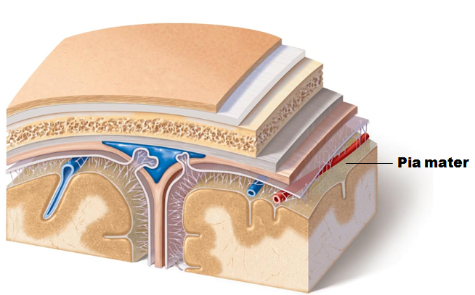
Pia Mater
_________________________________ vascularized connective tissue that _

Slide 108
Cerebrospinal Fluid (CSF)
Composition
Watery solution formed _
Functions
Gives ______________________________ to CNS structures
Reduces weight by 97%
________________________________CNS from blows and other trauma
________________________________ brain and carries chemical signals

Slide 109
Spinal Cord: Gross Anatomy and Protection
Location
Begins at the _
Ends at L₁ or L₂ vertebra
Functions
Provides two-way _________________________________ to and from brain
Contains spinal _

Slide 110
Spinal Cord: Gross Anatomy and Protection
Bone, meninges, and CSF
Cushion of fat and network of veins in space between vertebrae and spinal dura mater
CSF in subarachnoid space

Slide 111
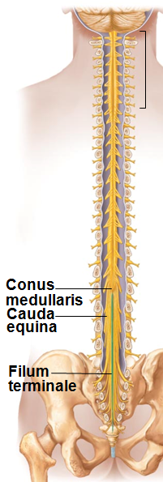
Spinal Cord: Gross Anatomy and Protection
Terminates in _
_______________________ extends to coccyx
Denticulate ligaments
Extensions of ____________ mater that secure cord to dura mater

Slide 112
Spinal Cord
Spinal nerves (Part of _____________________)
31 pairs
Cervical and lumbosacral _
Nerves serving upper and lower limbs emerge here
“horse tail”
Collection of _____________________________ at inferior end of vertebral canal

Slide 113
Cross-sectional Anatomy
Two lengthwise grooves partially divide cord into right and left halves
connects masses of gray matter; encloses central canal

Slide 114
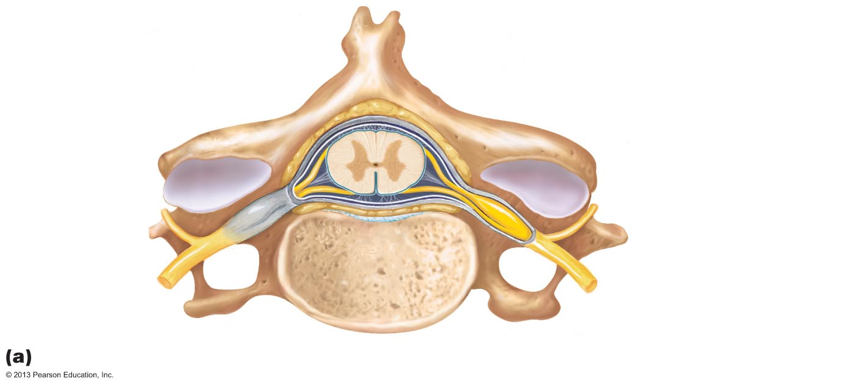
Figure 12.28a Anatomy of the spinal cord.
Epidural space
(contains fat)
Pia mater
Arachnoid mater
Spinal meninges
Subdural space
Dura mater
Subarachnoid
space
(contains CSF)
Dorsal root
ganglion
Cross section of spinal cord and vertebra

Slide 115
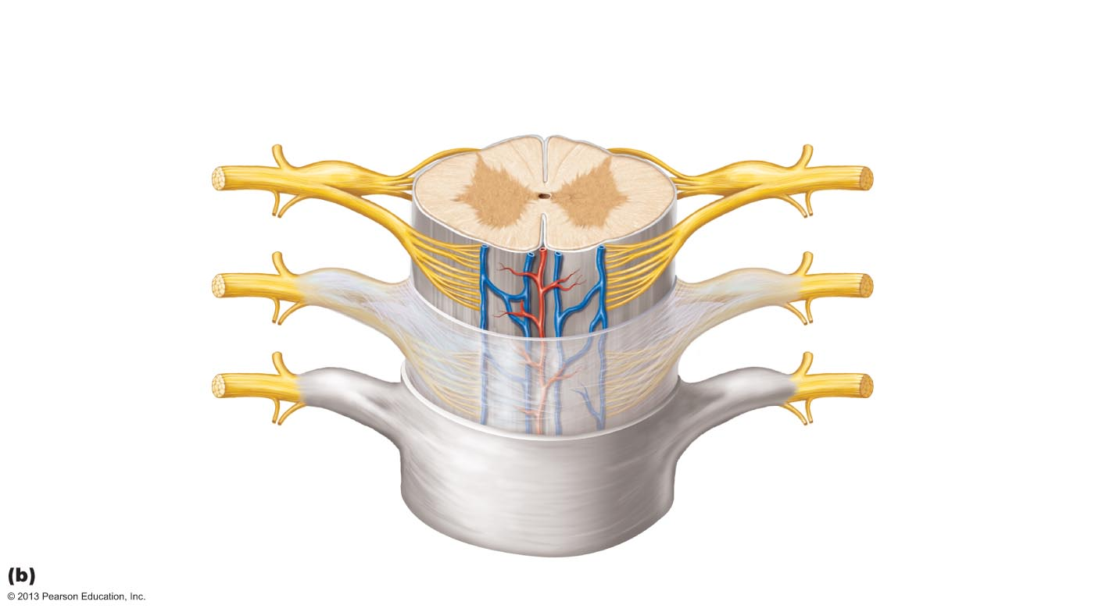
Figure 12.28b Anatomy of the spinal cord.
Posterior
median sulcus
Gray commissure
White
columns
Dorsal horn
Gray
matter
Ventral horn
Lateral horn
Dorsal root
ganglion
Spinal nerve
Dorsal root
Central canal
Anterior median
fissure
Pia mater
Ventral root
Arachnoid mater
Spinal dura mater
The spinal cord and its meningeal coverings

Slide 116
Gray Matter
interneurons that receive somatic and visceral sensory input
some interneurons;
somatic motor neurons;
axons exit cord via ventral roots
only in thoracic and superior lumbar regions
sympathetic neurons
sensory input to cord
Dorsal root (spinal) ganglia
cell bodies of sensory neurons

Slide 117
White Matter
Myelinated and nonmyelinated nerve fibers allow communication between parts of spinal cord, and spinal cord and brain
Run in three directions
up to higher centers
sensory inputs
from brain to cord or lower cord levels
motor outputs
from one side to other
commissural fibers

Slide 118
White Matter
Divided into three white columns (funiculi) on each side
Dorsal (posterior), lateral, and ventral (anterior)
Each spinal tract composed of _____________________________________ and functions

Slide 119
Ascending Pathways
Consist of three neurons
Conducts impulses from cutaneous receptors and proprioceptors
Branches diffusely as _______________________________ or medulla
Synapses with second-order neuron

Slide 120
Ascending Pathways
Second-order neuron
Cell body in ____________________________ or medullary nuclei
Axons extend to thalamus or cerebellum

Slide 121
Ascending Pathways
Third-order neuron
Cell body in _
Axon extends to somatosensory cortex
No third-order neurons in cerebellum

Slide 122
Ascending Pathways
Three main pathways:
Two transmit somatosensory information to sensory cortex via thalamus
Dorsal column–medial lemniscal pathways
Spinothalamic pathways
Transmit _________________________________________, coarse touch, and pressure impulses
Provide discriminatory touch and conscious proprioception
Spinocerebellar tracts terminate in the cerebellum
Convey information about __________________________________________ to cerebellum
Used to coordinate muscle activity

Slide 123
Descending Pathways and Tracts
Deliver __________________________ impulses from brain to spinal cord
Two groups
Direct pathways
Indirect pathways
all others

Slide 124
Descending Pathways and Tracts
Motor pathways involve two neurons:
Upper motor neurons
Pyramidal cells in _
pass through pyramidal (corticospinal)l tracts
Descend without synapsing
Axons synapse with interneurons or ventral horn motor neurons
Direct pathway _
Lower motor neurons
Innervate _

Slide 125
Indirect System
Includes brain stem motor nuclei, and all motor pathways except pyramidal pathways
These pathways regulate
muscles for _
coarse _
Head, neck, and eye movements that follow objects in visual field

Slide 126
Spinal Cord Trauma
Functional losses
Paresthesias
Paralysis

Slide 127
Spinal Cord Trauma
___________________________ paralysis
severe damage to __________________root or ventral horn cells
there is no voluntary or involuntary control of muscles
Muscles _

Slide 128
Spinal Cord Trauma
___________________________ paralysis
damage to _____________________________ of primary motor cortex
Spinal neurons remain intact; _
No voluntary control of muscles
Muscles often shorten permanently

