Slide 1
Peripheral Nervous System (PNS)
Provides links from and to world outside body
All neural structures outside brain
Peripheral nerves and _
____________________________motor endings

Slide 2
Sensory Receptors
Specialized to _ (stimuli)
Activation results in _____________________________________ that trigger nerve impulses
Sensation
awareness of stimulus
Perception
interpretation of meaning of stimulus

Slide 3
Classification of Receptors
Based on
__________________________________ in body
Structural complexity

Slide 4
Classification by Stimulus Type
respond to touch, pressure, vibration, and stretch
Thermoreceptors
sensitive to changes in temperature
Photoreceptors
respond to light energy (e.g., retina)
respond to chemicals (e.g., smell, taste, changes in blood chemistry)
sensitive to pain-causing stimuli
extreme heat or cold, excessive pressure, inflammatory chemicals

Slide 5
Classification by Location
Respond to stimuli arising from _
Receptors in ___________________ for touch, pressure, pain, and temperature
Most _______________________________ organs are exteroceptors

Slide 6
Classification by Location
Interoceptors (visceroceptors)
Respond to stimuli arising in _________________________________________
Sensitive to chemical changes, tissue stretch, and temperature changes
Sometimes cause _
We are usually _______________________________ of their workings

Slide 7
Classification by Location
Respond to stretch in ______________________, tendons, joints, ligaments, and connective tissue coverings of bones and muscles
Inform brain of one's movements

Slide 8
Classification by Receptor Structure
Simple receptors for _
___________________________________ sensations
touch, pressure, stretch, vibration
muscle sense
Modified dendritic endings of sensory neurons
Receptors for special senses
Vision, hearing, equilibrium, smell, and taste (Chapter 15)

Slide 9
Simple Receptors, Nonencapsulated
Nonencapsulated (free) nerve endings
Abundant in _
Associated with most nonmyelinated fibers , small-diameter group C fibers (pain fibers)
Respond mostly to
pressure-induced tissue movement
itch

Slide 10
Simple Receptors, Nonencapsulated Free Nerve Endings
Cold receptors
in ___________________________________ dermis
Heat receptors
in ____________________________________ dermis
Outside those temperature ranges → nociceptors activated → _

Slide 11
Simple Receptors, Nonencapsulated Free Nerve Endings
Nociceptors
Respond to:
chemicals from _
capsaicin

Slide 12
Simple, Nonencapsulated
Light touch receptors
Tactile (_________________________) discs
Sensitive to _
Hair follicle receptors
Sensitive to hair _

Slide 13
Encapsulated Dendritic Endings
Most mechanoreceptors in connective tissue capsule
Tactile (Meissner's) corpuscles
Found in nipples, external genitalia, finger tips, soles of the feet, and eyelids
Lamellar (Pacinian) corpuscles
Found in fingers, soles of feet, external genitalia, nipples
Bulbous corpuscles (Ruffini endings)
Found in dermis, hypodermis, and joint capsules
Muscle spindles
Tendon organs
stretch in tendons
Joint kinesthetic receptors

Slide 14
From Sensation to Perception
Survival depends upon sensation and perception
the awareness of changes in the internal and external environment
the conscious interpretation of those stimuli

Slide 15
Sensory Integration
part of sensory system serving body wall and limbs
Receives inputs from
Exteroceptors, proprioceptors, and interoceptors
Input relayed toward head, but _

Slide 16
Sensory Integration
Levels of neural integration in sensory systems:
sensory receptors
processing in ascending pathways
processing in cortical sensory areas

Slide 17
Notes:
Blank for drawing

Slide 18
Adaptation of Sensory Receptors
Adaptation is ______________________________ in the presence of _______________________ stimulus
Receptor membranes become _
Receptor potentials _______________________ in frequency or stop

Slide 19
Adaptation of Sensory Receptors
___________________________ (fast-adapting) receptors signal beginning or end of stimulus
receptors for pressure, touch, and smell
____________________________ receptors adapt slowly or not at all
_______________________________ and most proprioceptors

Slide 20
Processing at the Circuit Level
Pathways of three neurons conduct sensory impulses upward to appropriate cortical regions
Conduct impulses from receptor level to spinal reflexes or second-order neurons in CNS
Second-order sensory neurons
Transmit impulses to third-order sensory neurons
Third-order sensory neurons
Conduct impulses from _

Slide 21
Processing at the Perceptual Level
Interpretation of sensory input depends on __________________________________ of target neurons in sensory cortex
Aspects of sensory perception:
ability to detect a stimulus (requires summation of impulses)
Magnitude estimation
intensity coded in _
Spatial discrimination
identifying site or __________________________________ (studied by two-point discrimination test)

Slide 22
Main Aspects of Sensory Perception
identification of more complex aspects and several stimulus properties
ability to identify submodalities of a sensation
recognition of familiar or significant patterns in stimuli
melody in piece of music

Slide 23
Perception of Pain
Warns of actual or impending tissue damage → protective action
Stimuli include
K⁺
Acids
bradykinin
Some pain impulses are blocked by inhibitory __________________________________________ (e.g., endorphins)

Slide 24
Pain Tolerance
All perceive pain at same _
Pain _____________________________ varies
"Sensitive to pain" means __________________________________, not low pain threshold
Genes help determine pain tolerance, response to pain medications

Slide 25
Homeostatic Imbalance
Long-lasting/intense pain leads to
________________________________________ (pain amplification)
chronic pain
felt in limb no longer present
Now use epidural anesthesia to reduce
Early pain management critical to prevent pain amplification responses

Slide 26
Visceral Pain
Stimulation of _
Felt as _________________ aching, gnawing, burning
Activated by
Ischemia
Chemicals
muscle spasms

Slide 27
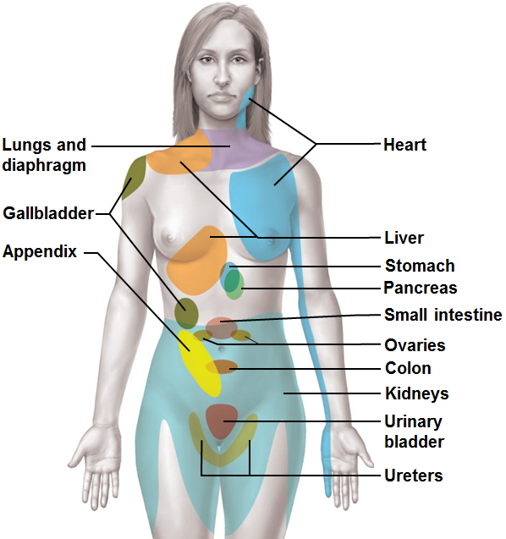
Referred Pain
Referred pain
Pain from one body region _
Visceral and somatic pain fibers travel in same nerves;
brain assumes stimulus from common (somatic) region
E.g., left arm pain during heart attack

Slide 28
Structure of a Nerve
Cordlike organ of the Peripheral Nervous System
Bundle of _________________________________________ peripheral axons enclosed by connective tissue

Slide 29
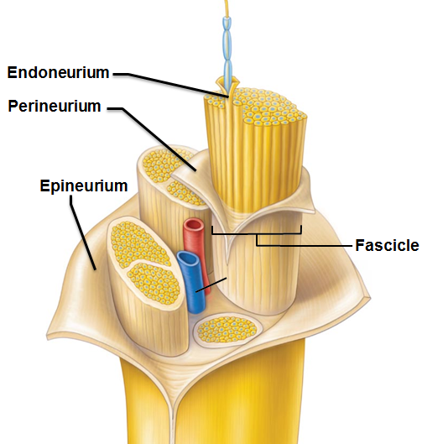
Structure of a Nerve
Connective tissue coverings include
loose connective tissue that encloses axons and their myelin sheaths
coarse connective tissue that bundles fibers into fascicles
tough fibrous sheath around a nerve

Slide 30
Classification of Nerves
Most nerves are ______________________ of afferent and efferent fibers and somatic and autonomic (visceral) fibers
Classified according to direction transmit impulses
both sensory and motor fibers
impulses both _
Sensory (afferent) nerves
impulses only toward CNS
Motor (efferent) nerves
impulses only away from CNS

Slide 31
Classification of Nerves
Pure sensory (afferent) or motor (efferent) nerves are __________________________; most mixed
Types of fibers in mixed nerves:
Somatic afferent
Somatic efferent
Visceral afferent
Visceral efferent
Peripheral nerves classified as _

Slide 32
Ganglia
Contain _____________________________ associated with nerves in _
Ganglia associated with
afferent nerve fibers
contain _
Ganglia associated with
efferent nerve fibers
contain _
Autonomic ganglia

Slide 33
Regeneration of Nerve Fibers
Mature neurons are _
if ____________________ of damaged nerve is ____________, peripheral axon may regenerate
If peripheral axon damaged
_____________________________________ clean dead axon; myelin sheath intact
Axon filaments grow through regeneration tube
Axon regenerates; _
Greater distance between severed ends-less chance of regeneration

Slide 34
Regeneration of Nerve Fibers
Most __________________fibers _
CNS oligodendrocytes bear _______________________________________ that prevent CNS fiber regeneration
Astrocytes at injury site _______________________________________ that blocks axonal regrowth

Slide 35
Cranial Nerves
______________________________ of nerves associated with brain
Two attach to forebrain; rest with brain stem
Most _________________________nerves; __________________________pairs purely sensory
Each numbered with Roman Numerals

Slide 36
I: The Olfactory Nerves
Sensory nerves of smell (_______________)
Receptors:
Purely sensory (olfactory) function

Slide 37
I: The Olfactory Nerves
Pathway
Receptors in olfactory epithelium in nasal cavity
Pass through _____________________________, roof of nasal cavity to olfactory bulb.
Synapse in _
Olfactory tract runs beneath frontal lobe to primary olfactory cortex

Slide 38
I: The Olfactory Nerves
Homeostatic Imbalance
Partial or total loss of smell

Slide 39
II: The Optic Nerves
Receptors: in retinas
Pathway
Photoreceptors in retina
Pass through optic canals as _______________________
converge and partially cross over at _
Optic tracts continue to _
where they synapse
Optic radiation fibers run to visual cortex in the occipital lobe

Slide 40
II: The Optic Nerves
Homeostatic Imbalance
Damage done to optic nerve: _
Damage done after optic chiasma
Clinical Tests
Acuity
Peripheral vision
Ophthalmascopic evaluation to view _

Slide 41
III: The Oculomotor Nerves
Origin: gray matter of midbrain
Pathway: gray matter of midbrain, near pons→ enters bony orbit through superior orbital fissure → eye
Function:
____________________________________________________ with some proprioception
Function in _
Voluntary Effectors:
4 of 6 extrinsic eye muscles
Inferior Oblique
Superior Rectus
Medial Rectus
Inferior Rectus
And _
Levator Palpebra Superioris

Slide 42
III: The Oculomotor Nerves
Involuntary Effectors
Pupillary constriction
Change in lens shape for focusing
Autonomic Fibers: _
Afferent Fibers
Sensory from the four extrinsic eye muscles for _

Slide 43
III: The Oculomotor Nerves
Clinical Tests
Pupillary reflex (________________________________)
Convergence (__________________________________)
H or Z pattern for extrinsic eye muscle movement
Homeostatic Imbalance
Oculomotor nerve paralysis:
eye rotates __________________________________________ at rest
(Lateral Rectus muscle is not affected by CN III.
Drooping eyelid (Levator Palpebra Superioris loses function)
Difficulty focusing (____________________________________)

Slide 44
IV: The Trochlear Nerves
Origin: midbrain
Pathway: from midbrain through superior orbital fissure to _
Primarily motor nerve that directs eyeball
Some afferent fibers from _

Slide 45
IV: The Trochlear Nerves
Clinical Testing
H or Z pattern of eye movements
Looking _
Damage to Trochlear Nerve
________________________________ and the inability to look down and laterally

Slide 46
V: The Trigeminal Nerves
Sensory and Motor: _
Largest cranial nerve
Origins for motor fibers: _
Sensory Receptors located
Scalp, upper eyelid, nose, nasal cavity, corneal, lacrimal gland
Ophthalmic division
Palate, upper teeth, skin of cheek, upper lip, lower eyelid
Maxillary division
Anterior tongue (_______________________________), lower teeth, chin, temples
Mandibular division
_______________________________________________ for sensory fibers located in _
Pathway: Runs in three branches to the face

Slide 47
V: The Trigeminal Nerves
Three divisions
Mandibular division
Muscles of mastication
sensory

Slide 48
V: The Trigeminal Nerves
Clinical Tests
Ophthalmic division
______________________________________________: check sensory to cornea by making light contact. Normal response: _
Check pain/temperature responses. Hot/cold and sharp/dull
Mandibular division
_______________________________: clench teeth, open mouth against resistance, move jaw side to side
Tests muscles _

Slide 49
V: The Trigeminal Nerves
Homeostatic Imbalance
Tic douloureux (painful twitch)
Possibly vascular compression of CN V
Mild sensory stimuli (a breeze) can cause ______________________________________________ that last for seconds to minutes
Can happen a hundred times a day
Treatment
NSAIDS/Analgesics are partially effective
Surgical destruction of the nerve
Loss of sensation to face

Slide 50
VI: The Abducens Nerves
Fibers from inferior pons enter orbits via superior orbital fissures
Primarily a _
innervates _
Some sensory:
_______________________________________ from Lateral Rectus muscle

Slide 51
VI: The Abducens Nerves
Homeostatic Imbalance
Damage causes an _
Lateral Rectus muscle can not pull the eye laterally, _
Clinical Tests, along with III and IV
H or Z pattern for eye movement

Slide 52
VII: The Facial Nerves
Pathway: from pons through internal acoustic meatus → emerge through stylomastoid foramina to lateral aspect of face
Chief motor nerves of face with _
Motor functions include
facial expression
_______________ glands
Nasal and palatine glands
salivary glands
Autonomic Motor, Involuntary

Slide 53
VII: The Facial Nerves
Sensory function from ____________________________________ of tongue
Clinical Tests
Test for _____________________________________, etc to see if sensory portion intact
Close eyes (_______________________________), smile (____________________________________)
to observe facial expressions
Encourage tear production (________________________)
Ammonia fumes

Slide 54
VII: The Facial Nerves
Homeostatic imbalance
Rapid onset
May be related to _
_________________________________________ of facial muscles on the affected side
Partial loss of _
Drooping _____________________________ eyelid
(upper eyelid controlled by CN III)
Mouth corners sag (facial muscles impacted)
Continual tearing (loss of Lacrimal Gland control)
Eye can not close completely
May result in dry eye syndrome

Slide 55
VIII: The Vestibulocochlear Nerves
__________________________ fibers from hearing receptors (_____________________) and equilibrium receptors (vestibular division) pass from inner ear through internal acoustic meatuses, and enter brain stem at pons-medulla border
_____________________________________; small motor component for adjustment of sensitivity of receptors
Formerly auditory nerve

Slide 56
VIII: The Vestibulocochlear Nerves
Vestibulo:
Vestibule is related to _
Cochlear
Cochlea houses the _
Mostly sensory
Minor motor component
Adjusts ______________________________ of the sensory receptors

Slide 57
VIII: The Vestibulocochlear Nerves
Origin: Receptors in the vestibule (balance) and cochlea (hearing).
Vestibular Nerve (____________________________________) joins Cochlear nerve (cell bodies in ____________________________) to pass through the internal acoustic meatus to go to brain stem

Slide 58
VIII: The Vestibulocochlear Nerves
Clinical Tests
Evaluate _____________________________________ with tuning fork
Check for _
Homeostatic Imbalance
Damage to cochlear nerve:
_______________________________________________ (nerve deafness)
Damage to vestibular nerve:
Rapid involuntary eye movements (______________________)
Loss of _
Nausea and vomiting

Slide 59
IX: The Glossopharyngeal Nerves
Origen/Pathway: from medulla→ leave skull via jugular foramen and run to throat
Motor functions
swallowing
Parotid salivary glands
Sensory functions
general sensory (touch, pressure, pain) impulses from pharynx and posterior tongue
impulses from carotid chemoreceptors and baroreceptors
Chemoreceptor: sensitive to changes in blood _
Baroreceptors: sensitive to changes in blood _

Slide 60
IX: The Glossopharyngeal Nerves
Clinical Testing
View ______________ while mouth is open, saying “aah”
Use cotton-tipped swab to test for _
Check __________________________________ for ability to taste
Homeostatic Imbalance
Damage to CN IX result in impaired ability to swallow and taste

Slide 61
X: The Vagus Nerves
Vagus: “_________________________” or wandering
Only cranial nerves _
Origin: from medulla through jugular foramen → neck, thorax, and abdomen
Most motor fibers are _
regulate activities of
Heart
Lungs
Abdominal viscera

Slide 62
X: The Vagus Nerves
Sensory fibers
carry impulses _________________ thoracic and _
Baroreceptors
taste buds of posterior tongue and pharynx
_______________________________ fibers from muscles of larynx and pharynx

Slide 63
X: The Vagus Nerves
Clinical Testing
Similar to the testing for CN IX since their areas overlap
Homeostatic Imbalance
Can lead to _______________________________ or loss of voice if CN X is damaged
Changes in gastrointestinal motility

Slide 64
XI: The Accessory Nerves
Origin differs from the other cranial nerves
Are _______________________________ from the upper cervical regions instead of cranial rootlets
Do not originate from _
Rootlets pass _________________ cranium through the foramen magnum

Slide 65
XI: The Accessory Nerves
Mostly Motor
Innervates ________________________ muscles and Sternocleidomastoid muscles
Minor sensory
Formerly spinal accessory nerve

Slide 66
XI: The Accessory Nerves
Clinical Testing
Muscle test the Traps and SCMs _
Ask them to rotate head and shrug shoulders
“I dunno” movement
Homeostatic Imbalance
Head turns toward side of injury _
Elevation of _

Slide 67
XII: The Hypoglossal Nerves
Origin: Fibers from medulla exit skull via hypoglossal canal to target the tongue
___________________nerve, _
Motor function
Innervate extrinsic and intrinsic ________________________________________that contribute to swallowing and speech
Sensory function

Slide 68
XII: The Hypoglossal Nerves
Clinical Testing
Ask subjects to _
(stick out their tongues)
Check for _____________________________________ to one side
Homeostatic Imbalance
Difficulty with speech and swallowing
Decreased movement/paralysis of tongue and eventual atrophy

Slide 69
Spinal Nerves
31 pairs of mixed nerves named for point of issue from spinal cord
Supply all body parts but _
8 cervical (C₁–C₈)
12 thoracic (T₁–T₁₂)
5 Lumbar (L₁–L₅)
5 Sacral (S₁–S₅)
1 Coccygeal (C₀)

Slide 70
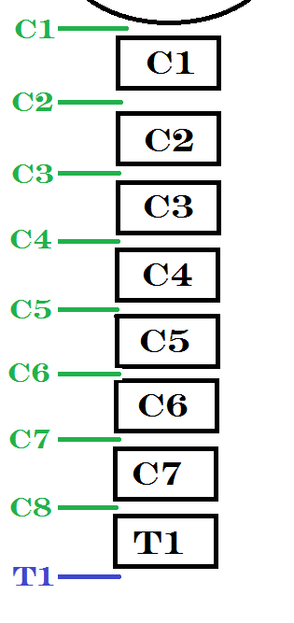
Spinal Nerves
Only 7 cervical vertebrae, _
7 exit vertebral canal superior to vertebrae for which named
1 exits canal inferior to C₇
Other spinal nerves _

Slide 71
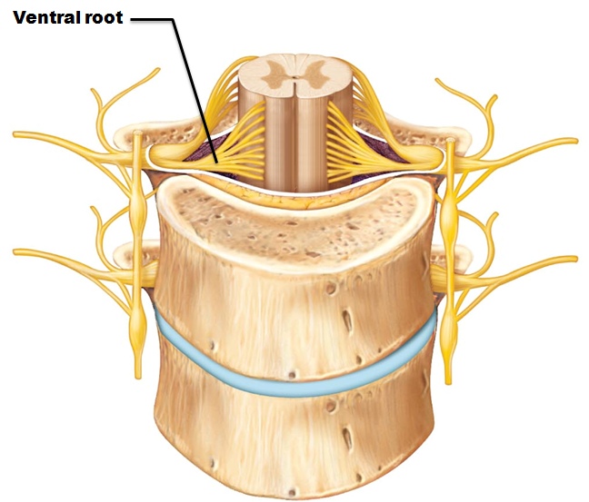
Spinal Nerves: Roots
Each spinal nerve connects to spinal cord via _
Contain motor (___________________) fibers from ventral horn motor neurons
Fibers innervate skeletal muscles

Slide 72
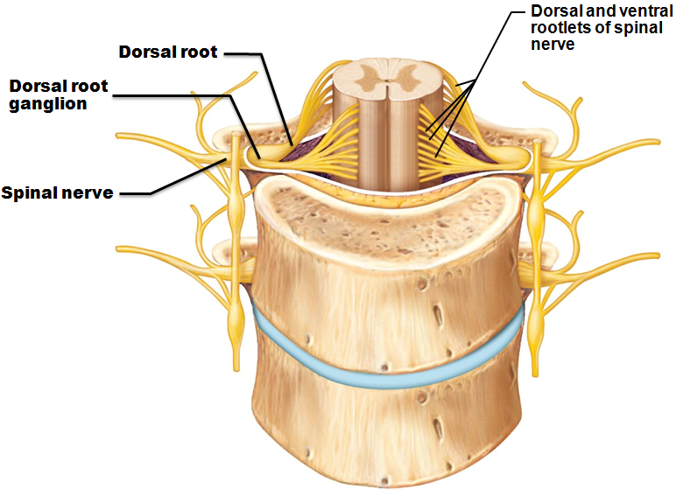
Spinal Nerves: Roots
Dorsal roots
Contain sensory (afferent) fibers from sensory neurons in dorsal root ______________________ and conduct impulses from peripheral receptors
Dorsal and ventral roots ______________________
emerge from vertebral column via _

Slide 73
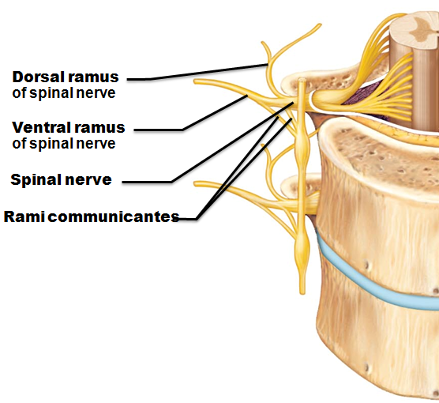
Spinal Nerves: Rami
Spinal nerves quite ________________________ (~1-2 cm)
Each branches into mixed rami
Ventral ramus
larger
tiny
reenters vertebral canal
innervates meninges and blood vessels
Rami communicantes
(__________________________ pathways) join ventral rami in thoracic region

Slide 74
Spinal Nerves: Rami
All ventral rami except ______________________ form interlacing nerve networks
called
cervical, brachial, lumbar, and sacral
The ____________________is innervated by __________________________________ via several branches
Ventral rami
supply muscles of ribs
anterolateral thorax
abdominal wall
Spinal roots longer as move _
Lumbar and sacral roots extend as _

Slide 75
Spinal Nerves: Plexuses
Within plexus fibers criss-cross
Fibers from ventral ramus go to body periphery via several routes
Each limb muscle innervated by _
Damage to one spinal nerve does not cause paralysis

Slide 76
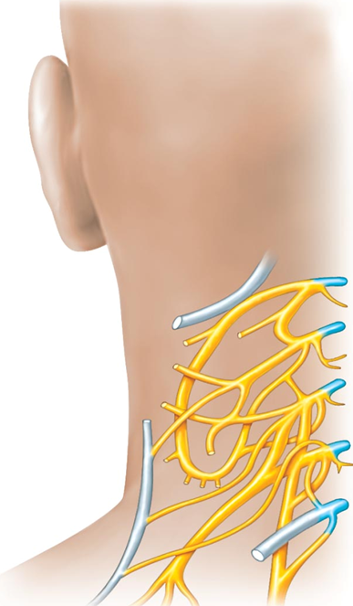
Cervical Plexus and the Neck
Formed by ventral rami of C₁–C₄
Most branches form _
Innervate ____________________________of neck, ear, back of head, and shoulders
Other branches innervate neck muscles
Major motor and sensory nerve of _________________________
receives fibers from C₃–C₅
Irritation → hiccups

Slide 77
Brachial Plexus and Upper Limb
Formed by ventral rami of C₅–C₈ and T₁
Gives rise to nerves that innervate upper limb
Major branches of this plexus:
five ventral rami (C₅–T₁
upper, middle, and lower
anterior and posterior
lateral, medial, and posterior

Slide 78
Brachial Plexus: Five Important Nerves
innervates deltoid, teres minor, and skin and joint capsule of shoulder
innervates biceps brachii and brachialis, coracobrachialis, and skin of lateral forearm
innervates skin, most flexors, forearm pronators, wrist and finger flexors, thumb opposition muscles
supplies flexor carpi ulnaris, part of flexor digitorum profundus, most intrinsic hand muscles, skin of medial aspect of hand, wrist/finger flexion
innervates essentially all extensor muscles, supinators, and posterior skin of limb

Slide 79
Lumbar Plexus
Arises from L₁–L₄
Innervates thigh, abdominal wall, and _
innervates quadriceps and skin of anterior thigh and medial surface of leg
passes through obturator foramen to innervate adductor muscles

Slide 80
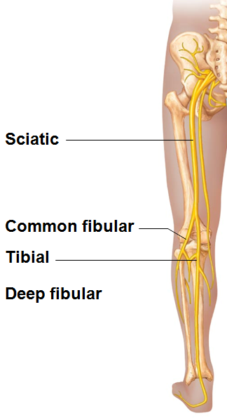
Sacral Plexus
Arises from L₄–S₄
Serves the buttock, lower limb, pelvic structures, and perineum
Sciatic nerve
Innervates hamstring muscles, adductor magnus, and most muscles in leg and foot
Composed of two nerves:

Slide 81
Anterolateral Thorax and Abdominal Wall
Ventral rami in thoracic wall run in a simple _
Form intercostal nerves that supply intercostal muscles, muscle and skin
Give off cutaneous branches to skin
Dorsal rami innervate _

Slide 82
Innervation of Skin: Dermatomes
Dermatome
area of skin innervated by _
All spinal nerves ______________________ participate in dermatomes
_______________________ of spinal cord injuries ascertained by affected dermatomes
Most dermatomes overlap, so destruction of a single spinal nerve _

Slide 83
Peripheral Motor Endings
PNS elements that _____________________________by releasing _

Slide 84
Review of Innervation of Skeletal Muscle
Takes place at _
Neurotransmitter acetylcholine (ACh) released when nerve impulse reaches axon terminal
ACh binds to receptors, resulting in:
Movement of Na⁺ and K⁺ across membrane
An end plate potential, which triggers an action potential → _

Slide 85
Review of Innervation of Visceral Muscle and Glands
____________________________motor endings and visceral effectors are _________________________ than somatic junctions
Branches form synapses using _
Visceral motor responses _________________ than somatic responses

Slide 86
Reflexes
Inborn (____________________) reflex - rapid, involuntary, predictable motor response to stimulus
Example – maintain ________________________, control visceral activities
Can be ________________________________by learning and conscious effort
Learned (___________________________) reflexes result from practice or repetition,
Example –

Slide 87
Reflex Arc
Components of a reflex arc (neural path)
site of stimulus action
transmits afferent impulses to CNS
Integration center
either monosynaptic or polysynaptic region within CNS
conducts efferent impulses from integration center to effector organ
muscle fiber or gland cell that responds to efferent impulses by contracting or secreting

Slide 88
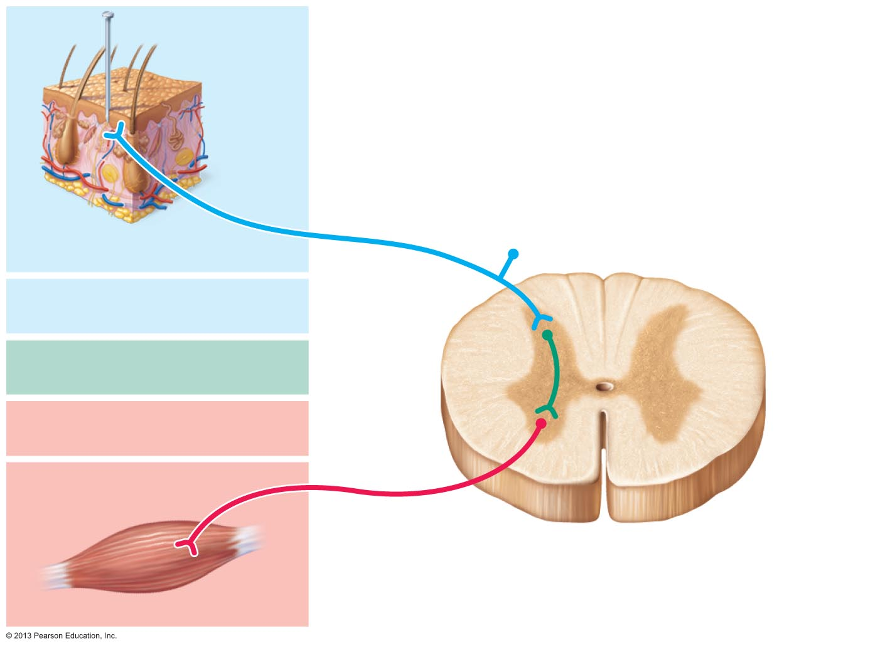
Figure 13.15 The five basic components of all reflex arcs.
Stimulus
Skin
1
Interneuron
2
3
4
5
Spinal cord
(in cross scetion)

Slide 89
Reflexes
Functional classification
_____________________________reflexes
Activate _______________________________muscle
________________________________ (visceral) reflexes
Activate _____________________________ effectors
smooth or cardiac muscle or glands

Slide 90
Spinal Reflexes
Spinal somatic reflexes
Integration center _
Effectors are _
Testing of somatic reflexes important clinically to _
If exaggerated, distorted, or absent
degeneration/pathology of specific nervous system regions

Slide 91
Stretch and Tendon Reflexes
To smoothly coordinate skeletal muscle nervous system must _
________________________________ of muscle
From _
Amount of _______________________ in muscle
From _

Slide 92
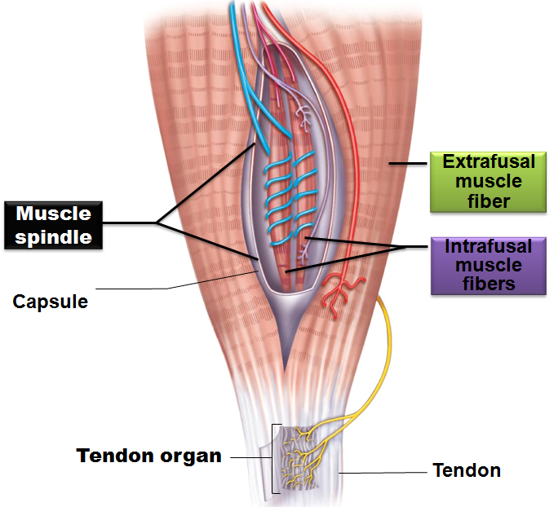
Functional Anatomy of Muscle Spindles
Composed of 3–10 _
intrafusal muscle fibers
wrapped in connective tissue capsule
Effector fibers
extrafusal muscle fibers

Slide 93
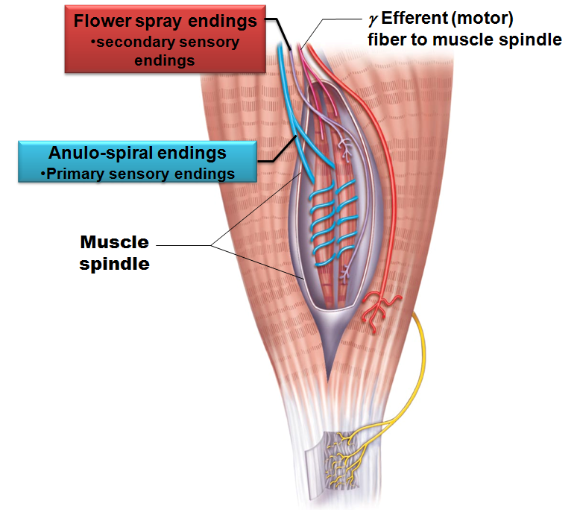
Intrafusal Fibers
__________________________ in central regions
lack myofilaments
Two types of afferent endings
Anulospiral endings
________________________ sensory endings
Endings wrap around spindle; stimulated by _
Flower spray endings _________________________ sensory endings
Small axons at spindle ends; respond to _

Slide 94
Muscle Spindles
Excited in two ways
_________________________________ stretch of muscle and muscle spindle
________________________ stretch of muscle spindle
Activating γ motor neurons stimulates ends to contract, thereby stretching spindle
Stretch causes __________________________________________ to spinal cord

Slide 95
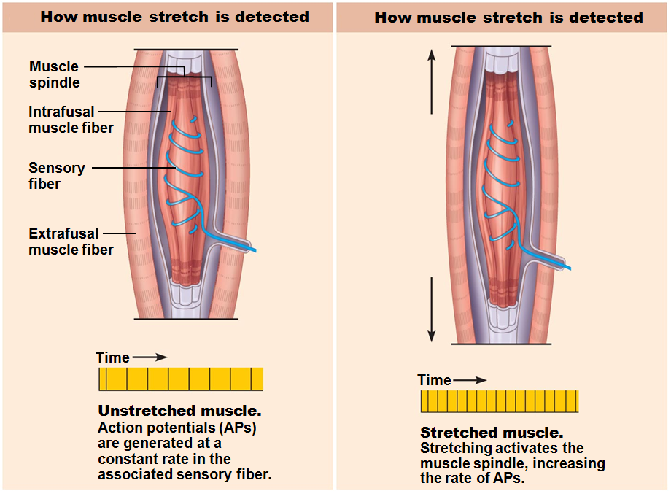

Slide 96
Muscle Spindles
______________________________ muscle __________________________ tension on muscle spindle
Sensitivity lost unless muscle spindle shortened

Slide 97
The Stretch Reflex
Maintains ____________________________ in large postural muscles, and adjusts it reflexively
Causes _______________________________ in response to increased muscle _

Slide 98
Stretch Reflexes
How stretch reflex works
Stretch activates _
Sensory neurons synapse directly with α motor neurons in spinal cord
α motor neurons cause _
All stretch reflexes are _____________________________ and _____________________________

Slide 99
Stretch Reflexes
___________________________________ also occurs
Specific fibers synapse with interneurons that _
Example
In patellar reflex:
stretched muscle (quadriceps) contracts
antagonists (hamstrings) relax

Slide 100
Stretch Reflexes
Positive reflex reactions indicate
Sensory and motor connections between muscle and spinal cord _
Strength of response indicates _
Hypoactive or ______________________ reflexes indicate
Hyperactive responses indicate
lesions of corticospinal tract

Slide 101
The Tendon Reflex
_____________________________ reflexes
Helps prevent damage due to _
Important for smooth onset and termination of muscle contraction

Slide 102
The Tendon Reflex
Produces ________________________________ (lengthening) in response to _
Contraction or passive stretch activates tendon reflex
Afferent impulses transmitted to spinal cord
Contracting muscle relaxes; antagonist contracts (______________________________________________)
Information transmitted simultaneously to ____________________________________ and used to adjust muscle tension

Slide 103
Tendon Reflex Responses
Example of a scale used for _________________________:
The usual gradation for deep tendon reflexes ranges from 0 to 4
0
1 Feeble reflex
2
3 Brisk reflex
4 Brisk reflex with _ sometimes a fifth possibility is listed:
5 Brisk reflex with sustained clonus

Slide 104
Tendon Reflex Repsones
Clonus
A series of _
Associated with hyperexcitability and upper motor neuron damage
Common with _
Can last from several seconds to several minutes
Sustained clonus: always _
More than 4 beats

Slide 105
The Flexor and Crossed-Extensor Reflexes
Flexor (________________________) reflex
Initiated by _________________________ stimulus
Causes automatic withdrawal of threatened body part
Ipsilateral and _
Protective; important
Brain can override
E.g., finger stick for blood test

Slide 106
Flexor and Crossed-Extensor Reflexes
Crossed extensor reflex
Occurs with flexor reflexes in ______________________________________ to maintain balance
Consists of ipsilateral withdrawal reflex and _________________________________________
Stimulated side _
Contralateral side _
e.g., step barefoot on broken glass

Slide 107
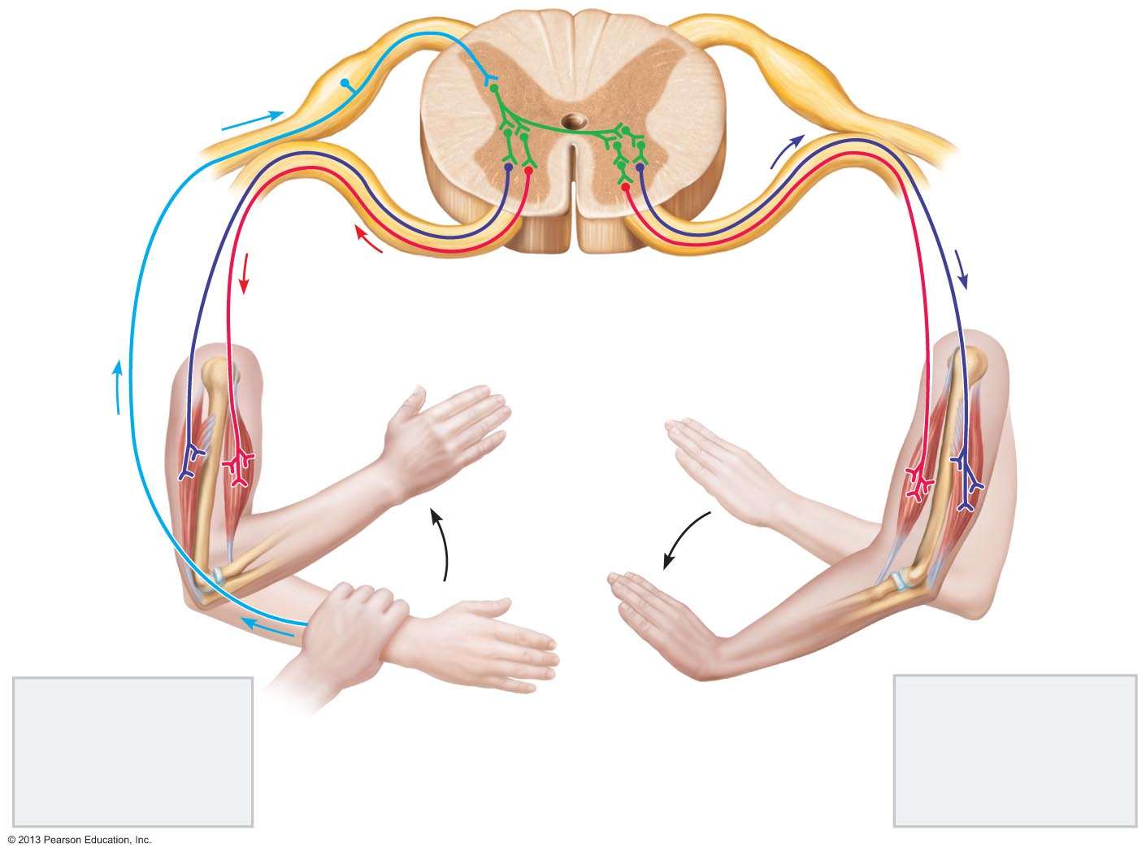
Figure 13.20 The crossed-extensor reflex.
+ Excitatory synapse
Interneurons
– Inhibitory synapse
+
+
–
+
+
–
Afferent
fiber
Efferent
fibers
Efferent
fibers
Extensor
inhibited
Flexor
inhibited
Flexor
stimulated
Flexes
Arm movements
Extensor
stimulated
Extends
Site of stimulus:
A noxious stimulus
causes a flexor
reflex on the same
side, withdrawing
that limb.
Site of reciprocal
activation: At the
same time, the
extensor muscles
on the opposite
side are activated.

Slide 108
Superficial Reflexes
Elicited by gentle _______________________ stimulation
Depend on upper motor pathways and cord-level reflex arcs
Best known:
Abdominal reflex
Cremasteric reflex

Slide 109
Superficial Reflexes: Plantar Reflex
Test integrity of cord from L₄ – S₂
Stimulus
stroke lateral aspect of _
Expected Response

Slide 110
Superficial Reflexes: Plantar Reflex
Damage to _
yields abnormal response
Babinski's sign
digits fan laterally
_____________________________ in infant to ~1 year due to incomplete myelination

Slide 111
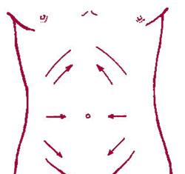
Superficial Reflexes: Abdominal Reflexes
Test integrity of cord from T₈ – T₁₂
Results in
movement of umbilicus in response _
Vary in intensity from one person to another
Absent when __________________________________ lesions are present

Slide 112
Superficial Reflexes: Cremasteric
The cremaster muscle is a _________________________ muscle responsible for _
Light touch to the __________________________ results in a superficial reflex
The Cremaster muscle is activated, and _
Evaluation helpful to evaluate nerve function following hernia repair

