Slide 1
Myofilaments: Banding Pattern
Thick filaments are composed of the _
extend the entire length of an A band
extend across the I band and partway into the A band
Z-disc
coin-shaped sheet of proteins (connectins) that anchors the thin filaments and connects myofibrils to one another

Slide 2
Ultrastructure of Myofilaments: Thick Filaments
Each ________________________________ molecule has a rod-like tail and two globular heads
two interwoven, heavy polypeptide chains
two smaller, light polypeptide chains called cross bridges

Slide 3
Ultrastructure of Myofilaments: Thin Filaments
Thin filaments are chiefly composed of the protein _
The subunits contain the ____________________________ to which myosin heads attach during contraction
Tropomyosin and troponin are regulatory subunits bound to actin

Slide 4
Sarcoplasmic Reticulum (SR)
SR is ___________________________________ that runs longitudinally and _
Functions in the regulation of _

Slide 5
T Tubules
T tubules are continuous with the _
They conduct impulses to the _
These impulses signal for the release of _

Slide 6
Sliding Filament Model of Contraction
Thin filaments _____________________ past the thick ones so that the actin and myosin filaments overlap to a greater degree
In the relaxed state, thin and thick filaments overlap _
Upon stimulation, myosin heads bind to actin and sliding begins

Slide 7
Sliding Filament Model of Contraction
Each myosin head binds and detaches several times during contraction, ______________________________________ to generate tension and propel the thin filaments to the center of the sarcomere
As this event occurs throughout the sarcomeres, the _

Slide 8
Skeletal Muscle Contraction
In order to contract, a skeletal muscle must:
Be ____________________________by a nerve ending
Send an electrical current, or ________________________________, along its sarcolemma
Have a ___________________ in intracellular Ca²⁺ levels, the final trigger for contraction
Linking the ______________________________________ is excitation-contraction coupling

Slide 9
Nerve Stimulus of Skeletal Muscle
Skeletal muscles are stimulated by _______________________________ of the somatic nervous system
Axons of these neurons travel in ____________________to muscle cells
Axons of motor neurons __________________ profusely as they enter muscles
Each axonal branch forms a _______________________________________ with a single muscle fiber

Slide 10
Neuromuscular Junction
The neuromuscular junction is formed from:
___________________________________, which have small membranous sacs (synaptic vesicles) that contain the neurotransmitter acetylcholine (ACh)
The __________________________________of a muscle, which is a specific part of the sarcolemma that contains ACh receptors and helps form the neuromuscular junction

Slide 11
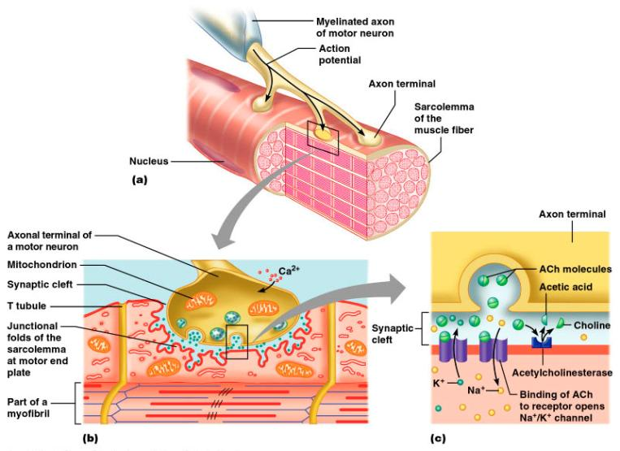
Neuromuscular Junction
Though exceedingly close, axonal ends and muscle fibers are ____________________________________ called the synaptic cleft

Slide 12
Neuromuscular Junction
When a nerve impulse reaches the end of an axon at the neuromuscular junction:
___________________________________________ calcium channels open and allow Ca²⁺ to enter the axon
Ca²⁺ causes axonal vesicles to ____________________ with the axonal membrane
This fusion releases _____________________ into the synaptic cleft
ACh _______________________________ across the synaptic cleft to ACh receptors on the sarcolemma
Binding of ACh to its receptors _

Slide 13
Destruction of Acetylcholine
ACh bound to ACh receptors is quickly _____________________________________by the enzyme _
This destruction prevents __________________________________ in the absence of additional stimuli

Slide 14
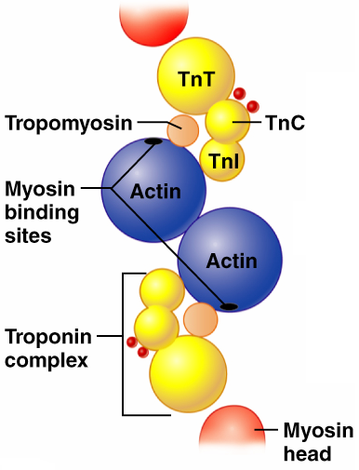
Role of Ionic Calcium (Ca²⁺) in the Contraction Mechanism
At __________ intracellular Ca²⁺ concentration:
Tropomyosin ________________the binding sites on actin
Myosin cross bridges cannot attach to binding sites on actin
Muscle remains _
Figure 9.11a

Slide 15
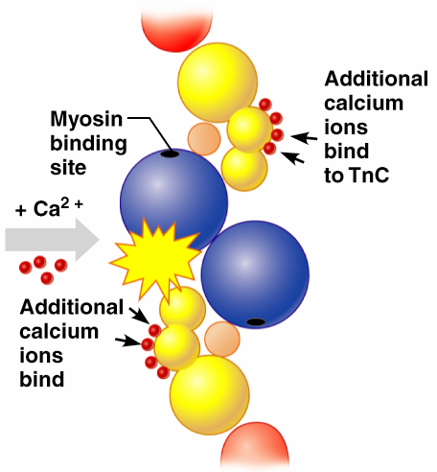
Role of Ionic Calcium (Ca²⁺) in the Contraction Mechanism
At __________________ intracellular Ca²⁺ concentrations:
Additional calcium binds to troponin
Calcium-activated troponin binds an additional two Ca²⁺ at a separate regulatory site
Figure 9.11b

Slide 16
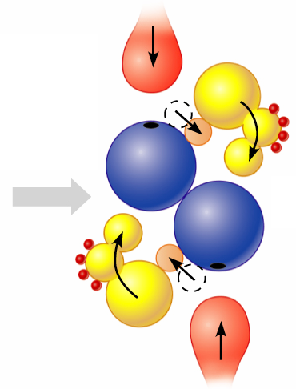
Role of Ionic Calcium (Ca²⁺) in the Contraction Mechanism
Calcium-activated troponin undergoes a _
This change moves tropomyosin away from _
Figure 9.11c

Slide 17
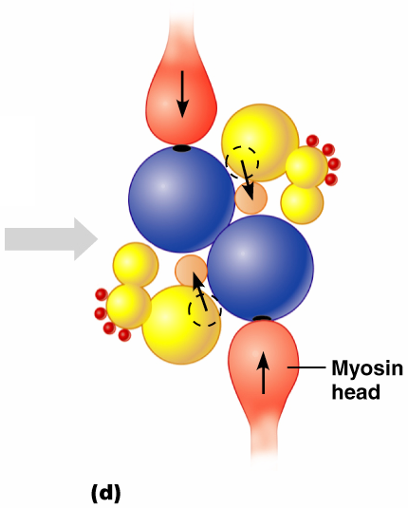
Role of Ionic Calcium (Ca²⁺) in the Contraction Mechanism
Myosin head can now _
This permits _
sliding of the thin filaments by the myosin cross bridges
Figure 9.11d

Slide 18
Sequential Events of Contraction
myosin cross bridge attaches to actin filament
myosin head pivots and pulls actin filament toward M line
ATP attaches to myosin head and the cross bridge detaches
“Cocking” of the myosin head
energy from hydrolysis of ATP cocks the myosin head into the high-energy state

Slide 19
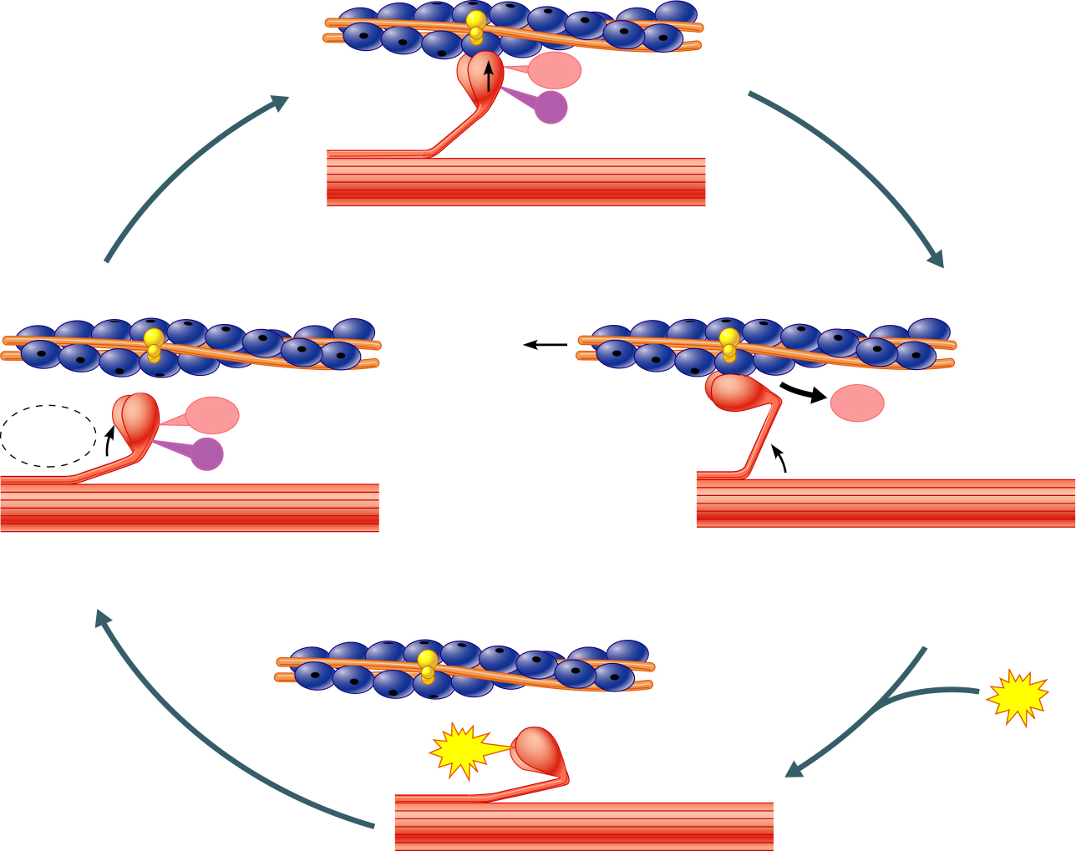
Myosin head
(high-energy
configuration)
ADP
P_{i}
1
Myosin head attaches to the actin
myofilament, forming a cross bridge.
Thin filament
ATP
ADP
ADP
Thick filament
hydrolysis
P_{i}
4
As ATP is split into ADP and P_{i}, the myosin
head is energized (cocked into the high-energy
conformation).
2
Inorganic phosphate (P_{i}) generated in the
previous contraction cycle is released, initiating
the power (working) stroke. The myosin head
pivots and bends as it pulls on the actin filament,
sliding it toward the M line. Then ADP is released.
ATP
ATP
Myosin head
(low-energy
configuration)
3
As new ATP attaches to the myosin head, the link between
myosin and actin weakens, and the cross bridge detaches.
Figure 9.12

Slide 20
Contraction of Skeletal Muscle Fibers
Contraction
refers to the _
ends when cross bridges become inactive, the tension generated declines, and relaxation is induced

Slide 21
Contraction of Skeletal Muscle (Organ Level)
The two types of muscle contractions are:
________________________contraction
muscle shortens during contraction
Iso = same; tonic = tone
increasing muscle tension
muscle does not ___________________________ during contraction
Iso = same; metric =length

Slide 22
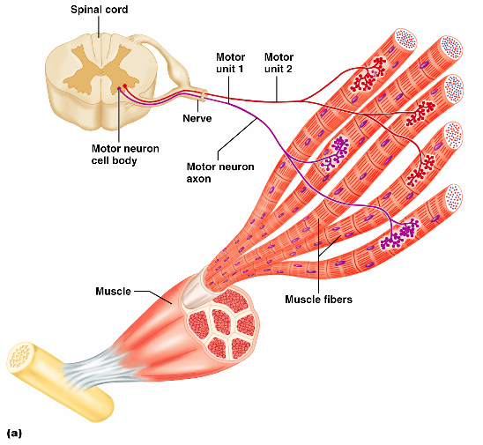
Motor Unit: The Nerve-Muscle Functional Unit
A motor unit is a _
The number of muscle fibers per motor unit varies
from _

Slide 23
Motor Unit: The Nerve-Muscle Functional Unit
Muscles that control fine movements have _
fingers, eyes
________________________weight-bearing muscles have ________________motor units
thighs, hips
Muscle fibers from a motor unit are spread throughout the muscle; therefore, contraction of a single motor unit causes weak contraction of the entire muscle

Slide 24
Muscle Twitch
A _______________________________is the response of a muscle to a single, brief threshold stimulus
There are three phases to a muscle twitch
Period of _
Period of _

Slide 25
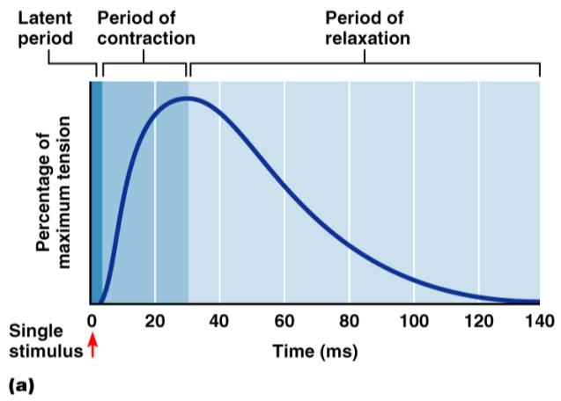
Phases of a Muscle Twitch
Latent period
first few msec after stimulus; EC coupling taking place
Period of contraction
______________________; muscle shortens
Period of relaxation
Ca²⁺ reabsorbed; _
Figure 9.14a

Slide 26
Graded Muscle Responses
_____________________________ responses are:
Variations in the degree of muscle contraction
Required for proper control of skeletal movement
Responses are graded by:
the
the

Slide 27
Muscle Response to Varying Stimuli
A single stimulus results in a single contractile response
a muscle twitch
With frequently delivered stimuli, muscle does not have time to completely relax and it increases contractile force
_
Figure 9.15

Slide 28
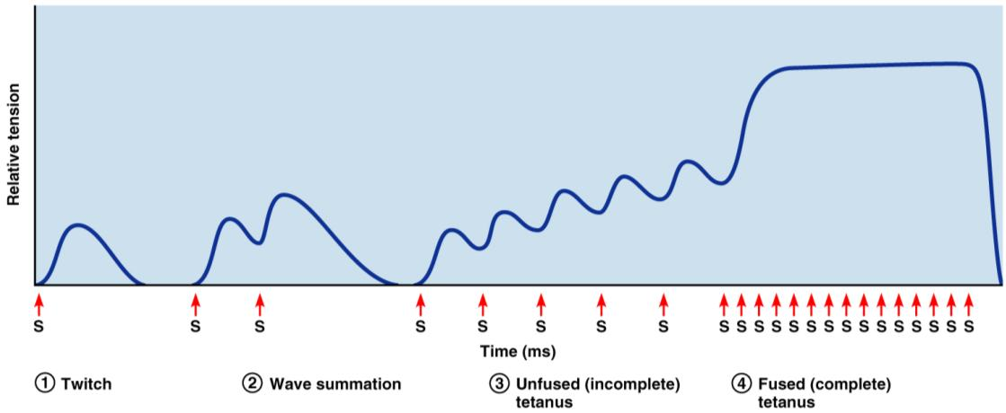
Muscle Response to Varying Stimuli
More rapidly delivered stimuli _
If stimuli are given quickly enough, _

Slide 29
Muscle Response: Stimulation Strength
the stimulus strength at which the first observable muscle contraction occurs
Beyond threshold, muscle contracts more vigorously as stimulus strength is increased
Force of contraction is precisely controlled by multiple motor unit summation
This phenomenon, called _____________________________, brings more and more muscle fibers into play

Slide 30
Treppe: The Staircase Effect
increased contraction in response to multiple stimuli of the same strength
Contractions increase because:
There is ________________________________________ in the sarcoplasm
Muscle enzyme systems become more efficient because _________________________________ as muscle contracts

