Slide 1
Muscles of the Forearm
Forearm muscle groups:
those that cause _
those that move the _
These muscles insert via the flexor and extensor retinacula
Most _
Most _

Slide 2
Muscles of the Forearm
The pronator teres and pronator quadratus are not flexors, but _
The supinator muscle is a synergist with the biceps brachii in _

Slide 3
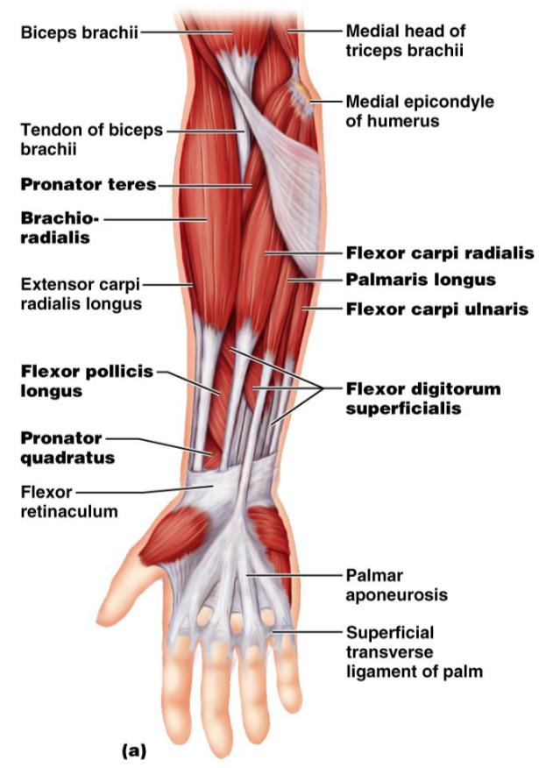
Muscles of the Forearm: Anterior
These muscles are primarily flexors of the wrist and fingers

Slide 4
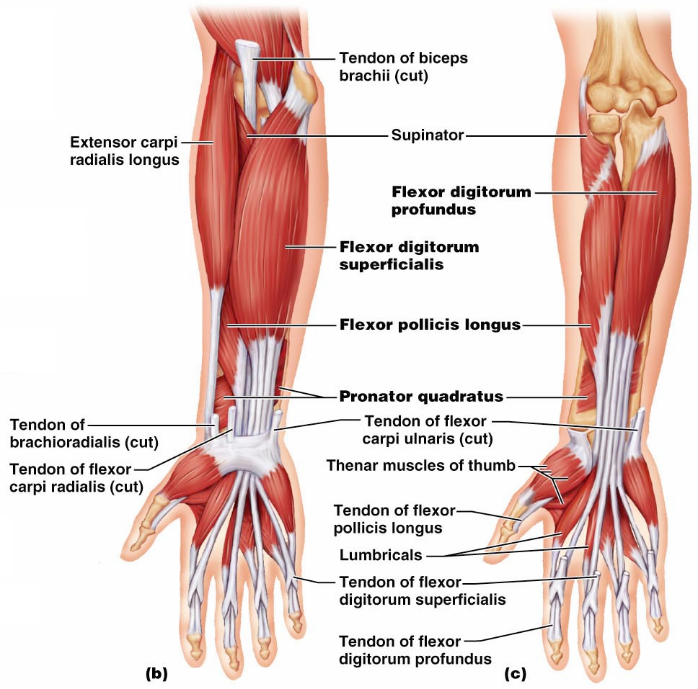
Figure 10.15b, c

Slide 5
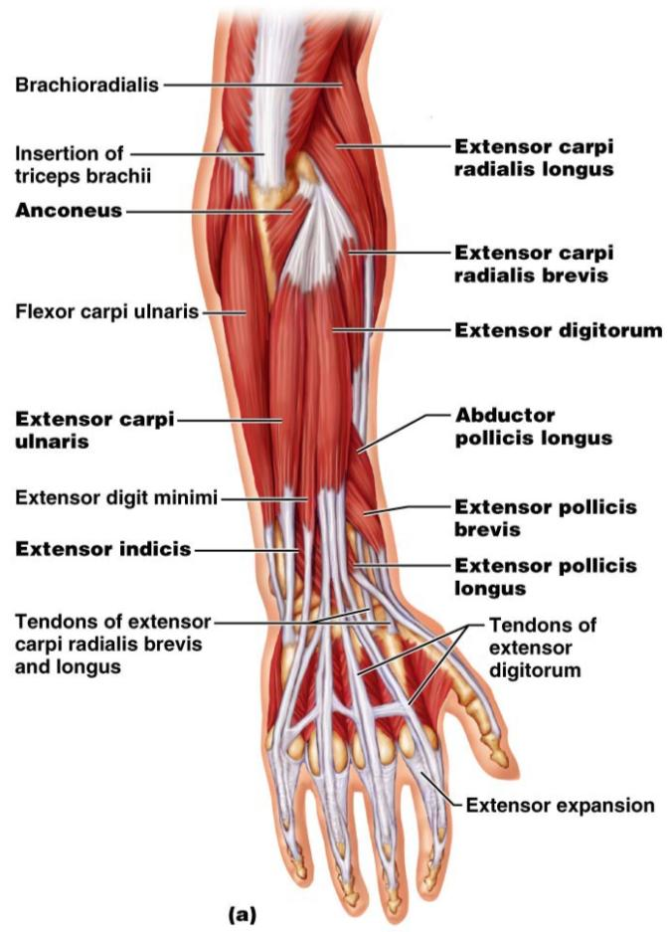
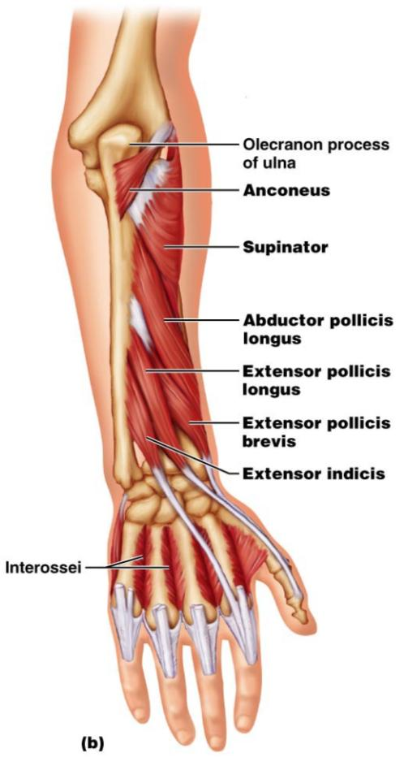
Muscles of the Forearm: Posterior
These muscles are primarily extensors of the wrist and digits
Figure 10.16a

Slide 6
Intrinsic Muscles of the Hand
These small muscles:
Lie ____________________________ of the hand
none on the dorsal side
Move the ______________________________ and fingers
Control precise movements
Are the main abductors and adductors of the fingers
Produce _
move the thumb toward the little finger

Slide 7
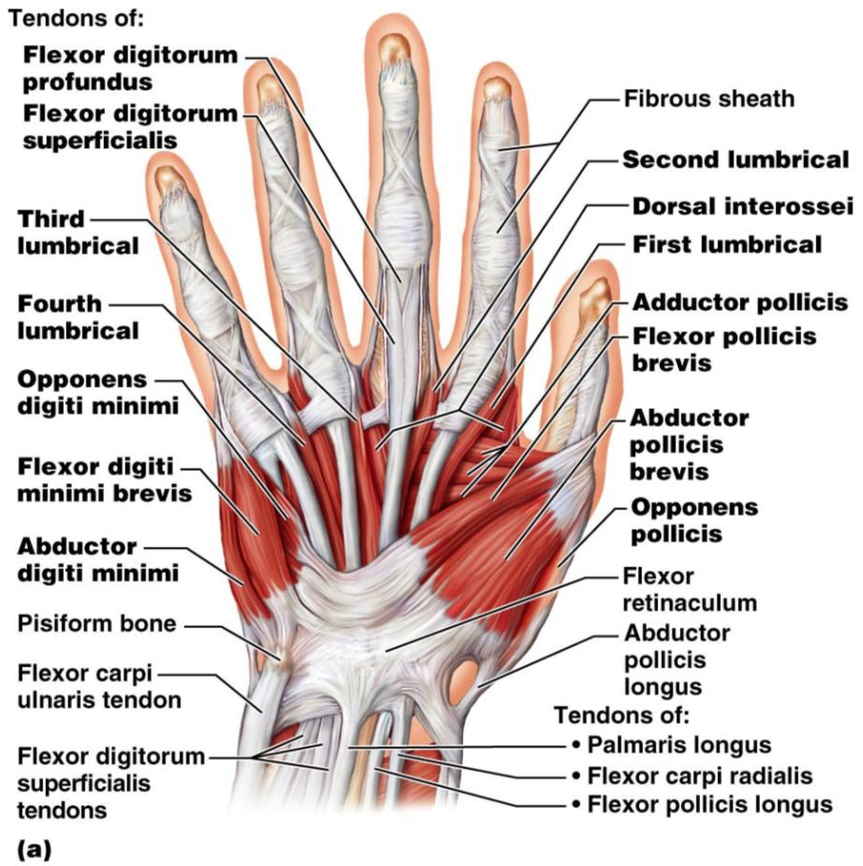
Intrinsic Muscles of the Hand
Figure 10.18a

Slide 8
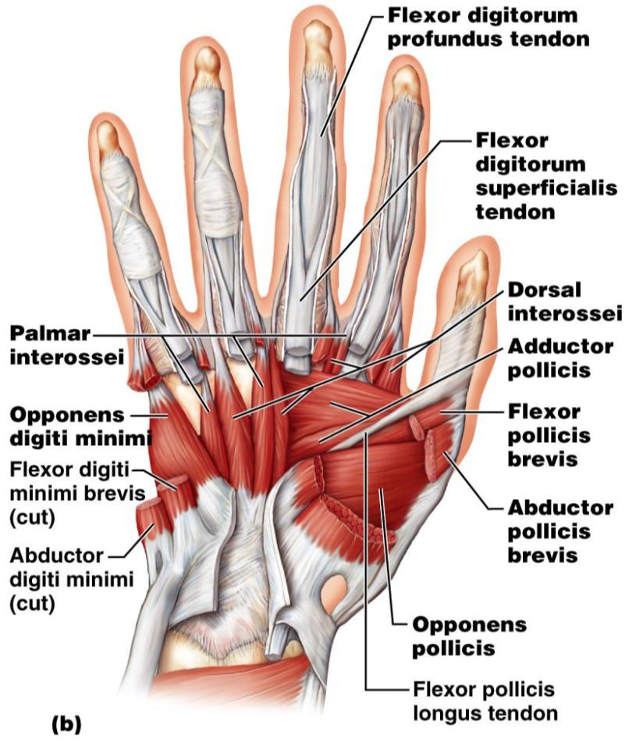
Intrinsic Muscles of the Hand
Figure 10.18b

Slide 9
Finger and Thumb Movements
Flexion
Thumb –
Fingers –
Extension
Thumb –
Fingers –

Slide 10
Intrinsic Muscles of the Hand: Groups
There are _____________________ groups of intrinsic hand muscles
The thenar eminence and hypothenar eminence
each have a _
The midpalm muscles, the lumbricals and interossei,
The _
abduct and adduct the fingers

Slide 11
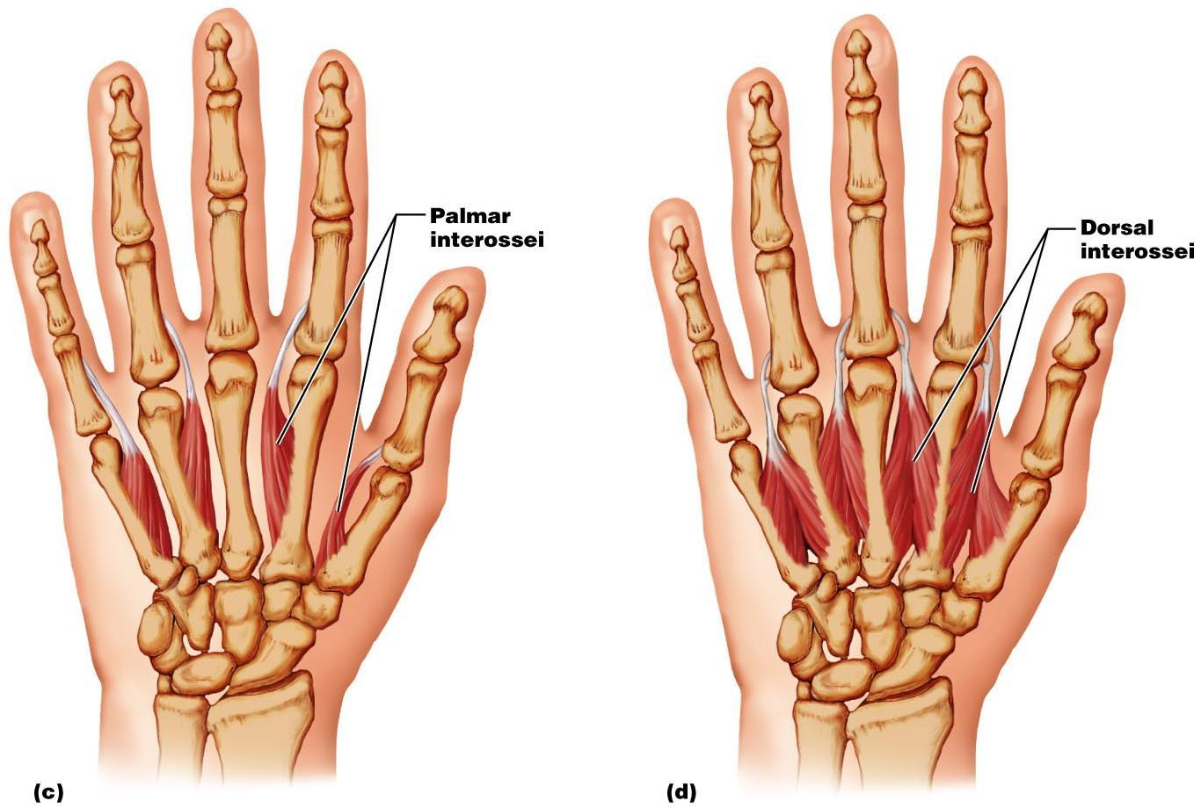
Intrinsic Muscles of the Hand: Groups
Figure 10.18c, d

Slide 12
Muscles Crossing Hip and Knee Joints
Most ___________________________________ muscles of the hip and thigh
Posterior compartment muscles of the hip and thigh
extend _
flex _
The medial compartment muscles
These three groups are enclosed by the fascia lata

Slide 13
Movements of the thigh at the Hip: Flexion and Extension
The ball-and-socket hip joint permits
Extension
Adduction
Rotation
The most important thigh flexors
The medially located adductor muscles and sartorius assist in thigh flexion

Slide 14
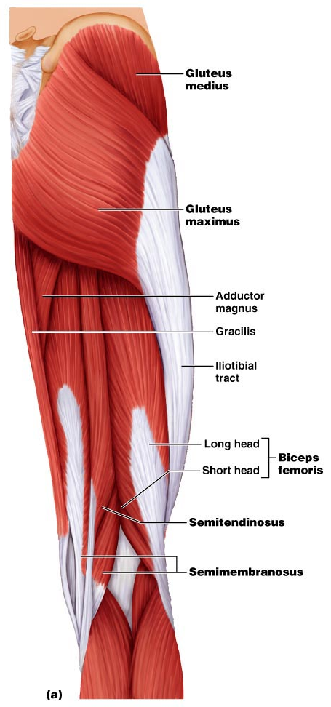
Movements of the Thigh at the Hip: Flexion and Extension
Thigh extension is primarily effected by the _
Forceful extension is aided by the gluteus maximus

Slide 15
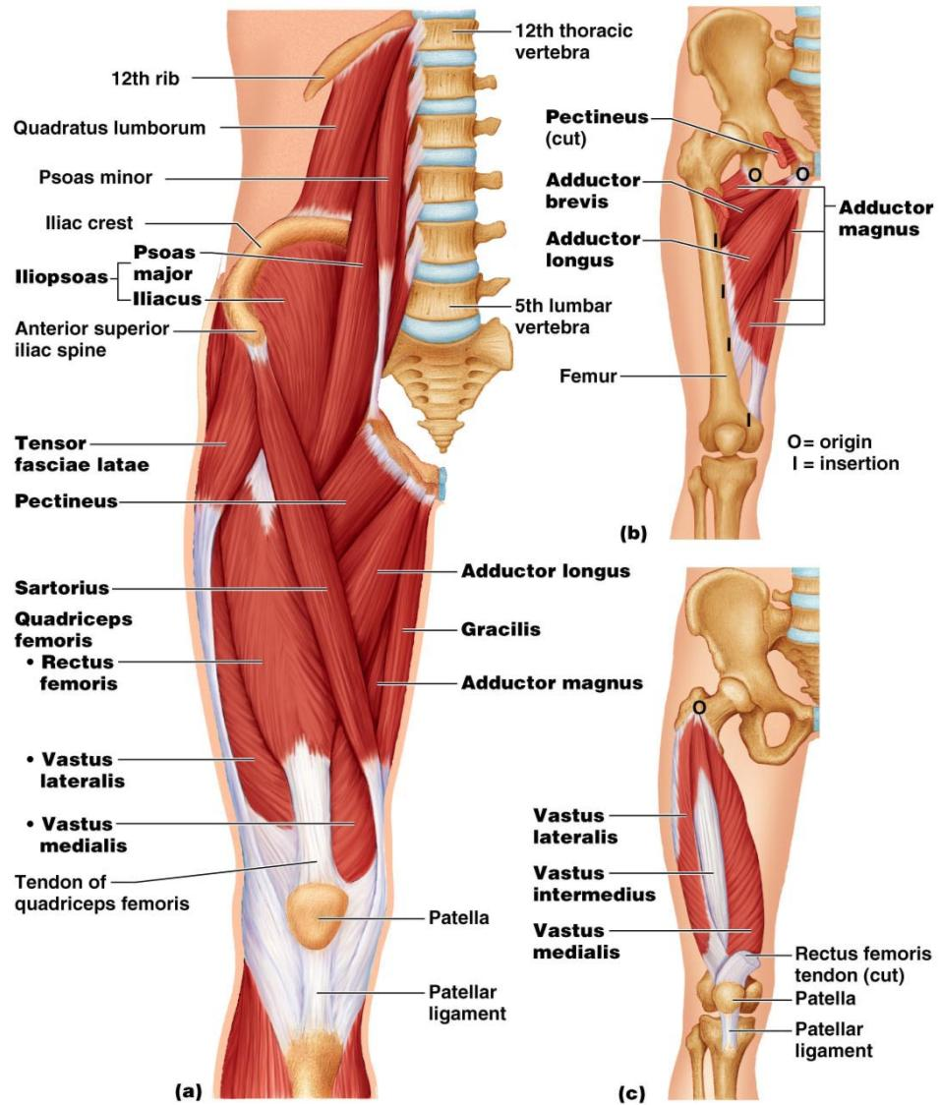

Slide 16
Movements of the Thigh at the Hip:
Abduction and rotation assisted by
antagonized by
lateral rotators
Thigh adduction is the role of five adductor muscles
adductor _
adductor _
adductor _
the _
gracilis

Slide 17
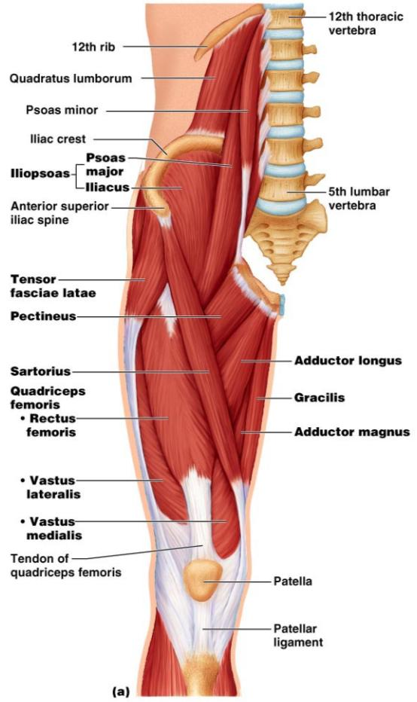
Movements of the Knee Joint
The sole extensor of the knee
flex the _
and act as antagonists to the quadriceps femoris
Figure 10.19a

Slide 18
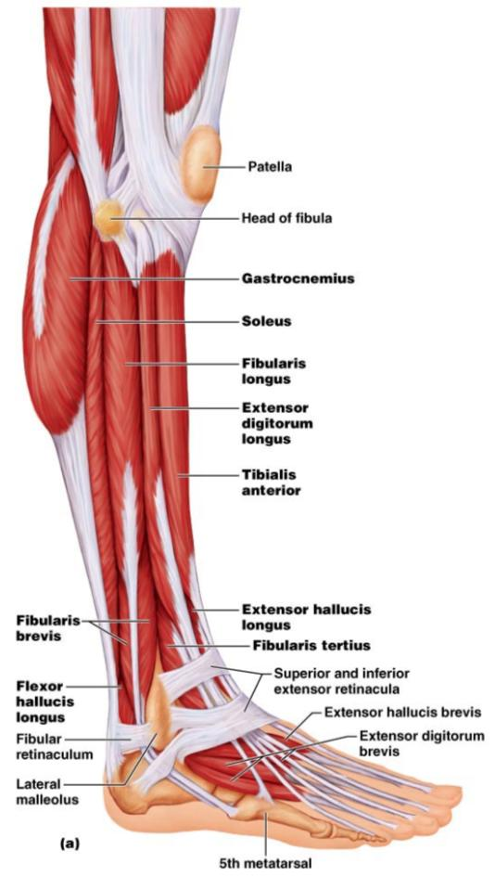
Fascia of the Leg
A deep fascia of the leg is continuous with the fascia lata
This fascia segregates the leg into _
Distally, the fascia thickens and forms the flexor, extensor, and fibular retinaculae
Figure 10.22a

Slide 19
Muscles of the Leg: Movements
Various leg muscles produce the following movements at the:
Ankle
Intertarsal joints
Toes

Slide 20
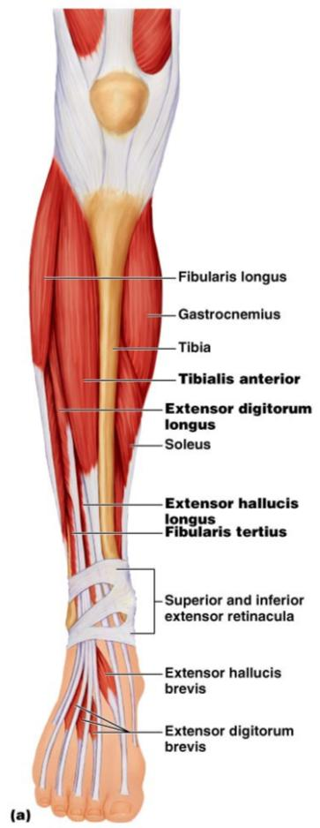
Muscles of the Anterior Compartment
primary toe extensors and ankle dorsiflexors
extensor digitorum longus,
fibularis tertius
Figure 10.21a

Slide 21
Muscles of the Lateral Compartment
Plantar-flex and evert the foot
fibularis _
Figure 10.22a

Slide 22
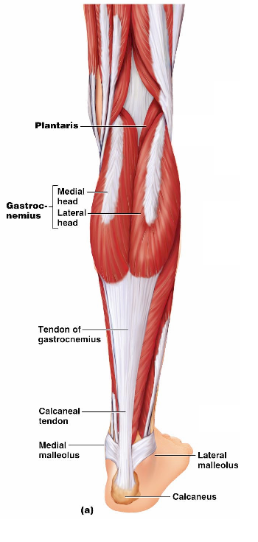
Muscles of the Posterior Compartment
flex the foot and the toes
Tibialis posterior
Flexor digitorum longus
Figure 10.23a

Slide 23
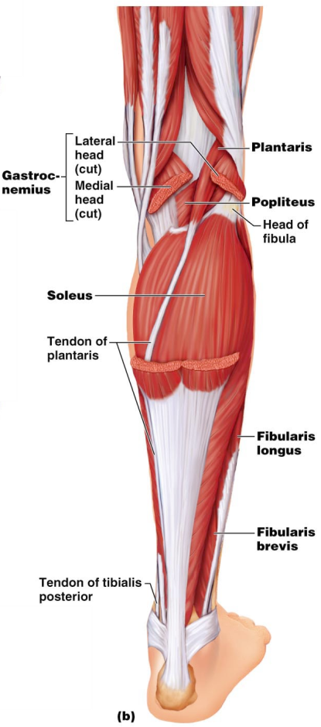
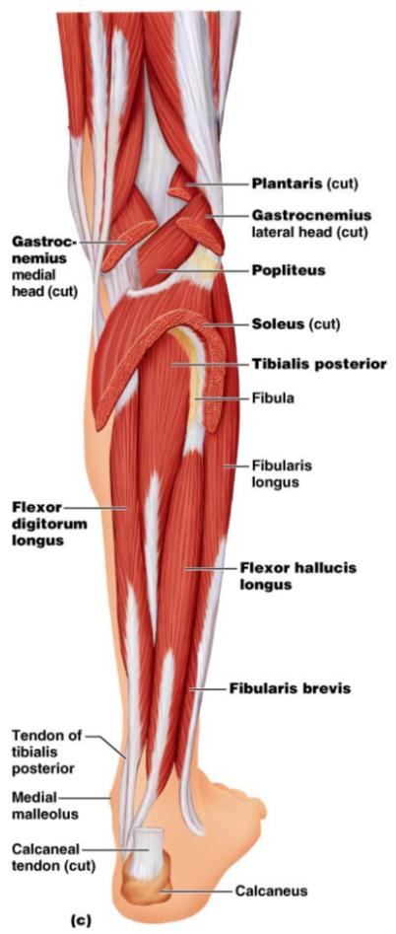
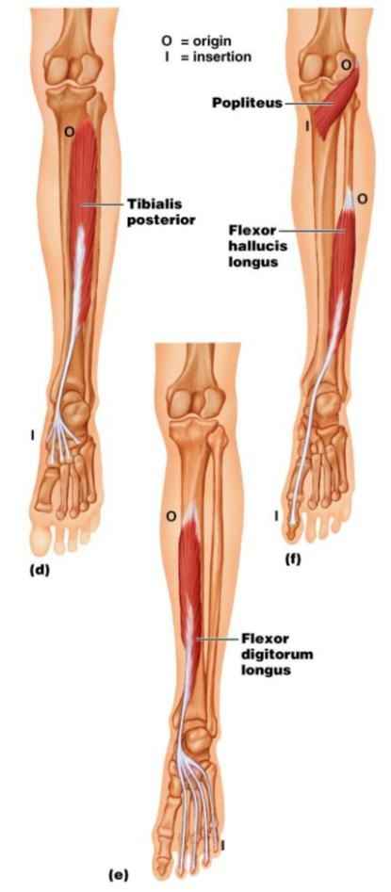
Muscles of the Posterior Compartment
Figure 10.23b, c

Slide 24
Muscle Actions of the Thigh: Summary
Thigh muscles:
Flex and extend the thigh (____________________________________)
Extend the leg (______________________________________)
Adduct the thigh (____________________________________)

Slide 25
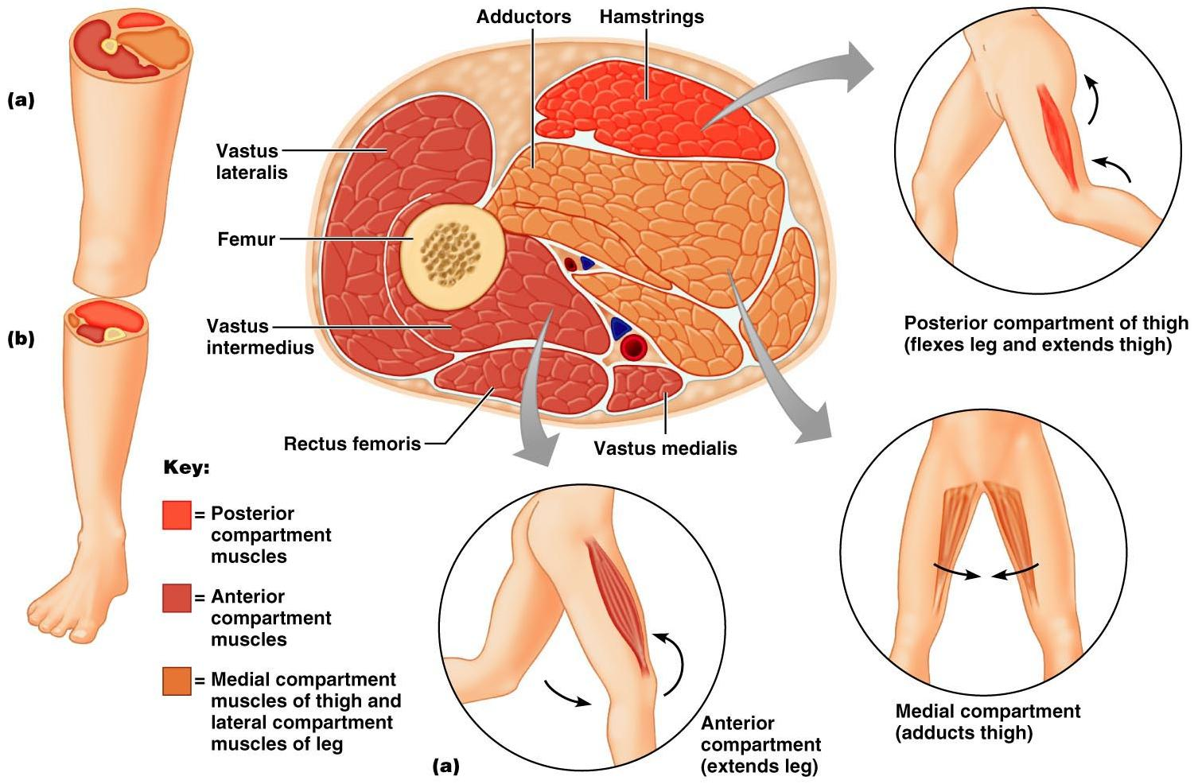

Slide 26
Muscle Actions of the Leg: Summary
Leg muscles:
Plantar flex and evert the foot
Plantar flex the foot and flex the toes
Dorsiflex the foot and extend the toes

Slide 27
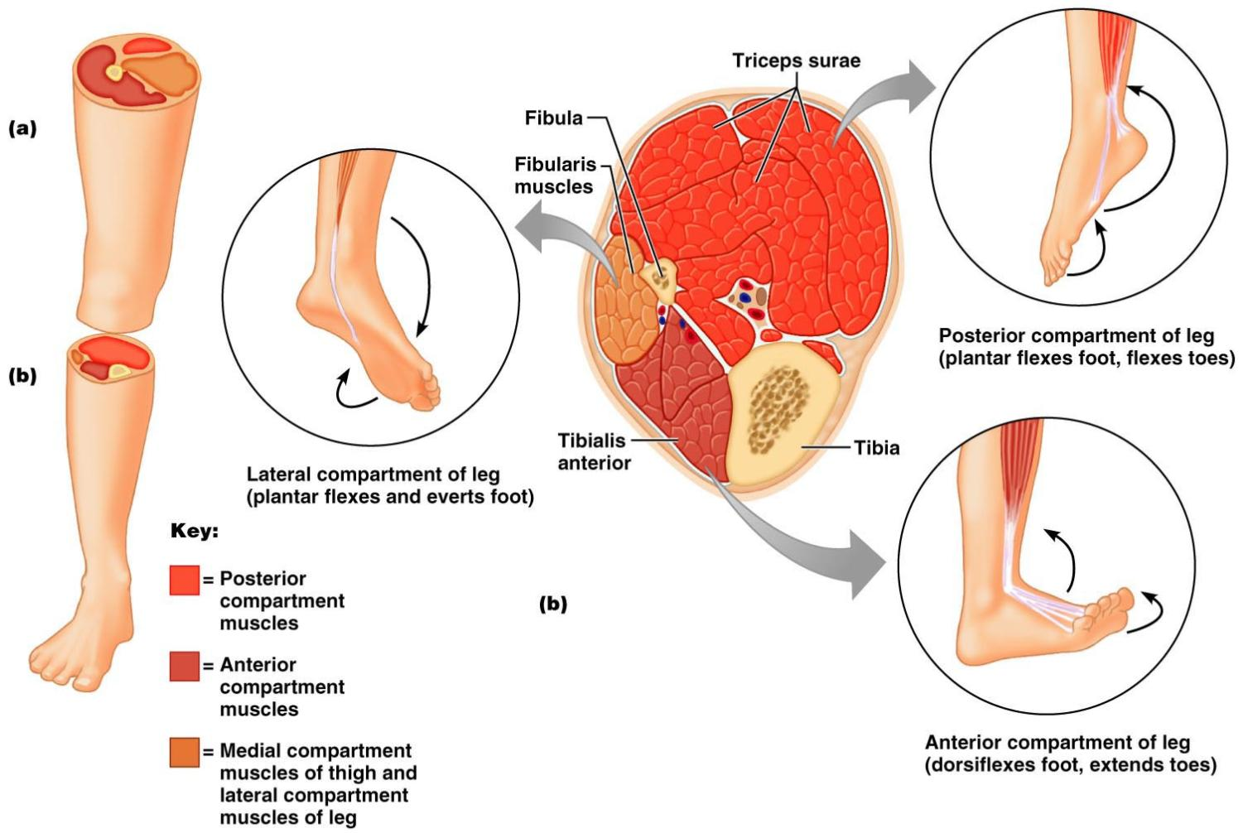

Slide 28
Intrinsic Muscles of the Foot
These muscles help _
In addition, along with some leg tendons, they support the _
There is a single dorsal foot muscle, the ___________________________________, which extends the toes
The plantar muscles occur in four layers

Slide 29
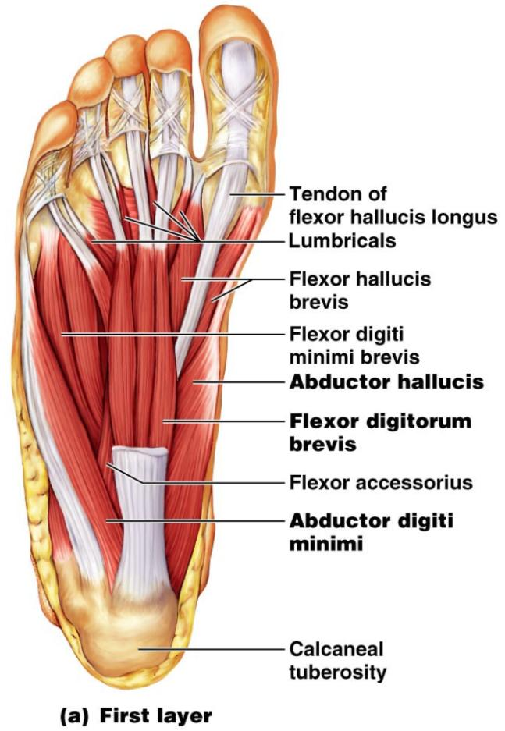
Plantar Muscles: First Layer (Superficial)
Superficial muscles of the _________________of the foot
These muscles are similar to the corresponding muscles of the hand

Slide 30
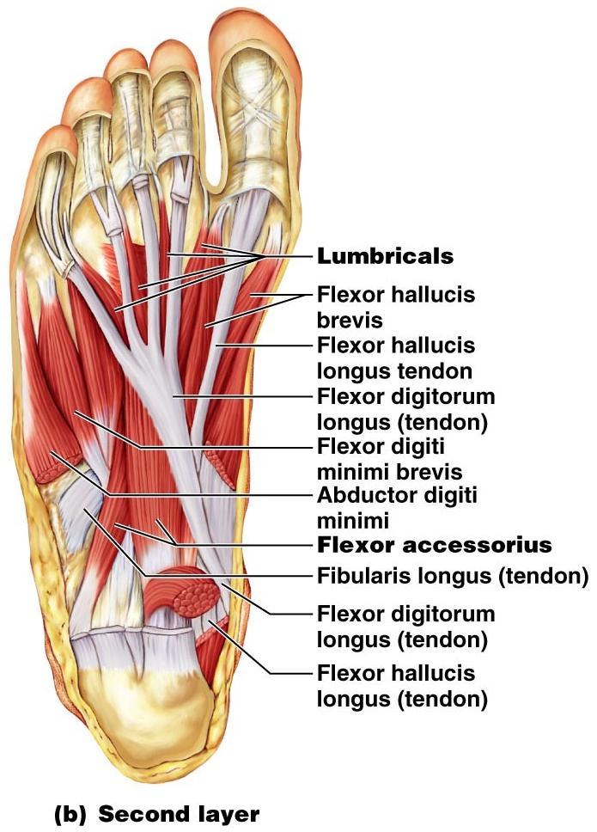
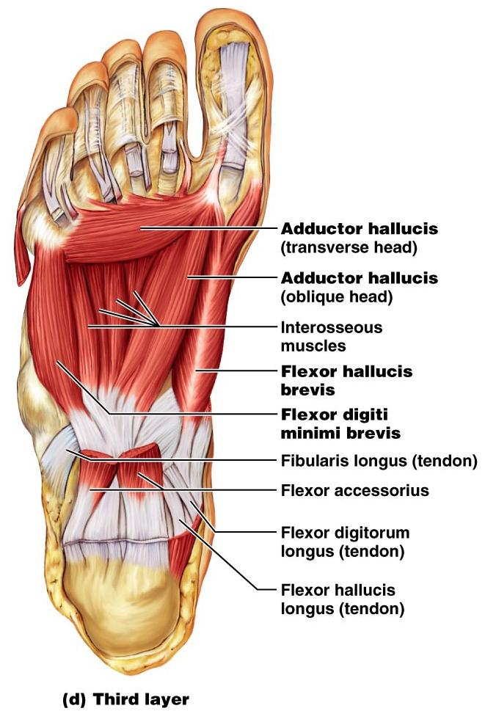
Figure 10.25b

Slide 31
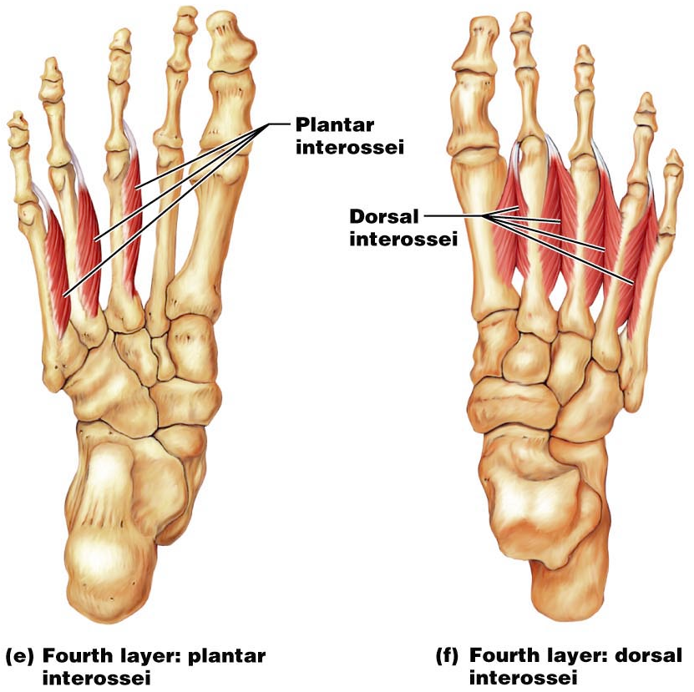
Plantar Muscles: Fourth Layer

