Slide 1
Nervous System
The master _________________________________ system of the body
Functions
monitoring stimuli
Integration
________________________ output
response to stimuli

Slide 2
Organization of the Nervous System
Central nervous system (CNS)
Integration and command center
Peripheral nervous system (PNS)
Carries messages to and from the spinal cord and brain

Slide 3
PNS: Two Functional Divisions
Sensory (_______________________) division
Sensory afferent fibers
carry impulses from _
Visceral afferent fibers
transmit impulses from _
Motor (__________________________) division
Transmits impulses from the _

Slide 4
Motor Division: Two Main Parts
__________________________ nervous system
________________________________ control of skeletal muscles
_____________________________ nervous system (ANS)
Regulates _
sympathetic
parasympathetic

Slide 5
Histology of Nerve Tissue
The two cell divisions in the nervous system are:
excitable cells that transmit electrical signals
cells that _

Slide 6
Supporting Cells: Neuroglia
The supporting cells: neuroglia or glial cells
Provide a _
Segregate and insulate neurons
____________________________ young neurons to the proper connections
Promote _

Slide 7
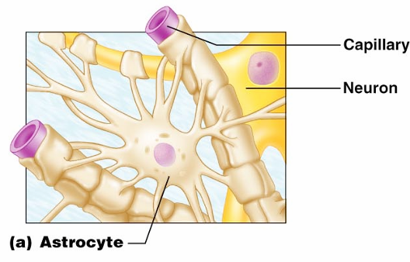
Astrocytes
Most _
They cling to neurons and their synaptic endings, and _

Slide 8
Astrocytes
Functionally, they:
Support and brace neurons
______________________________ neurons to their nutrient supplies
Guide migration of young neurons
Control the _

Slide 9
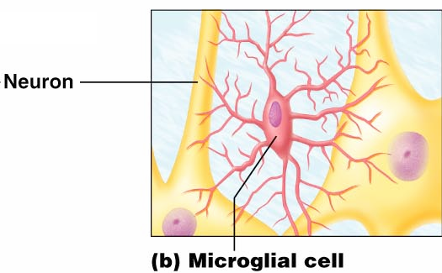
Microglia
small, ovoid cells with spiny processes
____________________________ that monitor the health of neurons

Slide 10
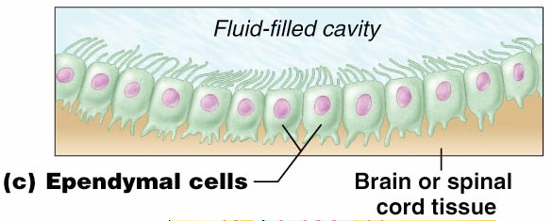
Ependymal Cells
Ependymal cells
range in shape from squamous to columnar
They ____________________________________ of the brain and spinal column

Slide 11
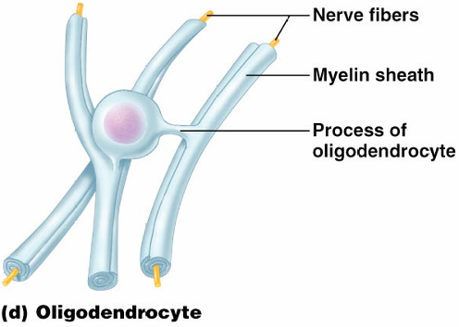
Oligodendrocytes,
Oligodendrocytes

Slide 12
Schwann Cells, and Satellite Cells
Schwann cells
surround _
Satellite cells
surround _

Slide 13
Neurons
Structural units of the nervous system
Composed of a _
Long-lived, _____________________, and have a high metabolic rate
Their plasma membrane function in:
Cell-to-cell signaling during development

Slide 14
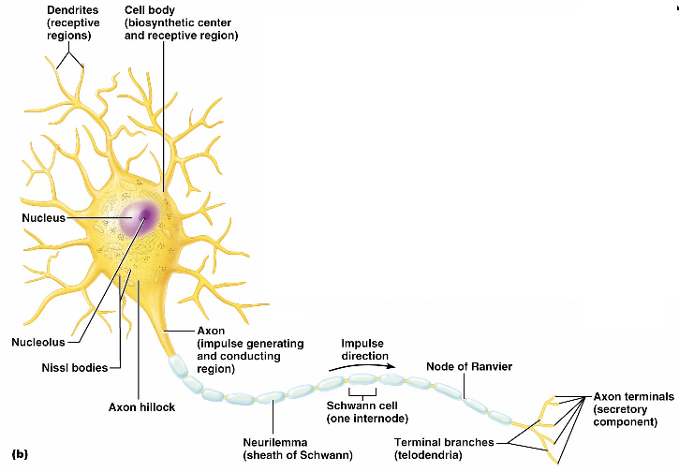
Neurons (Nerve Cells)

Slide 15
Nerve Cell Body: Soma
Contains the _
Is the major biosynthetic center
Is the focal point for the outgrowth of neuronal processes
Has well-developed _
Contains an axon hillock
cone-shaped area _

Slide 16
Processes
Armlike extensions from the soma
Called _________________ in the _
Called _________________ in the _
There are two types:

Slide 17
Dendrites of Motor Neurons
Short, tapering, and diffusely branched processes
They are the ______________________________, regions of the neuron
Electrical signals are conveyed as _________________________________ (not action potentials)

Slide 18
Axons: Structure
Slender processes _
Long axons are called _
Usually there is only one unbranched axon per neuron
Rare branches, if present, are called _
Axonal terminal
branched terminus of an axon

Slide 19
Axons: Function
Secrete ________________________________ from the axonal terminals
Movement along axons occurs in two ways
_____________________________________ axonal terminal
____________________________________ axonal terminal

Slide 20
Myelin Sheath
Whitish, fatty (protein-lipoid), _______________________________ around most long axons
It functions to:
Electrically ___________________________ fibers from one another
Increase the _

Slide 21
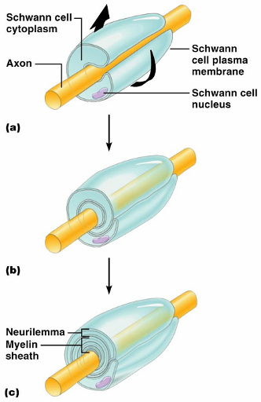
Myelin Sheath and Neurilemma
Formed by _________________ cells in the _
A Schwann cell:
Envelopes an axon
Encloses the axon with its plasma membrane
Has concentric layers of membrane that make up the myelin sheath
Neurilemma

Slide 22
Nodes of Ranvier
____________________ in the myelin sheath _
They are the sites where _

Slide 23
Unmyelinated Axons
A Schwann cell surrounds nerve fibers _
Schwann cells partially enclose 15 or more axons

Slide 24
Axons of the CNS
Both myelinated and unmyelinated fibers are present
______________________________ are formed by _
Nodes of Ranvier are _
There is no neurilemma

Slide 25
Regions of the Brain and Spinal Cord
________________________ matter
dense collections of _
________________________ matter
mostly _

Slide 26
Neuron Classification
Structural:
Multipolar
Bipolar
Unipolar

Slide 27
Neuron Classification
Functional:
transmit impulses _
Motor _
carry impulses _
_________________________________ (association neurons)
shuttle signals through CNS pathways

Slide 28
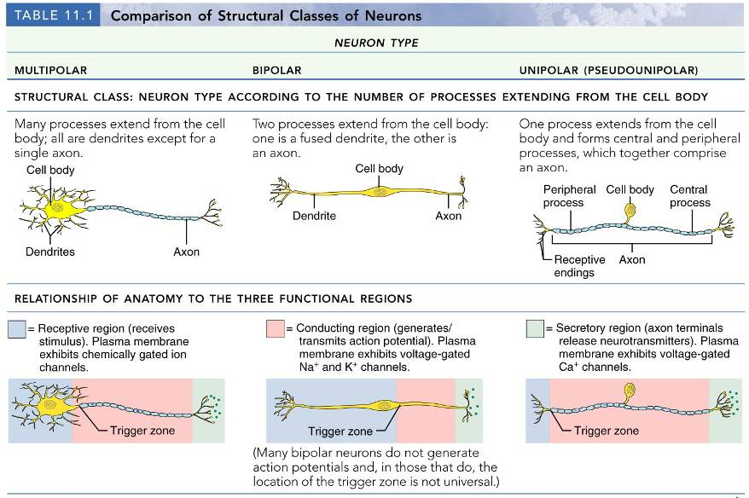

Slide 29
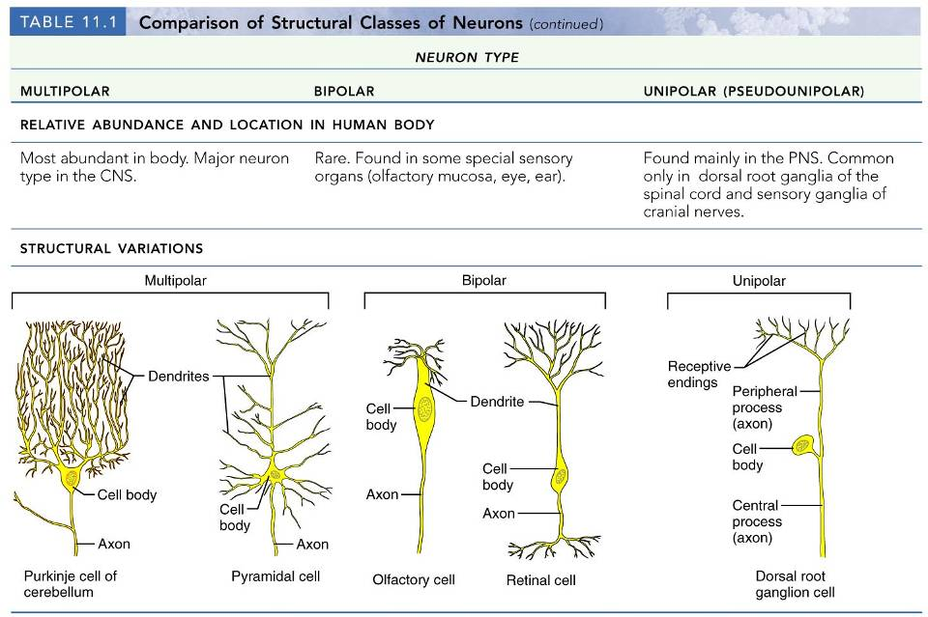

Slide 31
Neurophysiology
Neurons are _
Action potentials, or nerve impulses, are:
__________________________________ carried along the length of axons
The underlying _______________________________ of the nervous system

