Slide 1
Electrical Current and the Body
Reflects the flow of ________________ rather than electrons
There is a potential on either side of membranes when:
The number of ions is _
The membrane provides a resistance to ion flow

Slide 2
Role of Ion Channels
Types of plasma membrane ion channels:
always open
open with binding of a specific neurotransmitter
open and close in response to membrane potential
open and close in response to physical deformation of receptors

Slide 3
Electrochemical Gradient
chemical gradient
________ movement from an area of _
electrical gradient
Ion movement toward an area of _
Electrochemical gradient
the ____________________________________ gradients taken together

Slide 4
Resting Membrane Potential (V_{r})
The potential difference (–70 mV) across the membrane of a resting neuron
It is generated by different concentrations of Na⁺, K⁺, Cl⁻, and protein anions (A⁻)
Ionic differences are the consequence of:
Differential __________________________ of the neurilemma to Na⁺ and K⁺
Operation of the _

Slide 5
Membrane Potentials: Signals
Membrane potential changes are produced by:
Changes in membrane permeability to ions
Alterations of ion concentrations across the membrane
Types of signals

Slide 6
Changes in Membrane Potential
Changes are caused by three events
the inside of the membrane becomes _
the membrane returns to its resting membrane potential
the inside of the membrane becomes _______________________________________ than the resting potential

Slide 7
Graded Potentials
_________________________________ in membrane potential
Magnitude varies directly with the strength of the stimulus
Sufficiently strong graded potentials can initiate action potentials

Slide 8
Graded Potentials
Current is quickly dissipated due to the _
Only travel over _

Slide 9
Action Potentials (APs)
A brief reversal of membrane potential with a total amplitude of 100 mV
Action potentials are only generated by _
do ________ decrease in strength over distance
principal means of neural communication
An ________________________ in the axon of a neuron _

Slide 10
Action Potential: Resting State
Leakage accounts for small movements of Na⁺ and K⁺
Each Na⁺ channel has two voltage-regulated gates

Slide 11
Action Potential: Depolarization Phase
Na⁺_______________________________ increases; membrane potential reverses
Threshold
a critical level of depolarization
-55 to -50 mV
At threshold, depolarization becomes _

Slide 12
Action Potential: Repolarization Phase
Sodium inactivation gates close
Membrane permeability to Na⁺ declines to resting levels
As sodium gates close, _
K⁺ exits the cell and _

Slide 13
Action Potential: Hyperpolarization
Potassium gates remain open, causing an _
This movement causes _________________________________ of the membrane (undershoot)
The neuron is ___________________________ to stimulus and depolarization during this time

Slide 14
Action Potential: Role of the Sodium-Potassium Pump
___________________________________ electrical conditions of the neuron
Does _________ restore the resting ionic conditions
Ionic redistribution back to resting conditions _

Slide 15
Phases of the Action Potential
1 –
2 –
3 –
4 –

Slide 16
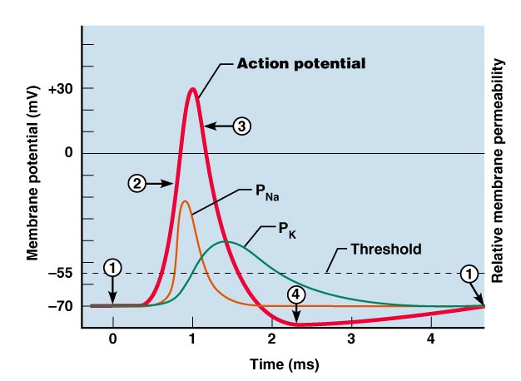
Phases of the Action Potential

Slide 17
Threshold and Action Potentials
Threshold
Established by the total amount of current flowing through the membrane
Subthreshold: _
Threshold: _
All-or-none phenomenon
action potentials _

Slide 18
Coding for Stimulus Intensity
All action potentials are _______________ and are independent of stimulus intensity
Strong stimuli can generate an action potential more often than weaker stimuli
The CNS determines stimulus intensity by the _

Slide 19
Absolute Refractory Period
The absolute refractory period:
Ensures that _
Enforces one-way transmission of nerve impulses

Slide 20
Relative Refractory Period
The interval following the absolute refractory period when _
The threshold level is _______________________, allowing _______________________________ to increase the frequency of action potential events

Slide 21
Conduction Velocities of Axons
Rate of impulse propagation is determined by:
the larger the diameter, the faster the impulse
Presence of a _
myelination dramatically _

Slide 22
Saltatory Conduction
Current passes through a myelinated axon only _
Voltage-gated Na⁺ channels are concentrated at these nodes
Action potentials are triggered only at the nodes and _
Much faster than conduction along unmyelinated axons

Slide 23
Nerve Fiber Classification
Nerve fibers are classified according to:
Degree of _

Slide 24
Synapses
A junction that mediates information transfer from one neuron:
Presynaptic neuron
conducts impulses _
Postsynaptic neuron
transmits impulses _

Slide 25
Synaptic Cleft
Fluid-filled space _
Prevents nerve impulses from directly passing from one neuron to the next
Transmission across the synaptic cleft:
___________________________________ (as opposed to an electrical one)
Ensures ____________________________ communication between neurons

Slide 26
Synaptic Cleft: Information Transfer
Nerve impulses reach the axonal terminal of the presynaptic neuron and _
Neurotransmitter is released into the synaptic cleft via _
Neurotransmitter crosses the synaptic cleft
binds to _
Postsynaptic membrane permeability changes, causing an _

Slide 27
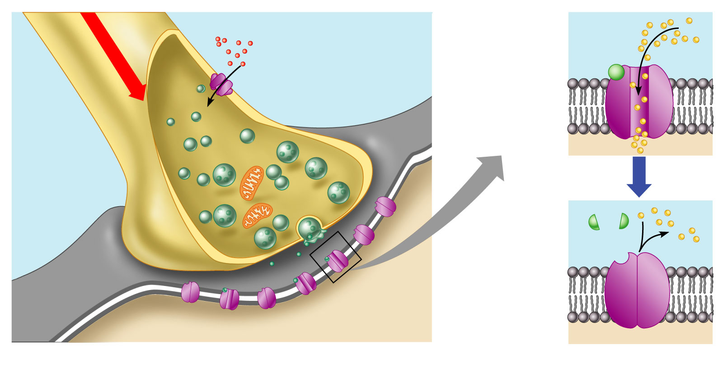
Synaptic Cleft: Information Transfer
Ca²⁺
Neurotransmitter
Na⁺
Action potential
Axon terminal of
presynaptic neuron
Receptor
1
Mitochondrion
Postsynaptic
membrane
Axon of
presynaptic
neuron
Postsynaptic
membrane
Ion channel open
Synaptic vesicles
containing
neurotransmitter
molecules
5
Degraded
neurotransmitter
2
Synaptic
cleft
3
4
Ion channel
(closed)
Ion channel closed
Ion channel (open)
Figure 11.18

Slide 28
Termination of Neurotransmitter Effects
Neurotransmitter bound to a postsynaptic receptor:
Produces a _
_________________________________________ of additional “messages”
Must be removed from its receptor
Removal of neurotransmitters occurs when they:
degraded by _
__________________________________ by astrocytes or the presynaptic terminals
Diffuse from the synaptic cleft

