Slide 1
Basic Pattern of the Central Nervous System
Spinal Cord
______________________________ surrounded by a _
Gray matter is surrounded by _
myelinated fiber _
Brain
Similar to spinal cord but with _
Cerebellum has gray matter in nuclei
Cerebrum has nuclei and additional gray matter in the cortex

Slide 2
Ventricles of the Brain
Arise from expansion of the lumen of the neural tube
The ventricles are:
The paired _
The third ventricle found in the diencephalon
The fourth ventricle found in the hindbrain dorsal to the pons

Slide 3
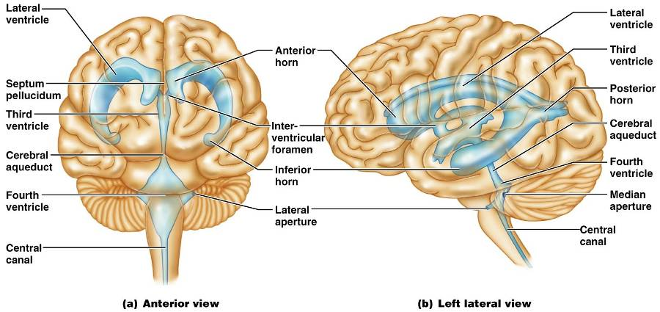
Ventricles of the Brain

Slide 4
Cerebral Hemispheres
Contains ridges
and shallow grooves
Contain deep grooves
Are separated by the _
Have three basic regions:
cortex, white matter, and basal nuclei

Slide 5
Major Lobes, Gyri, and Sulci of the Cerebral Hemisphere
Deep sulci divide the hemispheres into five lobes:
separates the frontal and parietal lobes

Slide 6
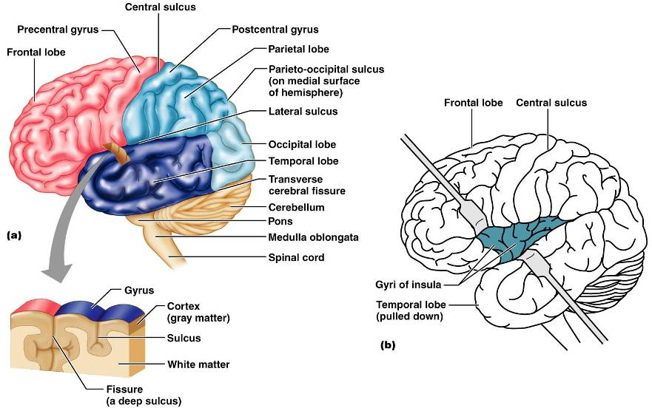
Brain Lobes

Slide 7
Major Lobes, Gyri, and Sulci of the Cerebral Hemisphere
separates the parietal and occipital lobes
separates the parietal and temporal lobes
The

Slide 8
Cerebral Cortex
The cortex
superficial gray matter
accounts for 40% of the mass of the brain
It enables
Each hemisphere acts _____________________________ (controls the opposite side of the body)
Hemispheres are not equal in function
No functional area acts alone; conscious behavior involves the entire cortex

Slide 9
Functional Areas of the Cerebral Cortex
The three types of functional areas are:
control voluntary movement
conscious awareness of sensation
integrate diverse information

Slide 10
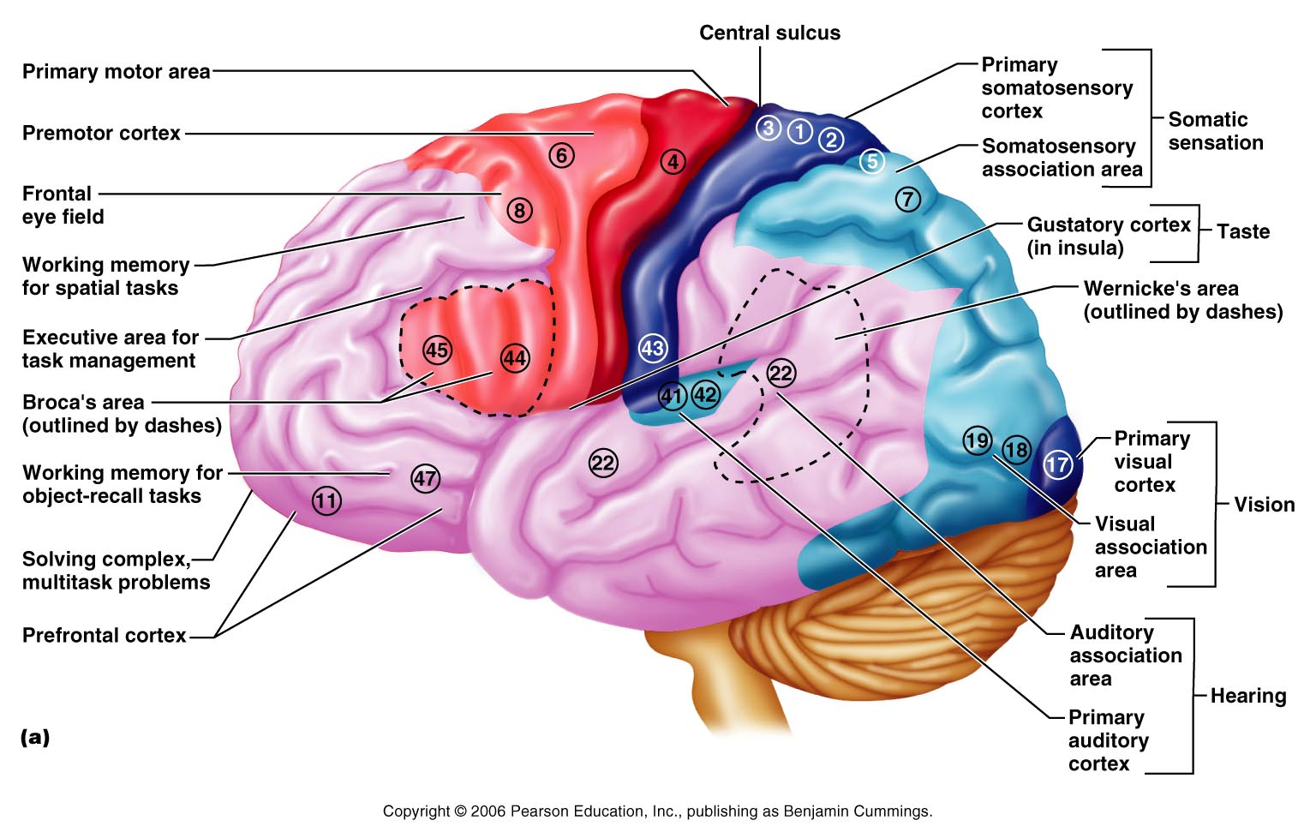
Functional Areas of the Cerebral Cortex

Slide 11
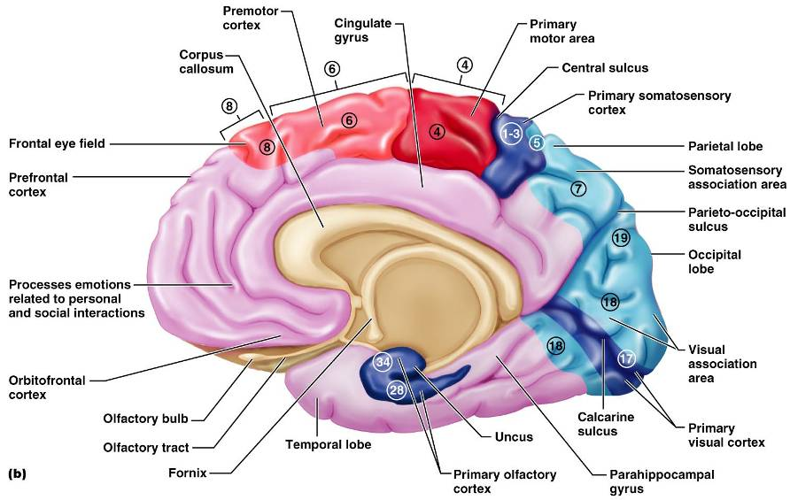
Functional Areas of the Cerebral Cortex

Slide 12
Cerebral Cortex: Motor Areas
Primary _
Premotor cortex
Frontal eye field

Slide 13
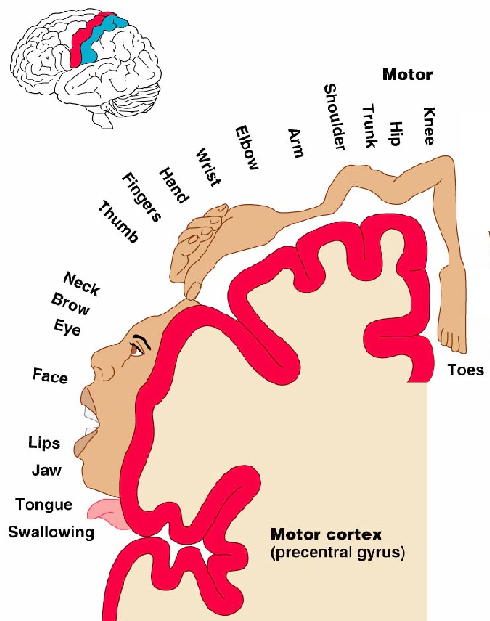
Primary Motor Cortex
Located in the _
Pyramidal cells whose axons make up the _
Allows conscious control of precise, skilled, voluntary movements

Slide 14
Premotor Cortex
Located _
Controls _
Coordinates simultaneous or sequential actions
Involved in the planning of movements

Slide 15
Broca’s Area
Broca’s area
Located anterior to the inferior region of the premotor area
Present in _
A motor speech area that _
Is active as one prepares to speak

Slide 16
Frontal Eye Field
Located anterior to the premotor cortex and superior to Broca’s area
Controls _

Slide 17
Sensory Areas
Primary _
Somatosensory association cortex
Visual and _
Olfactory, ___________________________, and vestibular cortices

Slide 18
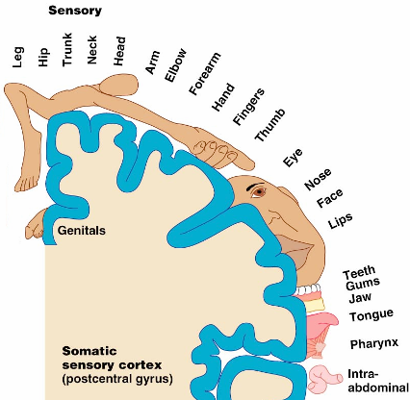
PrImary Somatosensory Cortex
Located in the postcentral gyrus, this area:
Receives information from the _
Exhibits _

Slide 19
Somatosensory Association Cortex
Located posterior to the primary somatosensory cortex
Forms _____________________________ understanding of the stimulus
Determines size, texture, and relationship of parts

Slide 20
Visual Areas
Primary visual (striate) cortex
Seen on the _
Most of it is buried in the calcarine sulcus
Receives visual information from the retinas
Visual association area
Interprets visual stimuli (e.g., color, form, and movement)

Slide 21
Auditory Areas
Primary auditory cortex
Located at the superior margin of the _
Receives information related to _
Auditory association area
Located posterior to the primary auditory cortex
____________________________________ and permits perception of sounds

Slide 22
Association Areas
Language areas
General (common) interpretation area

Slide 23
Prefrontal Cortex
Located in the _
Involved with ________________________, cognition, recall, and _
Necessary for judgment, _______________________, persistence, and conscience
Closely linked to the __________________ system (emotional part of the brain)

Slide 24
Cerebellar Cognitive Function
Plays a role in _
Recognizes and ______________________ sequences of events

Slide 25
Language Areas
Located in a large area surrounding the ________________ (or language-dominant) _
Major parts and functions:
sounding out unfamiliar words
speech preparation and production
language comprehension and word analysis
Lateral and ventral temporal lobe
coordinate auditory and visual aspects of language

Slide 26
General (Common) Interpretation Area
__________________________ region including parts of the temporal, parietal, and occipital lobes
Found in one hemisphere, _
Integrates incoming signals _
Involved in processing spatial relationships

Slide 27
Visceral Association Area
Located in the _
Involved in conscious perception of _

Slide 28
Lateralization of Cortical Function
Lateralization
each hemisphere has _
Cerebral dominance
designates the hemisphere _
Left hemisphere
controls _
Right hemisphere
controls _

Slide 29
Cerebral White Matter
Consists of deep _
It is responsible for communication between:
The cerebral cortex and lower CNS center, and areas of the cerebrum

