Slide 1
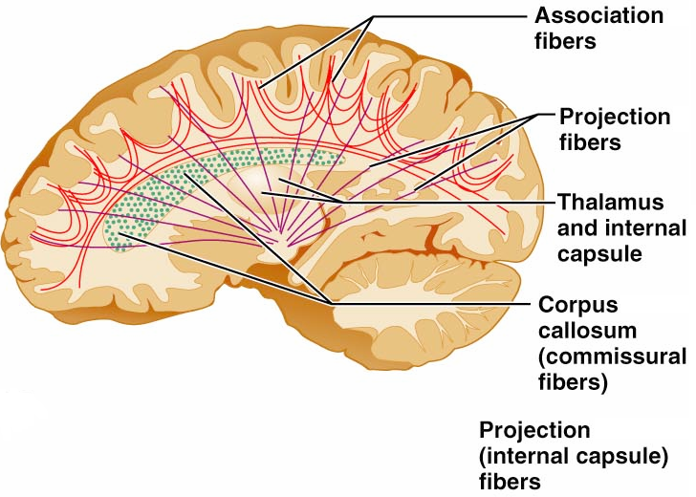
Cerebral White Matter
Types include:
connect corresponding gray areas of the two hemispheres
connect different parts of the same hemisphere
enter the hemispheres from lower brain or cord centers

Slide 2
Basal Nuclei
Masses of _________________________ found deep within the cortical white matter
The corpus striatum is composed of three parts
composed of the putamen and the globus pallidus
_______________________________ running between and through caudate and lentiform nuclei

Slide 3
Functions of Basal Nuclei
the following are thought to be functions of basal nuclei
Influence muscular activity
Regulate _
Regulate intensity of slow or stereotyped movements
_____________________________________ and unnecessary movement

Slide 4
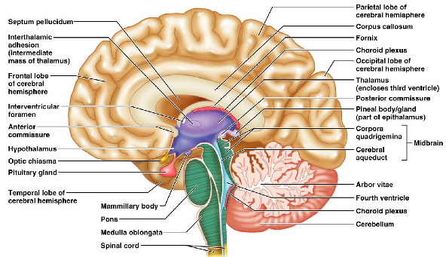
Diencephalon
Central core of the forebrain
Consists of three paired structures –
Encloses the _

Slide 5
Thalamus
Paired, egg-shaped masses that form the superolateral walls of the third ventricle
Contains four groups of nuclei
anterior, ventral, dorsal, and posterior
Nuclei _

Slide 6
Thalamic Function
___________________________________ and synapse in the thalamus
Impulses of similar function are sorted out, _________________________, and ______________________ as a group
All inputs ascending to the cerebral cortex pass through the thalamus
Mediates sensation, motor activities, cortical arousal, learning, and memory

Slide 7
Hypothalamus
Located below the thalamus, it caps the brainstem and forms the inferolateral walls of the third ventricle
Small, paired nuclei bulging anteriorly from the hypothalamus
_________________________________ for olfactory pathways
Infundibulum
stalk of the hypothalamus; _
Main _____________________________________ of the body

Slide 8
Hypothalamic Function
Regulates _
rate and force of _
______________________________ motility
rate and depth of _
many other visceral activities
Perception of _
Maintains normal body _
Regulates feelings of hunger and _
Regulates sleep and the _

Slide 9
Endocrine Functions of the Hypothalamus
____________________________________ control secretion of hormones by the anterior pituitary

Slide 10
Epithalamus
Most _______________________ of the diencephalon; forms roof of the third ventricle
extends from the posterior border and secretes _
a hormone involved with sleep regulation, sleep-wake cycles, and mood
a structure that _

Slide 11
Chapter 12

Slide 12
Brain Stem
Consists of three regions
Similar to spinal cord
but contains _
Controls ___________________________ behaviors necessary for survival
Provides the pathway for tracts between higher and lower brain centers

Slide 13
Midbrain
Located between the diencephalon and the pons
Midbrain structures include:
two bulging structures that contain descending pyramidal motor tracts
hollow tube that connects the _
Various nuclei

Slide 14
Pons
________________________________ region between the midbrain and the medulla oblongata
Fibers of the pons:
Connect higher brain centers and the spinal cord
_____________________________________ between the motor cortex and the cerebellum

Slide 15
Pons
Origin of cranial nerves

Slide 16
Medulla Oblongata
Most _______________________ part of the brain stem
Contains a ___________________________ of the fourth ventricle
two longitudinal ridges formed by _
___________________________ of the pyramids
____________________________ points of the corticospinal tracts

Slide 17
The Cerebellum
Located _
Protrudes under the occipital lobes of the cerebrum
Makes up 11% of the brain’s mass
Provides ____________________________ and appropriate patterns of skeletal muscle contraction
Cerebellar activity occurs _

Slide 18
Cerebellar Cognitive Function
Plays a role in _
Recognizes and ___________________________ sequences of events

Slide 19
Consciousness
Encompasses perception of _____________ __________________________________, and capabilities associated with higher mental processing
Involves simultaneous activity of large areas of the cerebral cortex
Is superimposed on other types of neural activity

Slide 20
Consciousness
Is holistic and _
Clinical consciousness is defined on a continuum that grades levels of behavior

Slide 21
Protection of the Brain
The brain is protected by _
Harmful substances are shielded from the brain by the _

Slide 22
Meninges
Three connective tissue membranes lie external to the CNS
Functions of the meninges
_____________________________________ and enclose venous sinuses
Contain cerebrospinal fluid (CSF)
Form ___________________________ within the skull

Slide 23
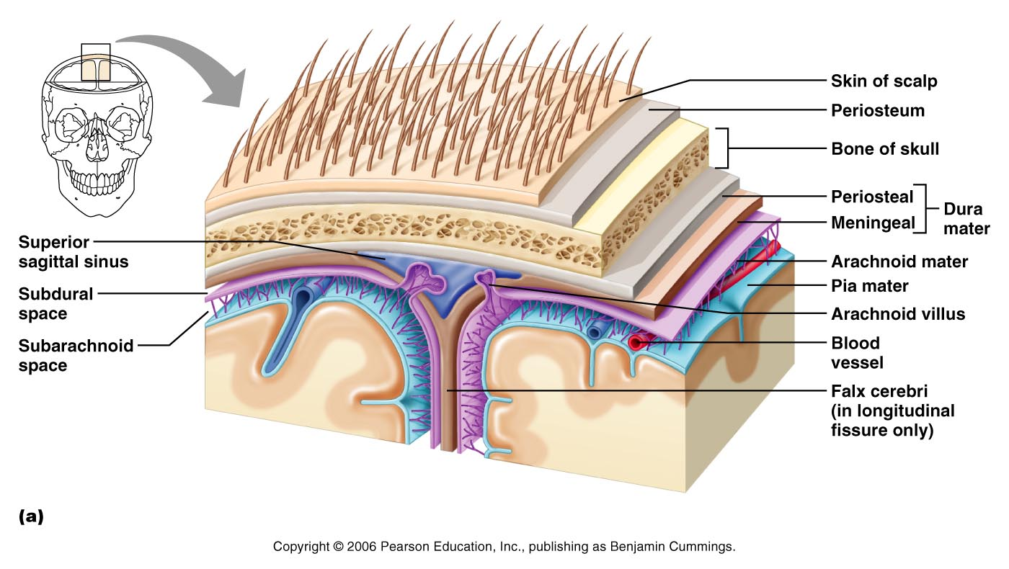
Meninges

Slide 24
Dura Mater
Leathery, strong covering composed of _
The two layers _______________________ in certain areas and _

Slide 25
Dura Mater
Three ___________________________ extend inward and limit excessive movement of the brain
fold that dips into the _
Falx _
runs along the _
Tentorium cerebelli
horizontal dural fold extends into the _

Slide 26
Arachnoid Mater
forms a _
It is separated from the dura mater by the _
Beneath the arachnoid is a wide subarachnoid space filled with CSF and large blood vessels
Arachnoid villi protrude superiorly and _

Slide 27
Pia Mater
_______________________ layer composed of delicate connective tissue that _

Slide 28
Cerebrospinal Fluid (CSF)
Watery solution similar in composition _
Forms a _____________________________ that gives buoyancy to the CNS organs

Slide 29
Cerebrospinal Fluid (CSF)
Prevents the brain from _
Protects the CNS from _
_______________________________ the brain and carries chemical signals throughout it

Slide 30
Choroid Plexuses
Clusters of _________________ that form tissue fluid filters, which hang from the roof of each ventricle
Help _

Slide 31
Blood-Brain Barrier
Protective mechanism that helps maintain a stable environment for the brain
Bloodborne substances are separated from neurons by:
Continuous _
Relatively thick _
Bulbous feet of _

Slide 32
Blood-Brain Barrier: Functions
Selective barrier that allows _______________________ to pass freely
Is ineffective against substances that can diffuse through plasma membranes
Absent in some areas __________________________________ allowing these areas to monitor the chemical composition of the blood
_____________________ increases the ability of chemicals to pass through the blood-brain barrier

