Slide 1
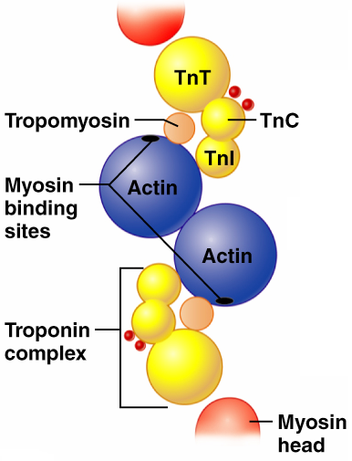
Role of Ionic Calcium (Ca²⁺) in the Contraction Mechanism
At __________ intracellular Ca²⁺ concentration:
Tropomyosin ________________the binding sites on actin
Myosin cross bridges cannot attach to binding sites on actin
Muscle remains _
Figure 9.11a

Slide 2
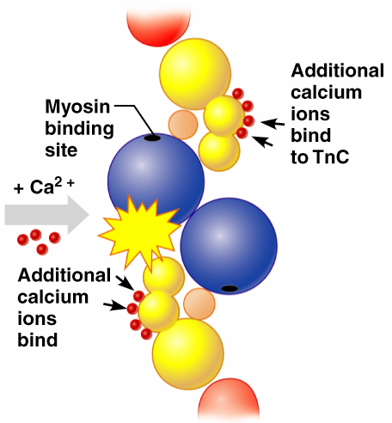
Role of Ionic Calcium (Ca²⁺) in the Contraction Mechanism
At __________________ intracellular Ca²⁺ concentrations:
Additional calcium binds to troponin
Calcium-activated troponin binds an additional two Ca²⁺ at a separate regulatory site
Figure 9.11b

Slide 3
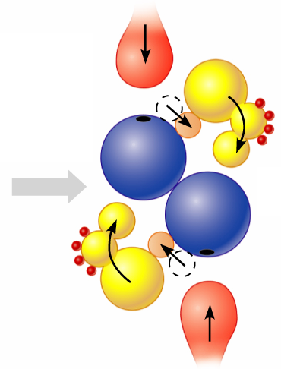
Role of Ionic Calcium (Ca²⁺) in the Contraction Mechanism
Calcium-activated troponin undergoes a _
This change moves tropomyosin away from _
Figure 9.11c

Slide 4
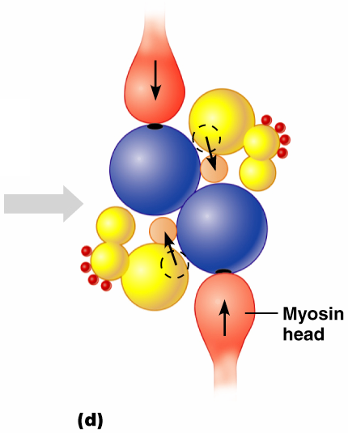
Role of Ionic Calcium (Ca²⁺) in the Contraction Mechanism
Myosin head can now _
This permits _
sliding of the thin filaments by the myosin cross bridges
Figure 9.11d

Slide 5
Sequential Events of Contraction
myosin cross bridge attaches to actin filament
myosin head pivots and pulls actin filament toward M line
ATP attaches to myosin head and the cross bridge detaches
“Cocking” of the myosin head
energy from hydrolysis of ATP cocks the myosin head into the high-energy state

Slide 6
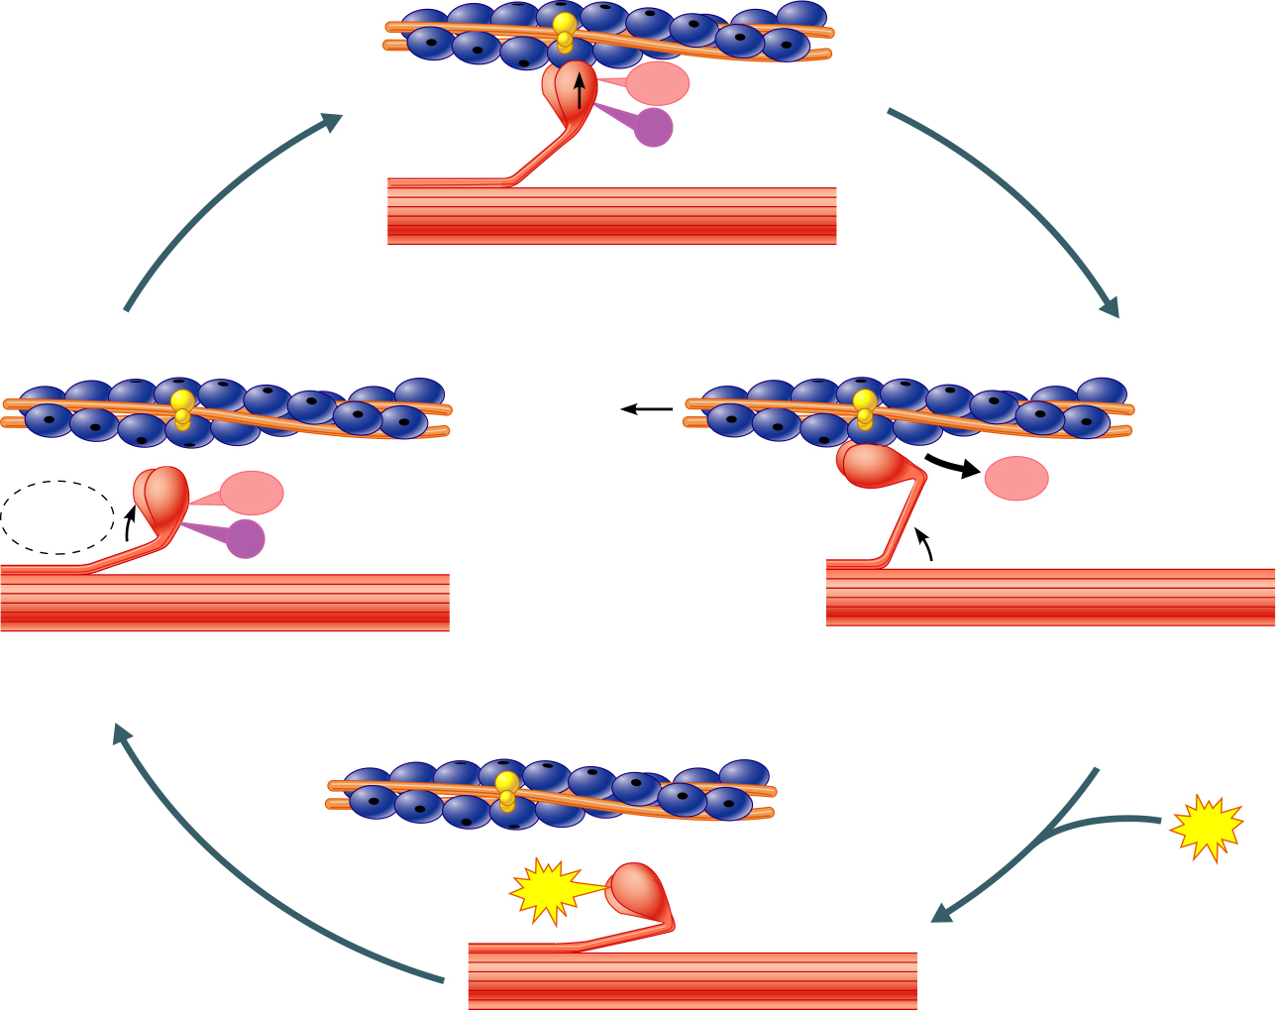
Myosin head
(high-energy
configuration)
ADP
P_{i}
1
Myosin head attaches to the actin
myofilament, forming a cross bridge.
Thin filament
ATP
ADP
ADP
Thick filament
hydrolysis
P_{i}
4
As ATP is split into ADP and P_{i}, the myosin
head is energized (cocked into the high-energy
conformation).
2
Inorganic phosphate (P_{i}) generated in the
previous contraction cycle is released, initiating
the power (working) stroke. The myosin head
pivots and bends as it pulls on the actin filament,
sliding it toward the M line. Then ADP is released.
ATP
ATP
Myosin head
(low-energy
configuration)
3
As new ATP attaches to the myosin head, the link between
myosin and actin weakens, and the cross bridge detaches.
Figure 9.12

Slide 7
Contraction of Skeletal Muscle Fibers
Contraction
refers to the _
ends when cross bridges become inactive, the tension generated declines, and relaxation is induced

Slide 8
Contraction of Skeletal Muscle (Organ Level)
The two types of muscle contractions are:
________________________contraction
muscle shortens during contraction
Iso = same; tonic = tone
increasing muscle tension
muscle does not ___________________________ during contraction
Iso = same; metric =length

Slide 9
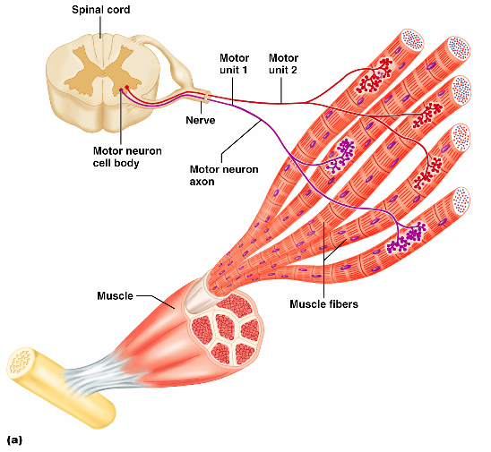
Motor Unit: The Nerve-Muscle Functional Unit
A motor unit is a _
The number of muscle fibers per motor unit varies
from _

Slide 10
Motor Unit: The Nerve-Muscle Functional Unit
Muscles that control fine movements have _
fingers, eyes
________________________weight-bearing muscles have ________________motor units
thighs, hips
Muscle fibers from a motor unit are spread throughout the muscle; therefore, contraction of a single motor unit causes weak contraction of the entire muscle

Slide 11
Muscle Tone
Muscle tone:
Is the _________________________________ state of all muscles, which does not _
Keeps the muscles firm, healthy, and _
Spinal reflexes account for muscle tone by:
Activating one motor unit and then another
Responding to activation of _

Slide 12
Heat Production During Muscle Activity
Only 40% of the energy released in muscle activity is _
The remaining 60% is _
Dangerous heat levels are prevented by radiation of heat from the skin and sweating

Slide 13
Force of Muscle Contraction
The force of contraction is affected by:
The _______________________________________ contracting
the more motor fibers in a muscle, the stronger the contraction
The relative _______________________ of the muscle
the bulkier the muscle, the greater its strength
____________________________ of muscle stretch
muscles contract strongest when muscle fibers are 80-120% of their normal resting length

Slide 14
Effects of Aerobic Exercise
Aerobic exercise results in an increase of:
Muscle _
Number of _
_______________________________ synthesis

Slide 15
Effects of Resistance Exercise
_____________________________ exercise (typically anaerobic) results in:
Muscle _
Increased
Myofilaments

Slide 16
The Overload Principle
Forcing a muscle to work promotes increased muscular strength
Muscles ______________________________ to increased demands
Muscles must be ______________________ to produce further gains

Slide 17
Smooth Muscle
Composed of _
____________________ the coarse connective tissue sheaths of skeletal muscle,
have fine endomysium

Slide 18
Smooth Muscle
Organized into ____________________ of closely apposed fibers
longitudinal
circular
Found in _
Have essentially the same contractile mechanisms as skeletal muscle

Slide 19
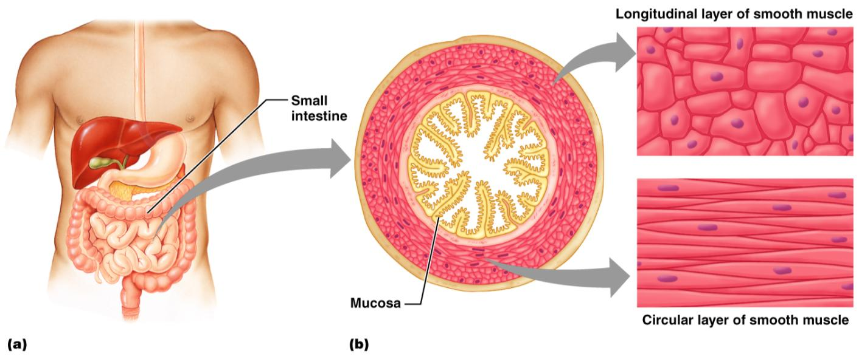
Smooth Muscle
Figure 9.24

Slide 20
Peristalsis
When the ________________________layer contracts
the organ dilates and contracts
When the _____________________ layer contracts
the organ elongates
alternating contractions and relaxations of smooth muscles that _____________________________ substances through the lumen of hollow organs

Slide 21
Innervation of Smooth Muscle
Smooth muscle _
Innervating nerves have bulbous swellings called _
Varicosities ____________________________ into wide synaptic clefts called diffuse junctions

Slide 22
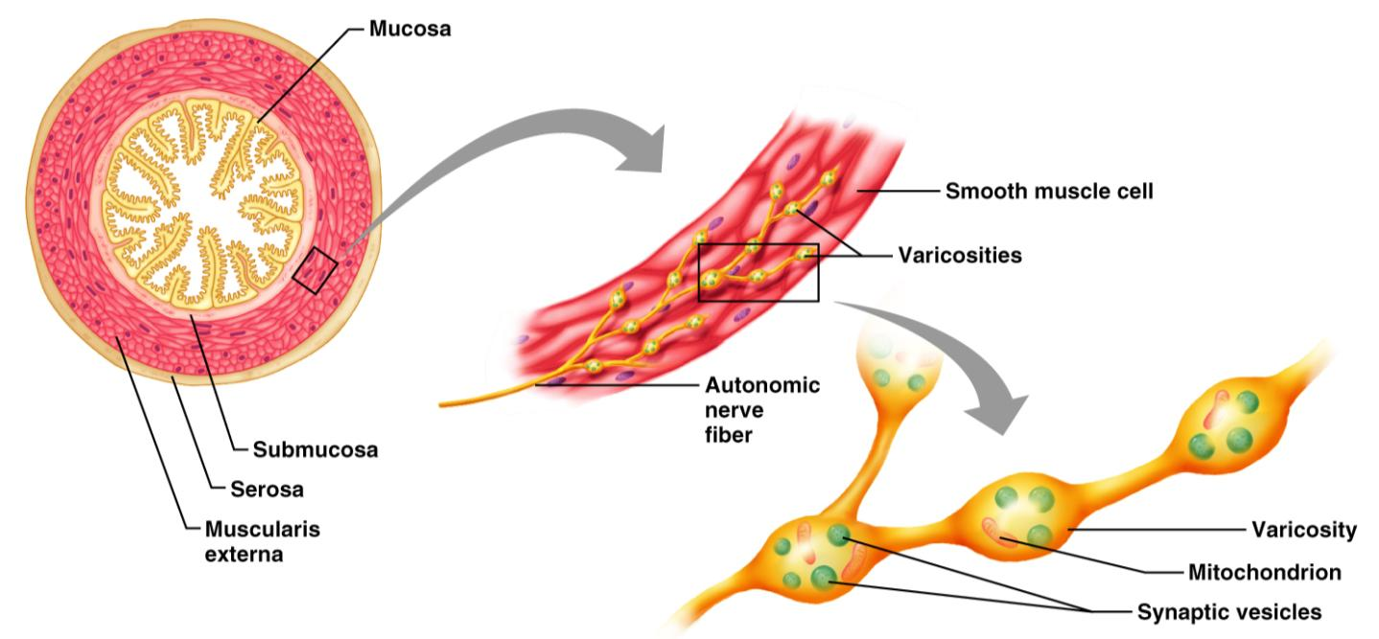
Innervation of Smooth Muscle
Figure 9.25

Slide 23
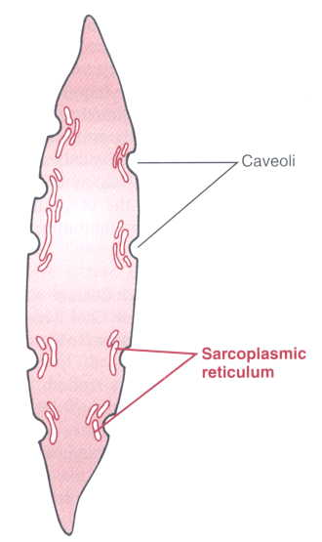
Microscopic Anatomy of Smooth Muscle
Sarcoplasmic Reticulum
is _____________________ than in skeletal muscle
lacks a specific pattern
T tubules are _
Plasma membranes have pouchlike infoldings called _

Slide 24
Microscopic Anatomy of Smooth Muscle
______________ is kept in the extracellular space near the caveoli, allowing rapid influx when channels are opened
There are ____________________________ and no sarcomeres
Thin and thick filaments are present

Slide 25
Myofilaments in Smooth Muscle
Ratio of thick to thin filaments is much lower than in skeletal muscle
Thick filaments have heads along their entire length
There is _

Slide 26
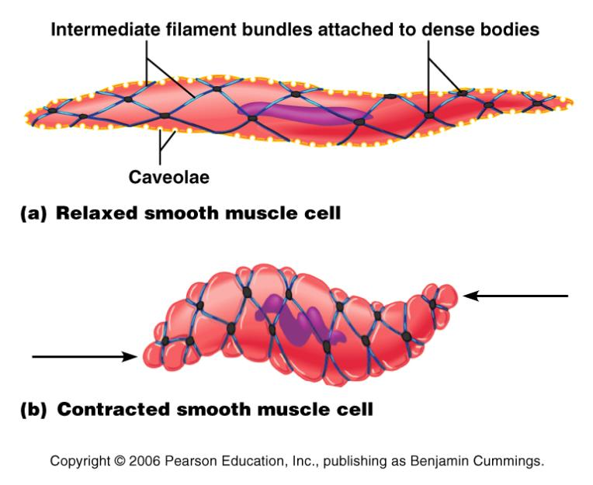
Myofilaments in Smooth Muscle
Thick and thin filaments are _____________________________, causing smooth muscle to contract in a _

Slide 27
Contraction of Smooth Muscle
Whole sheets of smooth muscle exhibit _
They contract in unison, reflecting their electrical coupling _
Action potentials are transmitted from cell to cell

Slide 28
Contraction of Smooth Muscle
Some smooth muscle cells:
Act as ______________________________ and set the contractile pace for _____________________________ of muscle
Are ___________________________________ and depolarize without external stimuli

Slide 29
Contraction Mechanism
Actin and myosin interact according to the _
The final trigger for contractions is a _
Ca²⁺ is released from the SR and from the extracellular space
Ca²⁺ interacts with calmodulin and myosin light chain kinase to activate myosin

Slide 30
Role of Calcium Ion
Ca²⁺ binds to __________________________ and activates it
Activated calmodulin activates the _
Activated kinase transfers ________________ from ATP to myosin cross bridges
Phosphorylated cross bridges interact with actin to produce shortening
Smooth muscle relaxes when intracellular Ca²⁺ levels drop

Slide 31
Special Features of Smooth Muscle Contraction
Unique characteristics of smooth muscle include:
Smooth muscle _
___________________________, prolonged contractile activity
Low energy requirements
Response _

Slide 32
Response to Stretch
Smooth muscle exhibits a phenomenon called ____________________________ response in which:
Smooth muscle responds to stretch only briefly, and then _
The new length, however, _
This enables organs such as the stomach and bladder to temporarily store contents

Slide 33
Hyperplasia
Certain _______________________ muscles can divide and ____________________________ by undergoing hyperplasia
This is shown by estrogen’s effect on _
At puberty,
estrogen stimulates the synthesis of more smooth muscle, causing the uterus to grow to adult size
During _
estrogen stimulates uterine growth to accommodate the increasing size of the growing fetus

Slide 34
Types of Smooth Muscle: Single Unit
The cells of single-unit smooth muscle, commonly called _______________________ muscle:
Contract rhythmically as a unit
Are electrically coupled to one another via _
Often exhibit _
Are arranged in opposing sheets and exhibit stress-relaxation response

Slide 35
Types of Smooth Muscle: Multiunit
Multiunit smooth muscles are found:
In large airways to the lungs
In _
In arrector pili muscles
Attached to _
In the internal eye muscles

Slide 36
Types of Smooth Muscle: Multiunit
Their characteristics include:
_________________ gap junctions
_________________________________ spontaneous depolarizations
Structurally independent muscle fibers
A rich nerve supply, which, with a number of muscle fibers, forms motor units
______________________________________ in response to neural stimuli

