Slide 1
Interactions of Skeletal Muscles
Skeletal muscles work _________________________ or in _
Muscles only _______________(never push)
As muscles shorten, the insertion generally moves toward the origin

Slide 2
Muscles: Functional Groups
provide the major force for producing a specific movement
oppose or reverse a particular movement
Add force to a movement
Reduce undesirable or unnecessary movement
synergists that immobilize a bone or muscle’s origin

Slide 3
Naming Skeletal Muscles
bone or body region associated with the muscle
e.g., the deltoid muscle (deltoid = triangle)

Slide 4
Naming Skeletal Muscles
maximus (largest), minimus (smallest), longus (long)
rectus (fibers run straight), transversus, and oblique (fibers run at angles to an imaginary defined axis)

Slide 5
Naming Skeletal Muscles
Number of _
biceps (two origins) and triceps (three origins)
Location of _
named according to point of origin or insertion
flexor or extensor, as in the names of muscles that flex or extend, respectively

Slide 6
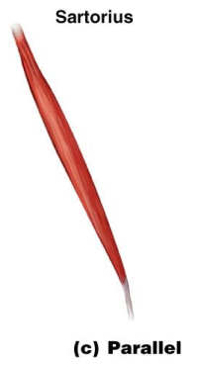
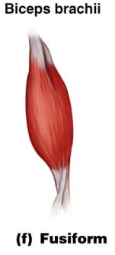
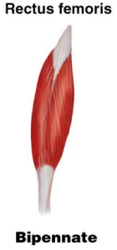
Arrangement of Fascicles
fascicles run parallel to the long axis of the muscle
sartorius
spindle-shaped muscles
biceps brachii
short fascicles that attach obliquely to a central tendon running the length of the muscle
rectus femoris

Slide 7
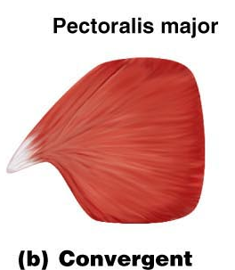
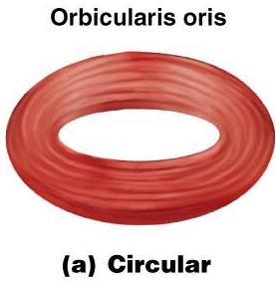
Arrangement of Fascicles
fascicles converge from a broad origin to a single tendon insertion
pectoralis major
fascicles are arranged in concentric rings
orbicularis oris

Slide 8
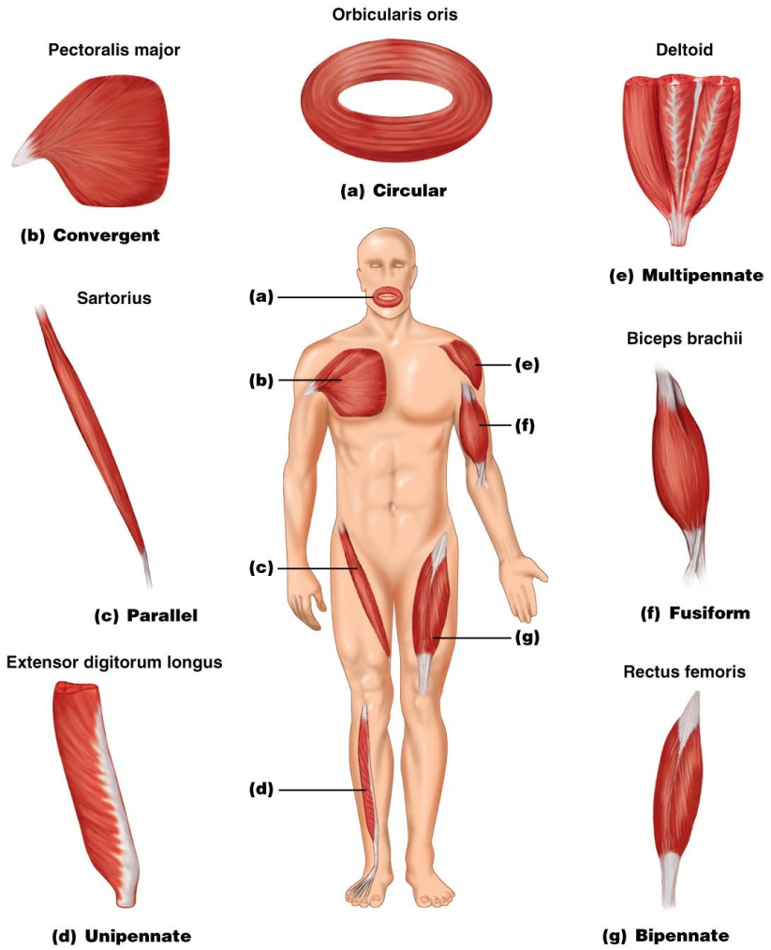
Figure 10.1

Slide 9
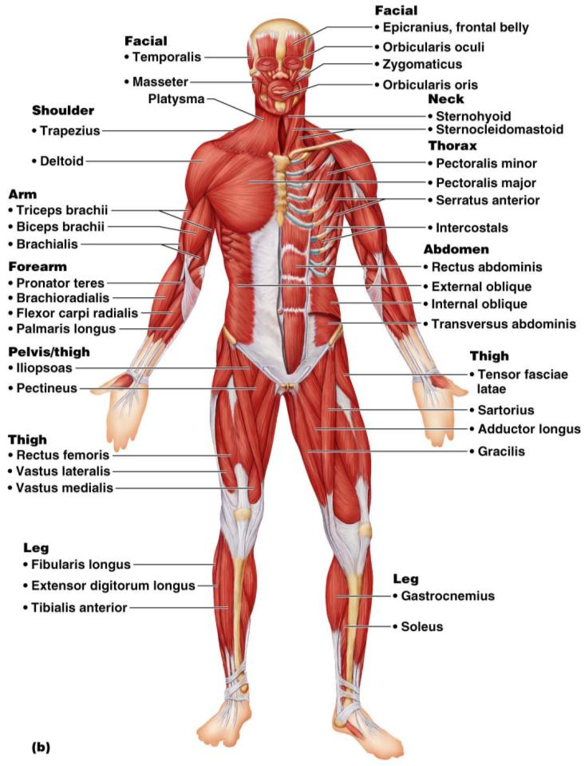
Major Skeletal Muscles: Anterior View
The 40 superficial muscles here are divided into 10 regional areas of the body
Figure 10.4b

Slide 10
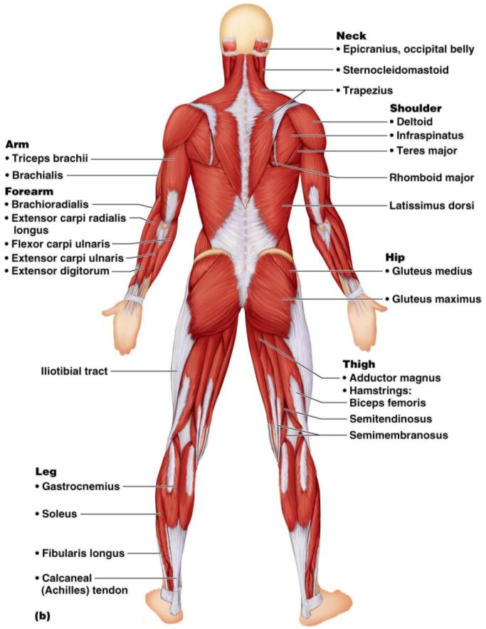
Major Skeletal Muscles: Posterior View
The 27 superficial muscles here are divided into seven regional areas of the body
Figure 10.5b

Slide 11
Muscles: Name, Action, and Innervation
Name and description of the muscle
be alert to information given in the name
Origin and insertion
Action
best learned by _________________________________________ on one’s own body
Nerve supply
name of major nerve that innervates the muscle

Slide 12
Muscles of the Scalp
Epicranius (___________________________) – bipartite muscle consisting of the:
Galea aponeurotica – cranial ___________________________________ connecting above muscles
These two muscles have alternate actions of pulling the scalp forward and backward

Slide 13
Muscles of the Face
11 muscles are involved in lifting the eyebrows, flaring the nostrils, opening and closing the eyes and mouth, and smiling
All are innervated by __________________________________ (facial nerve)
Usually insert ______________________ (rather than bone), and adjacent muscles often fuse

Slide 14
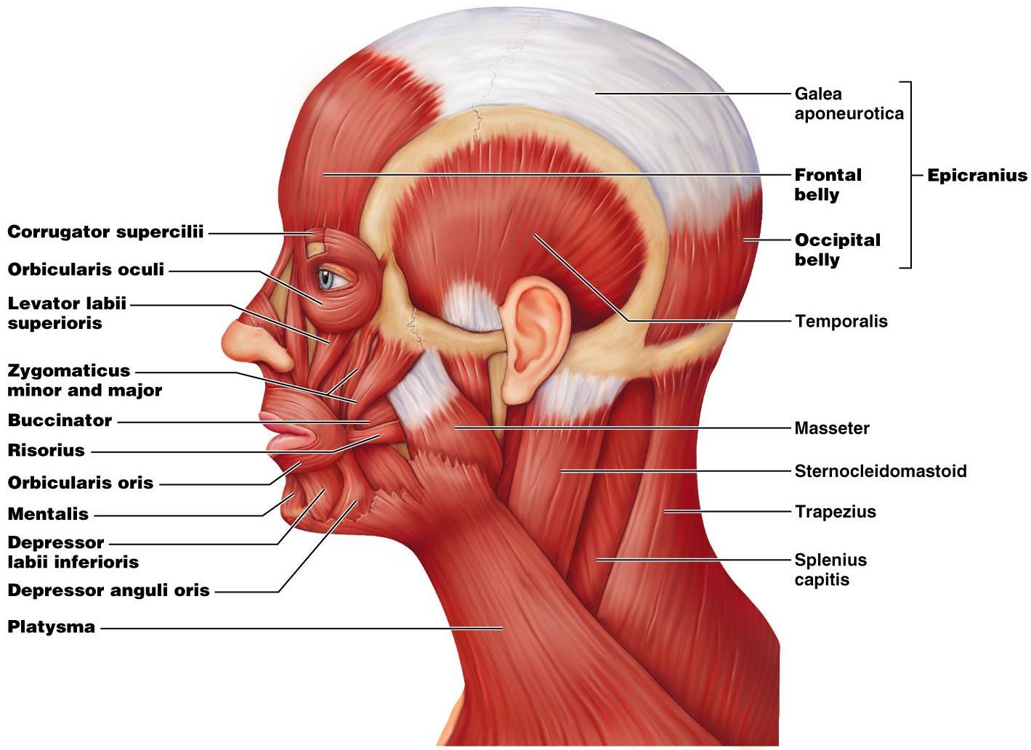

Slide 15
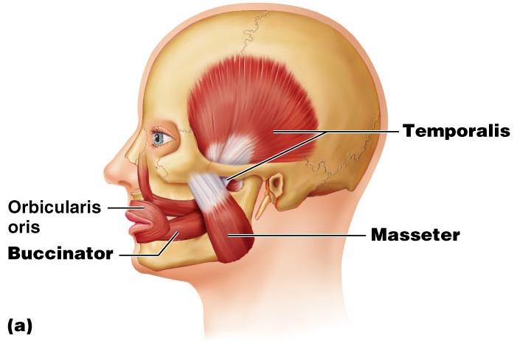
Muscles of Mastication
There are ____________________________________ of muscles involved in mastication
Prime movers
Grinding movements
All are innervated by _

Slide 16
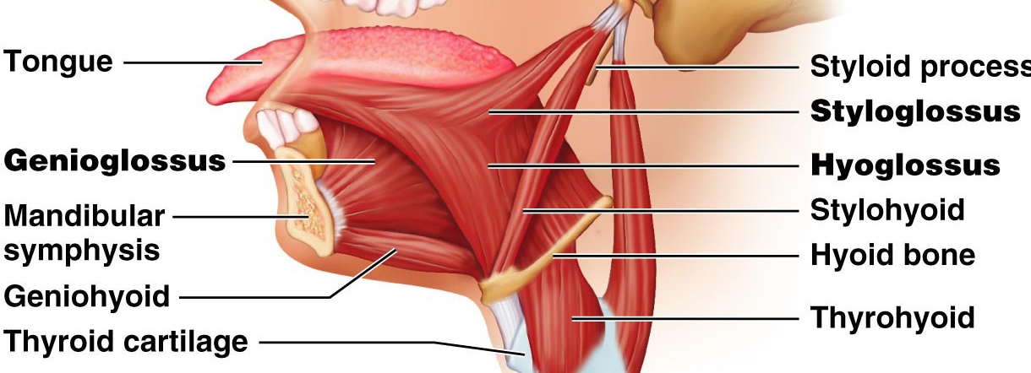
Extrinsic Tongue Muscles
Three major muscles that _
All are innervated by cranial nerve _

Slide 17
Muscles of the Neck: Head Movements
sternocleidomastoid
_____________________________ to head flexion
suprahyoid and infrahyoid
sternocleidomastoid and scalene muscles
Head extension
deep splenius muscles and aided by the _

Slide 18
Trunk Movements: Deep Back Muscles
The prime mover of _
erector spinae
Erector spinae muscles consist of ______________________________ on each side of the vertebrae
Lateral bending of the back
unilateral contraction of these muscles
Other deep back extensors include the semispinalis muscles and the quadratus lumborum

Slide 19
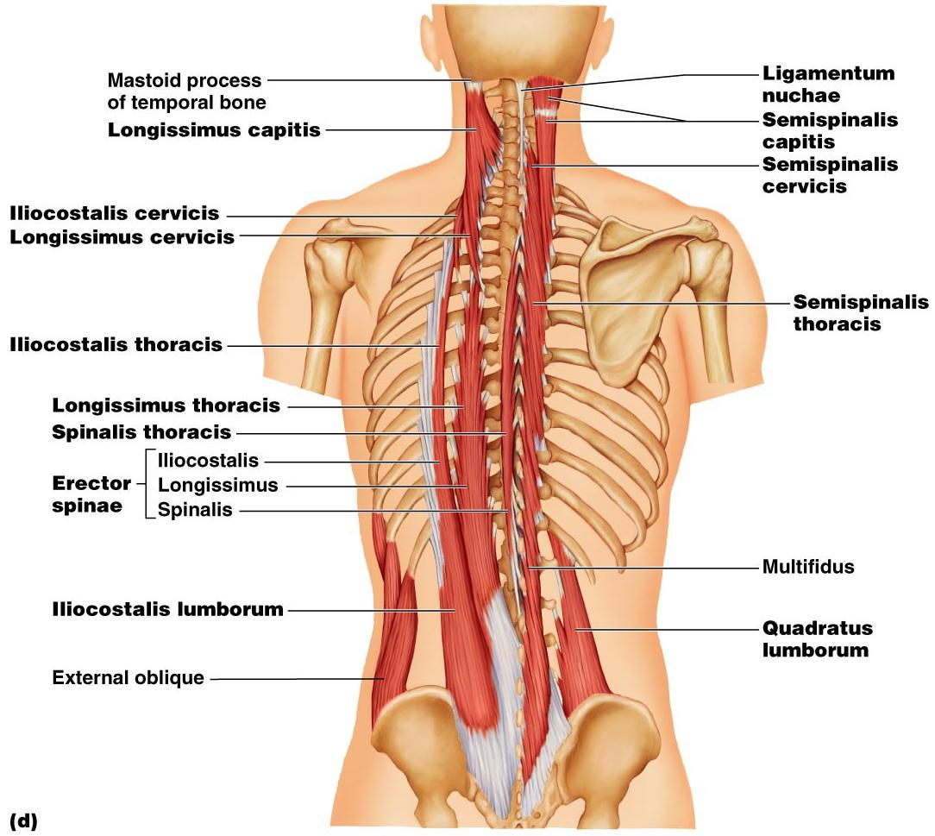
Figure 10.9d

Slide 20
Trunk Movements: Short Muscles
Four short muscles extend from one vertebra to another
These muscles are synergists in ________________________________ of the spine

Slide 21
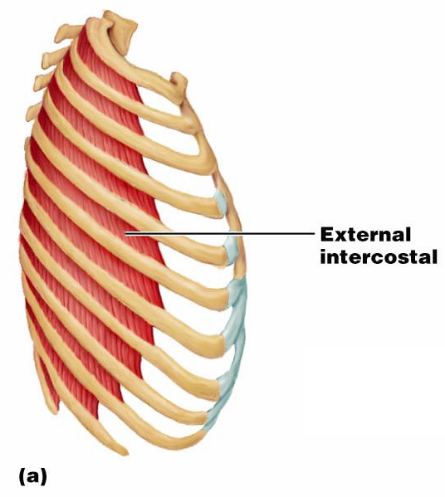
Muscles of Respiration: External Intercostals
The primary function of deep thoracic muscles is to _
______________________
more superficial layer that lifts the rib cage
increases thoracic volume to allow inspiration

Slide 22
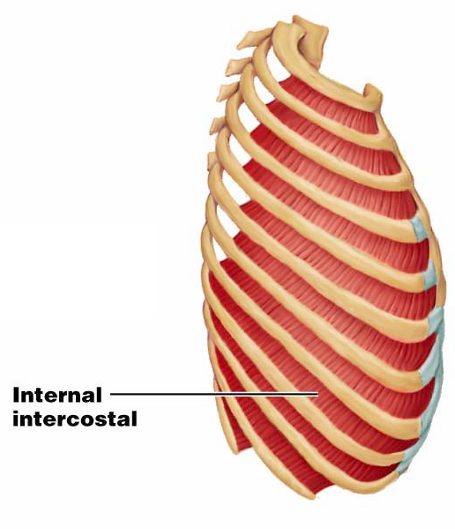
Muscles of Respiration: Internal Intercostals
deeper layer that aids in forced expiration
most important muscle in inspiration

Slide 23
Muscles of the Abdominal Wall
The abdominal wall is composed of four paired muscles
external obliques,
rectus abdominis),
their fasciae, and their _
Fascicles of these muscles run at right and oblique angles to one another, giving the abdominal wall added strength

Slide 24
Muscles of the Abdominal Wall
In addition to forming the abdominal wall, these muscles:
Are involved with ________________________ and rotation of the trunk
Help promote __________________________, defecation, ___________________________, vomiting, coughing, and _

Slide 25
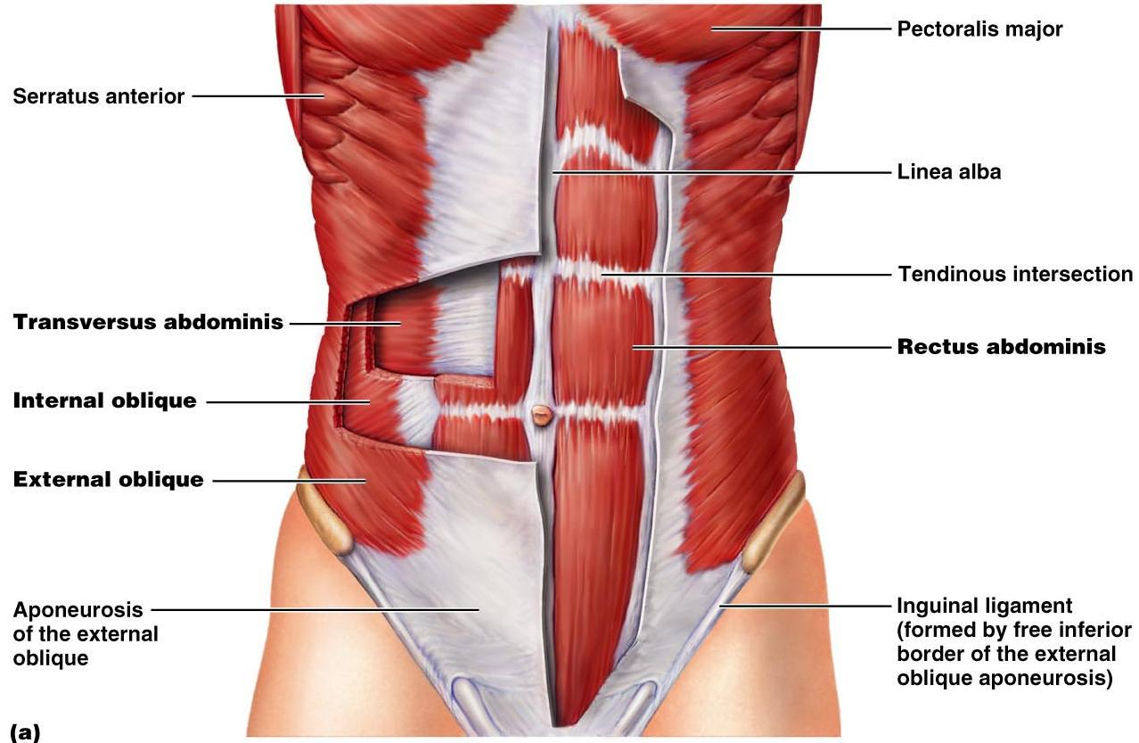
Muscles of the Abdominal Wall
Figure 10.11a

Slide 26
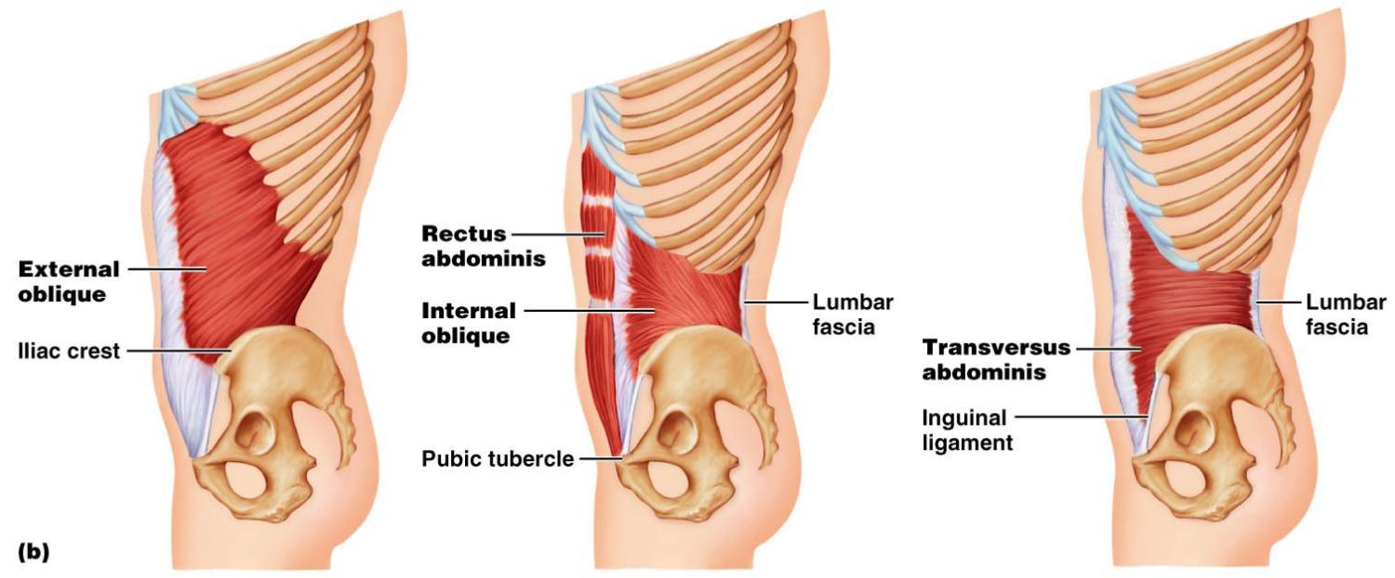
Muscles of the Abdominal Wall
Figure 10.11b

Slide 27
Extrinsic Shoulder Muscles
Muscles of the thorax
Anterior:
pectoralis major, pectoralis minor, serratus anterior, and subclavius
Posterior:
latissimus dorsi, trapezius muscles, levator scapulae, and rhomboids
These muscles are involved with the _________________________________________ including elevation, depression, rotation, and lateral and medial movements
Prime movers of shoulder elevation are the _

Slide 28
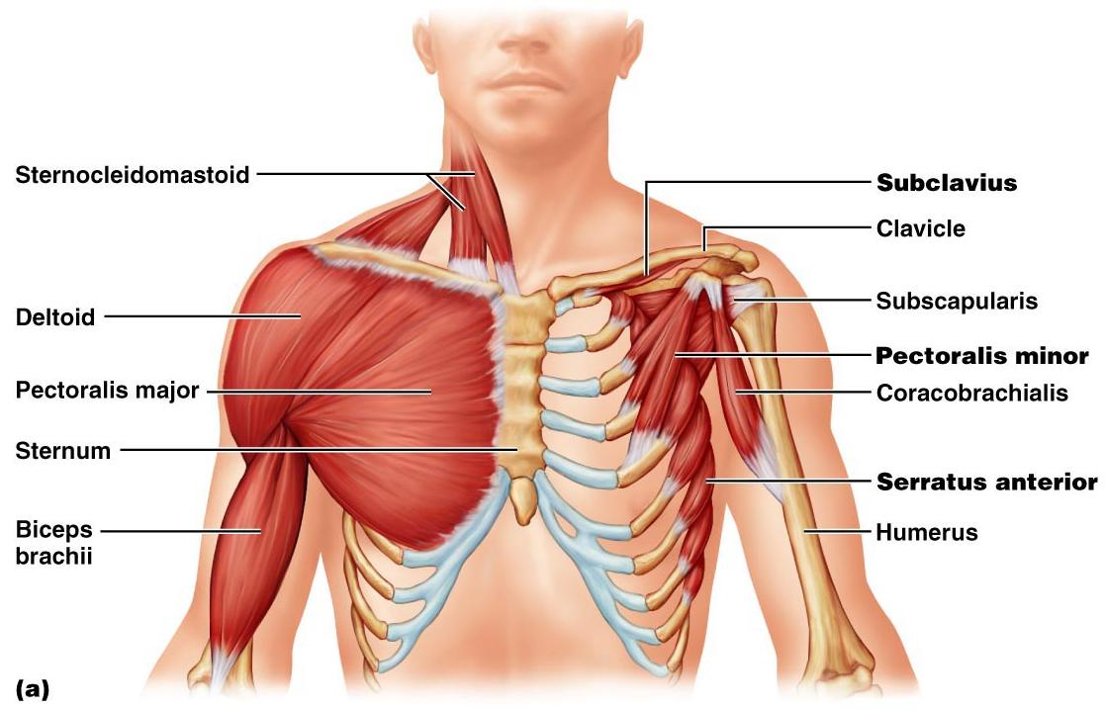
Extrinsic Shoulder Muscles
Figure 10.13a

Slide 29
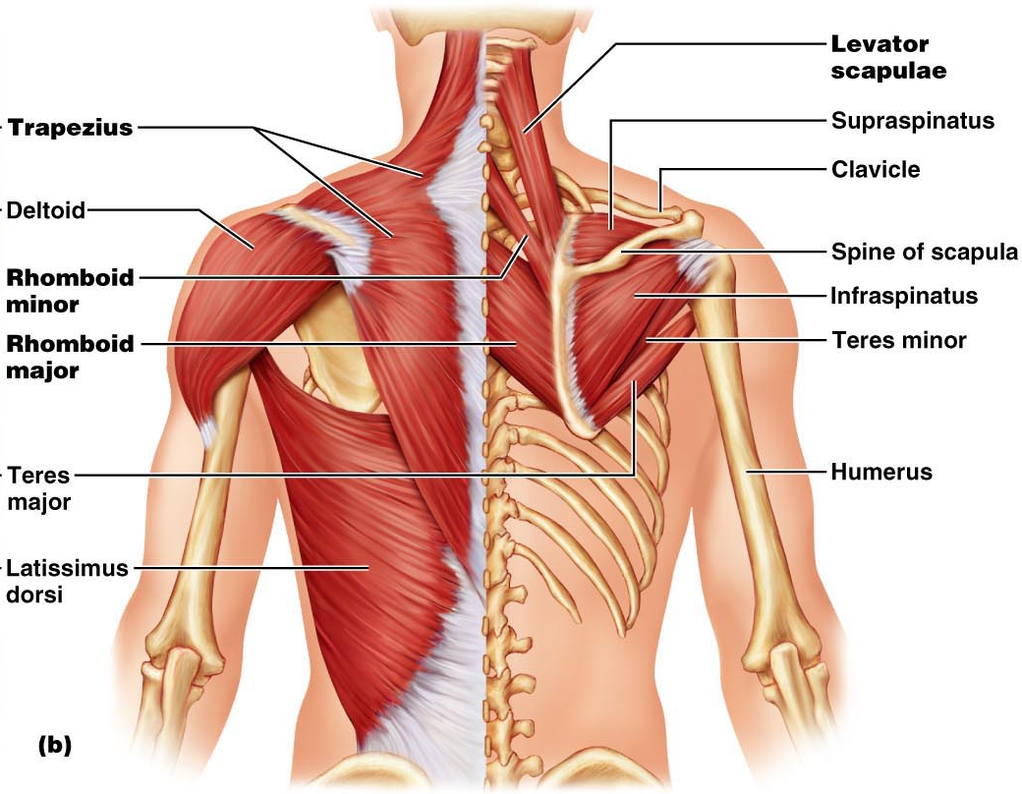
Figure 10.13b

Slide 30
Muscles Crossing the Shoulder
Nine muscles cross the shoulder joint and insert into the humerus
Prime movers include:
Pectoralis major
Latissimus dorsi and posterior fibers of the deltoid
Middle fibers of the deltoid

Slide 31
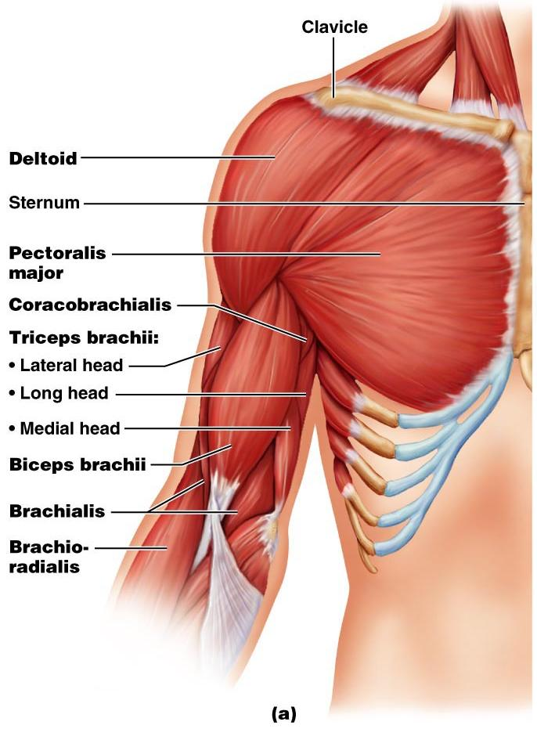
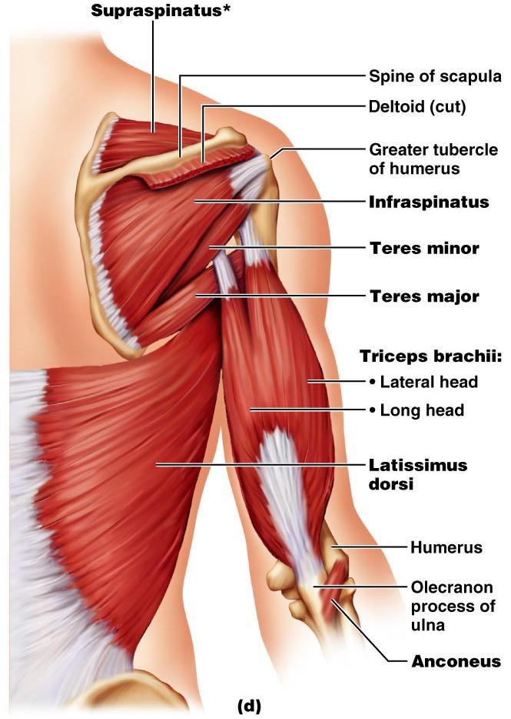
Muscles Crossing the Shoulder

Slide 32
Muscles Crossing the Shoulder
Rotator cuff muscles
Function mainly to reinforce the capsule of the shoulder
Secondarily act as synergists and fixators

Slide 33
Muscles Crossing the Elbow
Forearm extension
prime mover of forearm extension
weak synergist
The

Slide 34
Muscles Crossing the Elbow
Forearm flexion
chief forearm flexors
synergist
The _
helps stabilize the _

Slide 35
Muscles of the Forearm
Forearm muscle groups:
those that cause _
those that move the _
These muscles insert via the flexor and extensor retinacula
Most _
Most _

Slide 36
Muscles of the Forearm
The pronator teres and pronator quadratus are not flexors, but _
The supinator muscle is a synergist with the biceps brachii in _

Slide 37
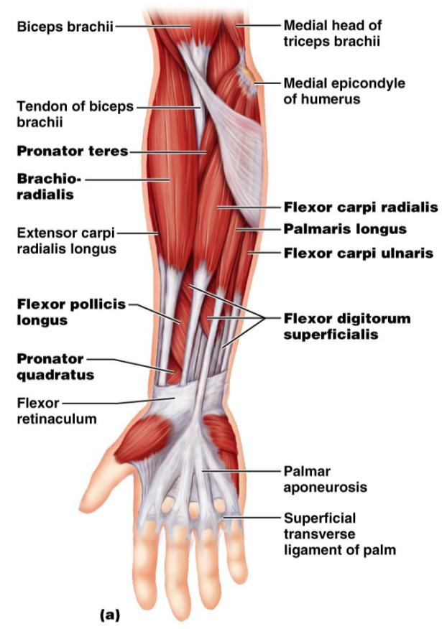
Muscles of the Forearm: Anterior
These muscles are primarily flexors of the wrist and fingers

Slide 38
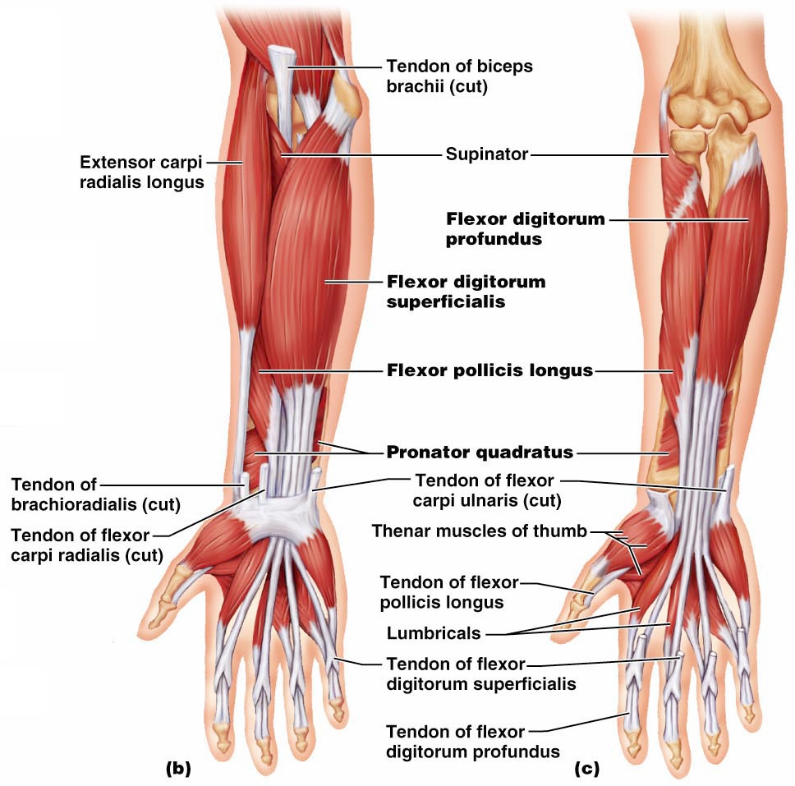
Figure 10.15b, c

Slide 39
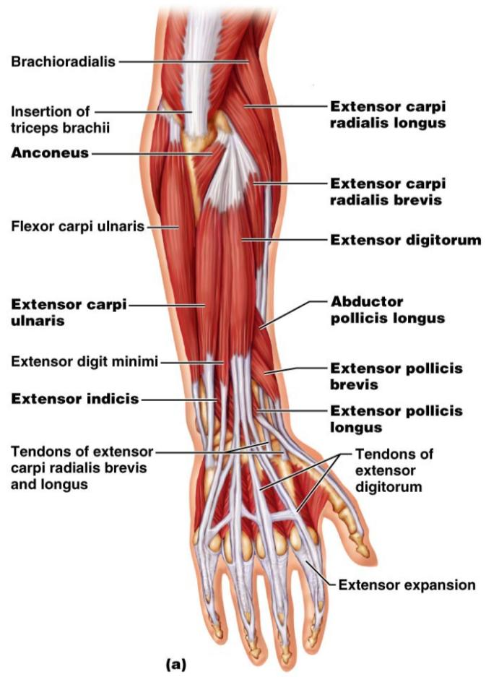
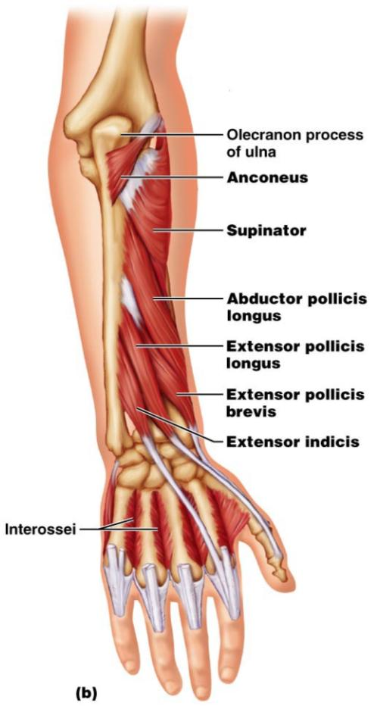
Muscles of the Forearm: Posterior
These muscles are primarily extensors of the wrist and digits
Figure 10.16a

Slide 40
Intrinsic Muscles of the Hand
These small muscles:
Lie ____________________________ of the hand
none on the dorsal side
Move the ______________________________ and fingers
Control precise movements
Are the main abductors and adductors of the fingers
Produce _
move the thumb toward the little finger

Slide 41
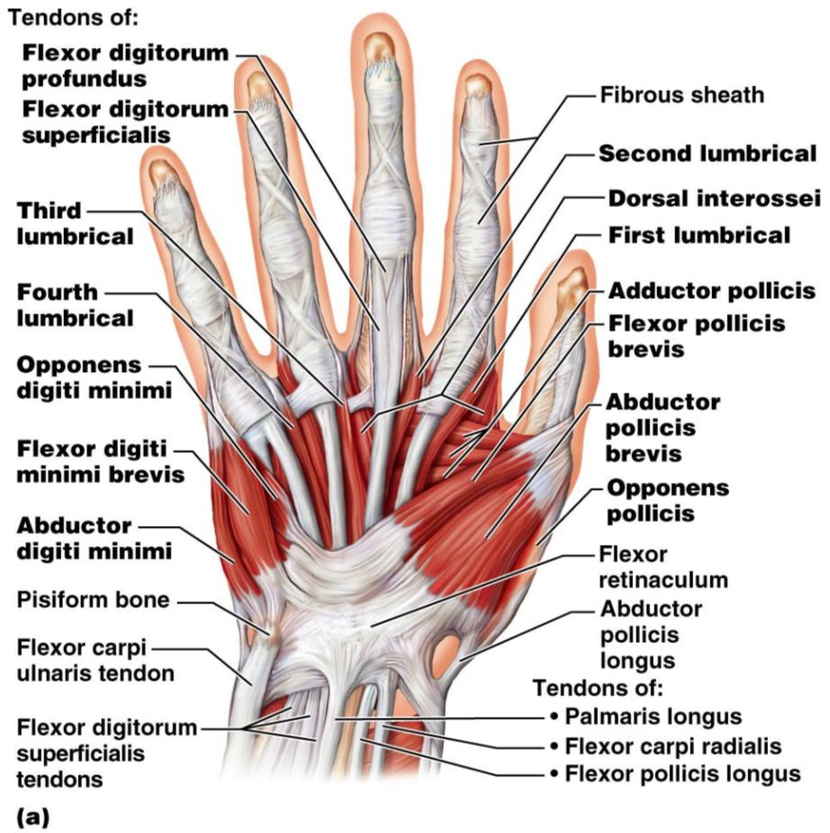
Intrinsic Muscles of the Hand
Figure 10.18a

Slide 42
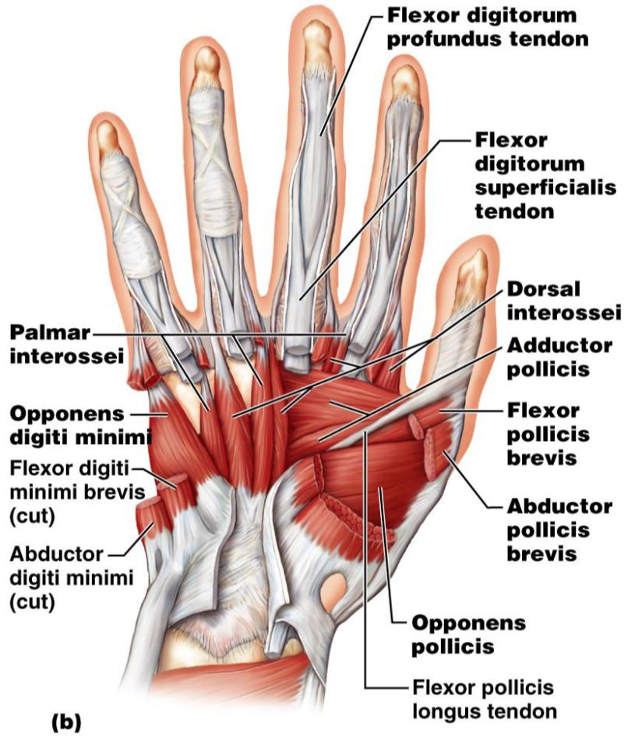
Intrinsic Muscles of the Hand
Figure 10.18b

Slide 43
Finger and Thumb Movements
Flexion
Thumb –
Fingers –
Extension
Thumb –
Fingers –

Slide 44
Intrinsic Muscles of the Hand: Groups
There are _____________________ groups of intrinsic hand muscles
The thenar eminence and hypothenar eminence
each have a _
The midpalm muscles, the lumbricals and interossei,
The _
abduct and adduct the fingers

Slide 45
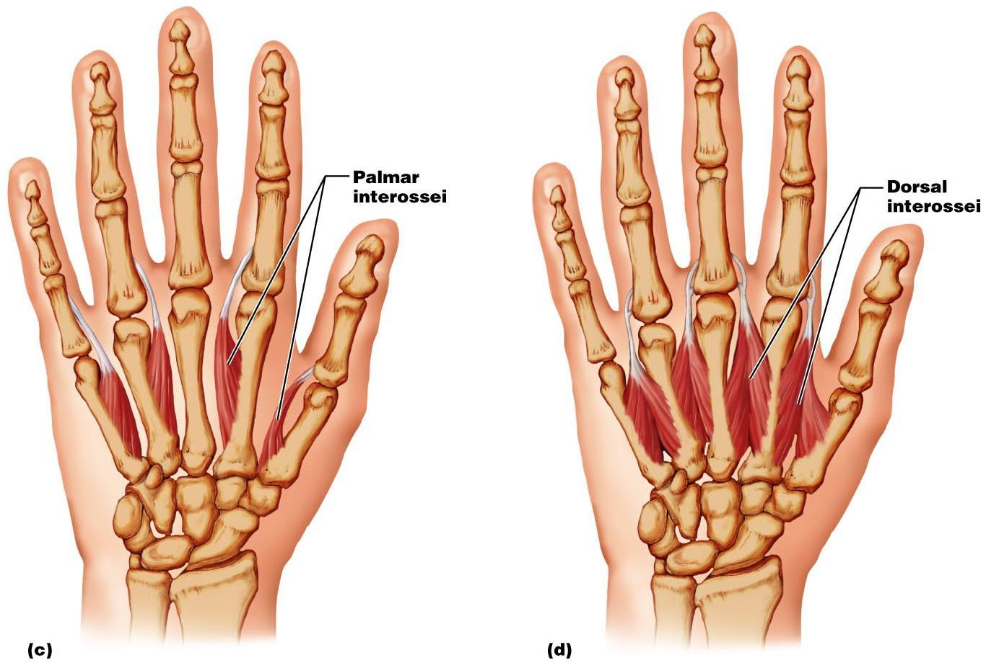
Intrinsic Muscles of the Hand: Groups
Figure 10.18c, d

Slide 46
Muscles Crossing Hip and Knee Joints
Most ___________________________________ muscles of the hip and thigh
Posterior compartment muscles of the hip and thigh
extend _
flex _
The medial compartment muscles
These three groups are enclosed by the fascia lata

Slide 47
Movements of the thigh at the Hip: Flexion and Extension
The ball-and-socket hip joint permits
Extension
Adduction
Rotation
The most important thigh flexors
The medially located adductor muscles and sartorius assist in thigh flexion

Slide 48
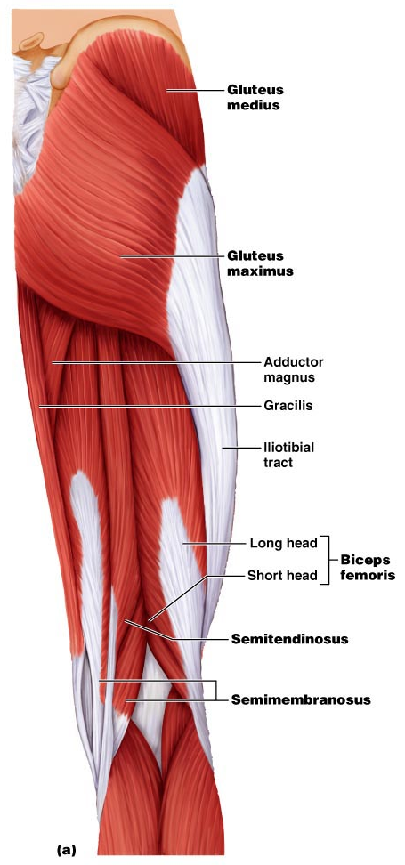
Movements of the Thigh at the Hip: Flexion and Extension
Thigh extension is primarily effected by the _
Forceful extension is aided by the gluteus maximus

Slide 49
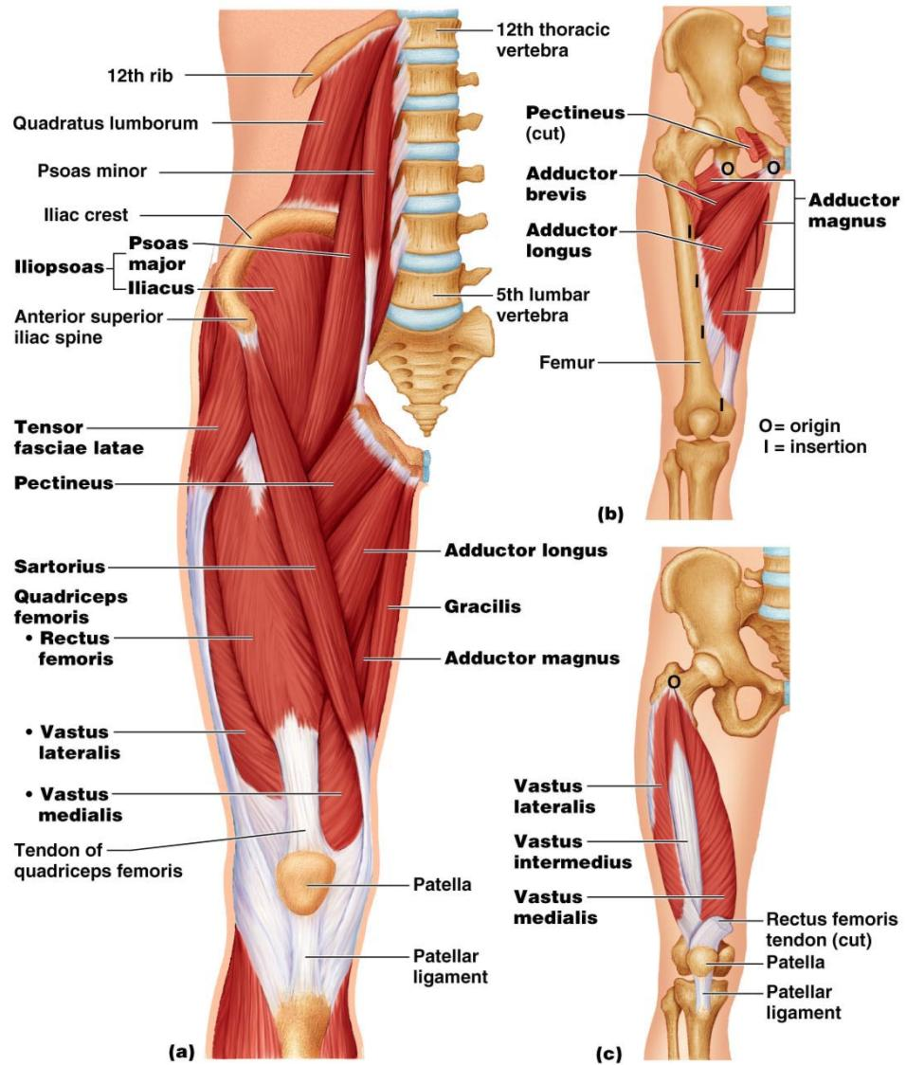

Slide 50
Movements of the Thigh at the Hip:
Abduction and rotation assisted by
antagonized by
lateral rotators
Thigh adduction is the role of five adductor muscles
adductor _
adductor _
adductor _
the _
gracilis

Slide 51
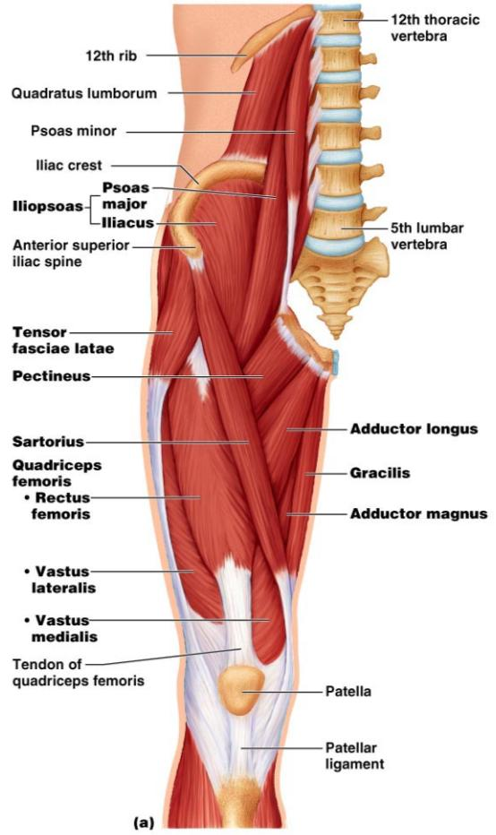
Movements of the Knee Joint
The sole extensor of the knee
flex the _
and act as antagonists to the quadriceps femoris
Figure 10.19a

Slide 52
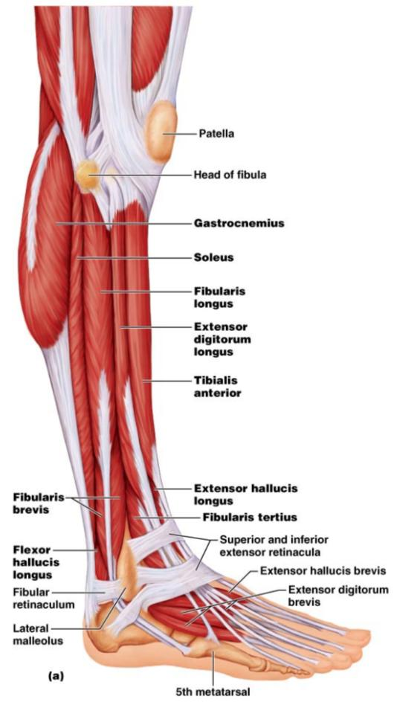
Fascia of the Leg
A deep fascia of the leg is continuous with the fascia lata
This fascia segregates the leg into _
Distally, the fascia thickens and forms the flexor, extensor, and fibular retinaculae
Figure 10.22a

Slide 53
Muscles of the Leg: Movements
Various leg muscles produce the following movements at the:
Ankle
Intertarsal joints
Toes

Slide 54
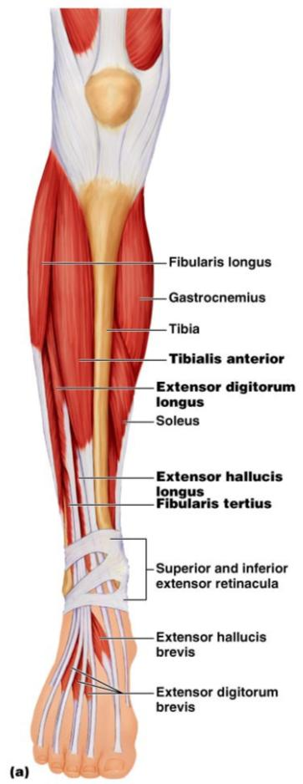
Muscles of the Anterior Compartment
primary toe extensors and ankle dorsiflexors
extensor digitorum longus,
fibularis tertius
Figure 10.21a

Slide 55
Muscles of the Lateral Compartment
Plantar-flex and evert the foot
fibularis _
Figure 10.22a

Slide 56
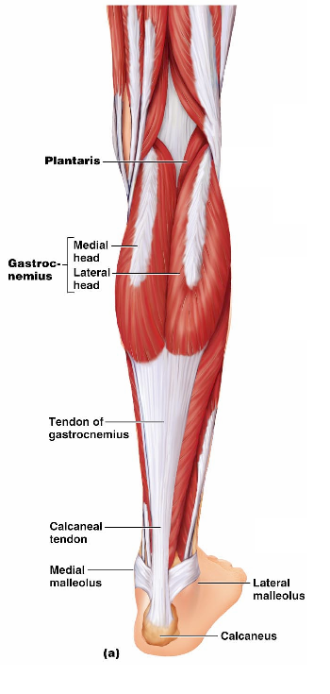
Muscles of the Posterior Compartment
flex the foot and the toes
Tibialis posterior
Flexor digitorum longus
Figure 10.23a

Slide 57
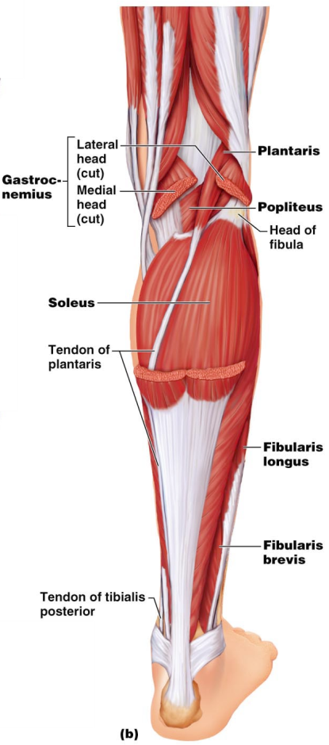
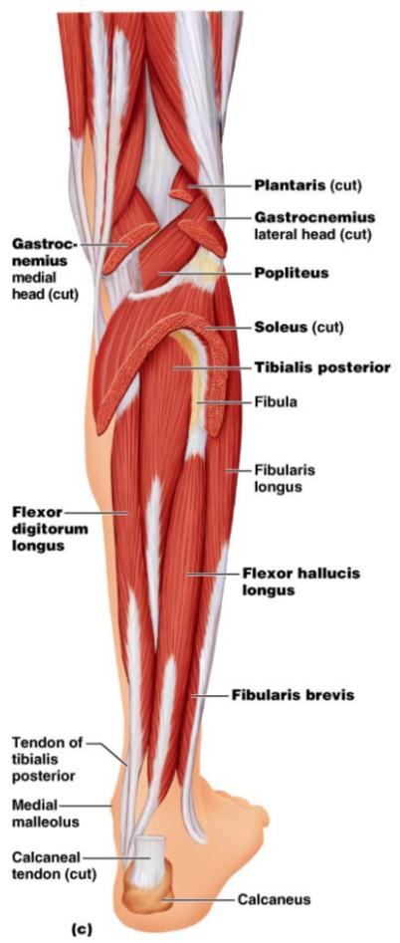
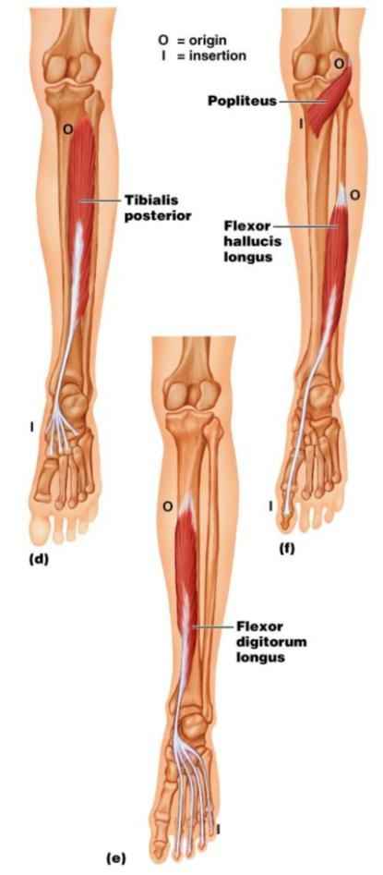
Muscles of the Posterior Compartment
Figure 10.23b, c

Slide 58
Muscle Actions of the Thigh: Summary
Thigh muscles:
Flex and extend the thigh (____________________________________)
Extend the leg (______________________________________)
Adduct the thigh (____________________________________)

Slide 59
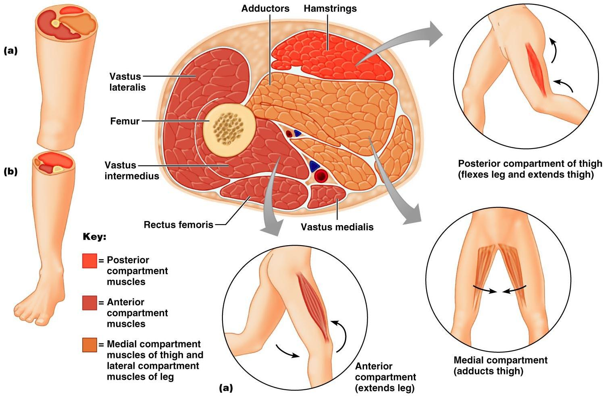

Slide 60
Muscle Actions of the Leg: Summary
Leg muscles:
Plantar flex and evert the foot
Plantar flex the foot and flex the toes
Dorsiflex the foot and extend the toes

Slide 61
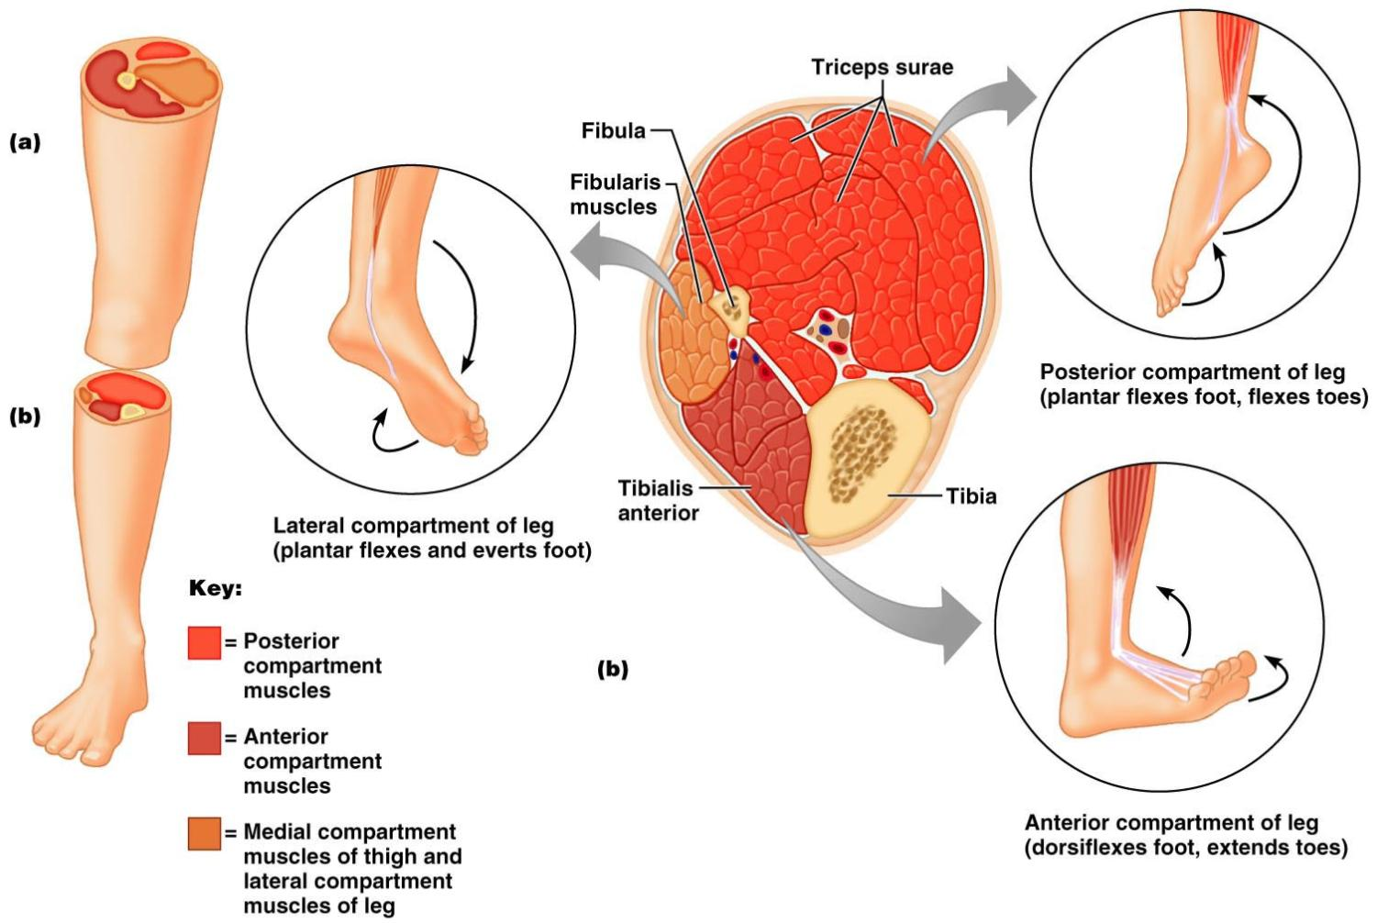

Slide 62
Intrinsic Muscles of the Foot
These muscles help _
In addition, along with some leg tendons, they support the _
There is a single dorsal foot muscle, the ___________________________________, which extends the toes
The plantar muscles occur in four layers

Slide 63
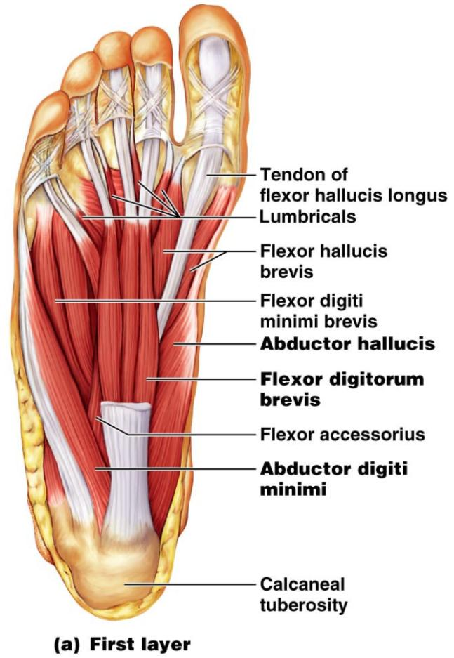
Plantar Muscles: First Layer (Superficial)
Superficial muscles of the _________________of the foot
These muscles are similar to the corresponding muscles of the hand

Slide 64
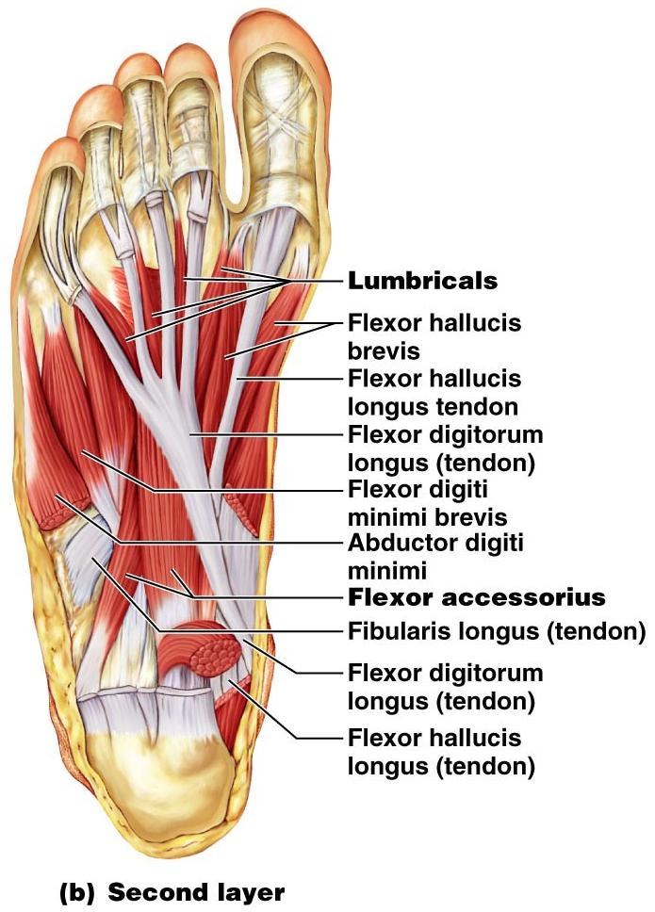
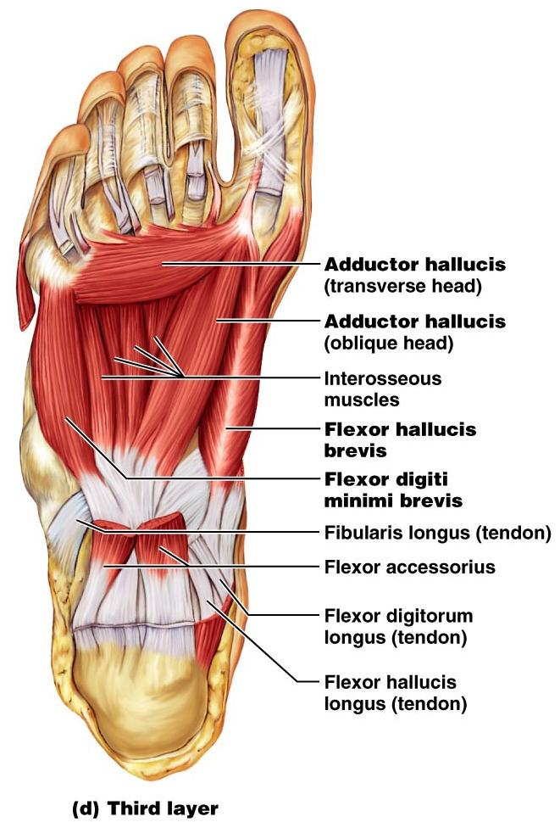
Figure 10.25b

Slide 65
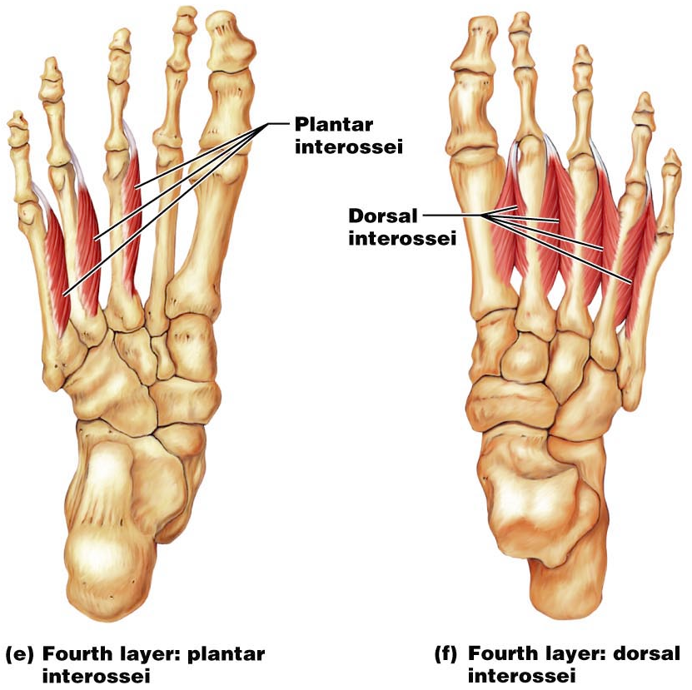
Plantar Muscles: Fourth Layer

