Slide 1
Functional Classification of Neurotransmitters
Two classifications: excitatory and inhibitory
Excitatory neurotransmitters cause _
Inhibitory neurotransmitters cause _

Slide 2
Functional Classification of Neurotransmitters
Some neurotransmitters have _
Determined by the ____________________ type of the postsynaptic neuron
Example: _
_____________________________ at neuromuscular junctions with skeletal muscle

Slide 3
Neurotransmitter Receptor Mechanisms
Direct: neurotransmitters that open _
Promote _
Examples: _____________ and amino acids
Indirect: neurotransmitters that _
Promote _
Examples: biogenic amines, peptides, and dissolved gases

Slide 4
Neural Integration: Neuronal Pools
Functional groups of neurons that:
__________________________ incoming information
Forward the processed information to its appropriate destination

Slide 5
Neural Integration: Neuronal Pools
Simple neuronal pool
Input fiber
Discharge zone
neurons _________________________________ with the incoming fiber
Facilitated zone
neurons farther away from _

Slide 6
Types of Circuits in Neuronal Pools
Divergent

Slide 7
Types of Circuits in Neuronal Pools
Convergent

Slide 8
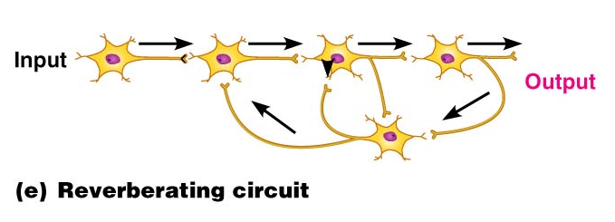
Types of Circuits in Neuronal Pools
Reverberating

Slide 9
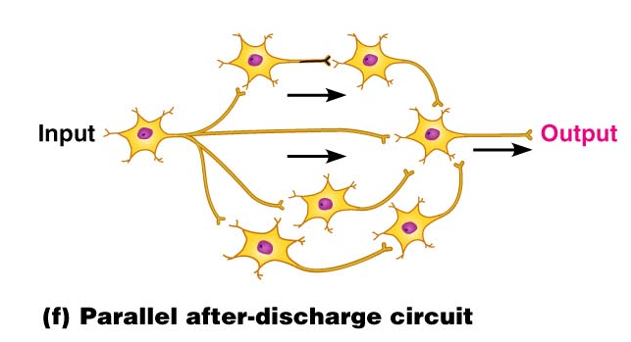
Types of Circuits in Neuronal Pools
Parallel after-discharge

Slide 10
Patterns of Neural Processing
Serial Processing
Input travels along one pathway to a specific destination
Works in an _
Example:

Slide 11
Patterns of Neural Processing
Parallel Processing
Input travels along _
Pathways are integrated in different CNS systems
Example:

Slide 12
Chapter 12

Slide 13
Central Nervous System (CNS)
CNS – composed of the _
Elaboration of the anterior portion of the CNS
Increase in ___________________________ in the head
Highest level is reached in the human brain

Slide 14
The Brain
Composed of wrinkled, pinkish gray tissue
Surface anatomy includes

Slide 15
Adult Brain Structures
cerebrum: cortex, white matter, and basal nuclei
thalamus, hypothalamus, and epithalamus
brain stem: midbrain
Metencephalon
brain stem: pons
Myelencephalon
brain stem: medulla oblongata

Slide 16
Adult Neural Canal Regions
Adult structures derived from the neural canal
Telencephalon –
Diencephalon –
Mesencephalon –
Metencephalon and myelencephalon –

Slide 17
Basic Pattern of the Central Nervous System
Spinal Cord
______________________________ surrounded by a _
Gray matter is surrounded by _
myelinated fiber _
Brain
Similar to spinal cord but with _
Cerebellum has gray matter in nuclei
Cerebrum has nuclei and additional gray matter in the cortex

Slide 18
Ventricles of the Brain
Arise from expansion of the lumen of the neural tube
The ventricles are:
The paired _
The third ventricle found in the diencephalon
The fourth ventricle found in the hindbrain dorsal to the pons

Slide 19
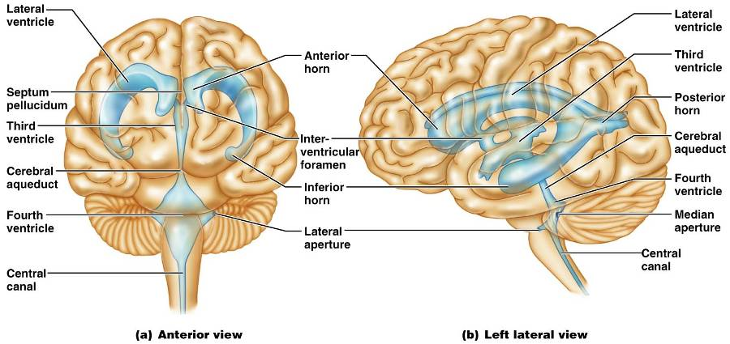
Ventricles of the Brain

Slide 20
Cerebral Hemispheres
Contains ridges
and shallow grooves
Contain deep grooves
Are separated by the _
Have three basic regions:
cortex, white matter, and basal nuclei

Slide 21
Major Lobes, Gyri, and Sulci of the Cerebral Hemisphere
Deep sulci divide the hemispheres into five lobes:
separates the frontal and parietal lobes

Slide 22
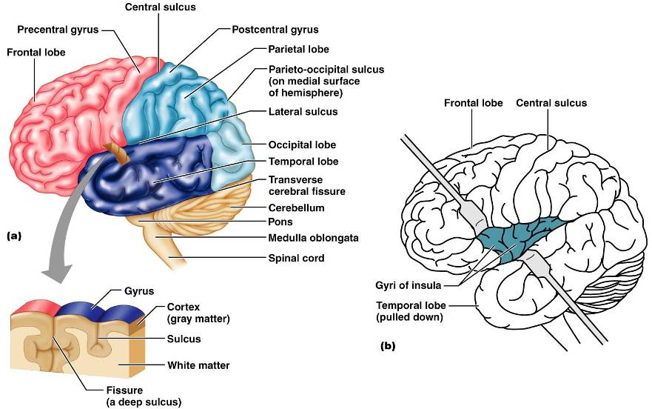
Brain Lobes

Slide 23
Major Lobes, Gyri, and Sulci of the Cerebral Hemisphere
separates the parietal and occipital lobes
separates the parietal and temporal lobes
The

Slide 24
Cerebral Cortex
The cortex
superficial gray matter
accounts for 40% of the mass of the brain
It enables
Each hemisphere acts _____________________________ (controls the opposite side of the body)
Hemispheres are not equal in function
No functional area acts alone; conscious behavior involves the entire cortex

Slide 25
Functional Areas of the Cerebral Cortex
The three types of functional areas are:
control voluntary movement
conscious awareness of sensation
integrate diverse information

Slide 26
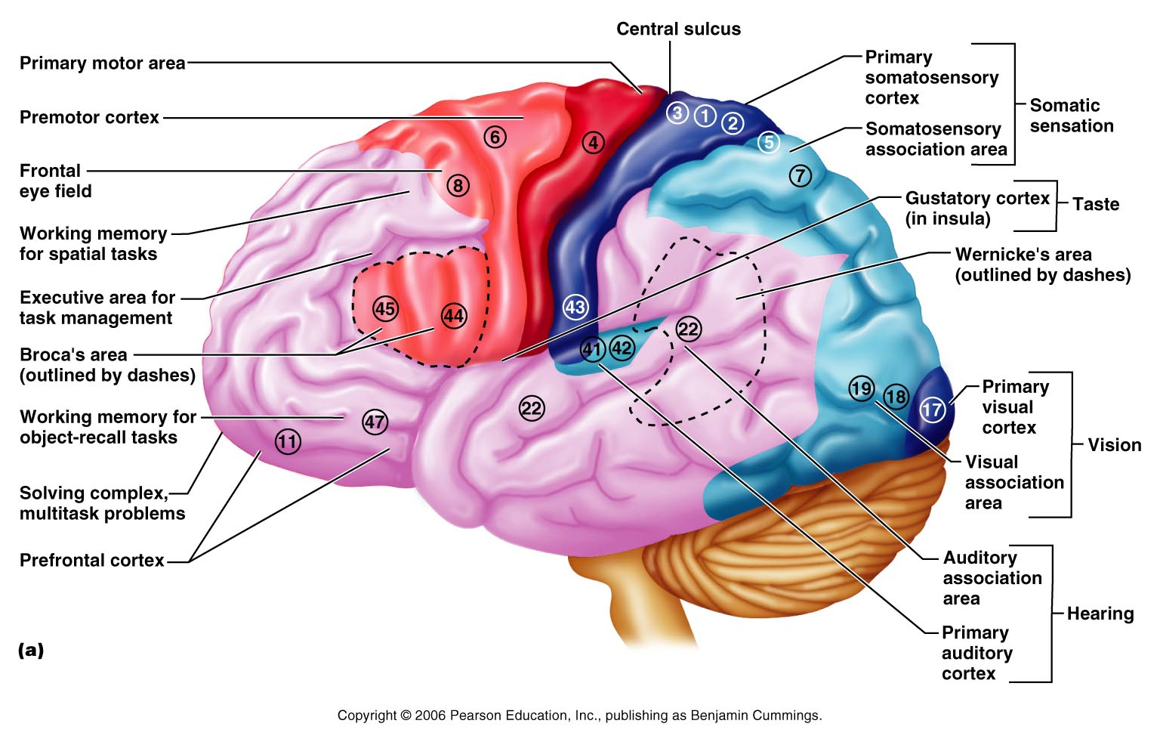
Functional Areas of the Cerebral Cortex

Slide 27
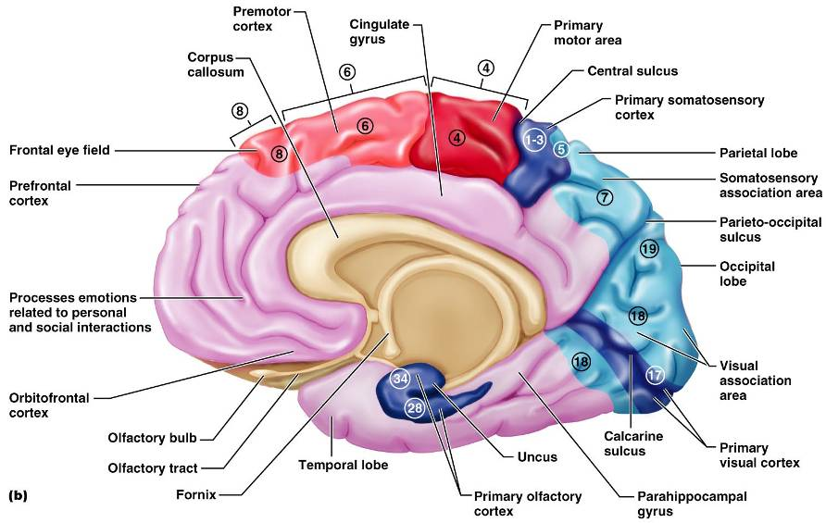
Functional Areas of the Cerebral Cortex

Slide 28
Cerebral Cortex: Motor Areas
Primary _
Premotor cortex
Frontal eye field

Slide 29
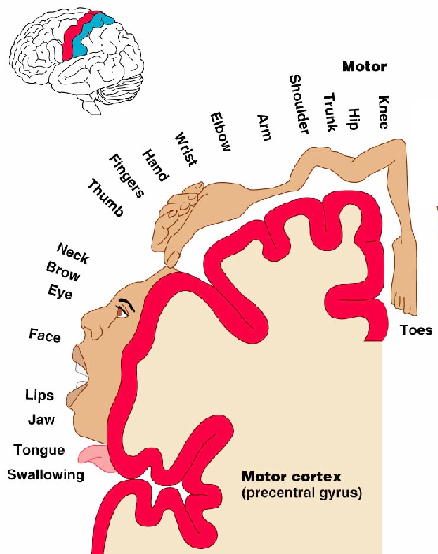
Primary Motor Cortex
Located in the _
Pyramidal cells whose axons make up the _
Allows conscious control of precise, skilled, voluntary movements

Slide 30
Premotor Cortex
Located _
Controls _
Coordinates simultaneous or sequential actions
Involved in the planning of movements

Slide 31
Broca’s Area
Broca’s area
Located anterior to the inferior region of the premotor area
Present in _
A motor speech area that _
Is active as one prepares to speak

Slide 32
Frontal Eye Field
Located anterior to the premotor cortex and superior to Broca’s area
Controls _

