Slide 1
Exam Five
Chapter 12 and 13

Slide 2
Spinal Cord
CNS tissue is _____________________________________ from the foramen magnum to L₁
Provides _______________________________________ to and from the brain
Protected by bone, meninges, and CSF
space between the vertebrae and the dural mater filled with fat and a network of veins

Slide 3
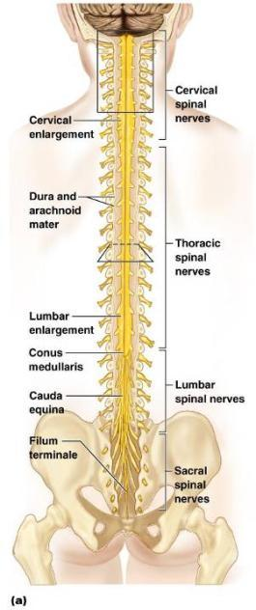
Spinal Cord
terminal portion of the spinal cord
fibrous extension of the __________________________ anchors the spinal cord to the coccyx
Denticulate ligaments
delicate shelves of pia mater; _

Slide 4
Spinal Cord
31 pairs attach to the cord by paired roots
Cervical and _
sites where nerves serving the upper and lower limbs emerge
collection of nerve roots at the _

Slide 5
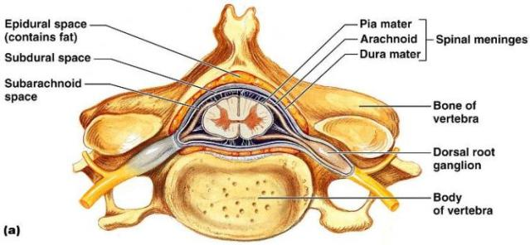
Cross-Sectional Anatomy of the Spinal Cord
______________________________________– separates anterior funiculi
______________________________________– divides posterior funiculi

Slide 6
Gray Matter and Spinal Roots
__________________________matter consists of
unmyelinated processes
Gray _
connects masses of gray matter; encloses central canal
Posterior (dorsal) _
interneurons
Anterior (ventral) horns
interneurons and _
Lateral horns
contain _

Slide 7
Gray Matter: Organization
Dorsal half
Ventral half
Dorsal and ventral roots _

Slide 8
White Matter in the Spinal Cord
Fibers run in three directions
Divided into three funiculi (_______________________)
posterior, lateral, and anterior
Each funiculus contains several fiber tracks
Fiber tract names reveal their _
Fiber tracts are composed of _

Slide 9
White Matter: Pathway Generalizations
Pathways _
Most consist of two or three neurons
Pathways are _
one on each side of the spinal cord or brain

Slide 10
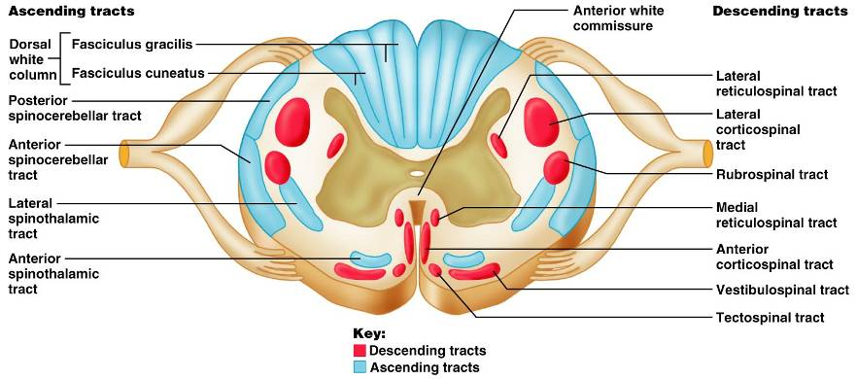
White Matter: Pathway Generalizations

Slide 11
Main Ascending Pathways
The central processes of first-order neurons branch diffusely as they enter the spinal cord and medulla
Some branches take part in spinal cord reflexes
Others synapse with ________________________________________in the cord and medullary nuclei
Fibers from touch and pressure receptors form collateral synapses with _______________________________________ in the dorsal horns

Slide 12
Three Ascending Pathways
The nonspecific and specific ascending pathways send impulses to the _
These pathways are responsible for discriminative_
The _________________________________ tracts send impulses to the cerebellum and do not contribute to sensory perception

Slide 13
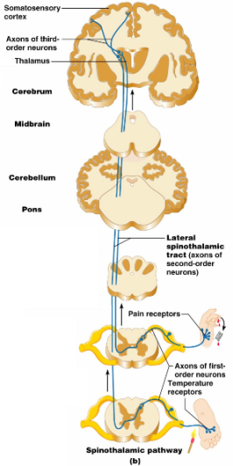
Nonspecific Ascending Pathway
Nonspecific pathway for
within the lateral ________________________tract

Slide 14
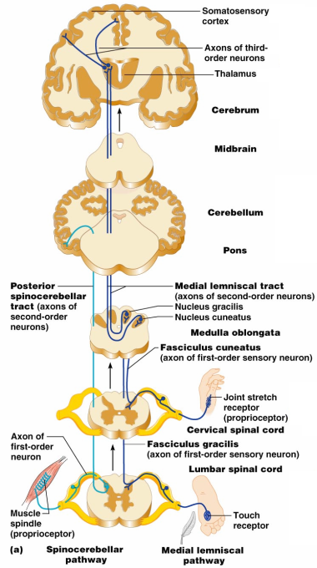
Specific and Posterior Spinocerebellar Tracts
Specific ascending pathways within the
fasciculus gracilis
fasciculus cuneatus tracts, and their continuation in the
medial lemniscal tracts
The posterior _

Slide 15
Descending (Motor) Pathways
Descending tracts deliver ____________________________________ from the brain to the spinal cord, and are divided into two groups
Direct pathways equivalent to the _
Indirect pathways, essentially _
Motor pathways involve _

Slide 16
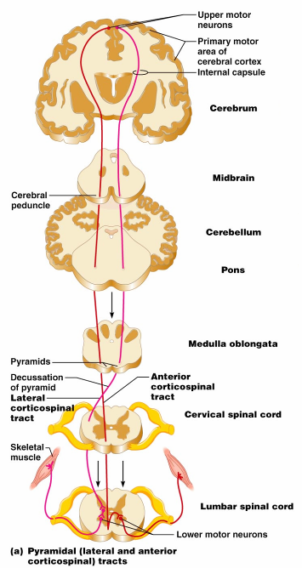
The Direct (Pyramidal) System
Direct pathways originate with the ___________________________ in the precentral gyri
Impulses are sent through the ____________________________ and synapse in the anterior horn
Stimulation of anterior horn neurons activates skeletal muscles
The direct pathway regulates fast and _

Slide 17
Indirect (Extrapyramidal) System
Includes the
motor nuclei
motor pathways not part of the pyramidal system
This system includes the
Vestibulospinal
Tectospinal tracts

Slide 18
Indirect (Extrapyramidal) System
These motor pathways are complex and multisynaptic, and regulate:
Axial muscles that maintain _
Muscles controlling ______________________________________ of the proximal portions of limbs
Head, neck, and eye movement

Slide 19
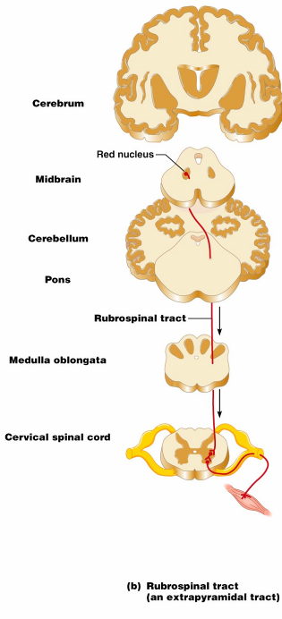
Extrapyramidal Pathways
Reticulospinal tracts
Rubrospinal tracts
control _
Superior colliculi and tectospinal tracts
mediate _

Slide 20
Spinal Cord Trauma: Paralysis
Paralysis
loss of _
_______________________________ paralysis
severe damage to the _
Lower motor neurons are damaged and impulses do not reach muscles
There is no _

Slide 21
Spinal Cord Trauma: Paralysis
________________________________ paralysis
only _____________________________________ of the primary motor cortex are damaged
Spinal neurons remain intact and _
There is no ________________________________________ of muscles

Slide 22
Spinal Cord Trauma: Transection
Cross sectioning of the spinal cord at any level results in __________________________________________________________________________ in regions inferior to the cut
Paraplegia
transection between _
transection in the _

Slide 23
Peripheral Nervous System (PNS)
PNS
all neural structures outside the brain and spinal cord
Includes
associated ganglia
Provides links to and from the external environment

Slide 24
Sensory Receptors
Structures specialized to _
Activation of sensory receptors results in _____________________________________ that trigger impulses to the CNS
The realization of these stimuli, sensation and perception, _

Slide 25
Receptor Classification by Stimulus Type
Mechanoreceptors
respond to _
sensitive to changes in temperature
Photoreceptors
respond to light energy (e.g., retina)
respond to chemicals (e.g., smell, taste, changes in _
Nociceptors
sensitive to _

Slide 26
Receptor Class by Location: Exteroceptors
Respond to stimuli arising _
Found near the body surface
Sensitive to _
Include the special sense organs

Slide 27
Receptor Class by Location: Interoceptors
Respond to stimuli arising _
Found in internal _______________________ and blood vessels
Sensitive to chemical changes, ___________________________________, and temperature changes

Slide 28
Receptor Class by Location: Proprioceptors
Respond to degree of stretch of the organs they occupy
Found in skeletal muscles, tendons, joints, ligaments, and connective tissue coverings of bones and muscles

Slide 29
Receptor Classification by Structural Complexity
Receptors are structurally classified as either simple or complex
Most receptors are _____________________________________ and include encapsulated and unencapsulated varieties
Complex receptors are _

Slide 30
Simple Receptors: Unencapsulated
Free dendritic nerve endings
Respond chiefly to _
_____________________________________ (tactile) discs
Hair _

Slide 31
Simple Receptors: Encapsulated
tactile corpuscles
lamellated corpuscles
Muscle spindles, Golgi tendon organs, and Ruffini’s corpuscles
Joint kinesthetic receptors

Slide 32
From Sensation to Perception
Survival depends upon sensation and perception
Sensation
the _________________________________________in the internal and external environment
Perception
the conscious _______________________________________ of those stimuli

Slide 33
Organization of the Somatosensory System
Input comes from exteroceptors, proprioceptors, and interoceptors
The three main levels of neural integration in the somatosensory system are:
the sensor receptors
ascending pathways
neuronal circuits in the cerebral cortex

Slide 34
Adaptation of Sensory Receptors
___________________________________ occurs when sensory receptors are subjected to an _
Receptor membranes become _
Receptor potentials decline in frequency or stop

Slide 35
Adaptation of Sensory Receptors
Receptors responding to _____________________________________ adapt quickly
Receptors responding slowly include Merkel’s discs, Ruffini’s corpuscles, and interoceptors that respond to chemical levels in the blood
_____________________________________and proprioceptors do not exhibit adaptation

Slide 36
Processing at the Circuit Level
Chains of three neurons conduct sensory impulses upward to the brain
soma reside in dorsal root or cranial ganglia, and conduct impulses _
_______________________________neurons
soma reside in the dorsal horn of the spinal cord or medullary nuclei and transmit impulses _
located in the thalamus and conduct impulses to the somatosensory _

Slide 37
Main Aspects of Sensory Perception
detecting that a stimulus has occurred and requires summation
Magnitude estimation
how much of a stimulus is acting
identifying the site or pattern of the stimulus

Slide 38
Main Aspects of Sensory Perception
Feature abstraction
used to identify a substance that has _
Quality discrimination
the ability to identify ______________________________________ of a sensation (e.g., sweet or sour tastes)
ability to recognize patterns in stimuli (e.g., melody, familiar face)

Slide 39
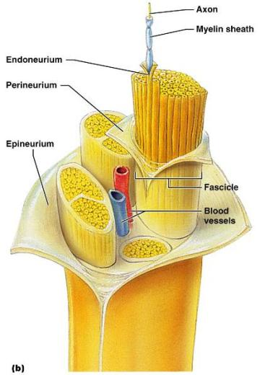
Structure of a Nerve
Nerve
cordlike organ of the PNS consisting of _
Connective tissue coverings include:
_____________________________– loose connective tissue that surrounds axons
_____________________________ coarse connective tissue that bundles fibers into fascicles
_____________________________tough fibrous sheath around a nerve

Slide 40
Classification of Nerves
Sensory and motor divisions
Sensory (afferent)
Motor (efferent)
Mixed

Slide 41
Peripheral Nerves
Mixed nerves
carry ____________________________________ (visceral) impulses
The _____________________________ of mixed nerves are:
Somatic afferent and somatic efferent
Visceral afferent and visceral efferent
Peripheral nerves originate from the brain or spinal column

Slide 42
Regeneration of Nerve Fibers
Damage to nerve tissue is serious _
If the _____________________________ of a damaged nerve remains intact, damage can be repaired
Regeneration involves coordinated activity among:
______________________________________– remove debris
Schwann cells – form regeneration tube and secrete growth factors
__________________________________________– regenerate damaged part

Slide 43
Cranial Nerves
____________________________________ of cranial nerves arise from the brain
They have sensory, motor, or both sensory and motor functions
Each nerve is identified by a ____________________________ (I through XII) and a _
Four cranial nerves carry ______________________________________ that serve muscles and glands

Slide 44
Cranial Nerve I: Olfactory
Arises from the _
Passes through the cribiform plate of the ethmoid bone
Fibers run through the _____________________________________ and terminate in the primary olfactory cortex
Functions solely by carrying _

Slide 45
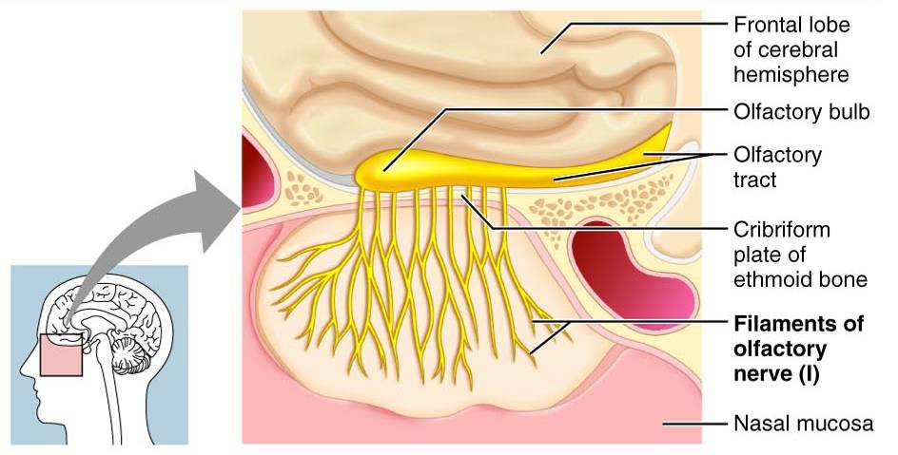
Cranial Nerve I: Olfactory

Slide 46
Cranial Nerve II: Optic
Arises from the _
Optic nerves pass through the optic canals and ______________________________ at the _
They continue to the _________________________________ where they synapse
From there, the _______________________________________ run to the visual cortex
Functions solely by carrying afferent impulses for vision

Slide 47
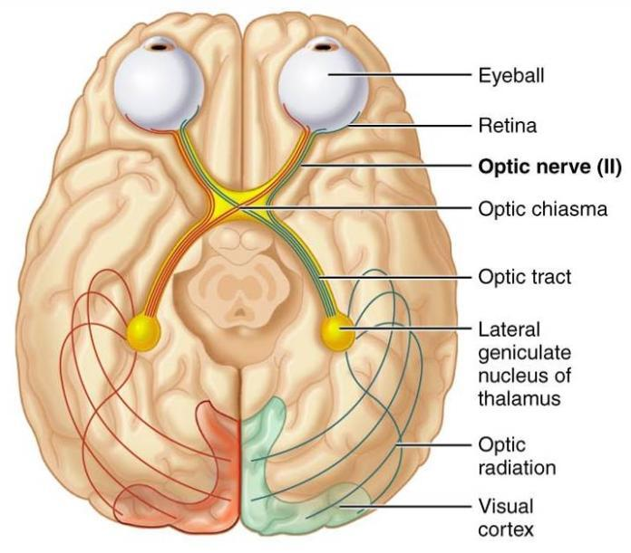
Cranial Nerve II: Optic

Slide 48
Cranial Nerve III: Oculomotor
Fibers extend from the ventral midbrain, pass through the superior orbital fissure, and go to the _
Functions in ____________________________________, directing the eyeball, _______________________________________, and controlling lens shape
Parasympathetic cell bodies are in the ciliary ganglia

Slide 49
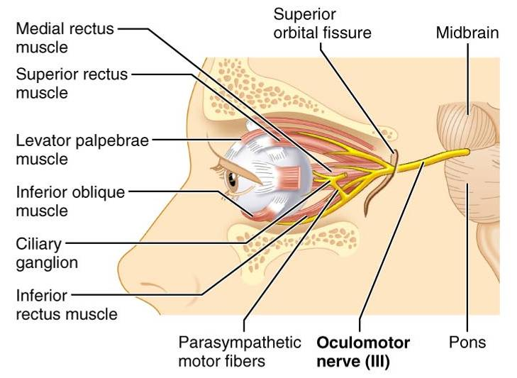
Cranial Nerve III: Oculomotor

Slide 50
Cranial Nerve IV: Trochlear
Fibers emerge from the dorsal midbrain and enter the orbits via the _____________________________________; innervate the _
Primarily a motor nerve that directs the eyeball

Slide 51
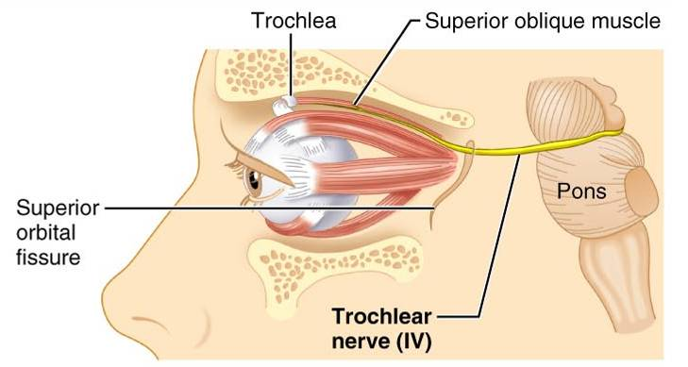
Cranial Nerve IV: Trochlear

