Slide 1
Neurotransmitter Effects
All ____________________________________ neurons release _
which has an _
In the ANS:
Preganglionic fibers _
Postganglionic fibers release
or _
the effect is either _
ANS effect depends on the
neurotransmitter released
and the _

Slide 2
Divisions of the ANS
ANS divisions:
mobilizes the body during _
performs ___________________________________________ and conserves body energy
The two divisions provide _

Slide 3
Role of the Parasympathetic Division
Concerned with keeping body energy use low
Involves the _
Its activity is illustrated in a person who relaxes after a meal
Blood pressure, heart rate, and respiratory rates are low
Gastrointestinal tract activity is high
The skin is warm and the pupils are constricted

Slide 4
Role of the Sympathetic Division
The sympathetic division is the _
Involves _
exercise, excitement, emergency, and embarrassment

Slide 5
Role of the Sympathetic Division
Promotes adjustments during exercise
blood flow to organs is reduced, _
Its activity is illustrated by a person who is threatened
Heart rate ______________________________ and breathing is _
The skin is cold and sweaty, and the pupils dilate

Slide 6
Anatomy of ANS
Division | Origin of Fibers | Length of Fibers | Location of Ganglia
Sympathetic | Thoracolumbar region of the spinal cord | Short preganglionic and long postganglionic | Close to the spinal cord
Parasympathetic | Brain and sacral spinal cord | Long preganglionic and short postganglionic | In the visceral effector organs

Slide 7
Parasympathetic Division Outflow
Cranial Outflow | Cranial Nerve | Ganglion | Effector Organ(s)
 | Occulomotor (III) | Ciliary | Eye
 | Facial (VII) | Pterygopalatin Submandibular | Salivary, nasal, and lacrimal glands
 | Glossopharyngeal (IX) | Otic | Parotid salivary glands
 | Vagus (X) | Located within the walls of target organs | Heart, lungs, and most visceral organs
Sacral Outflow | S₂-S₄ | Located within the walls of the target organs | Large intestine, urinary bladder, ureters, and reproductive organs

Slide 8
Sympathetic Outflow
Arises from spinal cord segments T₁ through L₂
Sympathetic neurons form _
Preganglionic fibers pass through the ______________________________________ and synapse in the chain (paravertebral) ganglia

Slide 9
Sympathetic Outflow
Fibers from T₅-L₂
form _
synapse with _
Postganglionic fibers innervate the numerous organs of the body

Slide 10
Sympathetic Trunks and Pathways
The __________________________________ form part of the sympathetic trunk or chain
Typically there are 23 ganglia
3 cervical
11 thoracic
4 lumbar
4 sacral
1 coccygeal

Slide 11
Sympathetic Trunks and Pathways
A preganglionic fiber follows one of three pathways upon entering the paravertebral ganglia
Synapse with the _
_______________________________________ the sympathetic chain to synapse in another chain ganglion
Pass through the chain ganglion and _

Slide 12
Pathways with Synapses in Chain Ganglia
Postganglionic axons enter the ventral rami via the _
These fibers innervate _
Rami communicantes are associated _______________ with the sympathetic division

Slide 13
Pathways to the Head
Preganglionic fibers emerge from T₁-T₄ and synapse in the superior cervical ganglion
These fibers:
Serve the _
Stimulate dilator muscles of the _
Inhibit nasal and salivary glands

Slide 14
Pathways to the Thorax
Preganglionic fibers emerge from T₁-T₆ and synapse in the _
Postganglionic fibers emerge from the middle and inferior cervical ganglia and enter nerves C₄-C₈
These fibers innervate the ___________________ via the cardiac plexus, as well as innervating the _

Slide 15
Pathways to the Thorax
Other T₁-T₆ preganglionic fibers synapse in the nearest chain ganglia
Postganglionic fibers directly serve the

Slide 16
Pathways with Synapses in Collateral Ganglia
These fibers (T₅-L₂) leave the sympathetic chain _
They form thoracic, lumbar, and sacral _
Their ganglia include
the
the superior and inferior mesenterics
the

Slide 17
Pathways to the Abdomen
Sympathetic nerves innervating the abdomen have preganglionic fibers from T₅-L₂
They travel through the thoracic splanchnic nerves and synapse at the celiac and superior mesenteric ganglia
Postganglionic fibers serve the

Slide 18
Pathways to the Pelvis
Preganglionic fibers originate from T₁₀-L₂
Most travel via the _____________________________________ splanchnic nerves to the inferior mesenteric and hypogastric ganglia
Postganglionic fibers serve the distal half of the large intestine, the ____________________________________, and the reproductive organs

Slide 19
Pathways with Synapses in the Adrenal Medulla
Fibers of the thoracic splanchnic nerve pass _
Upon stimulation, medullary cells secrete ____________________________________________________________________________into the blood

Slide 20
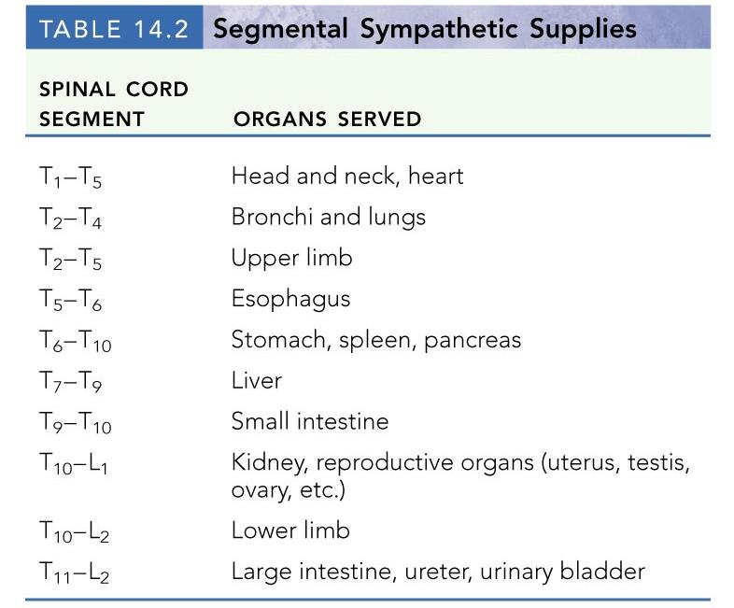

Slide 21
Visceral Reflexes
____________________________reflexes have the same elements as _______________________________reflexes
They are always _
Afferent fibers are found in spinal and autonomic nerves

Slide 22
Referred Pain
Pain stimuli arising from the __________________are _
This may be due to the fact that visceral pain afferents travel along the same pathways as somatic pain fibers

Slide 23
Neurotransmitters and Receptors
Acetylcholine (ACh) and norepinephrine (NE) are the two major neurotransmitters of the _
ACh-releasing fibers
ACh is released by all __________________________________________ axons and all parasympathetic _
Adrenergic fibers
______________________________________________ postganglionic axons that release NE
effects (excitatory/inhibitory) _

Slide 24
Cholinergic Receptors
The __________________________of receptors that bind ACh are _
These are named after drugs that bind to them and mimic _

Slide 25
Nicotinic Receptors
Nicotinic receptors are found on:
________________________________________ (somatic targets)
All ganglionic neurons of both sympathetic and parasympathetic divisions
The __________________________________ cells of the _
The effect of ACh binding to nicotinic receptors is _

Slide 26
Muscarinic Receptors
Muscarinic receptors occur on all effector cells stimulated by _
The effect of ACh binding:
Can be either _
Depends on the _________________________________________ of the target organ

Slide 27
Adrenergic Receptors
The two types of adrenergic receptors _
Effects of NE binding to:
α receptors is _
β receptors is _
A notable exception
NE binding to β receptors of the heart is stimulatory

Slide 28
Effects of Drugs
Atropine
blocks _
Tricyclic antidepressants
prolong the activity of NE on postsynaptic membranes
Over-the-counter drugs for colds, allergies, and nasal congestion
Beta-blockers
attach mainly to β₁ receptors and _

Slide 29
Interactions of the Autonomic Divisions
Most _________________________ organs are innervated by both _
increase heart and respiratory rates, and inhibit digestion and elimination
decrease heart and respiratory rates, and allow for digestion and the discarding of wastes

Slide 30
Sympathetic Tone
The sympathetic division ______________________________________ and keeps the blood vessels in a continual state of partial constriction
This sympathetic tone (vasomotor tone):
Constricts blood vessels and causes blood pressure to rise as needed
Prompts vessels to _______________________ if blood pressure is to be _

Slide 31
Parasympathetic Tone
Parasympathetic tone:
Dictates normal activity levels of the digestive and urinary systems
The sympathetic division can override these effects during times _
Drugs that block parasympathetic responses increase heart rate and block fecal and urinary retention

Slide 32
Cooperative Effects
ANS ______________________________ is best seen in control of the external genitalia
__________________________________ fibers cause ______________________________and are responsible for erection of the penis and clitoris
________________________________ fibers cause __________________________________ in males and reflex peristalsis in females

Slide 33
Unique Roles of the Sympathetic Division
Regulates many functions not subject to _
These include the activity of the
sweat glands
arrector pili muscles
most blood vessels

Slide 34
Unique Roles of the Sympathetic Division
The sympathetic division controls:
Thermoregulatory responses to _
Release of _
Metabolic effects

Slide 35
Thermoregulatory Responses to Heat
Applying heat to the skin causes ___________________________________ of blood vessels
Systemic body temperature elevation results in widespread dilation of blood vessels
This dilation brings warm blood to the surface
When temperature falls, blood vessels constrict and blood is retained in deeper vital organs

Slide 36
Release of Renin from the Kidneys
Sympathetic impulses activate the kidneys _
Renin is an enzyme that _

Slide 37
Metabolic Effects
The sympathetic division promotes metabolic effects _
Increases the metabolic rate of body cells
Raises _
Mobilizes _
Stimulates the reticular activating system (RAS) of the brain, increasing mental alertness

Slide 38
Localized Versus Diffuse Effects
The parasympathetic division exerts _
The sympathetic division exerts _

Slide 39
Effects of Sympathetic Activation
Sympathetic activation is long-lasting because NE:
Is ___________________________________ more slowly than _
Is an indirectly acting neurotransmitter, using a _
And epinephrine are released into the blood and _

Slide 40
Levels of ANS Control
The hypothalamus is the main ____________________________________ center of ANS activity
Subconscious cerebral input via limbic lobe connections influences hypothalamic function
Other controls come from the _______________________________ , the reticular formation, and the _

Slide 41
Hypothalamic Control
Centers of the hypothalamus control:
Body temperature, ________________________________________, and endocrine activity
________________________________________ (rage, pleasure) and biological drives (hunger, thirst, sex)
Reactions to ____________________________ and the “fight-or-flight” system

