Slide 1
Chapter 15
Exam Six Material

Slide 2
Eye and Associated Structures
_______________________________________are in the eye
Most of the eye is protected by a cushion of fat and the bony orbit
Accessory structures include

Slide 3
Eyebrows
____________________________________ that overlie the supraorbital margins
Functions include:
Preventing ______________________________ from reaching the eye
depresses the _
move the eyebrows _

Slide 4
Palpebrae (Eyelids)
Protect the eye anteriorly
separates _
medial and lateral _

Slide 5
Palpebrae (Eyelids)
contains _______________________________ that secrete a whitish, oily secretion (Sandman’s eye sand)
__________________________________ of connective tissue support the eyelids internally
gives the _

Slide 6
Palpebrae (Eyelids)
Eyelashes
Project from the free margin of each eyelid
Lubricating glands associated with the eyelids
__________________________________________ and sebaceous glands
_________________________________________ lie between the hair follicles

Slide 7
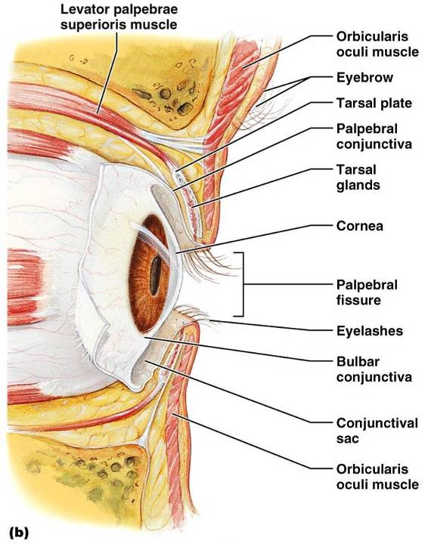
Palpebrae (Eyelids)

Slide 8
Conjunctiva
_________________________________ membrane that:
Lines the eyelids as the _
Covers the whites of the eyes as the _
______________________________________and protects the eye

Slide 9
Lacrimal Apparatus
Consists of the lacrimal gland and associated ducts
Lacrimal glands _
Tears
Contain _
Enter the eye via superolateral excretory ducts
_____________________the eye __________________________via the lacrimal punctum
Drain into _

Slide 10
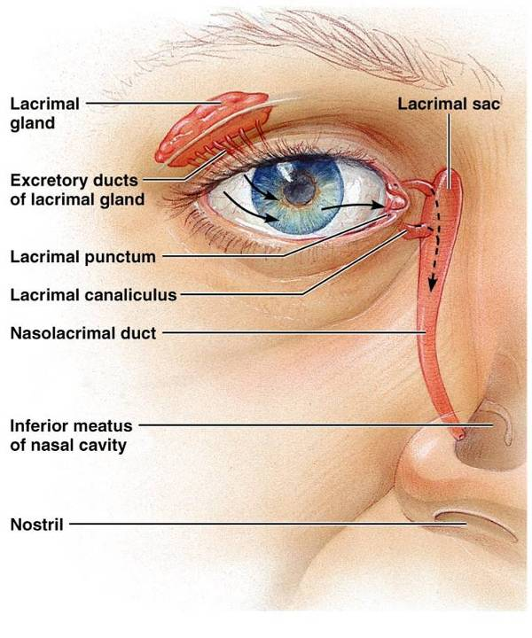
Lacrimal Apparatus
Figure 15.2

Slide 11
Extrinsic Eye Muscles
Six straplike extrinsic eye muscles
Enable the eye to _
Maintain the _
Four ________________________________ muscles originate from the annular ring
Two ______________________________ muscles move the eye in the vertical plane

Slide 12
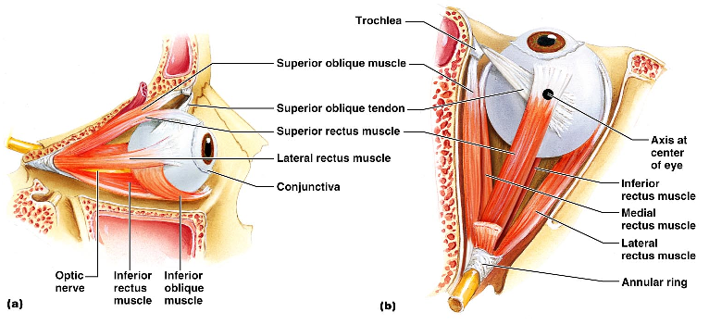
Extrinsic Eye Muscles

Slide 13
Summary of Cranial Nerves and Muscle Actions
Names, actions, and cranial nerve innervation of the extrinsic eye muscles

Slide 14
Structure of the Eyeball
A slightly _____________________________________with anterior and posterior poles
The wall is composed of three tunics –
The internal cavity is filled with fluids called _
The lens separates the internal cavity into anterior and posterior segments

Slide 15
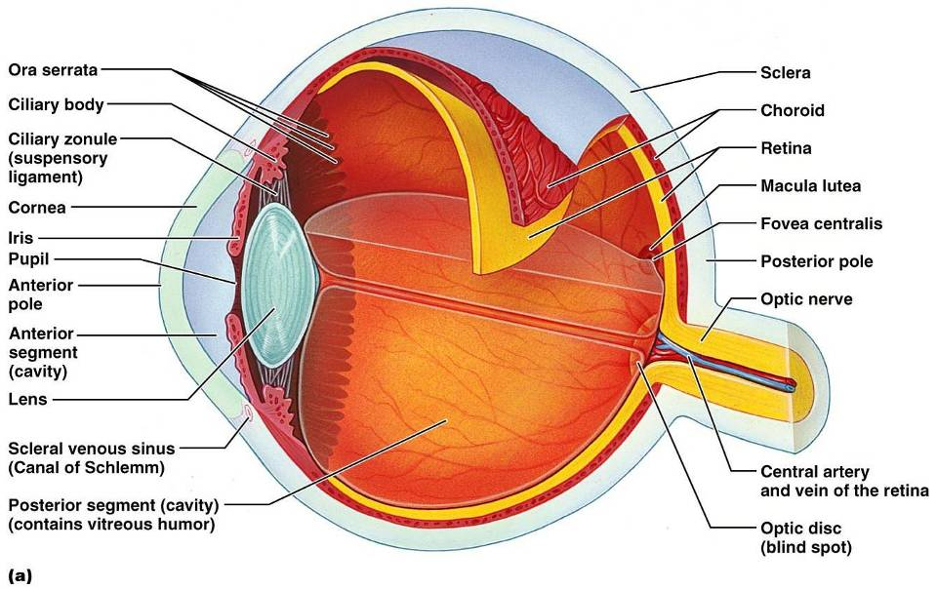
Structure of the Eyeball

Slide 16
Fibrous Tunic
Forms the outermost coat of the eye and is composed of:
The sclera _____________________________________ and anchors _
The cornea lets light enter the eye

Slide 17
Vascular Tunic: Choroid Region
Has three regions:
Choroid region
A dark brown membrane that forms the posterior portion of the vascular layer
Supplies _

Slide 18
Vascular Tunic: Ciliary Body
A thickened ring of tissue _
Composed of _
ciliary muscles
Anchors the _____________________________________ that holds the lens in place

Slide 19
Vascular Tunic: Iris
The _________________________________ of the eye
Pupil
central opening of the iris
Close vision and bright light
Distant vision and dim light
Changes in emotional state
pupils dilate when the subject matter is appealing or requires problem-solving skills

Slide 20
Sensory Tunic: Retina
A delicate _
Pigmented layer
the outer layer that ________________________________________ and prevents its scattering
Neural layer, which contains:
___________________________________________ that transduce light energy
Bipolar cells and ganglion cells
Amacrine and horizontal cells

Slide 21
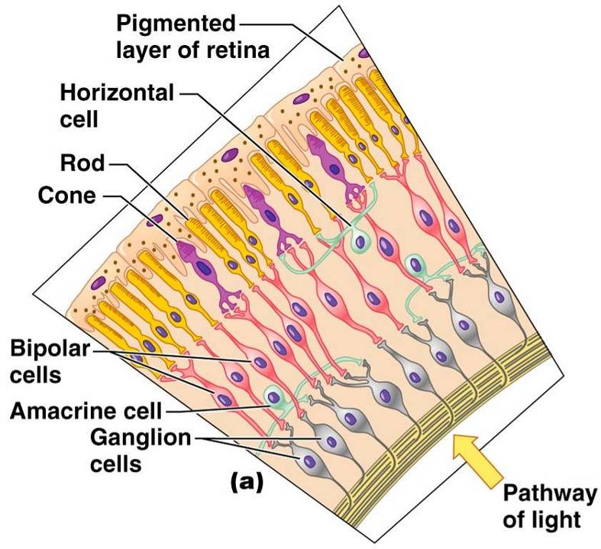
Sensory Tunic: Retina

Slide 22
The Retina: Ganglion Cells and the Optic Disc
Ganglion cell axons:
Run along the _
Leave the eye as the _
The _
Is the site where the optic nerve leaves the eye
Lacks _
the

Slide 23
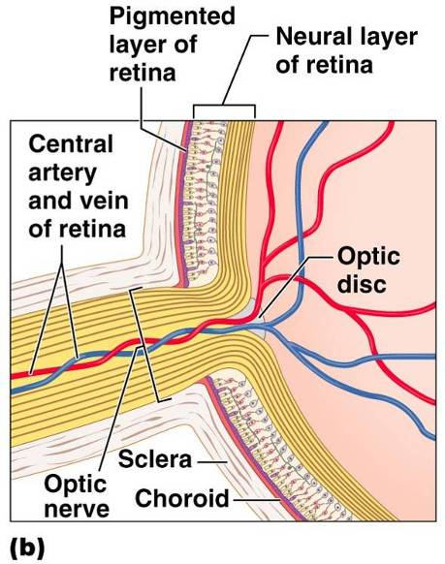
The Retina: Ganglion Cells and the Optic Disc

Slide 24
The Retina: Photoreceptors
Rods:
Respond to _
Are used for _
Cones:
Respond to _
Have _____________________________________ color vision
Are found in the _
Are concentrated in the _

Slide 25
Blood Supply to the Retina
The neural retina receives its blood supply from two sources
The outer third receives its blood from the _
The inner two-thirds is served by the _
Small vessels radiate out from the optic disc

Slide 26
Inner Chambers and Fluids
The lens separates the internal eye into _
The posterior segment is filled with _
Transmits light
Supports the posterior surface of the lens
Contributes to intraocular pressure

Slide 27
Anterior Segment
Composed of two chambers
between the cornea and the iris
between the iris and the lens
____________________________ humor
A plasmalike fluid that fills the anterior segment
Drains via the _
Supports, nourishes, and _

Slide 28
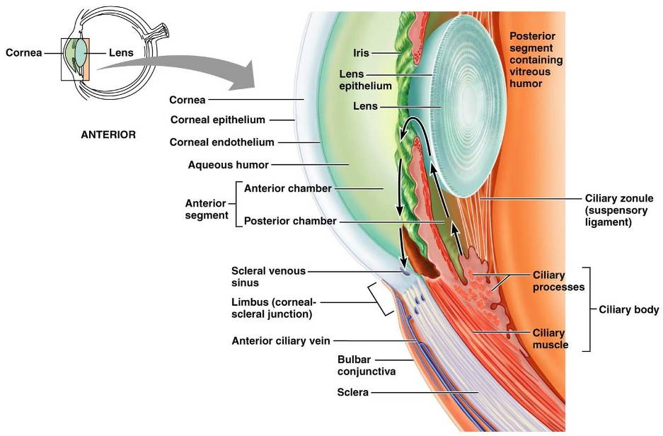
Anterior Segment

Slide 29
Lens
A biconvex, transparent, flexible, ________________________________structure that:
Allows ____________________________________of light onto the retina
Is composed of _
Lens fibers
cells filled with the transparent protein _
With age,
the lens becomes more compact
loses its _

Slide 30
Light
Our eyes respond to a small portion of this spectrum called the _
Different ___________________________ in the retina respond to different __________________________________ of the visible spectrum

Slide 31
Refraction and Lenses
When light passes from one transparent medium to another its speed changes and _
Light passing through a convex lens is bent so that the rays _
When a convex lens forms an image, the image is _

Slide 32
Focusing Light on the Retina
Pathway of light entering the eye:
Light is refracted:
At the cornea
Entering the lens
Leaving the lens
The lens curvature and shape allow for fine focusing of an image

Slide 33
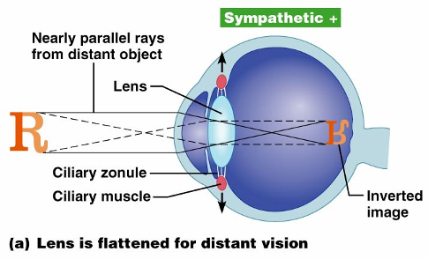
Focusing for Distant Vision
Light from a distance needs ______________________________________ for proper focusing
Far point of vision – the distance beyond which the lens does not need to change shape to focus (20 ft.)

Slide 34
Focusing for Close Vision
Close vision requires:
changing the lens shape by ciliary muscles to increase refractory power
the pupillary reflex constricts the pupils to prevent divergent light rays from entering the eye
medial rotation of the eyeballs toward the object being viewed

Slide 35
Problems of Refraction
normal eye with light focused properly
the focal point is in front of the retina
Corrected with a concave lens
the focal point is behind the retina
Corrected with a convex lens

Slide 36
