Slide 1
Chapter 15
Exam Six Material

Slide 2
Eye and Associated Structures
_______________________________________are in the eye
Most of the eye is protected by a cushion of fat and the bony orbit
Accessory structures include

Slide 3
Eyebrows
____________________________________ that overlie the supraorbital margins
Functions include:
Preventing ______________________________ from reaching the eye
depresses the _
move the eyebrows _

Slide 4
Palpebrae (Eyelids)
Protect the eye anteriorly
separates _
medial and lateral _

Slide 5
Palpebrae (Eyelids)
contains _______________________________ that secrete a whitish, oily secretion (Sandman’s eye sand)
__________________________________ of connective tissue support the eyelids internally
gives the _

Slide 6
Palpebrae (Eyelids)
Eyelashes
Project from the free margin of each eyelid
Lubricating glands associated with the eyelids
__________________________________________ and sebaceous glands
_________________________________________ lie between the hair follicles

Slide 7
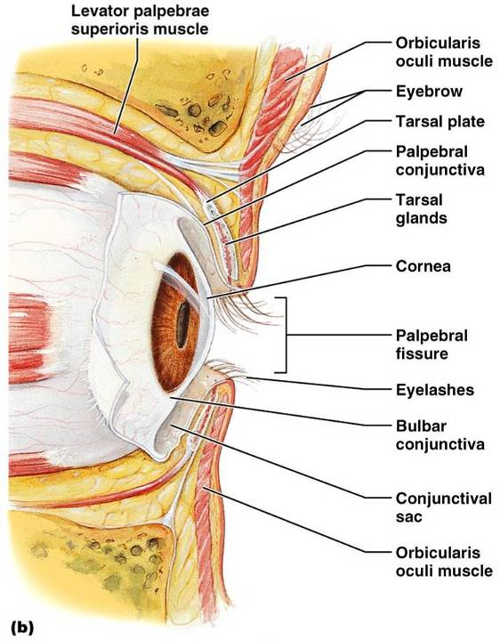
Palpebrae (Eyelids)

Slide 8
Conjunctiva
_________________________________ membrane that:
Lines the eyelids as the _
Covers the whites of the eyes as the _
______________________________________and protects the eye

Slide 9
Lacrimal Apparatus
Consists of the lacrimal gland and associated ducts
Lacrimal glands _
Tears
Contain _
Enter the eye via superolateral excretory ducts
_____________________the eye __________________________via the lacrimal punctum
Drain into _

Slide 10
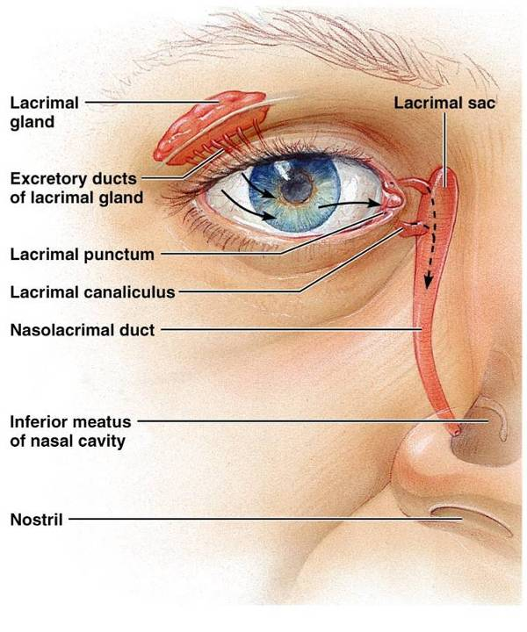
Lacrimal Apparatus
Figure 15.2

Slide 11
Extrinsic Eye Muscles
Six straplike extrinsic eye muscles
Enable the eye to _
Maintain the _
Four ________________________________ muscles originate from the annular ring
Two ______________________________ muscles move the eye in the vertical plane

Slide 12
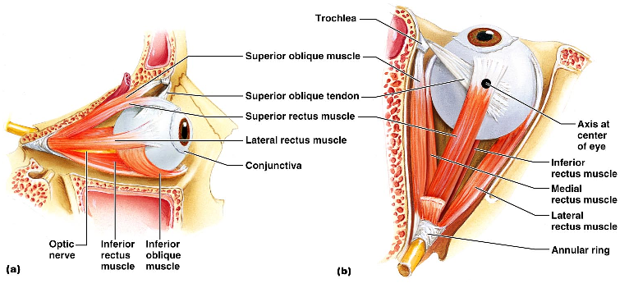
Extrinsic Eye Muscles

Slide 13
Summary of Cranial Nerves and Muscle Actions
Names, actions, and cranial nerve innervation of the extrinsic eye muscles

Slide 14
Structure of the Eyeball
A slightly _____________________________________with anterior and posterior poles
The wall is composed of three tunics –
The internal cavity is filled with fluids called _
The lens separates the internal cavity into anterior and posterior segments

Slide 15
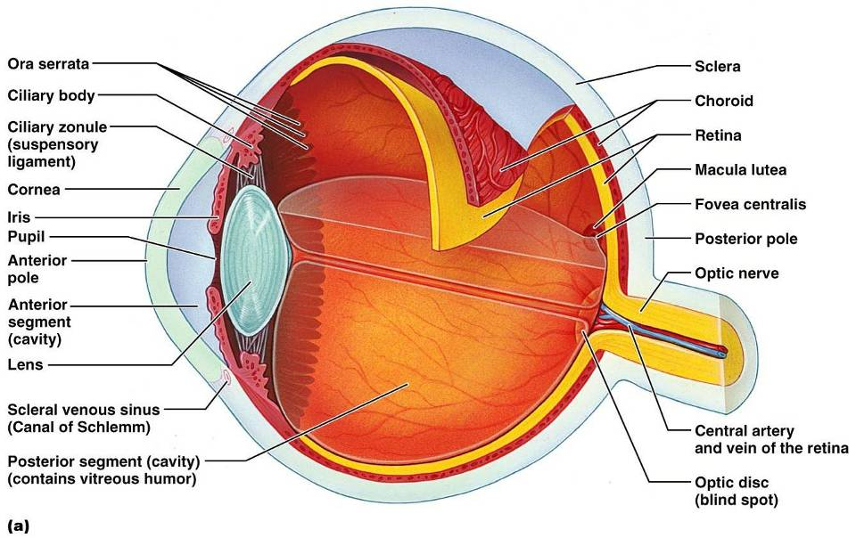
Structure of the Eyeball

Slide 16
Fibrous Tunic
Forms the outermost coat of the eye and is composed of:
The sclera _____________________________________ and anchors _
The cornea lets light enter the eye

Slide 17
Vascular Tunic: Choroid Region
Has three regions:
Choroid region
A dark brown membrane that forms the posterior portion of the vascular layer
Supplies _

Slide 18
Vascular Tunic: Ciliary Body
A thickened ring of tissue _
Composed of _
ciliary muscles
Anchors the _____________________________________ that holds the lens in place

Slide 19
Vascular Tunic: Iris
The _________________________________ of the eye
Pupil
central opening of the iris
Close vision and bright light
Distant vision and dim light
Changes in emotional state
pupils dilate when the subject matter is appealing or requires problem-solving skills

Slide 20
Sensory Tunic: Retina
A delicate _
Pigmented layer
the outer layer that ________________________________________ and prevents its scattering
Neural layer, which contains:
___________________________________________ that transduce light energy
Bipolar cells and ganglion cells
Amacrine and horizontal cells

Slide 21
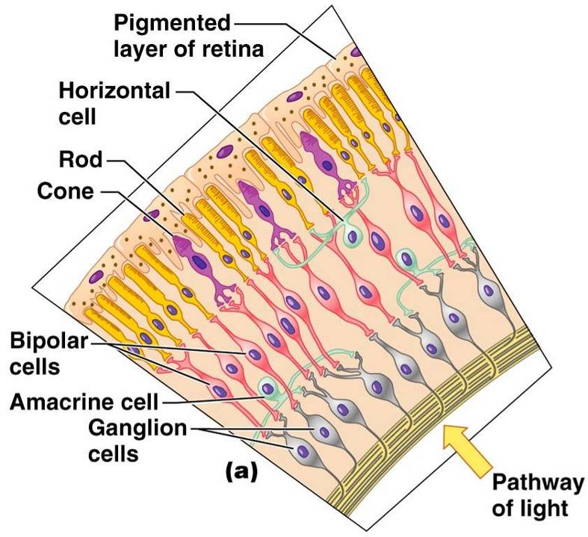
Sensory Tunic: Retina

Slide 22
The Retina: Ganglion Cells and the Optic Disc
Ganglion cell axons:
Run along the _
Leave the eye as the _
The _
Is the site where the optic nerve leaves the eye
Lacks _
the

Slide 23
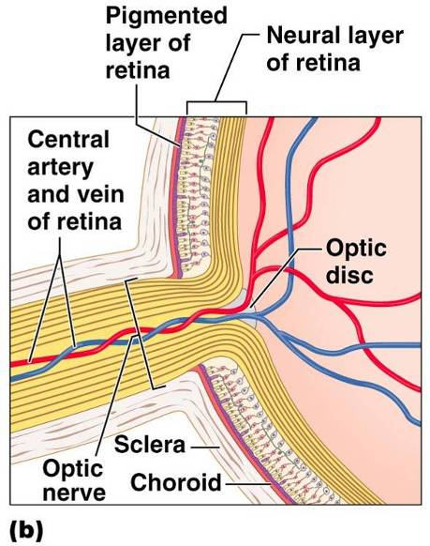
The Retina: Ganglion Cells and the Optic Disc

Slide 24
The Retina: Photoreceptors
Rods:
Respond to _
Are used for _
Cones:
Respond to _
Have _____________________________________ color vision
Are found in the _
Are concentrated in the _

Slide 25
Blood Supply to the Retina
The neural retina receives its blood supply from two sources
The outer third receives its blood from the _
The inner two-thirds is served by the _
Small vessels radiate out from the optic disc

Slide 26
Inner Chambers and Fluids
The lens separates the internal eye into _
The posterior segment is filled with _
Transmits light
Supports the posterior surface of the lens
Contributes to intraocular pressure

Slide 27
Anterior Segment
Composed of two chambers
between the cornea and the iris
between the iris and the lens
____________________________ humor
A plasmalike fluid that fills the anterior segment
Drains via the _
Supports, nourishes, and _

Slide 28
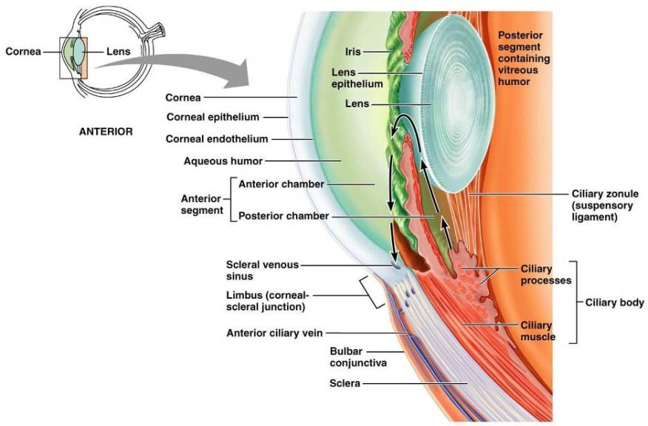
Anterior Segment

Slide 29
Lens
A biconvex, transparent, flexible, ________________________________structure that:
Allows ____________________________________of light onto the retina
Is composed of _
Lens fibers
cells filled with the transparent protein _
With age,
the lens becomes more compact
loses its _

Slide 30
Light
Our eyes respond to a small portion of this spectrum called the _
Different ___________________________ in the retina respond to different __________________________________ of the visible spectrum

Slide 31
Refraction and Lenses
When light passes from one transparent medium to another its speed changes and _
Light passing through a convex lens is bent so that the rays _
When a convex lens forms an image, the image is _

Slide 32
Focusing Light on the Retina
Pathway of light entering the eye:
Light is refracted:
At the cornea
Entering the lens
Leaving the lens
The lens curvature and shape allow for fine focusing of an image

Slide 33
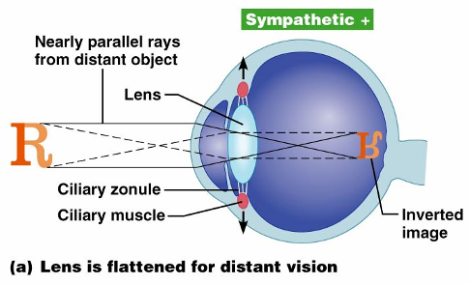
Focusing for Distant Vision
Light from a distance needs ______________________________________ for proper focusing
Far point of vision – the distance beyond which the lens does not need to change shape to focus (20 ft.)

Slide 34
Focusing for Close Vision
Close vision requires:
changing the lens shape by ciliary muscles to increase refractory power
the pupillary reflex constricts the pupils to prevent divergent light rays from entering the eye
medial rotation of the eyeballs toward the object being viewed

Slide 35
Problems of Refraction
normal eye with light focused properly
the focal point is in front of the retina
Corrected with a concave lens
the focal point is behind the retina
Corrected with a convex lens

Slide 36
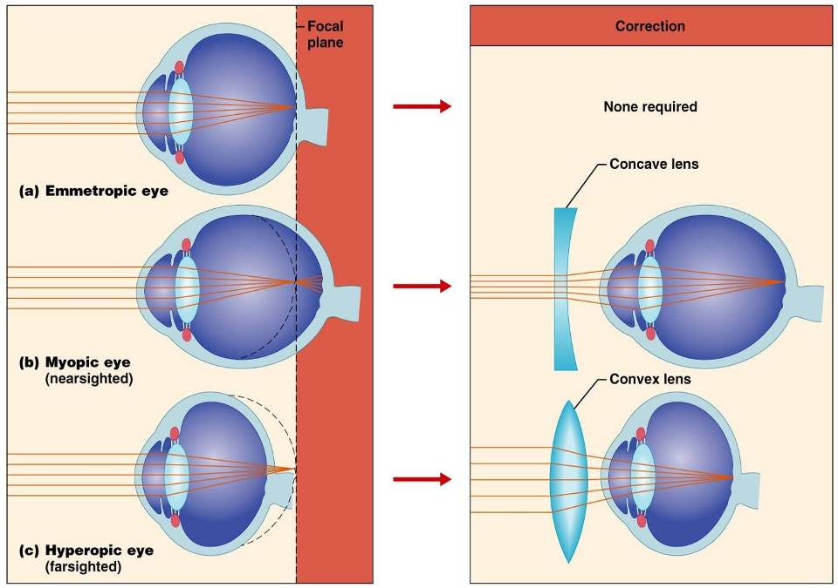

Slide 37
Photoreception: Functional Anatomy of Photoreceptors
process by which the eye detects light energy
Rods and cones contain _

Slide 38
Rods
Functional characteristics
Sensitive to ___________________________ and best suited for _
Absorb _
Perceived input is in _
Sum of visual input from many rods feeds into a single ganglion cell
Results in _

Slide 39
Cones
Functional characteristics
Need ___________________________________ for activation
have low _
Have pigments that allow a _
Each cone synapses with a _
Vision is _

Slide 40
Excitation of Cones
There are three types of cones:
Intermediate colors are perceived by activation of _
Method of excitation is similar to rods

Slide 41
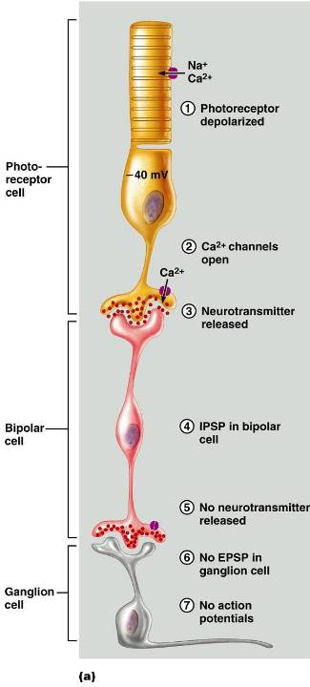
Signal Transmission in the Retina

Slide 42
Adaptation
_____________________________________ (going from dark to light) involves:
Dramatic decreases in retinal sensitivity
Switching from the rod to the cone system
Adaptation to dark is the reverse
Rhodopsin accumulates in the dark and retinal sensitivity is restored

Slide 43
Visual Pathways
Axons of retinal ganglion cells form the optic nerve
Medial fibers of the _
Most fibers of the optic tracts continue to the _

Slide 44
Visual Pathways
Other optic tract fibers end in _
Optic radiations travel from _

Slide 45
Visual Pathways
Some nerve fibers send tracts to the midbrain ending in the _
A small subset of visual fibers contain melanopsin (circadian pigment) which:
Mediates papillary light reflexes
Sets daily _

Slide 46
Depth Perception
Achieved by both eyes viewing the same image from _
Three-dimensional vision results from _____________________________________ of the slightly different images
If only one eye is used, _____________________________________and the observer must rely on learned clues to determine depth

Slide 47
Thalamic Processing
The _____________________________________ of the thalamus:
Relay information on _
Segregate the retinal axons in preparation _
Emphasize visual inputs from regions of high cone density
Sharpen the contrast information received by the retina

Slide 48
Cortical Processing
Basic dark/bright and _
Prestriate cortices (association areas) processes
Form, color, and movement
Visual information then proceeds anteriorly to the:
___________________________________ – processes identification of objects
___________________________________ and postcentral gyrus – processes spatial location

Slide 49
Chemical Senses
Chemical senses
Their chemoreceptors respond to chemicals in aqueous solution
Taste
to substances dissolved _
Smell
to substances dissolved in _

Slide 50
Sense of Smell
The organ of smell is the _____________________________________, which covers the superior nasal concha
Olfactory receptor cells are _____________________________________with radiating olfactory cilia
Basal cells lie at the base of the epithelium

Slide 51
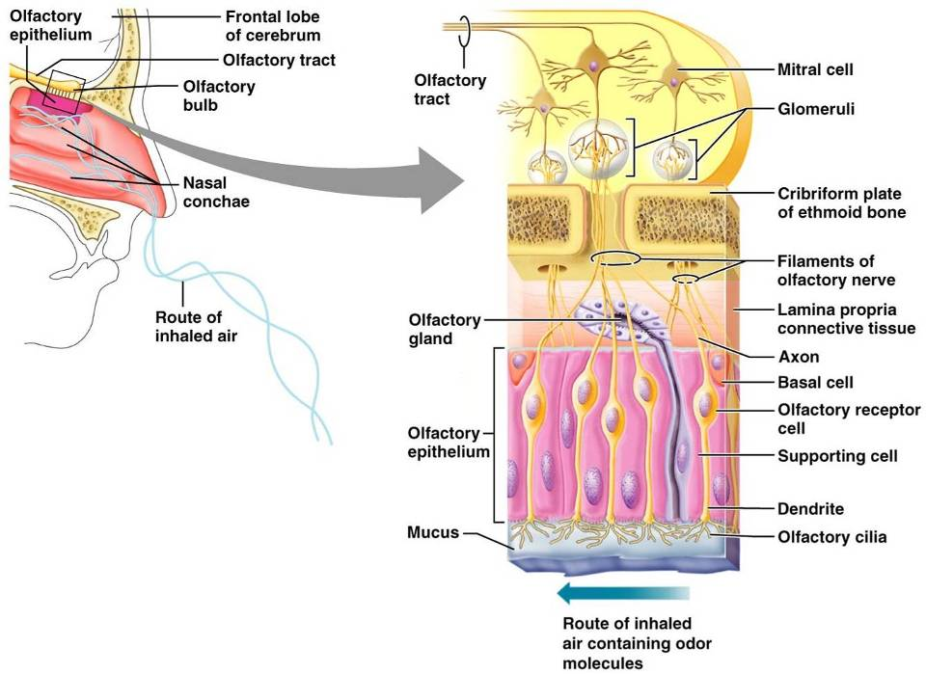
Olfactory Receptors

Slide 52
Physiology of Smell
Olfactory receptors respond to several different odor-causing chemicals
When bound to ligand these proteins _
cAMP (the second messenger) opens ion channels,
causing ___________________________________ of the receptor membrane that then triggers an action potential

Slide 53
Olfactory Pathway
Olfactory receptor cells _
Glomerular mitral cells _
Mitral cells send impulses to:
The
The hypothalamus, amygdala, and _

Slide 54
Taste Buds
_________________of the 10,000 or so taste buds are found on the _
Taste buds are found in papillae of the tongue mucosa
Papillae come in three types:
Fungiform and circumvallate papillae _

Slide 55
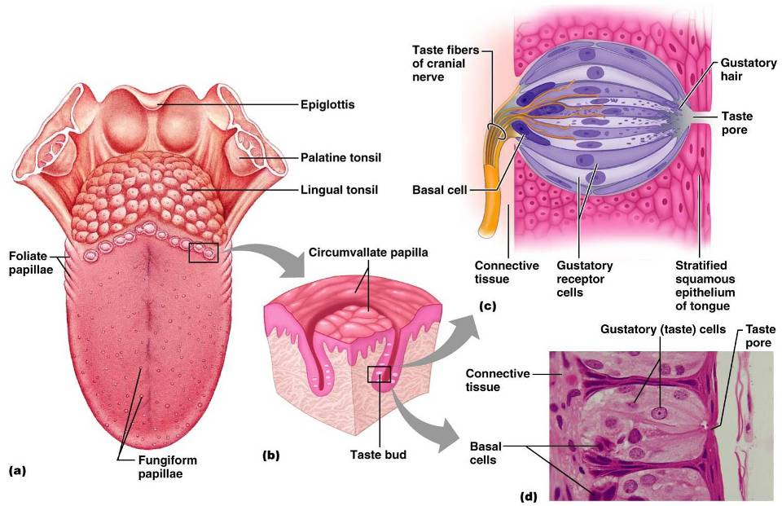

Slide 56
Structure of a Taste Bud
Each _________________________________ taste bud consists of three major cell types
insulate the receptor
dynamic stem cells

Slide 57
Taste Sensations
There are five basic taste sensations
sugars, saccharin, alcohol, and some amino acids
metal ions
hydrogen ions
alkaloids such as quinine and nicotine
elicited by the amino acid glutamate

Slide 58
Physiology of Taste
In order to be tasted, a chemical:
Must be _
Must contact _
Binding of the food chemical:
Depolarizes the taste cell membrane, _
Initiates a generator potential that elicits an _

Slide 59
Gustatory Pathway
Cranial Nerves _________________________ carry impulses from _
These impulses then travel to the _____________________________________, and from there fibers branch to the:
Hypothalamus and limbic system (________________________________of taste)

Slide 60
Influence of Other Sensations on Taste
Taste _
Thermoreceptors, mechanoreceptors, nociceptors also influence tastes
________________________________________ enhance or detract from taste

Slide 61
The Ear: Hearing and Balance
The three parts of the ear are the _
The outer and middle ear are involved with hearing
The inner ear functions
Receptors for hearing and balance:
Respond to _

Slide 62
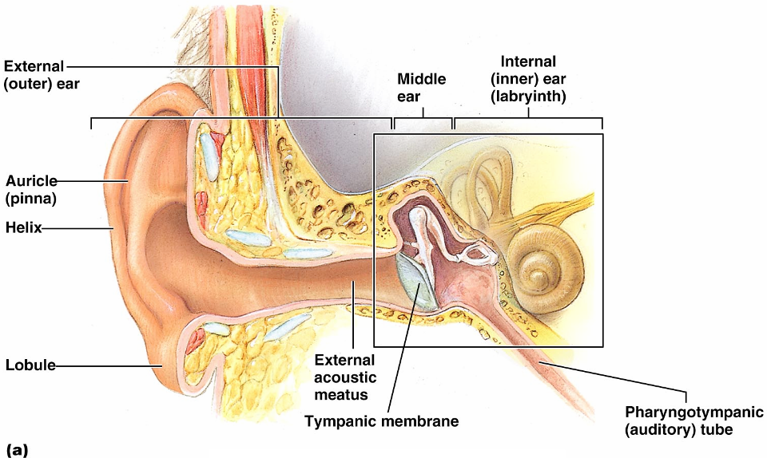
The Ear: Hearing and Balance

Slide 63
Outer Ear
The auricle (pinna) is composed of:
The _
External auditory canal
Short, curved tube filled with _

Slide 64
Outer Ear
Tympanic membrane _
Thin connective tissue membrane that vibrates in response to sound
Transfers sound energy to the _

Slide 65
Middle Ear (Tympanic Cavity)
A small, ___________________________, mucosa-lined cavity
Flanked _
Flanked medially by the _
Epitympanic recess
superior portion of the middle ear
connects the middle ear to the nasopharynx
______________________________________ in the middle ear cavity with the external air pressure

Slide 66
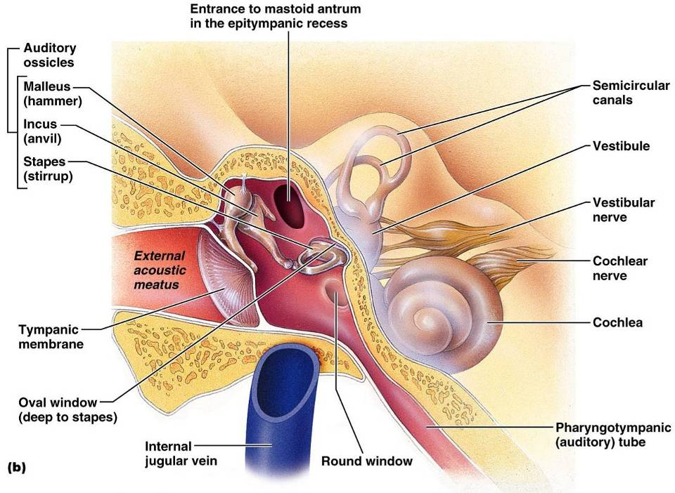
Middle and Internal Ear

Slide 67
Ear Ossicles
The tympanic cavity contains three small bones:
Transmit _________________________________ of the eardrum to the _
Dampened by the _

Slide 68
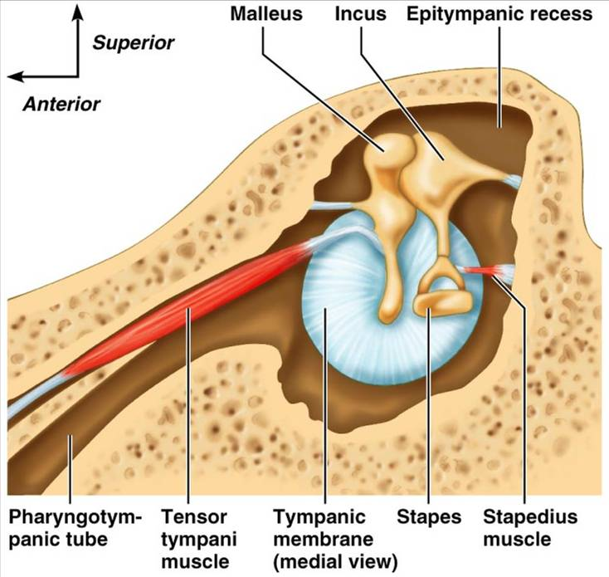

Slide 69
Inner Ear
Tortuous channels worming their way through _
Contains the _
Filled with perilymph
Membranous labyrinth
Series of membranous sacs within the bony labyrinth
Filled with a _

Slide 70
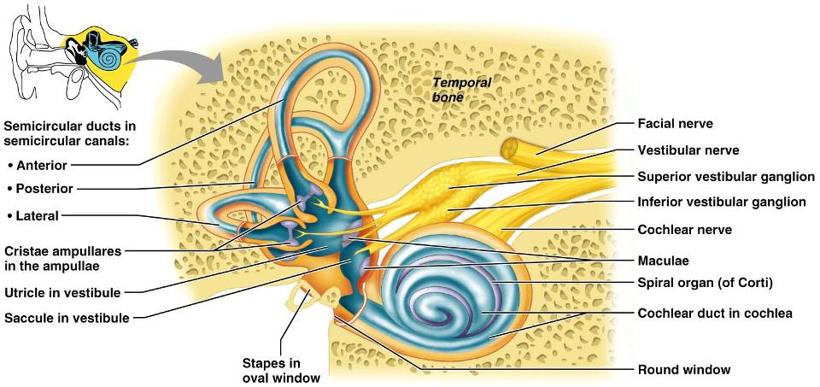
Inner Ear

Slide 71
The Vestibule
The __________________________________ of the bony labyrinth
Suspended in its perilymph are two sacs:
The saccule extends _

Slide 72
The Vestibule
The utricle extends into the _
These sacs:
House ___________________________________ called maculae
Respond to _______________________________ and changes in the _

Slide 73
The Semicircular Canals
Three canals that lie in the _
Membranous semicircular ducts line each canal and communicate with the utricle
The _________________________________is the swollen end of each canal and it houses equilibrium receptors in a region called the _
These receptors respond to _

Slide 74
The Cochlea
A ______________________________, conical, bony chamber that:
Extends from the anterior vestibule
Coils around a bony pillar called the _
Contains the cochlear duct, which ends at the cochlear apex
Contains the _

Slide 75
The Cochlea
The cochlea is divided into three chambers:
Scala _
Scala _
Scala _

Slide 76
The Cochlea
The scala tympani terminates at the _
The scalas tympani and vestibuli:
Are filled with
Are continuous with each other via the _
The scala media is filled with _

Slide 77
The Cochlea
The “floor” of the cochlear duct is composed of:
The bony spiral lamina
The ____________________________________, which supports the organ of Corti
The cochlear branch of nerve VIII runs _

Slide 78
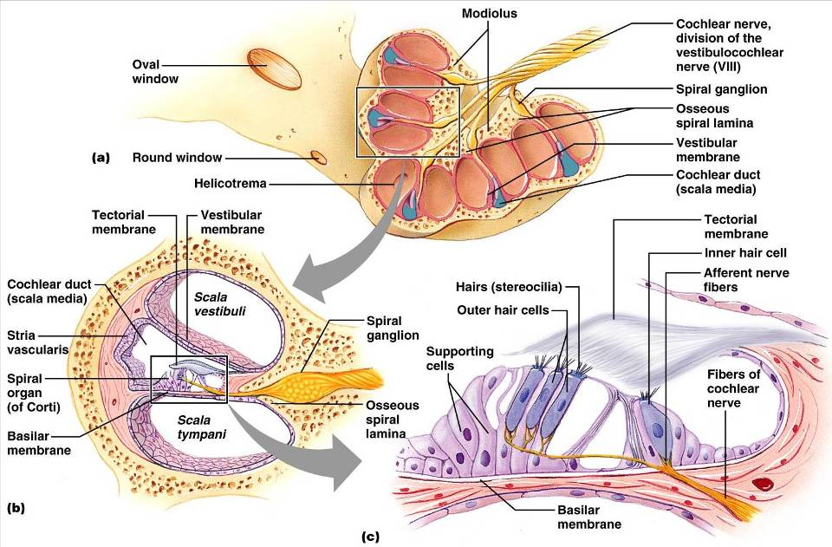

Slide 79
Sound and Mechanisms of Hearing
Sound vibrations beat against the eardrum
The eardrum pushes against the ossicles, which presses fluid in the inner ear against the oval and round windows
This movement sets up _
Moving hair cells stimulates the cochlear nerve _

Slide 80
Properties of Sound
the number of waves that pass a given point in a given time
perception of different frequencies (we hear from 20–20,000 Hz)
intensity of a sound measured in decibels (dB)
subjective interpretation of sound intensity

Slide 81
Transmission of Sound to the Inner Ear
The route of sound to the inner ear follows this pathway:
Outer ear
Middle ear
Inner ear
scalas vestibuli and tympani to the _
Stimulation of the _
Generation of impulses in the _

Slide 82
Resonance of the Basilar Membrane
Sound waves of low frequency (inaudible):
Travel around the helicotrema
Audible sound waves:
Penetrate through the cochlear duct
Vibrate the _
Excite specific hair cells according to ________________________________________ of the sound

Slide 83
The Organ of Corti
Is composed of ___________________________________ and outer and _
_____________________________________ fibers of the cochlear nerve attach to the base of hair cells
The _
Protrude into the endolymph
Touch the tectorial membrane

Slide 84
Excitation of Hair Cells in the Organ of Corti
Bending cilia:
Opens __________________________________ ion channels
Causes a _________________________________________ and the release of a neurotransmitter
The neurotransmitter causes cochlear fibers to transmit impulses to the brain, where sound is perceived

Slide 85
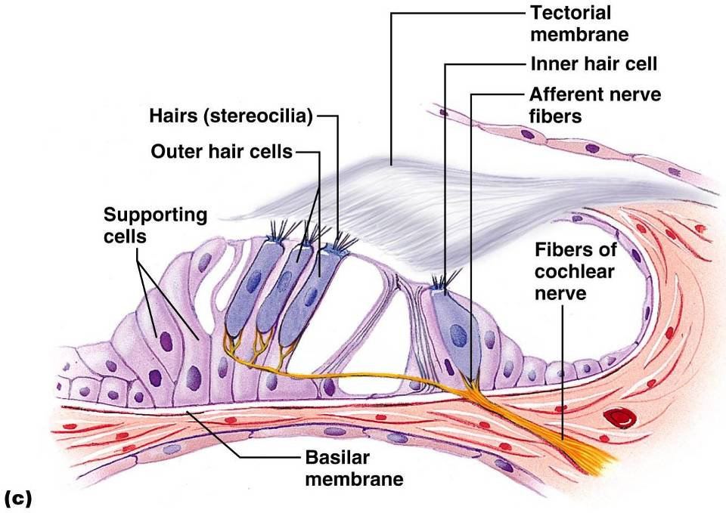

Slide 86
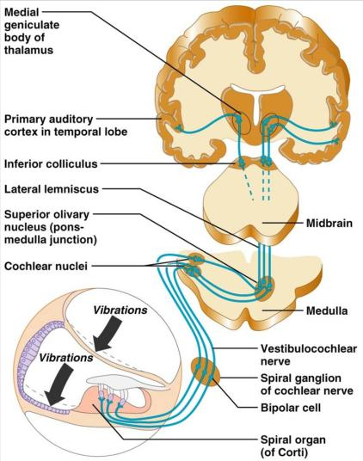
Auditory Pathway to the Brain
Impulses from the cochlea pass via the __________________________to the _
From there, impulses are sent to the:
From there, impulses pass to the _
Auditory pathways _________________________ so that both cortices receive input from both ears

Slide 87
Deafness
something hampers sound conduction to the fluids of the inner ear
results from damage to the ________________________________________ at any point from the cochlear hair cells to the auditory cortical cells

Slide 88
Deafness
ringing or clicking sound in the ears in the absence of auditory stimuli
labyrinth disorder that affects the cochlea and the semicircular canals, causing _

Slide 89
Mechanisms of Equilibrium and Orientation
equilibrium receptors in the semicircular canals and vestibule
Maintains our _
Vestibular receptors
monitor _
Semicircular canal receptors
monitor _

Slide 90
Anatomy of Maculae
____________________________________are the sensory receptors for static equilibrium
Contain supporting cells and hair cells
Each hair cell has stereocilia and kinocilium embedded in the otolithic membrane
jellylike mass studded with tiny stones called _
__________________________________ hairs respond to _
__________________________________ hairs respond to _

Slide 91
Effect of Gravity on Utricular Receptor Cells
Otolithic movement in the _
Depolarizes vestibular nerve fibers
_________________________________the number of action potentials generated
Movement in the _
_______________________________________ vestibular nerve fibers
____________________________________ the rate of impulse propagation

Slide 92
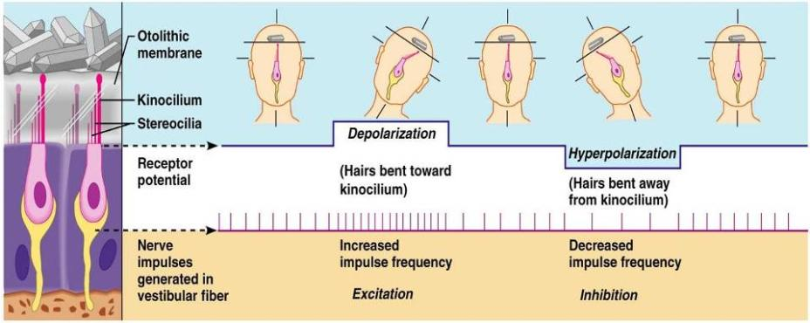
Effect of Gravity on Utricular Receptor Cells

Slide 93
Crista Ampullaris and Dynamic Equilibrium
The _
Is the receptor for _________________________________ equilibrium
Is located in the ampulla of each _
Responds to angular movements
Each crista has support cells and hair cells that extend into a gel-like mass called the _
Dendrites of vestibular nerve fibers encircle the base of the hair cells

Slide 94
Activating Crista Ampullaris Receptors
Cristae respond to _____________________________________ of rotatory movements of the head
Directional bending of hair cells in the cristae causes:
Hyperpolarizations, and fewer impulses reach the brain
The result is that the brain is informed of rotational movements of the head

Slide 95
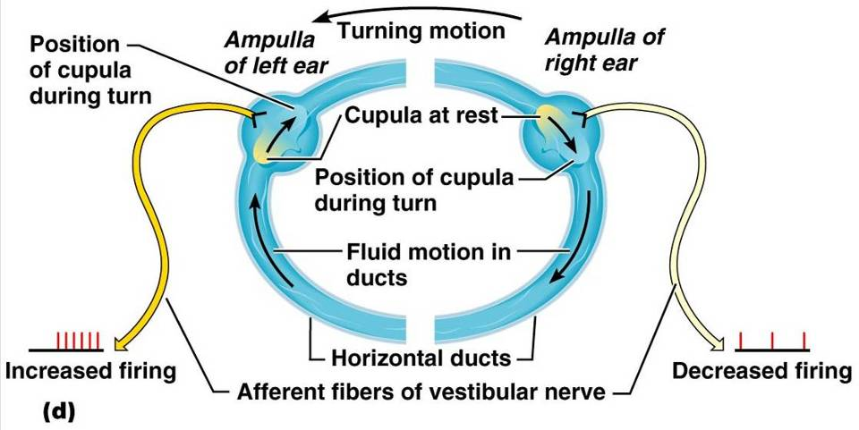
Rotary Head Movement

Slide 96
Balance and Orientation Pathways
There are ______________________________ for balance and orientation
These receptors allow our body to respond reflexively

