Slide 1
BSC 181 Human Physiology & Anatomy I
Dr. Betsy A. Wargo

Slide 2
Introduction
Dr. Wargo
bawargo@ilstu.edu
Office hours: MWF 11 – 11:45
Choose the “Sign Up” option in ReggieNet to schedule and office appointment
Background
Graduated from ISU 1994
Major: Biology
Graduated from National College of Chiropractic 1997
B.S. in Human Biology
Doctorate for Chiropractic

Slide 3
Introduction
Syllabus
Posted on ReggieNet
Exams
Six semester exams worth 100 points
Lowest exam from 1 – 5 automatically dropped when calculating grades
No make up exams
Grading
89.5 and up A
79.5 – 89.4 B
69.5 – 79.5 C
59.5 – 69.4 D
Below 69.4 F

Slide 4
Introduction
Assignments
You will submit one assignment by each of our six exam dates. The assignment will be open in ReggieNet several days before the due date. Instructions will be provided.
Encourage a type of Active Study
Ten high-quality quiz questions
Eight multiple choice questions that include at least four options. Indicate the correct response.
Two short answer questions. Asked and answered correctly
No late assignments will be accepted

Slide 5
Introduction
Format
Class will consist of PowerPoint lecture based on the information from your text book.
Lectures are intended to help you digest and comprehend the material from your book, not replace it.
Templates for the lectures will be available through the MODULES section of ReggieNet for you to download and print.
A picture is worth a thousand words…
Generally, if I draw it on the board, make sure it gets into your notes.

Slide 6
Introduction
Active versus Passive Studying
Passive:
reading or re-reading notes, listening to taped lectures
Low energy requirements
Begin to understand material

Slide 7
Introduction
Active Studying
Developing comprehension
Re-writing sections you don’t understand
Study efficiently!
Note-cards
Study groups
Discussing pathways or processes
Explaining to those who don’t get it yet
Forcing verbal recall of written material
Making exam questions
Answering exam questions correctly
Exchanging and reviewing assignments. This then becomes a study guide for class material.
Using supplemental study sites for practice quizzes

Slide 8
Introduction
Exam Format
Exams will be created mostly from material presented in lecture
We omit certain sections from the textbook chapters. Review from your class notes/templates.
You will be responsible for diagrams (Anatomy)
Images from the lecture presentation will be used. You will have access to these images through your notes (templates) as well as the through the posted exam reveiws

Slide 9
Lab
There will be lab this week
Please be sure to bring the BSC 182 lab manual with you to lab
Lab manuals can be purchased at the Phi Sigma bookstore (Felmley 101A) this week and next for $15.00
Lab format
There will be four lab practicals this semester
Lab assignments (case studies or article summaries) may be assigned throughout the semester.

Slide 10
Ready?
Before we begin, take a moment to introduce yourself to your neighbors make sure you have contact information from a classmate should you need to get a copy of the notes

Slide 11
Overview of Anatomy and Physiology
Anatomy
the study of the structure of body parts and their relationships to one another
Physiology
the study of the function of the body’s structural machinery

Slide 12
Overview of Anatomy and Physiology
Anatomy
Study of structure
Physiology
Study of the function of the body
Subdivisions based on organ systems (e.g., renal or cardiovascular physiology)
Often focuses on cellular and molecular level
Body's abilities depend on chemical reactions in individual cells

Slide 13
Principle of Complementarity
Anatomy and physiology are inseparable
Function always reflects structure
What a structure can do depends on its specific form

Slide 14
Levels of Structural Organization
Chemical
Atoms and molecules (chapter 2); and organelles (chapter 3)
Cellular
Cells (chapter 3)
Tissue
Groups of similar cells (chapter 4)
Organ
Contains two or more types of tissues
Organ System
Organs that work closely together
Organismal
All organ systems

Slide 15
Interdependence of Body Cells
Humans are multicellular
To function, must keep individual cells alive
All cells depend on organ systems to meet their survival needs
All body functions spread among different organ systems
Organ systems cooperate to maintain life

Slide 16
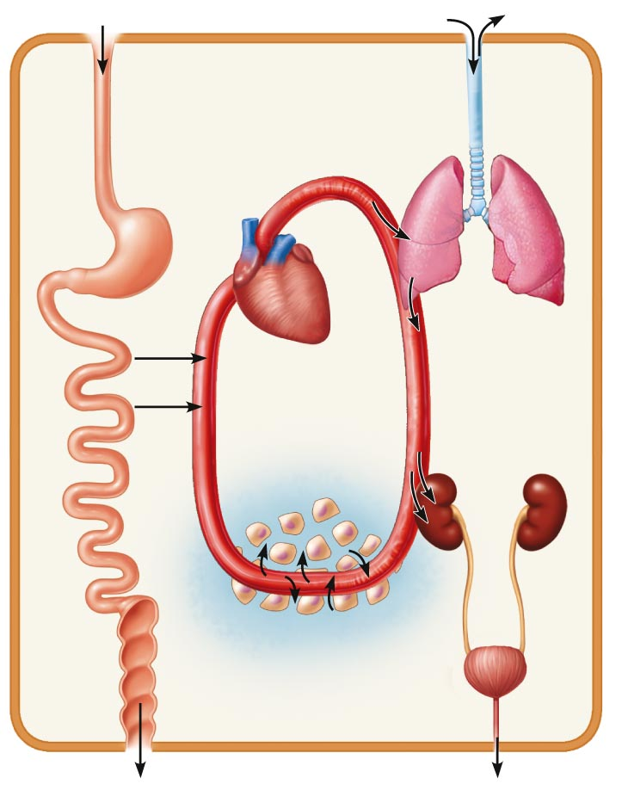
Figure 1.2 Examples of interrelationships among body organ systems.
Digestive system
Takes in nutrients, breaks them down, and eliminates unabsorbed matter (feces)
Respiratory system
Takes in oxygen and eliminates carbon dioxide
Food
O₂
CO₂
Cardiovascular system
Via the blood, distributes oxygen and nutrients to all body cells and delivers wastes and carbon dioxide to disposal organs
Blood
CO₂
O₂
Heart
Urinary system Eliminates nitrogenous
wastes and
excess ions
Nutrients
Interstitial fluid
Nutrients and wastes pass between blood and cells via the interstitial fluid
Integumentary system Protects the body as a whole from the external environment
Feces
Urine

Slide 17
Homeostasis
Homeostasis
Maintenance of relatively stable internal conditions despite continuous changes in environment
A dynamic state of equilibrium
Maintained by contributions of all organ systems

Slide 18
Homeostatic Control Mechanisms
Involve continuous monitoring and regulation of all variables
Communication necessary for monitoring and regulation
Functions of nervous and endocrine systems
Nervous and endocrine systems accomplish communication via nerve impulses and hormones

Slide 19
Components of a Control Mechanism
Receptor (sensor)
Monitors environment
Responds to stimuli
Control center
Determines set point at which variable is maintained
Receives input from receptor
Determines appropriate response
Effector
Receives output from control center
Provides the means to respond
Response either reduces (negative feedback) or enhances stimulus (positive feedback)

Slide 21
Negative Feedback
Most feedback mechanisms in body
Response reduces or shuts off original stimulus
Variable changes in opposite direction of initial change
Examples
Regulation of body temperature
Regulation of blood volume by ADH

Slide 22
Positive Feedback
Response enhances or exaggerates original stimulus
May exhibit a cascade or amplifying effect
Usually controls infrequent events that do not require continuous adjustment
Enhancement of labor contractions by oxytocin
Platelet plug formation and blood clotting

Slide 23
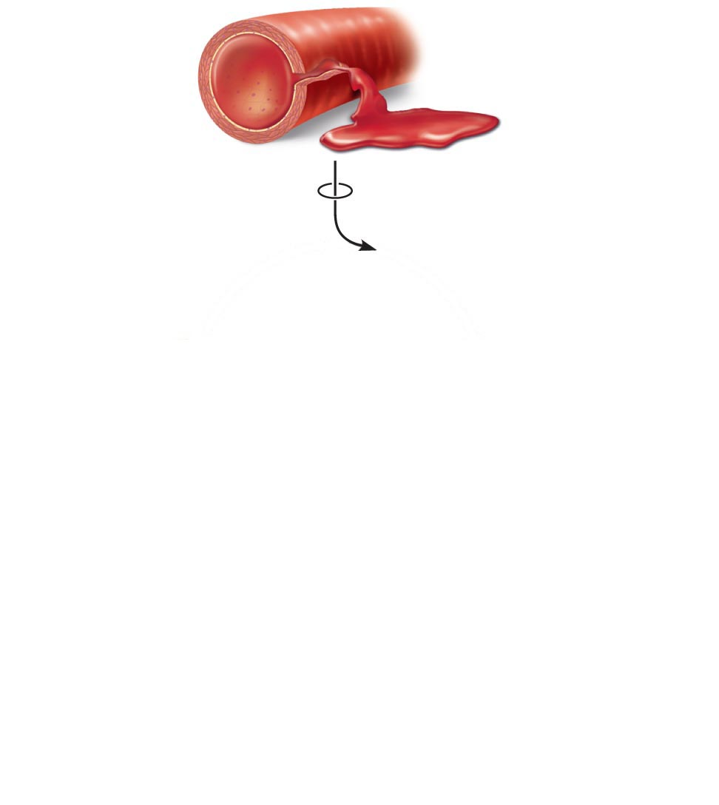
1
Break or tear
occurs in blood
vessel wall.
Positive feedback
cycle is initiated.

Slide 24
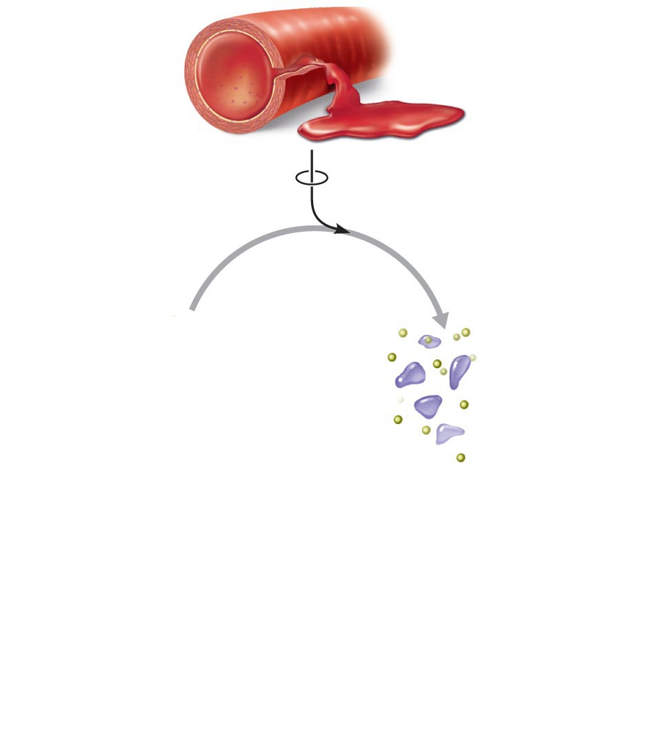
1
Break or tear
occurs in blood
vessel wall.
Positive feedback
cycle is initiated.
2
Platelets
adhere to site and
release chemicals.

Slide 25
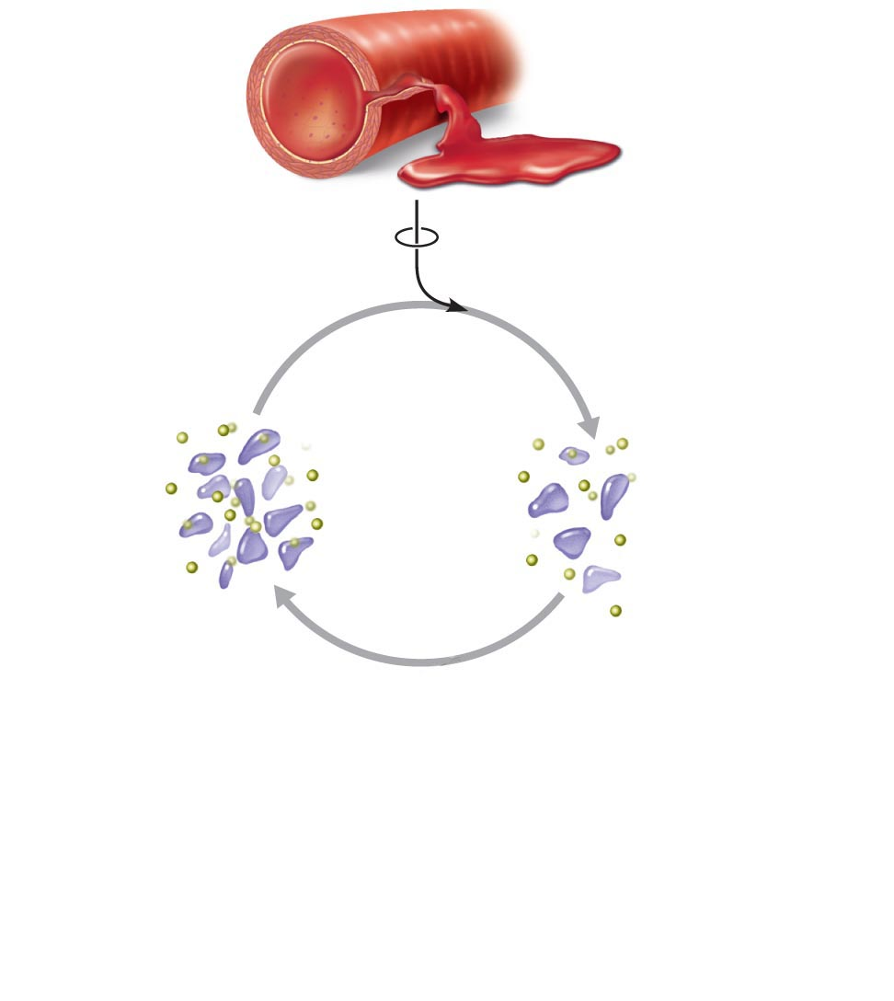
1
Break or tear
occurs in blood
vessel wall.
Positive feedback
cycle is initiated.
3
2
Released
chemicals
attract more
platelets.
Platelets
adhere to site and
release chemicals.
Positive
feedback
loop

Slide 26
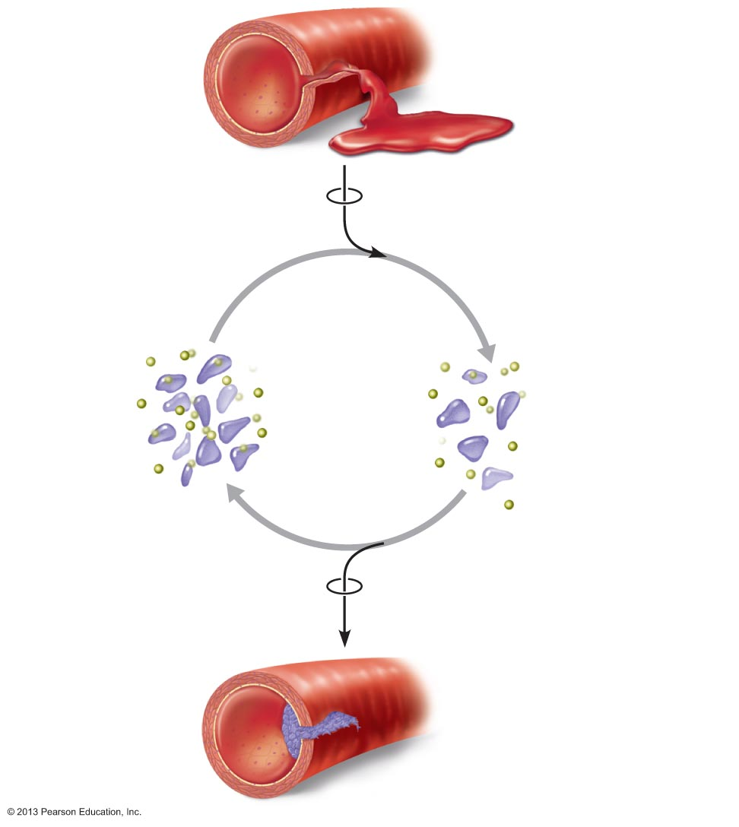
1
Break or tear
occurs in blood
vessel wall.
Positive feedback
cycle is initiated.
3
2
Released
chemicals
attract more
platelets.
Platelets
adhere to site and
release chemicals.
Positive
feedback
loop
Feedback cycle ends
when plug is formed.
4
Platelet plug
is fully formed.

Slide 27
Homeostatic Imbalance
Disturbance of homeostasis
Increases risk of disease
Contributes to changes associated with aging
Control systems less efficient
If negative feedback mechanisms overwhelmed
Destructive positive feedback mechanisms may take over (e.g., heart failure)

Slide 28
Anatomical Position
Standard anatomical body position
Body erect
Feet slightly apart
Palms facing forward
Thumbs point away from body
Always use directional terms as if body is in anatomical position
Right and left refer to body being viewed, not those of observer

Slide 29
Regional Terms
Two major divisions of body
Axial
Head, neck, and trunk
Appendicular
Limbs
Regional terms designate specific areas within body divisions

Slide 30
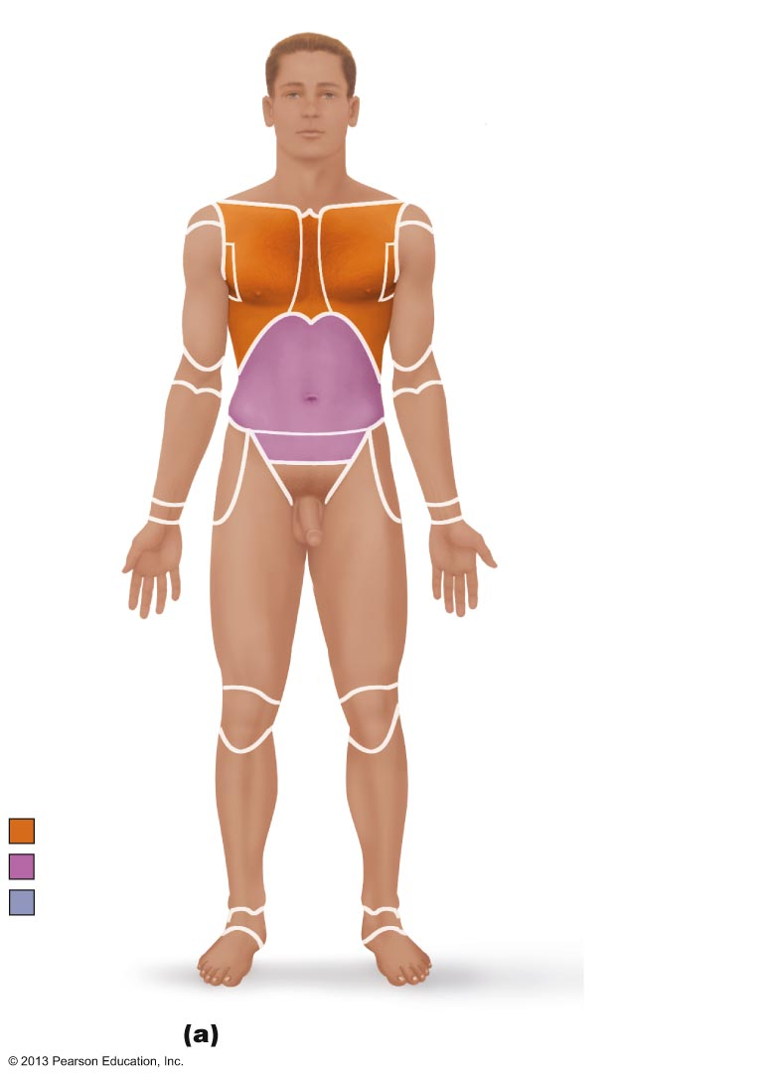
Figure 1.7a Regional terms used to designate specific body areas.
Cephalic
Frontal
Orbital
Nasal
Oral
Upper limb
Mental
Acromial
Cervical
Brachial (arm)
Thoracic
Antecubital
Sternal
Antebrachial
Axillary
(forearm)
Mammary
Carpal (wrist)
Abdominal
Umbilical
Manus (hand)
Pelvic
Pollex
Inguinal
(groin)
Palmar
Digital
Lower limb
Coxal (hip)
Pubic
(genital)
Femoral (thigh)
Patellar
Crural (leg)
Fibular or peroneal
Thorax
Pedal (foot)
Abdomen
Tarsal (ankle)
Back (Dorsum)
Metatarsal
Digital
Hallux
Anterior/Ventral

Slide 31
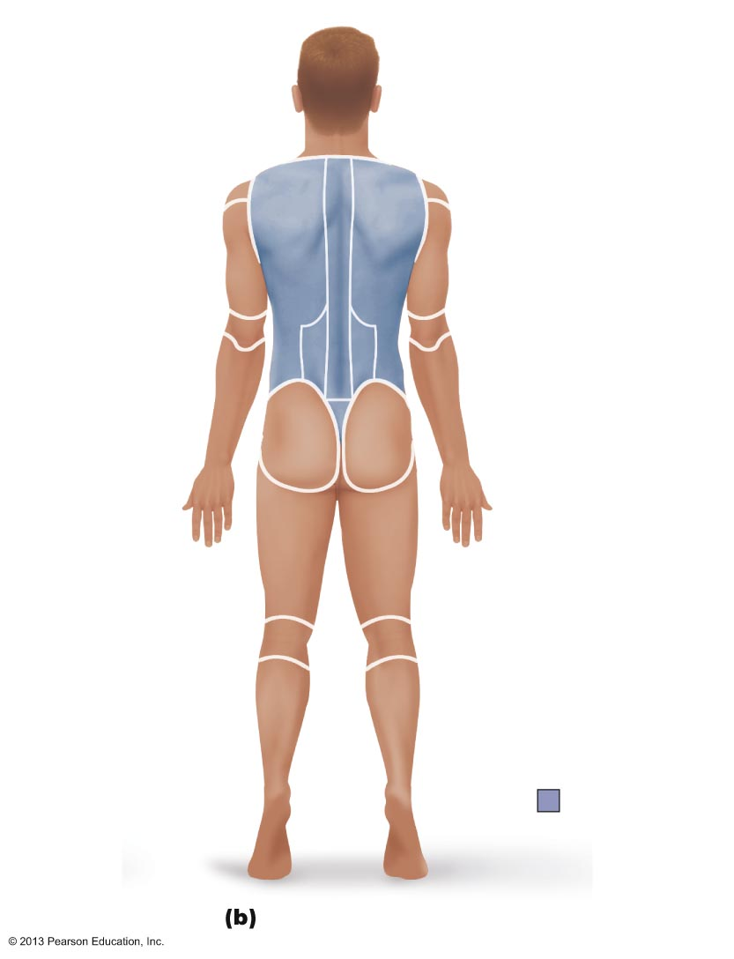
Figure 1.7b Regional terms used to designate specific body areas.
Cephalic
Otic
Occipital (back
of head)
Upper limb
Acromial
Cervical
Brachial (arm)
Olecranal
Back (dorsal)
Antebrachial
Scapular
(forearm)
Vertebral
Lumbar
Manus (hand)
Sacral
Metacarpal
Gluteal
Digital
Lower limb
Perineal (between
anus and external
genitalia)
Femoral (thigh)
Popliteal
Sural (calf)
Fibular or peroneal
Pedal (foot)
Calcaneal
Back (Dorsum)
Plantar
Posterior/Dorsal

Slide 32
Body Planes
Three most common
Lie at right angles to each other
Sagittal plane
Frontal (coronal) plane
Transverse (horizontal) plane

Slide 33
Sagittal Plane
Sagittal plane
Divides body vertically into right and left parts
Produces a sagittal section if cut along this plane
Midsagittal (median) plane
Lies on midline
Parasagittal plane
Not on midline

Slide 34
Body Planes
Frontal (coronal) plane
Divides body vertically into anterior and posterior parts
Produces a frontal or coronal section

Slide 35
Body Planes
Transverse (horizontal) plane
Divides body horizontally (90° to vertical plane) into superior and inferior parts
Produces a cross section
Oblique section
Result of cuts at angle other than 90° to vertical plane

Slide 36
Body Cavities
Two sets of internal body cavities
Closed to environment
Provide different degrees of protection to organs
Dorsal body cavity
Ventral body cavity

Slide 37
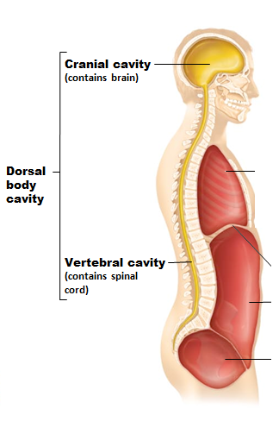
Dorsal Body Cavity
Protects nervous system
Two subdivisions:
Cranial cavity
Encases brain
Vertebral cavity
Encases spinal cord

Slide 38
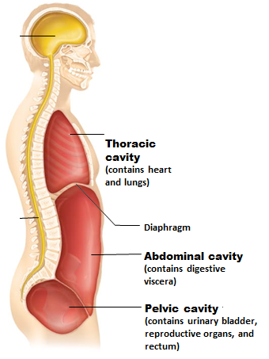
Ventral Body Cavity
Houses internal organs (viscera)
Two subdivisions (separated by diaphragm)
Thoracic cavity
Abdominopelvic cavity

Slide 39
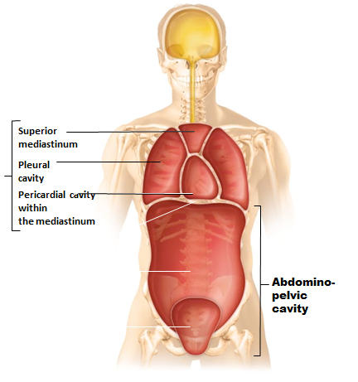
Ventral Body Cavity
Thoracic cavity subdivisions
Two pleural cavities
Each houses a lung
Mediastinum
Contains pericardial cavity
Surrounds thoracic organs
Pericardial cavity
Encloses heart

Slide 40
Ventral Body Cavity
Abdominopelvic cavity subdivisions
Abdominal cavity
Contains stomach, intestines, spleen, and liver
Pelvic cavity
Contains urinary bladder, reproductive organs, and rectum

Slide 41
Membranes in Ventral Body Cavity
Serous membrane or serosa
Thin, double-layered membranes
Parietal serosa lines internal body cavity walls
Visceral serosa covers internal organs (viscera)
Layers separated by slit-like cavity filled with serous fluid
Fluid secreted by both layers of membrane

Slide 42
Serous Membranes
Named for specific cavity and organs with which associated
Each has parietal and visceral layers
Pericardium
Heart
Pleurae
Lungs
Peritoneum
Abdominopelvic cavity

Slide 43
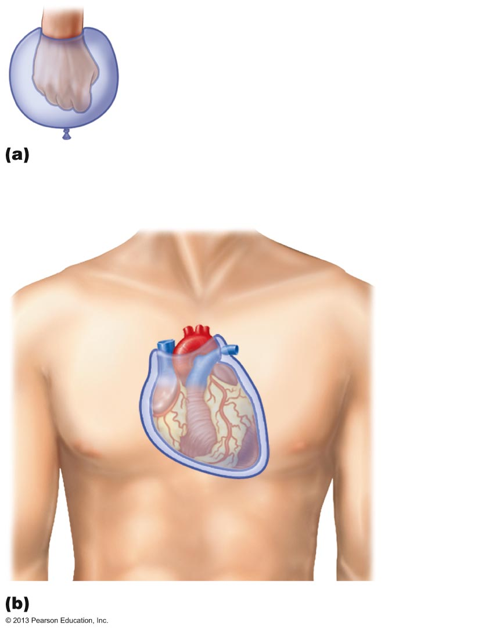
Figure 1.10 Serous membrane relationships.
Outer balloon wall
(comparable to parietal serosa)
Air (comparable to serous cavity)
Inner balloon wall
(comparable to visceral serosa)
A fist thrust into a flaccid balloon demonstrates
the relationship between the parietal and visceral
serous membrane layers.
Heart
Parietal
pericardium
Pericardial
space with
serous fluid
Visceral
pericardium
The serosae associated with the heart.

Slide 44
Other Body Cavities
Exposed to environment
Oral and digestive cavities
Nasal cavity
Orbital cavities
Middle ear cavities
Not exposed to environment
Synovial cavities

Slide 45
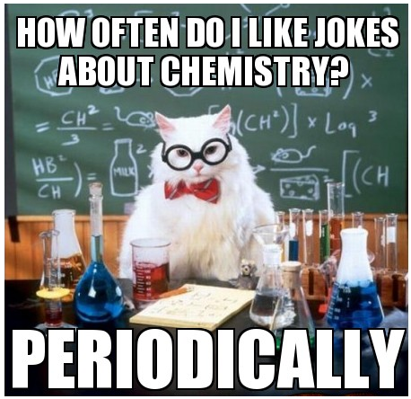

Slide 46
Matter
Matter—anything that has mass and occupies space
Weight—pull of gravity on mass
3 states of matter
Solid—definite shape and volume
Liquid—changeable shape; definite volume
Gas—changeable shape and volume

Slide 47
Composition of Matter: Elements
Elements
Matter is composed of elements
Elements cannot be broken into simpler substances by ordinary chemical methods
Each has unique properties
Physical properties
Detectable with our senses, or are measurable
Chemical properties
How atoms interact (bond) with one another

Slide 48
Composition of Matter
Atoms
Unique building blocks for each element
Give each element its physical & chemical properties
Smallest particles of an element with properties of that element
Atomic symbol
One- or two-letter chemical shorthand for each element

Slide 49
Atomic Structure
Atoms are composed of subatomic particles
Protons, neutrons, electrons
Protons and neutrons found in nucleus
Electrons orbit nucleus in an electron cloud

Slide 50
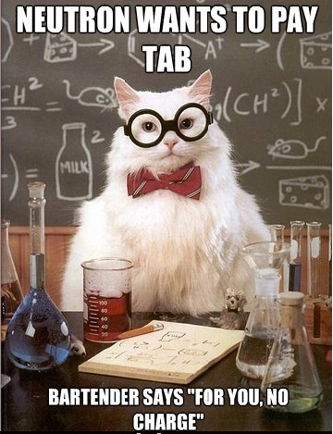
Atomic Structure: The Nucleus
Almost entire mass of the atom
Neutrons
Carry no charge
Mass = 1 atomic mass unit (amu)
Protons
Carry positive charge
Mass = 1 amu

Slide 51
Atomic Structure: Electrons
Electrons in orbitals within electron cloud
Carry negative charge
1/2000 the mass of a proton (0 amu)
Number of protons and electrons always equal

Slide 52
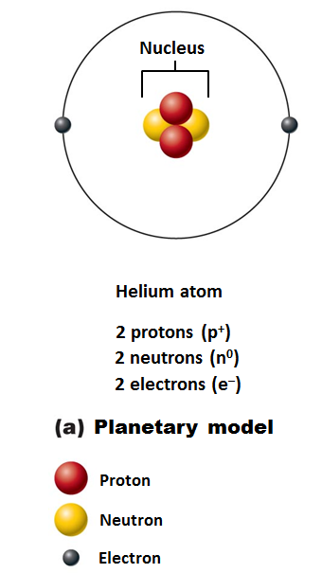
Models of the Atom
Planetary model
simplified; outdated
Incorrectly depicts fixed circular electron paths
But useful for illustrations

Slide 53
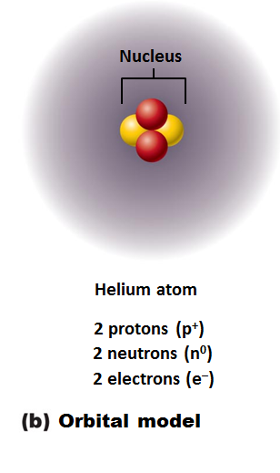
Models of the Atom
Orbital model
current model used by chemists
Probable regions of greatest electron density
an electron cloud
Useful for predicting chemical behavior of atoms

Slide 54
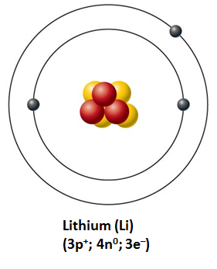
Identifying Elements
Different elements contain different numbers of subatomic particles
Hydrogen has 1 proton, 0 neutrons, and 1 electron
Lithium has 3 protons, 4 neutrons, and 3 electrons

Slide 55
Atomic Number and Mass Number
Atomic number = Number of protons in nucleus
Mass number
Total number of protons and neutrons in nucleus
Total mass of atom

Slide 56
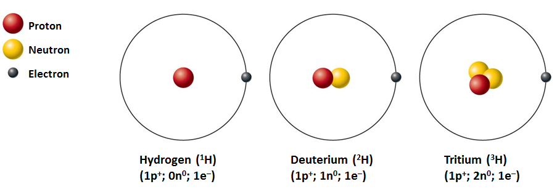
Isotopes and Atomic Weight
Isotopes
Structural variations of atoms
Differ in the number of neutrons they contain
Atomic numbers same; mass numbers different

Slide 57
Isotopes and Atomic Weight
Atomic weight
Average of mass numbers (relative weights) of all isotopes of an atom

Slide 58
Combining Matter: Molecules and Compounds
Most atoms chemically combined with other atoms to form molecules and compounds
Molecule
Two or more atoms bonded together
Can be the same type of atom: H₂
Or different types of atoms: C₆H₁₂O₆
Smallest particle of a compound with specific characteristics of the compound
Compound
Two or more different kinds of atoms bonded together
C₆H₁₂O₆ , but not H₂

Slide 59
Mixtures
Most matter exists as mixtures
Two or more components physically intermixed
Three types of mixtures
Solutions
Colloids
Suspensions

Slide 60
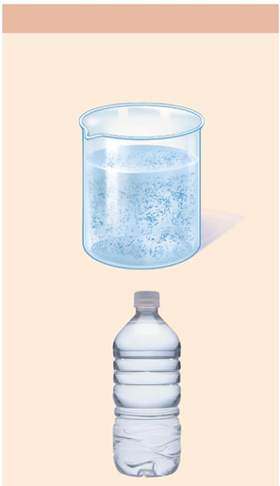
Types of Mixtures: Solutions
Homogeneous mixtures
Most are true solutions in body
Gases, liquids, or solids dissolved in water
Usually transparent, e.g., atmospheric air or saline solution
Solvent
Substance present in greatest amount
Usually a liquid; usually water
Solute(s)
Present in smaller amounts
Ex. If glucose is dissolved in blood, glucose is solute; blood is solvent

Slide 61
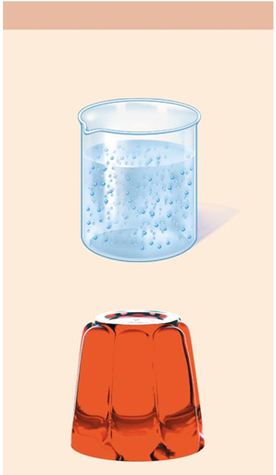
Colloids and Suspensions
Colloids
a substance microscopically dispersed evenly throughout another substance
emulsions
Heterogeneous mixtures
cytosol
Large solute particles do not settle out
Other examples:
Fog (water dispersed in air)
Smoke (burned particulates suspended in air)
Milk (fats dispersed in water)

Slide 62
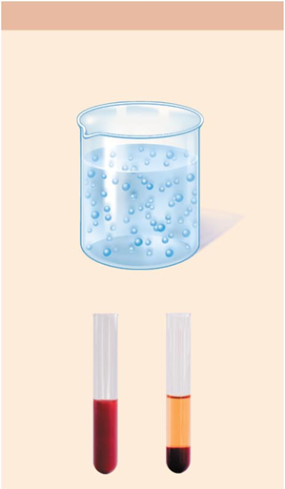
Colloids and Suspensions
Suspensions
Heterogeneous mixtures
blood
Large, visible solutes settle out
Unlike colloids which don’t separate
Other examples
Muddy water
Flour/water

Slide 63
Mixtures versus Compounds
Mixtures
No chemical bonding between components
Can be separated by physical means, such as straining or filtering
Compounds
Chemical bonding between components
Can be separated only by breaking bonds

Slide 64
Chemical Bonds
Chemical bonds are energy relationships between electrons of reacting atoms
Electrons can occupy up to seven electron shells (energy levels) around nucleus
Electrons in valence shell (outermost electron shell)
Have most potential energy
Are chemically reactive electrons
Octet rule (rule of eights)
Except for the first shell (full with two electrons) atoms interact to have eight electrons in their valence shell

Slide 65
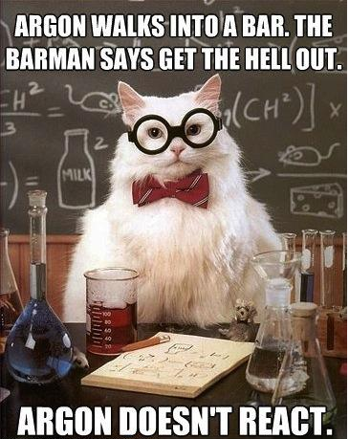
Chemically Inert Elements
Stable and unreactive
Valence shell fully occupied or contains eight electrons
Noble gases
Helium
Neon
Argon
Krypton
Xenon
Radon

Slide 66
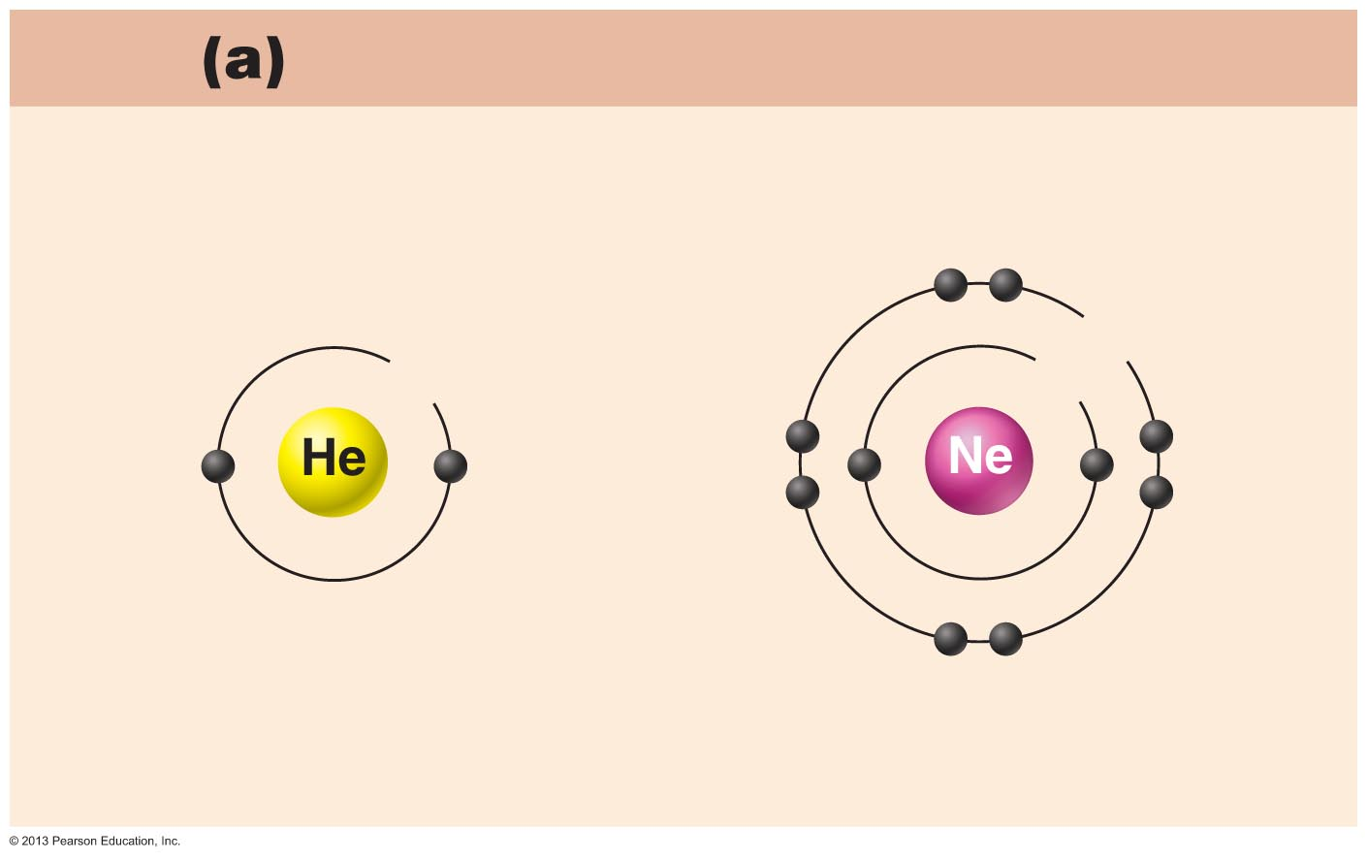
Figure 2.5a Chemically inert and reactive elements.
Chemically inert elements
Outermost energy level (valence shell) complete
8e
2e
2e
Helium (He)
(2p⁺; 2n⁰; 2e–)
Neon (Ne)
(10p⁺; 10n⁰; 10e–)

Slide 67
Chemically Reactive Elements
Valence shell not full
Tend to gain, lose, or share electrons (form bonds) with other atoms to achieve stability

Slide 68
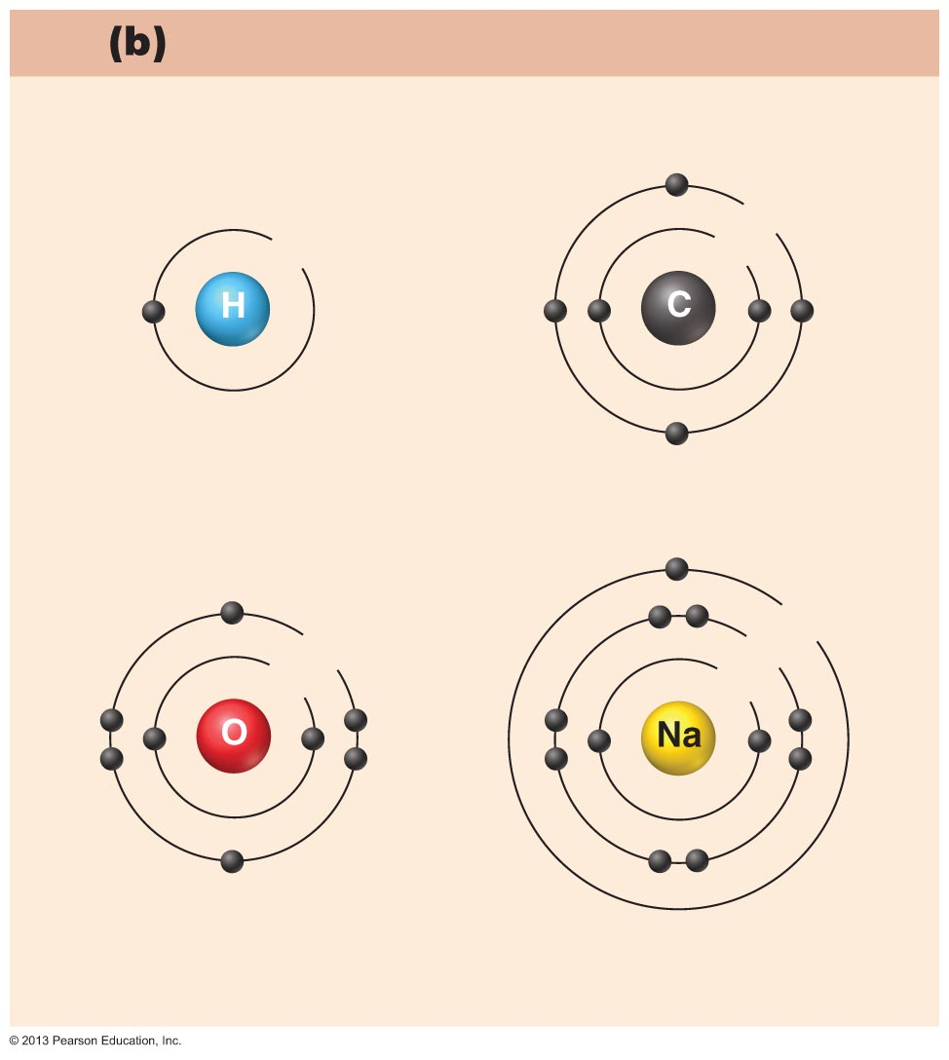
Chemically reactive elements
Outermost energy level (valence shell) incomplete
4e
1e
2e
Hydrogen (H)
(1p⁺; 0n⁰; 1e–)
Carbon (C)
(6p⁺; 6n⁰; 6e–)
1e
6e
8e
2e
2e
Oxygen (O)
(8p⁺; 8n⁰; 8e–)
Sodium (Na)
(11p⁺; 12n⁰; 11e–)

Slide 69
Types of Chemical Bonds
Three major types
Ionic bonds
Covalent bonds
Hydrogen bonds

Slide 70
Ionic Bonds
Ions
Atom gains or loses electrons and becomes charged
Proton number remains the same
Transfer of valence shell electrons from one atom to another forms ions
One becomes an anion
negative charge
Atom that gained one or more electrons
One becomes a cation
positive charge
Atom that lost one or more electrons
Attraction of opposite charges results in an ionic bond

Slide 71
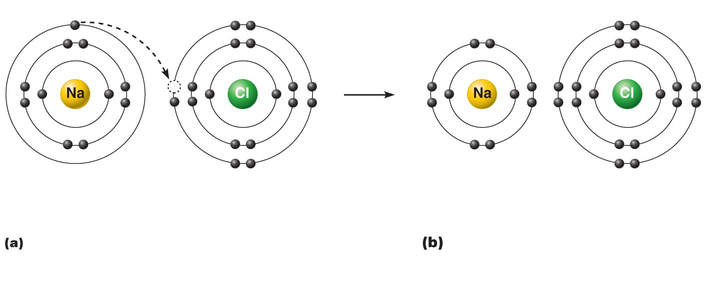
Figure 2.6a–b Formation of an ionic bond.
+
—
Sodium atom (Na)
(11p⁺; 12n⁰; 11e–)
Chlorine atom (Cl)
(17p⁺; 18n⁰; 17e–)
Sodium ion (Na⁺)
Chloride ion (Cl–)
Sodium chloride (NaCl)
Sodium gains stability by losing
one electron, and chlorine becomes
stable by gaining one electron.
After electron transfer,
the oppositely charged ions
formed attract each other.

Slide 72
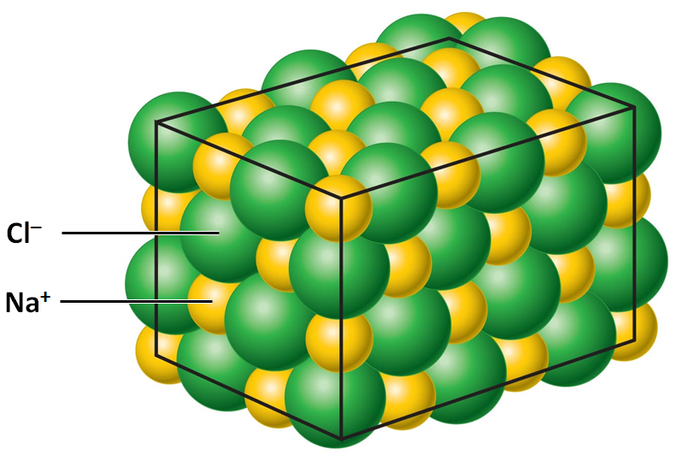
Ionic Compounds
Most ionic compounds are salts
When dry salts form crystals instead of individual molecules
Example is NaCl (sodium chloride)

Slide 73
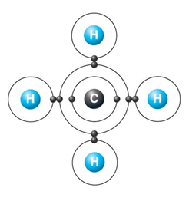
Covalent Bonds
Formed by sharing of two or more valence shell electrons
Allows each atom to fill its valence shell at least part of the time

Slide 74
Nonpolar Covalent Bonds
Electrons shared equally
Produces electrically balanced, nonpolar molecules such as CO₂

Slide 75
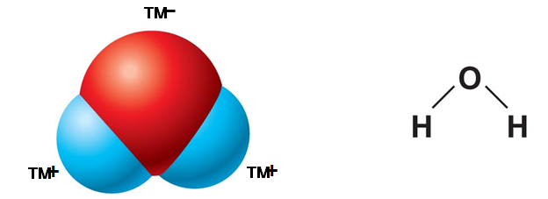
Polar Covalent Bonds
Unequal sharing of electrons produces polar molecules such as H₂O
Atoms in bond have different electron-attracting abilities
Dipole: two poles, one electronegative and the other electropositive

Slide 76
Hydrogen Bonds
Attractive force between electropositive hydrogen of one molecule and an electronegative atom of another molecule
Not true bond
Common between dipoles such as water
intermolecular
Maintains 3-dimensional shape of large molecules
intramolecular

Slide 77
Patterns of Chemical Reactions
Synthesis (combination) reactions
Decomposition reactions
Exchange reactions

Slide 78
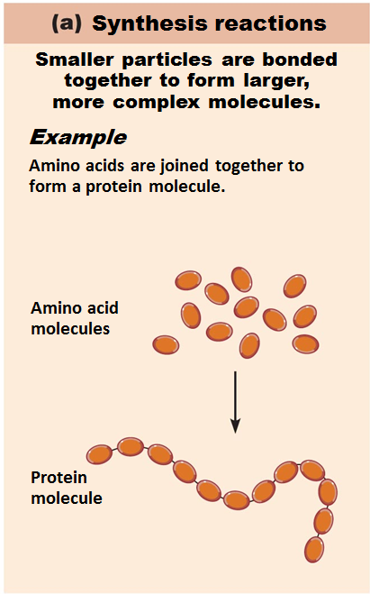
Synthesis Reactions
A + B → AB
Atoms or molecules combine to form larger, more complex molecule
Always involve bond formation
Anabolic

Slide 79
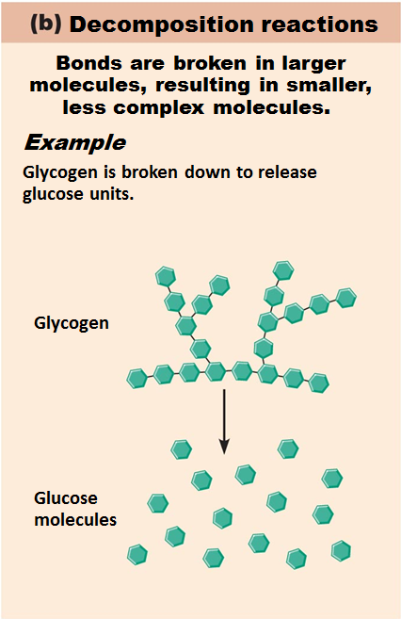
Decomposition Reactions
AB → A + B
Molecule is broken down into smaller molecules or its constituent atoms
Reverse of synthesis reactions
Involve breaking of bonds
Catabolic

Slide 80
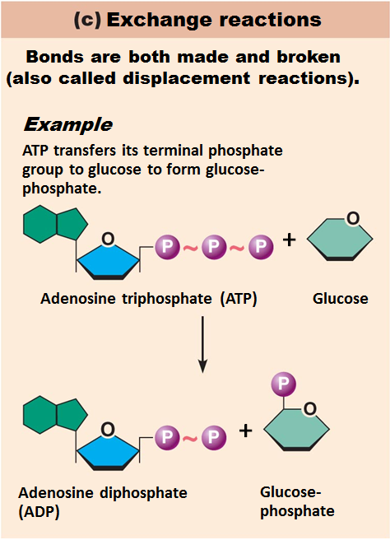
Exchange Reactions
AB + C → AC + B
Also called displacement reactions
Involve both synthesis and decomposition
Bonds are both made and broken

Slide 81
Oxidation-Reduction (Redox) Reactions
Are decomposition reactions
Reactions in which food fuels are broken down for energy
Are also exchange reactions because electrons are exchanged between reactants
Electron donors lose electrons and are oxidized
Electron acceptors receive electrons and become reduced

Slide 82
Please note that due to differing operating systems, some animations will not appear until the presentation is viewed in Presentation Mode (Slide Show view). You may see blank slides in the “Normal” or “Slide Sorter” views. All animations will appear after viewing in Presentation Mode and playing each animation. Most animations will require the latest version of the Flash Player, which is available at http://get.adobe.com/flashplayer.

Slide 83
Reversibility of Chemical Reactions
All chemical reactions are theoretically reversible
A + B → AB
AB → A + B
Chemical equilibrium occurs if neither a forward nor reverse reaction is dominant
Many biological reactions are essentially irreversible
Due to energy requirements
Due to removal of products

Slide 84
Rate of Chemical Reactions
Affected by
↑ Temperature → ↑ Rate
↑ Concentration of reactant → ↑ Rate
↓ Particle size → ↑ Rate
Catalysts: ↑ Rate without being chemically changed or part of product
Enzymes are biological catalysts

Slide 85
Classes of Compounds
Inorganic compounds
Water, salts, and many acids and bases
Do not contain carbon
Organic compounds
Carbohydrates, lipids, proteins, and nucleic acids
Contain carbon, usually large, and are covalently bonded
Both equally essential for life

Slide 86
Water in Living Organisms
Most abundant inorganic compound
60%–80% volume of living cells
Most important inorganic compound
Due to water’s properties

Slide 87
Acids and Bases
Both are electrolytes
Ionize and dissociate in water
Acids are proton donors
Release H⁺ (a bare proton) in solution
HCl → H⁺ + Cl–
Bases are proton acceptors
Take up H⁺ from solution
NaOH → Na⁺ + OH–
OH– accepts an available proton (H⁺)
OH– + H⁺ → H₂O

Slide 88
pH: Acid-base Concentration
Relative free [H⁺] of a solution measured on pH scale
As free [H⁺] increases, acidity increases
[OH–] decreases as [H⁺] increases
pH decreases
As free [H⁺] decreases alkalinity increases
[OH–] increases as [H⁺] decreases
pH increases

Slide 89
pH: Acid-base Concentration
pH = negative logarithm of [H⁺] in moles per liter
pH scale ranges from 0–14
Because pH scale is logarithmic
A pH 5 solution is 10 times more acidic than A pH 6 solution

Slide 90
pH: Acid-base Concentration
Acidic solutions
↑ [H⁺], ↓ pH
Acidic pH: 0–6.99
Neutral solutions
Equal numbers of H⁺ and OH–
All neutral solutions are pH 7
Pure water is pH neutral
pH of pure water = pH 7: [H⁺] = 10^{–7} m
Alkaline (basic) solutions
↓ [H⁺], ↑ pH
Alkaline pH: 7.01–14

Slide 91
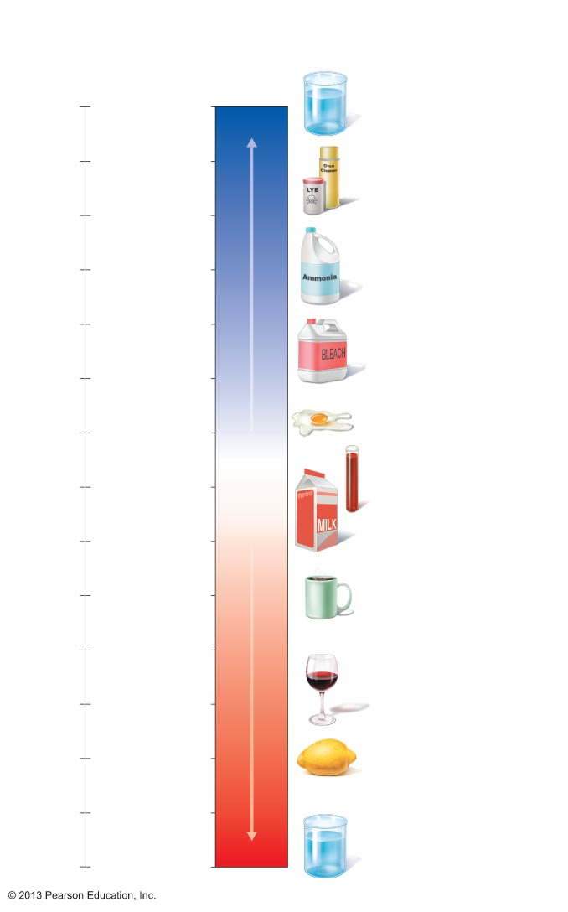
Figure 2.13 The pH scale and pH values of representative substances.
Concentration
(moles/liter)
[OH⁻]
[H⁺]
pH
Examples
10⁰
10⁻¹⁴
14
1M Sodium
hydroxide (pH=14)
10⁻¹
10⁻¹³
13
Oven cleaner, lye
(pH=13.5)
10⁻²
10⁻¹²
12
10⁻³
10⁻¹¹
11
Household ammonia
(pH=10.5–11.5)
Increasingly basic
10⁻⁴
10⁻¹⁰
10
Household bleach
(pH=9.5)
10⁻⁵
10⁻⁹
9
10⁻⁶
10⁻⁸
8
Egg white (pH=8)
7
Blood (pH=7.4)
10⁻⁷
10⁻⁷
Neutral
10⁻⁸
10⁻⁶
6
Milk (pH=6.3–6.6)
10⁻⁹
10⁻⁵
5
Black coffee (pH=5)
10⁻¹⁰
10⁻⁴
4
10⁻¹¹
10⁻³
Increasingly acidic
Wine (pH=2.5–3.5)
3
10⁻¹²
10⁻²
2
Lemon juice; gastric
juice (pH=2)
10⁻¹³
10⁻¹
1
10⁻¹⁴
10⁰
0
1M Hydrochloric
acid (pH=0)

Slide 92
Neutralization
Results from mixing acids and bases
Displacement reactions occur forming water and A salt
Neutralization reaction
Joining of H⁺ and OH– to form water neutralizes solution

Slide 93
Acid-base Homeostasis
pH change interferes with cell function and may damage living tissue
Even slight change in pH can be fatal
pH is regulated by kidneys, lungs, and chemical buffers

Slide 94
Buffers
Acidity reflects only free H⁺ in solution
Not those bound to anions
Buffers resist abrupt and large swings in pH
Release hydrogen ions if pH rises
Bind hydrogen ions if pH falls
Convert strong (completely dissociated) acids or bases into weak (slightly dissociated) ones
Carbonic acid-bicarbonate system (important buffer system of blood):

Slide 95
Organic Compounds
Molecules that contain carbon
Except CO₂ and CO, which are considered inorganic
Carbon is electroneutral
Shares electrons; never gains or loses them
Forms four covalent bonds with other elements
Unique to living systems
Carbohydrates, lipids, proteins, and nucleic acids

Slide 96
Organic Compounds
Many are polymers
Chains of similar units called monomers (building blocks)
Synthesized by dehydration synthesis
Broken down by hydrolysis reactions

Slide 97
Carbohydrates
Sugars and starches
Polymers
Contain C, H, and O
Three classes
Monosaccharides
one sugar
Disaccharides
two sugars
Polysaccharides
many sugars

Slide 98
Carbohydrates
Functions of carbohydrates
Major source of cellular fuel
glucose
Structural molecules
ribose sugar in RNA

Slide 99
Monosaccharides
Simple sugars containing three to seven C atoms
Monomers of carbohydrates
Important monosaccharides
Pentose sugars
Ribose and deoxyribose
Hexose sugars
Glucose (blood sugar)

Slide 100
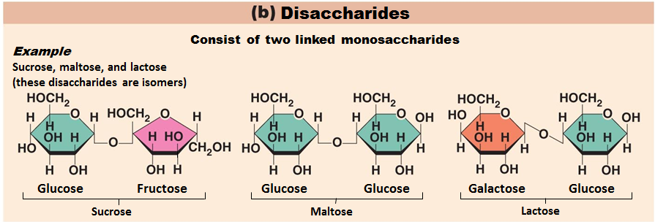
Disaccharides
Double sugars
Too large to pass through cell membranes
Important disaccharides
Sucrose, maltose, lactose

Slide 101
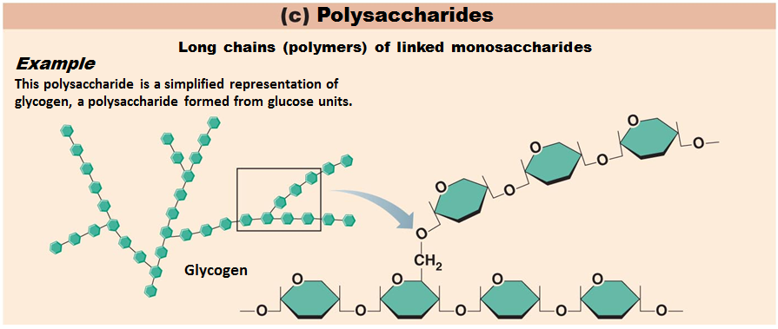
Polysaccharides
Polymers of monosaccharides
Important polysaccharides
Starch and glycogen
Not very soluble

Slide 102
Lipids
Contain C, H, O (less than in carbohydrates), and sometimes P
Insoluble in water
Main types:
Neutral fats or triglycerides
Phospholipids
Steroids
Eicosanoids

Slide 103
Neutral Fats or Triglycerides
Called fats when solid and oils when liquid
Composed of three fatty acids bonded to A glycerol molecule
Main functions
Energy storage
Insulation
Protection

Slide 104
Saturation of Fatty Acids
Saturated fatty acids
Single covalent bonds between C atoms
Maximum number of H atoms
Solid animal fats, e.g., butter
Unsaturated fatty acids
One or more double bonds between C atoms
Reduced number of H atoms
Plant oils, e.g., olive oil
“Heart healthy”
Trans fats – modified oils – unhealthy
Omega-3 fatty acids – “heart healthy”

Slide 105
Phospholipids
Modified triglycerides:
Glycerol + two fatty acids and A phosphorus (P) - containing group
“Head” and “tail” regions have different properties
Important in cell membrane structure

Slide 106
Steroids
Steroids
interlocking four-ring structure
Cholesterol, vitamin D, steroid hormones, and bile salts
Most important steroid
Cholesterol
Important in cell membranes, vitamin D synthesis, steroid hormones, and bile salts

Slide 107
Eicosanoids
Many different ones
Derived from a fatty acid (arachidonic acid) in cell membranes
Most important eicosanoid
Prostaglandins
Role in blood clotting, control of blood pressure, inflammation, and labor contractions

Slide 108
Other Lipids in the Body
Other fat-soluble vitamins
Vitamins A, D, E, and K
Lipoproteins
Transport fats in the blood

Slide 109
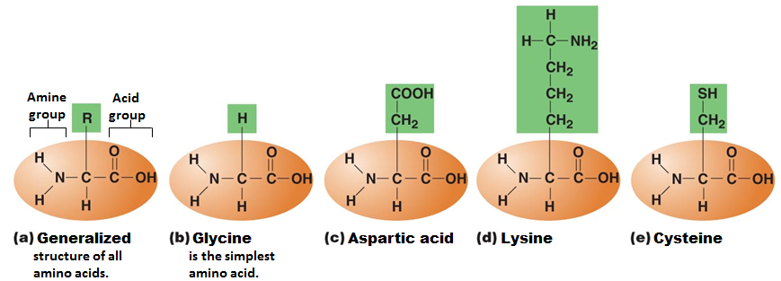
Proteins
Contain C, H, O, N, and sometimes S and P
Proteins are polymers
Amino acids (20 types) are the monomers in proteins
Joined by covalent bonds called peptide bonds
Contain amine group and acid group
Can act as either acid or base
All identical except for “R group” (in green on figure)

Slide 110
Primary Structure of Protein
The order in which the amino acids are arranged

Slide 111
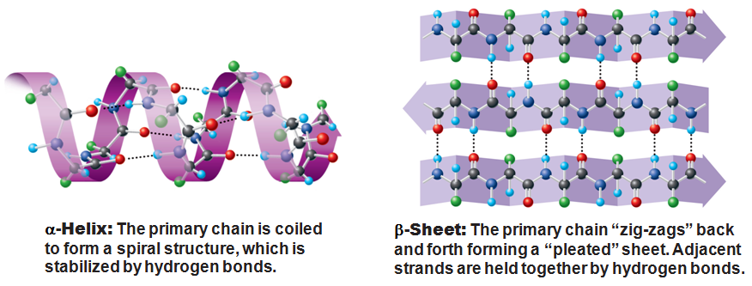
Secondary Structure of Protein
The shapes that the polypeptide chain takes
Coiled or Pleated

Slide 112
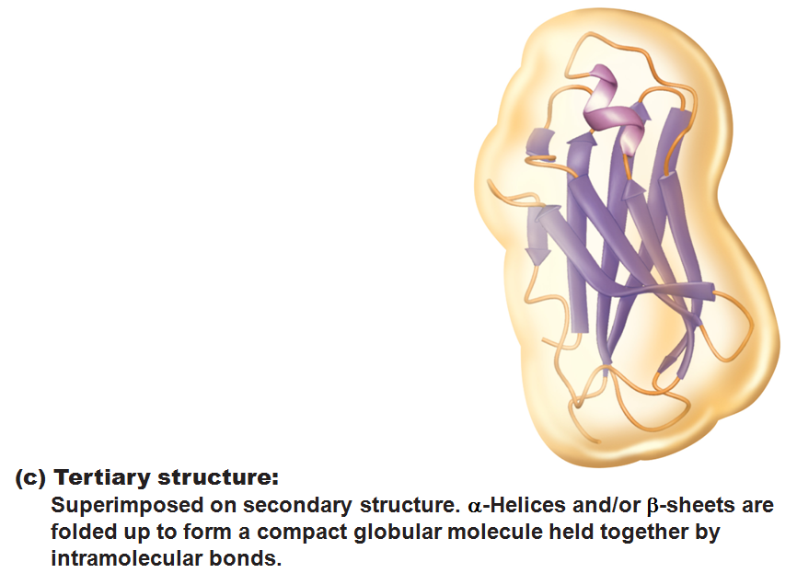
Tertiary Structure of Protein
The three-dimensional shape that the pleats or coils take

Slide 113
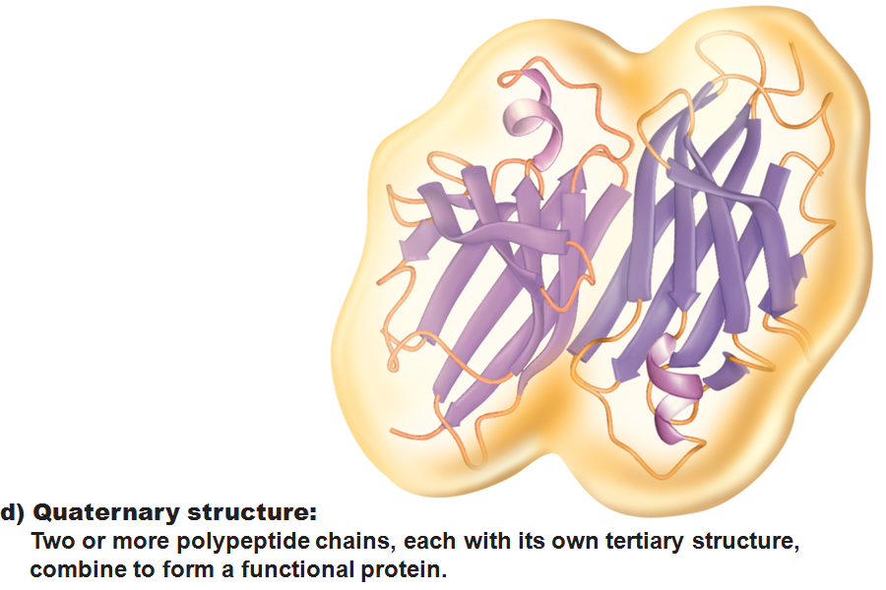
Quaternary Protein
A combination of two or more tertiary proteins
Not all proteins will reach this stage. Some are fully functional at the tertiary stage.

Slide 114
Fibrous and Globular Proteins
Fibrous (structural) proteins
Strandlike, water-insoluble, and stable
Most have tertiary or quaternary structure (3-D)
Provide mechanical support and tensile strength
Examples: keratin, elastin, collagen (single most abundant protein in body), and certain contractile fibers

Slide 115
Fibrous and Globular Proteins
Globular (functional) proteins
Compact, spherical, water-soluble and sensitive to environmental changes
Tertiary or quaternary structure (3-D)
Specific functional regions (active sites)
Examples: antibodies, hormones, molecular chaperones, and enzymes

Slide 116
Protein Denaturation
Denaturation
Globular proteins unfold and lose function
Active sites destroyed
Can be cause by decreased pH or increased temperature
Usually reversible if normal conditions restored
Irreversible if changes extreme
e.g., cooking an egg

Slide 117
Enzymes
Enzymes
Globular proteins that act as biological catalysts
Regulate and increase speed of chemical reactions
Lower the activation energy, increase the speed of a reaction
millions of reactions per minute

Slide 118
Please note that due to differing operating systems, some animations will not appear until the presentation is viewed in Presentation Mode (Slide Show view). You may see blank slides in the “Normal” or “Slide Sorter” views. All animations will appear after viewing in Presentation Mode and playing each animation. Most animations will require the latest version of the Flash Player, which is available at http://get.adobe.com/flashplayer.

Slide 119
Characteristics of Enzymes
Enzymes are specific
Act on specific substrate
Usually end in -ase
Often named for the reaction they catalyze
Hydrolases, oxidases

Slide 120
Nucleic Acids
Deoxyribonucleic acid (DNA) and ribonucleic acid (RNA)
Largest molecules in the body
Contain C, O, H, N, and P
Polymers
Monomer = nucleotide
Composed of nitrogen base, a pentose sugar, and a phosphate group

Slide 121
Deoxyribonucleic Acid (DNA)
Utilizes four nitrogen bases:
Purines: Adenine (A), Guanine (G)
Pyrimidines: Cytosine (C), and Thymine (T)
Base-pair rule
each base pairs with its complementary base
A always pairs with T; G always pairs with C
Double-stranded helical molecule in the cell nucleus
Pentose sugar is deoxyribose
Provides instructions for protein synthesis
Replicates before cell division ensuring genetic continuity

Slide 122
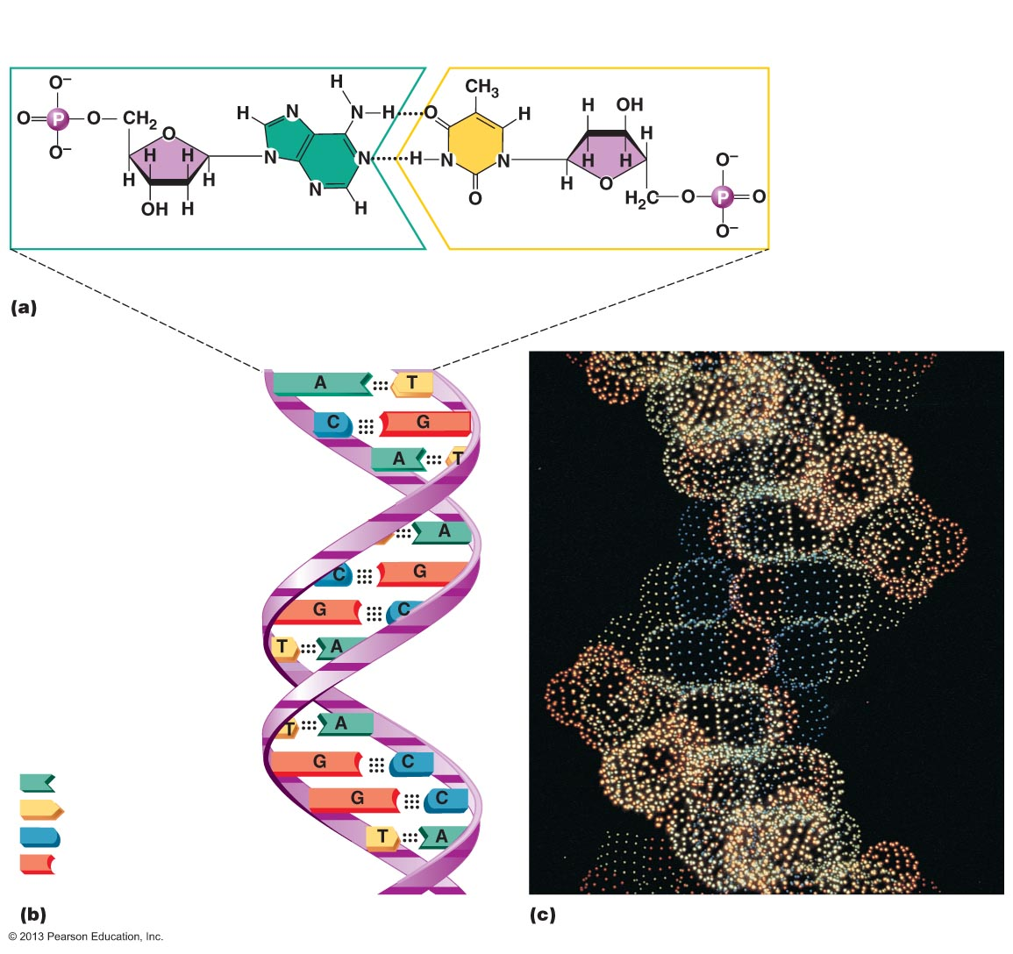
Figure 2.22 Structure of DNA.
Phosphate
Sugar:
Deoxyribose
Base:
Adenine (A)
Thymine (T)
Sugar
Phosphate
Adenine nucleotide
Thymine nucleotide
Hydrogen
bond
Deoxyribose
sugar
Sugar-
phosphate
backbone
Phosphate
Adenine (A)
Thymine (T)
Cytosine (C)
Guanine (G)

Slide 123
Ribonucleic Acid (RNA)
Four bases:
Adenine (A), Guanine (G), Cytosine (C), and Uracil (U)
Pentose sugar is ribose
Single-stranded molecule mostly active outside the nucleus
Three varieties of RNA carry out the DNA orders for protein synthesis
Messenger RNA (mRNA),
Transfer RNA (tRNA),
Ribosomal RNA (rRNA)

Slide 124
Adenosine Triphosphate (ATP)
Chemical energy in glucose captured in this important molecule
Directly powers chemical reactions in cells
Energy form immediately useable by all body cells
Structure of ATP
Adenine-containing RNA nucleotide with two additional phosphate groups

Slide 125
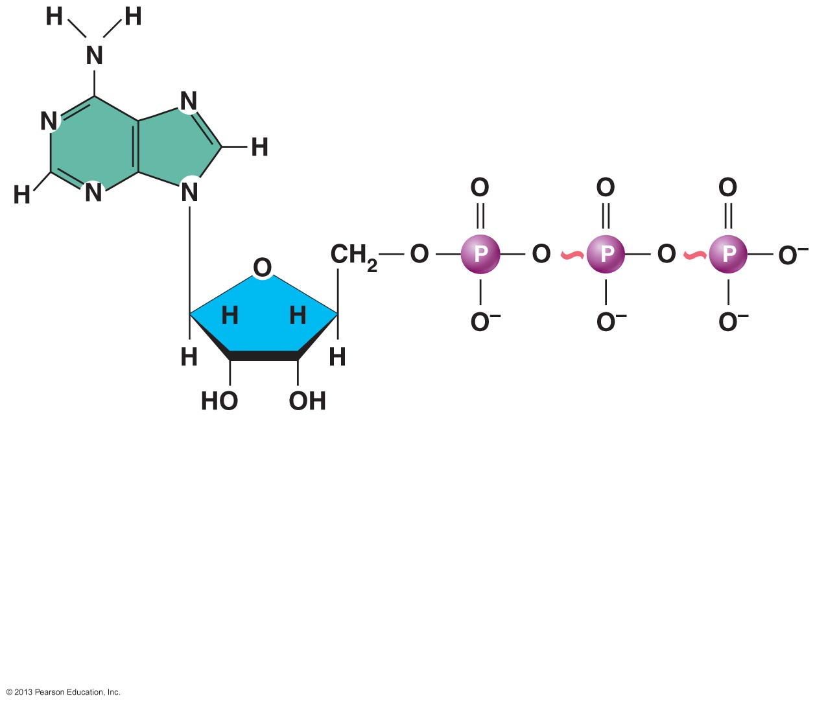
Figure 2.23 Structure of ATP (adenosine triphosphate).
High-energy phosphate
bonds can be hydrolyzed
to release energy.
Adenine
Phosphate groups
Ribose
Adenosine
Adenosine monophosphate (AMP)
Adenosine diphosphate (ADP)
Adenosine triphosphate (ATP)

Slide 126
Cell Theory
The cell is the smallest structural and functional living unit
Organismal functions depend on individual and collective cell functions
Biochemical activities of cells are dictated by their specific subcellular structures
Continuity of life has a cellular basis

Slide 127
Cell Diversity
Over 200 different types of human cells
Types differ in size, shape, subcellular components, and functions

Slide 128
Generalized Cell
All cells have some common structures and functions
Human cells have three basic parts:
Plasma membrane
flexible outer boundary
Cytoplasm
intracellular fluid containing organelles
Nucleus
control center

Slide 129
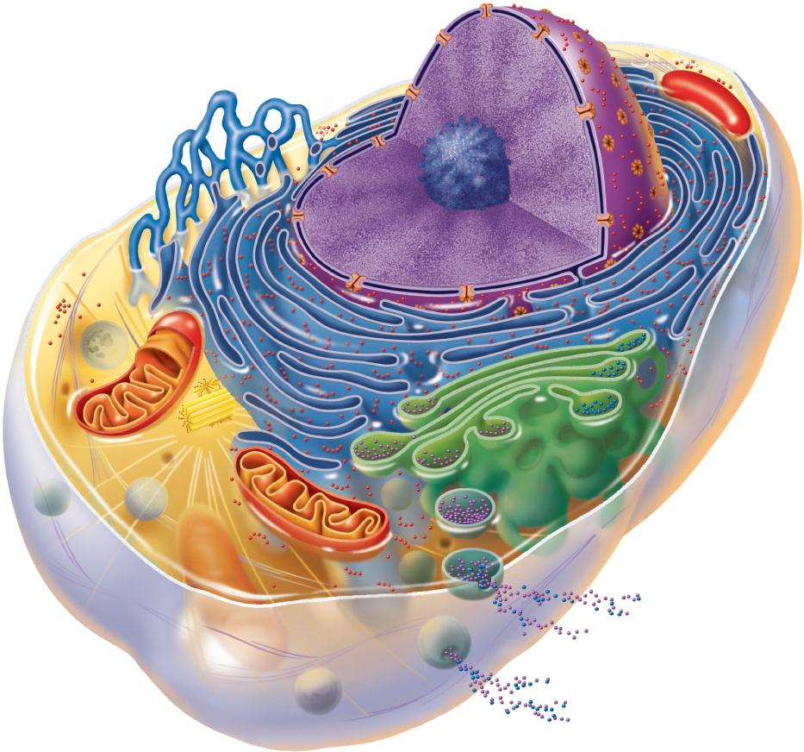
Chromatin
Nuclear envelope
Nucleolus
Nucleus
Smooth endoplasmic
reticulum
Plasma
membrane
Mitochondrion
Cytosol
Lysosome
Centrioles
Centrosome
matrix
Rough
endoplasmic
reticulum
Ribosomes
Golgi apparatus
Cytoskeletal
elements
• Microtubule
• Intermediate
filaments
Secretion being
released from cell
by exocytosis
Peroxisome
Figure 3.2

Slide 130
Plasma Membrane
Bimolecular layer of lipids and proteins in a constantly changing fluid mosaic
Plays a dynamic role in cellular activity
Separates intracellular fluid (ICF) from extracellular fluid (ECF)

Slide 131
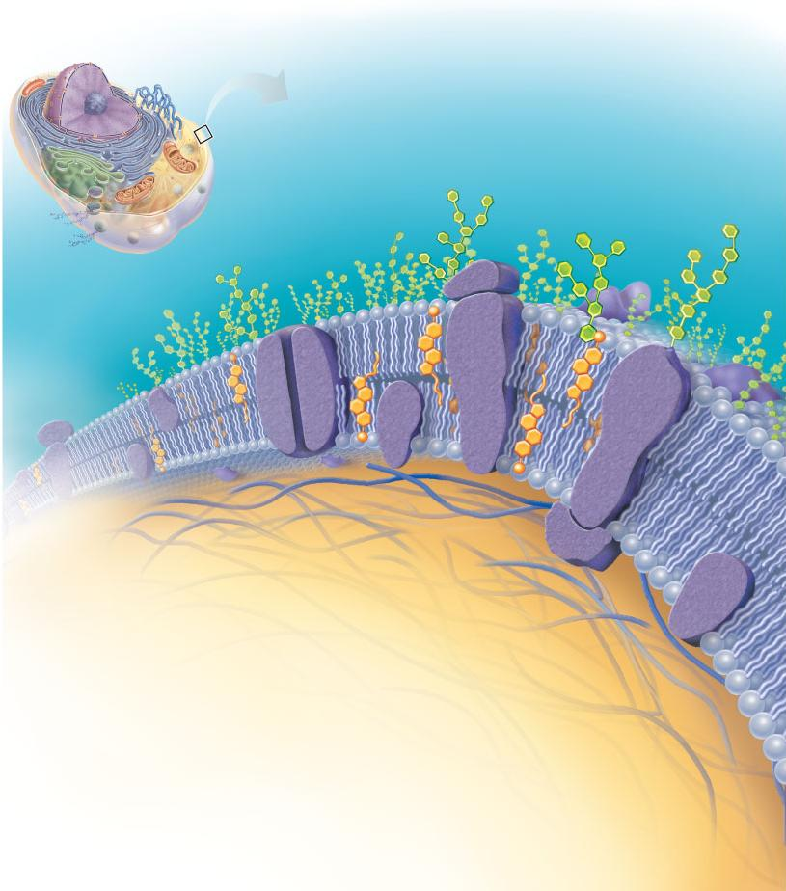
Extracellular fluid
(watery environment)
Polar head of
phospholipid
molecule
Cholesterol
Glycolipid
Glycoprotein
Carbohydrate
of glycocalyx
Outward-
facing
layer of
phospholipids
Integral
proteins
Filament of
cytoskeleton
Inward-facing
layer of
phospholipids
Bimolecular
lipid layer
containing
proteins
Peripheral
proteins
Nonpolar
tail of
phospholipid
molecule
Cytoplasm
(watery environment)
Figure 3.3

Slide 132
Membrane Proteins
Integral proteins
Firmly inserted into the membrane (most are transmembrane)
Functions:
Transport proteins (channels and carriers), enzymes, or receptors

Slide 133
Membrane Proteins
Peripheral proteins
Loosely attached to integral proteins
Include filaments on intracellular surface and glycoproteins on extracellular surface
Functions:
Enzymes, motor proteins, cell-to-cell links, provide support on intracellular surface, and form part of glycocalyx

Slide 134
Functions of Membrane Proteins
Transport
Receptors for signal transduction
Attachment to cytoskeleton and extracellular matrix

Slide 135
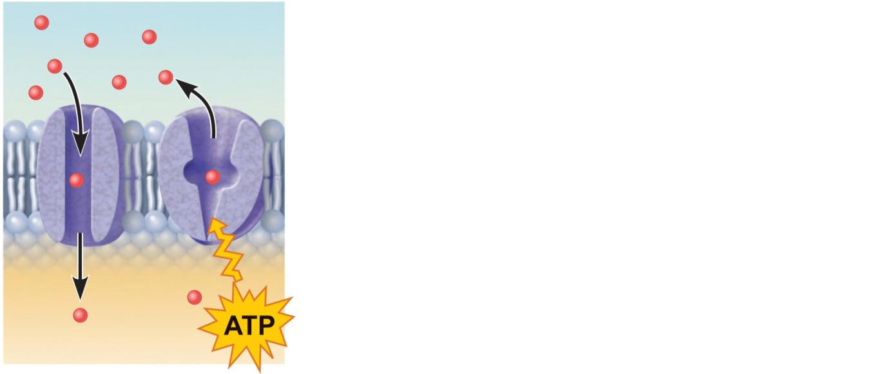
(a) Transport
A protein (left) that spans the membrane
may provide a hydrophilic channel across
the membrane that is selective for a
particular solute. Some transport proteins
(right) hydrolyze ATP as an energy source
to actively pump substances across the
membrane.
Figure 3.4a

Slide 136
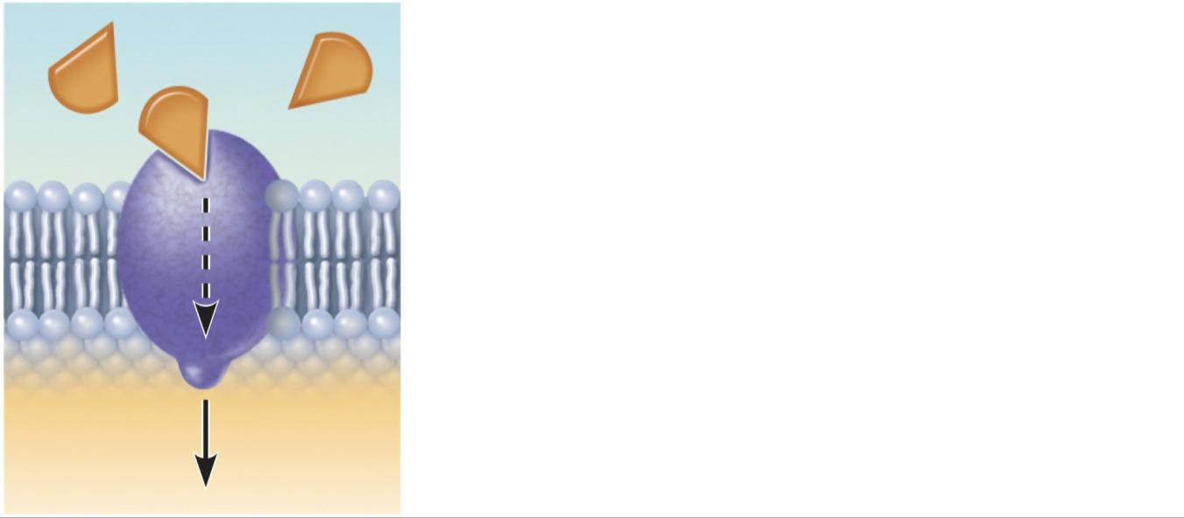
(b) Receptors for signal transduction
Signal
A membrane protein exposed to the
outside of the cell may have a binding
site with a specific shape that fits the
shape of a chemical messenger, such
as a hormone. The external signal may
cause a change in shape in the protein
that initiates a chain of chemical
reactions in the cell.
Receptor
Figure 3.4b

Slide 137
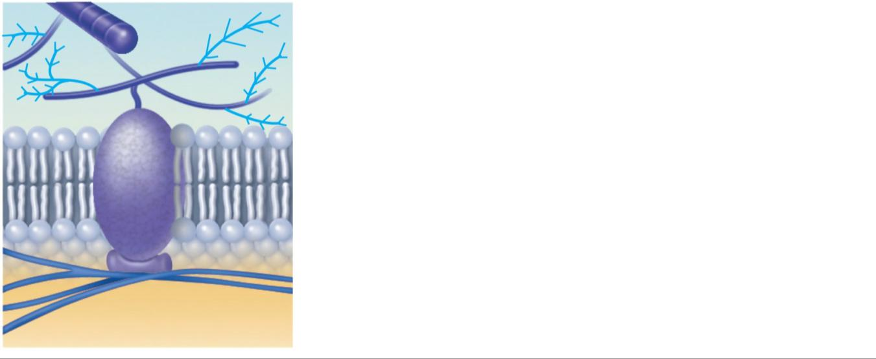
(c) Attachment to the cytoskeleton
and extracellular matrix (ECM)
Elements of the cytoskeleton (cell’s
internal supports) and the extracellular
matrix (fibers and other substances
outside the cell) may be anchored to
membrane proteins, which help maintain
cell shape and fix the location of certain
membrane proteins. Others play a role in
cell movement or bind adjacent cells
together.
Figure 3.4c

Slide 138
Functions of Membrane Proteins
Enzymatic activity
Intercellular joining
Cell-cell recognition

Slide 139
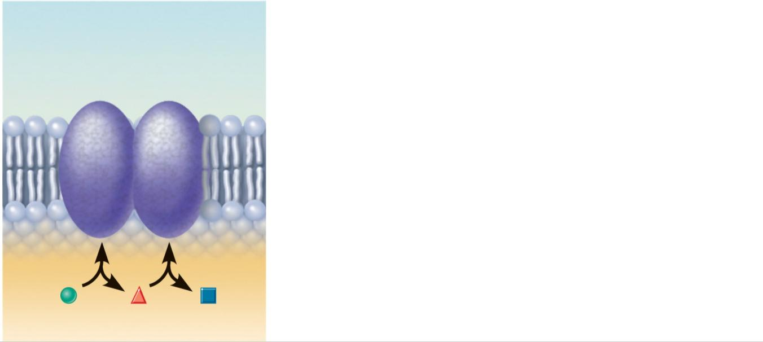
(d) Enzymatic activity
Enzymes
A protein built into the membrane may
be an enzyme with its active site
exposed to substances in the adjacent
solution. In some cases, several
enzymes in a membrane act as a team
that catalyzes sequential steps of a
metabolic pathway as indicated (left to
right) here.
Figure 3.4d

Slide 140
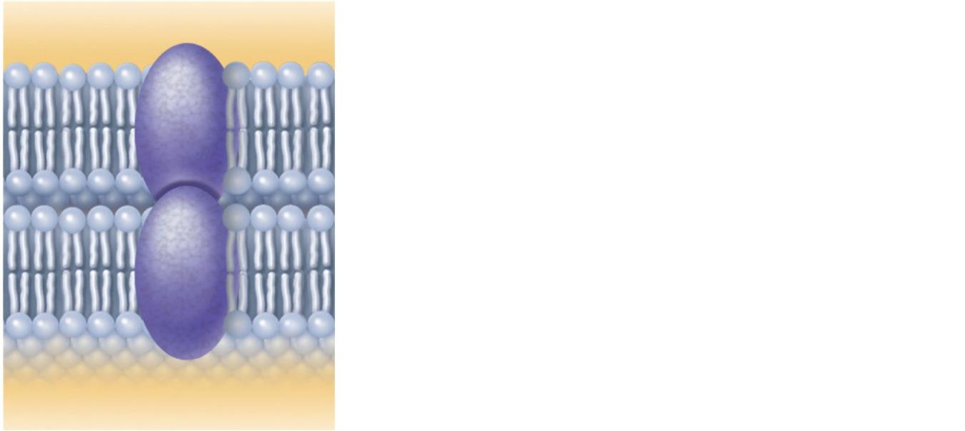
(e) Intercellular joining
Membrane proteins of adjacent cells
may be hooked together in various
kinds of intercellular junctions. Some
membrane proteins (CAMs) of this
group provide temporary binding sites
that guide cell migration and other
cell-to-cell interactions.
CAMs
Figure 3.4e

Slide 141
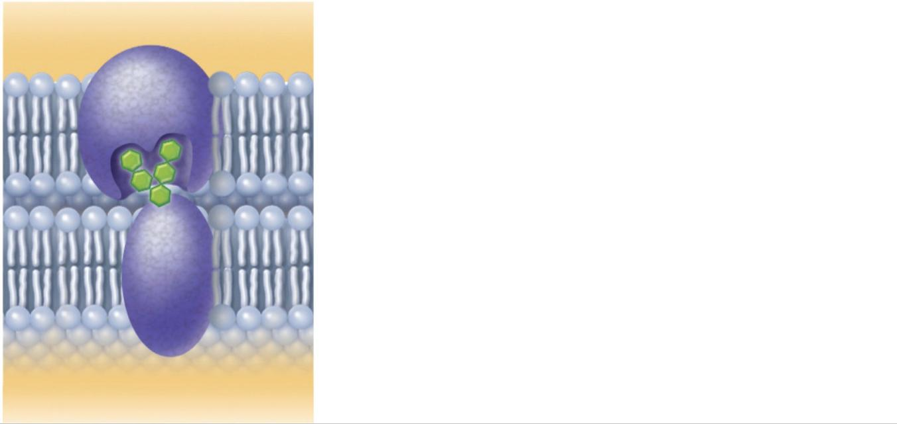
(f) Cell-cell recognition
Some glycoproteins (proteins bonded
to short chains of sugars) serve as
identification tags that are specifically
recognized by other cells.
Glycoprotein
Figure 3.4f

Slide 142
Membrane Junctions
Three types:
Tight junction
Desmosome
Gap junction

Slide 143
Membrane Junctions: Tight Junctions
Prevent fluids and most molecules from moving between cells

Slide 144
Membrane Junctions: Desmosomes
“Rivets” or “spot-welds” that anchor cells together

Slide 145
Membrane Junctions: Gap Junctions
Transmembrane proteins form pores that allow small molecules to pass from cell to cell
For spread of ions between cardiac or smooth muscle cells

Slide 146
Membrane Transport
Plasma membranes are selectively permeable
Some molecules easily pass through the membrane; others do not

Slide 147
Types of Membrane Transport
Passive processes
No cellular energy (ATP) required
Substance moves down its concentration gradient
Active processes
Energy (ATP) required
Occurs only in living cell membranes

Slide 148
Passive Processes
Simple diffusion
Carrier-mediated facilitated diffusion
Channel-mediated facilitated diffusion
Osmosis

Slide 149
Passive Processes: Simple Diffusion
Nonpolar lipid-soluble (hydrophobic) substances diffuse directly through the phospholipid bilayer

Slide 150
Diffusion
Please note that due to differing operating systems, some animations will not appear until the presentation is viewed in Presentation Mode (Slide Show view). You may see blank slides in the “Normal” or “Slide Sorter” views. All animations will appear after viewing in Presentation Mode and playing each animation. Most animations will require the latest version of the Flash Player, which is available at http://get.adobe.com/flashplayer.

Slide 151
Passive Processes: Facilitated Diffusion
Certain lipophobic molecules (e.g., glucose, amino acids, and ions) use carrier proteins or channel proteins, both of which:
Exhibit specificity (selectivity)
Are saturable; rate is determined by number of carriers or channels
Can be regulated in terms of activity and quantity

Slide 152
Facilitated Diffusion Using Carrier Proteins
Transmembrane integral proteins transport specific polar molecules (e.g., sugars and amino acids)
Binding of substrate causes shape change in carrier

Slide 153
Facilitated Diffusion Using Channel Proteins
Aqueous channels formed by transmembrane proteins selectively transport ions or water
Two types:
Leakage channels
Always open
Gated channels
Controlled by chemical or electrical signals

Slide 154
Facilitated Diffusion
Please note that due to differing operating systems, some animations will not appear until the presentation is viewed in Presentation Mode (Slide Show view). You may see blank slides in the “Normal” or “Slide Sorter” views. All animations will appear after viewing in Presentation Mode and playing each animation. Most animations will require the latest version of the Flash Player, which is available at http://get.adobe.com/flashplayer.

Slide 155
Passive Processes: Osmosis
Movement of solvent (water) across a selectively permeable membrane
Water diffuses through plasma membranes:
Through the lipid bilayer

Slide 156
Passive Processes: Osmosis
Water concentration is determined by solute concentration because solute particles displace water molecules
When solutions of different osmolarity are separated by a membrane, osmosis occurs until equilibrium is reached

Slide 157
Tonicity
Tonicity: The ability of a solution to cause a cell to shrink or swell
Isotonic:
A solution with the same solute concentration as that of the cytosol
Hypertonic:
A solution having greater solute concentration than that of the cytosol
Hypotonic:
A solution having lesser solute concentration than that of the cytosol

Slide 158
Osmosis
Please note that due to differing operating systems, some animations will not appear until the presentation is viewed in Presentation Mode (Slide Show view). You may see blank slides in the “Normal” or “Slide Sorter” views. All animations will appear after viewing in Presentation Mode and playing each animation. Most animations will require the latest version of the Flash Player, which is available at http://get.adobe.com/flashplayer.

Slide 159
Membrane Transport: Active Processes
Two types of active processes:
Active transport
Vesicular transport
Both use ATP to move solutes across a living plasma membrane

Slide 160
Active Transport
Requires carrier proteins (solute pumps)
Moves solutes against a concentration gradient

Slide 161
Vesicular Transport
Transport of large particles, macromolecules, and fluids across plasma membranes
Requires cellular energy (e.g., ATP)

Slide 162
Vesicular Transport
Functions:
Exocytosis
transport out of cell
Endocytosis
transport into cell
Phagocytosis
Pinocytosis
Transcytosis
transport into, across, and then out of cell
Substance (vesicular) trafficking
transport from one area or organelle in cell to another

Slide 163
Endocytosis and Transcytosis
Involve formation of protein-coated vesicles
Often receptor mediated, therefore very selective

Slide 164
Endocytosis
Phagocytosis “cell eating”
pseudopods engulf solids and bring them into cell’s interior
Macrophages and some white blood cells
Pinocytosis “cell drinking”
plasma membrane in-folds, bringing extracellular fluid and solutes into interior of the cell
Nutrient absorption in the small intestine

Slide 165
Exocytosis
Examples:
Hormone secretion
Neurotransmitter release
Mucus secretion
Ejection of wastes

Slide 166
Cytoplasm
Cytoplasm
material between plasma membrane and the nucleus
Cytosol
largely water with dissolved protein, salts, sugars, and other solutes

Slide 167
Cytoplasm
Cytoplasmic organelles
metabolic machinery of the cell
Inclusions
chemical substances such as glycosomes, glycogen granules, and pigment

Slide 168
Cytoplasmic Organelles
Specialized cellular compartments
Membranous
Mitochondria, peroxisomes, lysosomes, endoplasmic reticulum, and Golgi apparatus
Nonmembranous
Cytoskeleton, centrioles, and ribosomes

Slide 169
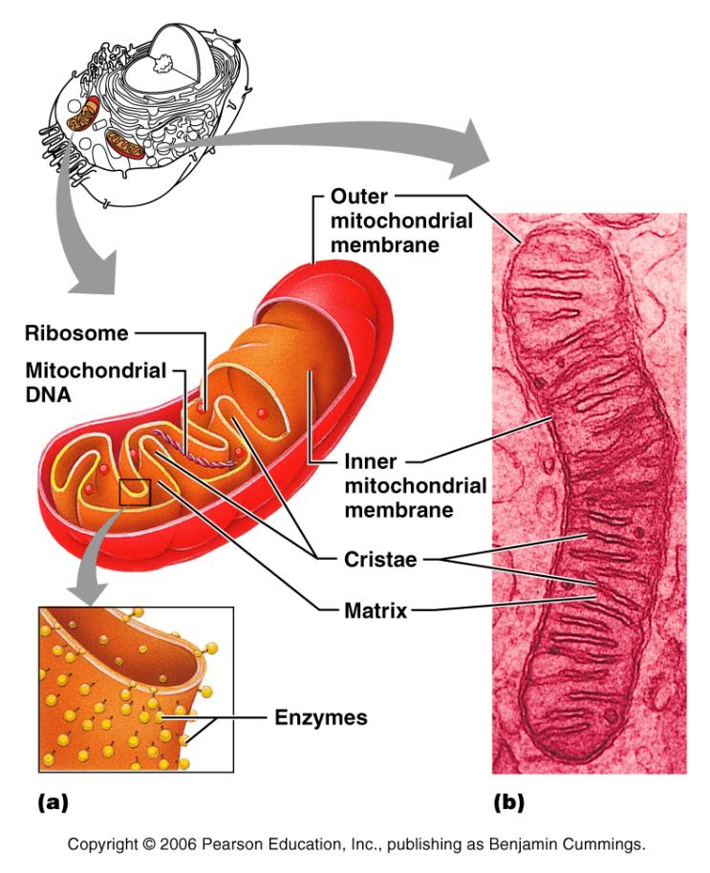
Mitochondria
Double membrane structure with shelf-like cristae
Provide most of the cell’s ATP via aerobic cellular respiration
Contain their own DNA and RNA

Slide 170
Ribosomes
Granules containing protein and rRNA
Site of protein synthesis
Free ribosomes synthesize soluble proteins
Membrane-bound ribosomes synthesize proteins to be incorporated into membranes

Slide 171
Endoplasmic Reticulum (ER)
Interconnected tubes and parallel membranes enclosing cisternae
Continuous with the nuclear membrane
Two varieties
rough ER
smooth ER

Slide 172
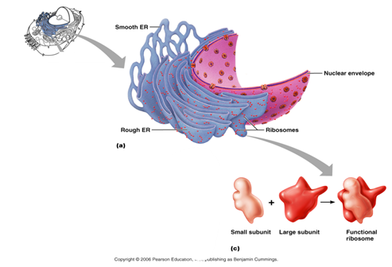
Rough (ER)
External surface studded with ribosomes
Manufactures all secreted proteins
Responsible for the synthesis of integral membrane proteins and phospholipids for cell membranes

Slide 173
Smooth ER
Tubules arranged in a looping network
Catalyzes the following reactions in various organs of the body
In the liver
lipid and cholesterol metabolism
breakdown of glycogen
detoxification of drugs
In the testes
synthesis of steroid-based hormones: testosterone

Slide 174
Golgi Apparatus
Stacked and flattened membranous sacs
Functions in
Modification
Concentration
Packaging of proteins
Transport vessels from the ER fuse with the cis face of the Golgi apparatus

Slide 175
Golgi Apparatus
Proteins then pass through the Golgi apparatus to the trans face
Secretory vesicles leave the trans face of the Golgi stack and move to designated parts of the cell

Slide 176
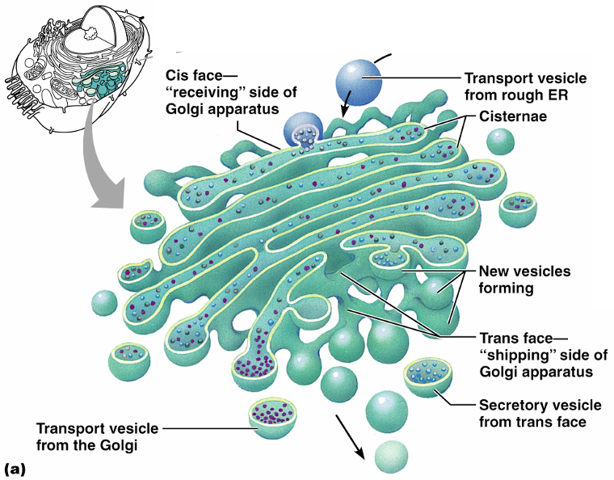

Slide 177
Lysosomes
Spherical membranous bags containing digestive enzymes
Digest ingested bacteria, viruses, and toxins
Degrade nonfunctional organelles
Breakdown nonuseful tissue
Breakdown bone to release Ca²⁺
Secretory lysosomes are found in white blood cells, immune cells, and melanocytes

Slide 178
Peroxisomes
Membranous sacs containing oxidases and catalases
Detoxify harmful or toxic substances
Neutralize dangerous free radicals
Free radicals – highly reactive chemicals with unpaired electrons (i.e., O₂–)

Slide 179
Cytoskeleton
The “skeleton” of the cell
Dynamic, elaborate series of rods running through the cytosol
Consists of microtubules, microfilaments, and intermediate filaments

Slide 180
Centrioles
Small barrel-shaped organelles located in the centrosome near the nucleus
Pinwheel array of nine triplets of microtubules
Organize mitotic spindle during mitosis
Form the bases of cilia and flagella

Slide 181
Cilia
Whip-like, motile cellular extensions on exposed surfaces of certain cells
Move substances in one direction across cell surfaces

Slide 182
Nucleus
Contains nuclear envelope, nucleoli, chromatin
Gene-containing control center of the cell
Contains the genetic library with blueprints for nearly all cellular proteins
Dictates the kinds and amounts of proteins to be synthesized

Slide 183
Figure 3.28a

Slide 184
Nuclear Envelope
Selectively permeable double membrane barrier containing pores
Encloses jellylike nucleoplasm

Slide 185
Nuclear Envelope
Outer membrane is continuous with the rough ER and is studded with ribosomes
Inner membrane is lined with the nuclear lamina,
which maintains the shape of the nucleus
Pore complex regulates transport of large molecules into and out of the nucleus

Slide 186
Nucleoli
Dark-staining spherical bodies within the nucleus
Site of ribosome production

Slide 187
Chromatin
Threadlike strands of DNA and histones
Form condensed, barlike bodies of chromosomes when the nucleus starts to divide

Slide 188
Cell Cycle
Interphase
Growth (G₁), synthesis (S), growth (G₂)
Mitotic phase
Mitosis and cytokinesis
Figure 3.30

Slide 189
Interphase: DNA Replication
DNA helices begin unwinding from the nucleosomes
Helicase untwists the double helix and exposes complementary strands
Each nucleotide strand serves as a template for building a new complementary strand

Slide 190
DNA Replication
uses RNA primers to begin DNA synthesis
DNA polymerase III continues from the primer and adds complementary nucleotides to the template

Slide 191
DNA Replication
Since DNA polymerase only works in one direction:
A continuous leading strand is synthesized
A discontinuous lagging strand is synthesized
DNA ligase splices together the short segments of the discontinuous strand
Two new telomeres are also synthesized
This process is called semiconservative replication

Slide 192
DNA Replication
Figure 3.31

Slide 193
Cell Division
Essential for body growth and tissue repair
Mitosis
nuclear division
Cytokinesis
division of the cytoplasm

Slide 194
Mitosis
The phases of mitosis are:
Prophase
Metaphase
Anaphase
Telophase

Slide 195
Cytokinesis
Cleavage furrow formed in late anaphase by contractile ring
Cytoplasm is pinched into two parts after mitosis ends

Slide 196
Early and Late Prophase
Asters are seen as chromatin condenses into chromosomes
Nucleoli disappear
Centriole pairs separate and the mitotic spindle is formed

Slide 197
Metaphase
Chromosomes cluster at the middle of the cell with their centromeres aligned at the exact center, or equator, of the cell
This arrangement of chromosomes along a plane midway between the poles is called the metaphase plate

Slide 198
Anaphase
Centromeres of the chromosomes split
Motor proteins in kinetochores pull chromosomes toward poles

Slide 199
Telophase and Cytokinesis
New sets of chromosomes extend into chromatin
New nuclear membrane is formed from the rough ER
Nucleoli reappear
Generally cytokinesis completes cell division

Slide 200
Control of Cell Division
Surface-to-volume ratio of cells
Chemical signals such as growth factors and hormones
Contact inhibition
Cyclins and cyclin-dependent kinases (Cdks) complexes

Slide 201
Protein Synthesis
DNA serves as master blueprint for protein synthesis
Genes are segments of DNA carrying instructions for a polypeptide chain
Triplets of nucleotide bases form the genetic library
Each triplet specifies coding for an amino acid

Slide 202
Nuclear
envelope
Transcription
DNA
Pre-mRNA
RNA Processing
mRNA
Ribosome
Translation
Polypeptide
Figure 3.33

Slide 203
From DNA to Protein
DNA
Figure 3.33

Slide 204
From DNA to Protein
Transcription
DNA
Figure 3.33

Slide 205
From DNA to Protein
Transcription
DNA
Pre-mRNA
RNA Processing
mRNA
Figure 3.33

Slide 206
From DNA to Protein
Nuclear
envelope
Transcription
DNA
Pre-mRNA
RNA Processing
mRNA
Figure 3.33

Slide 207
From DNA to Protein
Nuclear
envelope
Transcription
DNA
Pre-mRNA
RNA Processing
mRNA
Ribosome
Translation
Polypeptide
Figure 3.33

Slide 208
Roles of the Three Types of RNA
Messenger RNA (mRNA)
carries the genetic information from DNA in the nucleus to the ribosomes in the cytoplasm
Transfer RNAs (tRNAs)
bound to amino acids base pair with the codons of mRNA at the ribosome to begin the process of protein synthesis
Ribosomal RNA (rRNA)
a structural component of ribosomes

Slide 209
Transcription
Transfer of information from the sense strand of DNA to RNA

Slide 210
Transcription: RNA Polymerase
An enzyme that oversees the synthesis of RNA
Unwinds the DNA template
Adds complementary ribonucleoside triphosphates on the DNA template
Joins these RNA nucleotides together
Encodes a termination signal to stop transcription

Slide 211
Genetic Code
RNA codons code for amino acids according to a genetic code
Figure 3.35

Slide 212
Information Transfer from DNA to RNA
DNA triplets are transcribed into mRNA codons by RNA polymerase
Codons base pair with tRNA anticodons at the ribosomes
Amino acids are peptide bonded at the ribosomes to form polypeptide chains
Start and stop codons are used in initiating and ending translation

Slide 214
4
Tissue: The Living Fabric

Slide 215
Tissues
Groups of cells similar in structure and function
The four types of tissues
Epithelial
Connective
Muscle
Nerve

Slide 216
Epithelial Membranes
Cutaneous
skin
Mucus
lines body cavities open to the exterior (e.g., digestive and respiratory tracts)
Serous
moist membranes found in closed ventral body cavity

Slide 217
Epithelial Tissue
Cellularity
composed almost entirely of cells
Special contacts
form continuous sheets held together by tight junctions and desmosomes

Slide 218
Epithelial Tissue
Supported by connective tissue
reticular and basal laminae
Avascular but innervated
contains no blood vessels but supplied by nerve fibers
Regenerative
rapidly replaces lost cells by cell division

Slide 219
Classification of Epithelia
Simple or stratified
Squamous, cuboidal, or columnar

Slide 220
Epithelia: Simple Squamous
Single layer of flattened cells
disc-shaped nuclei
little cytoplasm
Functions
Diffusion and filtration
Provide a slick, friction-reducing lining in lymphatic and cardiovascular systems
Present in the kidney glomeruli, lining of heart, blood vessels, lymphatic vessels, and serosa

Slide 221
Epithelia: Simple Cuboidal
Single layer of cube-like cells with large, spherical central nuclei
Function in secretion and absorption
Present in kidney tubules, ducts and secretory portions of small glands, and ovary surface

Slide 222
Epithelia: Simple Columnar
Single layer of tall cells with oval nuclei
many contain cilia
Goblet cells are often found in this layer
Function in absorption and secretion
Nonciliated type line
digestive tract
gallbladder
Ciliated type line
small bronchi
uterine tubes
some regions of the uterus
Cilia help move substances through internal passageways

Slide 223
Epithelia: Pseudostratified Columnar
Single layer of cells with different heights; some do not reach the free surface
Nuclei are seen at different layers
Function in
secretion
propulsion of mucus
Present in the
male sperm-carrying ducts (nonciliated)
trachea (ciliated)

Slide 224
Epithelia: Stratified Squamous
Thick membrane composed of several layers of cells
Function in protection of underlying areas subjected to abrasion
external part of the skin’s epidermis
keratinized cells
linings of the esophagus, mouth, and vagina
Non-keratinized cells

Slide 225
Epithelia: Stratified Cuboidal and Columnar
Stratified cuboidal
Quite rare in the body
Found in some sweat and mammary glands
Typically two cell layers thick

Slide 226
Epithelia: Stratified Cuboidal and Columnar
Stratified columnar
Limited distribution in the body
Found in the pharynx, male urethra, and lining some glandular ducts
Also occurs at transition areas between two other types of epithelia

Slide 227
Epithelia: Transitional
Several cell layers, basal cells are cuboidal, surface cells are dome shaped
Stretches to permit the distension of the urinary bladder
Lines the urinary bladder, ureters, and part of the urethra

Slide 228
Epithelia: Glandular
A gland is one or more cells that makes and secretes an aqueous fluid
Classified by:
Site of product release
endocrine or exocrine
Relative number of cells forming the gland
unicellular or multicellular

Slide 229
Endocrine Glands
Ductless glands that produce hormones
Secretions include amino acids, proteins, glycoproteins, and steroids

Slide 230
Exocrine Glands
Secrete products
onto body surfaces
into body cavities
Examples include
mucus, sweat, oil, and salivary glands
The only important unicellular gland is the goblet cell
Multicellular exocrine glands are composed of a duct and secretory unit

Slide 231
Modes of Secretion
Merocrine
products are secreted by exocytosis (e.g., pancreas, sweat, and salivary glands)
Holocrine
products are secreted by the rupture of gland cells (e.g., sebaceous glands)

Slide 232
Connective Tissue
Found throughout the body; most abundant and widely distributed in primary tissues
Connective tissue proper
Cartilage
Bone
Blood

Slide 233
Functions of Connective Tissue
Binding and support
Protection
Insulation
Transportation

Slide 234
Characteristics of Connective Tissue
Connective tissues have:
Varying degrees of vascularity
Nonliving extracellular matrix, consisting of ground substance and fibers

Slide 235
Structural Elements of Connective Tissue
Ground substance
unstructured material that fills the space between cells
Fibers
collagen, elastic, or reticular
Cells
fibroblasts, chondroblasts, osteoblasts, and hematopoietic stem cells

Slide 236
Ground Substance
Interstitial (tissue) fluid
Adhesion proteins
Proteoglycans
Functions as a molecular sieve through which nutrients diffuse between blood capillaries and cells

Slide 237
Fibers
Collagen
tough; provides high tensile strength
Elastic
long, thin fibers that allow for stretch
Reticular
branched collagenous fibers that form delicate networks

Slide 238
Cells
Fibroblasts
connective tissue proper
Chondroblasts
cartilage
Osteoblasts
bone
Hematopoietic stem cells
blood
White blood cells, plasma cells, macrophages, and mast cells

Slide 239
Connective Tissue Proper: Loose
Areolar connective tissue
Gel-like matrix with all three connective tissue fibers
Fibroblasts, macrophages, mast cells, and some white blood cells
Wraps and cushions organs
Widely distributed throughout the body

Slide 240
Connective Tissue Proper: Loose
Adipose connective tissue
closely packed adipocytes
Reserves food stores,
insulates against heat loss
supports and protects
Found under skin, around kidneys, within abdomen, and in breasts
Local fat deposits serve nutrient needs of highly active organs

Slide 241
Connective Tissue Proper: Loose
Reticular connective tissue
Loose ground substance with reticular fibers
Reticular cells lie in a fiber network
Forms a soft internal skeleton, or stroma, that supports other cell types
Found in lymph nodes, bone marrow, and the spleen

Slide 242
Connective Tissue Proper: Dense Regular
Parallel collagen fibers
a few elastic fibers
Major cell type is fibroblasts
Attaches muscles to bone or to other muscles, and bone to bone
Found in tendons
ligaments
aponeuroses

Slide 243
Connective Tissue Proper: Dense Irregular
Irregularly arranged collagen fibers with some elastic fibers
Major cell type is fibroblasts
Withstands tension in many directions providing structural strength
Found in the dermis, submucosa of the digestive tract, and fibrous organ capsules

Slide 244
Connective Tissue: Hyaline Cartilage
Amorphous, firm matrix
network of collagen fibers
Chondrocytes lie in lacunae
Supports
reinforces
cushions
resists compression
Forms the costal cartilage
Found in embryonic skeleton, the end of long bones, nose, trachea, and larynx

Slide 245
Connective Tissue: Elastic Cartilage
Similar to hyaline cartilage but with more elastic fibers
Maintains shape and structure while allowing flexibility
Supports external ear (pinna) and the epiglottis

Slide 246
Connective Tissue: Fibrocartilage Cartilage
Matrix similar to hyaline cartilage
less firm
thick collagen fibers
Provides tensile strength and absorbs compression shock
Found in intervertebral discs, the pubic symphysis, and in discs of the knee joint

Slide 247
Connective Tissue: Bone (Osseous Tissue)
Hard, calcified matrix with collagen fibers
Osteocytes are found in lacunae and are well vascularized
Supports, protects, and provides levers for muscular action
Stores calcium, minerals, and fat
Marrow inside bones is the site of hematopoiesis

Slide 248
Connective Tissue: Blood
Red and white cells in a fluid matrix (plasma)
Contained within blood vessels
Functions in the transport of respiratory gases, nutrients, and wastes

Slide 249
Nervous Tissue
Branched neurons with long cellular processes and support cells
Transmits electrical signals from sensory receptors to effectors
Found in the brain, spinal cord, and peripheral nerves

Slide 250
Muscle Tissue: Skeletal
Long, cylindrical, multinucleate cells with obvious striations
Initiates and controls voluntary movement
Found in skeletal muscles that attach to bones or skin

Slide 251
Muscle Tissue: Cardiac
Branching, striated, uninucleate cells interlocking at intercalated discs
Propels blood into the circulation
Found in the walls of the heart

Slide 252
Muscle Tissue: Smooth
Sheets of spindle-shaped cells with central nuclei that have no striations
Propels substances along internal passageways (i.e., peristalsis)
Found in the walls of hollow organs

