Slide 1
Skin (Integument)
Consists of two distinct regions
Epidermis
superficial region
Epithelial tissue
Dermis
underlies epidermis
Mostly fibrous connective tissue
Hypodermis fascia)
Subcutaneous layer deep to skin
Not part of skin but shares some functions
Mostly adipose
absorbs shock & insulates
Anchors skin to underlying structures

Slide 2
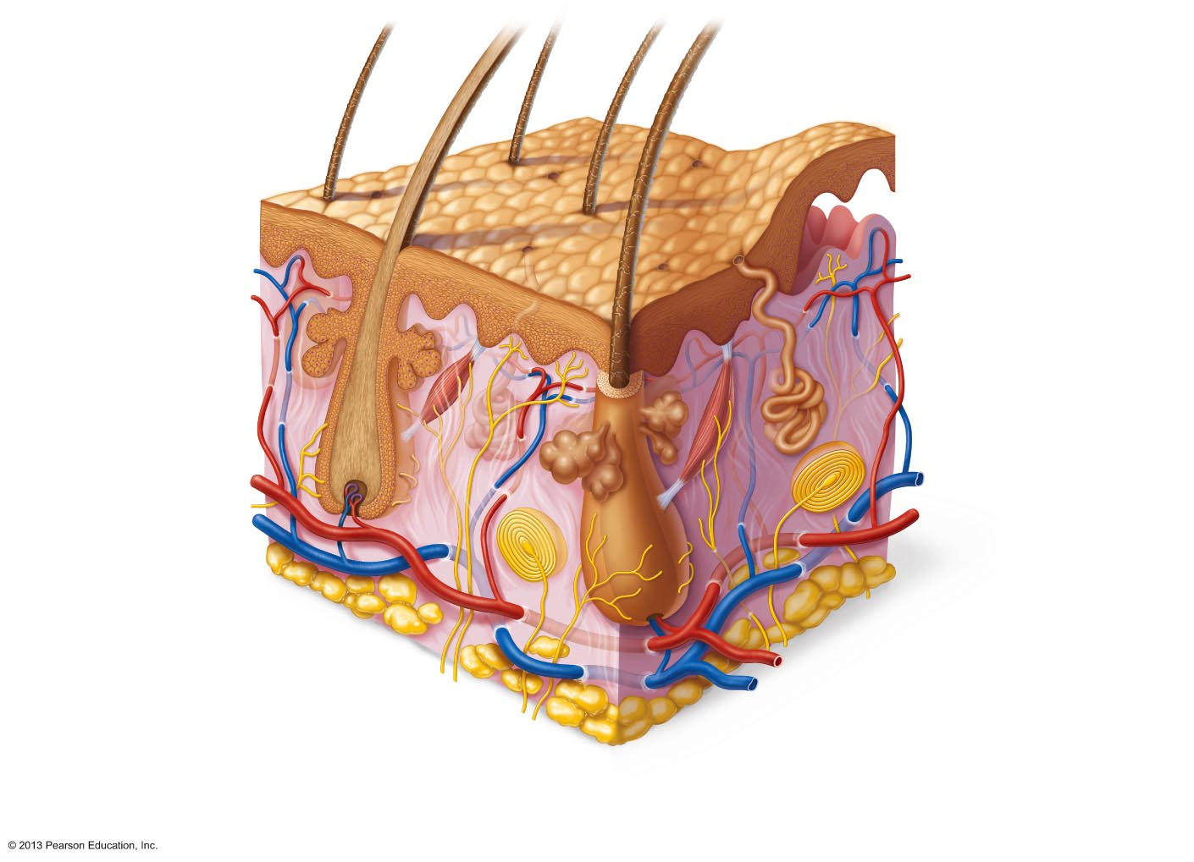
Figure 5.1 Skin structure.
Hair shaft
Dermal papillae
Epidermis
Subpapillary
plexus
Papillary
layer
Sweat pore
Appendages of
skin
Dermis
Reticular
layer
Eccrine sweat gland
Arrector pili muscle
Sebaceous (oil) gland
Hair follicle
Hypodermis
(subcutaneous
tissue; not part
of skin)
Hair root
Nervous structures
Cutaneous plexus
Sensory nerve fiber
with free nerve endings
Adipose tissue
Lamellar corpuscle
Hair follicle receptor
(root hair plexus)

Slide 3
Epidermis
Keratinized stratified squamous epithelium
Four or five distinct layers
Stratum basale
Stratum spinosum
Stratum granulosum
Stratum lucidum (only in thick skin)
Stratum corneum

Slide 4
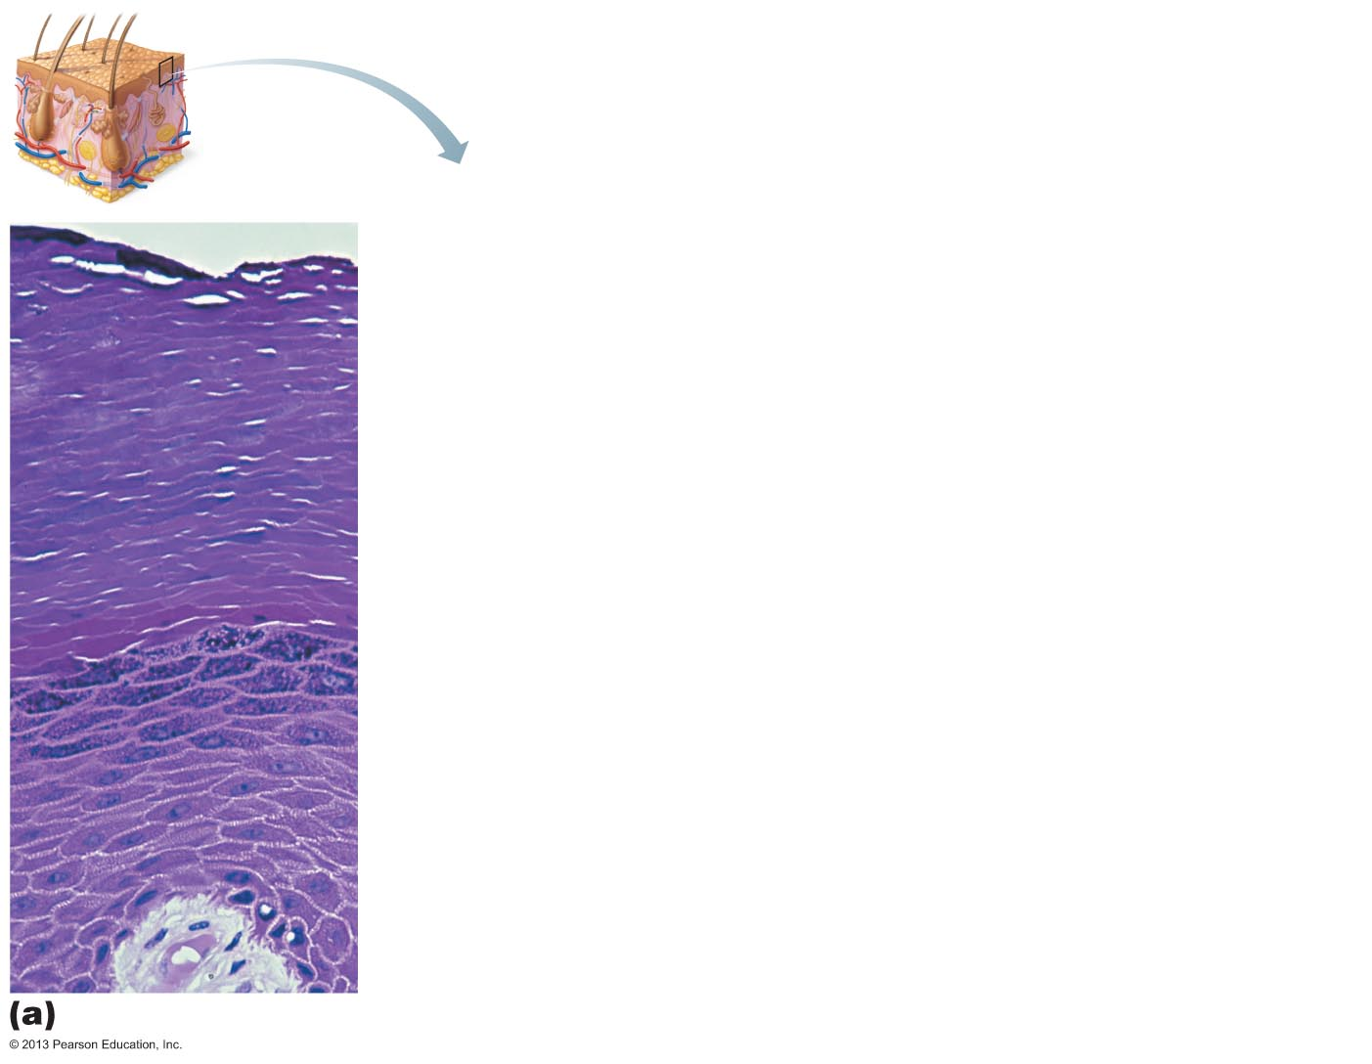
Figure 5.2a The main structural features of the skin epidermis.
Stratum corneum
Most superficial layer; 20–30 layers of dead cells, essentially
flat membranous sacs filled with keratin. Glycolipids in
extracellular space.
Stratum granulosum
Typically five layers of flattened cells, organelles deteriorating;
cytoplasm full of lamellar granules (release lipids) and
keratohyaline granules.
Stratum spinosum
Several layers of keratinocytes unified by desmosomes.
Cells contain thick bundles of intermediate filaments made of
pre-keratin.
Stratum basale
Deepest epidermal layer; one row of actively mitotic stem
cells; some newly formed cells become part of the more
superficial layers. See occasional melanocytes and dendritic
cells.
Dermis

Slide 5
Cells of the Epidermis
Keratinocytes
Produce fibrous protein keratin
Most cells of epidermis
Desmosome connections
Melanocytes
10–25% of cells in deepest epidermis
Produce pigment melanin
packaged into melanosomes
Protect nucleus from UV damage

Slide 6
Cells of the Epidermis
Dendritic (langerhans) cells
Macrophages
key activators of immune system
Tactile (merkel) cells
Sensory touch receptors

Slide 7
Layers of the Epidermis: Stratum Basale (Basal Layer)
Deepest epidermal layer
Also called stratum germinativum
Firmly attached to dermis
Single row of stem cells
Actively mitotic
Produces two daughter cells
One cell journeys from basal layer to surface
Takes 25–45 days
Dies as moves toward surface
One cell remains in stratum basale as stem cell
Melanocytes compose 10 – 25% of this layer

Slide 8
Layers of the Epidermis: Stratum Spinosum (Prickly Layer)
Several layers thick
Cells contain web-like system of filaments attached to desmosomes
Abundant melanosomes and dendritic cells

Slide 9
Layers of the Epidermis: Stratum Granulosum (Granular Layer)
Thin
four to six cell layers
Cell appearance changes
Cells flatten
Nuclei and organelles disintegrate
Keratinization begins
Cells above this layer die
Too far from dermal capillaries

Slide 10
Layers of the Epidermis: Stratum Lucidum (Clear Layer)
Only in thick skin
Thin, translucent band superficial to the stratum granulosum
A few rows of flat, dead keratinocytes

Slide 11
Layers of the Epidermis: Stratum Corneum (Horny Layer)
20–30 rows of cells that are
Dead
Flat
anucleate
keratinized
membranous sacs
Three-quarters of epidermal thickness
Though dead, its cells have functions
Protect deeper cells from environment and water loss
Protect from abrasion and penetration
Barrier against biological, chemical, and physical assaults

Slide 12
Dermis
Strong, flexible connective tissue
Cells
Fibroblasts
Macrophages
occasionally mast cells and white blood cells
Contains nerve fibers; blood and lymphatic vessels
Contains epidermal hair follicles; oil and sweat glands
Two layers
Papillary
Reticular

Slide 13
Figure 5.1 Skin structure.
Hair shaft
Dermal papillae
Epidermis
Subpapillary
plexus
Papillary
layer
Sweat pore
Appendages of
skin
Dermis
Reticular
layer
Eccrine sweat gland
Arrector pili muscle
Sebaceous (oil) gland
Hair follicle
Hypodermis
(subcutaneous
tissue; not part
of skin)
Hair root
Nervous structures
Cutaneous plexus
Sensory nerve fiber
with free nerve endings
Adipose tissue
Lamellar corpuscle
Hair follicle receptor
(root hair plexus)

Slide 14
Layers of the Dermis: Papillary Layer
Areolar connective tissue with collagen and elastic fibers and blood vessels
Loose tissue
Phagocytes can patrol for microorganisms
Dermal papillae
Superficial peglike projections

Slide 15
Dermal Papillae
Most contain capillary loops
Some contain meissner's corpuscles
(touch receptors)
Some contain free nerve endings
(pain receptors)

Slide 16
Layers of the Dermis: Reticular Layer
~80% of dermal thickness
Dense fibrous connective tissue
Elastic fibers provide stretch-recoil properties
Collagen fibers
Provide strength and resiliency
Bind water

Slide 17
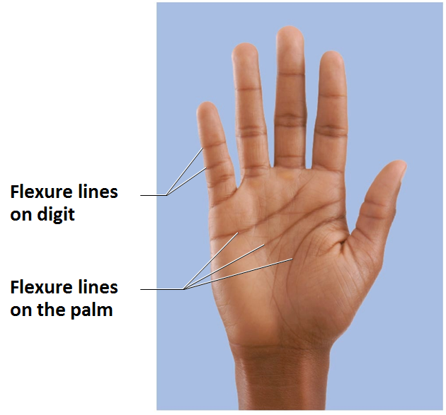
Skin Markings
Flexure lines
Dermal folds at or near joints
Dermis tightly secured to deeper structures
Skin cannot slide easily for joint movement causing deep creases
Visible on hands, wrists, fingers, soles, toes

Slide 18
Other Skin Markings
Striae
Silvery-white scars
"Stretch marks"
Extreme stretching causes dermal tears
Blister
From acute, short-term trauma
Fluid-filled pocket that separates epidermal and dermal layers

Slide 19
Skin Color
Three pigments contribute to skin color
Melanin
Only pigment made in skin
Carotene
Hemoglobin

Slide 20
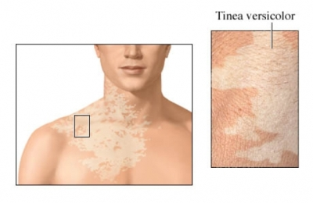
Melanin
Two forms
Reddish-yellow to brownish-black
Color differences due to amount and form
Produced in melanocytes
Freckles and pigmented moles
Local accumulations of melanin
Sun exposure stimulates melanin production
Sunspots (tinea versicolor) are fungal infection; not related to melanin

Slide 21
Carotene and Hemoglobin
Carotene
Yellow to orange pigment
Most obvious in palms and soles
Accumulates in stratum corneum and hypodermis
Can be converted to Vitamin A for vision and epidermal health
Hemoglobin
Pinkish hue of fair skin

Slide 22
Skin Color in Diagnosis
Cyanosis
Blue skin color
low oxygenation of hemoglobin
Erythema
(redness)
Fever, hypertension, inflammation, allergy
Pallor
(blanching)
Anemia, low blood pressure, fear, anger
Jaundice
(yellow cast)
Liver disorder
Bronzing
Inadequate steroid hormones in addison's disease
Bruises
Clotted blood beneath skin

Slide 23
Appendages of the Skin
Derivatives of the epidermis
Hairs and hair follicles
Nails
Sweat glands
Sebaceous (oil) glands

Slide 24
Hair
Dead keratinized cells of hard keratin
More durable than soft keratin of skin
Not in
Palms
Soles
Lips
Nipples
Portions of external genitalia
Functions include
Warn of insects on skin
Physical trauma
Heat loss
Sunlight

Slide 25
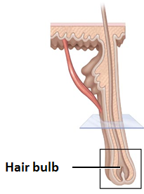
Hair Follicles
Extend from epidermal surface to dermis
Two-layered wall - part dermis, part epidermis
Hair bulb
Expanded deep end
Hair follicle receptor (root hair plexus)
Sensory nerve endings
touch receptors
Hair matrix
Actively dividing area

Slide 26
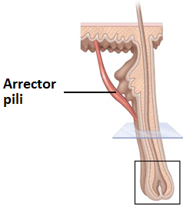
Hair Follicles
Arrector pili
Smooth muscle attached to follicle
Responsible for "goose bumps"
Hair papilla
Dermal tissue
blood supply

Slide 27
Types and Growth of Hair
Vellus hair
Pale, fine body hair of children and adult females
Terminal hair
Coarse, long hair of eyebrows, scalp
At puberty
Appear in axillary and pubic regions of both sexes
Face and neck of males
Nutrition and hormones affect hair growth

Slide 28
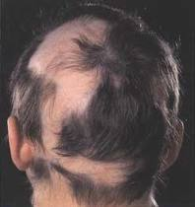
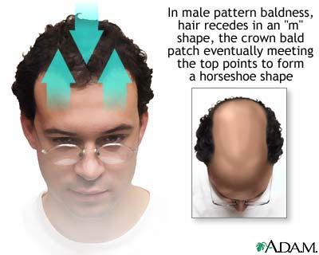
Hair Thinning and Baldness
Alopecia
Hair thinning in both sexes after a age 40
Alopecia Areata
Patchy hair loss from scalp, beard
May be autoimmune disorder
True (frank) baldness
Genetically determined and sex-influenced condition
Male pattern baldness caused by follicular response to DHT (dihydrotestosterone)

Slide 29
Nails
Scalelike modifications of epidermis
Protective cover for distal, dorsal surface of fingers and toes
Contain hard keratin
Nail matrix
Hair growth

Slide 30
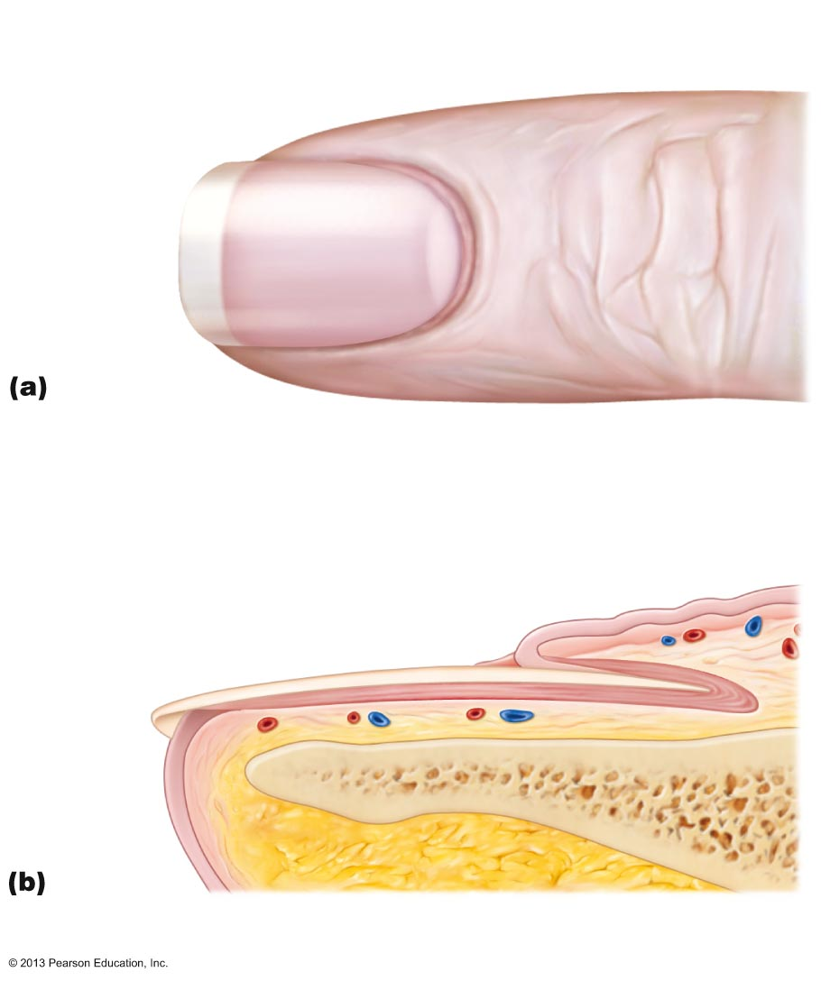
Figure 5.6 Skin appendages: Structure of a nail.
Lunule
Lateral
nail fold
Free edge
of nail
Body
of nail
Eponychium
(cuticle)
Root of nail
Proximal
nail fold
Nail
matrix
Hyponychium
Nail bed
Phalanx (bone of fingertip)

Slide 31
Sweat Glands
Also called sudoriferous glands
All skin surfaces except nipples and parts of external genitalia
~3 million per person
Two main types
Eccrine (merocrine) sweat glands
Apocrine sweat glands

Slide 32
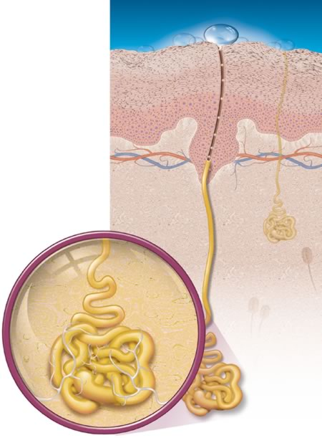
Eccrine Sweat Glands
Most numerous
Abundant on palms, soles, and forehead
Ducts connect to pores
Function in thermoregulation
Regulated by sympathetic nervous system
Evaporation of Eccrine sweat glands helps to cool the body

Slide 33
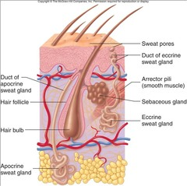
Apocrine Sweat Glands
Confined to axillary and anogenital areas
Sweat + fatty substances + proteins
Viscous; milky or yellowish
Odorless until bacterial interaction → body odor
Larger than eccrine sweat glands
Ducts empty into hair follicles

Slide 34
Apocrine Sweat Glands
Begin functioning at puberty
Function unknown but may act as sexual scent gland
Modified apocrine glands
Ceruminous glands
lining of external ear canal; secrete cerumen (earwax)
Mammary glands
secrete milk

Slide 35
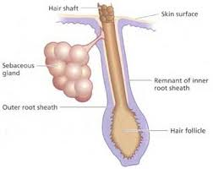
Sebaceous (Oil) Glands
Widely distributed
Not in thick skin of palms and soles
Most develop from hair follicles and secrete into hair follicles
Relatively inactive until puberty
Stimulated by hormones, especially androgens (testosterone)
Secrete sebum
Oily secretion
Bactericidal
Softens hair and skin

Slide 36
Functions of the Integumentary System
Protection
Body temperature regulation
Cutaneous sensation
Metabolic functions
Blood reservoir
Excretion

Slide 37
Protection
Three types of barriers
Chemical barriers
Physical barriers
Biological barriers

Slide 38
Chemical Barriers
Skin secretions
Low pH slows bacterial multiplication
Sebum and defensins kill bacteria
Melanin
Defense against UV radiation damage

Slide 39
Physical Barriers
Flat, dead cells of stratum corneum surrounded by lipids
Keratin and glycolipids block most water and water- soluble substances

Slide 40
Biological Barriers
Biological barriers
Dendritic cells of epidermis
Present foreign antigens to white blood cells
Macrophages of dermis
Present foreign antigens to white blood cells
DNA
Its electrons absorb UV radiation
Radiation converted to heat

Slide 41
Functions of the Integumentary System
Body temperature regulation
If body temperature rises:
dilation of dermal vessels
increased sweat gland activity (sensible perspiration) cool the body
Cold external environment
Dermal blood vessels constrict
Skin temperature drops to slow heat loss

Slide 42
Functions of the Integumentary System
Cutaneous sensations
detect temperature, touch, and pain
Metabolic functions
Synthesis of Vitamin D precursor
Chemical conversion of carcinogens and activate some hormones
Blood reservoir
up to 5% of body's blood volume
Excretion
nitrogenous wastes and salt in sweat

Slide 43
Skin Cancer
Most skin tumors are benign (not cancerous) and do not metastasize (spread)
Risk factors
Overexposure to UV radiation
Frequent irritation of skin
Three major types of skin cancer
Basal cell carcinoma
Squamous cell carcinoma
Melanoma

Slide 44
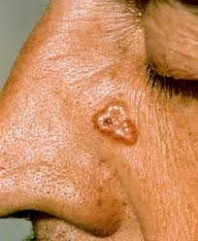
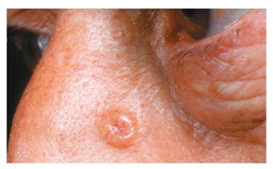
Basal Cell Carcinoma
Least malignant; most common
Stratum basale cells proliferate and slowly invade dermis and hypodermis
Cured by surgical excision in 99% of cases

Slide 45
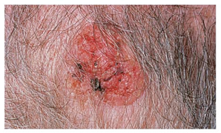
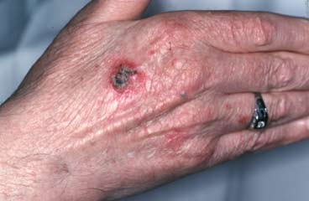
Squamous Cell Carcinoma
Second most common type
Involves keratinocytes of stratum spinosum
Usually scaly reddened papule on scalp, ears, lower lip, and hands
Does metastasize
Good prognosis if treated by radiation therapy or removed surgically

Slide 46
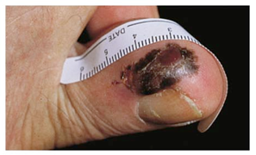
Melanoma
Cancer of melanocytes
Most dangerous
Highly metastatic and resistant to chemotherapy
Treated by wide surgical excision accompanied by immunotherapy

Slide 47
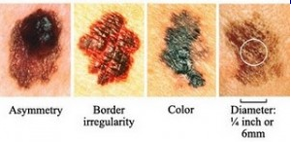
Melanoma
Key to survival is early detection – ABCD rule
A: asymmetry
the two sides of the pigmented area do not match
B: border irregularity
exhibits indentations
C: color
contains several (black, brown, tan, sometimes red or blue)
D: diameter
larger than 6 mm (size of pencil eraser)

Slide 48
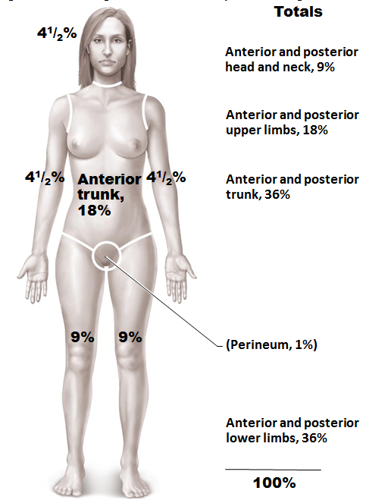
Burns
Tissue damage caused by heat, electricity, radiation, certain chemicals
Denatures proteins
Kills cells
Immediate threat:
Dehydration and electrolyte imbalance
Leads to renal shutdown and circulatory shock
To evaluate burns
Rule of nines
Used to estimate volume of fluid loss

Slide 49
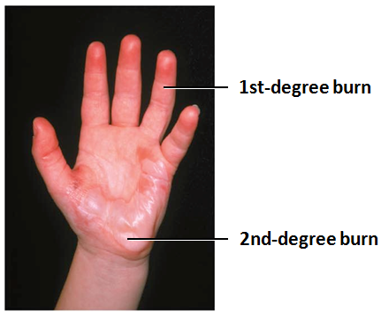
Burns Classified by Severity
Partial-thickness burns
First degree
Epidermal damage only
Localized redness, edema (swelling), and pain
Second degree
Epidermal and upper dermal damage
Blisters appear

Slide 50
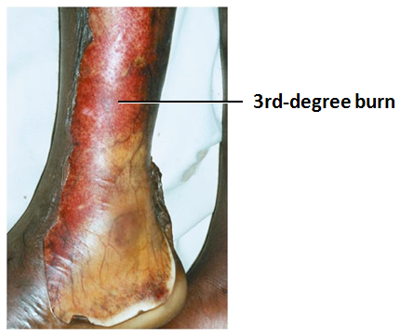
Burns Classified by Severity
Full-thickness burns
Third degree
Entire thickness of skin involved
Skin gray-white, cherry red, or blackened
Not painful (nerve endings destroyed) or swollen
Skin grafting usually necessary

Slide 51
Severity and Treatment of Burns
Critical if
>25% of body has second-degree burns
>10% of body has third-degree burns
Face, hands, or feet have third-degree burns
Treatment includes
Debridement (removal) of burned skin
Antibiotics
Temporary covering
Skin grafts

Slide 52
Classification of Bones
206 named bones in skeleton
Divided into two groups
Axial skeleton
Long axis of body
Skull, vertebral column, rib cage
Appendicular skeleton
Bones of upper and lower limbs
Girdles attaching limbs to axial skeleton

Slide 53
Classification of Bones by Shape
Long bones
Short bones
Flat bones
Irregular bones

Slide 54
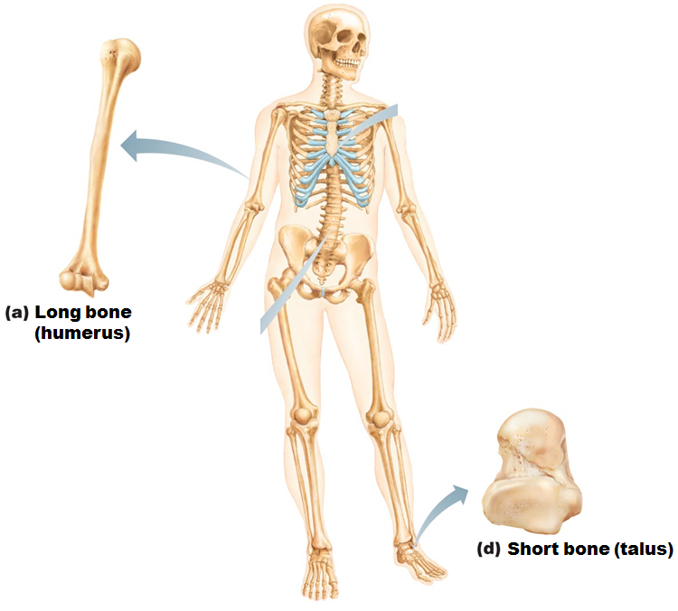
Classification of Bones by Shape
Long bones
Longer than they are wide
Limb, wrist, ankle bones
Short bones
Cube-shaped bones (in wrist and ankle)
Sesamoid bones (within tendons, e.g., Patella)
Vary in size and number in different individuals

Slide 55
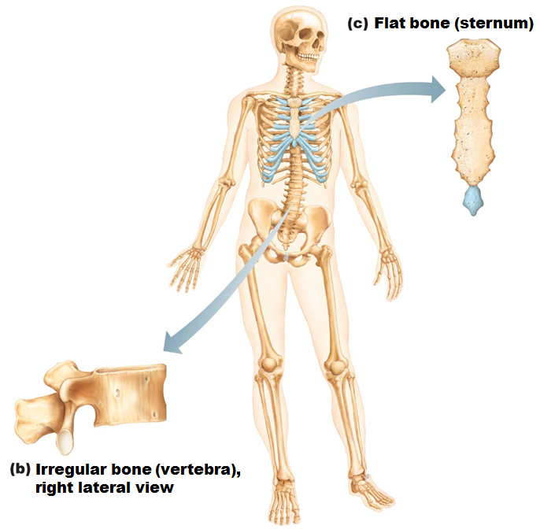
Classification of Bones by Shape
Flat bones
Thin, flat, slightly curved
Sternum, scapulae, ribs, most skull bones
Irregular bones
Complicated shapes
Vertebrae, coxal bones

Slide 56
Functions of Bones
Support
For body and soft organs
Protection
For brain, spinal cord, and vital organs
Movement
Levers for muscle action

Slide 57
Functions of Bones
Mineral and growth factor storage
Calcium and phosphorus, and growth factors reservoir
Blood cell formation (hematopoiesis) in red marrow cavities of certain bones

Slide 58
Functions of Bones
Triglyceride (fat) storage in bone cavities
Energy source
Hormone production
Osteocalcin
Regulates bone formation
Protects against obesity, glucose intolerance, diabetes mellitus

Slide 59
Bones
Are organs
Contain different types of tissues
Bone (osseous) tissue
nervous tissue
Cartilage
fibrous connective tissue
muscle
epithelial cells in its blood vessels
Three levels of structure
Gross anatomy
Microscopic
Chemical

Slide 60
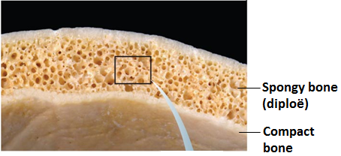
Gross Anatomy
Bone textures
Compact and spongy bone
Compact
Dense outer layer; smooth and solid
Spongy (cancellous or trabecular)
Honeycomb of flat pieces of bone deep to compact called trabeculae

Slide 61
Structure of Short, Irregular, and Flat Bones
Thin plates of spongy bone covered by compact bone
Plates sandwiched between connective tissue membranes
Periosteum (outer layer) and endosteum
No shaft or epiphyses
Bone marrow throughout spongy bone; no marrow cavity
Hyaline cartilage covers articular surfaces

Slide 62
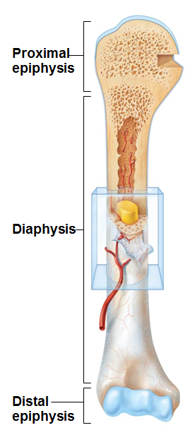
Structure of Typical Long Bone
Diaphysis
Tubular shaft forms long axis
Compact bone surrounding medullary cavity
Epiphyses
Bone ends
External compact bone; internal spongy bone
Articular cartilage covers articular surfaces
Between is epiphyseal line
Remnant of childhood bone growth at epiphyseal plate

Slide 63
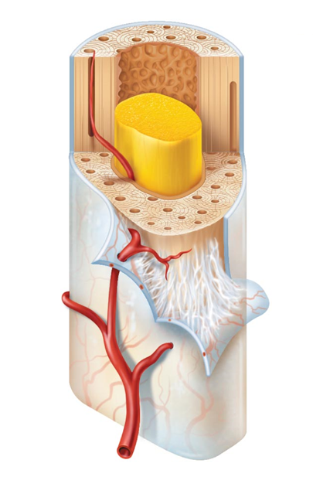
Membranes: Periosteum
White, double-layered membrane
Covers external surfaces except joint surfaces
Outer fibrous layer of dense irregular connective tissue
Sharpey's fibers secure to bone matrix
Many nerve fibers and blood vessels
Anchoring points for tendons and ligaments
periosteum
Sharpey’s fibers

Slide 64
Membranes: Endosteum
endosteum
Delicate connective tissue membrane covering internal bone surface
Covers trabeculae of spongy bone
Lines canals that pass through compact bone
Contains osteogenic cells that can differentiate into other bone cells

Slide 65
Hematopoietic Tissue in Bones
Red marrow
Found within trabecular cavities of spongy bone and diploë of flat bones (e.g., Sternum)
In medullary cavities and spongy bone of newborns
Adult long bones have little red marrow
Heads of femur and humerus only
Red marrow in diploë and some irregular bones is most active
Yellow marrow can convert to red, if necessary

Slide 66
Bone Markings
Bulges, depressions, and holes that serve as:
Sites of attachment for muscles, ligaments, and tendons
Joint surfaces
Conduits for blood vessels and nerves

Slide 67
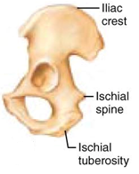
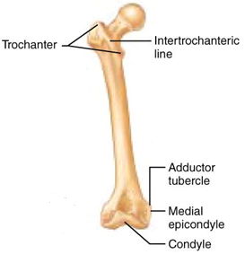
Bone Markings: Projections – Sites of Muscle and Ligament Attachment
Tuberosity
rounded projection
Crest
narrow, prominent ridge of bone
Trochanter
large, blunt, irregular surface
Line
narrow ridge of bone

Slide 68
Bone Markings: Projections – Sites of Muscle and Ligament Attachment
Tubercle
small rounded projection
Epicondyle
raised area above a condyle
Spine
sharp, slender projection
Process
any bony prominence

Slide 69
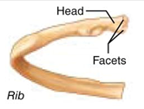
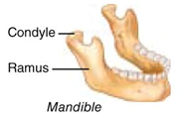
Bone Markings: Projections – Projections That Help to Form Joints
Head
bony expansion carried on a narrow neck
Facet
smooth, nearly flat articular surface
Condyle
rounded articular projection
Ramus
armlike bar of bone

Slide 70
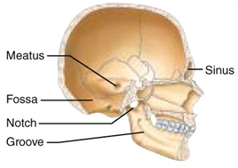
Bone Markings: Depressions and Openings
Meatus
canal-like passageway
Fossa
shallow, basin-like depression
Sinus
cavity within a bone
Groove
furrow

Slide 71
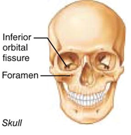
Bone Markings: Depressions and Openings
Fissure
narrow, slit-like opening
Foramen
round or oval opening through a bone

Slide 72
Microscopic Anatomy of Bone: Cells of Bone Tissue
Five major cell types
Each specialized form of same basic cell type
Osteogenic cells
Osteoblasts
Osteocytes
Bone lining cells
Osteoclasts

Slide 73
Osteoblasts
Bone-building cells
Secrete unmineralized bone matrix or osteoid
Includes collagen and calcium-binding proteins
Collagen = 90% of bone protein
Actively mitotic

Slide 74
Osteocytes
Mature bone cells in lacunae
Monitor and maintain bone matrix
Act as stress or strain sensors
Respond to and communicate with osteoblasts and osteoclasts so bone remodeling can occur

Slide 75
Osteoclasts
cells for bone resorption
Takes minerals out of bone

Slide 76
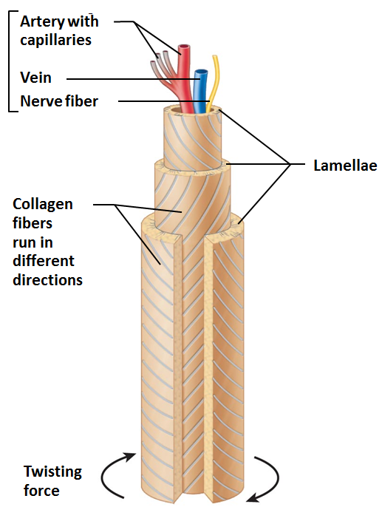
Microscopic Anatomy of Bone: Compact Bone
Also called lamellar bone
Osteon or haversian system
Structural unit of compact bone
Elongated cylinder runs the length of the bone
Hollow tubes of bone matrix called lamellae
Collagen fibers in adjacent rings run in different directions
Withstands stress – resist twisting

Slide 77
Microscopic Anatomy of Bone: Spongy Bone
Appears poorly organized
Trabeculae
Align along lines of stress to help resist it
No osteons
Contain irregularly arranged lamellae and osteocytes interconnected by canaliculi
Capillaries in endosteum supply nutrients

Slide 78
Bone Development
Ossification (osteogenesis)
Process of bone tissue formation
Formation of bony skeleton
Begins in 2nd month of development
Postnatal bone growth
Until early adulthood
Bone remodeling and repair
Lifelong

Slide 79
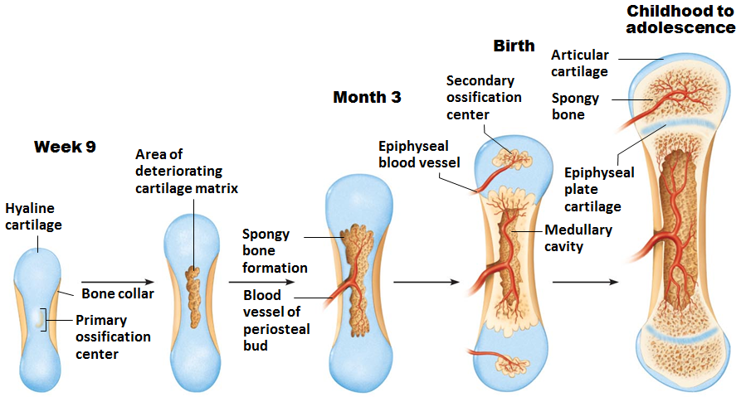
Types of Ossification
Endochondral ossification
Bone forms by replacing hyaline cartilage
Bones called cartilage (endochondral) bones
Forms most of skeleton

Slide 80
Endochondral Ossification
Forms most all bones inferior to base of skull
Except clavicles
Begins late in 2nd month of development
Uses hyaline cartilage models
Requires breakdown of hyaline cartilage prior to ossification

Slide 81
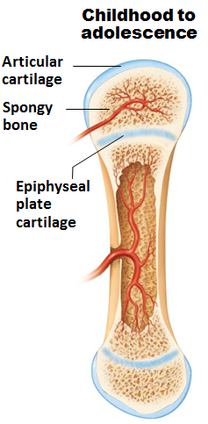
Endochondral Ossification
Begins at primary ossification center in center of shaft during embryonic stages
Develops secondary ossification center in epiphyses after birth
Primary bone growth grows towards secondary bone growth, meeting at the epiphyseal plate
AKA growth plate and epiphyseal disk.

Slide 82
Types of Ossification
Intramembranous ossification
Bone develops from fibrous membrane
Bones called membrane bones
Forms flat bones, e.g. clavicles and cranial bones

Slide 83
Intramembranous Ossification
Forms many skull bones and clavicles
Begins within fibrous connective tissue membranes
Ossification centers appear
Woven bone and periosteum form
Lamellar bone replaces woven bone & red marrow appears

Slide 84
Postnatal Bone Growth
Interstitial (longitudinal) growth
Increase in length of long bones
Appositional growth
Increase in bone thickness

Slide 85
Hormonal Regulation of Bone Growth
Growth hormone
Most important in stimulating epiphyseal plate activity in infancy and childhood
Thyroid hormone
Modulates activity of growth hormone
Ensures proper proportions
Testosterone (males) and estrogens (females) at puberty
Promote adolescent growth spurts
End growth by inducing epiphyseal plate closure
Excesses or deficits of any cause abnormal skeletal growth

Slide 86
Bone Homeostasis: Response to Mechanical Stress
Bones reflect stresses they encounter
Long bones thickest midway along diaphysis where bending stresses greatest
Bones stressed when weight bears on them or muscles pull on them
Usually off center so tends to bend bones
Bending compresses on one side; stretches on other

Slide 87
Results of Mechanical Stressors: Wolff's Law
Bones grow or remodel in response to demands placed on it
Explains
Handedness (right or left handed) results in thicker and stronger bone of that upper limb
Curved bones thickest where most likely to buckle
bony projections occur where muscles attach
Bones of fetus and bedridden featureless

Slide 88
Fracture Classification
Three "either/or" fracture classifications
Position of bone ends after fracture
Nondisplaced—ends retain normal position
Displaced—ends out of normal alignment
Completeness of break
Complete—broken all the way through
Incomplete—not broken all the way through
Whether skin is penetrated
Open (compound) - skin is penetrated
Closed (simple) – skin is not penetrated

Slide 89
Classification of Bone Fractures
Also described by location of fracture
External appearance
Nature of break

Slide 90
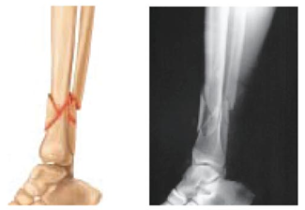
Types of Fractures
Comminuted
Bone breaks (shatters) into three or more pieces.
Common in the elderly, or those with brittle bones.

Slide 91
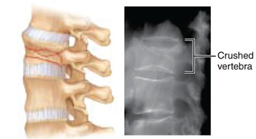
Types of Fractures
Compression
Bone is crushed
Common in bones with osteoporosis
Common with extreme trauma and falls
Seen frequently in the vertebrae

Slide 92
Types of Fractures
Epiphyseal
Epiphysis separates from diaphysis along or through the epiphyseal plate (growth plate)

Slide 93
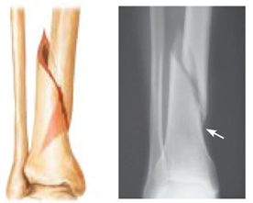
Types of Fractures
Spiral
Ragged break due to excessive twisting force
Common sports fracture

Slide 94
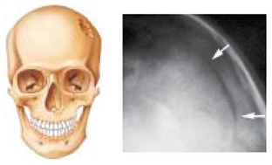
Types of Fractures
Depression
broken bone is pressed inward
Seen in skull trauma

Slide 95
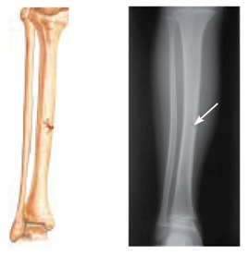
Types of Fractures
Greenstick fracture
Incomplete
Due to flexibility of the young bone, one side of the shaft breaks and the other side bends.
Common in children
Have more flexible bones

Slide 96
Fracture Treatment and Repair
Treatment
Reduction
Realignment of broken bone ends
Closed reduction
physician manipulates to correct position
Open reduction
surgical pins or wires secure ends
Immobilization by cast or traction for healing
Depends on break severity, bone broken, and age of patient

Slide 97
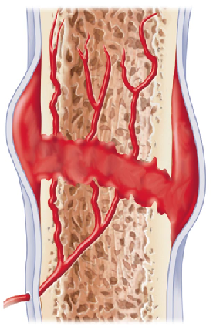
Stages of Bone Repair: HEMATOMA Forms
Torn blood vessels hemorrhage
Clot (hematoma) forms
Site swollen, painful, and inflamed

Slide 98
Stages of Bone Repair: Fibrocartilaginous Callus Forms
Capillaries grow into hematoma
Phagocytic cells clear debris
Fibroblasts secrete collagen fibers to span break and connect broken ends

Slide 99
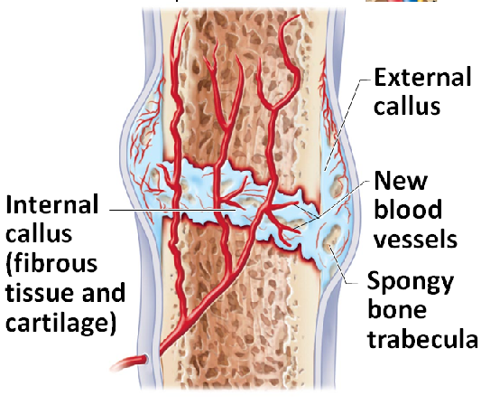
Stages of Bone Repair: Fibrocartilaginous Callus Forms
Fibroblasts, cartilage, and osteogenic cells begin reconstruction of bone
Create cartilage
Osteoblasts form spongy bone
Mass of repair tissue called fibrocartilaginous callus

Slide 100
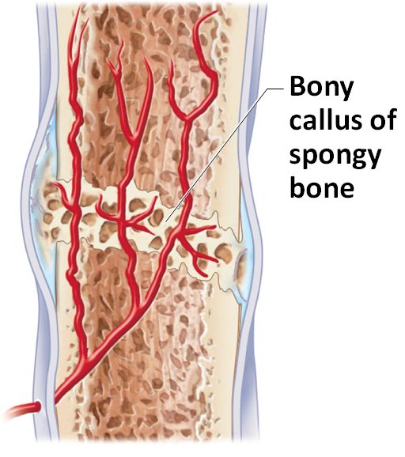
Stages of Bone Repair: Bony Callus Forms
Within one week new trabeculae appear in fibrocartilaginous callus
Callus converted to bony (hard) callus of spongy bone
~2 months later firm union forms

Slide 101
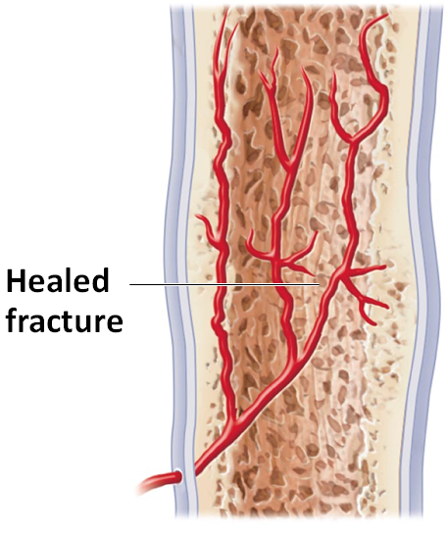
Stages of Bone Repair: Bone Remodeling Occurs
Begins during body callus formation
Continues for several months
Excess material removed
Compact bone laid down to reconstruct shaft walls

Slide 102
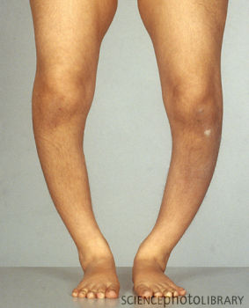
Homeostatic Imbalances
Osteomalacia
Bones poorly mineralized
Calcium salts not adequate
Soft, weak bones
Pain upon bearing weight
Rickets (osteomalacia of children)
Bowed legs and other bone deformities
Bones ends enlarged and abnormally long
Cause: Vitamin D deficiency or insufficient dietary calcium

Slide 103
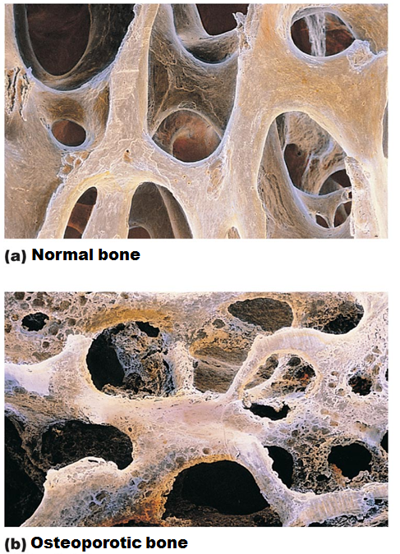
Homeostatic Imbalances
Osteoporosis
Group of diseases
Bone resorption outpaces deposit
Spongy bone of spine and neck of femur most susceptible
Vertebral and hip fractures common

Slide 104
Risk Factors for Osteoporosis
Risk factors
Most often aged, postmenopausal women
30% 60 – 70 years of age; 70% by age 80
30% caucasian women will fracture bone because of it
Men to lesser degree
Sex hormones maintain normal bone health and density
As secretion wanes with age osteoporosis can develop

Slide 105
Additional Risk Factors for Osteoporosis
Petite body form
Insufficient exercise to stress bones
Diet poor in calcium and protein
Smoking
Hormone-related conditions
Hyperthyroidism
Low blood levels of thyroid-stimulating hormone
Diabetes mellitus
Immobility
Males with prostate cancer taking androgen-suppressing drugs

Slide 106
Treating Osteoporosis
Traditional treatments
Calcium
Vitamin D supplements
Weight-bearing exercise
Hormone replacement therapy
Slows bone loss but does not reverse it
Controversial due to increased risk of heart attack, stroke, and breast cancer
Some take estrogenic compounds in soy as substitute

Slide 107
Preventing Osteoporosis
Plenty of calcium in diet in early adulthood
Reduce carbonated beverage and alcohol consumption
Leaches minerals from bone so decreases bone density
Plenty of weight-bearing exercise
Increases bone mass above normal for buffer against age-related bone loss

Slide 108
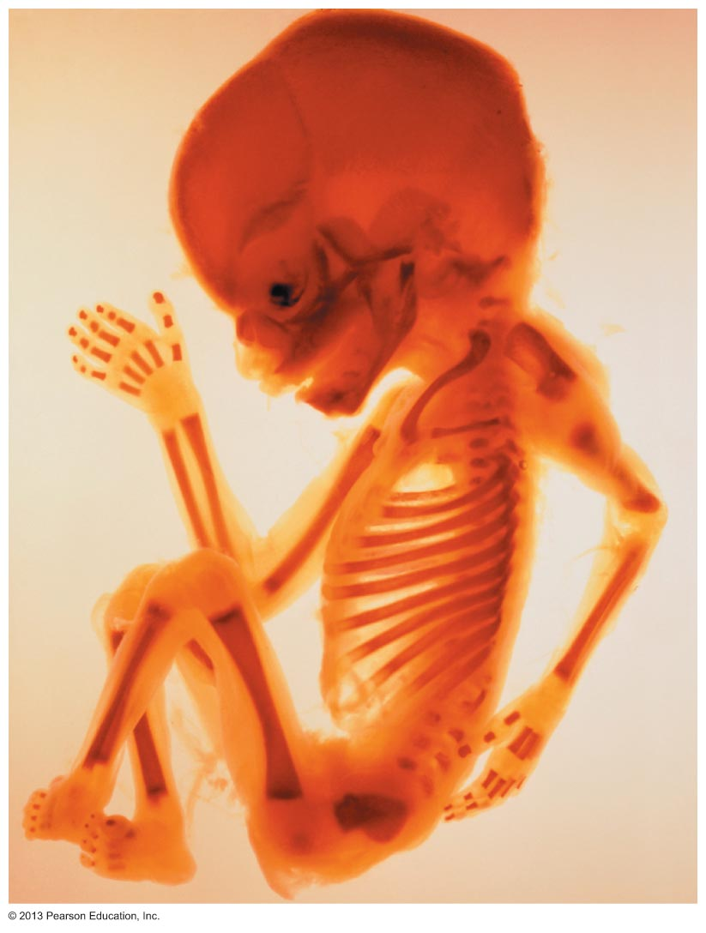
Developmental Aspects of Bones
Embryonic skeleton ossifies predictably
fetal age easily determined from X rays or sonograms
long bones begin ossifying by 8 weeks
Primary ossification centers by 12 weeks
At birth, most long bones ossified (except epiphyses)
At age 25 ~ all bones completely ossified and skeletal growth ceases

Slide 109
Age-related Changes in Bone
Children and adolescents
Bone formation exceeds resorption
Young adults
Both in balance; males greater mass
Bone density changes over lifetime largely determined by genetics
Gene for Vitamin D's cellular docking determines mass early in life and osteoporosis risk as age
Bone mass, mineralization, and healing ability decrease with age beginning in 4th decade
Except bones of skull
Bone loss greater in whites and in females
Electrical stimulation; Daily ultrasound treatments hasten repair

Slide 110
Skeletal System
Composed of bones, cartilages, joints, ligaments
Two major parts
Axial
Appendicular

Slide 111
The Axial Skeleton
Consists of 80 bones
Three major regions
Skull
Vertebral column
Thoracic cage

Slide 112
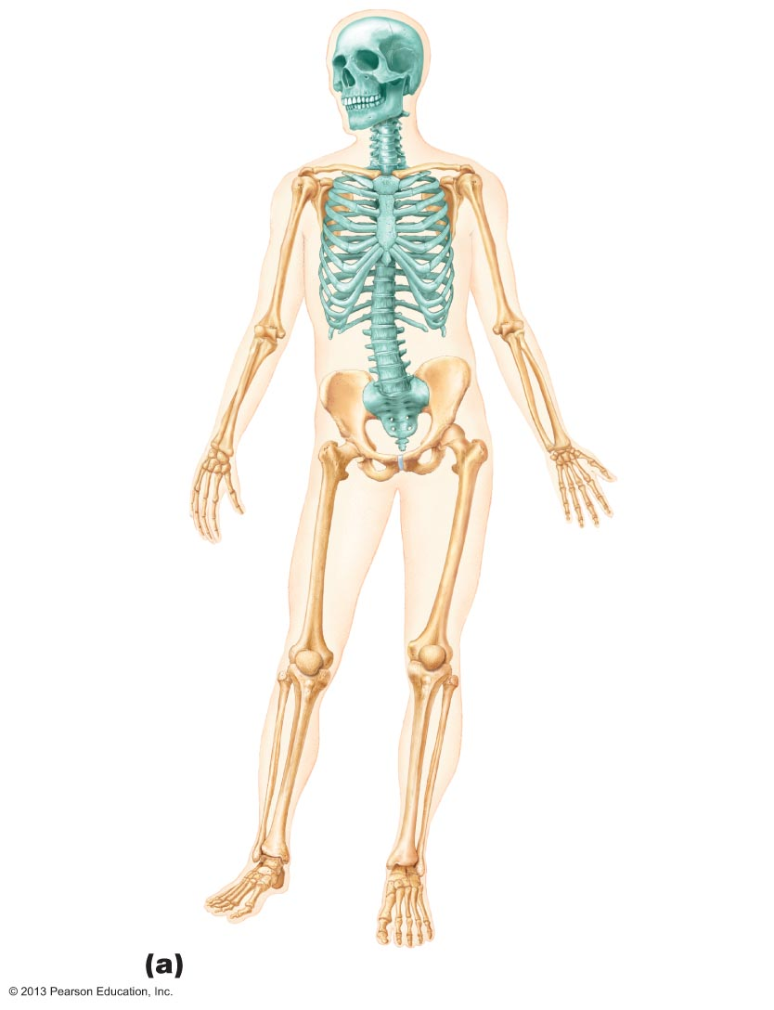
Figure 7.1a The human skeleton.
Cranium
Skull
Facial bones
Clavicle
Thoracic
cage
(ribs and
sternum)
Scapula
Sternum
Rib
Humerus
Vertebra
Vertebral
column
Radius
Ulna
Sacrum
Carpals
Phalanges
Metacarpals
Femur
Patella
Tibia
Fibula
Tarsals
Metatarsals
Phalanges
Anterior view

Slide 113
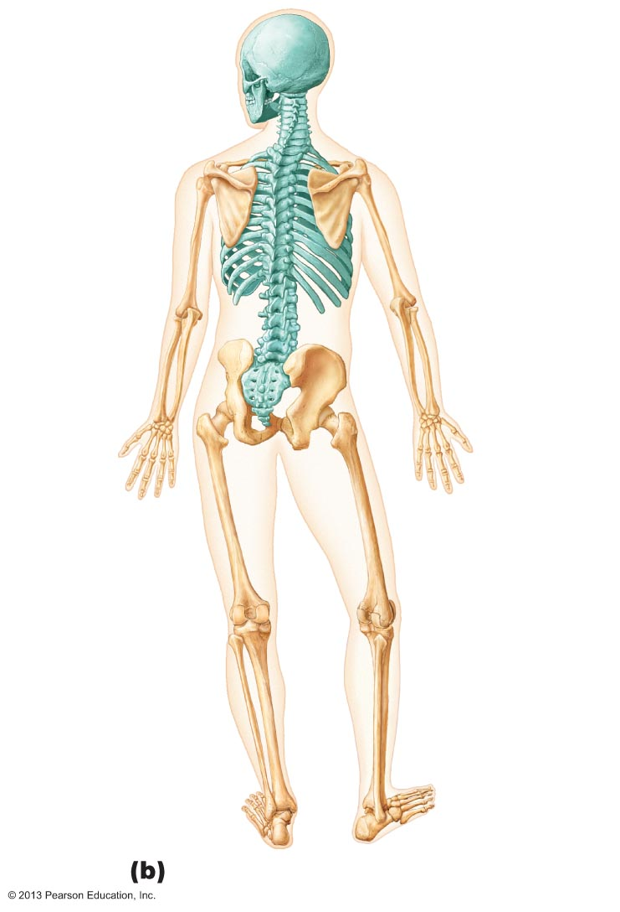
Figure 7.1b The human skeleton.
Cranium
Bones of
pectoral
girdle
Clavicle
Scapula
Sternum
Upper
limb
Rib
Humerus
Vertebra
Radius
Ulna
Bones
of
pelvic
girdle
Carpals
Phalanges
Metacarpals
Femur
Lower
limb
Tibia
Fibula
Posterior view

Slide 114
The Skull
Formed by two sets of bones
Cranial bones (cranium)
Enclose the brain in the cranial cavity
Cranial vault (calvaria)
Cranial base: anterior, middle, and posterior cranial fossae
Provide sites of attachment for head and neck muscles

Slide 115
The Skull
Facial bones
Framework of face
Cavities for special sense organs for sight, taste, and smell
Openings for air and food passage
Sites of attachment for teeth and muscles of facial expression

Slide 116
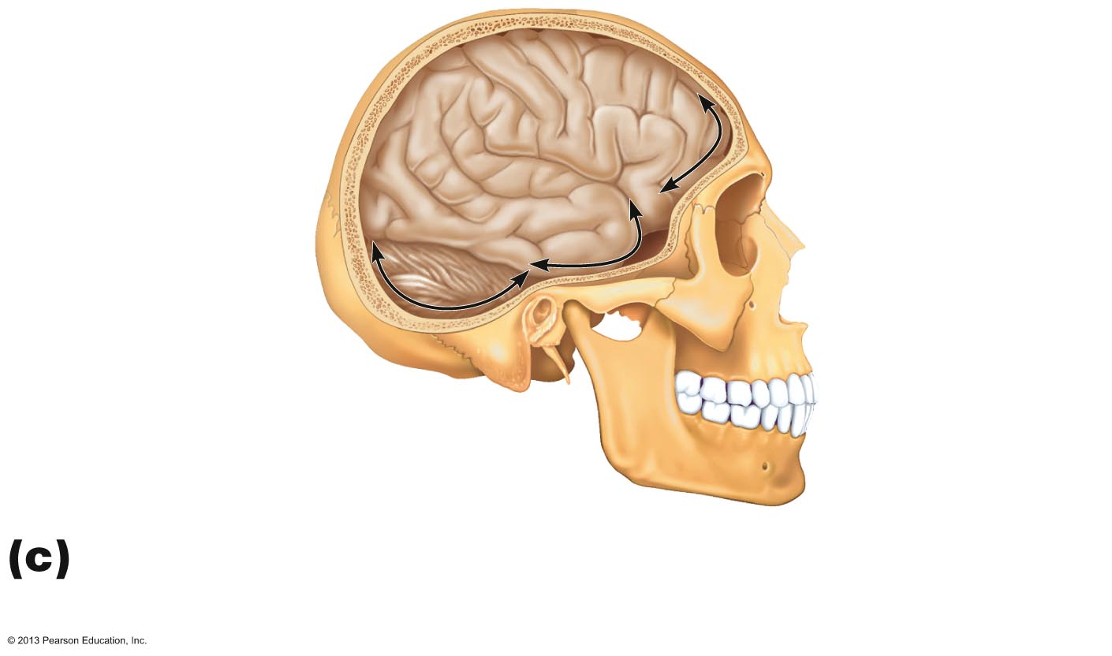
Figure 7.2c The skull: Cranial and facial divisions and fossae.
Temporal lobe
of cerebrum
Frontal lobe
of cerebrum
Cerebellum
Posterior
Cranial
fossae
Middle
Anterior
Lateral view of cranial fossae showing the
contained brain regions

Slide 117
Eight Cranial Bones
Frontal bone
Parietal bones (2)
Occipital bone
Temporal bones (2)
Sphenoid bone
Ethmoid bone

Slide 118
Sutural Bones
Tiny irregularly shaped bones that appear within sutures

Slide 119
Fourteen Facial Bones
Mandible
Maxillary bones (maxillae) (2)
Zygomatic bones (2)
Nasal bones (2)
Lacrimal bones (2)
Palatine bones (2)
Vomer
Inferior nasal conchae (2)

Slide 120
Mandible
Lower jaw
Largest, strongest bone of face
Temporomandibular joint
Only freely movable joint in skull

Slide 121
Maxillary Bones
form upper jaw and central portion of facial skeleton
Keystone bones
Articulate with all other facial bones except mandible
Contain maxillary sinuses
Largest of paranasal sinuses

Slide 122
Maxilla

Slide 123
Paranasal Sinuses
Mucosa-lined, air-filled spaces
Lighten skull
Enhance resonance of voice
Warm and humidify air
Found in frontal, sphenoid, ethmoid, and maxillary bones

Slide 124
Figure 7.14a Paranasal sinuses.
Frontal sinus
Ethmoidal air cells
(sinus)
Sphenoidal sinus
Maxillary sinus
Anterior aspect

Slide 125
Hyoid Bone
Not bone of skull
Does not articulate directly with another bone
Movable base for tongue
Site of attachment for muscles of swallowing and speech

Slide 126
Vertebral Column
Transmits weight of trunk to lower limbs
Surrounds and protects spinal cord
Flexible curved structure containing 26 irregular bones (vertebrae) in five major regions
Cervical vertebrae: 7
Thoracic vertebrae: 12
Lumbar vertebra: 5
Sacrum
bone inferior to lumbar vertebrae
Coccyx
End of vertebral column

Slide 127
Vertebral Column: Curvatures
Increase resilience and flexibility of spine
Cervical and lumbar curvatures
Concave posteriorly
Lordotic Curve
Secondary Curve: occurs due to muscular and positional changes.
Thoracic and sacral curvatures
Convex posteriorly
Kyphotic Curve
Primary Curve: born with it

Slide 128
Vertebral Column: Abnormal Curvatures
Abnormal spine curvatures
Scoliosis
abnormal lateral curve
Hyperkyphosis (hunchback)
exaggerated thoracic curvature
Hyperlordosis (swayback)
accentuated lumbar curvature

Slide 129
Figure 7.17 Abnormal spinal curvatures.
Scoliosis
Kyphosis
Lordosis

Slide 130
Intervertebral Discs
Cushionlike pad composed of two parts
Nucleus pulposus
Inner gelatinous nucleus
Gives disc its elasticity and compressibility
Anulus fibrosus
Outer collar composed of collagen and fibrocartilage

Slide 131
General Structure of Vertebrae
Body or centrum
Anterior weight-bearing region
Vertebral arch
Composed of pedicles and laminae that, along with centrum, enclose vertebral foramen
Vertebral foramina
Together make up vertebral canal for spinal cord
Intervertebral foramina
Lateral openings between adjacent vertebrae for spinal nerves

Slide 132
General Structure of Vertebrae
Seven processes per vertebra:
Spinous process
projects posteriorly
Transverse processes (2)
project laterally
Superior articular processes (2)
protrude superiorly
Create a joint with the vertebra above
Inferior articular processes (2)
protrude inferiorly
Create a joint with the vertebra below

Slide 133
Figure 7.19 Typical vertebral structures.
Posterior
Spinous
process
Transverse
process
Superior
articular
Vertebral
arch
facet
and
• Lamina
process
• Pedicle
Vertebral
foramen
Body
(centrum)
Anterior

Slide 134
Cervical Vertebrae
C₁ to C₇: smallest, lightest vertebrae
C₃ to C₇ share following features
Oval body
Spinous processes are bifid (except C₇)
Large, triangular vertebral foramen
Transverse foramen in each transverse process
C₇ is vertebra prominens

Slide 135
Cervical Vertebrae
C₁ (atlas) and C₂ (axis) have unique features
Atlas (C₁)
No body or spinous process
Consists of anterior and posterior arches, and two lateral masses
Superior surfaces of lateral masses articulate with occipital condyles
Movement for flexion/extension: "Yes"

Slide 136
Cervical Vertebrae
Axis (C₂)
Dens projects superiorly into anterior arch of atlas
Is "missing" body of atlas
Dens is a pivot for rotation of atlas
Movement for shaking head "No"

Slide 137
Thoracic Vertebrae
T₁ to T₁₂
All articulate with ribs at facets and demifacets
Long, spinous process that points inferiorly
Circular vertebral foramen
Location of articular facets allows rotation of this area of spine

Slide 138
Figure 7.21b Posterolateral views of articulated vertebrae.
Superior articular
process
Transverse
process
Transverse costal
facet (for tubercle of rib)
Intervertebral disc
Body
Inferior costal facet
(for head of rib)
Spinous
process
Inferior articular
process
Thoracic vertebrae

Slide 139
Lumbar Vertebrae
L₁ to L₅
Receives most stress
Short, thick pedicles and laminae
Flat hatchet-shaped spinous processes point posteriorly
Vertebral foramen triangular
Little rotation

Slide 140
Figure 7.21c Posterolateral views of articulated vertebrae.
Superior
articular
process
Body
Transverse
process
Intervertebral
disc
Inferior articular
process
Spinous
process
Lumbar vertebrae

Slide 141
Sacrum and Coccyx
Sacrum
5 fused vertebrae (S1–S5)
Forms posterior wall of pelvis
Articulates with L5 superiorly, and with auricular surfaces of hip bones, forming sacroiliac joints
Coccyx
Tailbone
3–5 fused vertebrae
Articulates superiorly with sacrum

Slide 142
Sacrum and Coccyx

Slide 143
Thoracic Cage
Composed of
Thoracic vertebrae posteriorly
Sternum and costal cartilages anteriorly
Ribs laterally
Functions
Protects vital organs of thoracic cavity
Supports shoulder girdles and upper limbs
Provides attachment sites for muscles of neck, back, chest, and shoulders

Slide 144
Sternum (Breastbone)
Three fused bones
Manubrium – Superior portion
Articulates with clavicles and ribs 1 and 2
Body (midportion)
Articulates with costal cartilages of ribs 2 through 7
Xiphoid process – Inferior end
Site of muscle attachment
Not ossified until ~age 40

Slide 145
Anatomical Landmarks Of Sternum
Jugular notch
Central indentation in superior border of manubrium
Sternal angle
Horizontal ridge across front of sternum
Xiphisternal joint
Point where sternal body and xiphoid process fuse

Slide 146
Ribs and Their Attachments
12 pairs
All attach posteriorly to
Vertebral bodies
transverse processes of thoracic vertebrae
Pairs 1 through 7
True (vertebrosternal) ribs
Attach directly to sternum by individual costal cartilages

Slide 147
Ribs and Their Attachments
Pairs 8 through12
False ribs
Pairs 8–10 also called vertebrochondral ribs
Attach indirectly to sternum by joining costal cartilage of rib above
Pairs 11–12 also called vertebral (floating) ribs
No attachment to sternum

Slide 148
Rib Structure
Main parts:
Head
Neck
Tubercle
Articulates with transverse costal facet
Shaft
Most of rib

Slide 149
Appendicular Skeleton
Bones of limbs and their girdles
Pectoral girdle
Attaches upper limbs to body trunk
Pelvic girdle
Attaches lower limbs to body trunk

Slide 150
Pectoral Girdle (Shoulder Girdle)
Clavicles and scapulae
Attach upper limbs to axial skeleton
Provide attachment sites for muscles that move upper limbs

Slide 151
Clavicles (Collarbones)
articulates with sternum medially
articulates laterally with scapula
Anchor muscles
Act as braces to hold the scapulae and arms out laterally

Slide 152
Scapulae (Shoulder Blades)
On dorsal surface of rib cage, between ribs 2 and 7
Flat and triangular, with three borders and three angles

Slide 153
Figure 7.26a The scapula.
Suprascapular notch
Acromion
Superior border
Coracoid
process
Superior
angle
Glenoid
cavity
Lateral border
Subscapular
fossa
Medial border
Inferior angle
Right scapula, anterior aspect

Slide 154
Figure 7.26b The scapula.
Coracoid process
Suprascapular notch
Superior
angle
Acromion
Supraspinous
fossa
Glenoid
cavity
at lateral
angle
Spine
Infraspinous
fossa
Medial border
Lateral border
Right scapula, posterior aspect

Slide 155
Figure 7.26c The scapula.
Supraspinous fossa
Supraspinous
fossa
Acromion
Supraglenoid
tubercle
Coracoid
process
Infraspinous
fossa
Subscapular
fossa
Spine
Glenoid
cavity
Posterior
Anterior
Infraspinous
fossa
Infraglenoid
tubercle
Subscapular
fossa
Inferior angle
Right scapula, lateral aspect

Slide 156
The Upper Limb
30 bones form skeletal framework of each upper limb
Arm
Humerus
Forearm
Radius and ulna
Hand
8 carpal bones in the wrist
5 metacarpal bones in the palm
14 phalanges in the fingers

Slide 157
Humerus
Largest, longest bone of upper limb
Articulates superiorly with glenoid cavity of scapula
Articulates inferiorly with radius and ulna

Slide 158
Humerus

Slide 159
Bones of the Forearm
Ulna
Medial bone in forearm
Forms major portion of elbow joint with humerus
Radius
Lateral bone in forearm
Head articulates with capitulum of humerus and radial notch of ulna
Interosseous membrane connects radius and ulna along their entire length

Slide 160
Figure 7.28a–b Radius and ulna of the right forearm.
Radial
notch of
the ulna
Olecranon
Head
Trochlear
notch
Head of
radius
Neck
Radial
tuberosity
Coronoid process
Neck of
radius
Proximal
radioulnar
joint
Interosseous
membrane
Ulna
Radius
Ulnar notch
of the radius
Radius
Head of ulna
Ulnar styloid
process
Radial styloid
process
Distal
radioulnar
joint
Radial styloid
process
Anterior view
Posterior view

Slide 161
Figure 7.27c–d The humerus of the right arm and detailed views of articulation at the elbow.
Humerus
Coronoid
fossa
Capitulum
Medial
epicondyle
Head of
radius
Trochlea
Coronoid
process of ulna
Radial
tuberosity
Radial notch
Radius
Ulna
Anterior view at the elbow region
Humerus
Olecranon
fossa
Olecranon
Lateral
epicondyle
Medial
epicondyle
Head
Neck
Ulna
Radius
Posterior view of extended elbow

Slide 162
Hand: Carpus, Metacarpus, and Phalanges
Carpus (Wrist)
Eight bones in two rows
Proximal row—lateral to medial
Scaphoid, lunate, triquetrum, and pisiform
Distal row—lateral to medial
Trapezium, trapezoid, capitate, and hamate
Only scaphoid, lunate, and triquetrum form wrist joint

Slide 163
Hand: Metacarpus and Phalanges
Metacarpus (Palm)
Five metacarpal bones form the palm
Phalanges (Fingers)
Fingers numbered 1–5
starting at thumb
pollex
Digit #1 (Pollex) has 2 bones
no middle phalanx
Digits #2 – 5 have 3 bones
distal, middle, and proximal phalanx

Slide 164
Figure 7.29 Bones of the right hand.
Phalanges
• Distal
• Middle
• Proximal
Metacarpals
• Head
Sesamoid
bones
• Shaft
Carpals
IV
III
II
• Base
• Hamate
V
I
Carpals
II
III
IV
V
• Capitate
• Trapezium
I
Carpals
• Pisiform
• Trapezoid
• Hamate
• Triquetrum
• Scaphoid
• Capitate
• Lunate
• Triquetrum
• Lunate
Ulna
Radius
Ulna
Anterior view of right hand
Posterior view of right hand

Slide 165
Pelvic (Hip) Girdle
Two hip bones (coxal bones or os coxae) and sacrum
Attach lower limbs to axial skeleton with strong ligaments
Transmit weight of upper body to lower limbs
Support pelvic organs
Less mobility but more stable than shoulder joint
Three fused bones form coxal bone
Ilium, ischium, and pubis
Bony pelvis formed by coxal bones, sacrum, and coccyx

Slide 166
Figure 7.30 Pelvis.

Slide 167
Hip Bone
Three regions
Ilium
Superior region of coxal bone
Auricular surface articulates with sacrum (sacroiliac joint)
Ischium
Posteroinferior part of hip bone
Pubis
Anterior portion of hip bone
Pubis bones join at pubic symphysis joint

Slide 168
Figure 7.31a The hip (coxal) bones.
Ilium
Anterior gluteal
line
Ala
Posterior
gluteal line
Iliac crest
Anterior
superior
iliac spine
Posterior
superior
iIiac spine
Inferior
gluteal line
Anterior inferior
iliac spine
Posterior inferior
iliac spine
Acetabulum
Greater sciatic
notch
Ischial body
Ischial spine
Pubic body
Lesser sciatic
notch
Pubis
Ischium
Ischial
tuberosity
Obturator
foramen
Inferior pubic
ramus
Ischial ramus
Lateral view, right hip bone

Slide 169
Figure 7.31b The hip (coxal) bones.
Ilium
Iliac crest
Iliac
fossa
Anterior
superior
iliac spine
Posterior
superior
iliac spine
Posterior
inferior
iliac spine
Anterior inferior
iliac spine
Body of
the ilium
Arcuate
line
Auricular
surface
Superior pubic
ramus
Greater sciatic notch
Ischial spine
Pubic tubercle
Lesser sciatic notch
Obturator
foramen
Articular surface of
pubis (at pubic
symphysis)
Ischium
Ischial ramus
Inferior pubic
ramus
Medial view, right hip bone

Slide 170
Comparison of Male and Female Pelves
Female pelvis
Adapted for childbearing
True pelvis defines birth canal
Cavity of true pelvis is broad, shallow, and has greater capacity
Male pelvis
Tilted less far forward
Adapted for support of male's heavier build and stronger muscles
Cavity of true pelvis is narrow and deep

Slide 171
Table 7.4 Comparison of the Male and Female Pelves (1 of 3)

Slide 172
The Lower Limb
Carries entire weight of erect body
Subjected to exceptional forces when jumping or running
Three segments of lower limb
Thigh
Leg
Foot

Slide 173
Bones Of The Thigh
Femur
Largest and strongest bone in the body
Length ~ ¼ of person's height
Articulates proximally with acetabulum of hip and distally with tibia and patella
Patella
Sesamoid bone in quadriceps tendon

Slide 174
Figure 7.32a–b Bones of the right knee and thigh.
Neck
Fovea
capitis
Greater
trochanter
Head
Inter-
trochanteric
crest
Lesser trochanter
Intertrochanteric
line
Gluteal
tuberosity
Apex
Linea aspera
Anterior
Facet for lateral
condyle of femur
Facet for
medial
condyle
of femur
Medial and
lateral supra-
condylar lines
Lateral
condyle
Popliteal surface
Lateral
epicondyle
Surface for
patellar
ligament
Intercondylar fossa
Posterior
Medial condyle
Patella (kneecap)
Lateral
epicondyle
Adductor
tubercle
Medial
epicondyle
Patellar
surface
Anterior view
Posterior view
Femur (thigh bone)

Slide 175
Bones Of The Leg
Tibia
Medial leg bone
Receives weight of body from femur; transmits to foot
Fibula
Not weight bearing; no articulation with femur
Several muscles originate from fibula
Articulates proximally and distally with tibia
Tibia and fibula connected by interosseous membrane

Slide 176
Foot: Tarsus, Metatarsus, Phalanges
Tarsus
Seven tarsal bones form posterior half of foot
Body weight carried primarily by talus and calcaneus
Other tarsal bones: cuboid, navicular, and medial, intermediate, and lateral cuneiform bones

Slide 177
Foot: Metatarsals and Phalanges
Metatarsals:
Five metatarsal bones
Enlarged head of metatarsal 1 forms "ball of the foot"
Phalanges
14 bones of toes
Digit #1
(Hallux) has 2 bones
no middle phalanx
Digits #2–5 have 3 bones
distal, middle, and proximal phalanx

