Slide 1
Please note that due to differing operating systems, some animations will not appear until the presentation is viewed in Presentation Mode (Slide Show view). You may see blank slides in the “Normal” or “Slide Sorter” views. All animations will appear after viewing in Presentation Mode and playing each animation. Most animations will require the latest version of the Flash Player, which is available at http://get.adobe.com/flashplayer.

Slide 2
Please note that due to differing operating systems, some animations will not appear until the presentation is viewed in Presentation Mode (Slide Show view). You may see blank slides in the “Normal” or “Slide Sorter” views. All animations will appear after viewing in Presentation Mode and playing each animation. Most animations will require the latest version of the Flash Player, which is available at http://get.adobe.com/flashplayer.

Slide 3
Please note that due to differing operating systems, some animations will not appear until the presentation is viewed in Presentation Mode (Slide Show view). You may see blank slides in the “Normal” or “Slide Sorter” views. All animations will appear after viewing in Presentation Mode and playing each animation. Most animations will require the latest version of the Flash Player, which is available at http://get.adobe.com/flashplayer.
Notes:
Divisions of Brain

Slide 4
The Nervous System
Master controlling and communicating system of body
Cells communicate via electrical and chemical signals
Rapid and specific
Usually cause almost immediate responses

Slide 5
Functions of the Nervous System
Sensory input
Information gathered by sensory receptors about internal and external changes
Integration
Processing and interpretation of sensory input
Motor output
Activation of effector organs (muscles and glands) produces a response

Slide 6
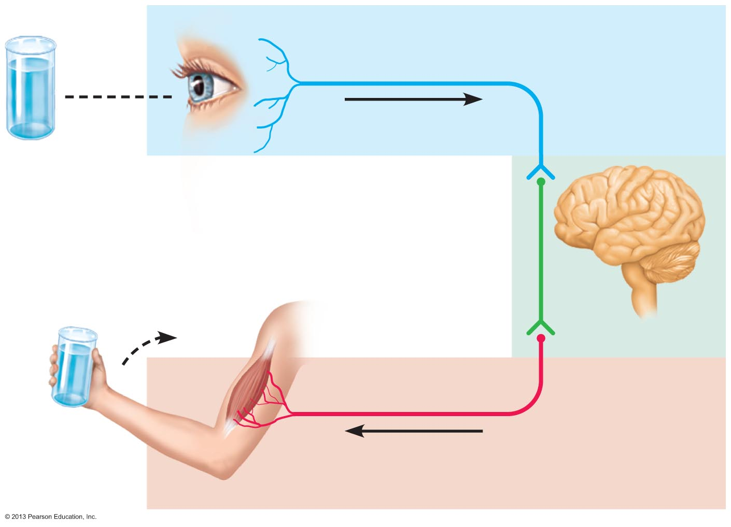
Figure 11.1 The nervous system’s functions.
Sensory input
Integration
Motor output

Slide 7
Divisions of the Nervous System
Central nervous system (CNS)
Brain and spinal cord
Integration and control center
Interprets sensory input and dictates motor output
Peripheral nervous system (PNS)
The portion of the nervous system outside CNS
Spinal nerves to and from spinal cord
Cranial nerves to and from brain

Slide 8
Peripheral Nervous System (PNS)
Two functional divisions
Sensory (afferent) division
Somatic sensory fibers—convey impulses from skin, skeletal muscles, and joints to CNS
Visceral sensory fibers—convey impulses from visceral organs to CNS
Motor (efferent) division
Transmits impulses from CNS to effector organs
Muscles and glands
Two divisions
Somatic nervous system
Autonomic nervous system

Slide 9
Motor Division of PNS: Somatic Nervous System
Somatic motor nerve fibers
Conducts impulses from CNS to skeletal muscle
Voluntary nervous system
Conscious control of skeletal muscles

Slide 10
Motor Division of PNS: Autonomic Nervous System
Visceral motor nerve fibers
Regulates smooth muscle, cardiac muscle, and glands
Involuntary nervous system
Two functional subdivisions
Work in opposition to each other
Sympathetic
Parasympathetic

Slide 11
Histology of Nervous Tissue
Highly cellular; little extracellular space
Tightly packed
Two principal cell types
Neuroglia
small cells that surround and wrap delicate neurons
Neurons (nerve cells)
excitable cells that transmit electrical signals

Slide 12
Histology of Nervous Tissue: Neuroglia
Central Nervous System Glial cells
Astrocytes
Microglial cells
Ependymal cells
Oligodendrocytes
Peripheral Nervous System Glial cells
Satellite cells
Schwann cells (PNS)

Slide 13
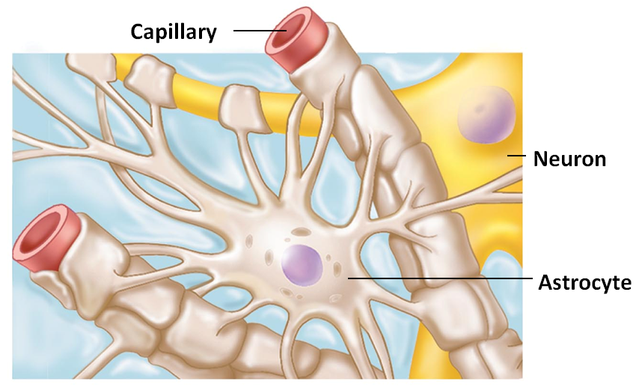
Astrocytes
Most abundant
highly branched glial cells
Cling to neurons, synaptic endings, and capillaries
Functions include
Support and brace neurons
Play role in exchanges between capillaries and neurons
Guide migration of young neurons

Slide 14
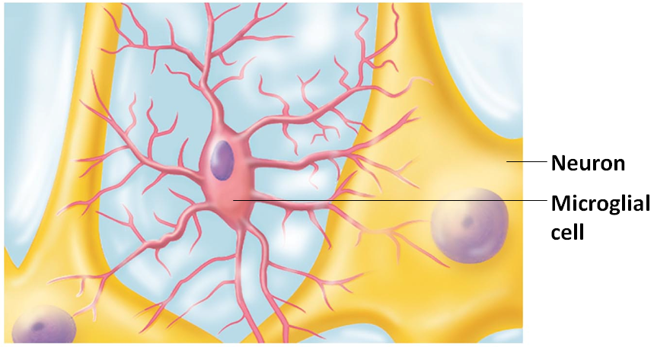
Microglial Cells
Small, ovoid cells
have thorny processes that touch and monitor neurons
Migrate toward injured neurons
Can act as phagocytes

Slide 15
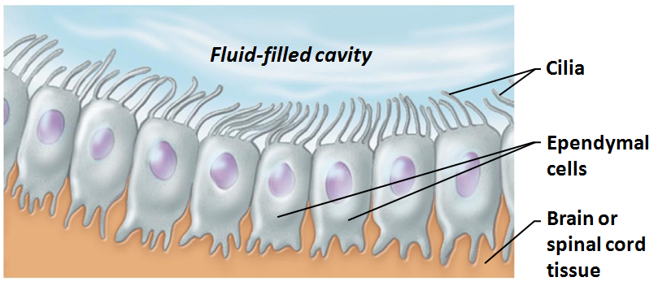
Ependymal Cells
Can be squamous or columnar
May be ciliated
circulates cerebrospinal fluid
Line the central cavities of the brain and spinal column

Slide 16
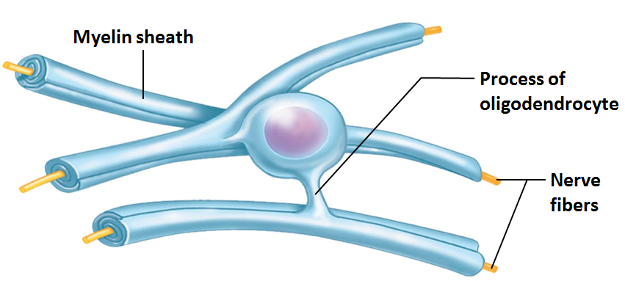
Oligodendrocytes
Branched cells
Processes wrap CNS nerve fibers
forming myelin sheaths

Slide 17
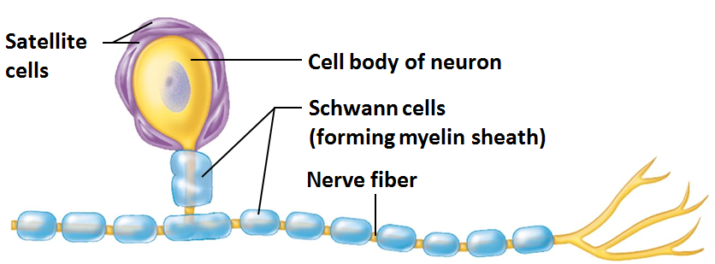
Satellite Cells and Schwann Cells
Satellite cells
Surround neuron cell bodies in PNS
Schwann cells
Surround all peripheral nerve fibers
form myelin sheaths in thicker nerve fibers
Vital to regeneration of damaged peripheral nerve fibers

Slide 18
Neurons
Structural units of nervous system
Large, highly specialized cells that conduct impulses
Extreme longevity (→ 100 years or more)
Amitotic
with few exceptions
High metabolic rate
requires continuous supply of oxygen and glucose
All have cell body and one or more processes

Slide 19
Neuron Cell Body or Soma
Biosynthetic center of neuron
Synthesizes proteins, membranes, and other chemicals
Rough ER (nissl bodies)
Most active and best developed in body
Spherical nucleus with nucleolus
In most, plasma membrane part of receptive region
Most neuron cell bodies are in CNS
Location of cell bodies
Central Nervous system:
In gray matter or clusters called nuclei
Peripheral Nervous System
In clusters called ganglia

Slide 20
Neuron Processes
CNS
Both neuron cell bodies and their processes
PNS
Chiefly neuron processes
Tracts
Bundles of neuron processes in CNS
Nerves
Bundles of neuron processes in PNS
Two types of processes
Dendrites
Axon

Slide 21
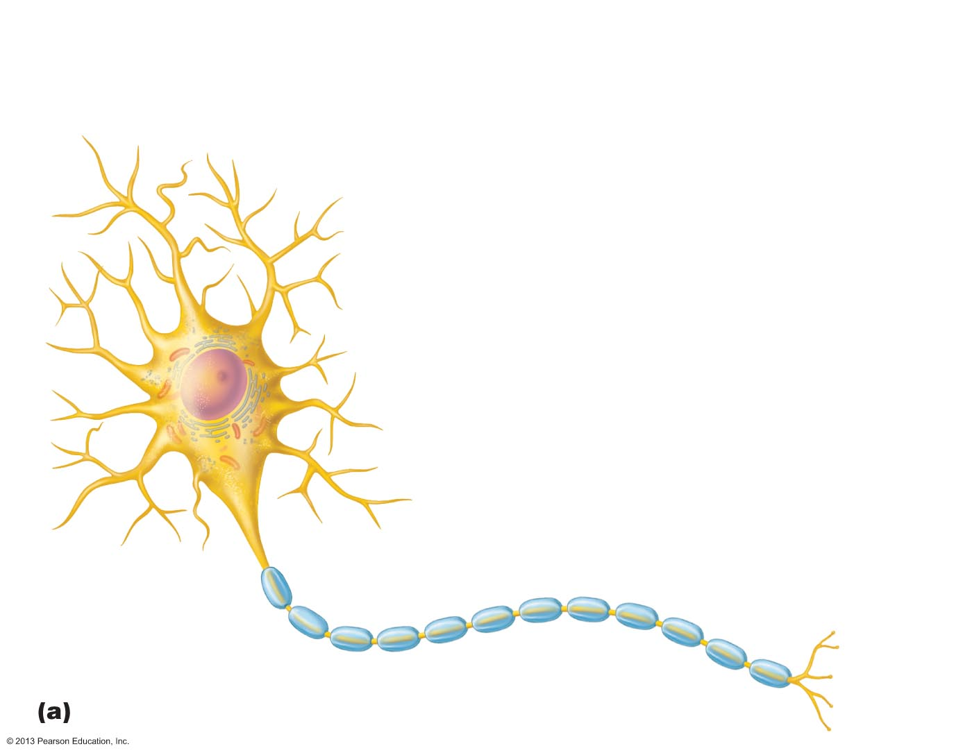
Figure 11.4a Structure of a motor neuron.
Dendrites
(receptive
regions)
Cell body
Nucleus
Axon
Nucleolus
Impulse
direction
Myelin sheath gap
(node of Ranvier)
Axon
terminals
(secretory
region)
Schwann cell
Axon hillock
Terminal branches

Slide 22
Dendrites
In motor neurons
hundreds of short, tapering, diffusely branched processes
Receptive (input) region of neuron
Convey incoming messages toward cell body
Use graded potentials
short distance signals

Slide 23
The Axon: Structure
One axon per cell arising from axon hillock
Cone-shaped area of cell body
Some 1 meter long
Long axons called nerve fibers
Occasional branches
Called axon collaterals
Branches profusely at end
Can be 10,000 terminal branches
Distal endings called axon terminals or terminal boutons

Slide 24
The Axon: Functional Characteristics
Conducting region of neuron
Generates nerve impulses
Transmits them along neuron cell membrane to axon terminal
Neurotransmitters released into extracellular space
Either excite or inhibit neurons with which axons in close contact
Lacks rough ER and Golgi apparatus
Relies on cell body to renew proteins and membranes
Efficient transport mechanisms
Quickly decay if cut or damaged

Slide 25
Myelin Sheath
Composed of myelin
Whitish, protein-lipoid substance
Function of myelin
Protects and electrically insulates axon
Increases speed of nerve impulse transmission
Nonmyelinated fibers conduct impulses more slowly

Slide 26
Myelination in the PNS
Formed by Schwann cells
Wrap around axon
One cell forms one segment of myelin sheath
Myelin sheath
Concentric layers of Schwann cell plasma membrane around axon

Slide 27
Figure 11.5a Nerve fiber myelination by Schwann cells in the PNS.
Schwann
cell plasma
membrane
Slide 2
A Schwann cell envelops an axon.
1
Schwann cell
cytoplasm
Axon
Schwann cell
nucleus
Myelination of a nerve fiber (axon)

Slide 28
Figure 11.5a Nerve fiber myelination by Schwann cells in the PNS.
Schwann
cell plasma
membrane
Slide 3
A Schwann cell envelops an axon.
1
Schwann cell
cytoplasm
Axon
Schwann cell
nucleus
2
The Schwann cell then rotates
around the axon, wrapping its
plasma membrane loosely around
it in successive layers.
Myelination of a nerve fiber (axon)

Slide 29
Figure 11.5a Nerve fiber myelination by Schwann cells in the PNS.
Schwann
cell plasma
membrane
Slide 4
A Schwann cell envelops an axon.
1
Schwann cell
cytoplasm
Axon
Schwann cell
nucleus
2
The Schwann cell then rotates
around the axon, wrapping its
plasma membrane loosely around
it in successive layers.
3
The Schwann cell cytoplasm is
forced from between the membranes.
The tight membrane wrappings
surrounding the axon form the myelin
sheath.
Myelin
sheath
Schwann cell cytoplasm
Myelination of a nerve fiber (axon)

Slide 30
Myelination in the PNS
Plasma membranes of myelinating have cells less protein
Good electrical insulators
Nodes of Ranvier
Myelin sheath gaps between adjacent Schwann cells
Sites where axon collaterals can emerge
Nonmyelinated fibers
Thin fibers not wrapped in myelin
surrounded by Schwann cells but no coiling
one cell may surround 15 different fibers

Slide 31
Myelin Sheaths in the CNS
Formed by multiple, flat processes of oligodendrocytes, not whole cells
Nodes of Ranvier are present
No neurilemma
Thinnest fibers are unmyelinated
White matter
Regions of brain and spinal cord with dense collections of myelinated fibers
usually fiber tracts
Gray matter
Mostly neuron cell bodies and nonmyelinated fibers

Slide 32
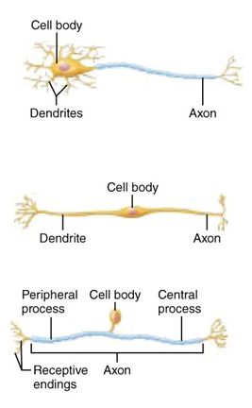
Structural Classification of Neurons
Grouped by number of processes
Three types
Multipolar
3 or more processes
1 axon, others dendrites
Most common; major neuron in CNS
Bipolar
2 processes
1 axon and 1 dendrite
Rare: Retina and olfactory mucosa
Unipolar
1 short process
Divides T-like – both branches now considered axons
Distal (peripheral) process – associated with sensory receptor
Proximal (central) process – enters CNS

Slide 33
Functional Classification of Neurons
Grouped by direction in which nerve impulse travels relative to CNS
Three types
Sensory (afferent)
Motor (efferent)
Interneurons

Slide 34
Functional Classification of Neurons
Sensory
Transmit impulses from sensory receptors toward CNS
Almost all are Unipolar
Cell bodies in ganglia in PNS
Motor
Carry impulses from CNS to effectors
Multipolar
Most cell bodies in CNS (except some autonomic neurons)
Interneurons (association neurons)
Lie between motor and sensory neurons
Shuttle signals through CNS pathways; most are entirely within CNS
99% of body's neurons
Most confined in CNS

Slide 35
Membrane Potentials
Neurons are highly irritable
Respond to adequate stimulus by generating an action potential (nerve impulse)
Impulse is always the same regardless of stimulus

Slide 36
Role of Membrane Ion Channels
Large proteins serve as selective membrane ion channels
Two main types of ion channels
Leakage (nongated) channels
Always open
Gated
Part of protein changes shape to open/close channel

Slide 37
Role of Membrane Ion Channels: Gated Channels
Three types
Chemically gated channels
Open with binding of a specific neurotransmitter
Voltage-gated channels
Open and close in response to changes in membrane potential
Mechanically gated channels
Open and close in response to physical deformation of receptors, as in sensory receptors

Slide 38
The Resting Membrane Potential
Potential difference across membrane of resting cell
Approximately –70 mV in neurons
Membrane called polarized

Slide 39
Resting Membrane Potential: Differences in Ionic Composition
Outside has higher concentration of Na⁺ than inside
Inside has higher concentration of K⁺ than outside
K⁺ plays most important role in membrane potential

Slide 40
Resting Membrane Potential
More potassium diffuses out than sodium diffuses in
Cell more negative inside
Establishes resting membrane potential
Sodium-potassium pump stabilizes resting membrane potential
Maintains concentration gradients for Na⁺ and K⁺

Slide 41
Membrane Potential Changes Used as Communication Signals
Membrane potential changes when
Concentrations of ions across membrane change
Membrane permeability to ions changes
Changes produce two types signals
Graded potentials
Incoming signals operating over short distances
Seen in dendrites
Action potentials
Long-distance signals of axons

Slide 42
Changes in Membrane Potential
Terms describing membrane potential changes relative to resting membrane potential
Depolarization
Decrease in membrane potential
inside of membrane becomes less negative
Increases probability of producing a nerve impulse

Slide 43
Changes in Membrane Potential
Terms describing membrane potential changes relative to resting membrane potential
Hyperpolarization
An increase in membrane potential
Becomes more negative
Reduces probability of producing a nerve impulse

Slide 44
Graded Potentials
Short-lived, localized changes in membrane potential
Magnitude varies with stimulus strength
Stronger stimulus → farther current flows
Either depolarization or hyperpolarization
Current dissipates quickly and decays
Graded potentials are signals only over short distances

Slide 45
Action Potentials (AP)
Principal means of long-distance neural communication
Occur only in muscle cells and axons of neurons
Brief reversal of membrane potential with a change in voltage of ~100 mV
Do not decay over distance as graded potentials do

Slide 46
Properties of Gated Channels
Each Na⁺ channel has two voltage-sensitive gates
Activation gates
Closed at rest; open with depolarization allowing Na⁺ to enter cell
Inactivation gates
Open at rest; block channel once it is open to prevent more Na⁺ from entering cell

Slide 47
Properties of Gated Channels
Each K⁺ channel has one voltage-sensitive gate
Closed at rest
Opens slowly with depolarization

Slide 48
Generation of an Action Potential: Resting State
All gated Na⁺ and K⁺ channels are closed
Only leakage channels for Na⁺ and K⁺ are open
This maintains the resting membrane potential

Slide 49
Generation of an Action Potential: Depolarizing Phase
Depolarizing local currents open voltage-gated Na⁺ channels
Na⁺ into cell
More positive charges moving inside the membrane
At threshold (–55 to –50 mV) positive feedback causes opening of all Na⁺ channels
a reversal of membrane polarity to +30mV
Spike of action potential

Slide 50
Generation of an Action Potential: Repolarizing Phase
Repolarizing phase
Na⁺ channel slow inactivation gates close
Slow voltage-gated K⁺ channels open
K⁺ exits the cell and internal negativity is restored

Slide 51
Generation of an Action Potential: Hyperpolarization
Some K⁺ channels remain open, allowing excessive K⁺ outpouring
Inside of membrane more negative than resting state
This causes hyperpolarization of the membrane

Slide 52
Role of the Sodium-Potassium Pump
Repolarization resets electrical conditions, not ionic conditions
Charges are correct, but ions are not in their original starting positions
Na⁺/K⁺ pumps return Na⁺ to the outside and K⁺ to the inside

Slide 53
Threshold
Not all depolarization events produce APs
For axon to "fire", depolarization must reach threshold
At threshold:
Membrane has been depolarized by 15 to 20 mV
The positive feedback cycle begins

Slide 54
Coding for Stimulus Intensity
All action potentials are alike and are independent of stimulus intensity
Strong stimuli cause action potentials to occur more frequently
CNS determines stimulus intensity by the frequency of impulses
Higher frequency means stronger stimulus

Slide 55
Conduction Velocity
Conduction velocities of neurons vary widely
Rate of Action Potential speed depends on
Axon diameter
Larger diameter fibers have faster impulse conduction
Degree of myelination
Continuous conduction in unmyelinated axons is slower
saltatory conduction in myelinated axons is faster

Slide 56
Conduction Velocity: Effects of Myelination
Myelin sheaths insulate and prevent leakage of charge
Saltatory conduction is about 30 times faster
Electrical signal appears to jump rapidly from gap to gap

Slide 57
The Synapse
Nervous system works because information flows from neuron to neuron
Neurons functionally connected by synapses
Junctions that mediate information transfer
From one neuron to another neuron
Or from one neuron to an effector cell

Slide 58
Important Terminology
Presynaptic neuron
Neuron conducting impulses toward synapse
Sends the information
Postsynaptic neuron
Neuron transmitting electrical signal away from synapse
Receives the information

Slide 59
Synaptic Cleft
Prevents nerve impulses from directly passing from one neuron to next
Transmission across synaptic cleft
Chemical event
Not electrical
Depends on release, diffusion, and receptor binding of neurotransmitters
Ensures one-way communication between neurons

Slide 60
Information Transfer Across Chemical Synapses
1. Action Potential arrives at axon terminal of presynaptic neuron
2. Causes voltage-gated Ca²⁺ channels to open
Ca²⁺ floods into cell
3. Calcium triggers exocytosis of neurotransmitter into synaptic cleft
Higher impulse frequency → more neutrotransmitter released

Slide 61
Information Transfer Across Chemical Synapses
4. Neurotransmitter diffuses across synapse
5. Binds to receptors on postsynaptic neuron
6. Ion channels are opened
Causes an excitatory or inhibitory event
graded potential
7. Neurotransmitter effects terminated

Slide 62
Termination of Neurotransmitter Effects
Within a few milliseconds neurotransmitter effect terminated in one of three ways
Reuptake
Taken back into axon by astrocytes or axon terminal
Degradation
By enzymes
Diffusion
Away from synaptic cleft

Slide 63
Postsynaptic Potentials
Neurotransmitter receptors cause graded potentials that vary in strength with
Amount of neurotransmitter released and
Time neurotransmitter stays in area

Slide 64
Postsynaptic Potentials
Types of postsynaptic potentials
EPSP
excitatory postsynaptic potentials
IPSP
inhibitory postsynaptic potentials

Slide 65
Excitatory Synapses and EPSPs
Neurotransmitter binding causes ion movement that results in a depolarization
Na+ enters the cell and makes the cell less negative
Slight depolarization is not enough to trigger an action potential
EPSP help trigger AP when threshold is reached

Slide 66
Inhibitory Synapses and IPSPs
Reduces postsynaptic neuron's ability to produce an action potential
K+ moves out or negative ions move in
Results in the membrane becoming more negative
Will be harder to reach threshhold
Therefore neurotransmitter hyperpolarizes cell

Slide 67
Synaptic Integration: Summation
A single EPSP cannot induce an AP
Too weak of a depolarization; won’t reach threshold on its own
EPSPs can summate to influence postsynaptic neuron
IPSPs can also summate
Most neurons receive both excitatory and inhibitory inputs from thousands of other neurons

Slide 68
Two Types of Summation
Temporal summation (time/rate)
One or more presynaptic neurons transmit impulses in rapid-fire order
Spatial summation (Space: multiple locations)
Postsynaptic neuron stimulated simultaneously by large number of terminals at same time

Slide 69
Regions and Organization of the CNS
Spinal cord
Central cavity surrounded by gray matter
External white matter composed of myelinated fiber tracts

Slide 70
Regions and Organization of the CNS
Brain
Similar pattern
Additional areas of gray matter in brain
Cerebral hemispheres and cerebellum
Outer gray matter called cortex
Cortex disappears in brain stem
Scattered gray matter nuclei within the white matter

Slide 71
Ventricles of the Brain
Filled with cerebrospinal fluid (CSF)
Lined by ependymal cells
Connected to one another and to central canal of spinal cord
Lateral ventricles connect to the third ventricle by the interventricular foramen
Third ventricle connects to the fourth ventricle via cerebral aqueduct

Slide 72
Ventricles of the Brain
Paired, C-shaped lateral ventricles in cerebral hemispheres
Third ventricle in diencephalon
Fourth ventricle in hindbrain

Slide 73
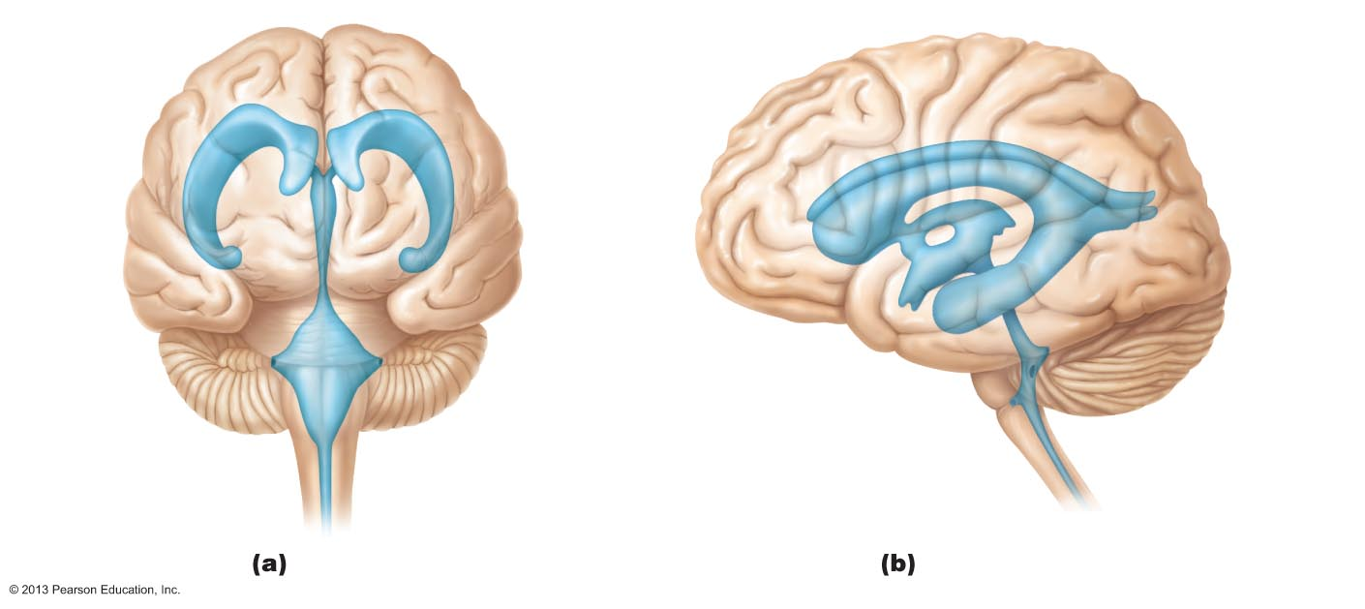
Figure 12.3 Ventricles of the brain.
Lateral
ventricle
Anterior
horn
Posterior
horn
Septum
pellucidum
Interventricular
foramen
Inferior
horn
Third
ventricle
Inferior
horn
Lateral
aperture
Cerebral aqueduct
Median
aperture
Fourth ventricle
Lateral
aperture
Central canal
Anterior view
Left lateral view

Slide 74
Cerebral Hemispheres
Surface markings
Ridges
Gyri
shallow grooves
Sulci
deep grooves
Fissures
Longitudinal fissure
Separates two hemispheres
Transverse cerebral fissure
Separates cerebrum and cerebellum

Slide 75
Cerebral Hemispheres
Five lobes
Frontal
Parietal
Temporal
Occipital
Insula

Slide 76
Cerebral Hemispheres
Central sulcus
Separates precentral gyrus (motor) of frontal lobe and postcentral gyrus (sensory) of parietal lobe
Parieto-occipital sulcus
Separates occipital and parietal lobes
Lateral sulcus outlines temporal lobes

Slide 77
Cerebral Hemispheres
Three basic regions
Cerebral cortex of gray matter superficially
White matter internally
Basal nuclei deep within white matter

Slide 78
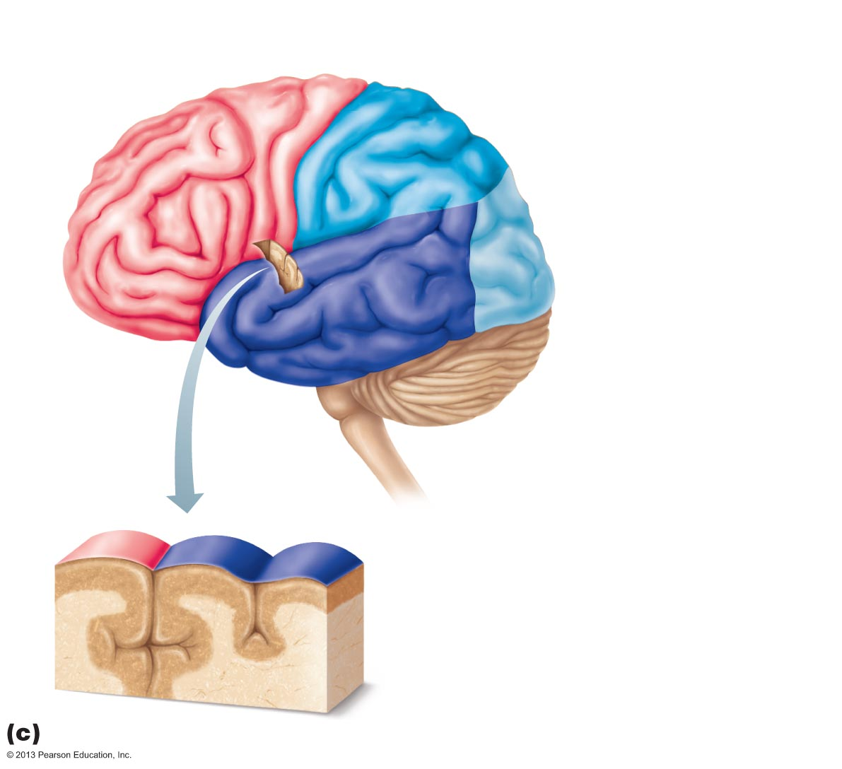
Figure 12.4c Lobes, sulci, and fissures of the cerebral hemispheres.
Precentral
gyrus
Central
sulcus
Postcentral
gyrus
Frontal lobe
Parietal lobe
Parieto-occipital sulcus
(on medial surface
of hemisphere)
Lateral sulcus
Occipital lobe
Temporal lobe
Transverse
cerebral fissure
Cerebellum
Pons
Medulla oblongata
Fissure
(a deep
sulcus)
Spinal cord
Gyrus
Cortex (gray matter)
Sulcus
White matter
Lobes and sulci of the cerebrum

Slide 79
Cerebral Cortex
Thin, superficial layer of gray matter
40% mass of brain
Site of conscious mind: awareness, sensory perception, voluntary motor initiation, communication, memory storage, understanding

Slide 80
4 General Considerations of Cerebral Cortex
Three types of functional areas
Motor areas
control voluntary movement
Sensory areas
conscious awareness of sensation
Association areas
integrate diverse information

Slide 81
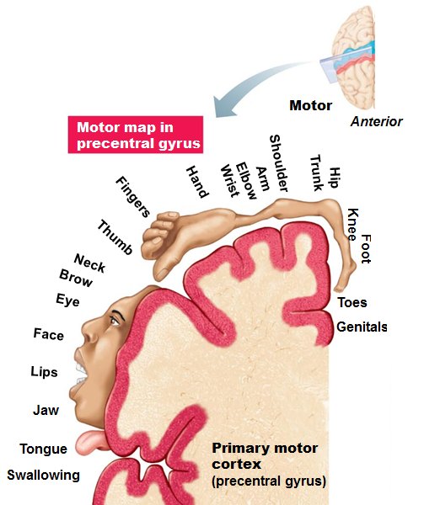
Motor Areas of Cerebral Cortex
In frontal lobe; control voluntary movement
Primary (somatic) motor cortex
in precentral gyrus
Allows conscious control of precise, skilled, skeletal muscle movements
Motor homunculi
upside-down caricatures represent contralateral motor innervation of body regions

Slide 82
Motor Areas of Cerebral Cortex
Premotor cortex anterior to precentral gyrus
Helps plan movements
Controls learned, repetitious, or patterned motor skills
Coordinates simultaneous or sequential actions
Controls voluntary actions that depend on sensory feedback
Broca's area anterior to inferior premotor area
Present in one hemisphere (usually the left)
directs muscles of speech production
Active in planning speech and voluntary motor activities

Slide 83
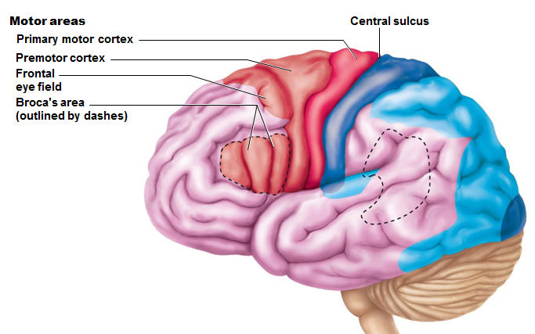
Motor Areas of Cerebral Cortex
Frontal eye field within and anterior to premotor cortex; superior to Broca's area
Controls voluntary eye movements

Slide 84
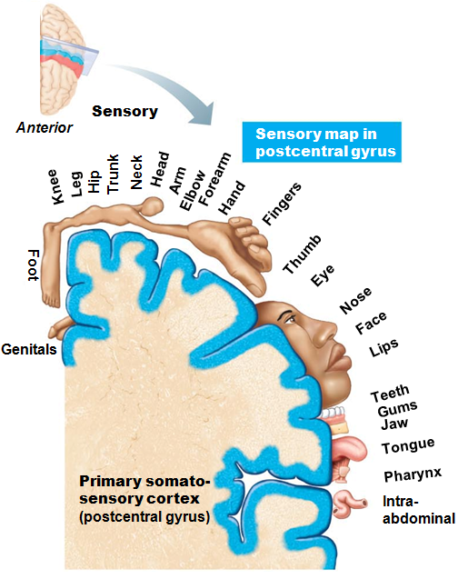
Primary Somatosensory Cortex
In postcentral gyrus
general sensory input from skin, joints, and tendons
Capable of spatial discrimination
identification of body region being stimulated
homunculus
upside-down caricatures represent contralateral sensory input from body regions

Slide 85
Somatosensory Association Cortex
Posterior to primary somatosensory cortex
Integrates sensory input from primary somatosensory cortex for understanding of object
Determines size, texture, and relationship of parts of objects being felt

Slide 86
Visual Areas
Primary visual (striate) cortex
Extreme posterior tip of occipital lobe
Receives visual information from retinas
Visual association area
Surrounds primary visual cortex
Uses past visual experiences to interpret visual stimuli
ability to recognize faces

Slide 87
Auditory Areas
Primary auditory cortex
Superior margin of temporal lobes
Interprets information from inner ear as pitch, loudness, and location
Auditory association area
Located posterior to primary auditory cortex
Stores memories of sounds and permits perception of sound stimulus

Slide 88
OIfactory and Gustatory
Primary olfactory (smell) cortex
Medial aspect of temporal lobes
Region of conscious awareness of odors
Gustatory Cortex
In insula just deep to temporal lobe
Involved in perception of taste

Slide 89
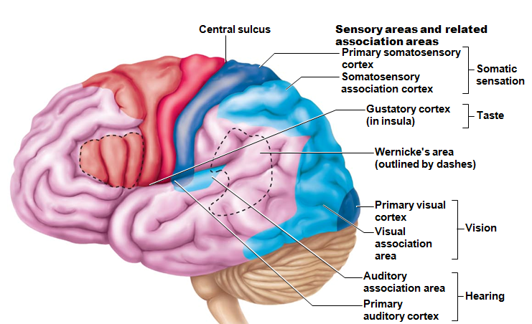
Visceral Sensory Area
Posterior to gustatory cortex
Conscious perception of visceral sensations,
upset stomach or full bladder

Slide 90
Cerebral White Matter
Myelinated fibers and tracts
Communication between cerebral areas, and between cortex and lower CNS
Association fibers
horizontal; connect different parts of same hemisphere
Commissural fibers
horizontal; connect gray matter of two hemispheres
Projection fibers
vertical; connect hemispheres with lower brain or spinal cord

Slide 91
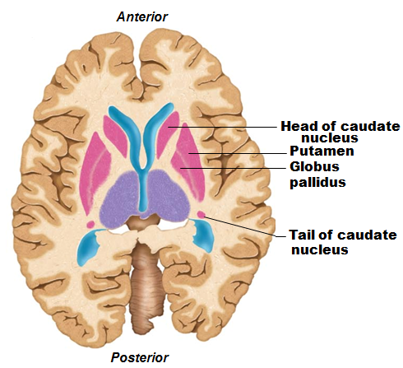
Functions of Basal Nuclei
Functions thought to be
Influence muscle movements
Role in cognition and emotion
Regulate intensity of slow or stereotyped movements
Filter out incorrect/inappropriate responses
Inhibit antagonistic/unnecessary movements

Slide 92
Diencephalon
Three paired structures
Thalamus
Hypothalamus
Epithalamus
Encloses third ventricle

Slide 93
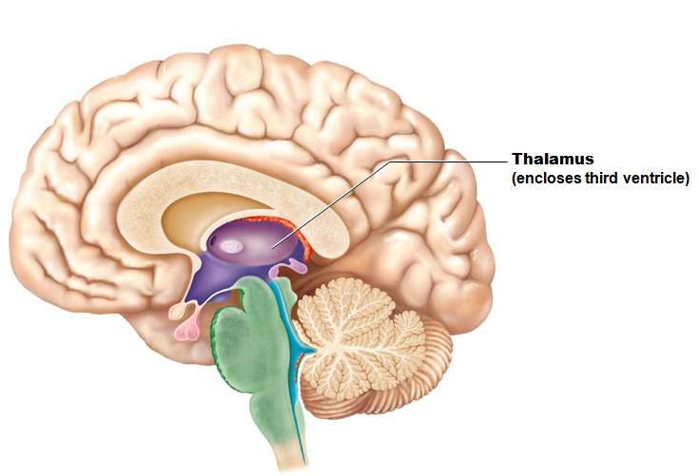
Thalamus
80% of diencephalon
Nuclei project and receive fibers from cerebral cortex

Slide 94
Thalamic Function
Gateway to cerebral cortex
Sorts, edits, and relays ascending input

Slide 95
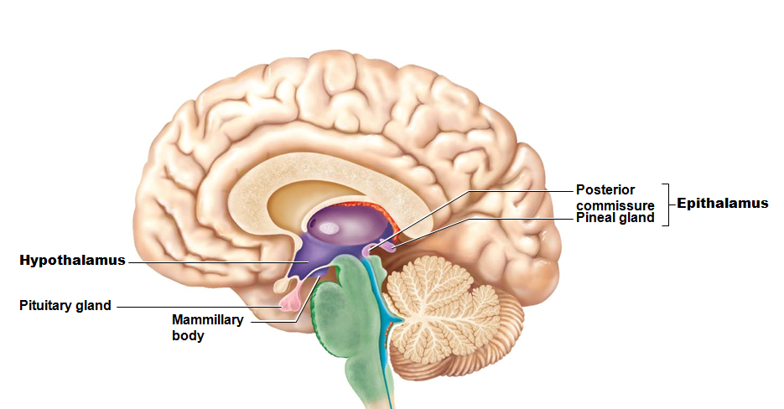
Hypothalamus
Contains many nuclei
Example: mammillary bodies
Infundibulum
stalk that connects to pituitary gland

Slide 96
Hypothalamic Function
Controls autonomic nervous system
blood pressure
rate and force of heartbeat
digestive tract motility
pupil size
Physical responses to
limbic system
Perception of pleasure, fear, and rage, and in biological rhythms and drives

Slide 97
Hypothalamic Function
Regulates body temperature
sweating/shivering
Regulates hunger and satiety
in response to nutrient blood levels or hormones
Regulates water balance and thirst
Regulates sleep-wake cycles
Controls endocrine system
Controls secretions of anterior pituitary gland
Produces posterior pituitary hormones

Slide 98
Epithalamus
Pineal gland (body)
extends from posterior border and secretes melatonin
Melatonin
helps regulate sleep-wake cycle

Slide 99
Brain Stem
Three regions
Midbrain
Pons
Medulla oblongata

Slide 100
Brain Stem
Similar structure to spinal cord
contains nuclei embedded in white matter
Controls automatic behaviors necessary for survival
Contains fiber tracts connecting higher and lower neural centers

Slide 101
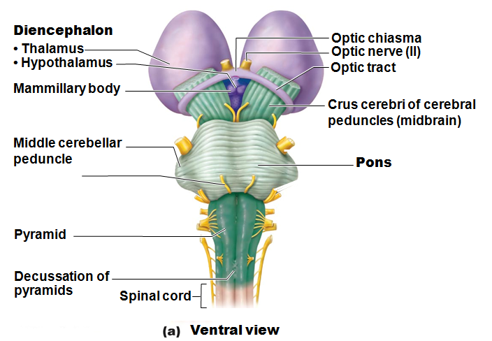

Slide 102
Pons
Fibers of pons
Connect higher brain centers and spinal cord
Relay impulses between motor cortex and cerebellum
Nuclei help maintain normal rhythm of breathing

Slide 103
Medulla Oblongata (Medulla)
Joins spinal cord at foramen magnum
Contains choroid plexus of fourth ventricle
Pyramids
two ventral longitudinal ridges formed by pyramidal tracts
Decussation of the pyramids
crossover of corticospinal tracts

Slide 104
Medulla Oblongata: Functions
Autonomic reflex center
Functions overlap with hypothalamus
Hypothalamus relays instructions via medulla
Cardiovascular center
Cardiac center adjusts force and rate of heart contraction
Vasomotor center adjusts blood vessel diameter for blood pressure regulation

Slide 105
Medulla Oblongata
Respiratory centers
Generate respiratory rhythm
Control rate and depth of breathing (with pontine centers)

Slide 106
Medulla Oblongata
Additional centers regulate
Vomiting
Hiccuping
Swallowing
Coughing
Sneezing

Slide 107
Cerebellum
11% of brain mass
Input from cortex, brain stem and sensory receptors
Allows smooth, coordinated movements
Arbor vitae
treelike pattern of cerebellar white matter
Role in thinking, language, and emotion
May compare actual with expected output and adjust accordingly

Slide 108
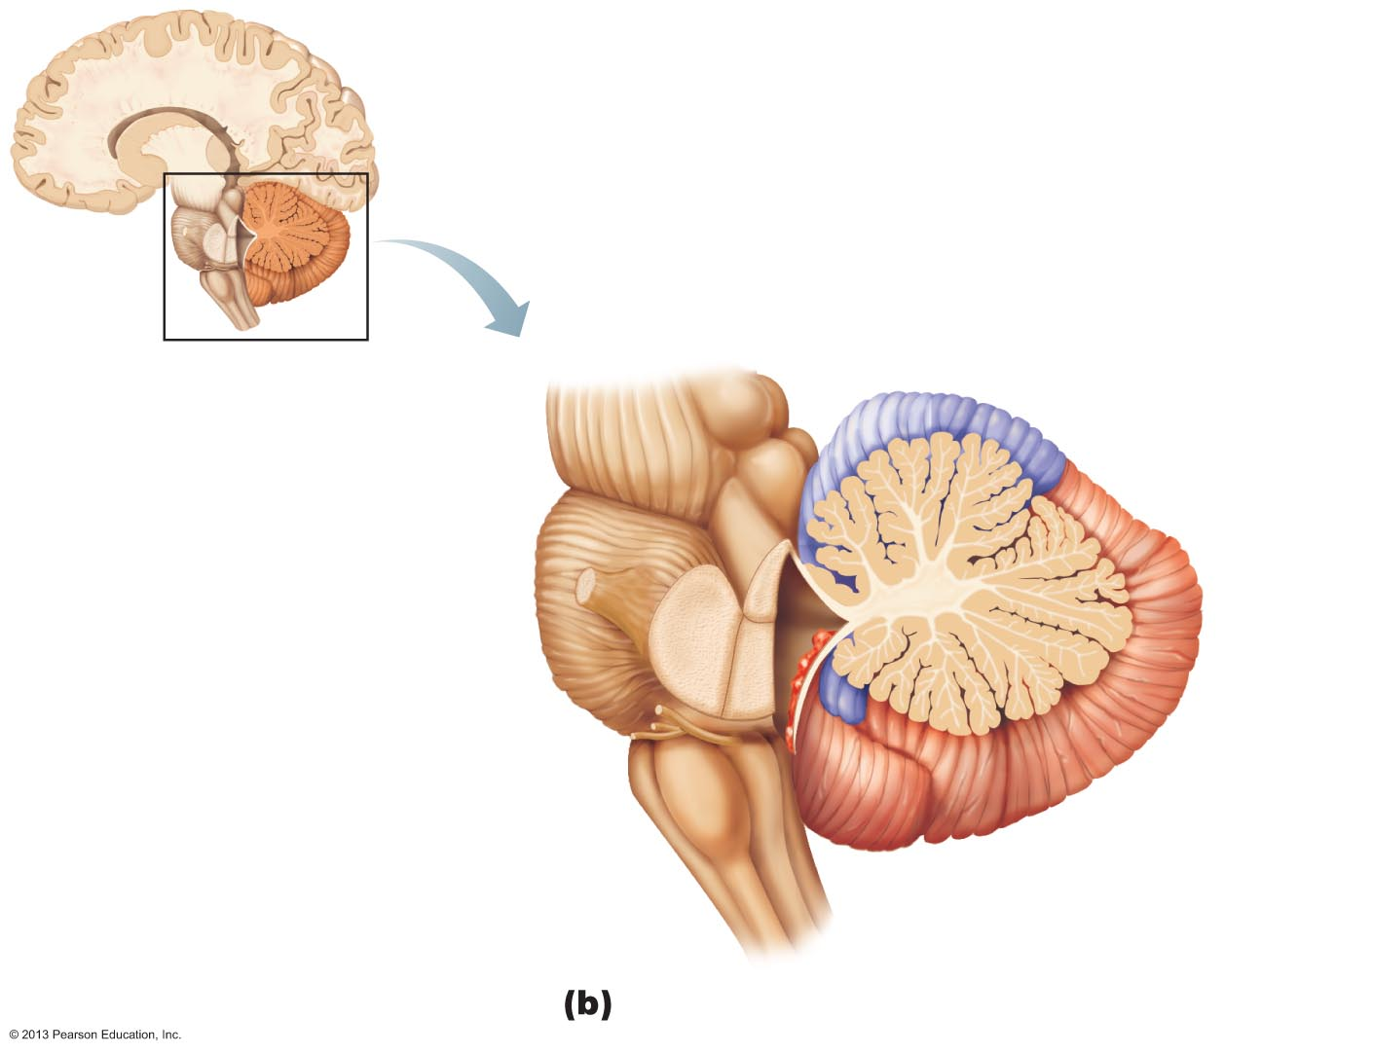
Figure 12.15b Cerebellum.
Anterior lobe
Cerebellar cortex
Arbor
vitae
Cerebellar
peduncles
Posterior
lobe
• Superior
• Middle
Choroid
plexus of
fourth
ventricle
• Inferior
Medulla
oblongata
Flocculonodular
lobe

Slide 109
Protection of the Brain
Bone (skull)
Membranes (meninges)
Watery cushion (cerebrospinal fluid)
Blood brain barrier

Slide 110
Please note that due to differing operating systems, some animations will not appear until the presentation is viewed in Presentation Mode (Slide Show view). You may see blank slides in the “Normal” or “Slide Sorter” views. All animations will appear after viewing in Presentation Mode and playing each animation. Most animations will require the latest version of the Flash Player, which is available at http://get.adobe.com/flashplayer.
Notes:
Meninges

Slide 111
Meninges
Cover and protect CNS
Protect blood vessels and enclose venous sinuses
Contain cerebrospinal fluid (CSF)
Form partitions in skull

Slide 112
Meninges
Three layers
Dura mater
Arachnoid mater
Pia mater
Meningitis
Inflammation of meninges

Slide 113
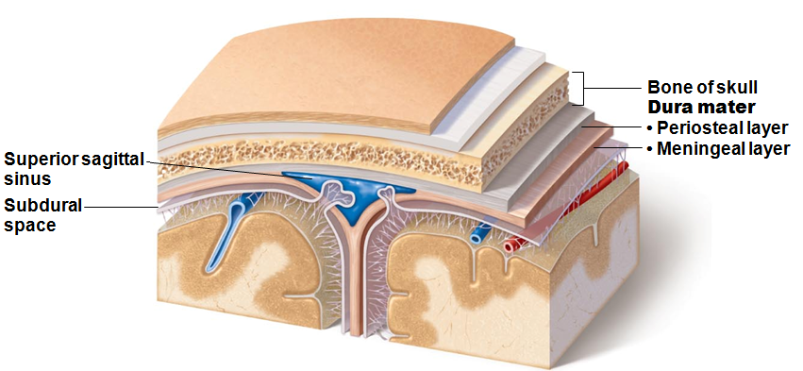
Dura Mater
Strongest layer
Two layers of fibrous connective tissue (around brain) separate to form dural venous sinuses

Slide 114
Dura Mater
Dural septa limit excessive movement of brain
Falx cerebri
in longitudinal fissure; attached to crista galli
Falx cerebelli
along vermis of cerebellum
Tentorium cerebelli
horizontal dural fold over cerebellum and in transverse fissure

Slide 115
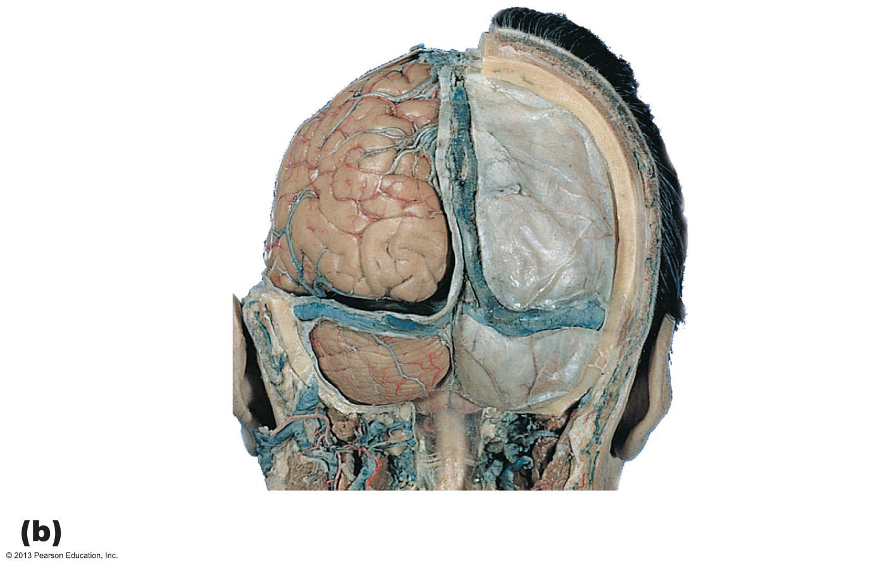
Figure 12.23b Dural septa and dural venous sinuses.
Parietal
bone
Scalp
Falx cerebri
Tentorium
cerebelli
Dura mater
Falx
cerebelli
Transverse
sinus
Cerebellum
Posterior dissection

Slide 116
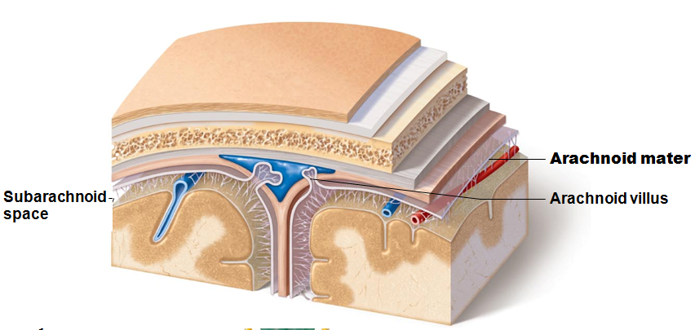
Arachnoid Mater
Middle layer with weblike extensions
Separated from dura mater by subdural space
contains CSF and largest blood vessels of brain
Arachnoid villi
permit cerebrospinal fluid reabsorption

Slide 117
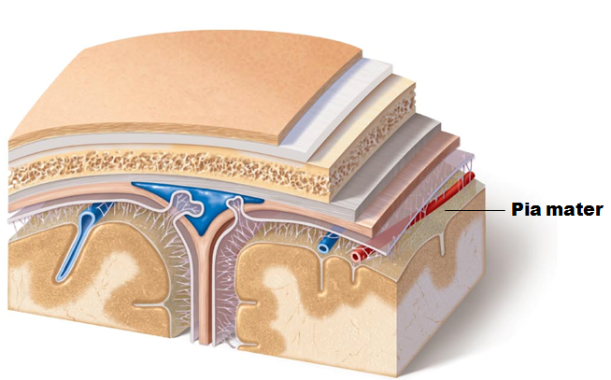
Pia Mater
Delicate vascularized connective tissue that clings tightly to brain

Slide 118
Cerebrospinal Fluid (CSF)
Composition
Watery solution formed from blood plasma
Functions
Gives buoyancy to CNS structures
Reduces weight by 97%
Protects CNS from blows and other trauma
Nourishes brain and carries chemical signals

Slide 119
Please note that due to differing operating systems, some animations will not appear until the presentation is viewed in Presentation Mode (Slide Show view). You may see blank slides in the “Normal” or “Slide Sorter” views. All animations will appear after viewing in Presentation Mode and playing each animation. Most animations will require the latest version of the Flash Player, which is available at http://get.adobe.com/flashplayer.
Notes:
CSF Flow

Slide 120
Spinal Cord: Gross Anatomy and Protection
Location
Begins at the foramen magnum
Ends at L₁ or L₂ vertebra
Functions
Provides two-way communication to and from brain
Contains spinal reflex centers

Slide 121
Spinal Cord: Gross Anatomy and Protection
Bone, meninges, and CSF
Epidural space
Cushion of fat and network of veins in space between vertebrae and spinal dura mater
CSF in subarachnoid space

Slide 122
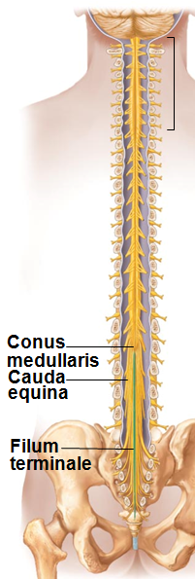
Spinal Cord: Gross Anatomy and Protection
Terminates in conus medullaris
Filum terminale extends to coccyx
Anchors spinal cord
Denticulate ligaments
Extensions of pia mater that secure cord to dura mater

Slide 123
Spinal Cord
Spinal nerves (Part of PNS)
31 pairs
Cervical and lumbosacral enlargements
Nerves serving upper and lower limbs emerge here
Cauda equina
“horse tail”
Collection of nerve roots at inferior end of vertebral canal

Slide 124
Cross-sectional Anatomy
Two lengthwise grooves partially divide cord into right and left halves
Anterior median fissure
Posterior median sulcus
Gray commissure
connects masses of gray matter; encloses central canal

Slide 125
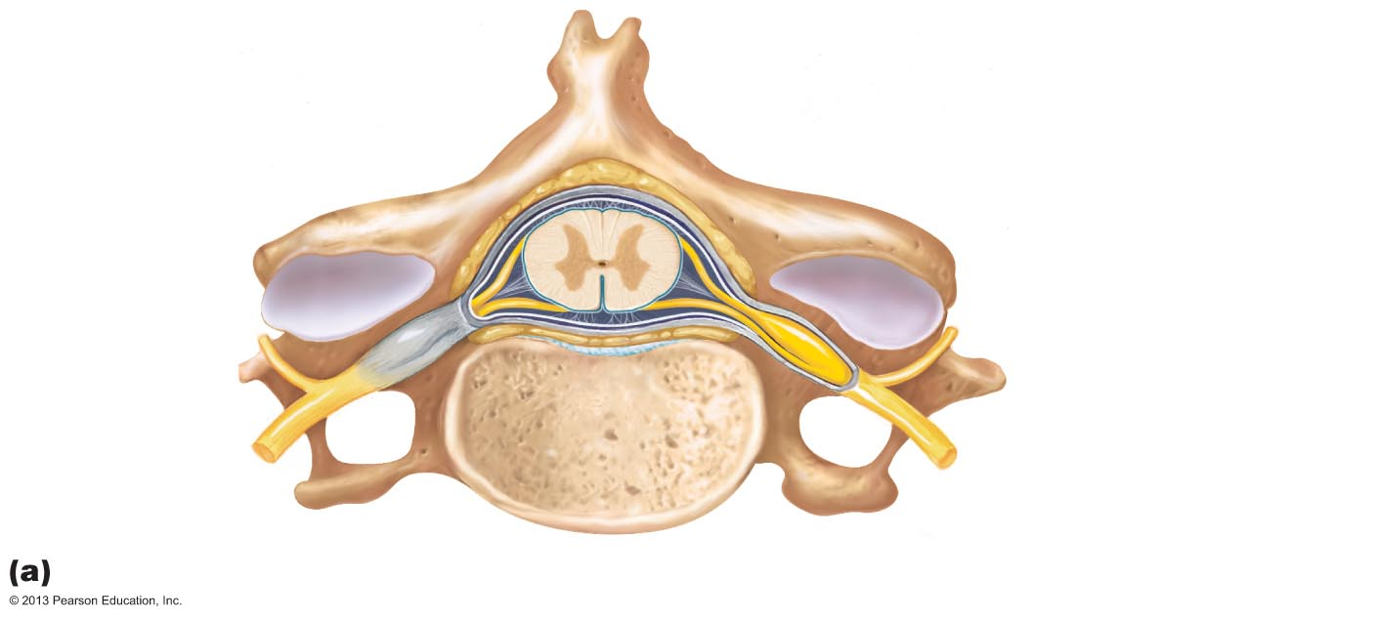
Figure 12.28a Anatomy of the spinal cord.
Epidural space
(contains fat)
Pia mater
Arachnoid mater
Spinal meninges
Subdural space
Dura mater
Subarachnoid
space
(contains CSF)
Dorsal root
ganglion
Cross section of spinal cord and vertebra

Slide 126
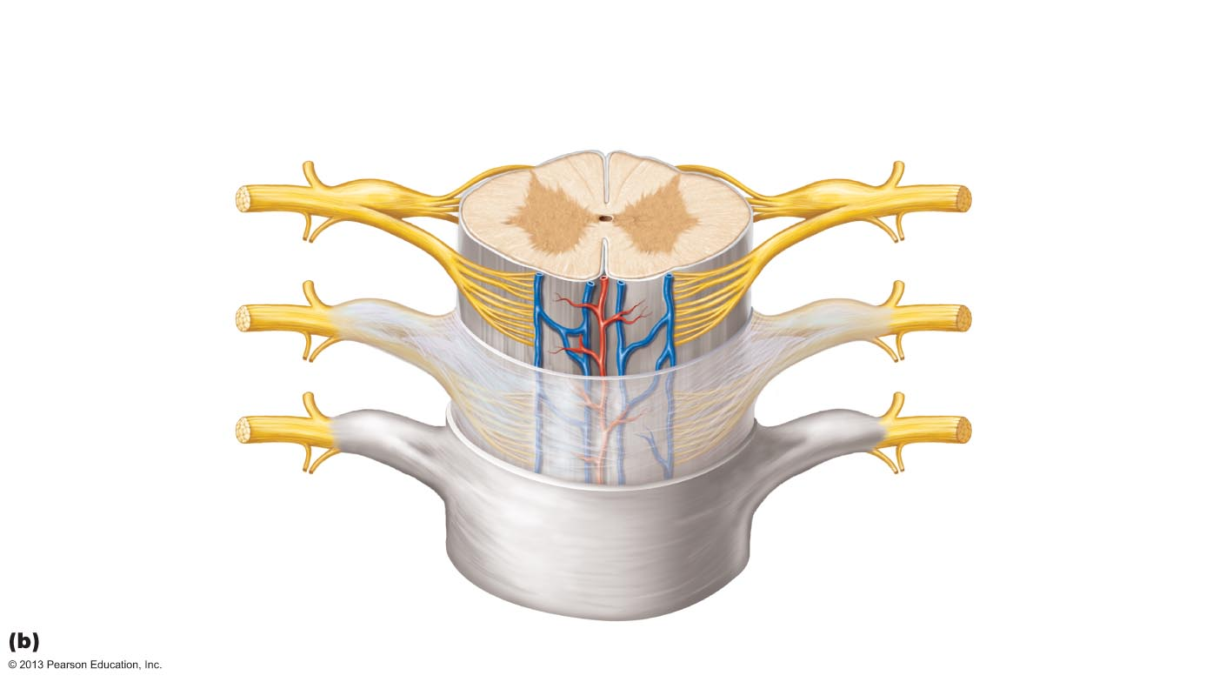
Figure 12.28b Anatomy of the spinal cord.
Posterior
median sulcus
Gray commissure
White
columns
Dorsal horn
Gray
matter
Ventral horn
Lateral horn
Dorsal root
ganglion
Spinal nerve
Dorsal root
Central canal
Anterior median
fissure
Pia mater
Ventral root
Arachnoid mater
Spinal dura mater
The spinal cord and its meningeal coverings

Slide 127
Gray Matter
Dorsal horns
interneurons that receive somatic and visceral sensory input
Ventral horns
some interneurons;
somatic motor neurons;
axons exit cord via ventral roots
Lateral horns
only in thoracic and superior lumbar regions
sympathetic neurons
Dorsal roots
sensory input to cord
Dorsal root (spinal) ganglia
cell bodies of sensory neurons

Slide 128
White Matter
Myelinated and nonmyelinated nerve fibers allow communication between parts of spinal cord, and spinal cord and brain
Run in three directions
Ascending
up to higher centers
sensory inputs
Descending
from brain to cord or lower cord levels
motor outputs
Transverse
from one side to other
commissural fibers

Slide 129
White Matter
Divided into three white columns (funiculi) on each side
Dorsal (posterior), lateral, and ventral (anterior)
Each spinal tract composed of axons with similar destinations and functions

Slide 130
Ascending Pathways
Consist of three neurons
First-order neuron
Conducts impulses from cutaneous receptors and proprioceptors
Branches diffusely as enters spinal cord or medulla
Synapses with second-order neuron

Slide 131
Ascending Pathways
Second-order neuron
Interneuron
Cell body in dorsal horn of spinal cord or medullary nuclei
Axons extend to thalamus or cerebellum

Slide 132
Ascending Pathways
Third-order neuron
Interneuron
Cell body in thalamus
Axon extends to somatosensory cortex
No third-order neurons in cerebellum

Slide 133
Ascending Pathways
Three main pathways:
Two transmit somatosensory information to sensory cortex via thalamus
Dorsal column–medial lemniscal pathways
Spinothalamic pathways
Transmit pain, temperature, coarse touch, and pressure impulses
Provide discriminatory touch and conscious proprioception
Spinocerebellar tracts terminate in the cerebellum
Convey information about muscle or tendon stretch to cerebellum
Used to coordinate muscle activity

Slide 134
Descending Pathways and Tracts
Deliver efferent impulses from brain to spinal cord
Two groups
Direct pathways
pyramidal tracts
Indirect pathways
all others

Slide 135
Descending Pathways and Tracts
Motor pathways involve two neurons:
Upper motor neurons
Pyramidal cells in primary motor cortex
pass through pyramidal (corticospinal)l tracts
Descend without synapsing
Axons synapse with interneurons or ventral horn motor neurons
Direct pathway regulates fast and fine (skilled) movements
Lower motor neurons
Ventral horn motor neurons
Innervate skeletal muscles

Slide 136
Indirect System
Includes brain stem motor nuclei, and all motor pathways except pyramidal pathways
These pathways regulate
muscles for balance and posture
coarse limb movements
Head, neck, and eye movements that follow objects in visual field

Slide 137
Spinal Cord Trauma
Functional losses
Paresthesias
Sensory loss
Paralysis
Loss of motor function

Slide 138
Spinal Cord Trauma
Flaccid paralysis
severe damage to ventral root or ventral horn cells
Impulses do not reach muscles
there is no voluntary or involuntary control of muscles
Muscles atrophy

Slide 139
Spinal Cord Trauma
Spastic paralysis
damage to upper motor neurons of primary motor cortex
Spinal neurons remain intact; muscles are stimulated by reflex activity
No voluntary control of muscles
Muscles often shorten permanently

