Slide 1
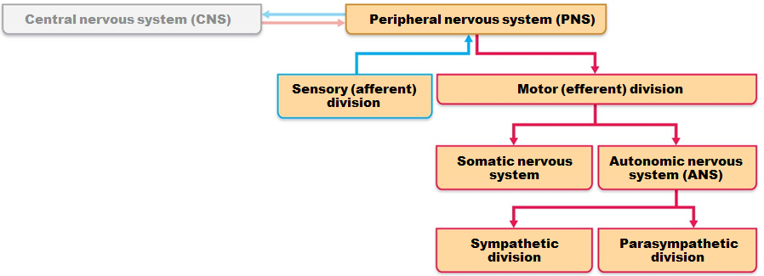
Peripheral Nervous System (PNS)
Provides links from and to world outside body
All neural structures outside brain
  Sensory receptors
  Peripheral nerves and associated ganglia
  Efferent motor endings

Slide 2
Sensory Receptors
Specialized to respond to changes in environment (stimuli)
Activation results in graded potentials that trigger nerve impulses
Sensation
  awareness of stimulus
Perception
  interpretation of meaning of stimulus
Both take place
in brain

Slide 3
Classification of Receptors
Based on
  Type of stimulus they detect
  Location in body
  Structural complexity

Slide 4
Classification by Stimulus Type
Mechanoreceptors
  respond to touch, pressure, vibration, and stretch
Thermoreceptors
  sensitive to changes in temperature
Photoreceptors
  respond to light energy (e.g., retina)
Chemoreceptors
  respond to chemicals (e.g., smell, taste, changes in blood chemistry)
Nociceptors
  sensitive to pain-causing stimuli
    extreme heat or cold, excessive pressure, inflammatory chemicals

Slide 5
Classification by Location
Exteroceptors
  Respond to stimuli arising from outside body
  Receptors in skin for touch, pressure, pain, and temperature
  Most special sense organs are exteroceptors

Slide 6
Classification by Location
Interoceptors (visceroceptors)
  Respond to stimuli arising in internal viscera and blood vessels
  Sensitive to chemical changes, tissue stretch, and temperature changes
  Sometimes cause discomfort
    We are usually unaware of their workings

Slide 7
Classification by Location
Proprioceptors
  Respond to stretch in skeletal muscles, tendons, joints, ligaments, and connective tissue coverings of bones and muscles
  Inform brain of one's movements

Slide 8
Classification by Receptor Structure
Simple receptors for general senses
  Tactile sensations
    touch, pressure, stretch, vibration
  Temperature
  Pain
  muscle sense
  Modified dendritic endings of sensory neurons
Receptors for special senses
  Vision, hearing, equilibrium, smell, and taste (Chapter 15)

Slide 9
Simple Receptors, Nonencapsulated
Nonencapsulated (free) nerve endings
  Abundant in epithelia and connective tissues
  Associated with most nonmyelinated fibers , small-diameter group C fibers (pain fibers)
  Respond mostly to
    temperature and pain;
    pressure-induced tissue movement
    itch

Slide 10
Simple Receptors, Nonencapsulated Free Nerve Endings
Thermoreceptors
  Cold receptors
    in superficial dermis
  Heat receptors
    in deeper dermis
  Outside those temperature ranges → nociceptors activated → pain

Slide 11
Simple Receptors, Nonencapsulated Free Nerve Endings
Nociceptors
  Respond to:
    Pinching
    chemicals from damaged tissue
    capsaicin

Slide 12
Simple, Nonencapsulated
Light touch receptors
  Tactile (Merkel) discs
    Sensitive to light pressure
  Hair follicle receptors
    Sensitive to hair movement

Slide 13
Encapsulated Dendritic Endings
Most mechanoreceptors in connective tissue capsule
  Tactile (Meissner's) corpuscles
    discriminative touch
    Found in nipples, external genitalia, finger tips, soles of the feet, and eyelids
  Lamellar (Pacinian) corpuscles
    deep pressure and vibration
    Found in fingers, soles of feet, external genitalia, nipples
  Bulbous corpuscles (Ruffini endings)
    deep continuous pressure
    Found in dermis, hypodermis, and joint capsules
  Muscle spindles
    muscle stretch
  Tendon organs
    stretch in tendons
  Joint kinesthetic receptors
    joint position and motion

Slide 14
From Sensation to Perception
Survival depends upon sensation and perception
Sensation
  the awareness of changes in the internal and external environment
Perception
  the conscious interpretation of those stimuli

Slide 15
Sensory Integration
Somatosensory system
  part of sensory system serving body wall and limbs
Receives inputs from
  Exteroceptors, proprioceptors, and interoceptors
Input relayed toward head, but processed along way

Slide 16
Sensory Integration
Levels of neural integration in sensory systems:
  Receptor level
    sensory receptors
  Circuit level
    processing in ascending pathways
  Perceptual level
    processing in cortical sensory areas

Slide 17
Adaptation of Sensory Receptors
Adaptation is change in sensitivity in the presence of constant stimulus
  Receptor membranes become less responsive
  Receptor potentials decline in frequency or stop

Slide 18
Adaptation of Sensory Receptors
Phasic (fast-adapting) receptors signal beginning or end of stimulus
  receptors for pressure, touch, and smell
Tonic receptors adapt slowly or not at all
  nociceptors and most proprioceptors

Slide 19
Processing at the Circuit Level
Pathways of three neurons conduct sensory impulses upward to appropriate cortical regions
First-order sensory neurons
  Conduct impulses from receptor level to spinal reflexes or second-order neurons in CNS
Second-order sensory neurons
  Transmit impulses to third-order sensory neurons
Third-order sensory neurons
  Conduct impulses from thalamus to the somatosensory cortex (perceptual level)

Slide 20
Processing at the Perceptual Level
Interpretation of sensory input depends on specific location of target neurons in sensory cortex
Aspects of sensory perception:
  Perceptual detection
    ability to detect a stimulus (requires summation of impulses)
  Magnitude estimation
    intensity coded in frequency of impulses
  Spatial discrimination
    identifying site or pattern of stimulus (studied by two-point discrimination test)

Slide 21
Main Aspects of Sensory Perception
Feature abstraction
  identification of more complex aspects and several stimulus properties
Quality discrimination
  ability to identify submodalities of a sensation
    sweet or sour tastes
Pattern recognition
  recognition of familiar or significant patterns in stimuli
    melody in piece of music

Slide 22
Perception of Pain
Warns of actual or impending tissue damage → protective action
Stimuli include
  extreme pressure
  extreme temperature
  Histamine
  K⁺
  ATP
  Acids
  bradykinin
Some pain impulses are blocked by inhibitory endogenous opioids (e.g., endorphins)

Slide 23
Pain Tolerance
All perceive pain at same stimulus intensity
Pain tolerance varies
"Sensitive to pain" means low pain tolerance, not low pain threshold
Genes help determine pain tolerance, response to pain medications

Slide 24
Homeostatic Imbalance
Long-lasting/intense pain leads to
  hyperalgesia (pain amplification)
  chronic pain
  phantom limb pain
    felt in limb no longer present
    Now use epidural anesthesia to reduce
Early pain management critical to prevent pain amplification responses

Slide 25
Visceral Pain
Stimulation of visceral organ receptors
  Felt as vague aching, gnawing, burning
  Activated by
    tissue stretching
    Ischemia
    Chemicals
    muscle spasms

Slide 26
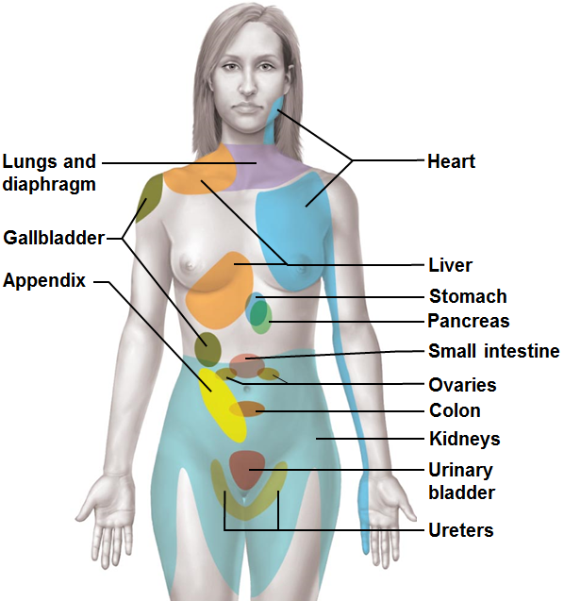
Referred Pain
Referred pain
  Pain from one body region perceived from different region
  Visceral and somatic pain fibers travel in same nerves;
    brain assumes stimulus from common (somatic) region
    E.g., left arm pain during heart attack

Slide 27
Structure of a Nerve
Cordlike organ of the Peripheral Nervous System
  Bundle of myelinated and unmyelinated peripheral axons enclosed by connective tissue

Slide 28
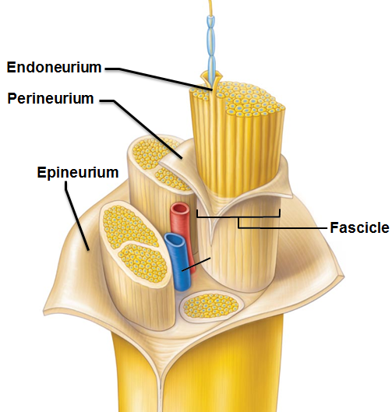
Structure of a Nerve
Connective tissue coverings include
  Endoneurium
    loose connective tissue that encloses axons and their myelin sheaths
  Perineurium
    coarse connective tissue that bundles fibers into fascicles
  Epineurium
    tough fibrous sheath around a nerve

Slide 29
Classification of Nerves
Most nerves are mixtures of afferent and efferent fibers and somatic and autonomic (visceral) fibers
Classified according to direction transmit impulses
  Mixed nerves
    both sensory and motor fibers
    impulses both to and from CNS
  Sensory (afferent) nerves
    impulses only toward CNS
  Motor (efferent) nerves
    impulses only away from CNS

Slide 30
Classification of Nerves
Pure sensory (afferent) or motor (efferent) nerves are rare; most mixed
Types of fibers in mixed nerves:
  Somatic afferent
  Somatic efferent
  Visceral afferent
  Visceral efferent
Peripheral nerves classified as cranial or spinal nerves

Slide 31
Ganglia
Contain neuron cell bodies associated with nerves in PNS
  Ganglia associated with
    afferent nerve fibers
      contain cell bodies of sensory neurons
      Dorsal root ganglia
  Ganglia associated with
    efferent nerve fibers
      contain autonomic motor neurons
      Autonomic ganglia

Slide 32
Regeneration of Nerve Fibers
Mature neurons are amitotic
  if soma of damaged nerve is intact, peripheral axon may regenerate
If peripheral axon damaged
  Macrophages clean dead axon; myelin sheath intact
  Axon filaments grow through regeneration tube
  Axon regenerates; new myelin sheath forms
Greater distance between severed ends-less chance of regeneration

Slide 33
Regeneration of Nerve Fibers
Most CNS fibers never regenerate
CNS oligodendrocytes bear growth-inhibiting proteins that prevent CNS fiber regeneration
Astrocytes at injury site form scar tissue that blocks axonal regrowth

Slide 34
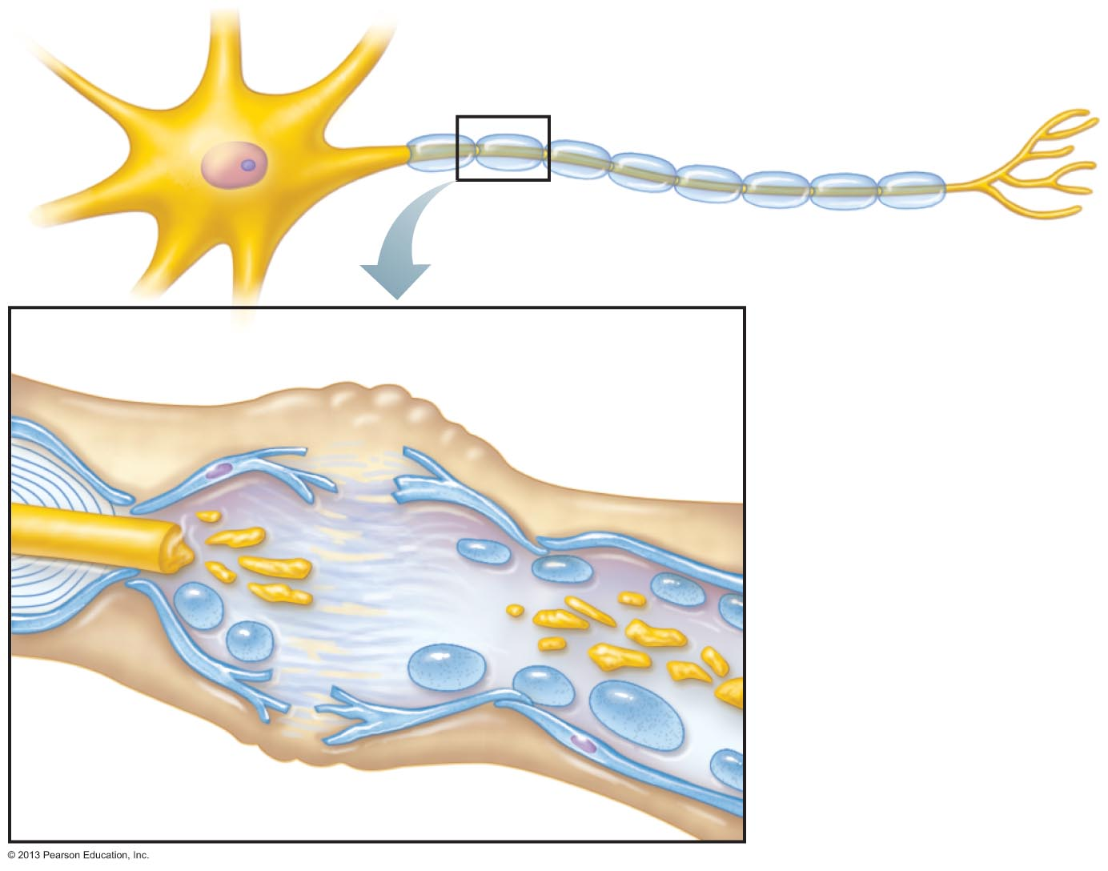
Figure 13.5 Regeneration of a nerve fiber in a peripheral nerve. (1 of 4)
Endoneurium
Schwann cells
1
The axon
becomes
fragmented at
the injury site.
Droplets
of myelin
Fragmented
axon
Site of nerve damage

Slide 35
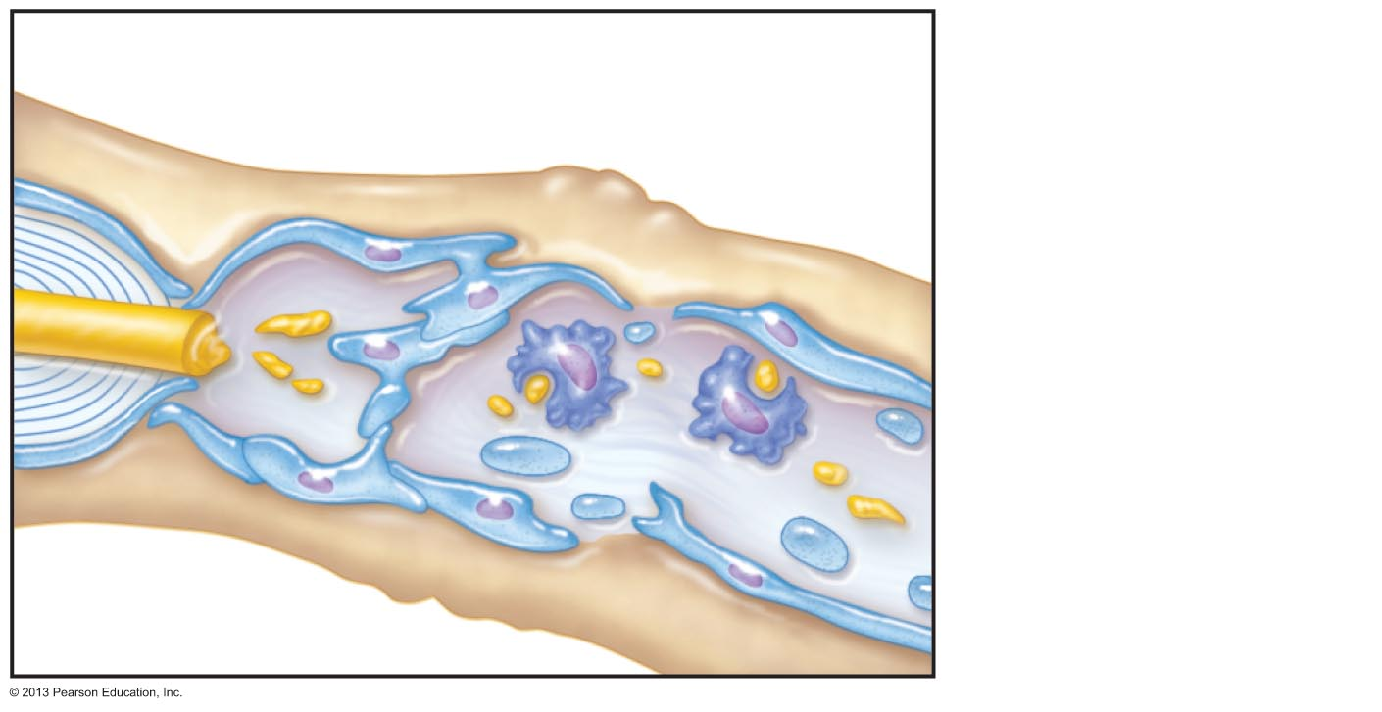
Figure 13.5 Regeneration of a nerve fiber in a peripheral nerve. (2 of 4)
2
Macrophages
clean out the dead
axon distal to the
injury.
Schwann cell
Macrophage

Slide 36
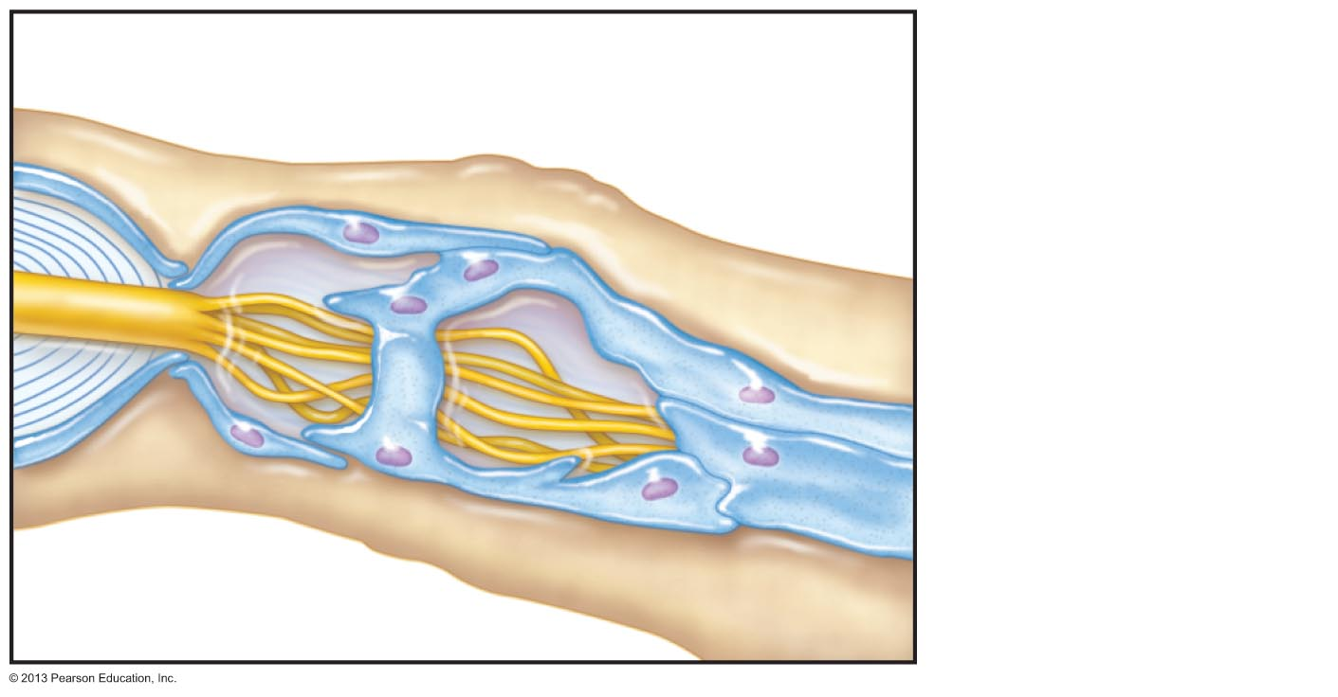
Figure 13.5 Regeneration of a nerve fiber in a peripheral nerve. (3 of 4)
3
Aligning Schwann cells
form regeneration tube
Axon sprouts,
or filaments, grow
through a
regeneration tube
formed by
Schwann cells.
Fine axon sprouts
or filaments

Slide 37
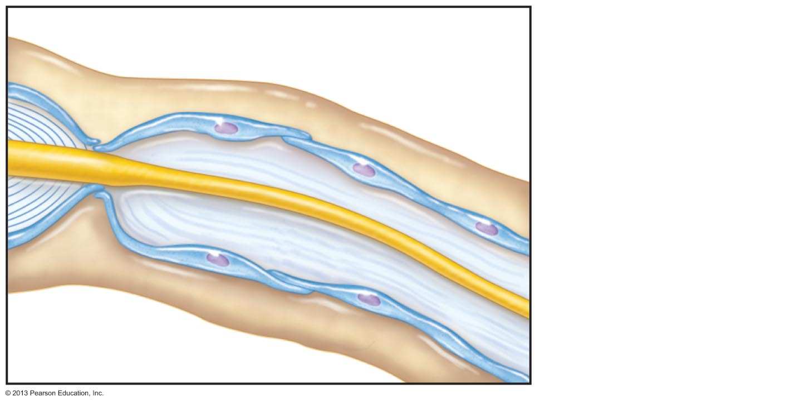
Figure 13.5 Regeneration of a nerve fiber in a peripheral nerve. (4 of 4)
4
Schwann cell
New myelin
sheath forming
The axon
regenerates and a
new myelin sheath
forms.
Single enlarging
axon filament

Slide 38
Cranial Nerves
Twelve pairs of nerves associated with brain
  Two attach to forebrain; rest with brain stem
Most mixed nerves; two pairs purely sensory
Each numbered with Roman Numerals

Slide 39
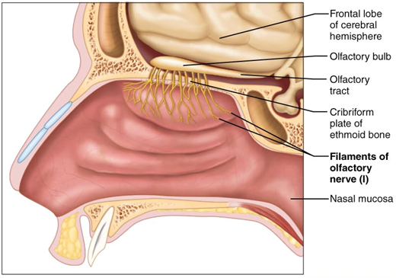
I: The Olfactory Nerves
Sensory nerves of smell (sensory only)
Receptors: nasal mucosa
Purely sensory (olfactory) function

Slide 40
I: The Olfactory Nerves
Pathway
  Receptors in olfactory epithelium in nasal cavity
  Pass through cribriform plate, roof of nasal cavity to olfactory bulb.
  Synapse in olfactory bulb
  Olfactory tract runs beneath frontal lobe to primary olfactory cortex

Slide 41
I: The Olfactory Nerves
Homeostatic Imbalance
  Anosmia
    Partial or total loss of smell

Slide 42
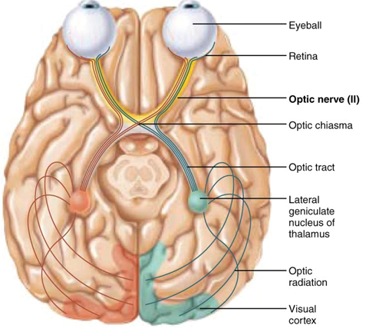
II: The Optic Nerves
Receptors: in retinas
Purely Sensory
Pathway
  Photoreceptors in retina
  Pass through optic canals as Optic Nerve
  converge and partially cross over at optic chiasma
  Optic tracts continue to thalamus
    where they synapse
  Optic radiation fibers run to visual cortex in the occipital lobe

Slide 43
II: The Optic Nerves
Homeostatic Imbalance
  Damage done to optic nerve: blindness in affected eye
  Damage done after optic chiasma
    Partial visual loss
  Clinical Tests
    Acuity
    Peripheral vision
    Ophthalmascopic evaluation to view optic disc and blood vessels

Slide 44
III: The Oculomotor Nerves
Origin: gray matter of midbrain
Pathway: gray matter of midbrain, near pons→ enters bony orbit through superior orbital fissure → eye
Function:
  Motor Nerve with some proprioception
  Function in raising eyelid, directing eyeball
Voluntary Effectors:
  4 of 6 extrinsic eye muscles
    Inferior Oblique
    Superior Rectus
    Medial Rectus
    Inferior Rectus
  And upper eyelid muscle
    Levator Palpebra Superioris

Slide 45
III: The Oculomotor Nerves
Involuntary Effectors
  Iris
    Pupillary constriction
  Ciliary muscle
    Change in lens shape for focusing
    Autonomic Fibers: Parasympathetic
Afferent Fibers
  Sensory from the four extrinsic eye muscles for proprioception

Slide 46
III: The Oculomotor Nerves
Clinical Tests
  Pupillary reflex (pupils constrict)
  Convergence (Medial Rectus and Lens)
  H or Z pattern for extrinsic eye muscle movement
Homeostatic Imbalance
  Oculomotor nerve paralysis:
    External Strabismus
      eye rotates laterally at rest
      (Lateral Rectus muscle is not affected by CN III.
    Ptosis
      Drooping eyelid (Levator Palpebra Superioris loses function)
    Difficulty focusing (Lens)

Slide 47
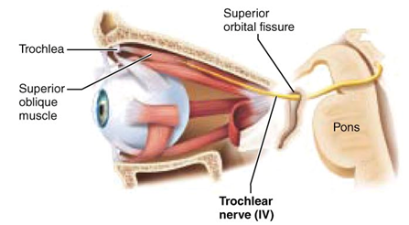
IV: The Trochlear Nerves
Origin: midbrain
Pathway: from midbrain through superior orbital fissure to Superior Oblique muscle
Primarily motor nerve that directs eyeball
  Some afferent fibers from proprioceptors

Slide 48
IV: The Trochlear Nerves
Clinical Testing
  H or Z pattern of eye movements
  Looking down and laterally
Damage to Trochlear Nerve
  Double vision and the inability to look down and laterally

Slide 49
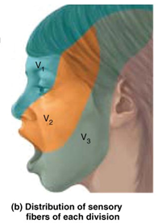
V: The Trigeminal Nerves
Sensory and Motor: Mixed
Largest cranial nerve
Origins for motor fibers: Pons
Sensory Receptors located
  Scalp, upper eyelid, nose, nasal cavity, corneal, lacrimal gland
    Ophthalmic division
  Palate, upper teeth, skin of cheek, upper lip, lower eyelid
    Maxillary division
  Anterior tongue (not taste), lower teeth, chin, temples
    Mandibular division
Cell bodies for sensory fibers located in Trigeminal Ganglion
Pathway: Runs in three branches to the face

Slide 50
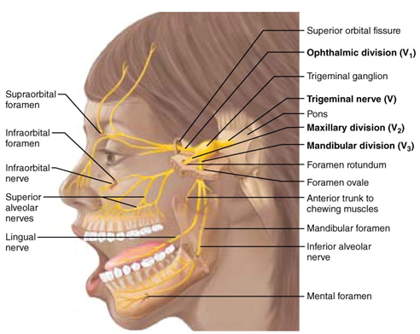
V: The Trigeminal Nerves
Three divisions
  Ophthalmic division
  Maxillary division
  Mandibular division
    Muscles of mastication
sensory
Motor and sensory

Slide 51
V: The Trigeminal Nerves
Clinical Tests
  Ophthalmic division
    Corneal reflex: check sensory to cornea by making light contact. Normal response: blinking
  Maxillary division
    Check pain/temperature responses. Hot/cold and sharp/dull
  Mandibular division
    Motor: clench teeth, open mouth against resistance, move jaw side to side
      Tests muscles of mastication

Slide 52
V: The Trigeminal Nerves
Homeostatic Imbalance
  Trigeminal neuralgia
    Tic douloureux (painful twitch)
    Possibly vascular compression of CN V
    Mild sensory stimuli (a breeze) can cause excruciating pain that last for seconds to minutes
      Can happen a hundred times a day
  Treatment
    NSAIDS/Analgesics are partially effective
    Surgical destruction of the nerve
      Loss of sensation to face

Slide 53
VI: The Abducens Nerves
Fibers from inferior pons enter orbits via superior orbital fissures
Primarily a motor nerve
  innervates Lateral Rectus muscle
  Some sensory:
    Proprioception from Lateral Rectus muscle

Slide 54
VI: The Abducens Nerves
Homeostatic Imbalance
  Damage causes an Internal Strabismus
    Lateral Rectus muscle can not pull the eye laterally, so it rotates medially
Clinical Tests, along with III and IV
  H or Z pattern for eye movement

Slide 55
VII: The Facial Nerves
Pathway: from pons through internal acoustic meatus → emerge through stylomastoid foramina to lateral aspect of face
Chief motor nerves of face with 5 major branches
  Includes parasympathetic fibers
Motor functions include
  facial expression
  Lacrimal glands
  Nasal and palatine glands
  salivary glands
    Submandibular
    Sublingual
Somatic Motor, Voluntary
Autonomic Motor, Involuntary

Slide 56
VII: The Facial Nerves
Sensory function from anterior two-thirds of tongue
  Taste
Clinical Tests
  Test for sweet/salty, etc to see if sensory portion intact
  Close eyes (oribicularis oculi), smile (facial muscles)
    to observe facial expressions
  Encourage tear production (Lacrimal glands)
    Ammonia fumes

Slide 57
VII: The Facial Nerves
Homeostatic imbalance
Bells Palsy
Rapid onset
  May be related to Herpes Simplex 1 Virus
  Paralysis of facial muscles on the affected side
    Partial loss of taste sensation
    Drooping lower eyelid
      (upper eyelid controlled by CN III)
    Mouth corners sag (facial muscles impacted)
      Speaking and eating become difficult
    Continual tearing (loss of Lacrimal Gland control)
    Eye can not close completely
      May result in dry eye syndrome

Slide 58
VIII: The Vestibulocochlear Nerves
Afferent fibers from hearing receptors (cochlear division) and equilibrium receptors (vestibular division) pass from inner ear through internal acoustic meatuses, and enter brain stem at pons-medulla border
Mostly sensory function; small motor component for adjustment of sensitivity of receptors
Formerly auditory nerve

Slide 59
VIII: The Vestibulocochlear Nerves
Vestibulo:
  Vestibule is related to balance and equilibrium
Cochlear
  Cochlea houses the hearing receptors
Mostly sensory
  Hearing and balance
Minor motor component
  Adjusts sensitivity of the sensory receptors

Slide 60
VIII: The Vestibulocochlear Nerves
Origin: Receptors in the vestibule (balance) and cochlea (hearing).
  Vestibular Nerve (cell bodies in the Vestibular Ganglion) joins Cochlear nerve (cell bodies in the Spiral Ganglion) to pass through the internal acoustic meatus to go to brain stem

Slide 61
VIII: The Vestibulocochlear Nerves
Clinical Tests
  Evaluate air conduction/bone conduction with tuning fork
  Check for hearing acuity
Homeostatic Imbalance
  Damage to cochlear nerve:
    central deafness (nerve deafness)
  Damage to vestibular nerve:
    Dizziness
    Rapid involuntary eye movements (Nystagmus)
    Loss of balance
    Nausea and vomiting

Slide 62
IX: The Glossopharyngeal Nerves
Origen/Pathway: from medulla→ leave skull via jugular foramen and run to throat
Motor functions
  innervates part of tongue and pharynx
    swallowing
  Parotid salivary glands
Sensory functions
  taste from pharynx and posterior tongue
  general sensory (touch, pressure, pain) impulses from pharynx and posterior tongue
  impulses from carotid chemoreceptors and baroreceptors
    Chemoreceptor: sensitive to changes in blood O₂ and CO₂ levels
    Baroreceptors: sensitive to changes in blood pressure
SNS; Voluntary, skeletal
ANS; Parasympathetic
involuntary

Slide 63
IX: The Glossopharyngeal Nerves
Clinical Testing
  View uvula while mouth is open, saying “aah”
  Use cotton-tipped swab to test for gag reflex
  Check posterior tongue for ability to taste
Homeostatic Imbalance
  Damage to CN IX result in impaired ability to swallow and taste

Slide 64
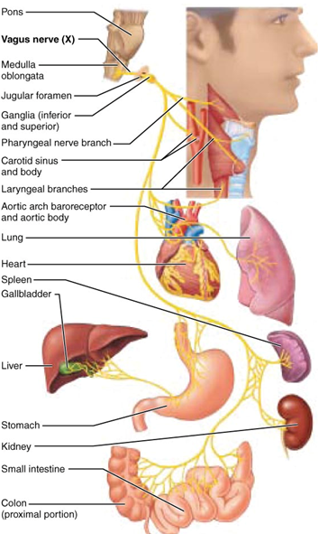
X: The Vagus Nerves
Vagus: “Vague” or wandering
Only cranial nerves that extend beyond head and neck region
Origin: from medulla through jugular foramen → neck, thorax, and abdomen
Most motor fibers are parasympathetic fibers
  regulate activities of
    Heart
    Lungs
    Abdominal viscera

Slide 65
X: The Vagus Nerves
Sensory fibers
  carry impulses from thoracic and abdominal viscera
  Baroreceptors
  Chemoreceptors
  taste buds of posterior tongue and pharynx
  proprioceptive fibers from muscles of larynx and pharynx

Slide 66
X: The Vagus Nerves
Clinical Testing
  Similar to the testing for CN IX since their areas overlap
Homeostatic Imbalance
  Can lead to hoarseness or loss of voice if CN X is damaged
  Difficulty swallowing
  Changes in gastrointestinal motility

Slide 67
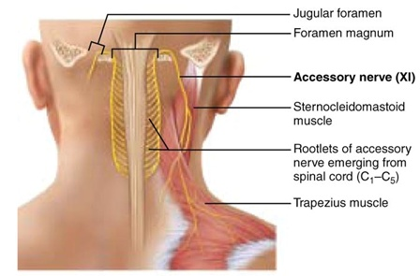
XI: The Accessory Nerves
Origin differs from the other cranial nerves
  Are spinal rootlets from the upper cervical regions instead of cranial rootlets
  Do not originate from the brain
Rootlets pass into cranium through the foramen magnum

Slide 68
XI: The Accessory Nerves
Mostly Motor
  Innervates Trapezius muscles and Sternocleidomastoid muscles
Minor sensory
  Proprioceptive input from the skeletal muscles
Formerly spinal accessory nerve

Slide 69
XI: The Accessory Nerves
Clinical Testing
  Muscle test the Traps and SCMs against resistance
    Ask them to rotate head and shrug shoulders
      “I dunno” movement
Homeostatic Imbalance
  Head turns toward side of injury due to SCM paralysis
  Elevation of shoulder (shrugging) becomes difficult

Slide 70
XII: The Hypoglossal Nerves
Origin: Fibers from medulla exit skull via hypoglossal canal to target the tongue
Mixed nerve, mostly motor
Motor function
  Innervate extrinsic and intrinsic muscles of tongue that contribute to swallowing and speech
Sensory function
  Proprioceptive input from the skeletal muscles

Slide 71
XII: The Hypoglossal Nerves
Clinical Testing
  Ask subjects to protrude and retract tongue
    (stick out their tongues)
    Check for deviation to one side
Homeostatic Imbalance
  Difficulty with speech and swallowing
  Decreased movement/paralysis of tongue and eventual atrophy

Slide 72
Spinal Nerves
31 pairs of mixed nerves named for point of issue from spinal cord
  Supply all body parts but head and part of neck
  8 cervical (C₁–C₈)
  12 thoracic (T₁–T₁₂)
  5 Lumbar (L₁–L₅)
  5 Sacral (S₁–S₅)
  1 Coccygeal (C₀)

Slide 73
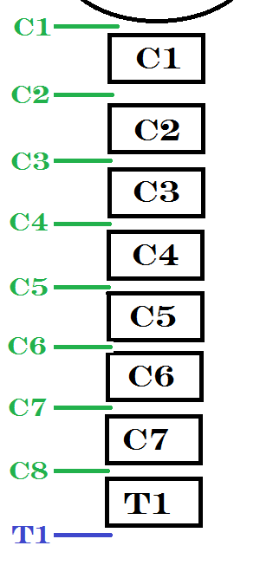
Spinal Nerves
Only 7 cervical vertebrae, yet 8 pairs cervical spinal nerves
  7 exit vertebral canal superior to vertebrae for which named
  1 exits canal inferior to C₇
Other spinal nerves exit inferior to vertebra for which named

Slide 74
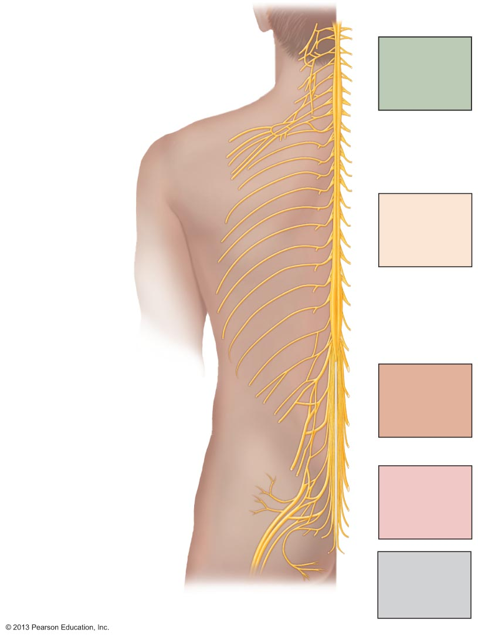
Figure 13.7 Spinal nerves.
Cervical plexus
Cervical
nerves
C₁ – C₈
Brachial plexus
Cervical
enlargement
Intercostal
nerves
Thoracic
nerves
T₁ – T₁₂
Lumbar
enlargement
Lumbar plexus
Lumbar
nerves
L₁ – L₅
Sacral plexus
Sacral
nerves
S₁ – S₅
Cauda equina
Coccygeal
nerve
Co₁

Slide 75
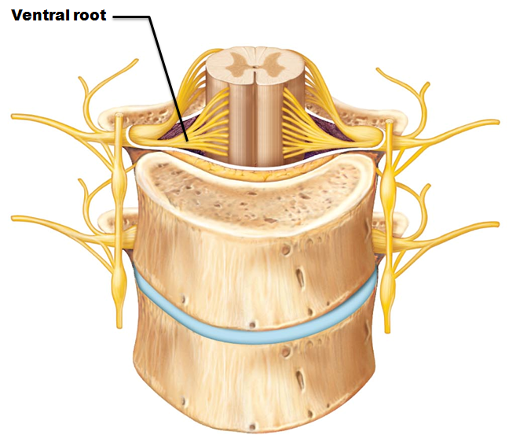
Spinal Nerves: Roots
Each spinal nerve connects to spinal cord via two roots
Ventral roots
  Contain motor (efferent) fibers from ventral horn motor neurons
  Fibers innervate skeletal muscles

Slide 76
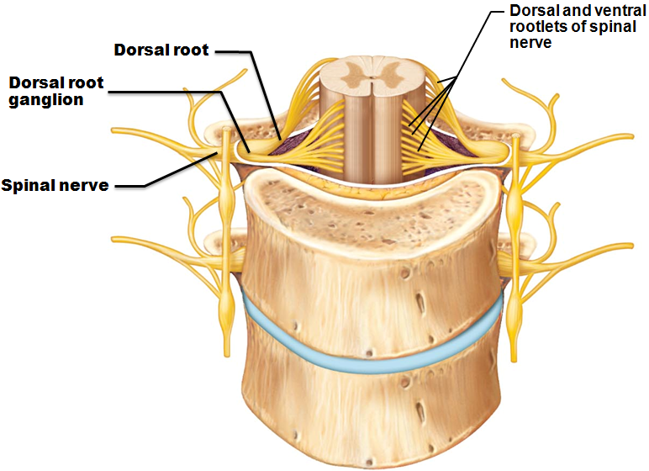
Spinal Nerves: Roots
Dorsal roots
  Contain sensory (afferent) fibers from sensory neurons in dorsal root ganglia and conduct impulses from peripheral receptors
Dorsal and ventral roots unite to form spinal nerves
  emerge from vertebral column via intervertebral foramina

Slide 77
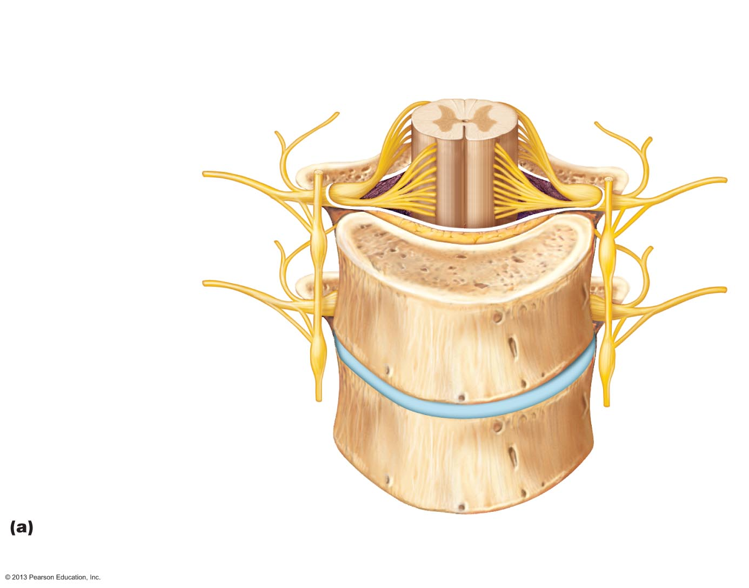
Figure 13.8a Formation of spinal nerves and rami distribution.
Gray matter
White matter
Ventral root
Dorsal and ventral
rootlets of spinal
nerve
Dorsal root
Dorsal root
ganglion
Dorsal ramus
of spinal nerve
Ventral ramus
of spinal nerve
Spinal nerve
Rami communicantes
Sympathetic trunk
ganglion
Anterior view showing spinal cord, associated nerves, and vertebrae.
The dorsal and ventral roots arise medially as rootlets and join laterally to
form the spinal nerve.

Slide 78
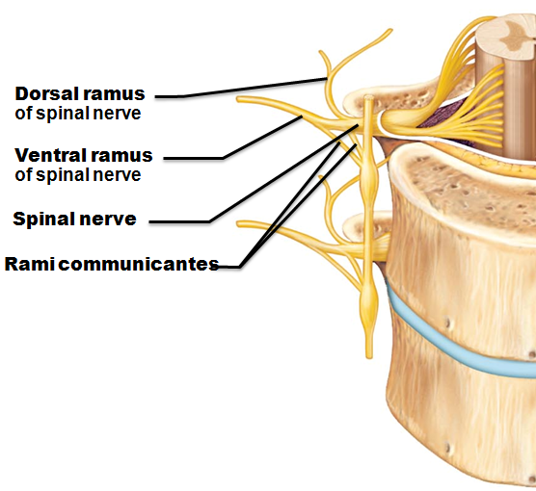
Spinal Nerves: Rami
Spinal nerves quite short (~1-2 cm)
Each branches into mixed rami
  Dorsal ramus
  Ventral ramus
    larger
  Meningeal branch
    tiny
    reenters vertebral canal
    innervates meninges and blood vessels
  Rami communicantes
    (autonomic pathways) join ventral rami in thoracic region

Slide 79
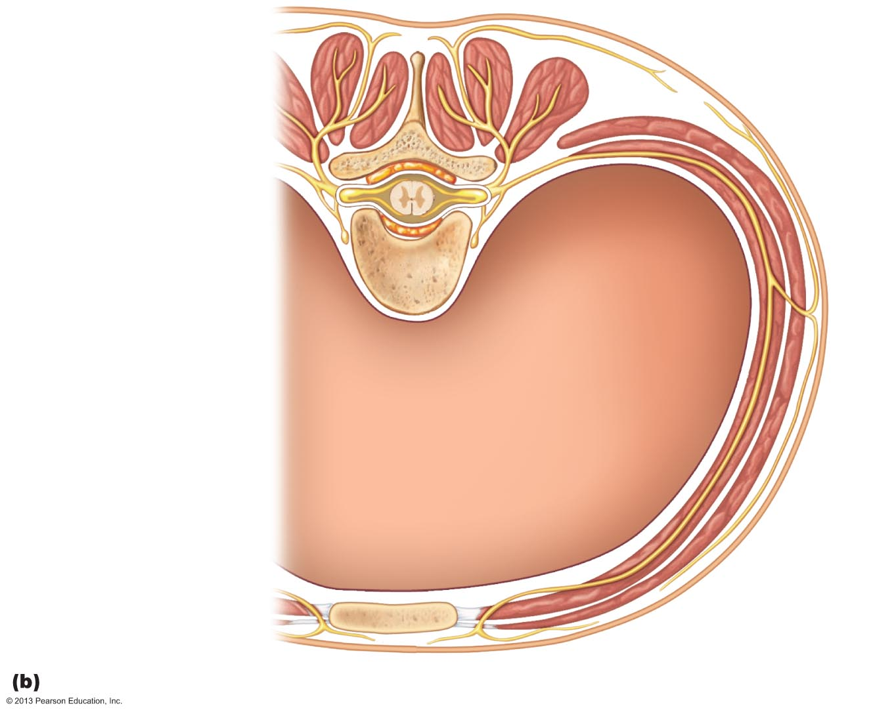
Figure 13.8b Formation of spinal nerves and rami distribution.
Dorsal ramus
Ventral ramus
Spinal nerve
Rami communicantes
Sympathetic trunk
ganglion
Intercostal nerve
Dorsal root ganglion
Dorsal root
Ventral root
Branches of intercostal nerve
Lateral cutaneous
Anterior cutaneous
Sternum
Cross section of thorax showing the main roots and branches of a spinal nerve.

Slide 80
Spinal Nerves: Rami
All ventral rami except T₂–T₁₂ form interlacing nerve networks
  called nerve plexuses
    cervical, brachial, lumbar, and sacral
The back is innervated by dorsal rami via several branches
Ventral rami
  supply muscles of ribs
  anterolateral thorax
  abdominal wall
Spinal roots longer as move inferiorly in cord
  Lumbar and sacral roots extend as cauda equina

Slide 81

Typical Spinal Nerve
Please note that due to differing operating systems, some animations will not appear until the presentation is viewed in Presentation Mode (Slide Show view). You may see blank slides in the “Normal” or “Slide Sorter” views. All animations will appear after viewing in Presentation Mode and playing each animation. Most animations will require the latest version of the Flash Player, which is available at http://get.adobe.com/flashplayer.
Notes:
Typical spinal nerve 1:43

Slide 82
Spinal Nerves: Plexuses
Within plexus fibers criss-cross
  Each branch contains fibers from several spinal nerves
  Fibers from ventral ramus go to body periphery via several routes
    Each limb muscle innervated by more than one spinal nerve
      Damage to one spinal nerve does not cause paralysis

Slide 83
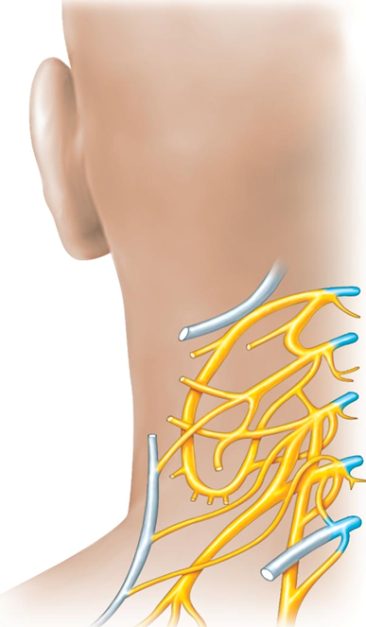
Cervical Plexus and the Neck
Formed by ventral rami of C₁–C₄
Most branches form cutaneous nerves
  Innervate skin of neck, ear, back of head, and shoulders
  Other branches innervate neck muscles
Phrenic nerve
  Major motor and sensory nerve of diaphragm
    receives fibers from C₃–C₅
  Irritation → hiccups

Slide 84
Brachial Plexus and Upper Limb
Formed by ventral rami of C₅–C₈ and T₁
Gives rise to nerves that innervate upper limb
Major branches of this plexus:
  Roots
    five ventral rami (C₅–T₁
  Trunks
    upper, middle, and lower
  Divisions
    anterior and posterior
  Cords
    lateral, medial, and posterior

Slide 85
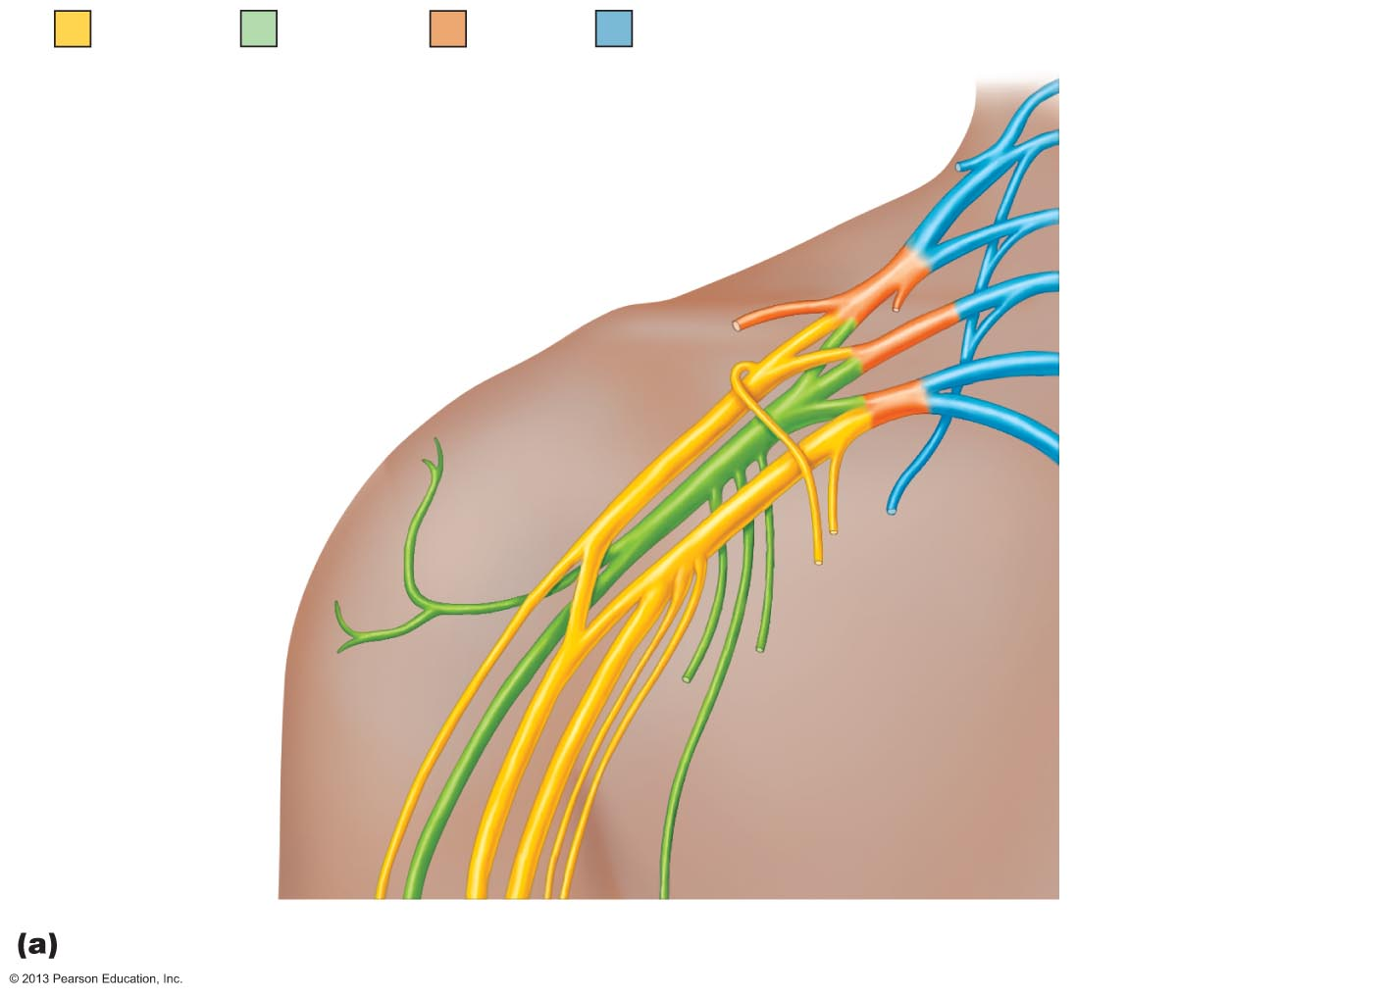
Figure 13.10a The brachial plexus.
Anterior
divisions
Posterior
divisions
Trunks
Roots
Roots (ventral rami):
C₄
C₅
C₆
Upper
Posterior
divisions
C₇
Middle
Trunks
Lateral
C₈
Lower
Cords
Posterior
T₁
Medial

Slide 86
Brachial Plexus: Five Important Nerves
Axillary
  innervates deltoid, teres minor, and skin and joint capsule of shoulder
Musculocutaneous
  innervates biceps brachii and brachialis, coracobrachialis, and skin of lateral forearm
Median
  innervates skin, most flexors, forearm pronators, wrist and finger flexors, thumb opposition muscles
Ulnar
  supplies flexor carpi ulnaris, part of flexor digitorum profundus, most intrinsic hand muscles, skin of medial aspect of hand, wrist/finger flexion
Radial
  innervates essentially all extensor muscles, supinators, and posterior skin of limb

Slide 87
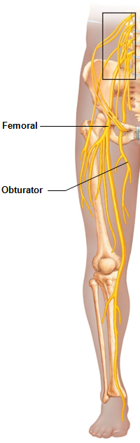
Lumbar Plexus
Arises from L₁–L₄
Innervates thigh, abdominal wall, and psoas muscle
Femoral nerve
  innervates quadriceps and skin of anterior thigh and medial surface of leg
Obturator nerve
  passes through obturator foramen to innervate adductor muscles

Slide 88
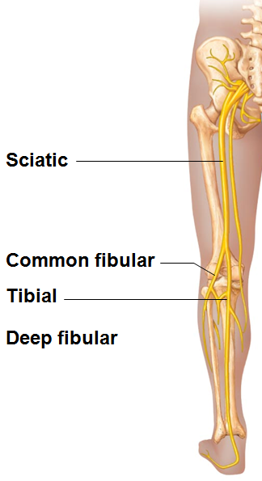
Sacral Plexus
Arises from L₄–S₄
Serves the buttock, lower limb, pelvic structures, and perineum
Sciatic nerve
  Longest and thickest nerve of body
  Innervates hamstring muscles, adductor magnus, and most muscles in leg and foot
  Composed of two nerves:
    tibial
    common fibular

Slide 89
Anterolateral Thorax and Abdominal Wall
Ventral rami in thoracic wall run in a simple segmental pattern
  Form intercostal nerves that supply intercostal muscles, muscle and skin
  Give off cutaneous branches to skin
Dorsal rami innervate posterior body trunk

Slide 90
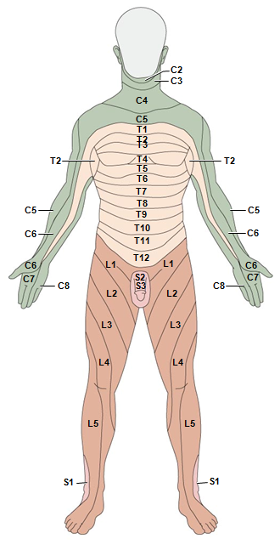
Innervation of Skin: Dermatomes
Dermatome
  area of skin innervated by cutaneous branches of single spinal nerve
All spinal nerves except C₁ participate in dermatomes
Extent of spinal cord injuries ascertained by affected dermatomes
  Most dermatomes overlap, so destruction of a single spinal nerve will not cause complete numbness

Slide 91
Peripheral Motor Endings
PNS elements that activate effectors by releasing neurotransmitters

Slide 92
Review of Innervation of Skeletal Muscle
Takes place at neuromuscular junction
Neurotransmitter acetylcholine (ACh) released when nerve impulse reaches axon terminal
ACh binds to receptors, resulting in:
  Movement of Na⁺ and K⁺ across membrane
  Depolarization of muscle cell
  An end plate potential, which triggers an action potential → muscle contraction

Slide 93
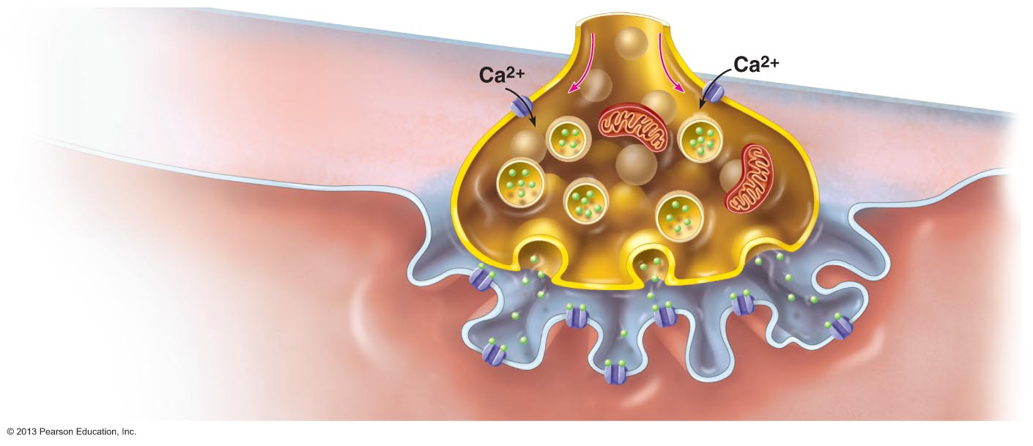
Figure 9.8 When a nerve impulse reaches a neuromuscular junction, acetylcholine (ACh) is released.
Slide 2
Action potential arrives at axon terminal of motor neuron.
1
Synaptic vesicle
containing ACh
Synaptic cleft
Junctional
folds of
sarcolemma
Sarcoplasm of
muscle fiber
Notes:
93

Slide 94
Figure 9.8 When a nerve impulse reaches a neuromuscular junction, acetylcholine (ACh) is released.
Slide 3
Voltage-gated Ca²⁺ channels open. Ca²⁺ enters the axon terminal moving down its electochemical gradient.
Synaptic vesicle
containing ACh
2
Synaptic cleft
Junctional
folds of
sarcolemma
Sarcoplasm of
muscle fiber
Notes:
94

Slide 95
Figure 9.8 When a nerve impulse reaches a neuromuscular junction, acetylcholine (ACh) is released.
Slide 4
Synaptic vesicle
containing ACh
Synaptic cleft
Ca²⁺ entry causes ACh (a
neurotransmitter) to be released
by exocytosis.
3
ACh
Junctional
folds of
sarcolemma
Sarcoplasm of
muscle fiber
Notes:
95

Slide 96
Figure 9.8 When a nerve impulse reaches a neuromuscular junction, acetylcholine (ACh) is released.
Slide 5
Synaptic vesicle
containing ACh
Synaptic cleft
Junctional
folds of
sarcolemma
ACh diffuses across the synaptic cleft and binds to its receptors on
the sarcolemma.
4
Sarcoplasm of
muscle fiber
Notes:
96

Slide 97
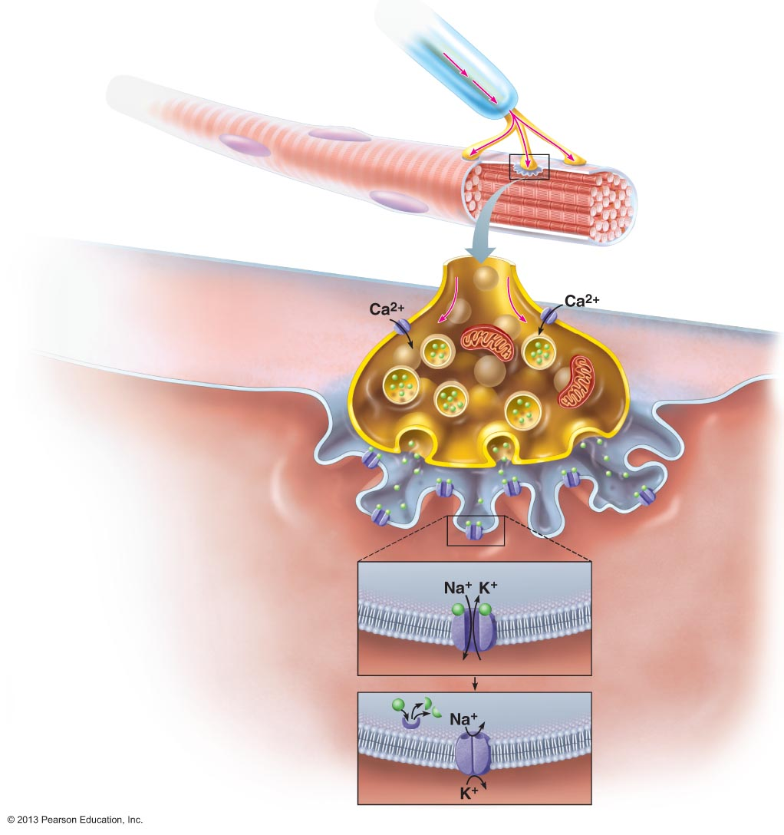
Figure 9.8 When a nerve impulse reaches a neuromuscular junction, acetylcholine (ACh) is released.
Slide 8
Myelinated axon
of motor neuron
Action
potential (AP)
Axon terminal of
neuromuscular
junction
Sarcolemma of
the muscle fiber
Synaptic vesicle
containing ACh
Synaptic
cleft
Junctional
folds of
sarcolemma
Sarcoplasm of
muscle fiber
ACh binding opens ion
channels in the receptors that
allow simultaneous passage of
Na⁺ into the muscle fiber and K⁺
out of the muscle fiber. More Na⁺
ions enter than K⁺ ions exit,
which produces a local change
in the membrane potential called
the end plate potential.
5
Postsynaptic
membrane
ion channel opens;
ions pass.
ACh
Degraded ACh
Ion channel closes;
ions cannot pass.
Acetylcho-
linesterase
Notes:
97

Slide 98
Figure 9.8 When a nerve impulse reaches a neuromuscular junction, acetylcholine (ACh) is released.
Slide 8
Myelinated axon
of motor neuron
Action
potential (AP)
Axon terminal of
neuromuscular
junction
Sarcolemma of
the muscle fiber
Junctional
folds of
sarcolemma
ACh
Ion channel closes;
ions cannot pass.
ACh effects are terminated by
its breakdown in the synaptic
cleft by acetylcholinesterase and
diffusion away from the junction.
6
Acetylcho-
linesterase
Notes:
98

Slide 99
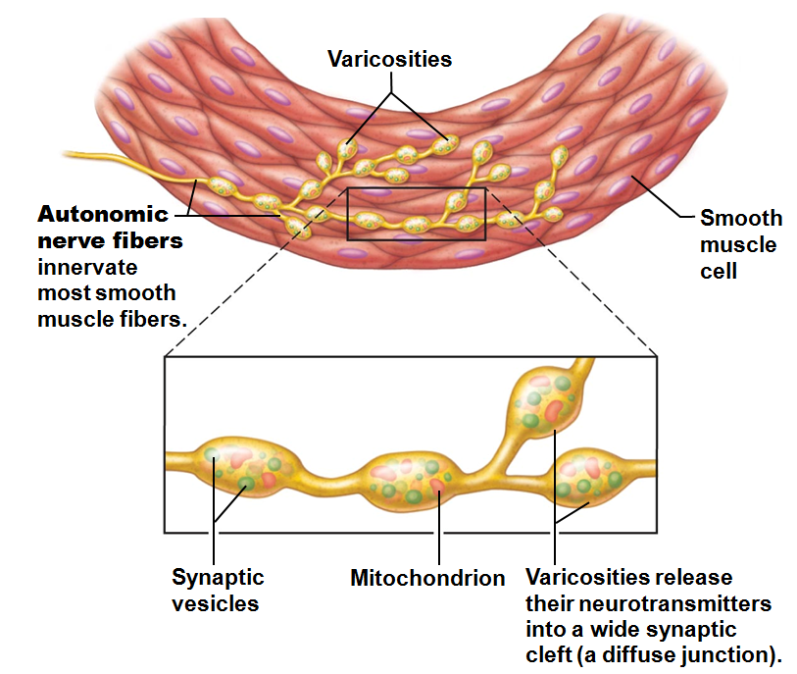
Review of Innervation of Visceral Muscle and Glands
Autonomic motor endings and visceral effectors are simpler than somatic junctions
  Branches form synapses using varicosities
Visceral motor responses slower than somatic responses

Slide 100
Reflexes
Inborn (intrinsic) reflex - rapid, involuntary, predictable motor response to stimulus
  Example – maintain posture, control visceral activities
  Can be modified by learning and conscious effort
Learned (acquired) reflexes result from practice or repetition,
  Example – driving skills

Slide 101
Reflex Arc
Components of a reflex arc (neural path)
  Receptor
    site of stimulus action
  Sensory neuron
    transmits afferent impulses to CNS
  Integration center
    either monosynaptic or polysynaptic region within CNS
  Motor neuron
    conducts efferent impulses from integration center to effector organ
  Effector
    muscle fiber or gland cell that responds to efferent impulses by contracting or secreting

Slide 102
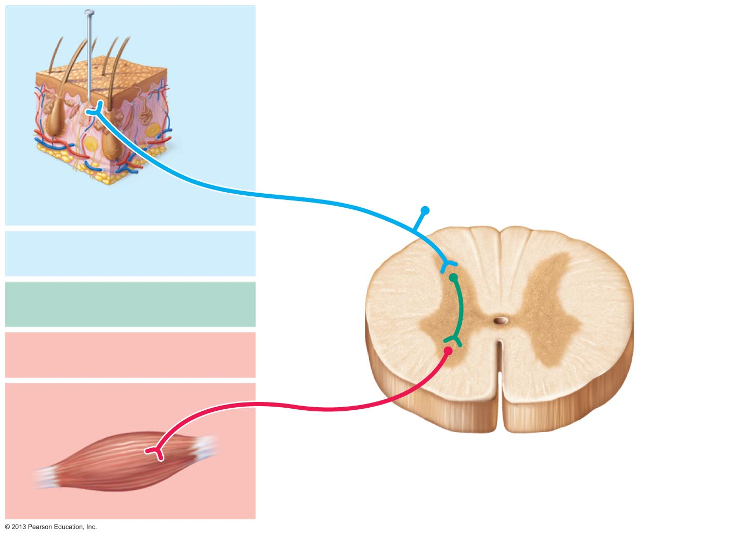
Figure 13.15 The five basic components of all reflex arcs.
Stimulus
Skin
1
Receptor

Slide 103
Figure 13.15 The five basic components of all reflex arcs.
Stimulus
Skin
1
Receptor
2
Sensory neuron

Slide 104
Figure 13.15 The five basic components of all reflex arcs.
Stimulus
Skin
1
Receptor
Interneuron
2
Sensory neuron
3
Integration center

Slide 105
Figure 13.15 The five basic components of all reflex arcs.
Stimulus
Skin
1
Receptor
2
Sensory neuron
3
Integration center
4
Motor neuron

Slide 106
Figure 13.15 The five basic components of all reflex arcs.
Stimulus
Skin
1
Receptor
2
Sensory neuron
3
Integration center
4
Motor neuron
5
Effector

Slide 107
Figure 13.15 The five basic components of all reflex arcs.
Stimulus
Skin
1
Receptor
Interneuron
2
Sensory neuron
3
Integration center
4
Motor neuron
5
Effector
Spinal cord
(in cross scetion)

Slide 108
Reflex Arc
Please note that due to differing operating systems, some animations will not appear until the presentation is viewed in Presentation Mode (Slide Show view). You may see blank slides in the “Normal” or “Slide Sorter” views. All animations will appear after viewing in Presentation Mode and playing each animation. Most animations will require the latest version of the Flash Player, which is available at http://get.adobe.com/flashplayer.

Slide 109
Reflexes
Functional classification
  Somatic reflexes
    Activate skeletal muscle
  Autonomic (visceral) reflexes
    Activate visceral effectors
      smooth or cardiac muscle or glands

Slide 110
Spinal Reflexes
Spinal somatic reflexes
  Integration center in spinal cord
  Effectors are skeletal muscle
Testing of somatic reflexes important clinically to assess condition of nervous system
  If exaggerated, distorted, or absent
    degeneration/pathology of specific nervous system regions

Slide 111
Stretch and Tendon Reflexes
To smoothly coordinate skeletal muscle nervous system must receive proprioceptor input regarding
  Length of muscle
    From muscle spindles
  Amount of tension in muscle
    From tendon organs

Slide 112
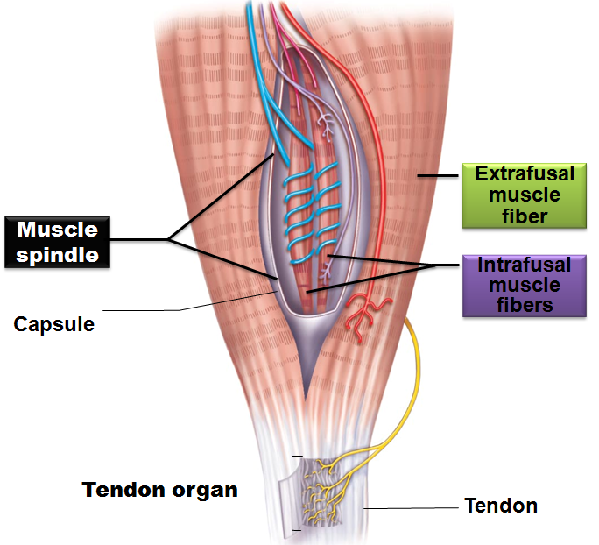
Functional Anatomy of Muscle Spindles
Composed of 3–10 modified skeletal muscle fibers
  intrafusal muscle fibers
    wrapped in connective tissue capsule
Effector fibers
  extrafusal muscle fibers

Slide 113
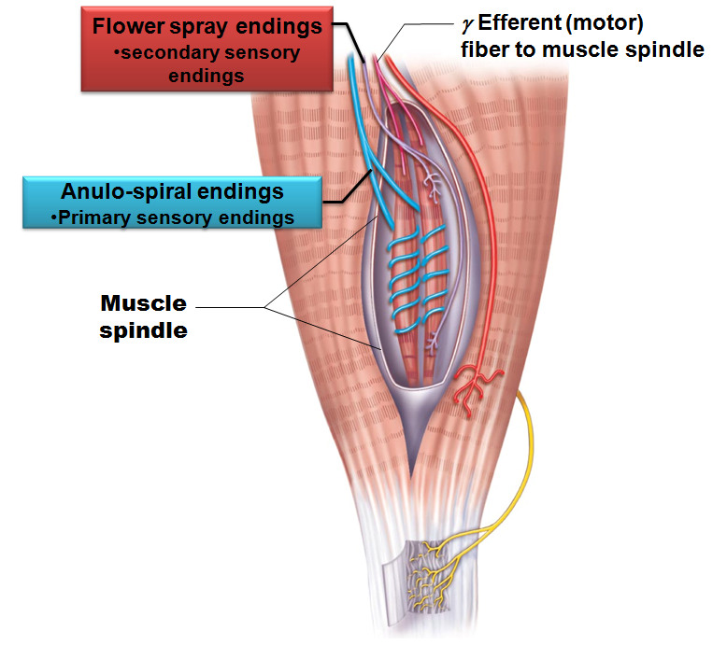
Intrafusal Fibers
Noncontractile in central regions
  lack myofilaments)
Two types of afferent endings
  Anulospiral endings
  primary sensory endings
    Endings wrap around spindle; stimulated by rate and degree of stretch
  Flower spray endings secondary sensory endings
    Small axons at spindle ends; respond to stretch

Slide 114
Muscle Spindles
Excited in two ways
  External stretch of muscle and muscle spindle
  Internal stretch of muscle spindle
    Activating γ motor neurons stimulates ends to contract, thereby stretching spindle
Stretch causes increased rate of impulses to spinal cord

Slide 115
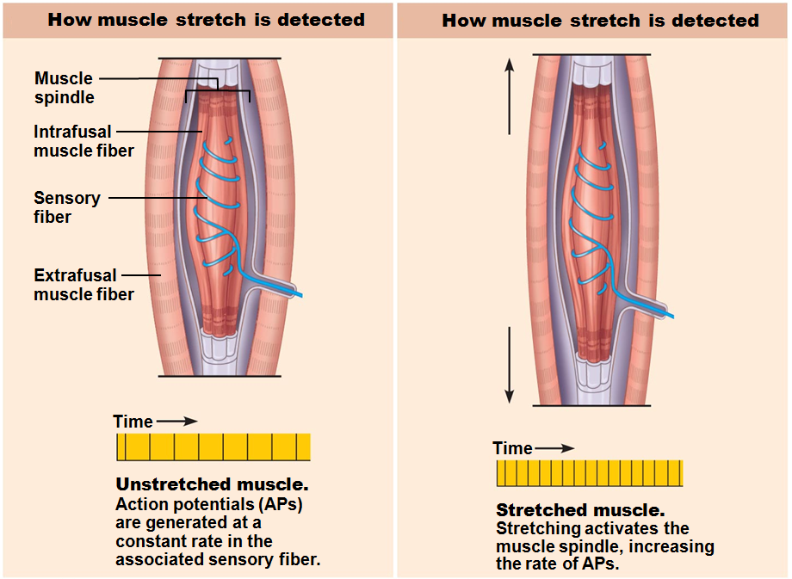

Slide 116
Muscle Spindles
Contracting muscle reduces tension on muscle spindle
Sensitivity lost unless muscle spindle shortened

Slide 117
The Stretch Reflex
Maintains muscle tone in large postural muscles, and adjusts it reflexively
  Causes muscle contraction in response to increased muscle length (stretch)

Slide 118
Stretch Reflexes
How stretch reflex works
  Stretch activates muscle spindle
  Sensory neurons synapse directly with α motor neurons in spinal cord
  α motor neurons cause stretched muscle to contract
All stretch reflexes are monosynaptic and ipsilateral

Slide 119
Stretch Reflexes
Reciprocal inhibition also occurs
  Specific fibers synapse with interneurons that inhibit motor neurons of antagonistic muscles
  Example
    In patellar reflex:
      stretched muscle (quadriceps) contracts
      antagonists (hamstrings) relax

Slide 121
Stretch Reflexes
Positive reflex reactions indicate
  Sensory and motor connections between muscle and spinal cord intact
  Strength of response indicates degree of spinal cord excitability
Hypoactive or absent reflexes indicate
  peripheral nerve damage
  ventral horn injury
Hyperactive responses indicate
  lesions of corticospinal tract

Slide 122
The Tendon Reflex
Polysynaptic reflexes
Helps prevent damage due to excessive stretch
Important for smooth onset and termination of muscle contraction

Slide 123
The Tendon Reflex
Produces muscle relaxation (lengthening) in response to tension
  Contraction or passive stretch activates tendon reflex
  Afferent impulses transmitted to spinal cord
    Contracting muscle relaxes; antagonist contracts (reciprocal activation)
  Information transmitted simultaneously to cerebellum and used to adjust muscle tension

Slide 124
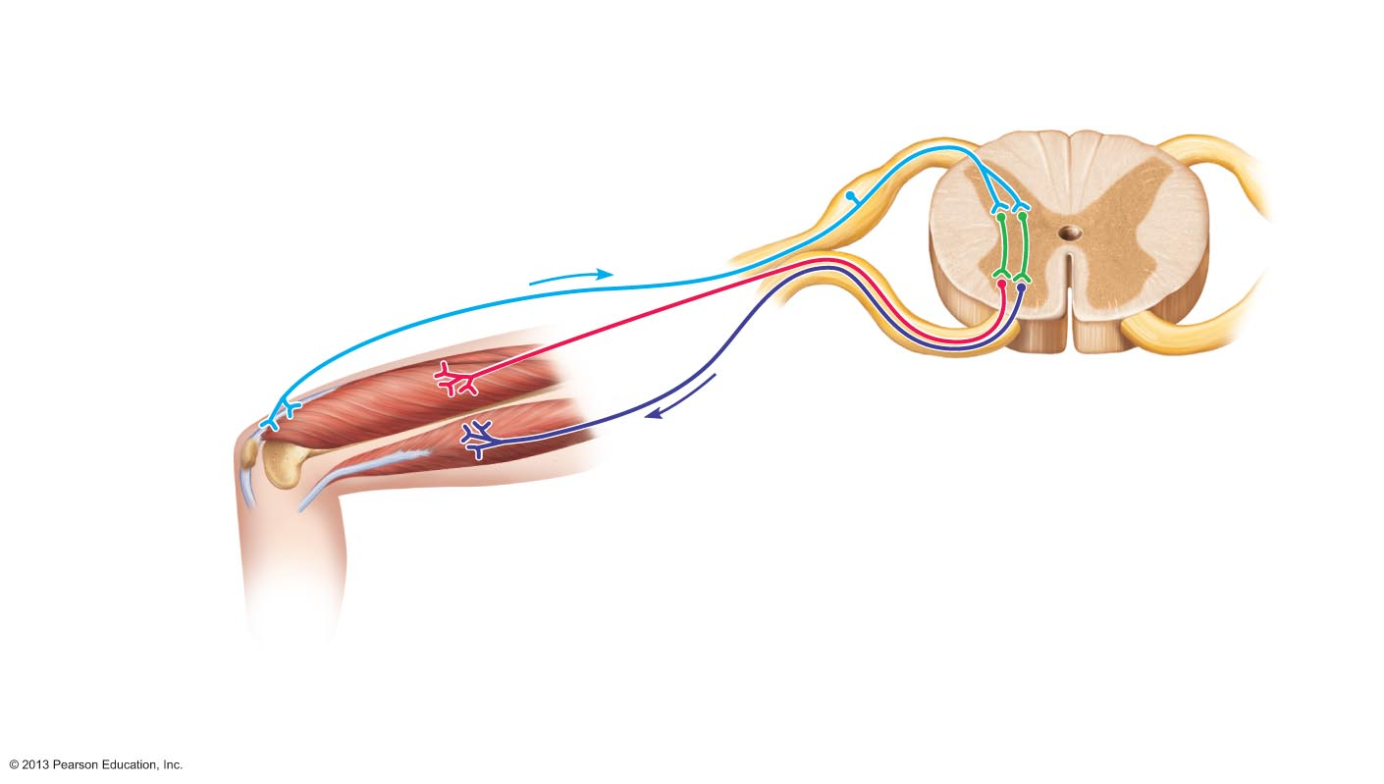
Figure 13.19 The tendon reflex.
Slide 2
1
Quadriceps strongly contracts.
Tendon organs are activated.
+
+
Quadriceps
(extensors)
–
+
Tendon organ
Spinal cord
Hamstrings
(flexors)
+ Excitatory synapse
– Inhibitory synapse

Slide 125
Figure 13.19 The tendon reflex.
Slide 3
Afferent fibers synapse with
interneurons in the spinal cord.
2
Interneurons
+
+
Quadriceps
(extensors)
–
+
Tendon organ
Spinal cord
Hamstrings
(flexors)
+ Excitatory synapse
– Inhibitory synapse

Slide 126
Figure 13.19 The tendon reflex.
Slide 4
+
+
Quadriceps
(extensors)
–
+
Tendon organ
Spinal cord
Hamstrings
(flexors)
Efferent impulses to muscle
with stretched tendon are damped.
Muscle relaxes, reducing tension.
3a
+ Excitatory synapse
– Inhibitory synapse

Slide 127
Figure 13.19 The tendon reflex.
Slide 5
+
+
Quadriceps
(extensors)
–
+
Tendon organ
Spinal cord
Hamstrings
(flexors)
Efferent impulses to antagonist muscle cause it to contract.
3b
+ Excitatory synapse
– Inhibitory synapse

Slide 128
Tendon Reflex Responses
Example of a scale used for deep tendon reflexes:
  The usual gradation for deep tendon reflexes ranges from 0 to 4
  0 Absent reflex
  1 Feeble reflex
  2 Normal reflex
  3 Brisk reflex
  4 Brisk reflex with clonus
  sometimes a fifth possibility is listed:
  5 Brisk reflex with sustained clonus

Slide 129
Tendon Reflex Repsones
Clonus
  A series of short rhythmic contractions and relaxations
    Associated with hyperexcitability and upper motor neuron damage
      Common with stroke and spinal cord injury
    Can last from several seconds to several minutes
Sustained clonus: always pathological
  More than 4 beats

Slide 130
The Flexor and Crossed-Extensor Reflexes
Flexor (withdrawal) reflex
  Initiated by painful stimulus
  Causes automatic withdrawal of threatened body part
  Ipsilateral and polysynaptic
  Protective; important
  Brain can override
    E.g., finger stick for blood test

Slide 131
Reflex Arc
Please note that due to differing operating systems, some animations will not appear until the presentation is viewed in Presentation Mode (Slide Show view). You may see blank slides in the “Normal” or “Slide Sorter” views. All animations will appear after viewing in Presentation Mode and playing each animation. Most animations will require the latest version of the Flash Player, which is available at http://get.adobe.com/flashplayer.
Notes:
Reflex arc 1:08

Slide 132
Flexor and Crossed-Extensor Reflexes
Crossed extensor reflex
  Occurs with flexor reflexes in weight-bearing limbs to maintain balance
  Consists of ipsilateral withdrawal reflex and contralateral extensor reflex
    Stimulated side withdrawn (flexed)
    Contralateral side extended
      e.g., step barefoot on broken glass

Slide 133
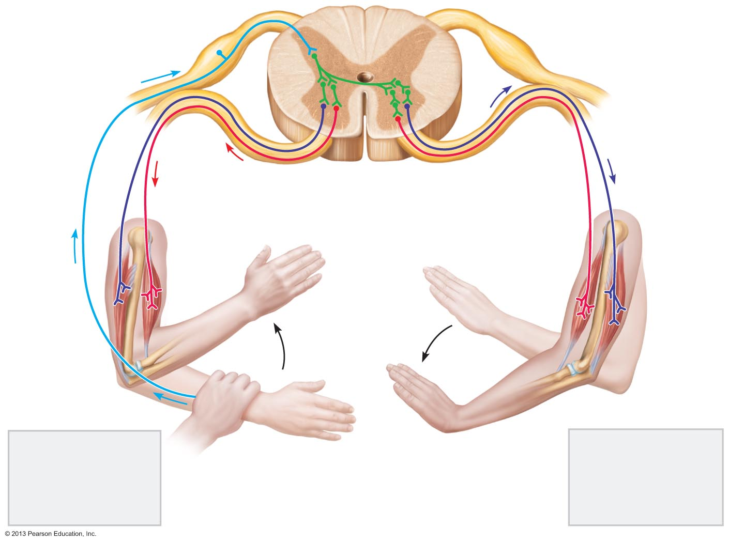
Figure 13.20 The crossed-extensor reflex.
+ Excitatory synapse
Interneurons
– Inhibitory synapse
+
+
–
+
+
–
Afferent
fiber
Efferent
fibers
Efferent
fibers
Extensor
inhibited
Flexor
inhibited
Flexor
stimulated
Flexes
Arm movements
Extensor
stimulated
Extends
Site of stimulus:
A noxious stimulus
causes a flexor
reflex on the same
side, withdrawing
that limb.
Site of reciprocal
activation: At the
same time, the
extensor muscles
on the opposite
side are activated.

Slide 134
Superficial Reflexes
Elicited by gentle cutaneous stimulation
Depend on upper motor pathways and cord-level reflex arcs
Best known:
  Plantar reflex
  Abdominal reflex
  Cremasteric reflex

Slide 135
Superficial Reflexes: Plantar Reflex
Test integrity of cord from L₄ – S₂
Stimulus
  stroke lateral aspect of sole of foot
Expected Response
  flexion of toes

Slide 136
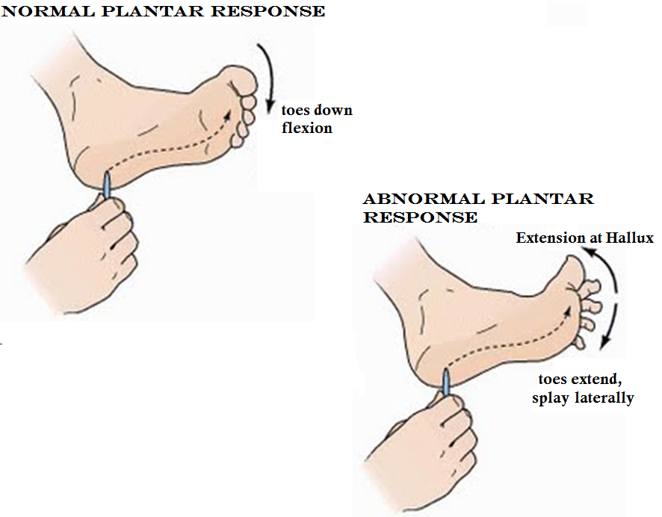
Superficial Reflexes: Plantar Reflex
Damage to motor cortex or corticospinal tracts
  yields abnormal response
Babinski's sign
  Hallux extends
  digits fan laterally
  Normal in infant to ~1 year due to incomplete myelination

Slide 137
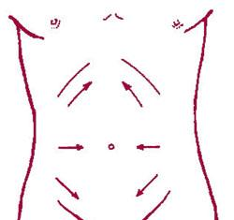
Superficial Reflexes: Abdominal Reflexes
Test integrity of cord from T₈ – T₁₂
Results in
  contraction of abdominal muscles
  movement of umbilicus in response to stroking of skin
Vary in intensity from one person to another
Absent when corticospinal tract lesions are present

Slide 138
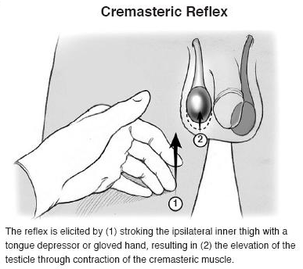
Superficial Reflexes: Cremasteric
The cremaster muscle is a skeletal muscle responsible for elevating the testes
  Light touch to the medial thigh results in a superficial reflex
  The Cremaster muscle is activated, and the ipsilateral testis is elevated
Evaluation helpful to evaluate nerve function following hernia repair

