Slide 1
Granulocytes
A collection of white blood cells whose cytoplasm has a _________________________________________ when viewed under a microscope
Function: generally _
Generated in red bone marrow

Slide 2
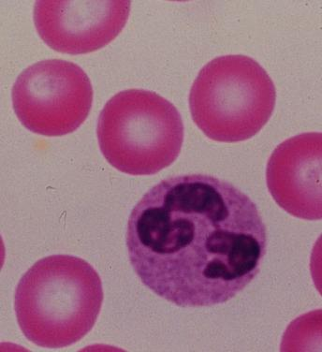
Granulocytes
Neutrophils
Appearance:
Very fine _
Multi-lobed nucleus
Aka: PML: Polymorphonuclear Leukocytes
Function
First WBCs to arrive at the infection site
Phagocytize bacteria and fungus

Slide 3
Neutrophils
Kill bacteria by process called _
Oxygen is metabolized to form _________________________________________________ by the neutrophil
Able to ________________________________ offending bacteria

Slide 4
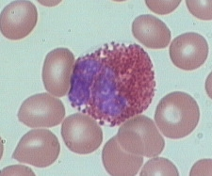
Granulocytes
Eosinophils
Eosin:
Phil: loving
Appearance:

Slide 5
Eosinophils
Function:
Lysosome-like: filled with _
tapeworms, flukes, pinworms, hookworms

Slide 6
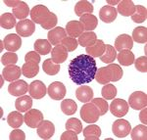
Granulocytes
Basophils
Baso: basic
Phils: loving
Appearance:
Bi-lobed nucleus
Fewer, but larger granules… _
Function
Promotes inflammation: histamines

Slide 7
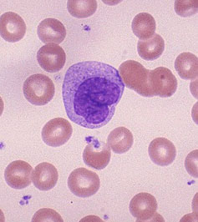
Agranulocytes
________________________develop in the bone marrow
Appearance:
__________________________. (2-3 times larger than RBC)
Nuclei is large and _

Slide 8
Agranulocytes
Monocytes
Function:
Become ________________________________________ as they leave the blood stream
Highly mobile, _
Phagocytize bacteria, viruses, cellular debris

Slide 9
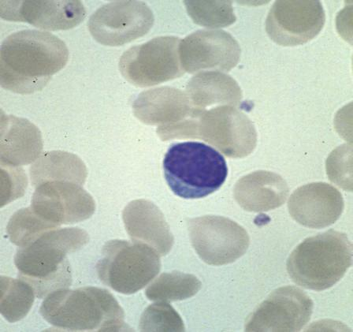
Agranulocytes
Lymphocytes ___________________________as well as lymph tissues
Appearance
About the same _____________________________
Mostly nucleus. Thin crescent of cytoplasm

Slide 10
Lymphocytes
Function:
_____________________________: cell mediated responses against _
______________________________: change into plasma cells which release antibodies

Slide 11
White Blood Cells
Distribution:
Neutrophils 54-62%
Eosinophils 1-3 %
Basophils 1%
Monocytes 3-9%
Lymphocytes 25-33%

Slide 12
Leukopoeisis
___________________________________: production of white blood cells
Stimulated by chemical messengers
Two types of glycoproteins
Colony Stimulating Factors

Slide 13
Leukopoiesis
Hemocytoblast →
Will give rise to basophils, eosinophils, neutrophils, and monocytes
Will give rise to _

Slide 14
Leukopoiesis: granulocytes
Myeloid cells → ______________________________________ → promyelocytes →
_________________________________ myelocytye
_________________________________ myelocyte
_________________________________ myelocyte

Slide 15
Leukopoiesis: monocyte
Hemocytoblast → myeloid stem cell → myeloblast
Up to this point, no changes from the granular leukocytes
→ ___________________________________________ → monocyte

Slide 16
Leukopoiesis: Lymphocyte
Hemocytoblast →
__________________________________→
Lymphoblast →
__________________________________ →
Lymphocyte

Slide 17
White Blood Cell Counts
Percentages of the WBCs are of clinical value
Increased leukocytes (overall)
May indicate infection, exercise, strong emotions or loss of body fluids

Slide 18
White Blood Cell counts
Decreased Leukocytes
Penia: _
Flu, measles, mumps, chicken pox, AIDS, polio
___________________________________________, lead, arsenic or mercury poisoning

Slide 19
Leukemia
Group of cancerous conditions _
Increased _
Impairs bone marrow function
Severe _
Named according to the _
Myelocytic: myeloblast descendants: granulocytes and monocytes
Lymphocytic: lymphocytes

Slide 20
Leukemias
_______________________________________ advancing
Seen in _
Seen more in children
_______________________________________ advancing
Seen in later cells stages _
Seen more in elderly

Slide 21
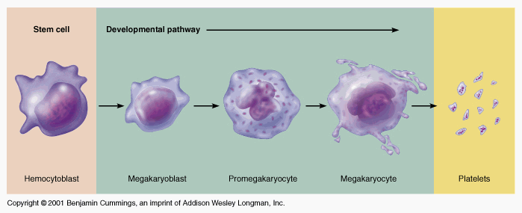
Platelets
fragments
Hemocytoblast→
________________________________________ →
_________________________________________ →
megakaryocyte →

Slide 22
Hemostasis
Heme: blood stasis: stopping
Process is fast, localized and controlled
Hemostasis causes

Slide 23
Vascular Spasm
Damage to blood vessel→ stimulates ________________________________________ → results in less blood loss
Allows for formation of _
Platelets release _______________________________ which further constricts the smooth muscle in the vessel wall.

Slide 24
Platelet Plug Formation
Platelets adhere to _
Particularly the __________________________________ in the connective tissue
Platelets + collagen→
change in shape
Becomes _
Effective for ______________________________ but not large ones

Slide 25
Blood Coagulation
A set of reactions in which blood is transformed _
Coagulation follows _

Slide 26
Blood coagulation
Blood coagulation is dependent on balance
The ____________ ______________________of pro-coagulants and anti-coagulants
Inability to synthesize procoagulants by the ______________________________________ results in severe bleeding disorders

Slide 27
Major event of coagulation
The ______________________________ of the plasma protein _
Fibrin is composed of insoluble threads

Slide 28
Extrinsic Clotting Factors
Triggered when contacts
Any _______________________________ outside the blood vessels

Slide 29
Extrinsic Clotting
Damaged tissues release thromboplastin also called Factor III
Depends also on _

Slide 30
Extrinsic Clotting
End result: Fibrinogen pieces _
Before: soluble
After:
Fibrin sticks to exposed surfaces, ____________________________________________, and prevents blood loss

Slide 31
Intrinsic Clotting
Initiated by Factor VII aka Hageman Factor
Due to _________________________________ in the _
Foreign substances in the blood
Blood stored in _

Slide 32
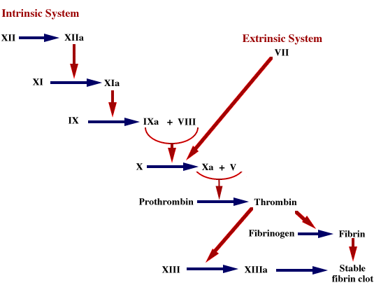

Slide 33
Clots
Fibrin prevents blood loss by forming clots
Plasminogen converted to Plasmin
Plasmin _

Slide 34
Clots
Thrombus: _
DVT
Deep Vein Thrombosis
Embolus:
if a thrombus fragments or breaks loose and travels through the blood stream, it becomes an embolus

Slide 35
Clots
Embolism: the traveling embolus becomes lodged at a _
Pulmonary embolism: blood clot gets lodged in lung vessels

Slide 36
Hemostasis Disorders
Disseminated Intravascular Coagulation (DIC):
Residual blood cannot clot
Most common as:
A complication of pregnancy
A result of ___________________________________________ or incompatible blood transfusions

Slide 37
Hemostasis Disorders: Bleeding Disorders
Thrombocytopenia
condition where the number of _
Patients show petechiae due to _
Caused by suppression or destruction of bone marrow (e.g., malignancy, radiation)
Platelet counts less than 50,000/mm³ is diagnostic for this condition
Treated with _

Slide 38
Hemostasis Disorders: Bleeding Disorders
Hemophilias
hereditary bleeding disorders caused by lack of clotting factors
Symptoms include _

Slide 39
Hemostasis Disorders: Bleeding Disorders
Hemophilia A
________________________________________________ due to a deficiency of factor VIII
Hemophilia B
due to a deficiency of _
Hemophilia C
______________________________________________, due to a deficiency of factor XI

Slide 40
Transfusions
Whole blood transfusions
Used _
Rapid and voluminous blood loss
Infusions
_____________________________________________ are transferred

Slide 41
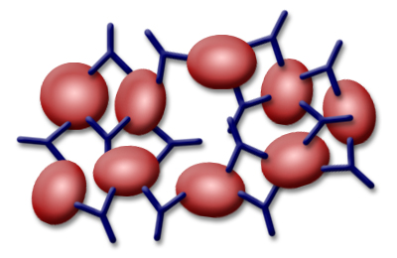
Antigens and Antibodies
Agglutination is caused by the interaction of ___________________________________________ and the _

Slide 42
ABO
Type A Blood: Has _________________________________ on surface
Has ______________________________________ in blood plasma, Anti-B
Will agglutinate when exposed to Anti-A

Slide 43
ABO
Type B Blood: Has __________________________ on surface
Has Antibody A in blood plasma: Anti-A
Will _

Slide 44
ABO Blood groups
Type AB Blood: Has _
Has _
Will agglutinate when exposed to either

Slide 45
ABO Blood Groups
Type O Blood: Has neither antigen on the surface
Has both _

Slide 46
Rh Factor
Named after _
Antigen originally found in the monkey, later found in humans as Antigen D
If any of the rhesus antigens are present_
Antigen D

Slide 47
Rh –
If an Rh – person is exposed to Rh antigens, _
No complications following first exposure

Slide 48
Rh-
If Rh- person again exposed to Rh antigens, _
Erythroblastosis fetalis: hemolytic disease of newborn. Mother’s antibodies can cross placental barrier and _

