Slide 1
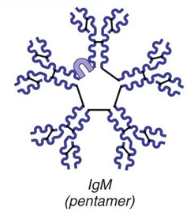
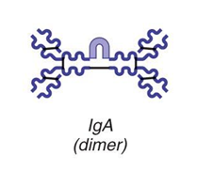
Classes of Antibodies
IgM
A _____________________________; first antibody released
Potent agglutinating agent
Readily fixes and activates complement
IgA (secretory IgA)
Monomer or _____________________ ; in _____________________and other secretions
Helps prevent entry of pathogens

Slide 2
Classes of Antibodies
IgD
Monomer attached to the surface of _
Functions as a _
IgG
Monomer; 75–85% of antibodies in plasma
From _
Crosses the _

Slide 3
Classes of Antibodies
IgE
Monomer active in some _
Causes mast cells and basophils to release _

Slide 4
Antibody Targets
Antibodies _
Form antigen-antibody (immune) complexes
Defensive mechanisms used by antibodies
Agglutination
Lysis by Complement fixation

Slide 5
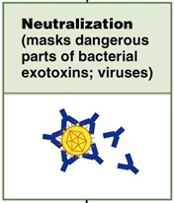
Neutralization
___________________mechanism
Antibodies block _____________________________ or bacterial exotoxins
Prevent these antigens from binding to receptors on tissue cells
Antigen-antibody complexes undergo _

Slide 6
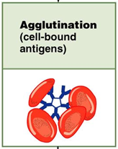
Agglutination
Antibodies bind the same determinant on _
Cross-linked antigen-antibody complexes agglutinate
Example: clumping of _

Slide 7
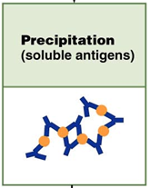
Precipitation
___________________________ are cross-linked
Complexes precipitate and are subject to _

Slide 8
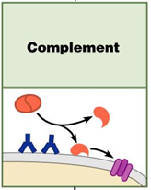
Complement Fixation and Activation
Main antibody defense against cellular antigens
Several antibodies __________________________ on a cellular antigen
Their complement-binding sites trigger ____________________________ into the cell’s surface
Complement triggers cell _

Slide 9
Complement Fixation and Activation
Activated complement functions
Amplifies the _
Enlists more and more defensive elements

Slide 10
Cell-Mediated Immune Response
T cells provide defense against ____________________________ antigens
Two types of surface receptors of T cells
Play a role in T cell interactions with other cells

Slide 11
Cell-Mediated Immune Response
Major types of T cells
CD4 cells become _
CD8 cells become _______________________________________ that destroy cells harboring foreign antigens
Other types of T cells
Regulatory T cells (T_{REG})

Slide 12
Comparison of Humoral and Cell-Mediated Response
Antibodies of the _
The simplest ammunition of the immune response
Targets
__________________________________ and molecules in extracellular environments (body secretions, tissue fluid, blood, and lymph)

Slide 13
Comparison of Humoral and Cell-Mediated Response
T cells of the cell-mediated response
Recognize and respond _____________________________________ displayed on the surface of body cells
Targets
_______________________________________ infected by viruses or bacteria
Abnormal or _
Cells of infused or ____________________________________ foreign tissue

Slide 14
Antigen Recognition
_______________________________ T cells are activated when their surface receptors bind to a recognized antigen: _
T cells must simultaneously recognize
Nonself :
Self:

Slide 15
MHC Proteins
Two types of MHC proteins are important to T cell activation
_________________________ MHC proteins
displayed by ______________________except RBCs
_________________________MHC proteins
displayed ____________________________-: dendritic cells, macrophages and B cells
Both types are synthesized at the ER and bind to peptide fragments

Slide 16
Class I MHC Proteins
Bind with fragment of a protein synthesized in the cell (_____________________________)
Endogenous antigen is a _________________ in a normal cell;
a nonself antigen in an infected or abnormal cell
Informs cytotoxic T cells of the _

Slide 17
Class II MHC Proteins
Bind with fragments of _________________________________ that have been engulfed and broken down
Recognized by _

Slide 18
T cell activation: step one
Phagocytic cell engulfs material
Becomes _
MHC protein will present the antigen on the APC surface
T cells will _______________________________ on the APC
Helper T (CD4) cells bind to _
Cytotoxic T (CD8) cells will be activated through _

Slide 19
T cell activation: step two
Once the T cell has found the MHC and the antigen, it needs a few more signals from the APC
Surface __________________________________ on the APC help to activate T cells
Cytokines (_____________________________________) are released and cause the T cell to activate and differentiate
Results in clone formation

Slide 20
Cytokines
Cytokines
General term for _________________________ that influence cell development, differentiation and response
Interleukin _
Released by _
Stimulates T cells to _
Synthesizes more _
Interleukin _
Encourages activated T cells to divide rapidly

Slide 21
Roles of Helper T(T_{H}) Cells
Play a central role in the __________________________ immune response
Once primed by APC presentation of antigen, they
Induce T and B cell proliferation
_______________________________________________ and recruit other immune cells
Without T_{H}, there is _

Slide 22
Helper T Cells
Interact _
Stimulate B cells to __________________________________ and begin _
Most antigens require T_{H} co-stimulation to activate B cells

Slide 23
Roles of Cytotoxic T(T_{C}) Cells
_____________________________ and kill other cells
Activated T_{C} cells circulate in ___________________________________ and lymphoid organs in search of body cells displaying antigen they recognize

Slide 24
Roles of Cytotoxic T(T_{C}) Cells
Targets
Cells with _______________________________ bacteria or parasites
Foreign cells (transfusions or transplants)

Slide 25
Cytotoxic T Cells
Bind to a self-nonself complex
Can destroy all _

Slide 26
Cytotoxic T Cells
Lethal hit
Tc cell releases ___________________________ and granzymes by exocytosis
Perforins create __________________________ through which granzymes enter the target cell
Granzymes stimulate _

Slide 27
Natural Killer Cells
Recognize other signs of abnormality
Lack of _
____________________________________ a target cell
Different surface marker on _
Use the same key mechanisms as Tc cells for killing their target cells

Slide 28
Regulatory T (T_{Reg}) Cells
Dampen the immune response by _
Important in _

Slide 29
Organ Transplants
Four varieties
Autografts:
from one body site to _
Isografts:
:
between individuals who are not identical twins
Xenografts:
from _

Slide 30
Prevention of Rejection
Depends on the similarity of the tissues
Patient is treated with _
Corticosteroid drugs to suppress inflammation
Antiproliferative drugs
Immunosuppressant drugs
Many of these have severe side effects

Slide 31
Clinical Terms
Caused by _______________________ invading the lymphatic system in the lower extremities
Lymphatic filariasis
Results in _
Lower limbs and scrotum
May be a combination of lymph blockage and immune response to the parasite
Typically a tropical disease

Slide 32
Hodgkin’s disease
Lymphoid tissue malignancy
Cancerous growth of cells in _
Symptoms:
Swollen, _
Fatigue

Slide 33
Hodgkin’s disease
Characterized by _
Thought to be a _
Treatment:
Chemotherapy and radiation

Slide 34
Non-Hodgkin’s lymphoma
Includes all cancers of lymphoid tissue _
Uncontrolled multiplication and metastasis of _
Swelling of the _
Spleen
Peyer’s patches
Is the 5th most common type of cancer

Slide 35
Lymphoma
General term
Any _________________of the lymphoid tissue

Slide 36
Mononucleosis
Viral disease “mono”
Caused by _
Present in
“kissing disease”_coughing
Virus attacks B lymphocytes → activation of T lymphocytes which _
Symptoms
Fever
Swollen lymph nodes
Duration: _

