Slide 1
Central Venous Pressure
Factors that increase the blood flow into RA…elevate the CVP:
Widespread _
Increased CVP can lead ________________________________ due to the _______________________________ forcing fluid into tissues.

Slide 2
Blood Pressure
Is the force the blood exerts against the inner walls of the blood vessels.
Most commonly refers to pressure in the _

Slide 3
Blood Pressure
Arterial blood pressure: rises and falls in a pattern with the _
When ventricles contract: ________________________________: walls squeeze blood into pulmonary trunk and aorta. Pressure in the _

Slide 4
Blood Pressure
Maximum pressure achieved during _________________________________ is _

Slide 5
Blood Pressure
When ventricles relax =_
the arterial pressure drops, and the lowest pressure that remains in the arteries before the next contraction is the _

Slide 6
Blood Pressure
BP read as _________________________________ which translates into
ventricular contraction pressure/ventricular relaxation pressure.

Slide 7
Short term BP control
Short term controls of blood pressure
Function to correct minor fluctuations in BP
By altering _
By altering _

Slide 8
Vasomotor Center
Short term control: _
Two main goals
Maintaining adequate mean arterial pressure by _
Distributing blood to those _

Slide 9
Vasomotor center
Vasomotor center: neurons _
With the cardiac center in the medulla, they form the _
Vasomotor center in medulla →_______________________________ efferent fibers → ______________________________ of the arterioles
Arterioles under state of constant constriction called vasomotor tone

Slide 10
Vasomotor activity
Vasomotor control modified by
Higher brain centers

Slide 11
Vasomotor: Baroreceptors
Increased ___________________________ causes stretch in baroreceptors
Located in _
Carotid provides the major blood flow to the brain
Carotid __________________________________ protects the brain
Located in _____________________________ and walls of large arteries
Aortic sinus reflex protects the systemic circuit

Slide 12
Vasomotor: baroreceptors
Increased BP →
______________________________________→
triggers baroreceptors →
impulses sent _____________________________→
arterioles and veins ________________________ →

Slide 13
Vasomotor: chemoreceptors
Sensitive to
Carbon dioxide
Locations:
________________________________________ located in Carotid artery
Aortic bodies located in Aorta
Main function:
regulating respiratory rate, but does have some blood pressure function

Slide 14
Vasomotor: chemoreceptors
Decreased oxygen → ______________________________→
signals sent to cardioacceleratory center → cardiac output increases
AND signals sent to vasomotor center → vasoconstriction → _____________________________→ blood supply returns to heart (and lungs) quickly

Slide 15
Vasomotor: brain functions
Medulla is not the only brain area that controls blood pressure
Both of these regions have input into medulla to ___________________________ control BP

Slide 16
Hormone effects on BP
Adrenal medulla
increases _
General _
Specific vasodilation: skeletal and cardiac muscles
Norepinephrine
Enhance sympathetic fight/flight response

Slide 17
Hormone effects on BP
Atrial natriuretic peptide: _
_________________________________ stimulates ANP release.
Results in ____________________________________ after ANP causes sodium to be excreted from kidneys
Where sodium goes, water goes

Slide 18
Hormone effects on BP
Antidiuretic Hormone ADH/ vasopressin
Results in the _____________________________________ in the body
If low BP or blood volume, ADH will prevent water from being lost as urine
Water restores blood volume/pressure
Also can cause _

Slide 19
Hormone effects on BP
stimulates vasoconstriction
Causes the release of ADH and _
Causes long-term regulation by increasing blood volume

Slide 20
Hormone effects on BP
Angiotensin II
Low BP →
Kidneys release _
Renin acts as an _______________________, breaking _____________________________ into angiotensin I
Angiotensin I is changed into angiotensin ____ by _________________________ : Angiotensin Converting Enzyme

Slide 21
BP Control: Long term
Will change blood pressure based on changes in blood volume
Recall that short term controls dealt mostly with ________________________________ to control blood pressure
Short term solutions like baroreceptors can
Respond _
_______________________________ to chronic conditions

Slide 22
BP control: long term
Kidneys
_____________________________ regulate arterial pressure
Alters ____________________________________ as a function of filtration pressure
High blood pressure forces blood to be filtered and processed quickly through the renal system. Larger amounts of water will be lost as urine causing the blood pressure to lower
________________________________ regulates arterial pressure
Renin-angiotensin mechanism:
stimulates ___________________________________ which reabsorbs sodium and in turn causes the _

Slide 23
Monitoring Circulatory Efficiency
_________________________________:
pulse and blood pressure, along with respiratory rate and body temperature
Pulse:
pressure wave caused by the _

Slide 24
Pulse
the expansion/recoil of artery walls due to increased pressure _.
Felt near surfaces.

Slide 25
Head and neck pulses
Temporal artery
Branches off of _
Pulse is palpable ___________________ to the zygomatic arch, anterior and superior to the _

Slide 26
Head and neck pulses
Common carotid artery
The left common carotid artery is one of three arteries that originate along the _
The right common carotid artery arises from the _
Pulse: palpated in the neck at _
Baroreceptors in carotids are sensitive to bilateral palpation, may cause _

Slide 27
Upper limb pulses
Brachial artery
Origin: ______________________→ axillary artery → to brachial artery
Palpation: at the _
Is the artery used to determine _

Slide 28
Upper limb pulses
Radial Artery
Origin: Subclavian a → axillary a → brachial a → splits into _
Palpation: at the ____________________ wrist: three finger-widths _

Slide 29
Lower Limb Pulses
___________________ arterial pulses are routinely felt in the lower limb.
Posterior tibial
Dorsalis pedis (dorsum of foot)

Slide 30
Femoral pulse
Most of the blood supply to the lower limb is carried in the _
Aorta →
descending aorta →
_________________________________→
external iliac artery →
becomes _________________________→
deep femoral

Slide 31
Finding the Femoral Pulse
Locate the superior border of the ___________________ in the mid line of the body;
Feel the _______________________________. The femoral pulse can be found midway between these two bony points
(the ___________________________________ point)

Slide 32
Popliteal
The femoral artery leaves enters the popliteal fossa by passing through the _
The name of the vessel then changes to the _

Slide 33
Palpating popliteal artery
bend the knee so that it is flexed to about _
press the tips of your fingers into the popliteal fossa.
The popliteal pulse is deep and __________________
Can be difficult to palpate

Slide 34
Posterior Tibial
The Popliteal artery branches into _

Slide 35
Palpating Posterior tibial artery
Locate the medial _
_______________________________ to the medial malleolus you should find the posterior tibial pulse.

Slide 36
Dorsalis Pedis
Below the knee, the popliteal artery divides into the anterior and posterior tibial arteries.
The anterior branch enters the ____________________________________________ of the leg by passing between the tibia and fibula above the interosseous membrane.
It continues on to the _______________________________ as the dorsalis pedis artery

Slide 37
Palpating dorsalis pedis pulse
Place your fingers _____________________ down the dorsum of the foot in the line between the _
The bones you can feel are the dorsal aspect of the navicular and the intermediate cuneiform bones.
The pulse is palpated where the artery passes over this area.

Slide 38
Measuring Blood Pressure
Systemic arterial BP
Measured ________________________ by the __________________________________ method using a sphygmomanometer
Pressure is increased in the cuff until it exceeds systolic pressure in the brachial artery

Slide 39
Alterations in Blood Pressure
Hypotension:
Systolic pressure below _
Often associated with long life and lack of cardiovascular illness

Slide 40
Homeostatic Imbalance: Hypotension
Orthostatic hypotension
_____________________________________ and dizziness when suddenly rising from a sitting or reclining position
Chronic hypotension
hint of _
warning sign for Addison’s disease or hypothyroidism
___________________________ hypotension
important sign of _

Slide 41
Alterations in Blood Pressure
Hypertension
______________________________ elevated arterial pressure of 140/90 or higher
May be transient adaptations during fever, physical exertion, and emotional upset
Often persistent in _

Slide 42
Temperature Regulation
As temperature rises (e.g., heat exposure, fever, vigorous exercise)
Hypothalamic ___________________________________ of the skin vessels
Heat radiates from the skin

Slide 43
Temperature Regulation
Sweat also causes ____________________________ via bradykinin in perspiration
Bradykinin stimulates the _
As temperature decreases, blood is shunted to deeper, more _

Slide 44
Capillary Exchange of Respiratory Gases and Nutrients
Diffusion of
O₂ and nutrients from _
CO₂ and metabolic wastes from _
Lipid-soluble molecules diffuse directly through endothelial membranes
Water-soluble solutes pass through _
Larger molecules, such as proteins, are actively transported in ________________________________ or caveolae

Slide 45
Circulatory Shock
Any condition in which
Blood vessels _
Blood _
Results in inadequate blood flow to meet tissue needs

Slide 46
Circulatory Shock
Hypovolemic shock
results from _
results from _____________________________________ and ____________________peripheral resistance
Cardiogenic shock
results when an ________________________________________ cannot sustain adequate circulation

Slide 47
Circulatory Pathways
Two main circulations
__________________________________: short loop that runs from the heart to the lungs and back to the heart
__________________________________: long loop to all parts of the body and back to the heart

Slide 48
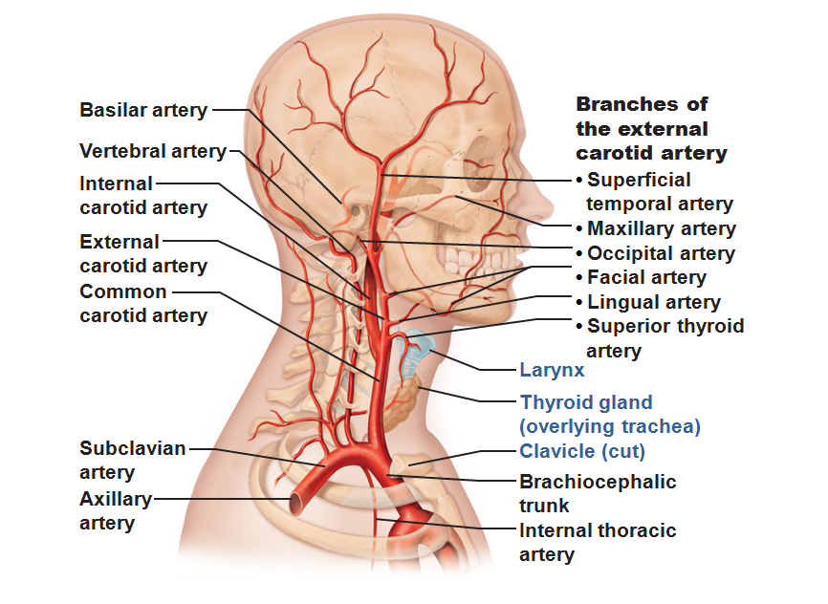

Slide 49
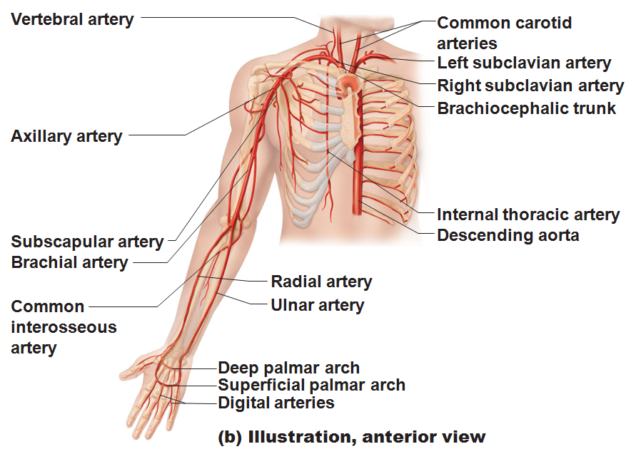

Slide 50
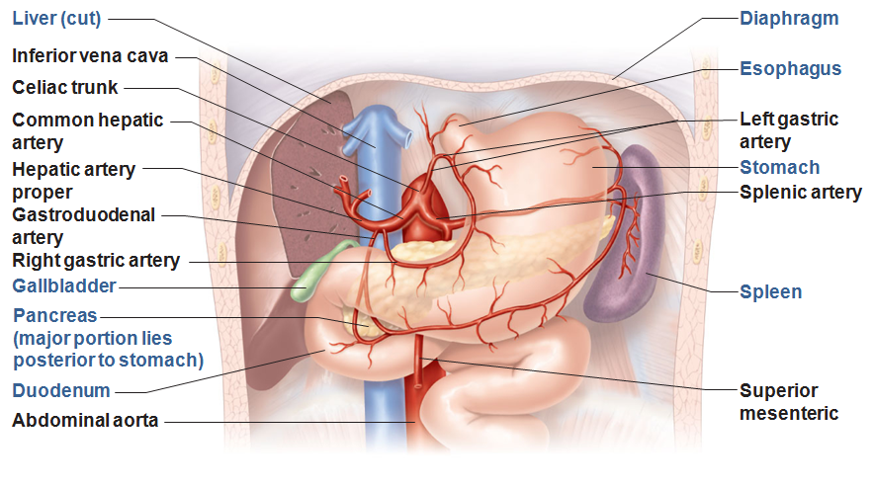

Slide 51
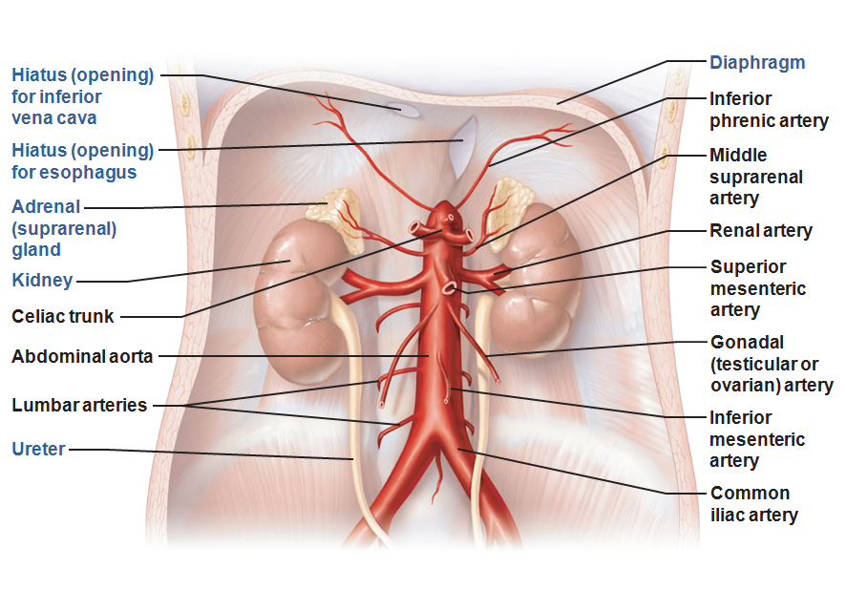

Slide 52
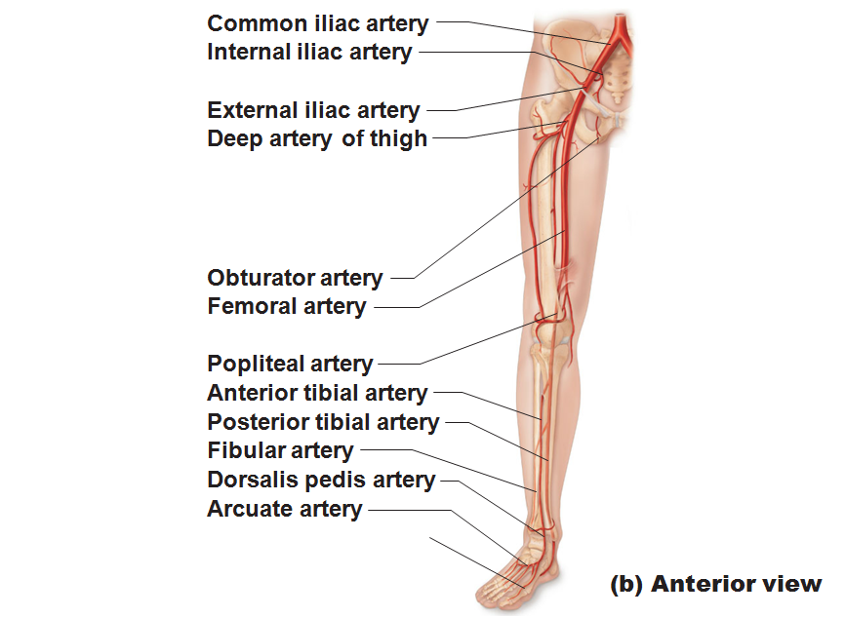

Slide 53
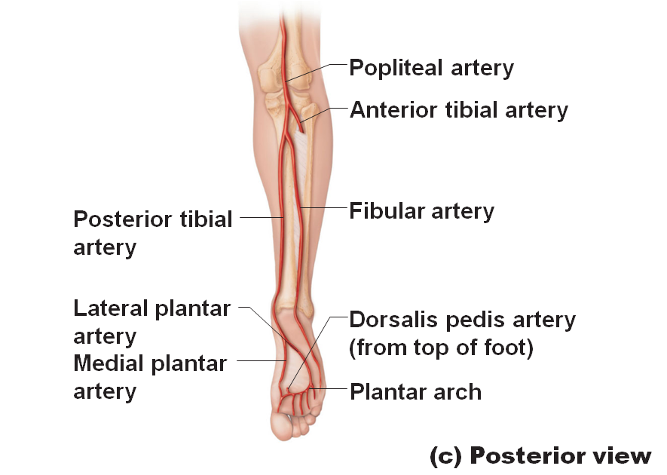

Slide 54
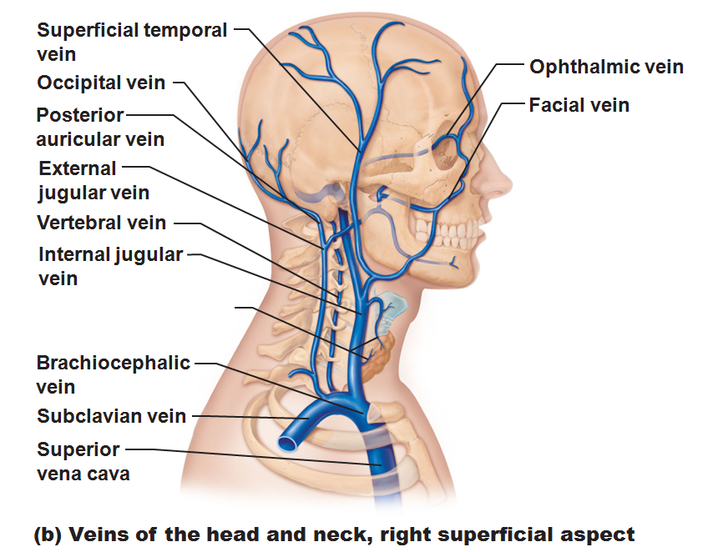

Slide 55
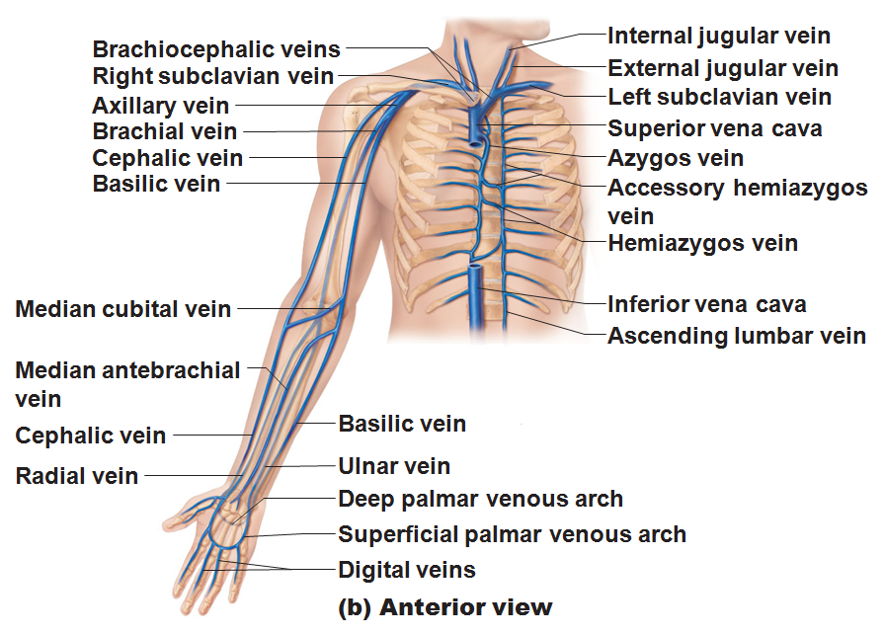

Slide 56
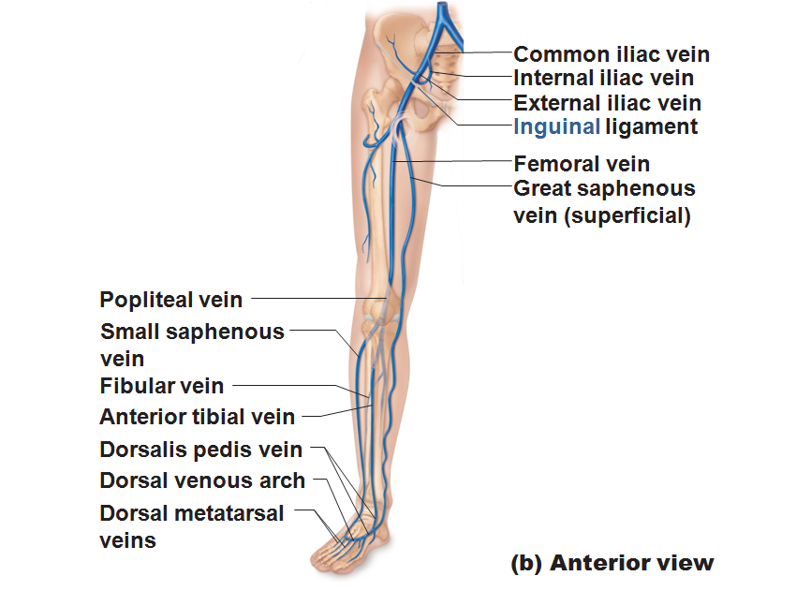

Slide 57
