Slide 1
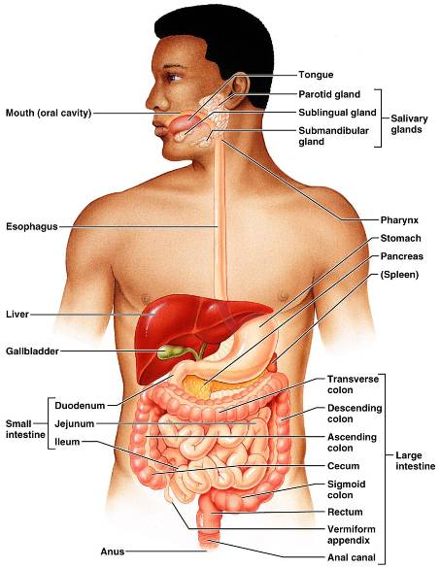
Digestive System: Overview
mouth, pharynx, esophagus, stomach, small intestine, and large intestine
teeth, tongue, gallbladder, salivary glands, liver, and pancreas

Slide 2
Digestive Process
The GI tract is a _____________________________________ line
Nutrients become more available to the body in each step
There are six essential activities:
Ingestion
mechanical digestion
defecation

Slide 3
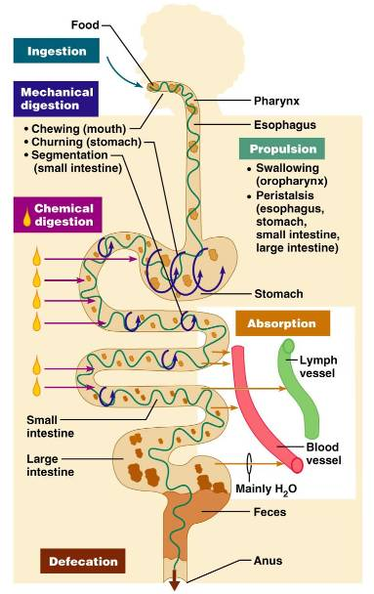
G.I. Tract Activities
Ingestion –
Propulsion – swallowing and peristalsis
Peristalsis – ______________________ of muscles in the organ walls
Mechanical digestion –

Slide 4
Gastrointestinal Tract Activities
Chemical digestion
catabolic _
movement of nutrients _
Defecation
elimination of _

Slide 5
GI Tract
___________________________________ for the digestive process
Regulation of digestion involves:
Mechanical and chemical stimuli – _________________________________, osmolarity, and presence of substrate in the lumen
Extrinsic control by _
Intrinsic control by _

Slide 6
Receptors of the GI Tract
Mechano- and chemoreceptors respond to:
Stretch, osmolarity, and pH
Presence of substrate, and end products of digestion
They initiate reflexes that:

Slide 7
Nervous Control of the GI Tract
Intrinsic controls
______________________________________ initiate short reflexes
Short reflexes are mediated by local enteric plexuses (gut brain)
Extrinsic controls
Long reflexes arising within or outside the GI tract
____________________________ and extrinsic _

Slide 8
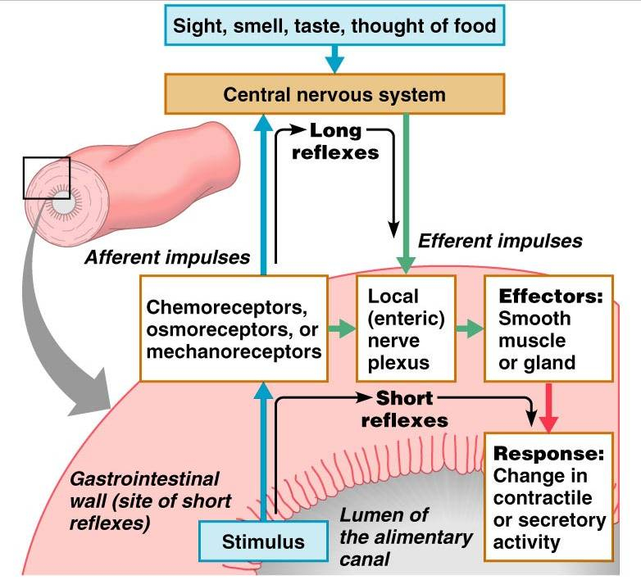

Slide 9
Peritoneum and Peritoneal Cavity
Peritoneum
______________________________________ of the abdominal cavity
covers external surface of most _
lines the _
Peritoneal cavity
________________________________ digestive organs
Allows them to slide across one another

Slide 10
Peritoneum and Peritoneal Cavity
Mesentery :
supplies _____________________________ to the viscera
Holds digestive organs in place and _

Slide 11
Histology of the Alimentary Canal
From esophagus to the anal canal the walls of the GI tract have the _
From the lumen outward they are the _________________________, _________________________, muscularis externa, and ___________________________
Each tunic has a predominant tissue type and a specific digestive function

Slide 12
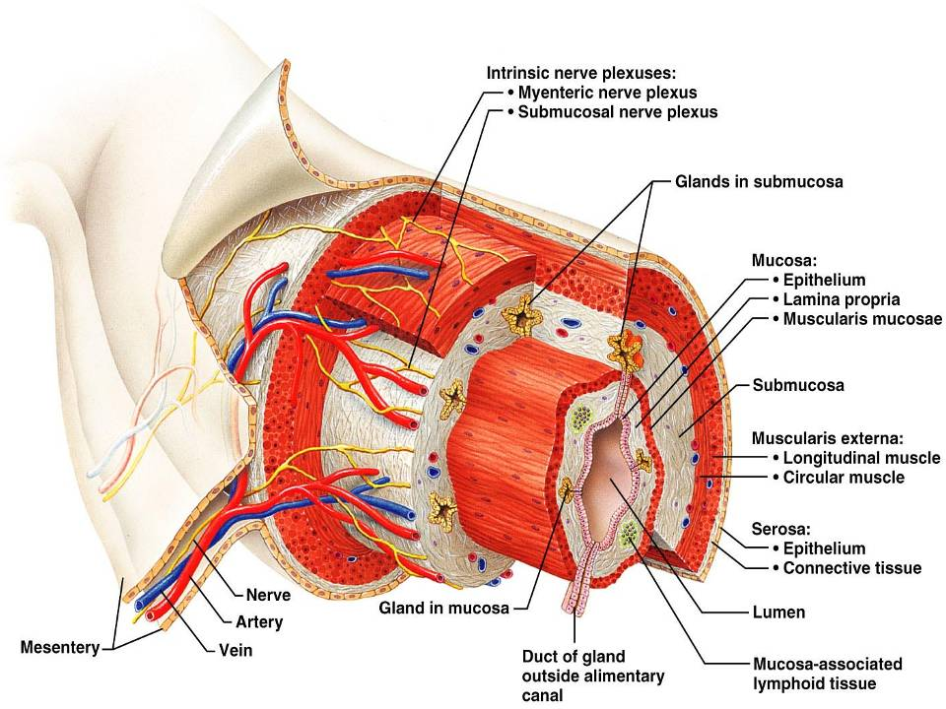
Figure 23.6

Slide 13
Mucosa
Moist epithelial layer that _____________________________ of the alimentary canal
Three major functions:
_______________________________ against infectious disease
Consists of three layers: a lining epithelium, lamina propria, and muscularis mucosae

Slide 14
Mucosa: Epithelial Lining
________________________________ and mucus-secreting goblet cells
Mucus secretions:
_______________________________________ from digesting themselves
Ease food along the tract
Stomach and small intestine mucosa contain:
__________________________________ -secreting cells (making them endocrine and digestive organs)

Slide 15
Mucosa: Lamina Propria and Muscularis Mucosae
Nourishes the epithelium and absorbs nutrients
Contains lymph nodes _____________________________ important in defense against bacteria
Muscularis mucosae
__________________________________ that produce local movements of mucosa

Slide 16
Mucosa: Other Sublayers
dense connective tissue containing elastic fibers, blood and lymphatic vessels, lymph nodes, and nerves
Muscularis externa
responsible for _
Serosa
the _
Replaced by the fibrous adventitia in the esophagus
Retroperitoneal organs have both an adventitia and serosa

Slide 17
Enteric Nervous System
two major intrinsic nerve plexuses:
regulates glands and smooth muscle in the mucosa
_____________________________ – Major nerve supply that controls GI tract mobility

Slide 18
Enteric Nervous System
Segmentation and peristalsis are largely ______________________________ involving local reflex arcs
Linked to the CNS via long _____________________________ reflex arc

Slide 19
Mouth
Oral or _____________________ cavity:
Is bounded by lips, cheeks, palate, and tongue
oral orifice
continuous with the oropharynx posteriorly

Slide 20
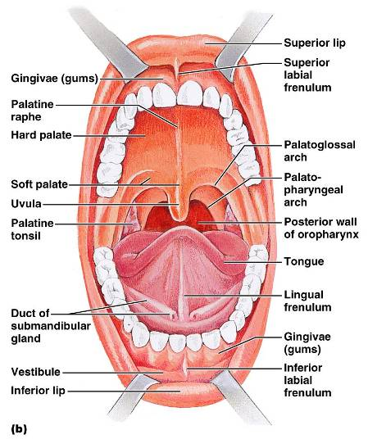
Mouth
To withstand _
The mouth is lined with _
The gums, hard palate, and dorsum of the tongue are _

Slide 21
Lips and Cheeks
Have a core of skeletal muscles
Lips:
Cheeks:
bounded by the lips and cheeks externally, and teeth and gums internally

Slide 22
Lips and Cheeks
Oral cavity proper
area that lies _
median fold that joins the internal aspect of each lip to the gum

Slide 23
Palate
Hard palate
palatine bones and palatine processes of the maxillae
Slightly _________________________ on either side of the raphe (midline ridge)

Slide 24
Palate
Soft palate – mobile fold _
Closes off the nasopharynx during swallowing

Slide 25
Tongue
Occupies the _
fills the oral cavity when mouth is closed
Functions include:
____________________________________ food during chewing
_____________________________________ and forming the bolus
Initiation of _

Slide 26
Tongue
______________________________ muscles change the _
_______________________________ muscles alter the tongue’s _
___________________________________ secures the tongue to the floor of the mouth

Slide 27
Tongue
three types of papillae
give the tongue roughness and provide friction
scattered widely over the tongue and give it a reddish hue
V-shaped row in back of tongue

Slide 28
Tongue
groove that separates the tongue into two areas:
Anterior 2/3 residing in the _
Posterior third residing in the _

Slide 29
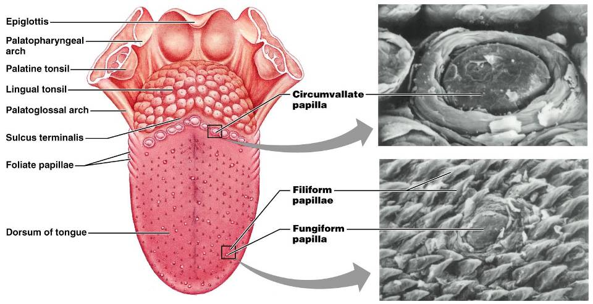
Tongue
Figure 23.8

Slide 30
Salivary Glands
Produce and secrete saliva that:
Moistens and dissolves food chemicals
Aids in bolus formation
Contains _

Slide 31
Salivary Glands
Three pairs of ____________________ glands
Intrinsic salivary glands (_______________________ glands) – scattered throughout the oral mucosa

Slide 32
Salivary Glands
Parotid
lies _______________________________ between the masseter muscle and skin
_________________________________ opens into the vestibule next to second upper molar
Submandibular
lies along the medial aspect of the mandibular body
ducts open at the _

Slide 33
Salivary Glands
Sublingual
lies anterior to the submandibular gland _
It opens via 10-12 ducts into the _

Slide 34
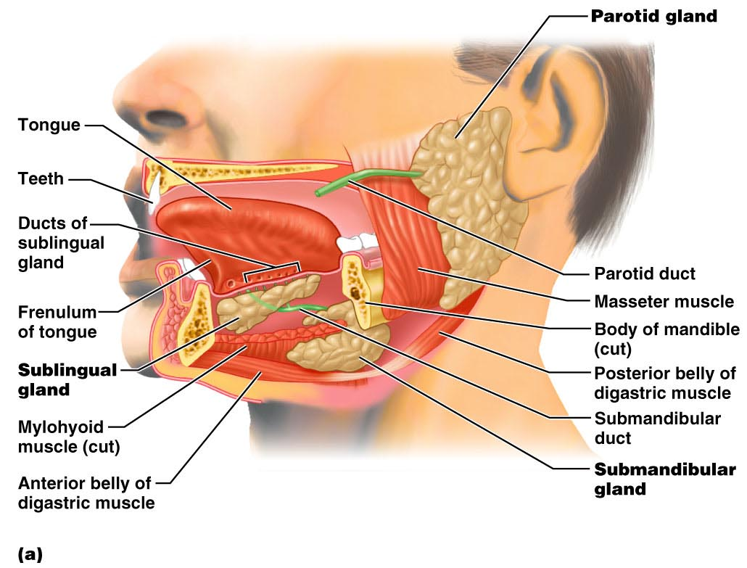
Salivary Glands
Figure 23.9a

Slide 35
Saliva: Source and Composition
Secreted from ________________________ cells of salivary glands
contains
_______________________________ – Na⁺, K⁺, Cl–, PO₄^{2–}, HCO₃–
Digestive enzyme –
Proteins – mucin, lysozyme, defensins, and IgA
____________________________________ – urea and uric acid

Slide 36
Control of Salivation
Intrinsic glands keep the mouth _
Extrinsic salivary glands secrete serous, enzyme-rich saliva in response to:
Ingested food which stimulates chemoreceptors and pressoreceptors
The thought of food
Strong ________________________________ inhibits salivation and results in dry mouth

Slide 37
Teeth
Primary
__________________________________ that erupt at intervals between 6 and 24 months
Permanent
enlarge and develop causing the root of deciduous teeth to be resorbed
fall out between the ages of _
All but the third molars have erupted by the end of adolescence
Usually _

Slide 38
Classification of Teeth
Based on shape and function
chisel-shaped teeth for cutting or nipping
Canines
fanglike teeth that _
Premolars (bicuspids) and molars
have _______________________________; best suited for grinding or crushing

Slide 39
Tooth Structure
Two main regions –
Crown
______________________________ above the gingiva
Enamel
acellular, brittle material composed of calcium salts and hydroxyapatite crystals;
Root
portion of the tooth _

Slide 40
Tooth Structure
Neck
constriction _
Cementum
Attaches it to the periodontal ligament

Slide 41
Tooth Structure
Periodontal ligament
________________________________ in the alveolus of the jaw
Forms the _
Gingival sulcus
depression where the gingiva borders the tooth

Slide 42
Tooth Structure
Dentin
bonelike material ________________________________ that forms the bulk of the tooth
cavity surrounded by dentin that contains pulp
Pulp
connective tissue, _

Slide 43
Tooth Structure
Root canal
portion of the pulp cavity that extends into the root
Odontoblasts
secrete and maintain dentin throughout life

Slide 44
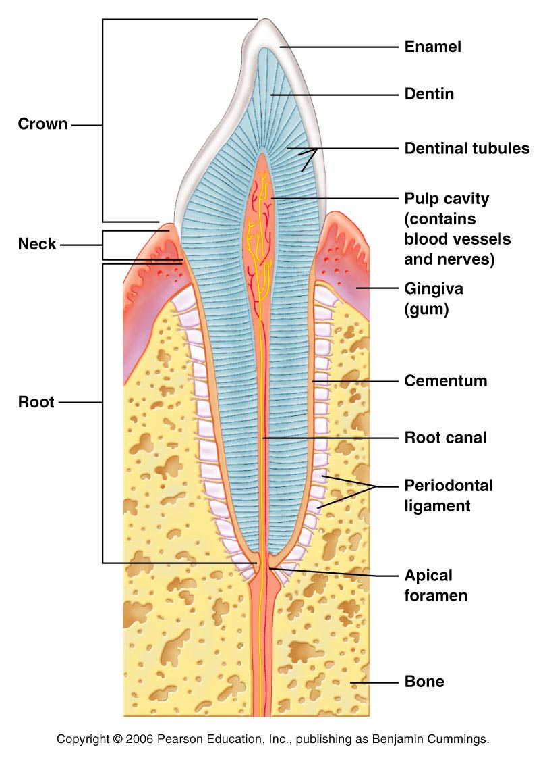

Slide 45
Tooth and Gum Disease
Dental _
gradual ___________________________ of enamel and dentin by bacterial action
Dental plaque adheres to teeth
a film of _
Acid from the bacteria dissolves calcium salts
Without calcium salts, organic matter is digested by _
Daily flossing and brushing help prevent caries by removing forming plaque

