Slide 1
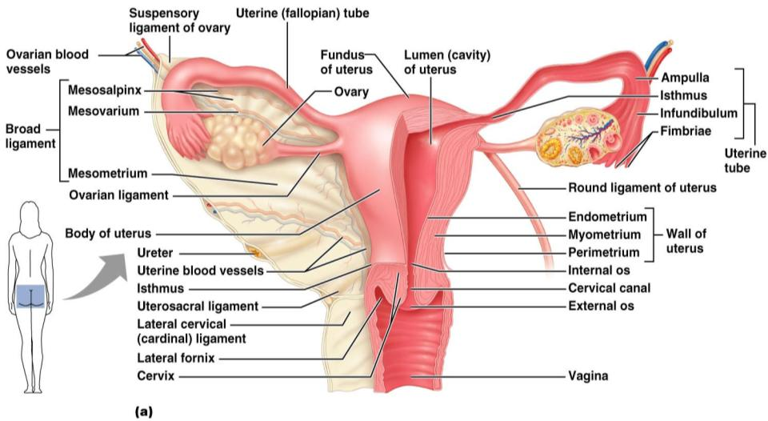
The Ovaries
Figure 27.14a

Slide 2
Ovaries
Blood supply
______________________________________ and the ovarian branch of _
They are surrounded by a fibrous tunica albuginea,
covered by a layer of epithelial cells called the _
Embedded in the __________________________ are ovarian follicles

Slide 3
Ovaries
Each follicle consists of an _
Cells around the oocyte are called:
one cell layer thick
when ______________________________________ is present

Slide 4
Ovaries
one layer of squamous-like follicle cells surrounds the oocyte
two or more layers of ___________________________________________ cells enclose the oocyte
has a _________________________________________ between granulosa cells that coalesces to form a central _

Slide 5
Ovaries
secondary follicle at its _____________________________________ that bulges from the surface of the ovary
Ovulation
_________________________________________from the ripening follicle
ruptured follicle _

Slide 6
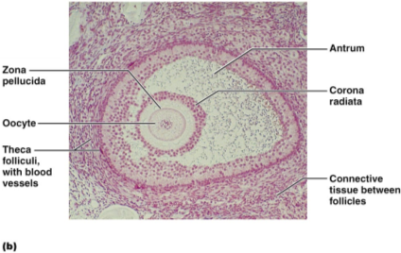
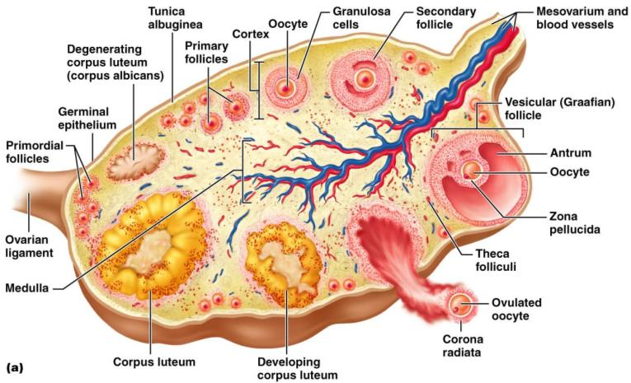
Ovaries

Slide 7
Fallopian Tubes
Receive the _
provide a _
Empty into the uterus via the isthmus
Expand distally around the ovary forming the _
The ampulla ends in the funnel-shaped, ciliated infundibulum containing fingerlike projections called fimbriae

Slide 8
Uterine Tubes
The uterine tubes have __________________________________ with the ovaries and the ovulated oocyte is cast into the _
Beating __________________________ on the fimbriae create currents to carry the oocyte into the uterine tube

Slide 9
Uterine Tubes
The oocyte is carried toward the uterus by _
Nonciliated cells keep the oocyte and the _

Slide 10
Uterus
Hollow, thick-walled organ
located in the pelvis ___________________________________________ and posterosuperior to the bladder
major portion of the uterus
rounded region superior to the entrance of the uterine tubes
narrowed region between the body and cervix

Slide 11
Uterus
narrow _______________________________ which projects into the vagina inferiorly
Cervical canal
cavity of the cervix that communicates with:
The vagina via the _
The uterine body via the _
Cervical glands ________________________________________ that covers the external os and ______________________________________________ except during midcycle

Slide 12
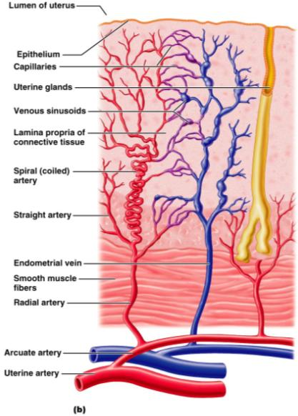
Uterine Wall
three layers
outermost serous layer
the visceral peritoneum
middle layer
smooth muscle
mucosal lining of the uterine cavity

Slide 13
Endometrium
Has numerous uterine glands that change in length as the endometrial thickness changes
Undergoes cyclic changes in response to ovarian hormones
Is shed during _
Forms a new functionalis after menstruation ends
Does not respond to ovarian hormones

Slide 14
Uterine Vascular Supply
Uterine arteries
arise from _
ascend the sides of the uterus and send branches into the uterine wall
branches of the uterine arteries in the myometrium that give rise to radial branches

Slide 15
Uterine Vascular Supply
Radial branches
descend into the endometrium and give off:
______________________________________ to the stratum functionalis
______________________________________ to the stratum basalis

Slide 16
Uterine Vascular Supply
__________________________________________________________________________ causes the functionalis to shed during menstruation

Slide 17
Vagina
Thin-walled tube
between the _
The urethra is embedded in the anterior wall
Provides a passageway for birth, menstrual flow, and is the organ of copulation

Slide 18
Vagina
Wall consists of three coats:
fibroelastic adventitia
smooth muscle muscularis,
stratified squamous mucosa
______________________________ near the _______________________________________ forms an incomplete partition called the _
Vaginal _
upper end of the vagina surrounding the cervix

Slide 19
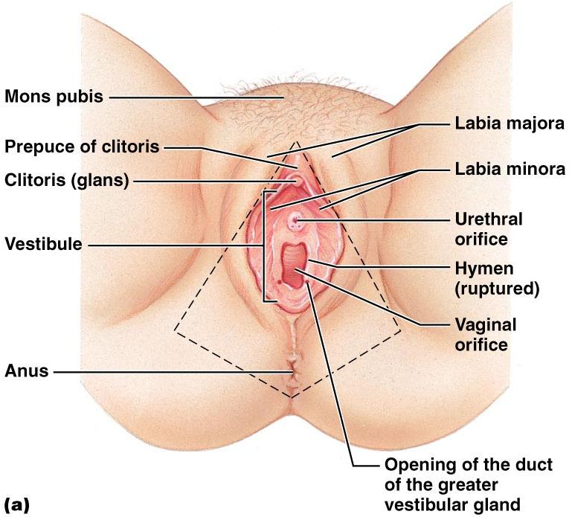
Vagina

Slide 20
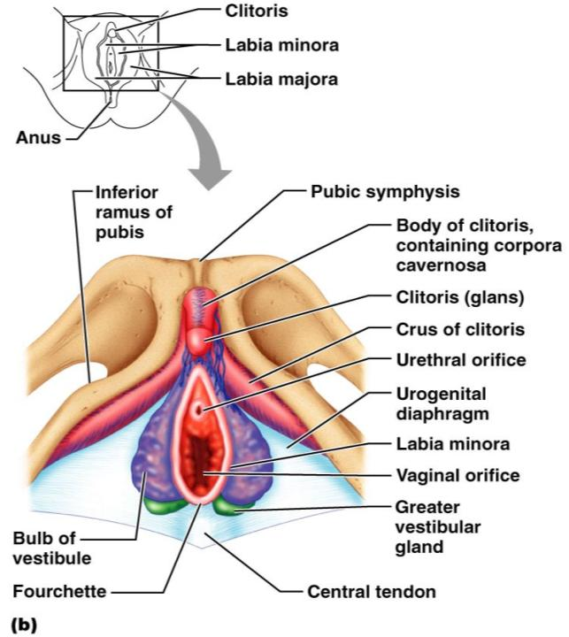
Female External Genitalia: Deep
Figure 27.16b

Slide 21
External Genitalia: Vulva
_______________________________: Lies external to the vagina and includes
Labia
Vestibular structures

Slide 22
External Genitalia: Vulva
Mons pubis
round, __________________________________ overlying the _
Labia _
elongated, hair-covered, _
homologous to the _

Slide 23
External Genitalia: Vulva
Labia _
__________________________________ skin folds lying within the labia majora
homologous to the _
Greater _
Pea-size glands flanking the vagina
Homologous to _
Keep the vestibule _

Slide 24
External Genitalia: Vulva (Pudendum)
Clitoris (______________________________)
exposed portion is the _
Diamond-shaped region between the pubic arch and coccyx
Bordered by the _______________________________________ laterally

Slide 25
Mammary Glands
Modified _____________________________ consisting of 15-25 lobes that radiate around and open at the nipple
pigmented skin surrounding the nipple
____________________________________ attach the breast to underlying muscle fascia

Slide 26
Mammary Glands
Lobes contain ____________________________________ that _________________________________ in lactating women
Compound alveolar glands pass milk to _____________________________________, which open to the outside

Slide 27
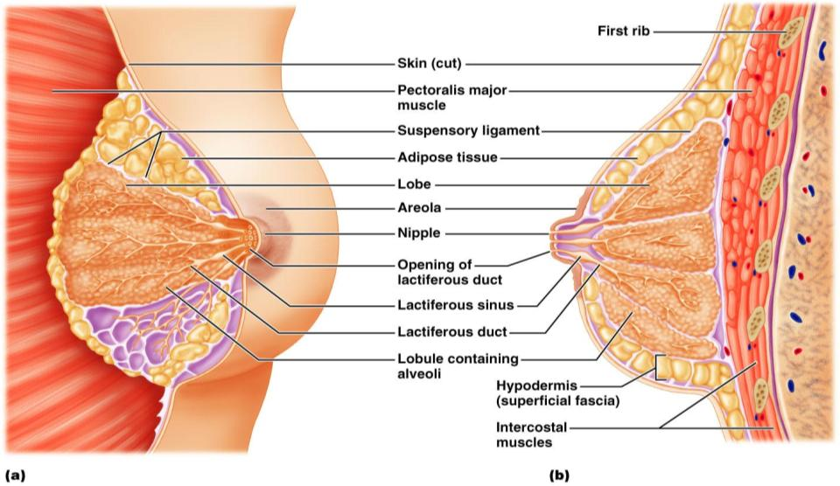
Structure of Lactating Mammary Glands
Figure 27.17

Slide 28
Breast Cancer
Usually arises from the epithelial cells of the ducts
Risk factors include:
______________________________________________ or late menopause
No pregnancies or the _
Previous history of breast cancer or family history of breast cancer
Hereditary factors including mutations to the genes BRCA1 and BRCA2
___________________ of women with breast cancer have _

Slide 29
Detection and Treatment
Early detection is by _________________________________________ and mammography
Treatment depends upon the characteristics of the lesion
Radiation, chemotherapy, and surgery followed by irradiation and chemotherapy
Today, _______________________________________ is the surgery used rather than radical mastectomy

Slide 30
Oogenesis
Production of _
In the fetal period, oogonia (2n ovarian stem cells) multiply by mitosis and store nutrients
___________________________________ appear as oogonia are transformed into _

Slide 31
Oogenesis: Puberty
Primary oocytes begin meiosis but _
At puberty, one activated primary oocyte produces two haploid cells
The first _
The secondary _
The secondary oocyte arrests in ______________________________________ and is ovulated

Slide 32
Oogenesis: Puberty
_____________________________________ the second oocyte completes meiosis II, yielding:
One large ovum (the functional gamete)
A tiny second _

Slide 33
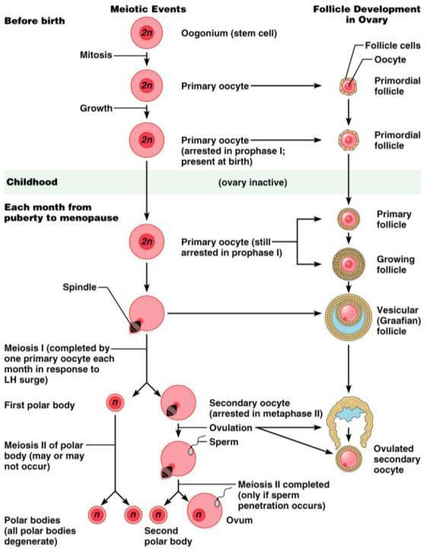

Slide 34
Ovarian Cycle
Monthly series of events associated with the maturation of an egg
period of ________________________________________ (days 1–14)
period of corpus luteum activity (days 14–28)
Ovulation occurs _

Slide 35
Follicular Phase
The primordial follicle, directed by the oocyte, becomes a _
Primary follicle becomes a _
The theca folliculi and granulosa cells cooperate to produce estrogens
The ___________________________________ forms around the oocyte
The antrum is formed

Slide 36
Follicular Phase
The secondary follicle becomes a vesicular follicle
The ____________________________________ and isolates the oocyte and the corona radiata
The full size follicle (vesicular follicle) _________________________________ from the external surface of the ovary
The primary oocyte completes meiosis I, and the stage is set for ovulation

Slide 37
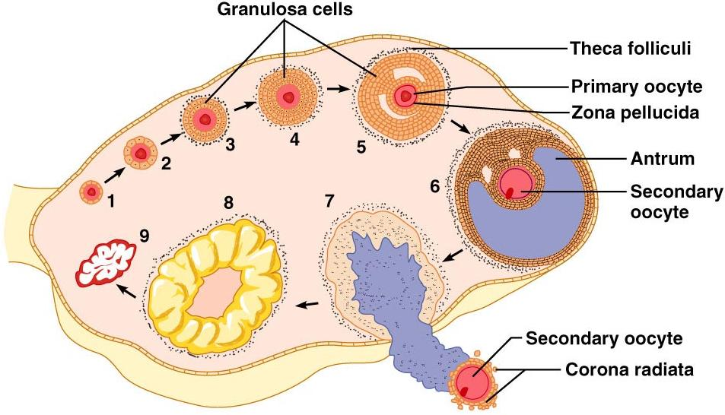
Ovarian Cycle
Figure 27.20

Slide 38
Ovulation
Ovulation occurs when the _
Mittelschmerz
a twinge of ___________________________ sometimes felt at _
1-2% of ovulations release more than one secondary oocyte, which if fertilized, results in fraternal twins

Slide 39
Luteal Phase
After ovulation,
the ruptured _
forms the _
The corpus luteum secretes _

Slide 40
Luteal Phase
If pregnancy does not occur:
the corpus luteum degenerates in 10 days, leaving a scar
If pregnancy does occur
the corpus luteum produces hormones _
at about 3 months

