Slide 1
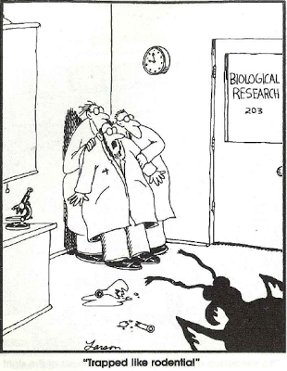
Lab practical

Slide 2
Announcements
Collections:
Turn in on the last day of Class (Fri. 7 December)
Course evaluations:
If you missed, you can fill one out in Biology office
Study guide
posted
Final:
Tuesday 11 Dec. 3:10-5:10PM
Cumulative: ~30-40% from the first 2/3 of the course
Same general format

Slide 3
Insect pests and pest management
Overwhelmingly about agricultural pests
Principles, methods, and ideas apply to
Structural pests [termites]
Medical / veterinary pests [mosquitoes]
Domestic pests [flour beetles; grain moths]
Pests of ornamentals [Japanese beetles]
Conservation pests [cactus moth]
Forest pests [pine bark beetle]

Slide 4
Insect pests
Harm = economic loss
Economic injury level (EIL)
Abundance of the pest (insects / ha) at which control efforts are economically justified
EIL = C/VDK
C = cost ($/ha) of control
V = value ($/ton) of yield from crop
D = loss crop due to some insect density (tons / 10⁶)
K = proportional reduction of insect due to control

Slide 5
Economic threshold
Wait until EIL is reached?
ET = economic threshold (action threshold)
Denotes TIME for action
May be at a number just below, or far below EIL
Depends on the speed with which control can be achieved and on rate of increase of insect population

Slide 6
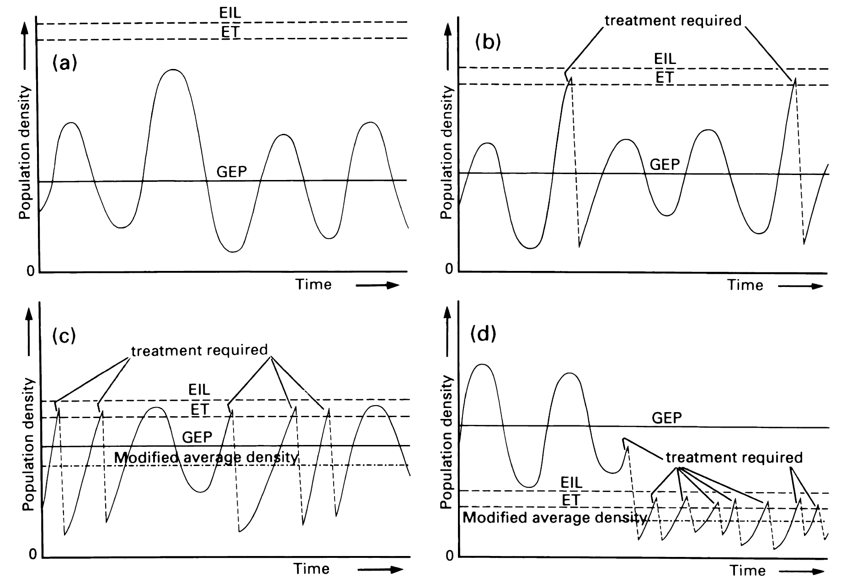
Economic impact of pests noneconomic, occasional, perennial, severe

Slide 7
How/Why insects become pests
Introduced invasive species
Encounter new victims
Escape enemies
Arrival of pathogens
Vectors of plant/animal disease
Shift native plant to economically important agricultural species
opportunity

Slide 8
Negative effects of (chemical) control
1 selection for insects that are resistant
2 destruction of non-target organisms
3 pest resurgence due to 1 and 2
4 secondary pest outbreak
new pest
5 adverse environmental effects
contamination
biomagnification
6 dangers to human health

Slide 9
Insect resistance to insecticides
Product of natural selection
Mutant forms less affected
More likely to survive and reproduce
Mechanisms
Behavioral avoidance
Sequestration
Cuticular permeability
Increased excretion
Detroxification
Decreased sensitivity (receptors)

Slide 10
Integrated pest management (IPM)
Using multiple approaches to limit damage by insects
May include pesticide application
Biological control by enemies
Cultural control (tillage type)
Crop resistance to pest
Successes: Rice, Citrus, Alfalfa, Cotton

Slide 11
Chemical pesticides
Most are neurotoxins
Inhibit acetylcholine esterase (enzyme critical for nerve transmission)
Kill nerve cells directly
Hormone mimics
Inhibit cuticle synthesis

Slide 12
Natural Chemicals
Plant-derived
Alkaloids (Nicotine)
Rotenone (from legumes)
Pyrethroids (from composites)
Neem (from Azadirachta indica Meliaceae)
Spinosad (from a Bactrium)

Slide 13
Synthetic organic chemicals
Carbamates (Carbaryl)
Organophosphates (Malathion, Parathion)
Organochlorine (DDT, Chlordane)
Phenylpyrazoles (Frontline)
Generally:
Broad spectrum
Toxic to noninsects

Slide 14
Synthetic organic chemicals
Organochlorines –
sequestered in fat
Bioaccumulation
Environmentally persistent
Relatively low short term toxicity to vertebrates
Organophosphates –
Relatively high toxicity to vertebrates
Not environmentally persistent
Not sequestered, no accumulation

Slide 15
Insect growth regulators
Hormone mimics
JH mimics
Methoprene, pyrpoxifen
Disrupt normal development
Chitin synthesis inhibitors (diflubenzuron)
Neem
Molting hormone mimics (teflubenzon)

Slide 16
Biological control
Using natural enemies to control pests
Classical biological control
Nonnative pest
Nonnative enemy imported
Released, establishes population
New equilibrium population of pest below EIL
Successes (boxes 16.3-16.5)
Nontarget effects

Slide 17
Neoclassical Biological Control
Using introduced enemies to control native pests
By definition, enemies must be polyphagous
Nontarget effects likely

Slide 18
Other sorts of biological contol
Inundation
Release massive numbers of enemy
No equilibrium established
Inoculation
Release enemies that will increase for a few generations, but not persist
Egg parasitoids
Conservation biological control
Agricultural practices to foster existing enemies

Slide 19
Bacterial control
Bacillus thuringiensis (Bt)
Produces toxin (Bt toxin) that kills insects
Different Bt strains specific for different insect groups
Bti for Diptera
Btk for Lepidoptera
Btt for Coleopera
Control mostly involves disseminating toxin

Slide 20
Transgenic Bt plants
Insert Bt toxin genes into crop plants
Toxin poisons insects feeding on plant
Corn, Cotton, Soybean
Creates strong selection for resistance in target insects
Resistance management strategies
Strips of non-Bt crops

