Slide 1
Aquatic insects
Ch. 10
All freshwater habitats are occupied by insects
Inland saline habitats (salt lakes) and estuarine habitats (where rivers meet the sea) have insect populations
Only oceanic habitats have very few insect species
Most orders of insects occupy freshwater in some way
  Those that DON’T
  Mantodea, Phasmatodea, Blattodea, Thysanoptera [Orthopteroid orders]
  Apterygota

Slide 2
Aquatic orders
Exclusively aquatic larvae/nymphs; terrestrial adults
  Odonata, Ephemeroptera, Plecoptera,
  Trichoptera (pupae aquatic), Megaloptera (pupae terrestrial)
Some groups with aquatic larvae; terrestrial adults
  A few Lepidoptera (pupae terrestrial), Neuroptera (pupae terrestrial)
  Many Diptera (pupae aquatic)
  Some Coleoptera (pupae terrestrial)
Surface of the water
  Some Hemiptera, Collembola
Aquatic larvae/nymphs and adults
  Some Coleoptera (Pupae terrestrial), Some Hemiptera
Terrestrial larvae, aquatic adult
  A few Coleoptera (pupae terrestrial)

Slide 3
Terminology of immatures
Lepidoptera, Coleoptera, Neuroptera, Megaloptera, Trichoptera, Diptera
  Larvae (And Pupae)
Hemiptera, Plecoptera, Odonata, Ephemeroptera, Collembola
  Naiad or Nymph
Larvae only when life cycle includes pupa (Holometabolous)

Slide 4
Colonization of the aquatic habitat
Ephemeroptera, Odonata, Plecoptera, Trichoptera, Megaloptera
  Shared ancestral trait within the order
  presumably one radiation
Lepidoptera
  A few lineages independently
  Colonizing aquatic host plants
Neuroptera
  One or a few lineages
  Feed on freshwater sponges

Slide 5
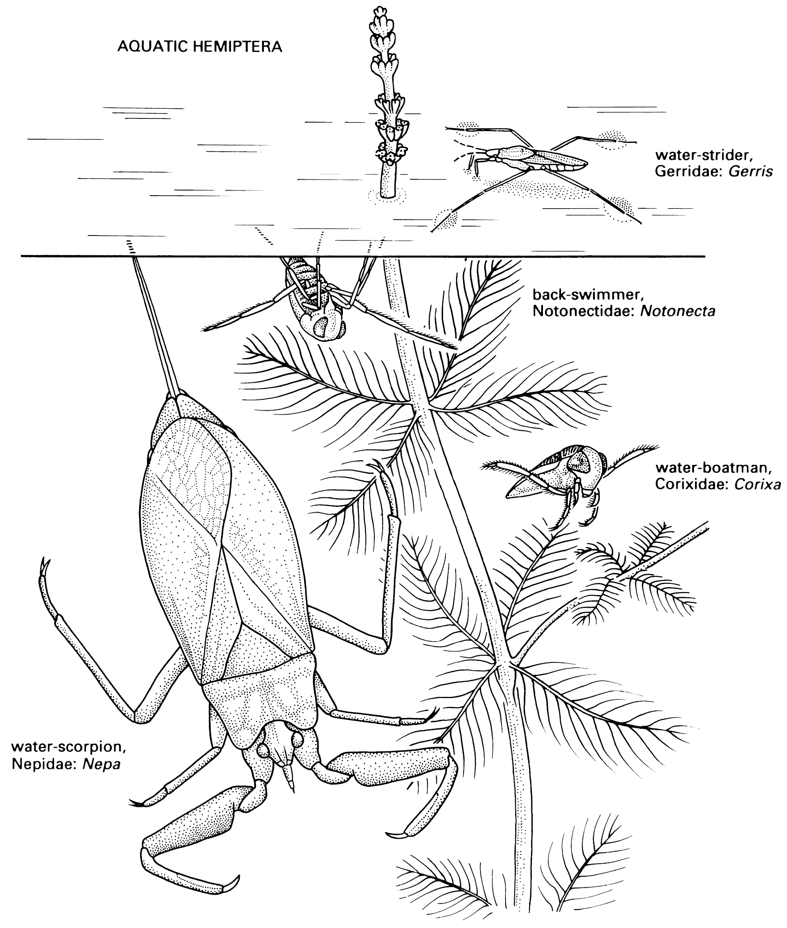
Colonization of the aquatic habitat
Hemiptera
  At least 2 separate colonizations of aquatic habitat
    Gerrimorphs
      Gerridae, Veliidae, Hydrometridae
      Live on the surface
    Nepimorphs
      Nepidae, Naucoridae, Notonectidae, Belostomatidae, Pleidae, Corixidae
      Diving

Slide 6
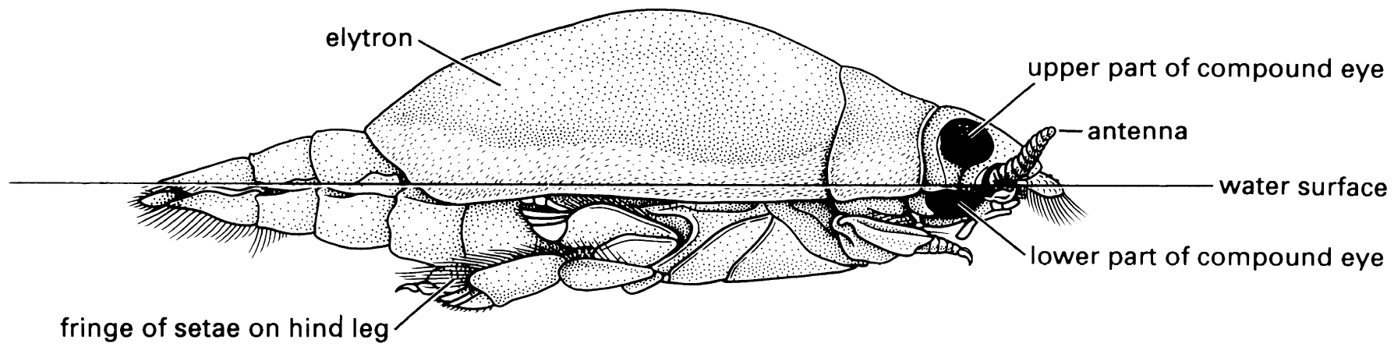
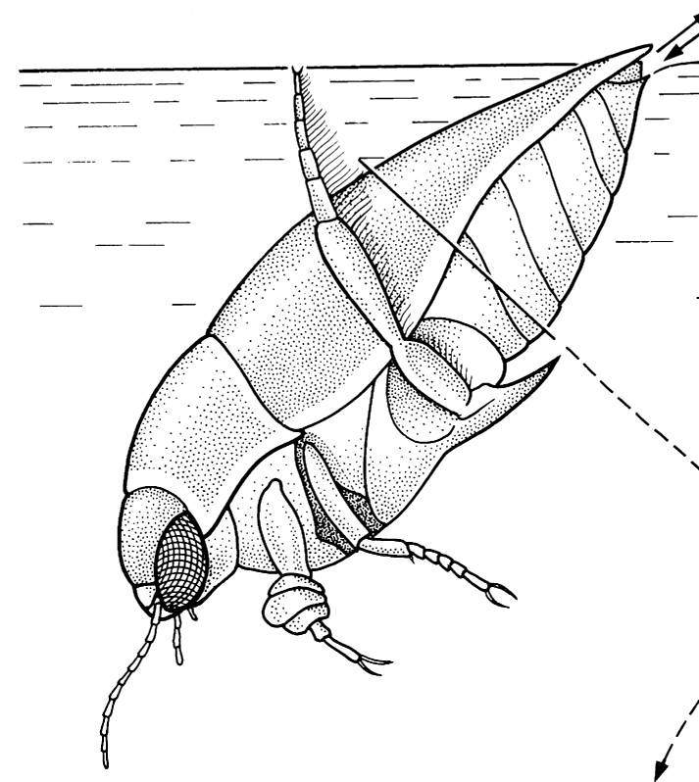
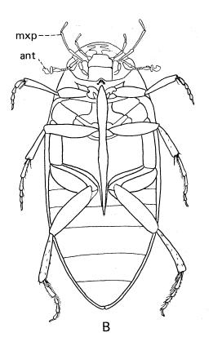
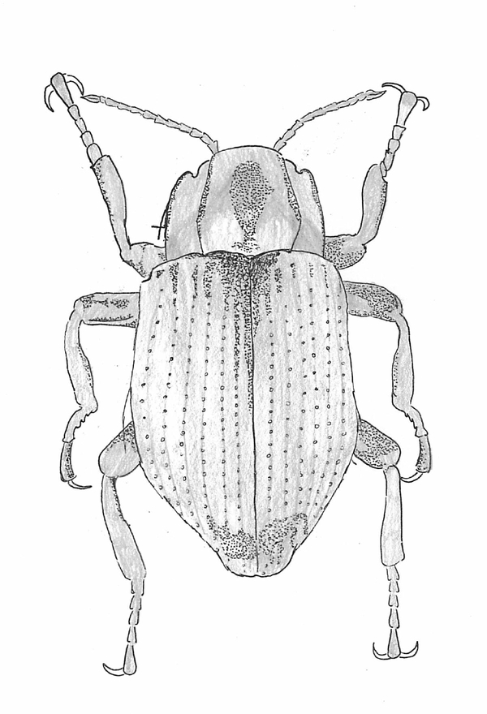
Colonization of aquatic habitats
Coleoptera
  Adephaga (Suborder)
  At least 3 separate lineages colonized freshwater
    Dytiscidae (and related families), Haliplidae, Gyrinidae
  Polyphaga (Suborder)
  At least 4 separate lineages colonized freshwater
    Dryopidae+Elimidae, Scirtidae, Hydrophilidae, Psephenidae

Slide 7
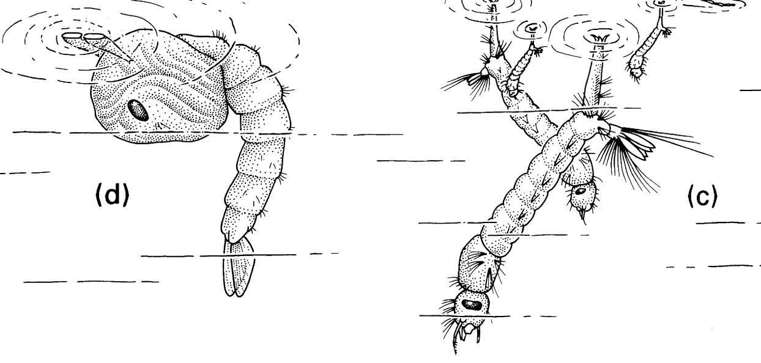
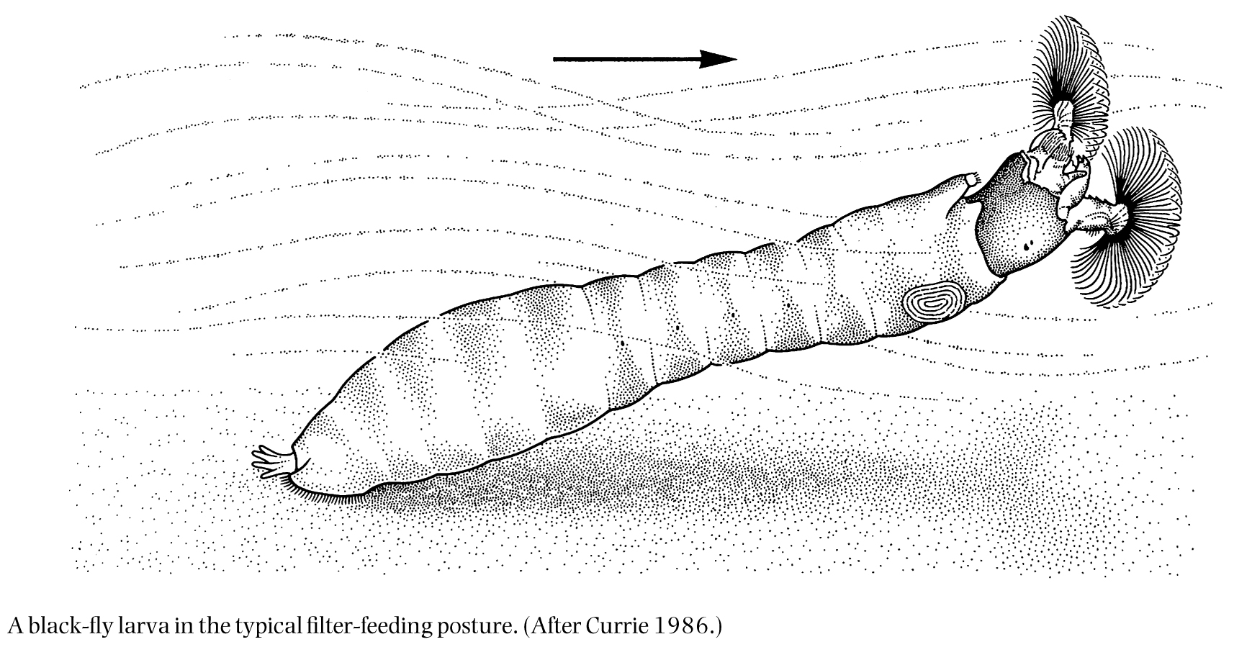
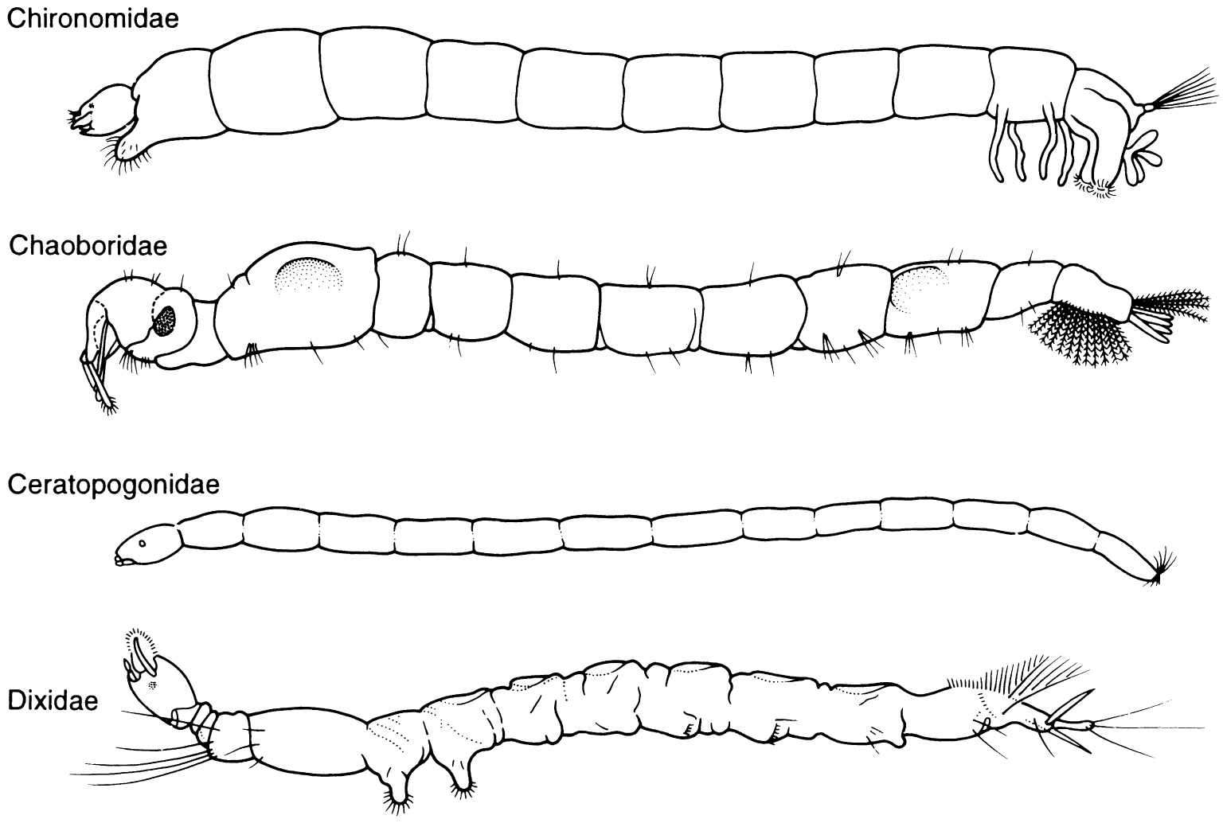
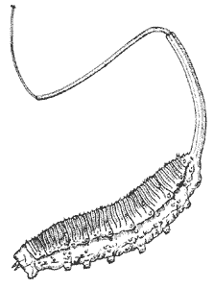
Colonization of aquatic habitats
Diptera
  Many Nematocera are aquatic; Ancestral?
    Tipulidae, Dixidae, Chironomidae, Culicidae, Ceratopogonidae, Simuliidae, others
  A few Brachycera
    Tabanidae, Syrphidae, Rhagionidae, Muscidae, Stratiomyiidae, others

Slide 8
Problem #1: Oxygen
200,000 ppm in air
15 ppm in saturated cold water
  Less in warm water
  Less in still water (unsaturated)
Some aquatic insects function in Anoxic conditions
Vast majority need oxygen
Two solutions:
  Gills (O₂ from water)
  Spiracles (O₂ From air)

Slide 9
Spiracular systems of aquatic insects
Polypneustic: Multiple spiracles
Oligopneustic: 1-2 pairs of spiracles
  Usually at the posterior end of the body
  Sometimes on a long tube
Apneustic: Closed tracheal system
  Gills
  Surface exchange

Slide 10
Gills
Apneustic, without gills
  Gas exchange via body surface
  High O₂ water
  Small body (Simuliidae, Small Trichoptera)
Apneustic with gills
  Abdomen (Megaloptera, Coleoptera, Odonata, Plecoptera, Trichoptera, Ephemeroptera, Lepidoptera, some Diptera,)
  Rectum (Odonata)
  Neck, base of legs (Plecoptera, Trichoptera)
  Gills expand surface area for gas exchange, bring closed trachea into proximity to water

Slide 11
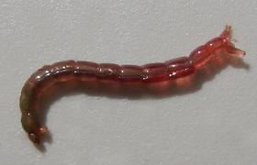
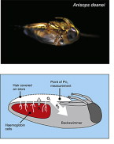
Hemoglobin
Chironomidae from low O₂ water
Some Notonectidae

Slide 12
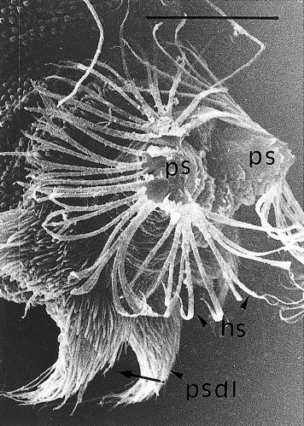
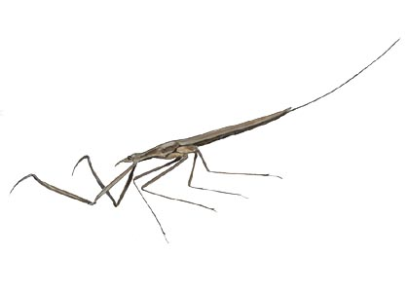
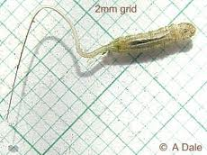
Oligopneustic open system
Insect gets O₂ by bringing spiracle into contact with air
  At surface
  From plants (Culicidae, aquatic Chrysomelidae)
Unwettable hairs at spiracles “hold” surface tension
Long siphons

Slide 13
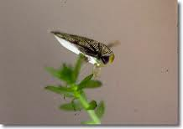
Polypneustic
Carry bubbles that remain in contact with spiracles
Under wings (Coleoptera adults)
On Fringes of Hairs (Hemiptera adults)
Held on a carpet of setae (Plastron)
  Thin layer – large surface:volume
  Small Coleoptera (Elimdae)
  Small Hemiptera (Pleidae, Corixidae)
  Hairs hold bubble volume
  Act as Incompressible physical gill

Slide 14
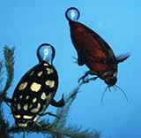
Compressible gill
O₂ exchange from bubble
Bubble mostly N₂
Not soluble
  O₂ depleted, sets up gradient
  Lower in bubble than in water
  Diffuses in
  CO₂ diffuses out
  Net O₂ as much as 8x the amount in the bubble

Slide 15
Aquatic habitat terms
Lentic: Still water
Lotic: Flowing water
Planktonic: Free floating in the open water
Benthic: On the bottom, or in the surface layers of the substrate
Littoral: Shallow near-shore areas where light reaches benthos
Limnetic: Well-lit open water away from shore
Neustic: On the water’s surface
Hyporheic: Within the substrate below flowing surface water

Slide 16
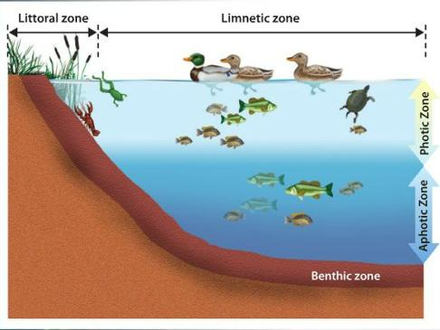

Slide 17
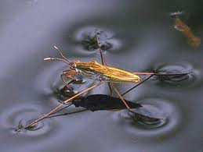
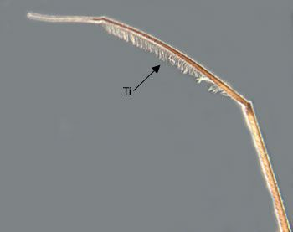
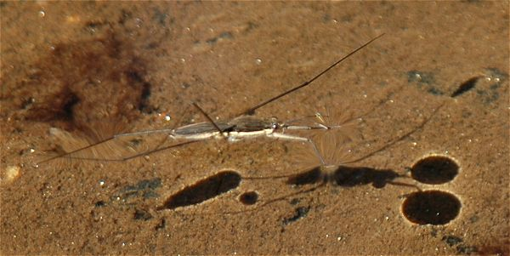
Neustic
Walking on water
  High surface tension
  Long thin legs distribute mass
  Hydrofuge hairs on tarsus, tibia

Slide 18
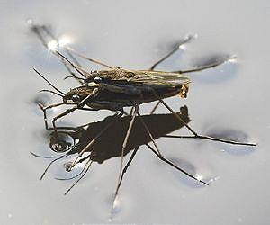
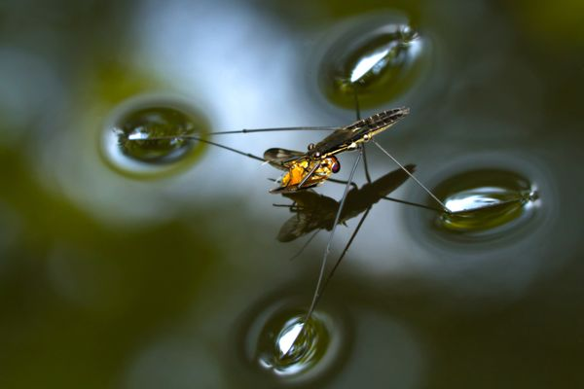
Gerridae
Use surface tension like a spider web
Sense vibrations (waves) and orient

Slide 19
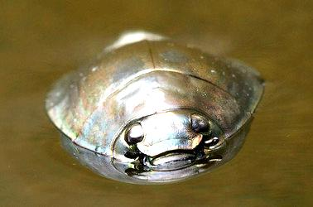
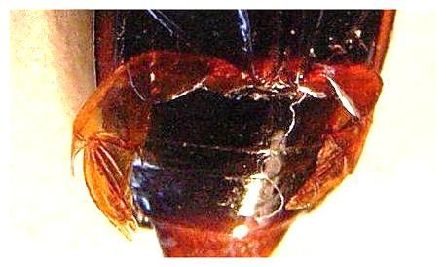
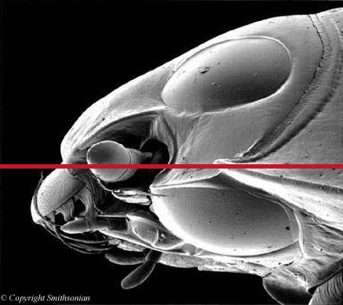
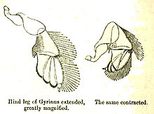
Gyrinidae
Also use surface tension as a sensory web
Capable of diving for escape

Slide 20
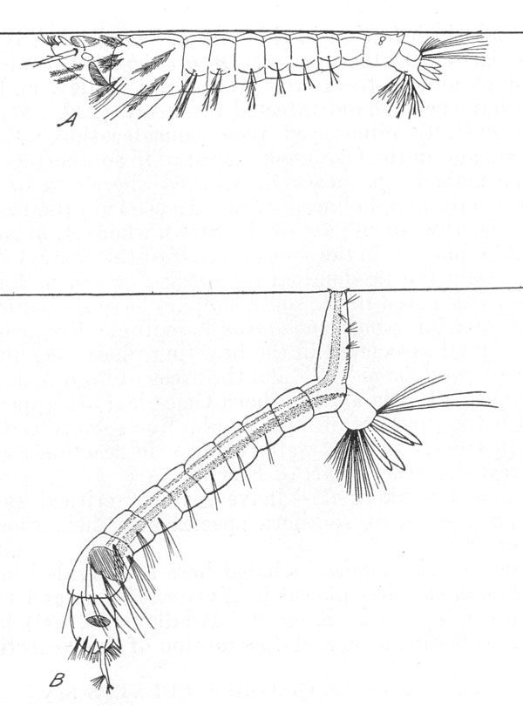
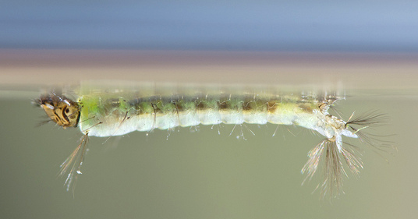
Culicide
Anopheles larvae
  Neustic from below
  Particulates catch on surface tension
  Larvae pull them in with filtering currents.
  Filter feeding from surface film

Slide 21
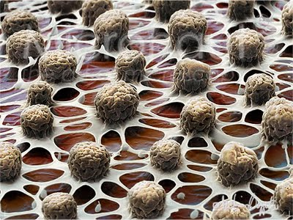
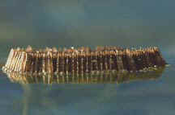
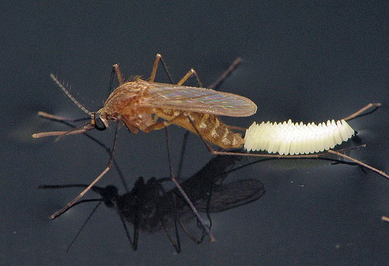
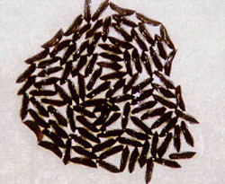
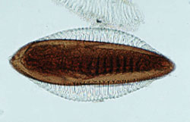
Culicide
Culex eggs
  Anopheles eggs
  Neustic from above

Slide 22
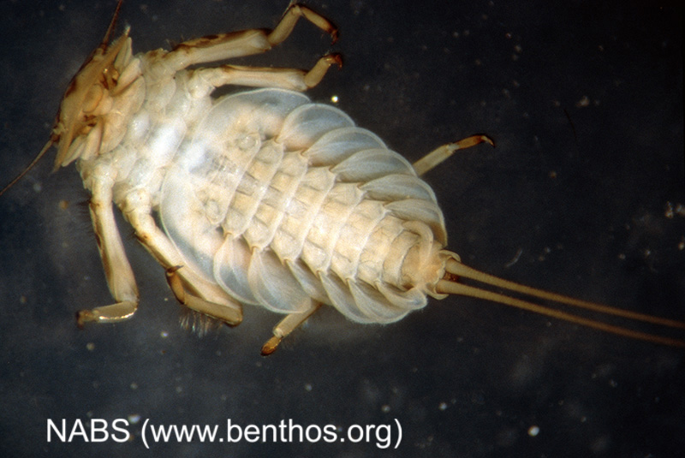
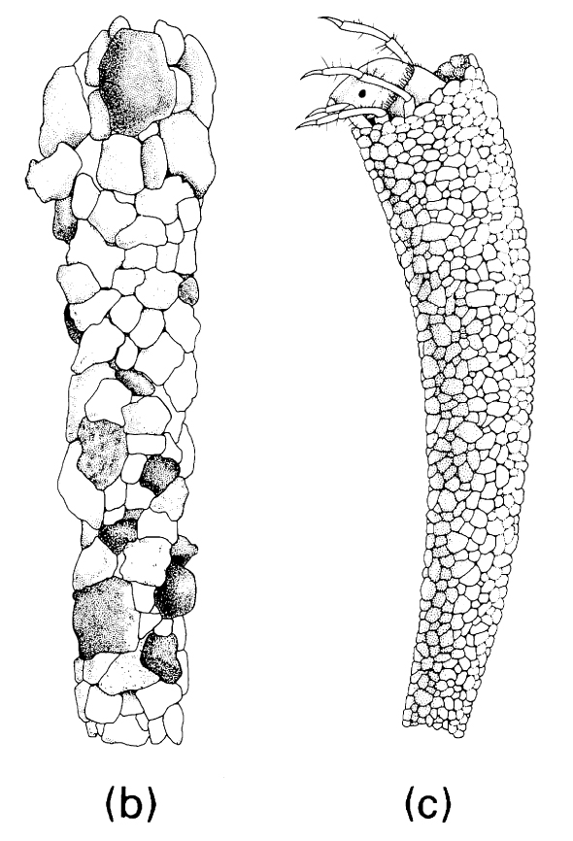
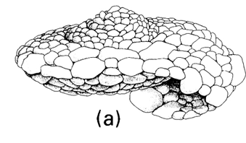
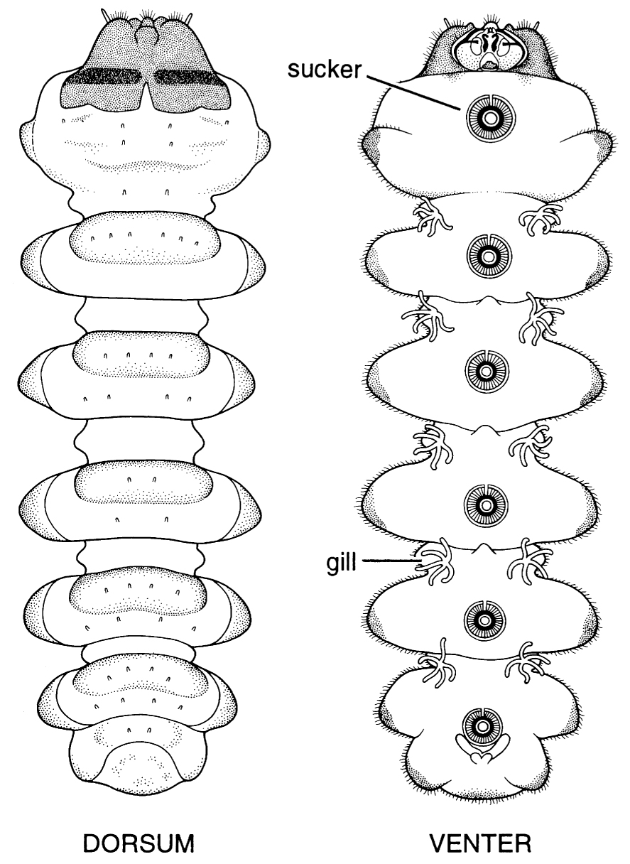
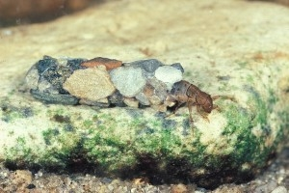
Lotic habitats
Adaptations to current
  Ballast
  Suckers
  Attachment by silk

Slide 23
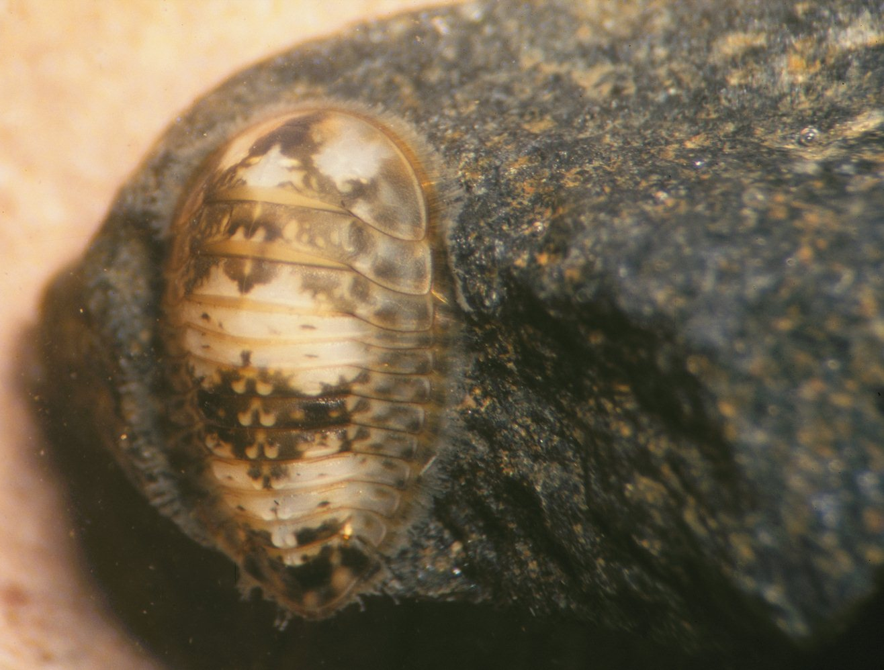
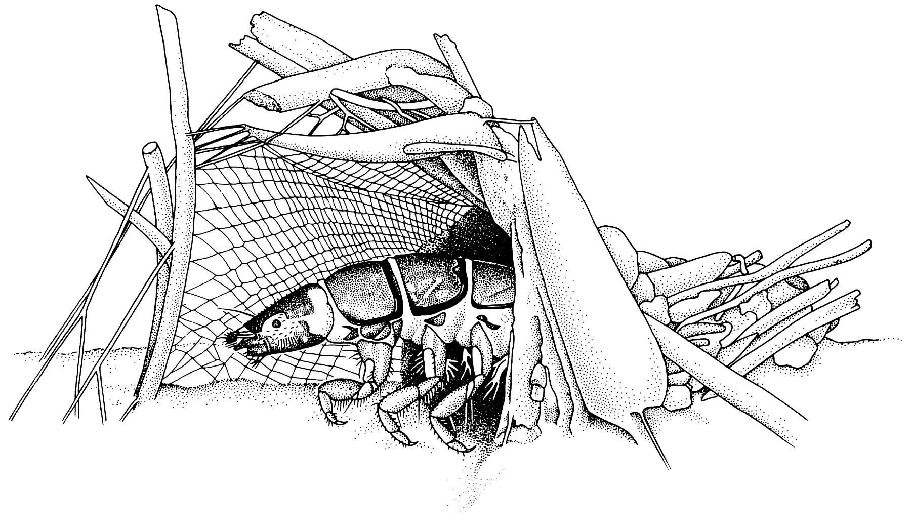
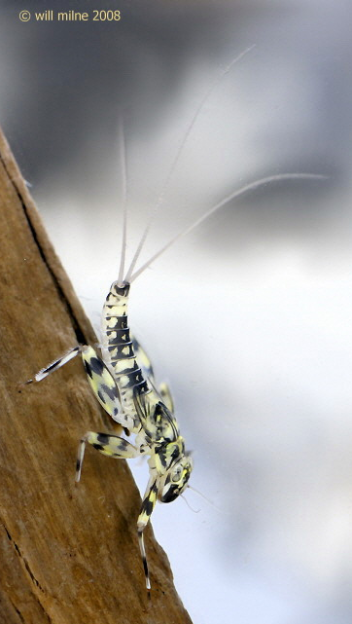
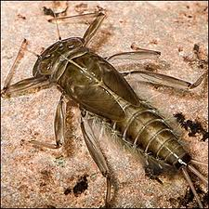
Lotic habitats
Adaptations to current
  Dorso-ventrally flattened
  Nets for filter feeding

Slide 24
Freshwater insects as indicators of pollution
Eutrophication: Addition of nutrients (N, P) to freshwater
  Results in excess algal growth
  Excess decomposition, and resulting O₂ depletion
Major Orders, families, genera of aquatic insects are accurate bioindicators of Eutrophication
Eutrophication -> reduced taxonomic diversity
Other pollutants
  Pesticides
  Metals
  Silt

Slide 25
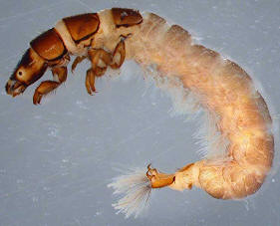
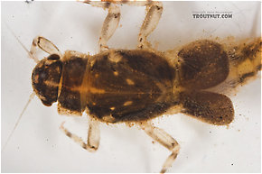
Taxa that are useful bioindicators
Caenidae (protected gills) and Hydropsychidae (net builders) increase with particulate material
Hemoglobin-possessing Chironomidae increase as dissolved O₂ declines
Plecoptera usually decline as O₂ declines or temperature increases
Diversity declines as pesticide run-off increases and as eutrophication increases

Slide 26
Functional feeding groups
Utility depends on families or genera having consistent feeding modes.
Relevant groups different from terrestrial systems
Shredders: living or (more often) decomposing plant tissues (leaves, wood)
  Often feed on fungi, bacteria on the food
Collectors: fine particulate organic matter
  Filtering
  Deposit feeding

Slide 27
Functional feeding groups
(Contd.)
Scrapers: attached algae, fungi, bacteria on solid surfaces;
Piercers: cell and tissue fluids from vascular plants or large algae
Predators: living animal tissues by:
  Engulfing
  Piercing and sucking
Parasites: feed on living animal tissue (Endo-, Ecto-)

Slide 28
Hydroperiod
Water bodies range from “permanent” to temporary
Permanent = never dry out
Temporary = dries out, often once per year
  Vernal pools: Fill with spring snow melt and rain
  Aquatic community often dominated by insects
  Dry out in summer or fall
Insects are very well adapted to temporary water
  Mobile adults can disperse
  Desiccation resistant stages

Slide 29
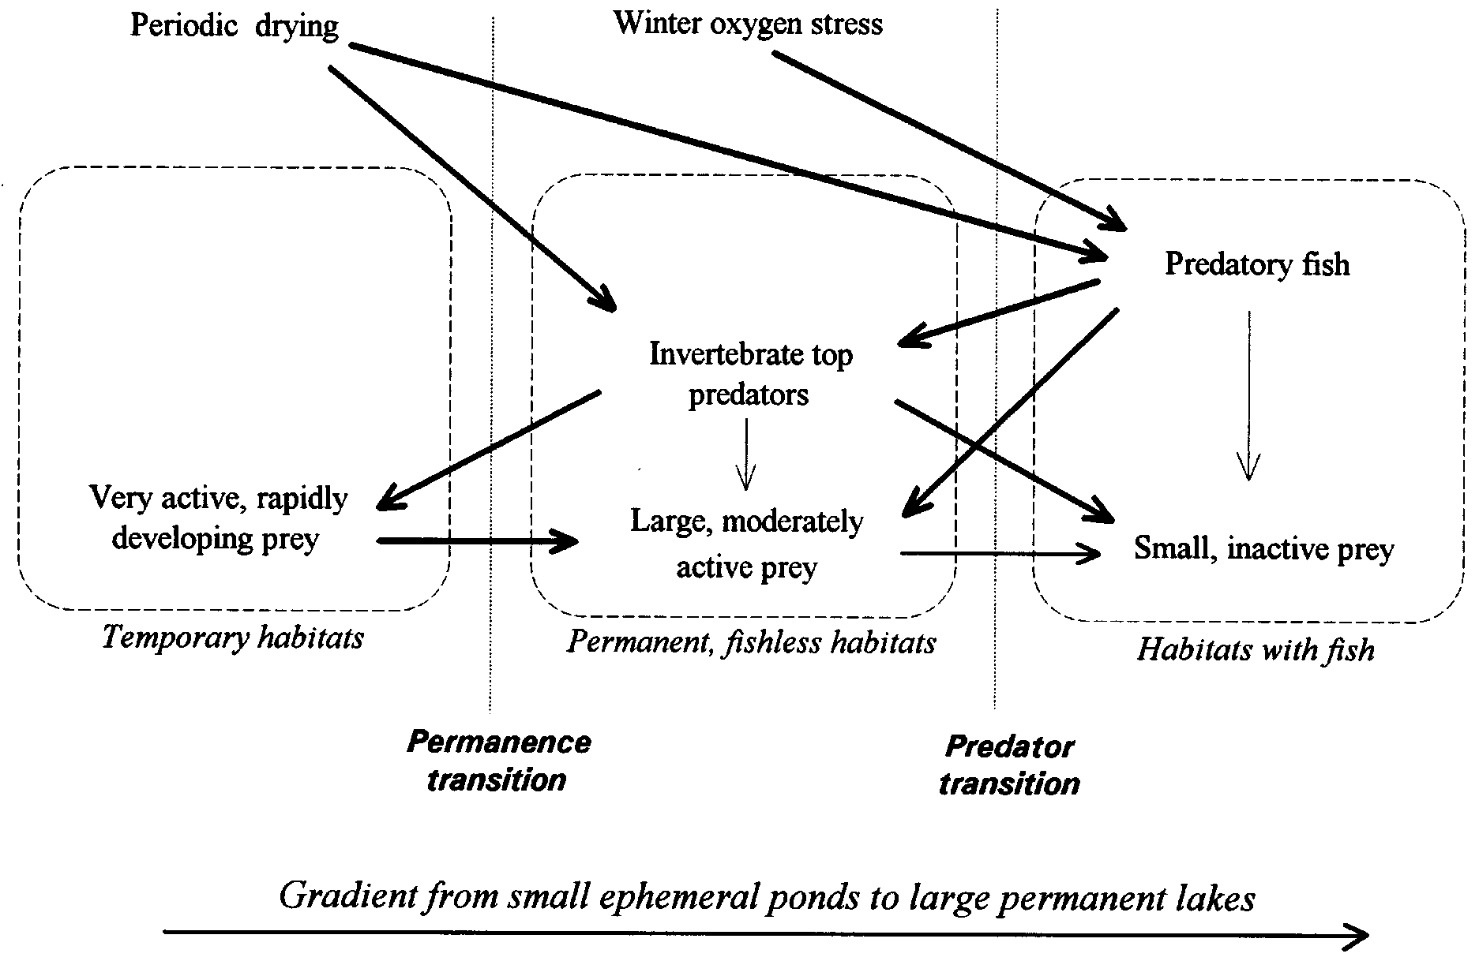
GA. Wellborn, DK. Skelly, EE. Werner. 1996 MECHANISMS CREATING COMMUNITY STRUCTURE ACROSS A FRESHWATER HABITAT GRADIENT. Annual Review of Ecoogy & Systematics. 27:337–63

Slide 30
Consequences of gradient
Temporary waters
  Rapid development; variable size and asynchrony [?]
  Active feeding; Highly competitive; Predator naïve
  Desiccation resistant stages
Fishless permanent waters
  Selection for predator avoidance
  Less active, more resistant to predation
  Large bodies (escape by size)
Large bodies of water with fish
  Small, inactive prey
  Intermediate predators rare

Slide 31
Effects of occasional drying
Temporary seasonal (dry every year)
Semipermanent (usually full; dry in drought years)
Permanent (never dry)
Consequences for insect community?
  Chase, JC & Knight, TM. 2003. Drought-induced mosquito outbreaks in wetlands. Ecology Letters 6: 1017–1024
Compared temporary, semipermanent, permanent over 3 years, including first year drought

Slide 32
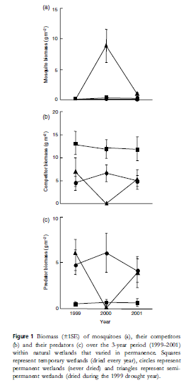
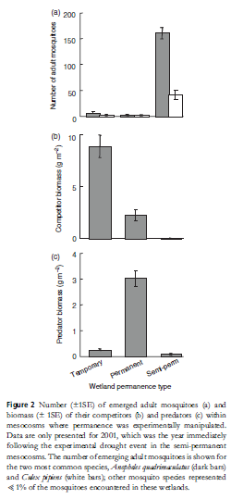
Chase & Knight

Slide 33
Main point
In aquatic habitats the effects of the physical habitat (e.g., drying) on populations and communities of insects are often indirect – resulting from effects on competitors and predators

Slide 34
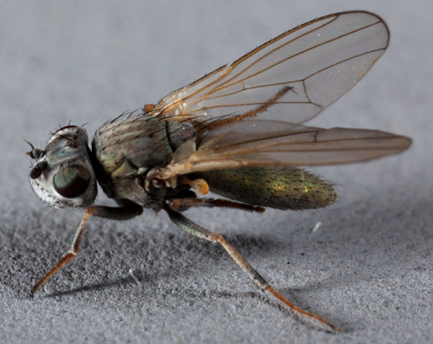
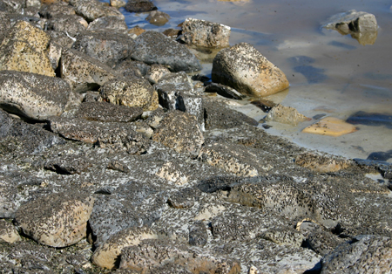
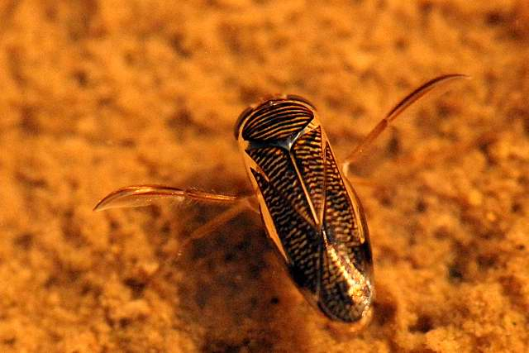

Saline environments
Great Salt Lake and others
  Brine flies (Ephydridae), Water boatmen (Corixidae)

Slide 35

Saline environments
Salt marshes, estuaries
  Mosquitoes, Ceratopogonidae, other Diptera can be abundant
  Everglades quotes 1,000,000 larvae/m²

Slide 36


Open ocean
Halobates (Gerridae)
  Can be found 100s km out from shore

Slide 37
Why so few insects in the sea?
Salinity is a physiological barrier
  Unlikely:
    Insects succeed in saline inland waters
    Also in hypersaline inland waters
    Abundant in the rapidly changing salinities of estuaries
Community processes
  Available marine niches largely occupied primarily by the other members of Pancrustacea
  Insect origins later, after radiation of Pancrustacea in marine habitats
Alternative question: Why so few crustaceans in terrestrial/freshwater habitats?

