Slide 1
Insect development and life history (Ch. 6)
Life history: timing and scope of key events in an organism's lifetime, as shaped by natural or sexual selection
Size at birth/hatching
Age at first reproduction
Reproductive lifespan
Size and number of offspring
Senescence
Tied to life tables (BSC 201)

Slide 2
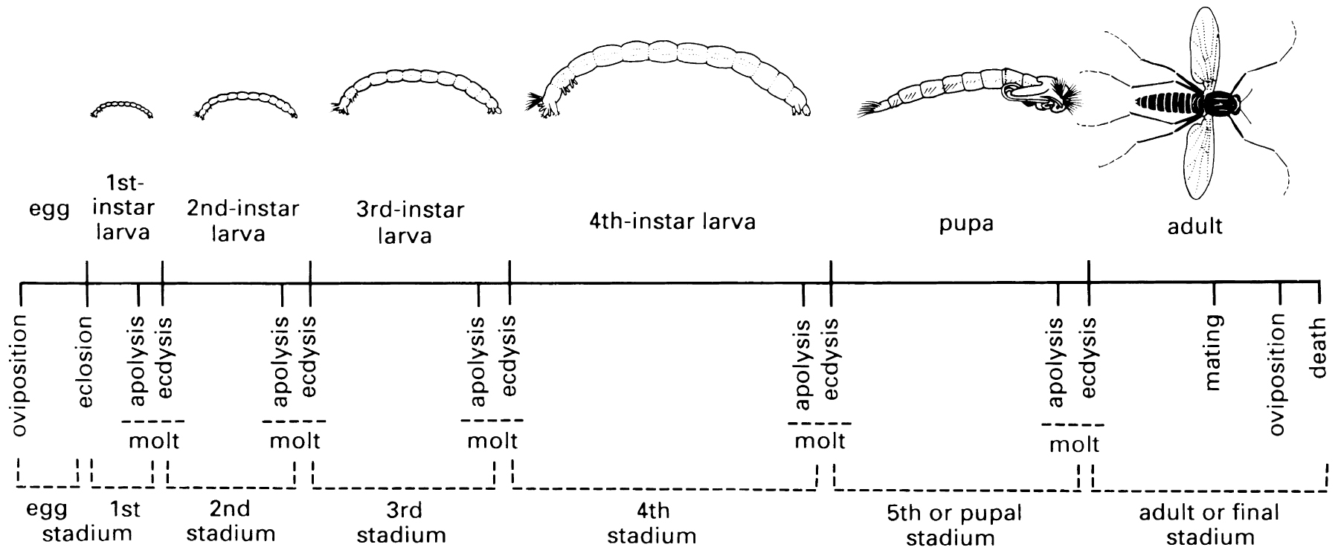
Development and Growth
Growth: Increase in size (mass, length) with time
mass (μg)
time
Development: Change in stage with time

Slide 3
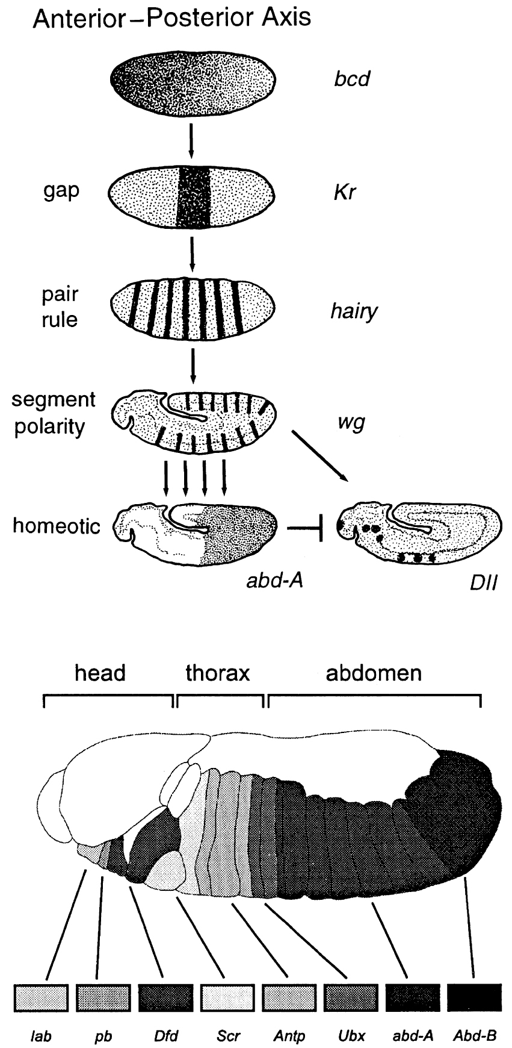
Insect development [Box 6.1]
Bicoid mRNA
Maternal
anterior
Transcription factors
Molecular switches
Turn on/off other genes
Cis-regulatory [same DNA strand]
Regulate in a hierarchy in early embryo
Hox (homeotic)
Expression localized; creates segmental identity
Stimulates development of limbs, other structures
Gene structure, position on chromosome, evolutionarily conserved
Order of expression follows position on chromosome (start=head)
Pleiotropy common
Particular Hox genes may regulate 100s of others
Kruppel
zygotic
zonation
Hairy
zygotic
Segmentation
wingless
zygotic
Segment polarity

Slide 4
Growth
Length change is discontinuous
Constrained by hard exoskeleton
Molt increment: increase in length between instars
Instar: the insect between two molts
Stadium: the time between two molts
Entognatha, apterygote insects – indeterminate growth
Molting continues entire life, including adults
Pterygote insects – adults (Imagines) do not molt
Exception: Ephemeroptera subimago (winged, sexually immature, molts to imago)

Slide 5
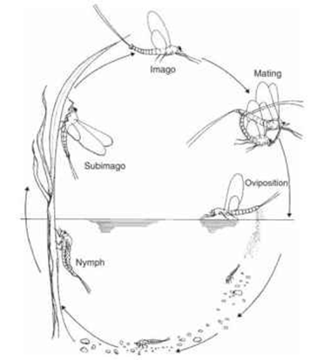
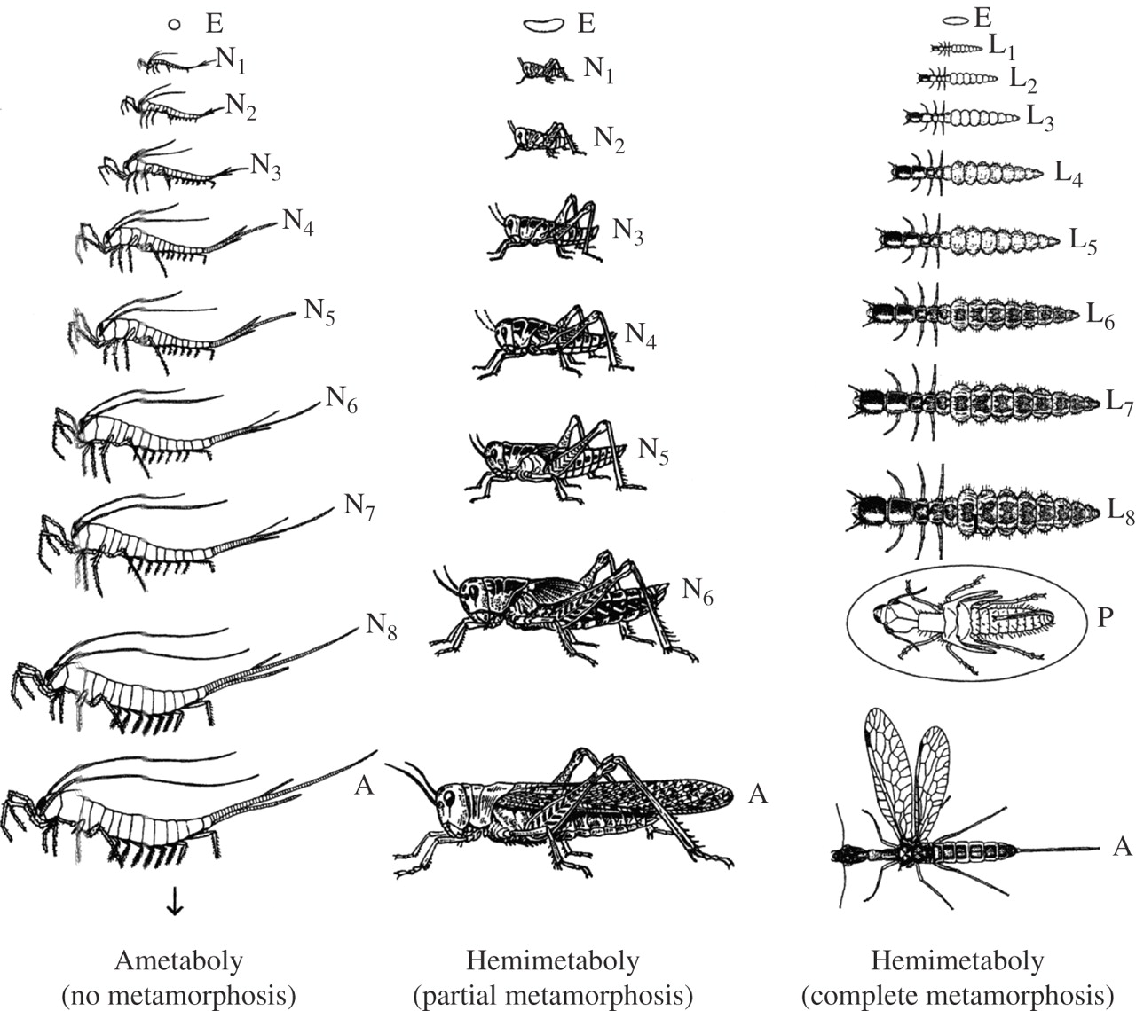
Paleoptera (e.g., Mayfly): Hemimetaboly
A figure adapted from a review by Sehnal and colleagues (1996).
Holometaboly
Erezyilmaz D F Integr. Comp. Biol. 2006;46:795-807
© 2006 The Author(s)‏
Notes:
A figure adapted from a review by Sehnal and colleagues (1996). In ametabolous development, the immature stages simply increase in size to produce the adult. Unlike other types of insect development, these insects, represented here by a silverfish, continue to molt once they have become sexually mature (arrow). The immature stages (called nymphs) of hemimetabolous insects resemble the ultimate adult, except that wings and genitalia are acquired at the final molt. With holometaboly, or complete metamorphosis, the form of the larval stages often differs dramatically from that of the adult. The group is represented here by a snake fly, with the pupal stage circled. E = embryo; L = larva; N = nymph; P = pupa; and A = adult. The numbers associated with these letters indicate the instar (duration between molts) (for example, N1 is the first nymphal instar).

Slide 6
terms
Exopterygote: Wing rudiments present in immatures; Gradually increase in size over development
Hemimetabolous development
Includes Paleoptera and some Neoptera
Endopterygote: wing rudiments absent in immatures; wings develop from internal structures – imaginal disks
Pupal stage = reorganization of the body
Holometabolous development

Slide 7
Immatures
Hemimetabolous (Terrestrial Neoptera): Nymphs
Hemimetabolous (Aquatic Paleoptera): Naiads or Nymphs
Holometabolous: Larvae
Holometabolous: Pupa
Product of a molt
Fully-developed stage inside exoskeleton of the previous stage = Pharate
Pharate larva
Pharate adult

Slide 8
Larvae

Slide 9
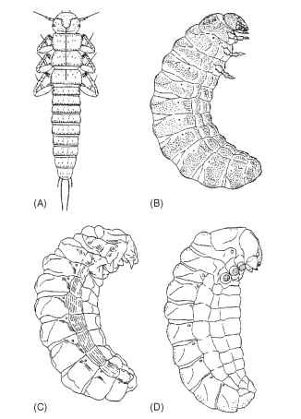
Hypermetamorphosis
Finding larval site
1st – mobile
Later – feeding
Coleoptera (Carabidae, Meloidae, others)
Strepsiptera (all)
Neuroptera (Mantispidae)
Diptera (Tachinidae, others)
Hymenoptera (multiple)
Lepidoptera (Epipyropidae)
Contest over larval site
1st – combat
Later – feeding
Hymenoptera (many)
Diptera (Cryptochetidae)

Slide 10
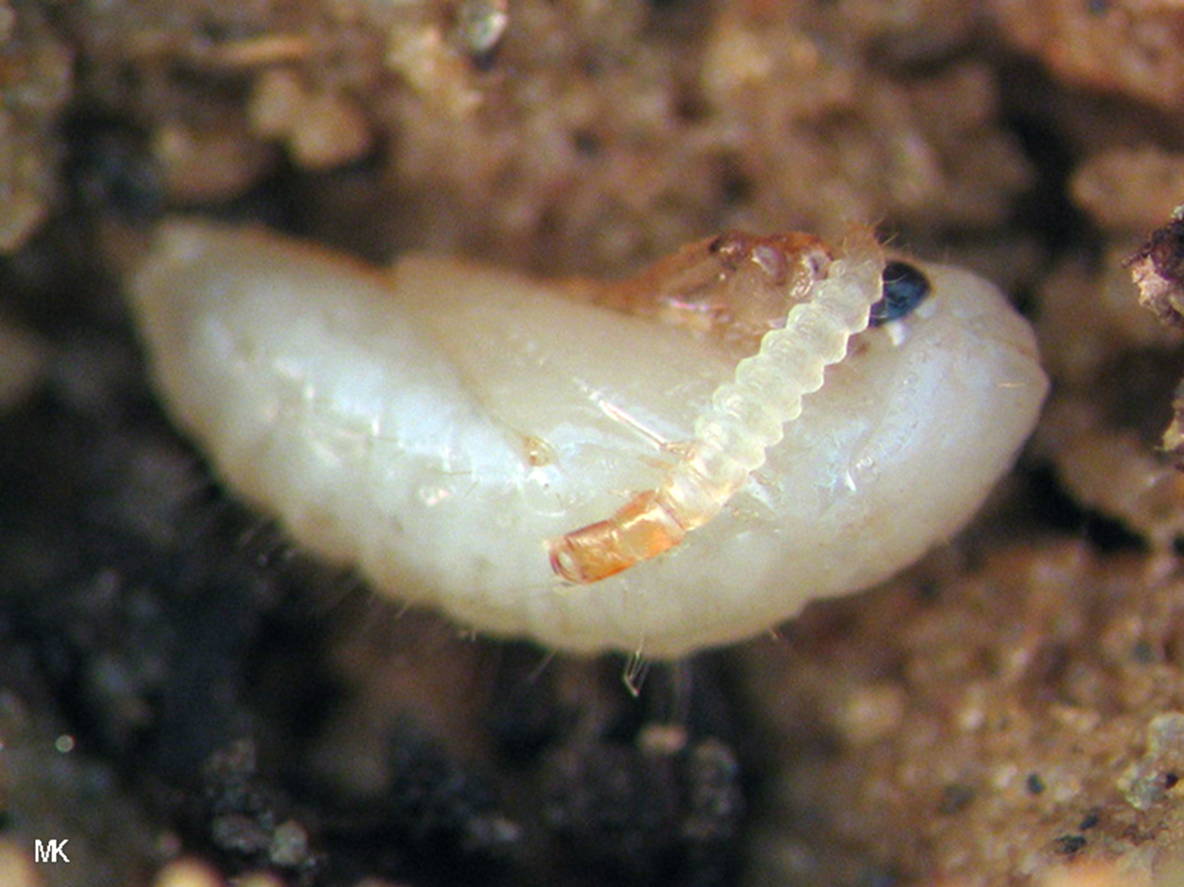
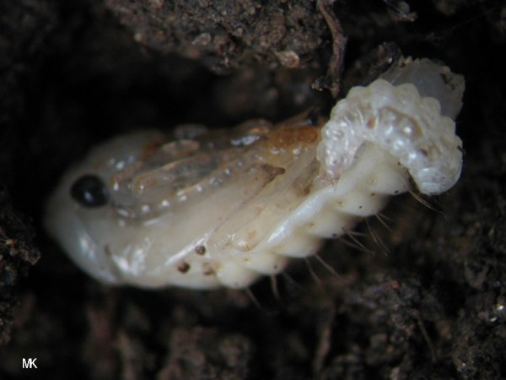
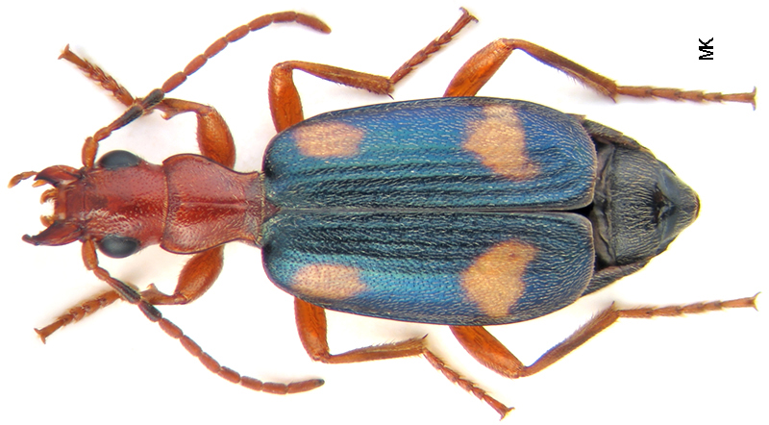
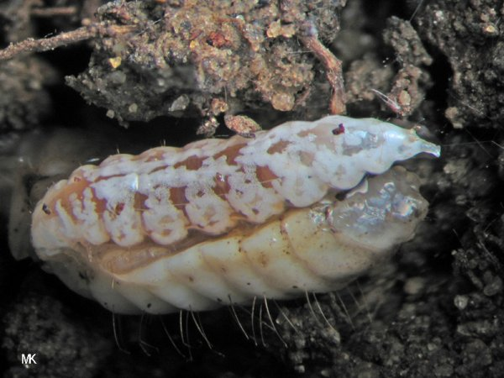
http://www.carabidae.ru/foto/thumbnails.php?album=83

Slide 11
Pupae
puparium

Slide 12
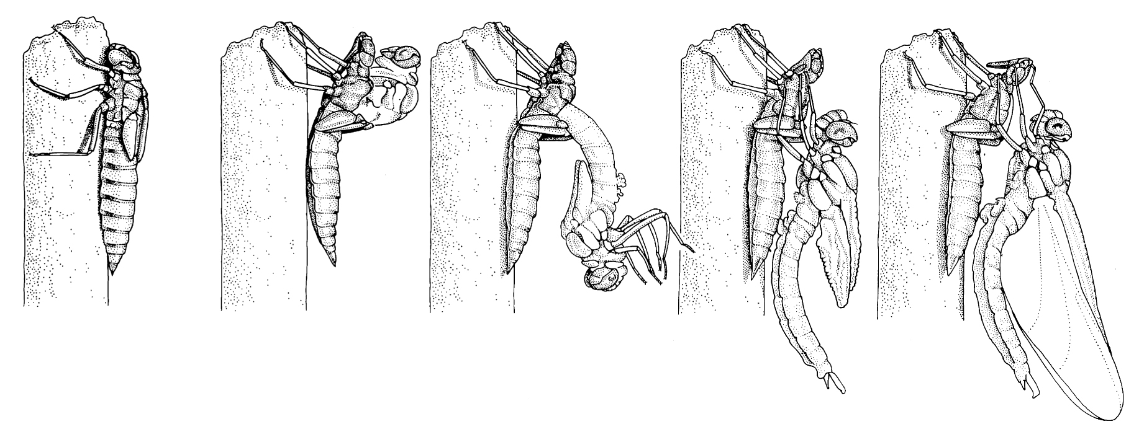
Molt to adult
http://www.youtube.com/watch?v=go4MqVq9HVM
Newly emerged, still soft = teneral
Mecomium: metabolic waste accumulated during pupal stage; excreted after adult molt

Slide 13
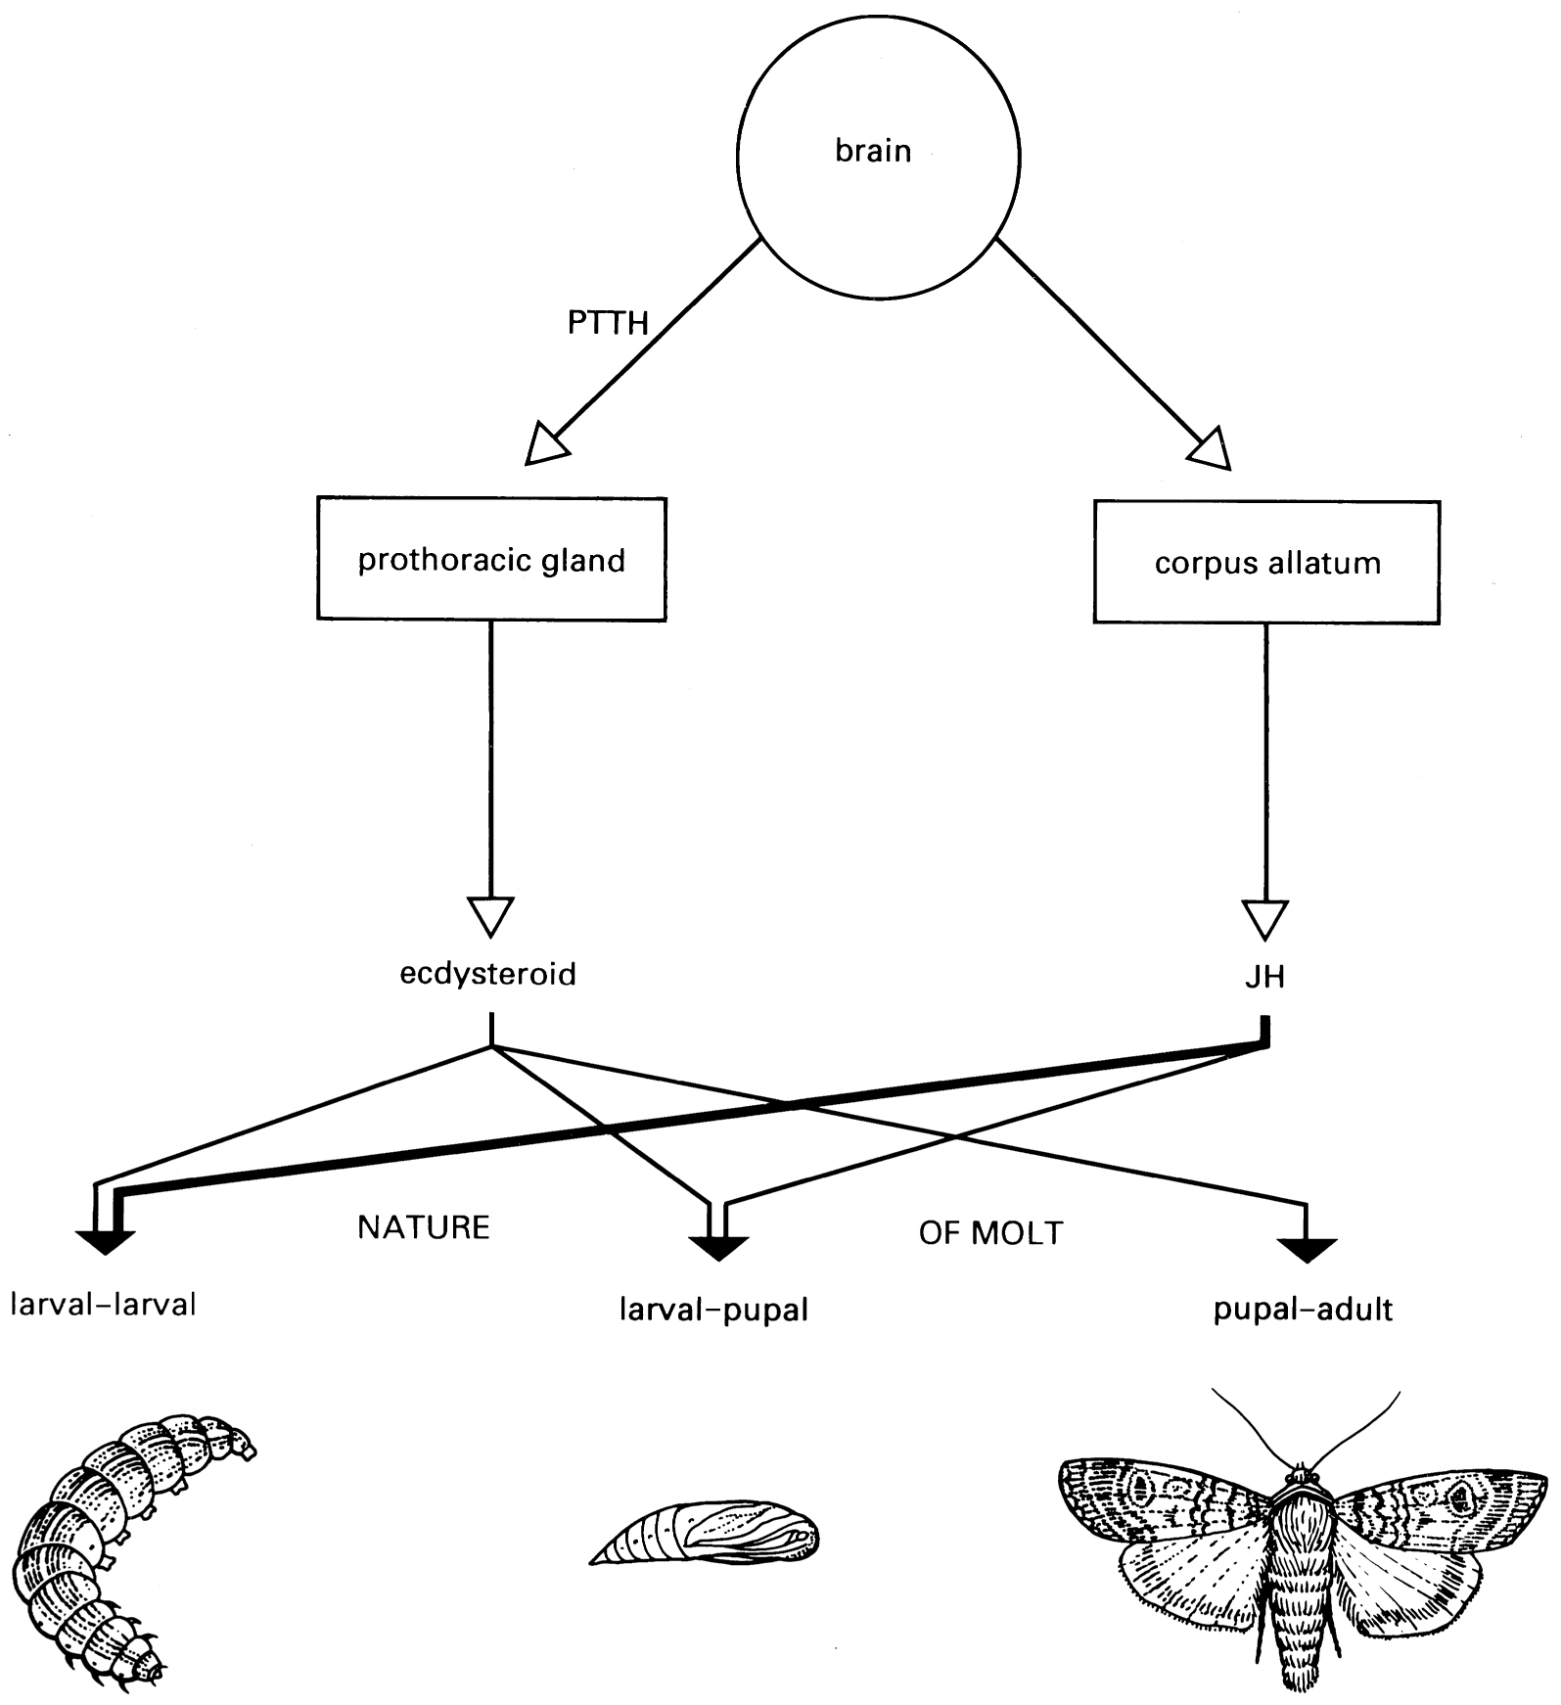
Hormonal control of molt
Produced by neurosecretory cells of the brain; stored in and secreted by Corpora cardiaca
Allatotropins & allatostatins produced by neurosecretory cells of the brain;
Ecdysteroids
Control epidermal breakdown and production of new cuticle
Juvenile hormone
Controls kind of new cuticle produced

Slide 14
Apolysial space

Slide 15
Other ecdysis related hormones
Eclosion hormone:
Neuropeptide
Targets nervous system
Coordinates behavior involved in molt
Ecdysis triggering hormone:
Neuropeptide
Targets nervous system, epidermis
Stimulates loosening of muscle attachments and production of Eclosion hormone

Slide 16
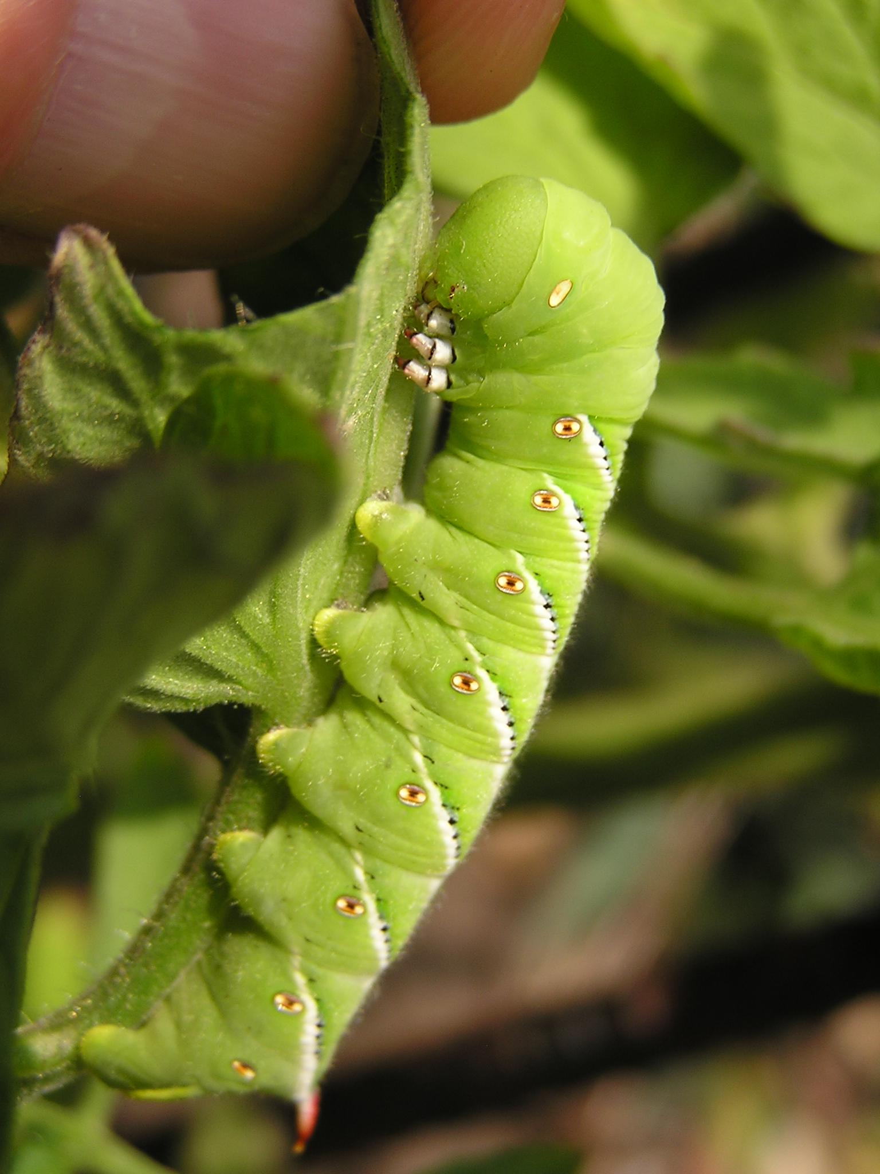
Overall physiological control (Manduca sexta)

Slide 17
Reorganizing the body
Ametabolous, Hemimetabolous
Adult structures externally visible but small in nymphs
Develop gradually over molts
Holometabolous
Adult strutures not visible
Present as imaginal discs
Most larval structures undergo apoptosis during pupal phase
Growth of imaginal discs into adult structures

Slide 18
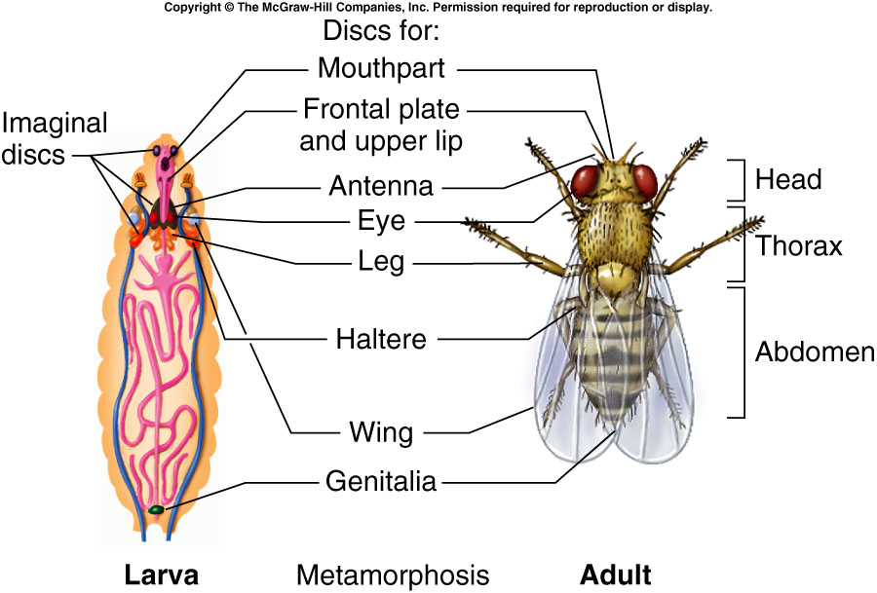
Reorganizing the body

Slide 19
Mosquito imaginal discs

Slide 20
Voltinism
Number of generations per year
Univoltine
Bivoltine
Multivoltine or Polyvoltine
Semivoltine
Changes with latitude within a single species
Varies widely among species.
Some take much longer than 1 year
Cicadas
Large Dragonflies

Slide 21
Diapause
Arrested development
With physiological changes that require particular physiological cues to resume development
Return to favorable conditions is not sufficient
Warming up is not enough
Usually photoperiod is the cue.
Often cold period is necessary
Across groups, any stage
Adults and larvae can move and be active and feed
Development (change in stage) does not occur

Slide 22
Diapause
Dormancy ≠ Diapause
Dormancy
Diapause
Quiescence: development halted as a direct effect of unfavorable conditions (e.g., cold)
Summer dormancy: Aestivation (dry conditions)
Winter dormancy: Hibernation (cold conditions)

Slide 23
Why photoperiod?
Photoperiod is the most reliable cue to seasonal changes in environment (at a given location)
Temperature, moisture, food quality, etc. can all vary from year to year, day to day
May provide an inappropriate cue to resume development
Getting it wrong has enormous fitness cost
Investigations comparing effects of cold adaptation vs. timing of development
Selective effect on timing is much stronger

Slide 24
Environmental extremes
Freezing: Tolerance or avoidance
Arctic, antarctic: Tolerate as low as -80ºC
Mechanisms
Ice nucleation (Tolerance)
Induce ice crystals outside of cells
Minimize cell damage
Proteins, lipids, urate granules
Supercooling (Avoidance)
Remain liquid at sub 0ºC
Glycerol, propylene glycol, ethlyene glycol;
trehalose, sorbitol

Slide 25
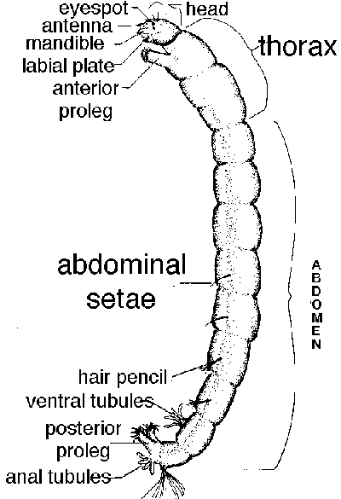
Environmental extremes
Heat
Thermal springs: 43-50ºC
Protein structure, membrane structure
Acclimation
Duration
Cryptobiosis: ability to dry out
0 metabolism
No water
Tolerate 100ºC to -27ºC

Slide 26
Migration
Dispersal vs. Migration
Definitions vary.
Seasonal movement
Physiologically cued movement
Physiological and behavioral changes
Reproduction shuts down
sometimes reproductive diapause
Energy stored, diverted to flight
Usually pre-reproductive individuals migrate
Reproduction commences after migration

Slide 27
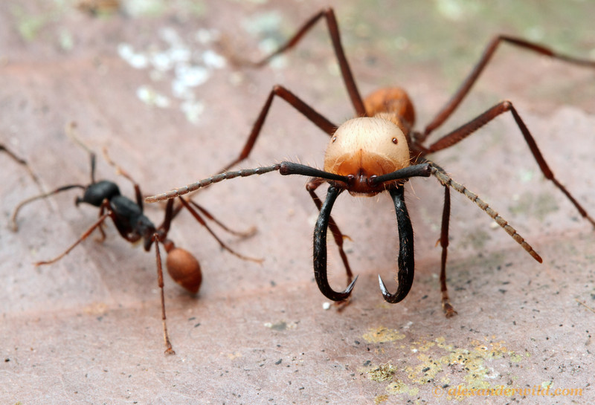
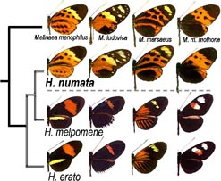
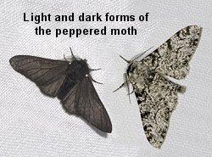
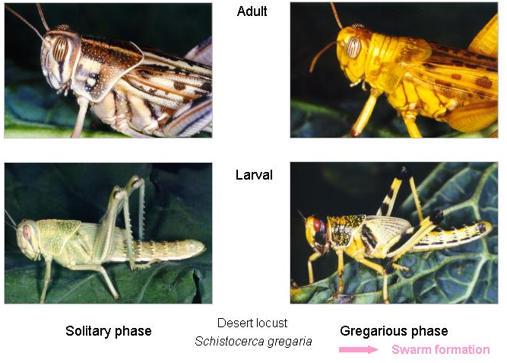
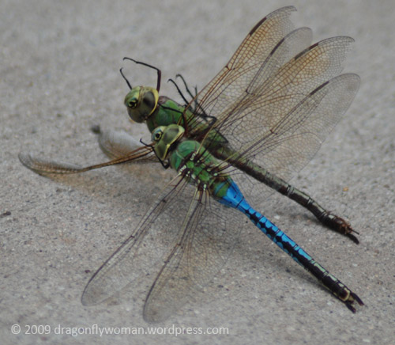
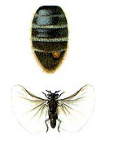
Polymorphism
Existence of distinct morphological forms of the same stage within a species or population
Usually discrete

Slide 28
Kinds of polymorphism
Genetic
Color, melanism
Mimicry, crypsis
Maintained by balancing selection or geneflow
Environmental {polyphenism}
Diet
Growth and Size
Social environment
Behavior correlates with morphology (Mating, dispersal)
May be adaptive instance of phenotypic plasticity

Slide 29
Age/Stage grading: immatures

Slide 30
Size and stage
Dyar’s rule: Ratio of linear size of stage i to stage i-1 is a constant between 1.3 and 1.7
Przibram’s rule: Mass doubles each instar
Both have lots of exceptions and sources of variation
Different body parts grow allometrically
Don’t all increase at the same rate
Horn polymorphism in dung beetles

Slide 31
Age grading of adults
Reproductive structures
Stage, not age
Cuticular components
Hydrocarbons
Cuticular growth lines
All dependent on temperature, not just age

