Slide 1
Environmental extremes
Freezing: Tolerance or avoidance
Arctic, antarctic: Tolerate as low as -80ºC
Mechanisms
Ice nucleation (Tolerance)
Induce ice crystals outside of cells
Minimize cell damage
Proteins, lipids, urate granules
Supercooling (Avoidance)
Remain liquid at sub 0ºC
Glycerol, propylene glycol, ethlyene glycol;
trehalose, sorbitol

Slide 2
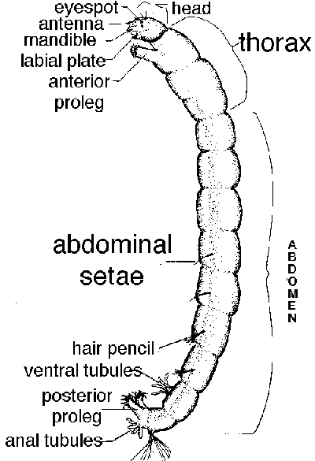
Environmental extremes
Heat
Thermal springs: 43-50ºC
Protein structure, membrane structure
Acclimation
Duration
Cryptobiosis: ability to dry out
0 metabolism
No water
Tolerate 100ºC to -27ºC

Slide 3
Migration
Dispersal vs. Migration
Definitions vary.
Seasonal movement
Physiologically cued movement
Physiological and behavioral changes
Reproduction shuts down
sometimes reproductive diapause
Energy stored, diverted to flight
Usually pre-reproductive individuals migrate
Reproduction commences after migration

Slide 4
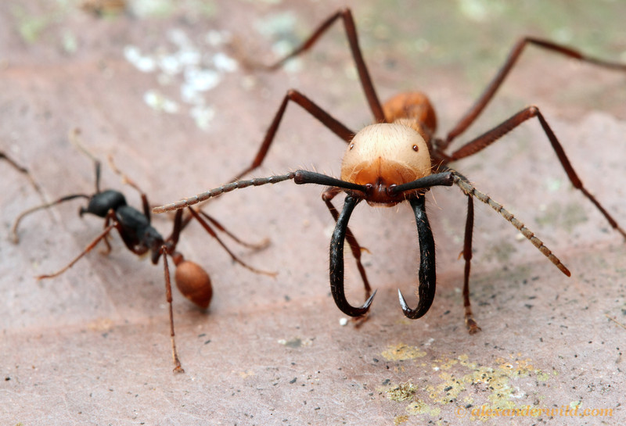
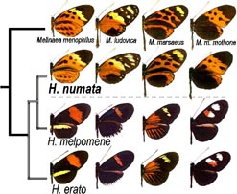
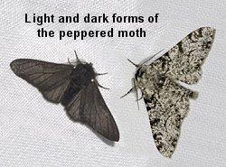
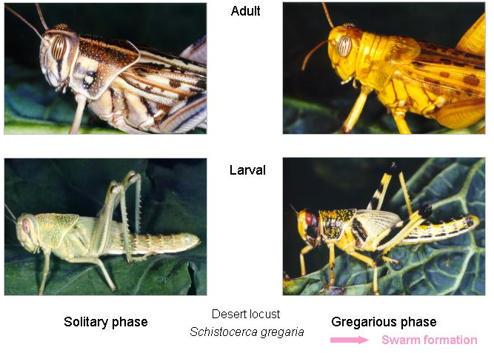
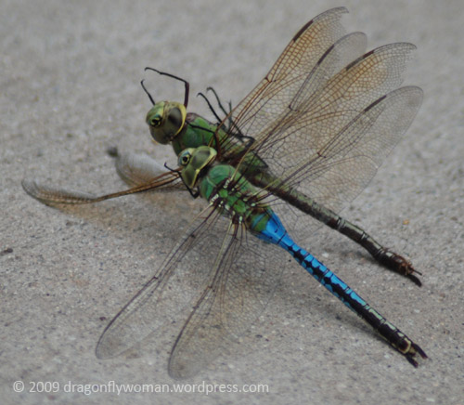
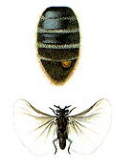
Polymorphism
Existence of distinct morphological forms of the same stage within a species or population
Usually discrete

Slide 5
Kinds of polymorphism
Genetic
Color, melanism
Mimicry, crypsis
Maintained by balancing selection or geneflow
Environmental {polyphenism}
Diet
Growth and Size
Social environment
Behavior correlates with morphology (Mating, dispersal)
May be adaptive instance of phenotypic plasticity

Slide 6
Environment and development
Food quantity and quality
Temperature
Humidity; moisture
Season (photoperiod)
Toxins
Other organisms

Slide 7
Temperature and development
Physiological Time
Ectotherms
Temperature determines rate of development
(and other physiological properties)
Not amount of time required to complete development but amount of heat required
Degree-days
Time above a threshold temperature x degrees C above that temperature
Estimated statistically (box 6.2)

Slide 8
Estimating degree-days required for development
Rear individuals at different temperatures (ample food, good conditions)
Record H ( hours to a stage – e.g., adult)
Plot 1/H vs. TºC [in fig., plot is 1000/H vs. Tº]
Fit linear regression to points 1/H = k(Tº) + b
k = slope
b = Y intercept

Slide 9
Degree-days [or degree-hours]
Slope: increased development rate per 1 ºC
1/slope = degree-hours above threshold to complete development
Threshold = ‘developmental zero’
temperature below which development stops
X intercept of regression line (13.3ºC)
1/H = k(TºC – T^{t} )
T^{t} is the threshold = -b/k
Thermal constant = K = 1/k = H(TºC – T^{t} )
Calculate for each Tº, then average
K = 2740 degree-hours for Aedes aegypti in box 6.2

Slide 10
Why?
Forecasting
Knowing degree-day requirements of a species (e.g., pest) you can predict when it will become mature
Target for control based on weather
Fluctuating temperatures and other factors make this only approximate

Slide 11
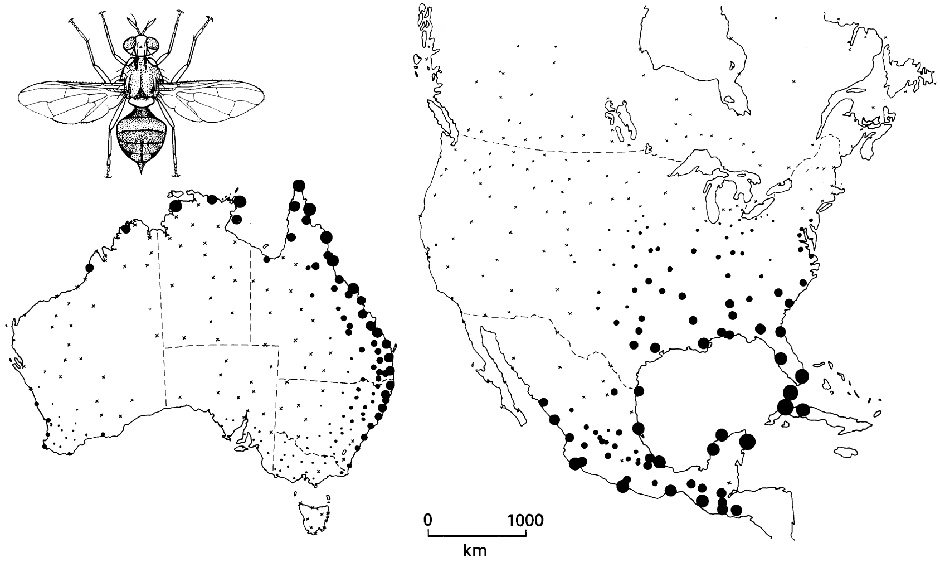
Predicting invasions, effects of climate change
Ecoclimatic index (box 6.3)
Climatic correlates of a large, population
Temperature, moisture
Use this to predict new areas where species could establish permanent populations
Adaptation involves thermal tolerance and seasonal timing
Climate change = change in climate, not timing cues (photoperiod)
Two short papers for discussion
Parmesan et al. 1999. Nature
Bradshaw & Holzapfel 2006. Science

Slide 12
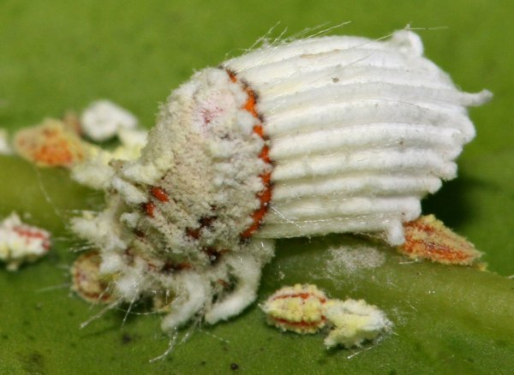
Insect reproduction and mating Ch. 5
Typically 2 sexes
Hermaphrodites: Scale insects (Hemiptera)
Females only [Thelytoky]
Most orders
Common in Aphids, Thysanoptera, Phasmatodea
Sex determination is genetic
XX female, XO male [many groups]
XX female, XY male [Drosophila]
ZW female, ZZ male [Lepidoptera]
Single gene – no sex chromosome [midges, mosquitoes]
Haplodiploid sex determination

Slide 13
Hymenoptera: Haplodiploid sex determination
Males are haploid
From unfertilized eggs [Arrehnotoky]
Females diploid
Fertilized egg
Sperm storage in spermatheca
Fertilization at oviposition
Precise control of sex of offspring and of sex ratio

Slide 14
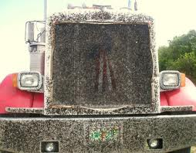
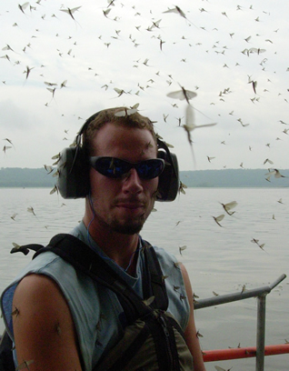
Insect reproduction and mating
Swarming
Mass emergence
Visual markers
Leks
Terrestrial aggregation of (usually) male for male-male competition
Displays
No resources

Slide 15
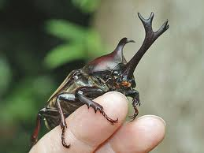
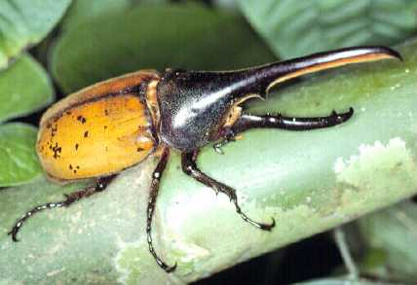
Insect reproduction and mating
Territory defense and male-male competition
http://www.youtube.com/watch?v=ALuRtPA_H7s
Sexual dimorphism
Resource defense

Slide 16
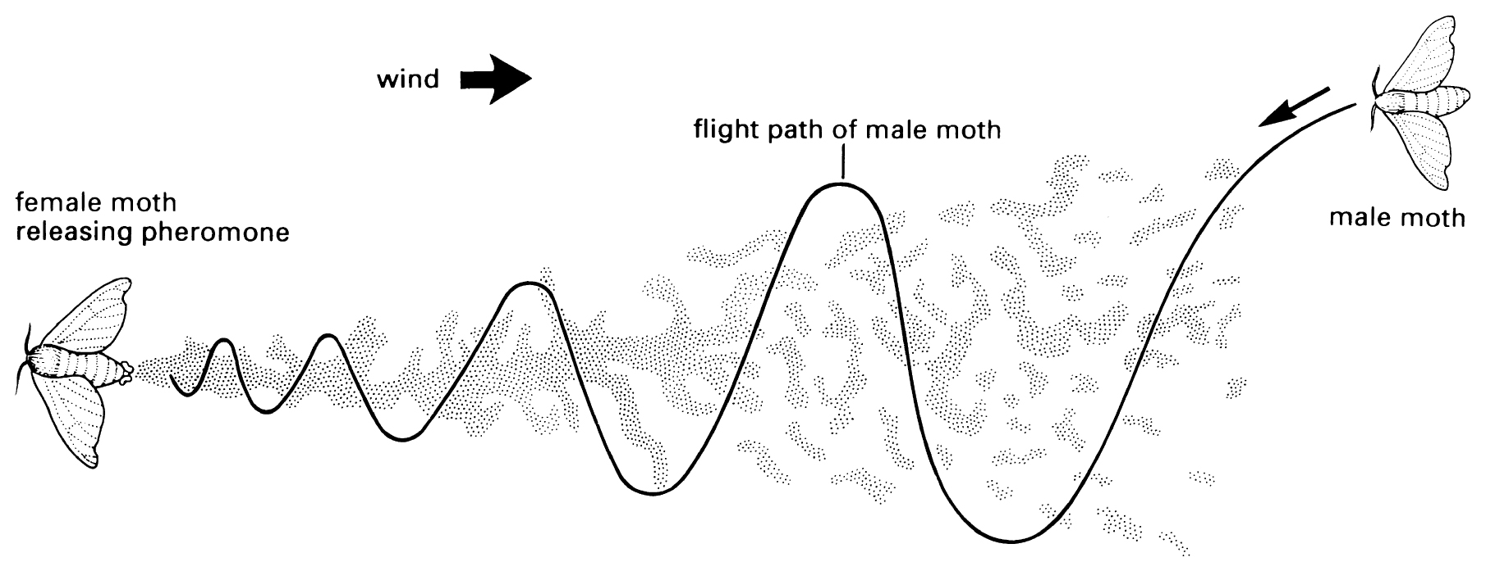
Insect reproduction and mating
Pheromones: Chemicals or chemical combinations emitted by one individual and sensed by conspecifics
Sex pheromones:
commonly emitted by one sex
Attractive to members of the opposite sex

Slide 17
Insect reproduction and mating
Song: Males produce sound that both attracts females from a distance and serves as a basis for mate choice.
Orthoptera
Hemiptera (Cicadas)
Diptera (Drosophila – close range only)
Plecoptera (drumming)

Slide 18
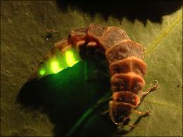
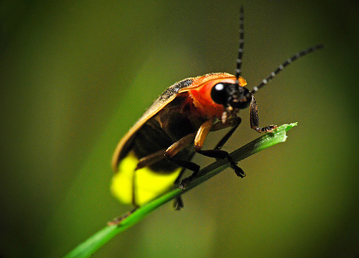
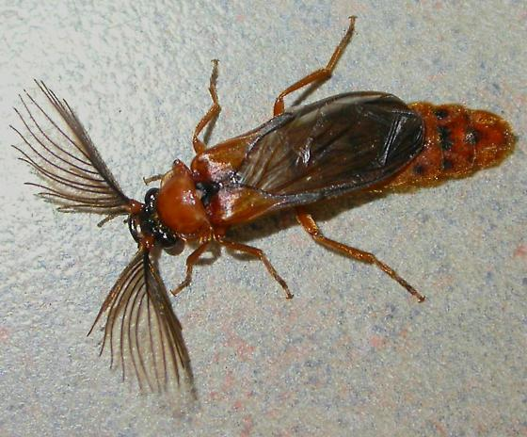
Insect reproduction and mating
Visual: Males or females produce light that attracts potential mates
Lampyridae, Phengodidae
Distance attraction; mate choice

Slide 19
Sperm transfer
Entognatha, Apterygote orders
Indirect sperm transfer
Male deposits spermatophore (sperm packet) on substrate
Female picks it up
May be accompanied by an elaborate mating “dance”
Pterygote orders
Internal fertilization
Male inserts spermatophore via copulation
Female stores sperm in spermatheca

Slide 20
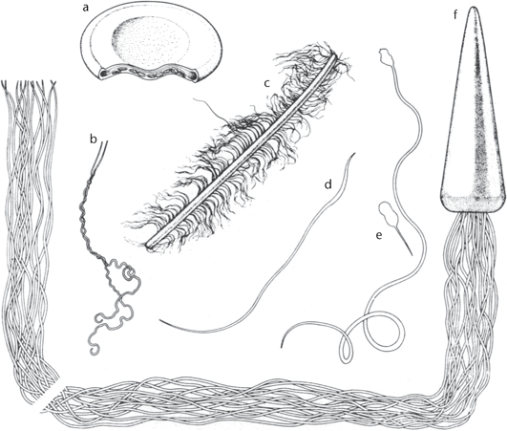
Insect sperm
Figure 1. Different morphologies of insect sperm: (a) the aflagellate sperm of the proturan, Eosentonon transitorium; (b) paired sperm of a firebrat, Thermobia domestica; (c) spermatostyle and spermatozoa from a gyrinid beetle, Dineutus sp.; (d) firefly sperm, Pyractomena barveri; (e) heteromorphic sperm of the symphlan, Symphylella vulgaris; (f) multiflagellate sperm of the termite, Mastotermes darwiniensis. (Modified from Sivinski, 1980. © Florida Entomological Society.)

Slide 21
Sexual selection
Selection acting via different levels of success in securing mates
Intrasexual selection: Contests among one sex to secure mates; e.g., Male-male competition
Intersexual selection: Choice of mates with particular traits by the opposite sex; e.g., female choice
Usually males are the subjects of sexual selection
Exceptions

Slide 22
Sexual selection
Gametic investment:
Female gametes large, costly to produce
Male gametes small, low cost
Females (or their ova) are a limited resource for males
Nearly all females mate
Some males mate a lot; others rarely or never
Variance in mating success: Males >> Females
Females choosy; Males compete

Slide 23
Mating systems
Promiscuous: both sexes mate with multiple partners
Polygynous: Males have multiple mates; females one
Polyandrous: Females have multiple mates; males one
Monogamous: One male and one female
Could define this based on a batch of eggs or for a lifetime

Slide 24
Reproductive conflict
Male fitness maximized by
Mating many different females
Having those females mate with no other males
Female fitness maximized by
Maximizing resources for investment in offspring
Material benefits
Mating with genetically desirable males
Sexy sons
High quality offspring
Male and female interests often in conflict

Slide 25
Sperm competition
Females store sperm
Use it later for fertilization
If there are multiple male mates: Sperm competition
Sperm use
Last in, first out: most recent male sires most offspring
“Sperm precedence”
First in, first out: First male sires most offspring
Mixing: more sperm, more offspring

Slide 26
Consequences of sperm competition
Mate guarding
Sperm plugs
Accessory gland substances that manipulate female behavior [reduce probability of competing sperm]
Reduce receptivity
Induce oviposition
Sperm removal
Nuptial gifts
Prey
Nutrients
Edible parts of spermatophore

Slide 27
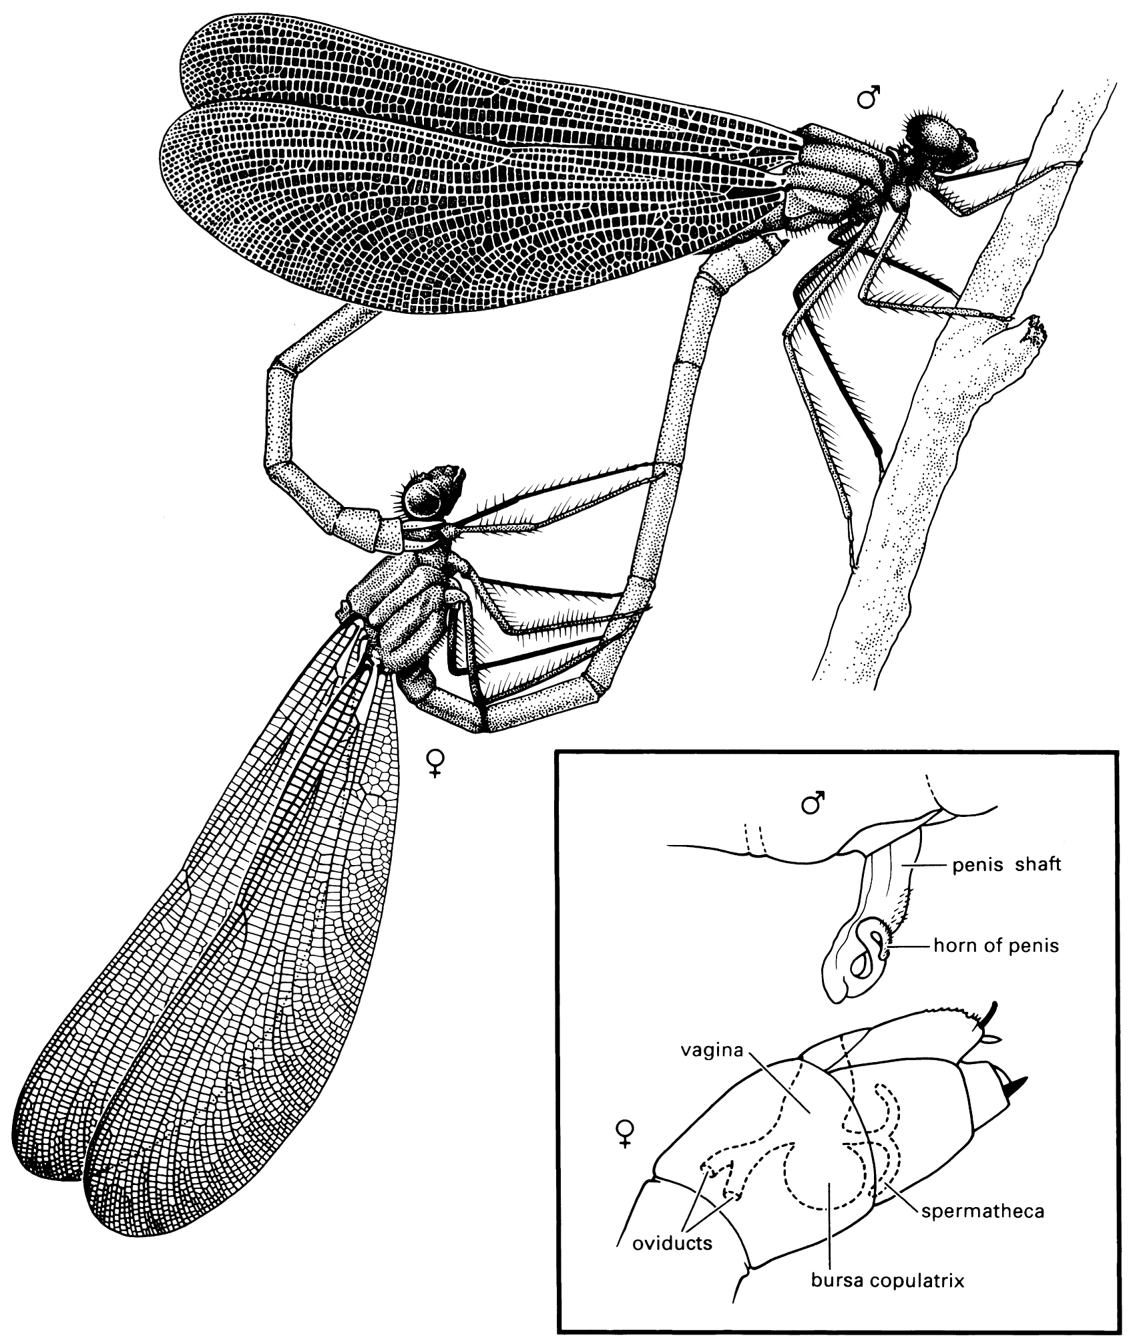
Ensuring paternity

Slide 28
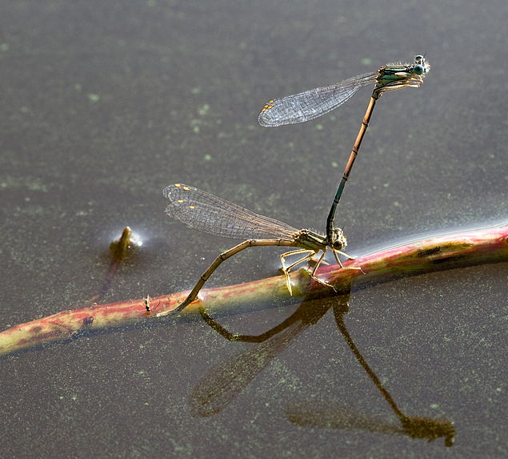
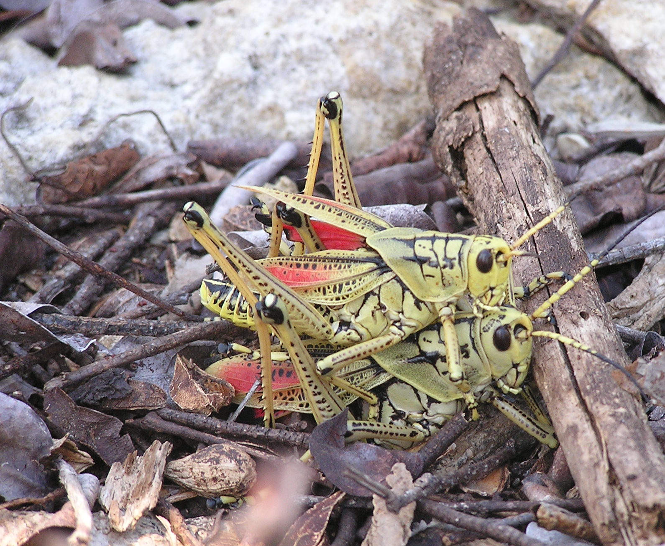
Ensuring paternity

Slide 29
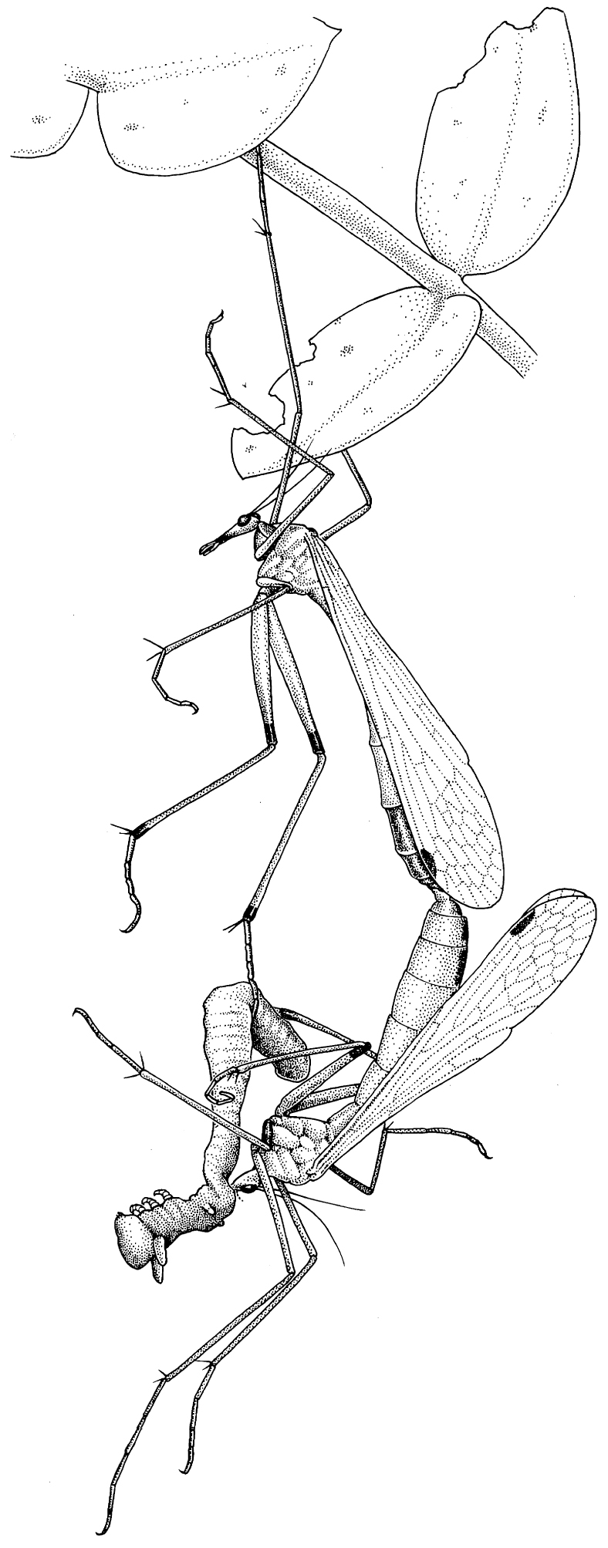
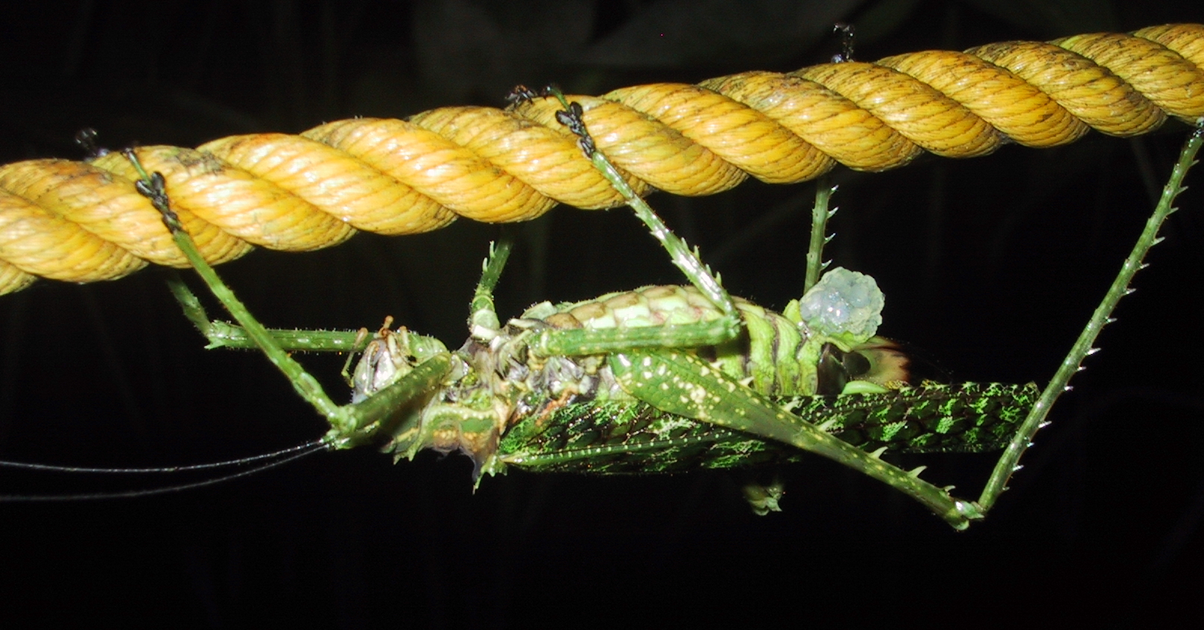
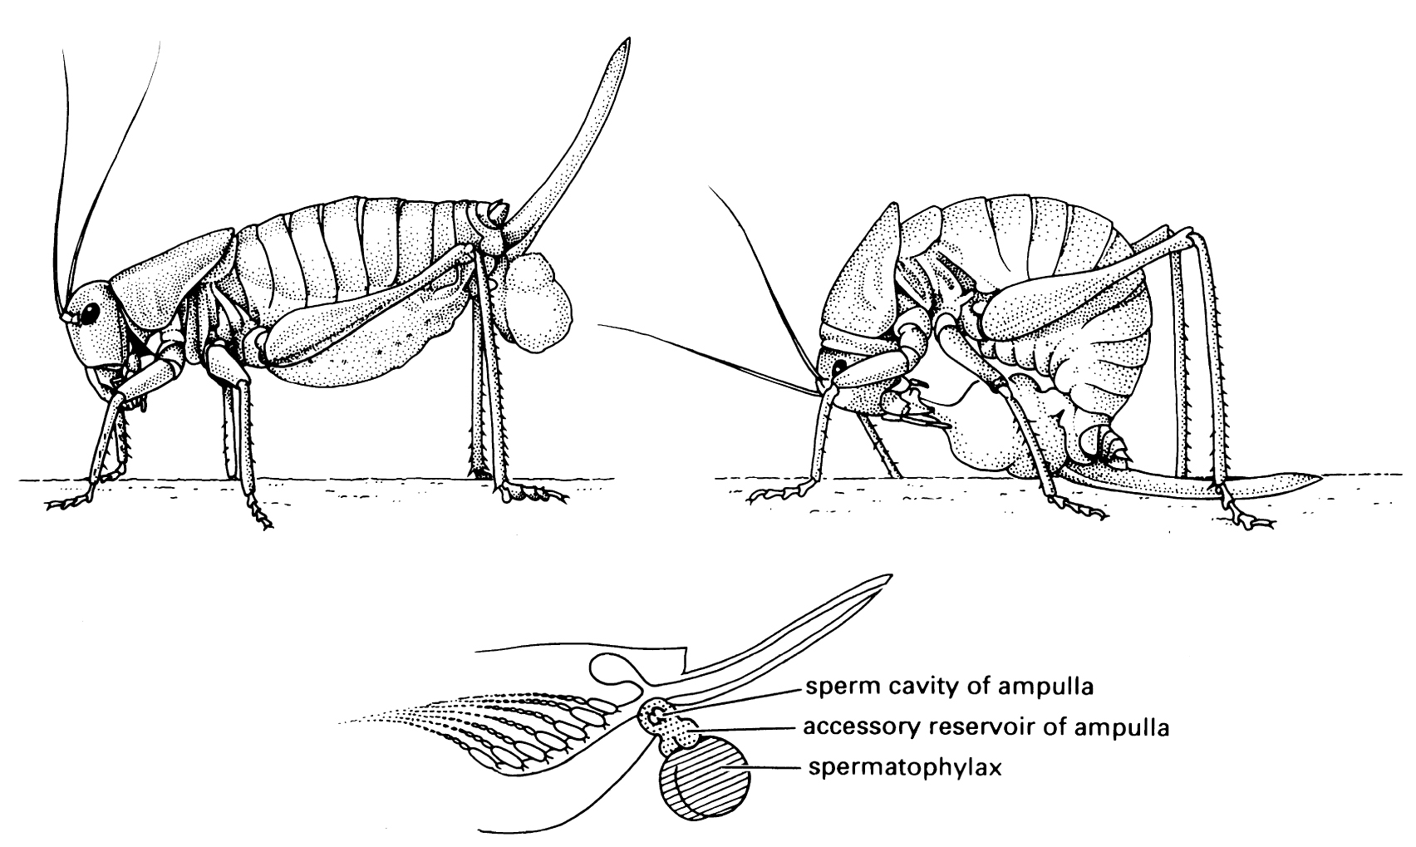
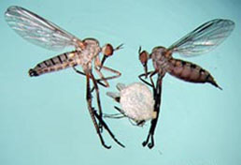
Ensuring paternity

Slide 30
Hypotheses for nuptial gifts
Male provides direct benefit (Nutrition) to female or to offspring
Meta-analysis (spermatophore gifts)
INCREASE DUE TO MULTIPLE MATING | Groups that give gifts | Groups that give no gifts
Female fecundity * | 35% | 11%
Female longevity * | 6% | -12%
Offspring | 9% | 20%
Fertility | 83% | 52%
Male is manipulating female behavior for his benefit
Varies among species
some spermatophylaxes contain little nutrition
some male empidids give balloons with no prey
Male is advertising his quality (indirect or genetic benefits)

Slide 31
Ensuring paternity Sheep blow fly, Lucilia cuprina box 5.4

Slide 32
Monogamous mating and eusociality
Mating system is central to the proposed evolution of eusociality (coming in ch. 12)
Colonies of social insects (Hymenoptera, Isoptera)
Reproductive individuals (Queen, King, Drone)
Nonreproductive individuals (Workers, Soldiers)
Cooperative reproduction
Overlapping of generations (mothers, daughters)
Typically offspring forgo reproduction, help mother raise more offspring
Monogamy: Ensures high relatedness among offspring
Thus high fitness gain for helping raise sisters
Monogamy window for the early evolution of eusociality
After evolution of eusociality, monogamy may be secondarily lost

Slide 33
Oviposition
Most insects lay eggs (Oviparity)
A few give birth to 1st instar larvae (Viviparity)
Ovoviviparity: eggs retained in the reproductive tract; hatch before or at oviposition; Blattidae, Aphidae, Scale insects, Thysanoptera, Parasitic Diptera
Pseudoplacental viviparity: yolkless eggs retained in reproductive tract; provisioned via placenta like organ; aphids, other Hemiptera, Pscodea, Dermaptera
Hemocoelous viviparity: eggs develop in the hemocoel; absorb nutrients from hemolymph; Strepsiptera; some Cecidomyiidae
Adenotrophic viviparity: Larva hatches internally; feeds from specialized “milk” gland; Higher Diptera – Glossinidae, Hippoboscidae, Nycteribidae, Streblidae

Slide 34
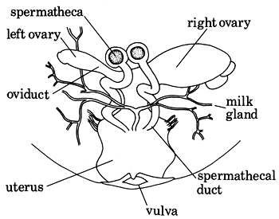
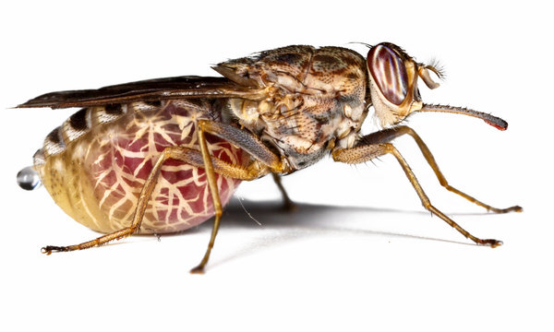
Tsetse fly

Slide 35
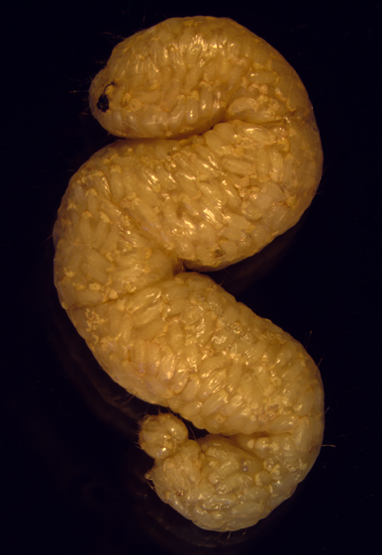
Polyembryonic development
Hymenoptera
Multiple embryos from one egg
Family Encrytidae (Hymenoptera)
Parasitoids
Hosts variable in size
Polyembryony enables parasitoids to maximize production from single host
Trophamnion: membrane that allows absorption of nutrients from the host
Enables multiplication of the embryo without additional yolk

Slide 36
Wolbachia
Now for something really strange
Endosymbiotic bacteria (parasitic?)
Common in some insects, other groups
Cytoplasmic inheritance (like mitochondria)
Distort host reproduction in ways that benefit Wolbachia

Slide 37
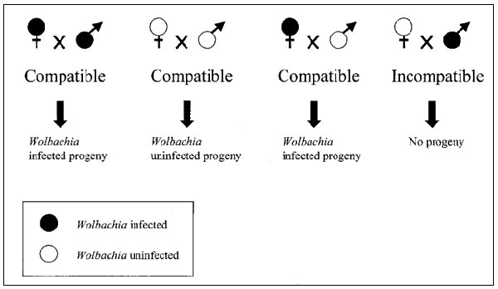
Wolbachia
Cytoplasmic incompatibility
Gives reproductive advantage to Wolbachia infected females
Result: Wolbachia infections spread throughout the population

Slide 38
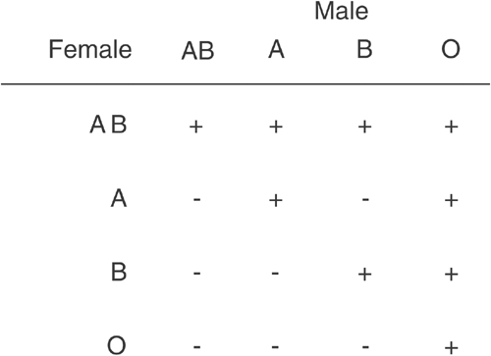
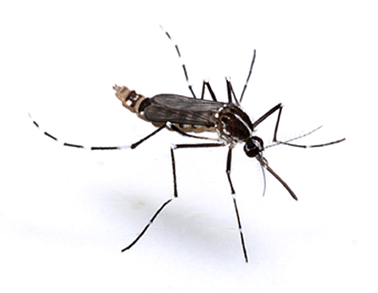
Superinfection

Slide 39
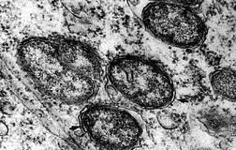
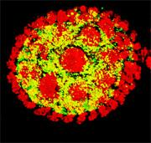
Wolbachia
Sex ratio distortion
Wolbachia cause duplication of female genome in unfertilized eggs of Hymenoptera
Makes egg diploid
Males converted to females
Propagates more Wolbachia
Feminization
Non Hymenoptera
Turns genetic males into females
Turns off male-determining genes
Male killing

Slide 40
Hormonal control of reproduction

Slide 41
Hormonal control of female reproduction in Romalea
Newly eclosed females have little stored reserves
No reproduction (anautogenous)
Feeding by the adult results in accumulation of Hexamerins (“storage proteins”)
Hemolymph
Fat body
Critical amount of Hexamerins triggers hormone cascade
Juvenile hormone
Ecdysteroids

Slide 42
Hormonal control of female reproduction in Romalea
Vitellogenesis
Amino acids in Hexamerins used to synthesize Vitellogenin
Vitellogenin circulates via hemolymphs
Transferred via nurse cells to oocytes
Converted to vitellin (yolk protein)
Once hormonal signal is given, process proceeds independent of feeding
Oocytes can be resorbed if insufficient vitellin is available
Reduces number of eggs laid
Timing seems to be inflexible once initiated (“canalized”)

