Slide 1
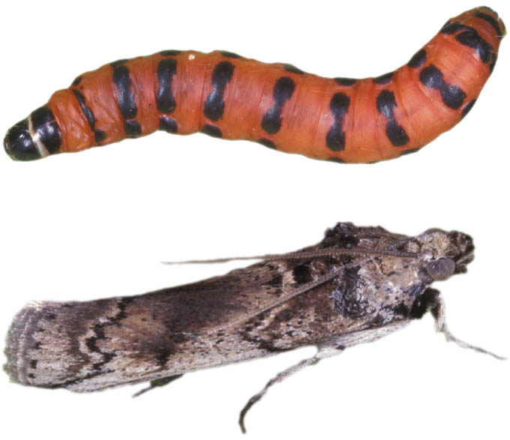
Biological control gone bad
Cactoblastis cactorum success in Australia
no native cacti; no non target effects
Imported to Caribbean in 1957
Spread among islands since
Reached Florida Keys in 1989
Reached Mexico 2006
Now a major threat to native cacti in North and Central America
Effects on nontarget species
Common theme in ALL attempts at controlling pests

Slide 2
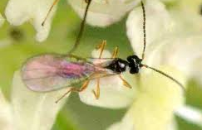
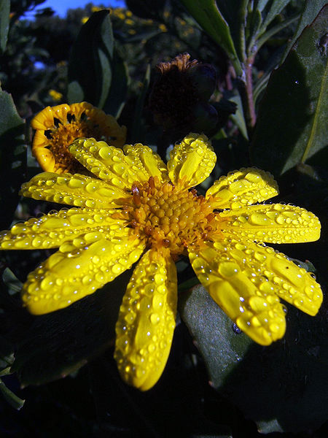
Oligophagous vs. Monophagous
Oligophagous C. cactorum in the Americas
Monophagous herbivores?
Even these interact in food webs
Parasitoids of introduced monophagous herbivore may attack native insects and reduce them
Apparent competition: negative effects produced by shared enemies.
P
+
-
H2
Chrysanthemoides monilifera Australia
From S. Africa
Control attempt by seed eating fly Mesoclanis polana
Little effect on plant; Large M. polana populations
Apparent competition reduced of native Diptera
Parasitoids attacking natives and M. polana

Slide 3
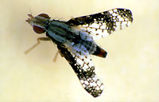
Oligophagous vs. Monophagous
Oligophagous C. cactorum in the Americas
Monophagous herbivores?
Even these interact in food webs
Parasitoids of introduced monophagous herbivore may attack native insects and reduce them
Apparent competition: negative effects produced by shared enemies.
P
+
+
-
-
H1
H2
Chrysanthemoides monilifera Australia
From S. Africa
Control attempt by seed eating fly Mesoclanis polana
Little effect on plant; Large M. polana populations
Apparent competition reduced of native Diptera
Parasitoids attacking natives and M. polana

Slide 4
Pollination
Entomophily – pollination by insects
One Major reason for dominance by angiosperms
Advantages for the plan
Directed mobility (compare to wind)
Pollinator constancy/reliability
Outcrossing, even when rare
Anthophilous insect orders
Hymenoptera, Coleoptera, Diptera, Lepidoptera, Thysanoptera
Trade reward (usually food) for mobility services
Nectar, pollen, food bodies,

Slide 5
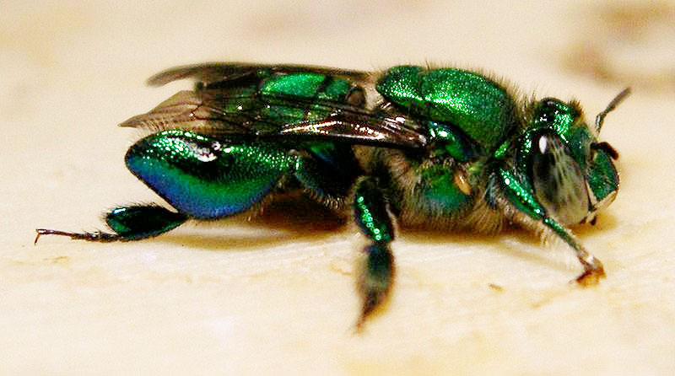
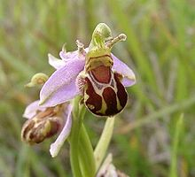
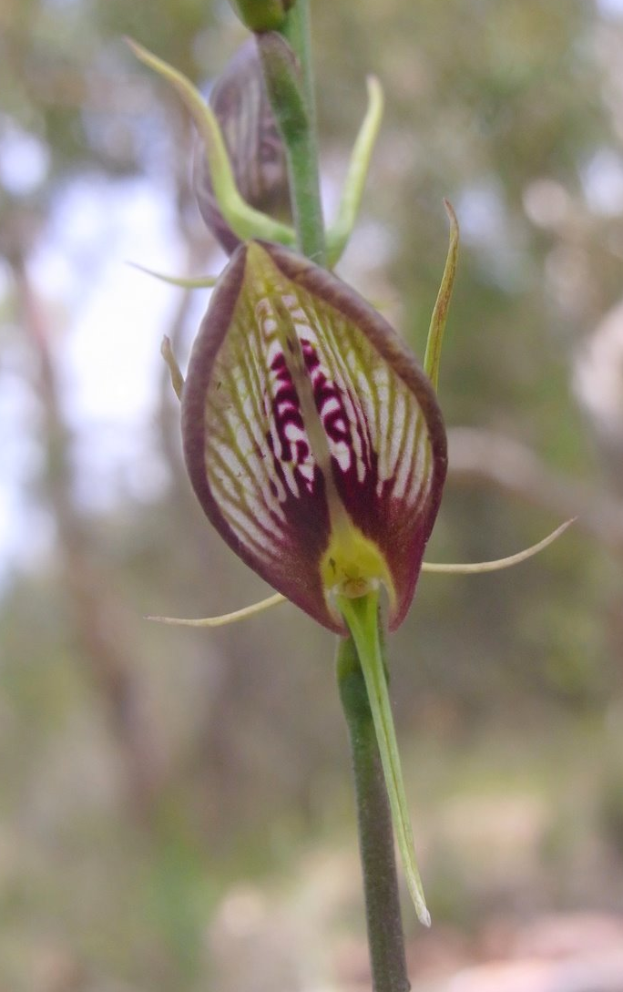
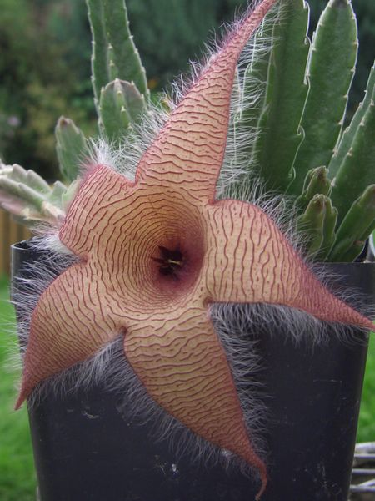
Some strange sorts of pollination
Scent reward in orchid bees
Apidae, Subf. Euglossinae
Mate attractants
Pseudocopulation in wasps, bees
Tiphiidae, Ichneumonidae, and orchids
Sapromyophily – plant mimics carrion
Attracts Muscidae, Calliphoridae, Sarcophagidae

Slide 6
Pollination syndromes
Cantharophily (Beetles)
White, dull; strong aroma; bowl shaped; ovaries protected; petals etc. may be rewards, along with nectar and pollen
Phalaenophily (Moths)
White; strong aroma; Noctural; tubular; lots of nectar; physical nectar guides
Psychophily (Butterflies)
large; pink, yellow, lavender; nectar; nectar guides; diurnal
Myophily (Flies)
little scent; open; purple, blue, white; nectar+pollen reward
Melittophily (Bees)
sweet smell; yellow, blue; UV nectar guides; nectar+pollen reward

Slide 7
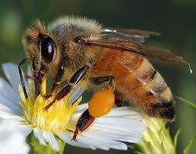
Honey bee [Apis mellifera]
Value as pollinators est. at $217,000,000,000
9.5% of the value of all food crops
Feral honey bees displace native bees and even compete with birds for nectar
Domesticated bees
Egypt 3000 BC
Probably first for honey

Slide 8
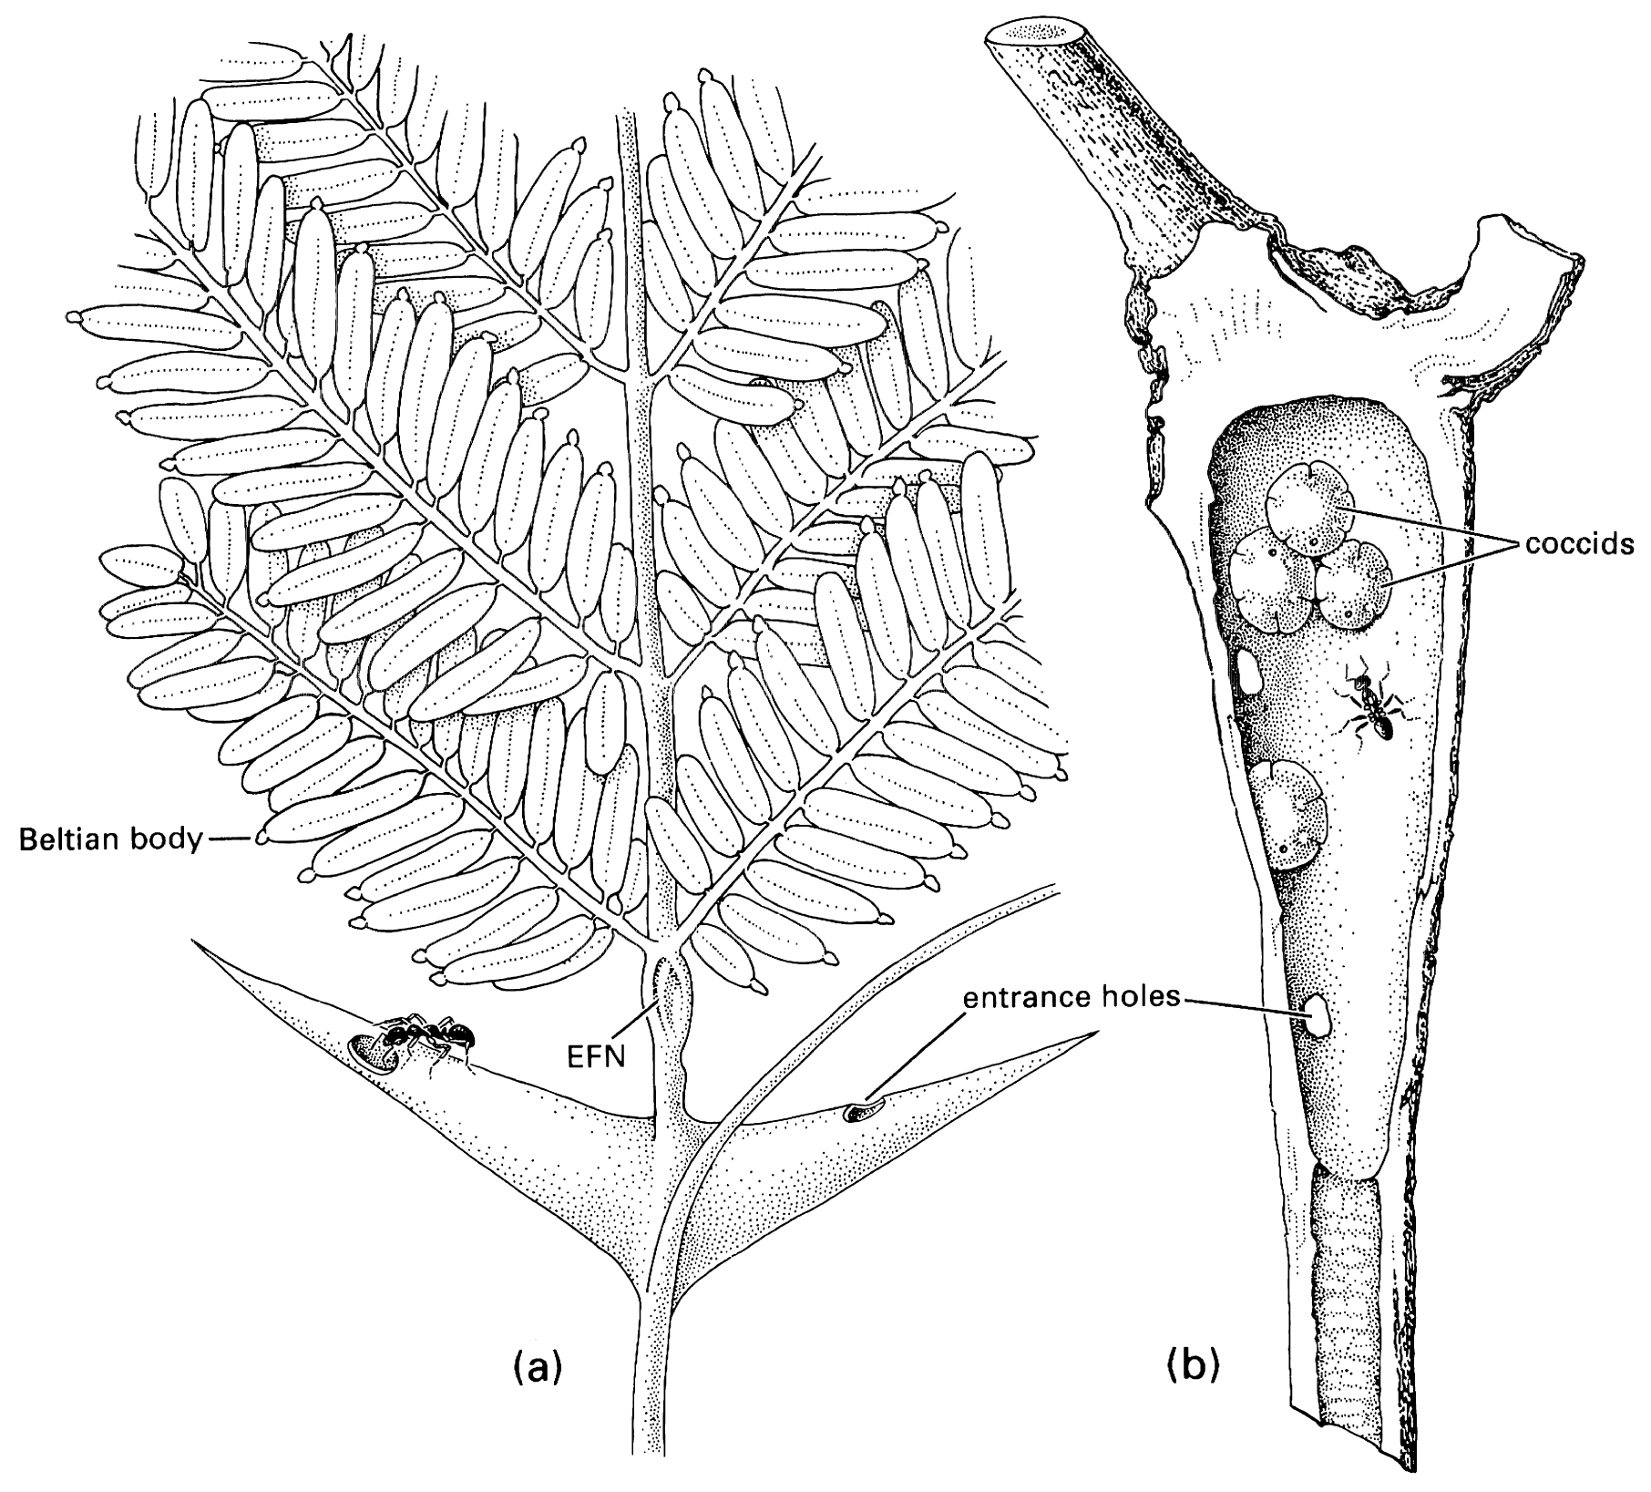
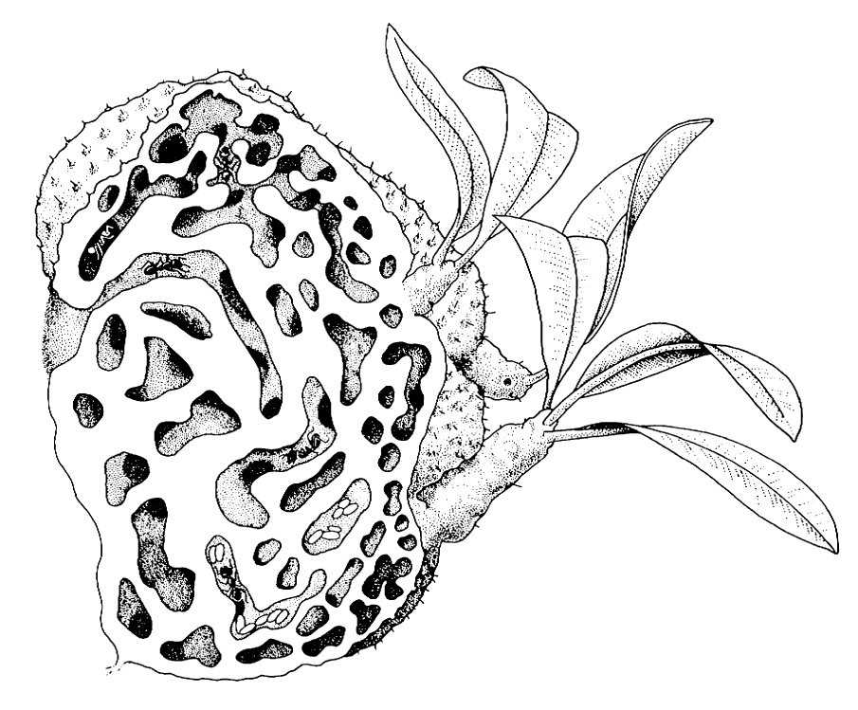
Plant Domatia
Housing for insects (and other arthropods)
Mutualistic
Ants
Aquatic insects
Also mites

Slide 9
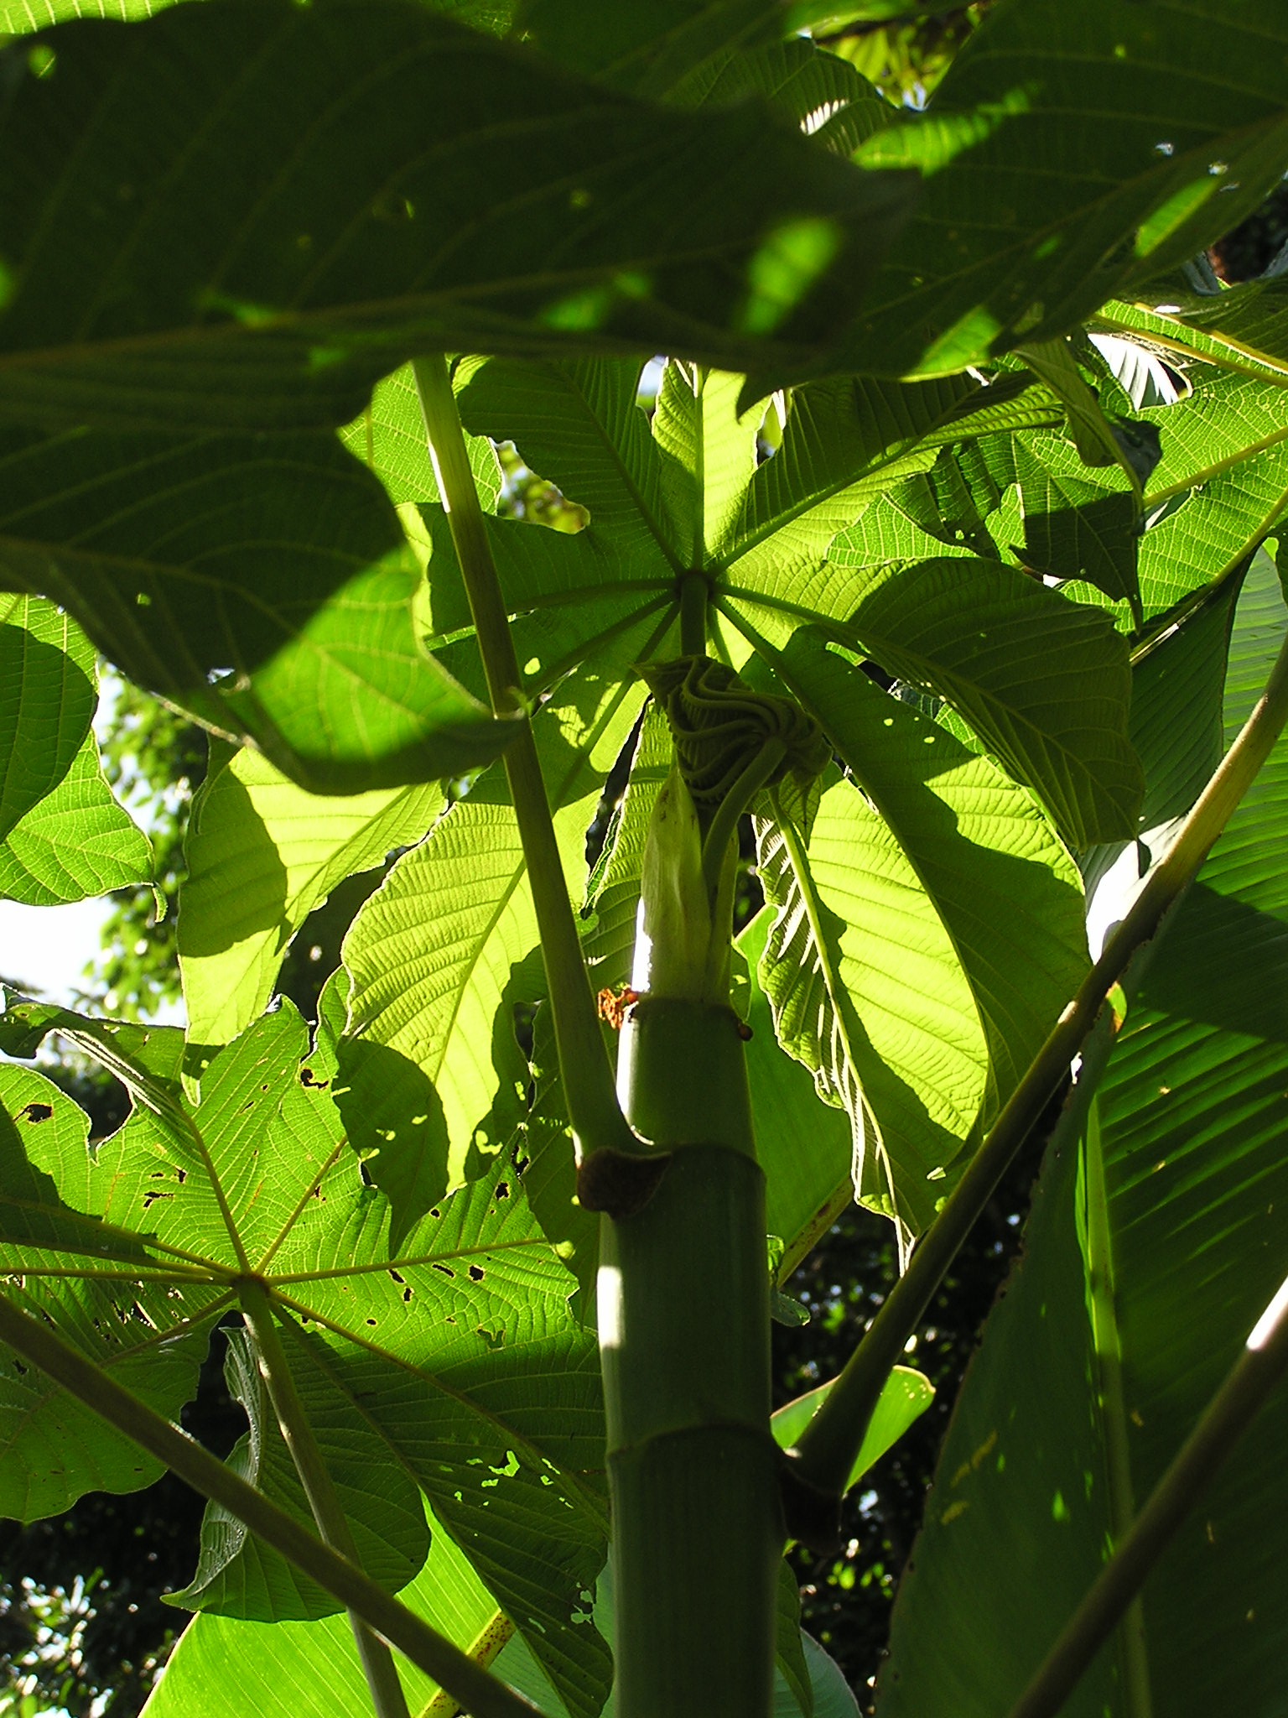
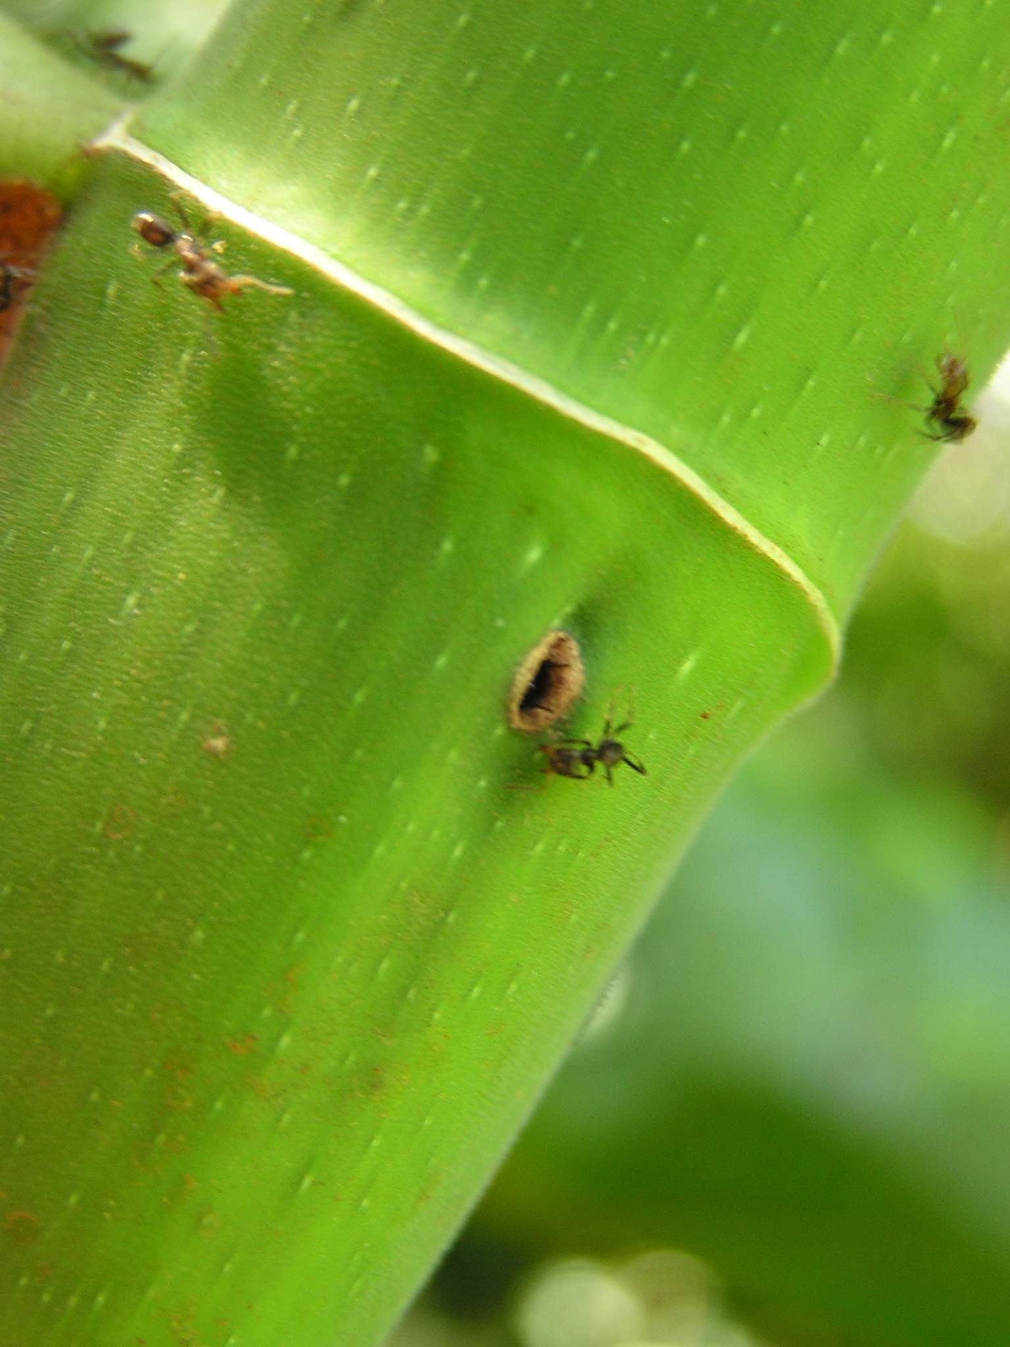
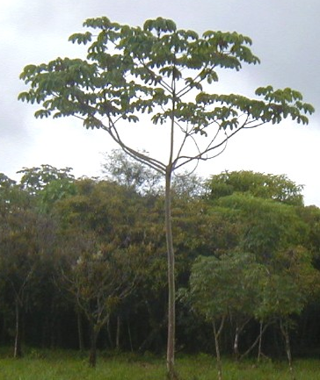
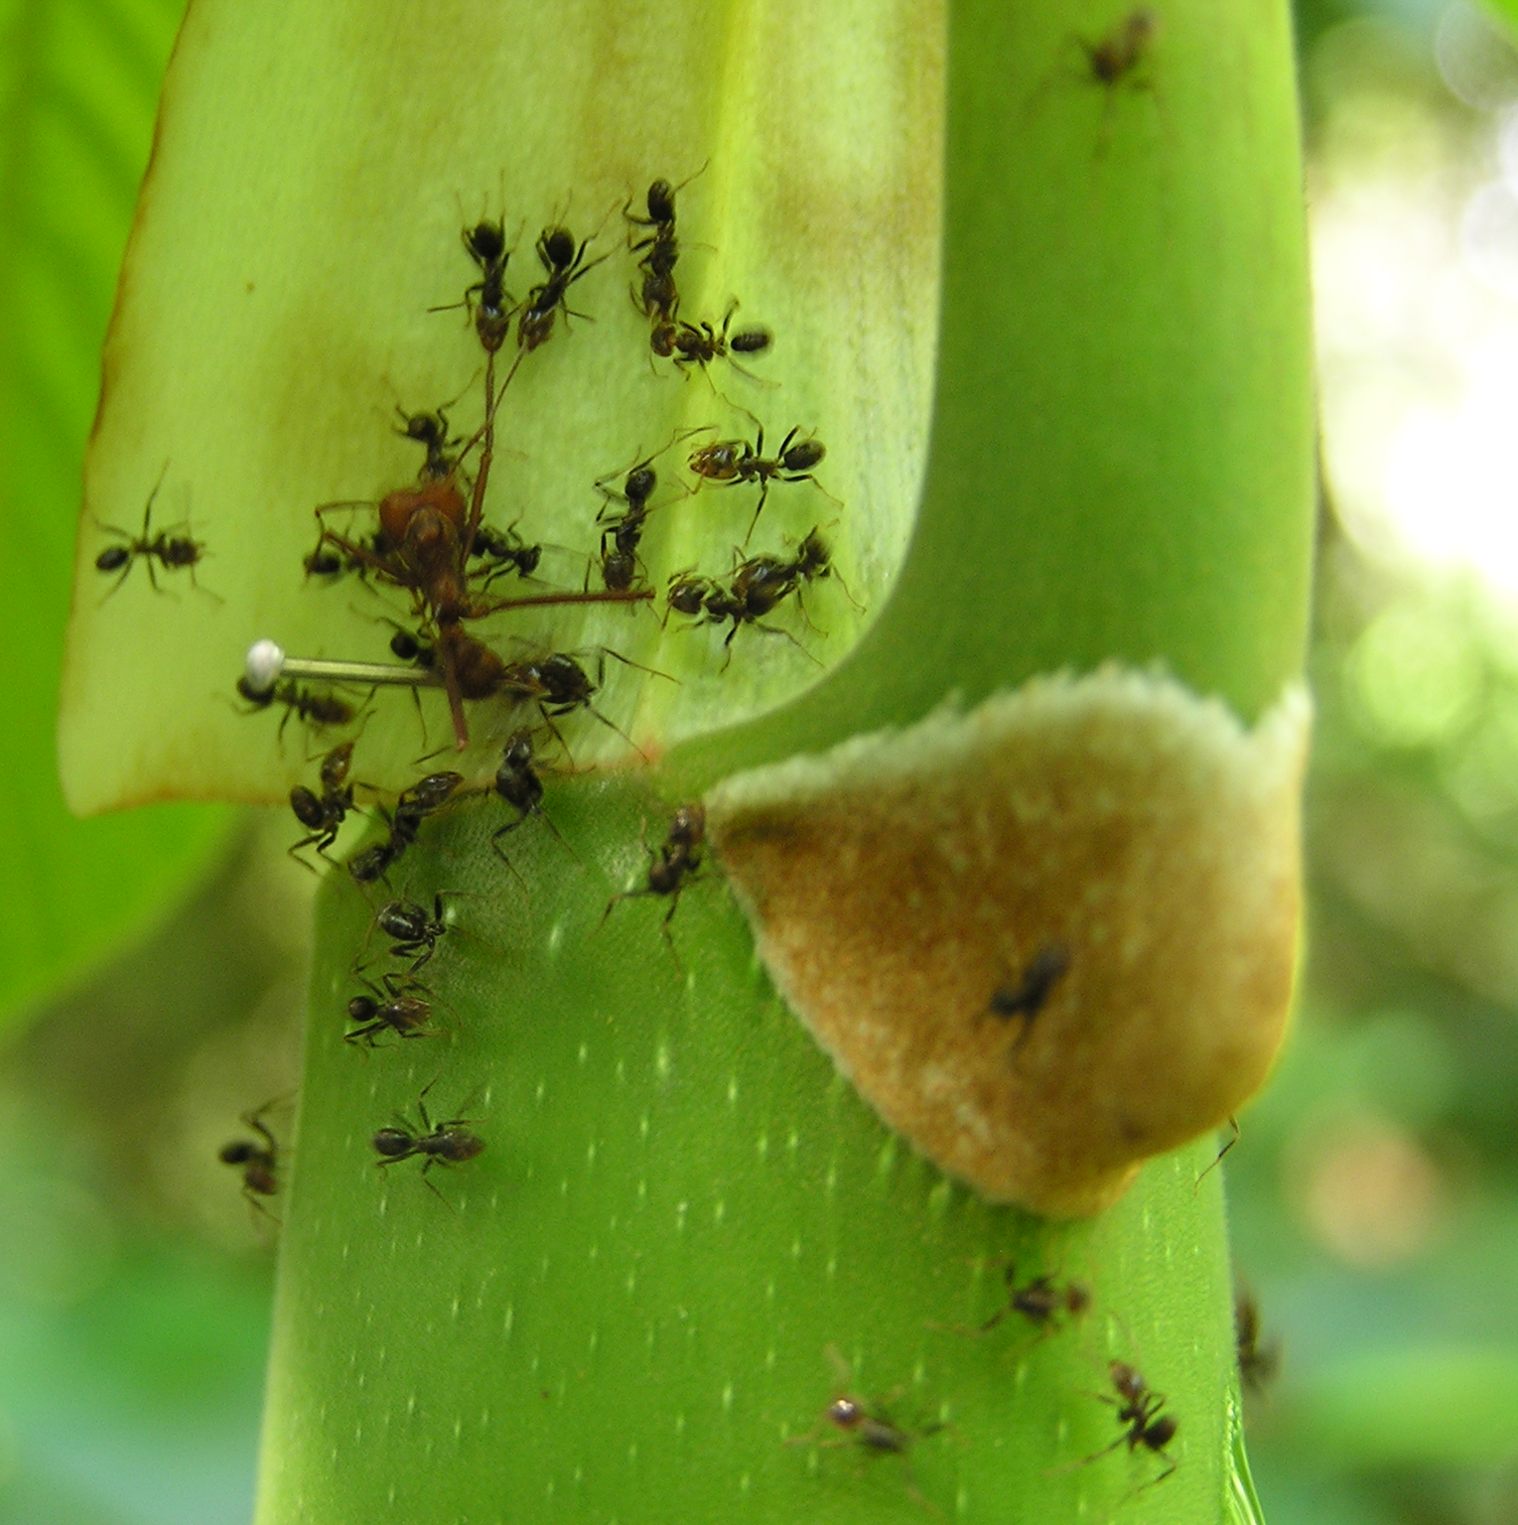
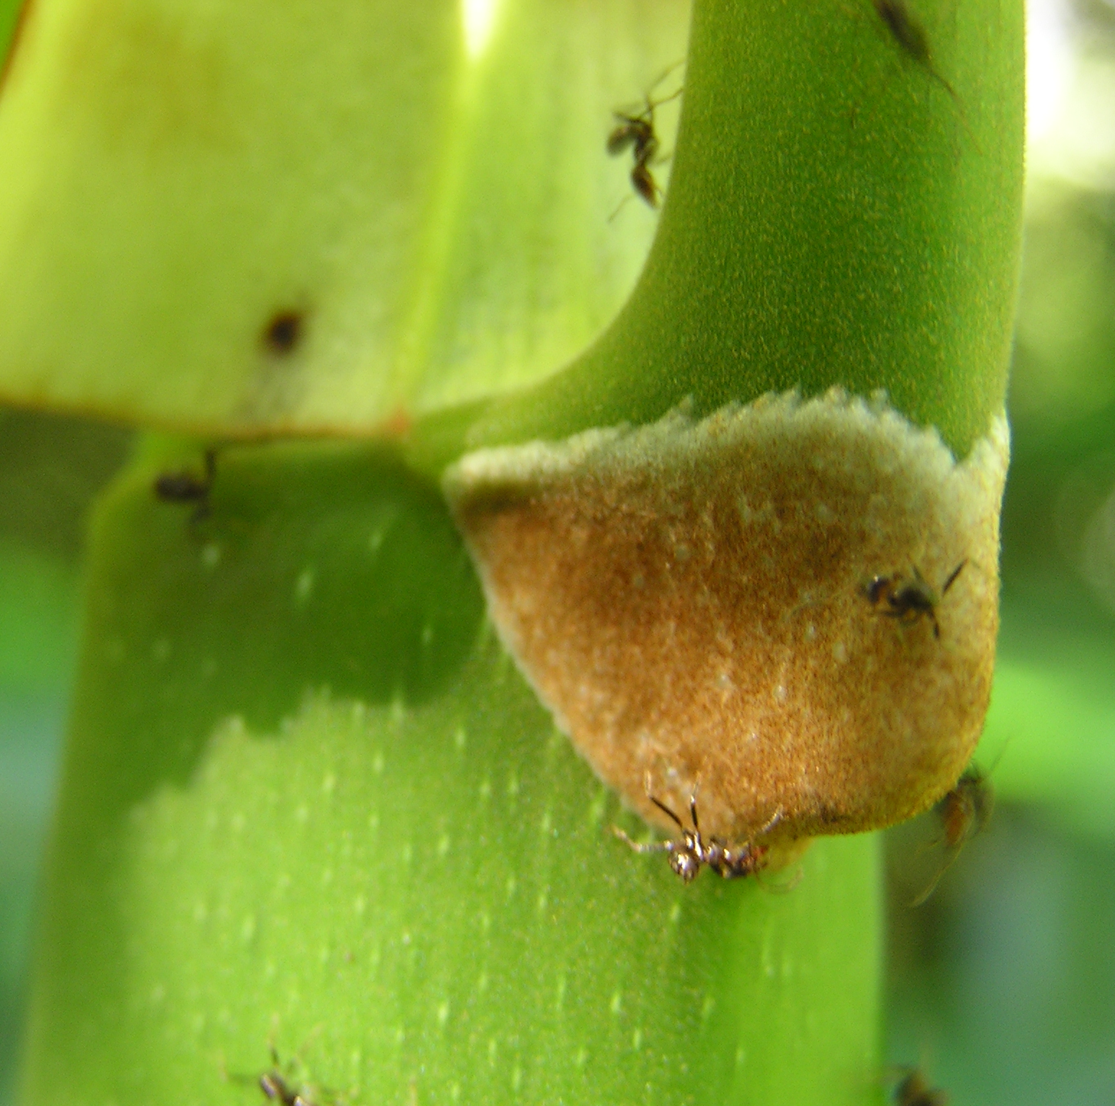
Cecropia - Azteca

Slide 10
Phytotelmata
Water held in plant parts
Insect communities in plants
Tree holes, Bamboo, Pitcher plants
Pitchers trap insects
Aquatic larvae assist in breakdown of prey and release of N
Most pitcher plants found in N poor soils
Mostly Diptera
Culicidae, Chironmomidae, Syrphidae
Specialists
Some Bromeliads do the same thing

Slide 11
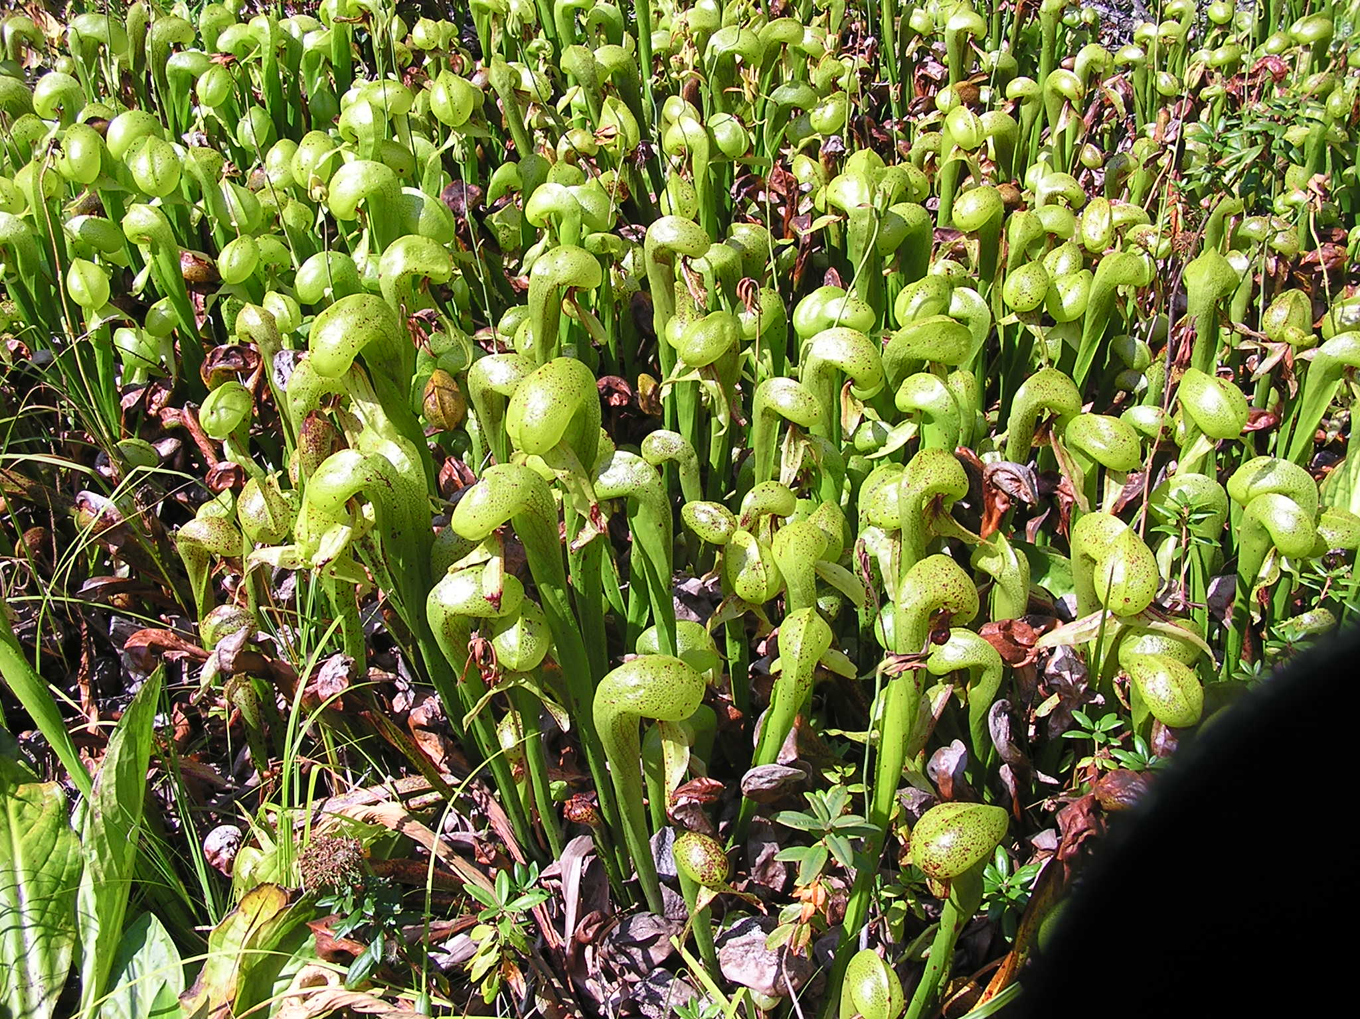
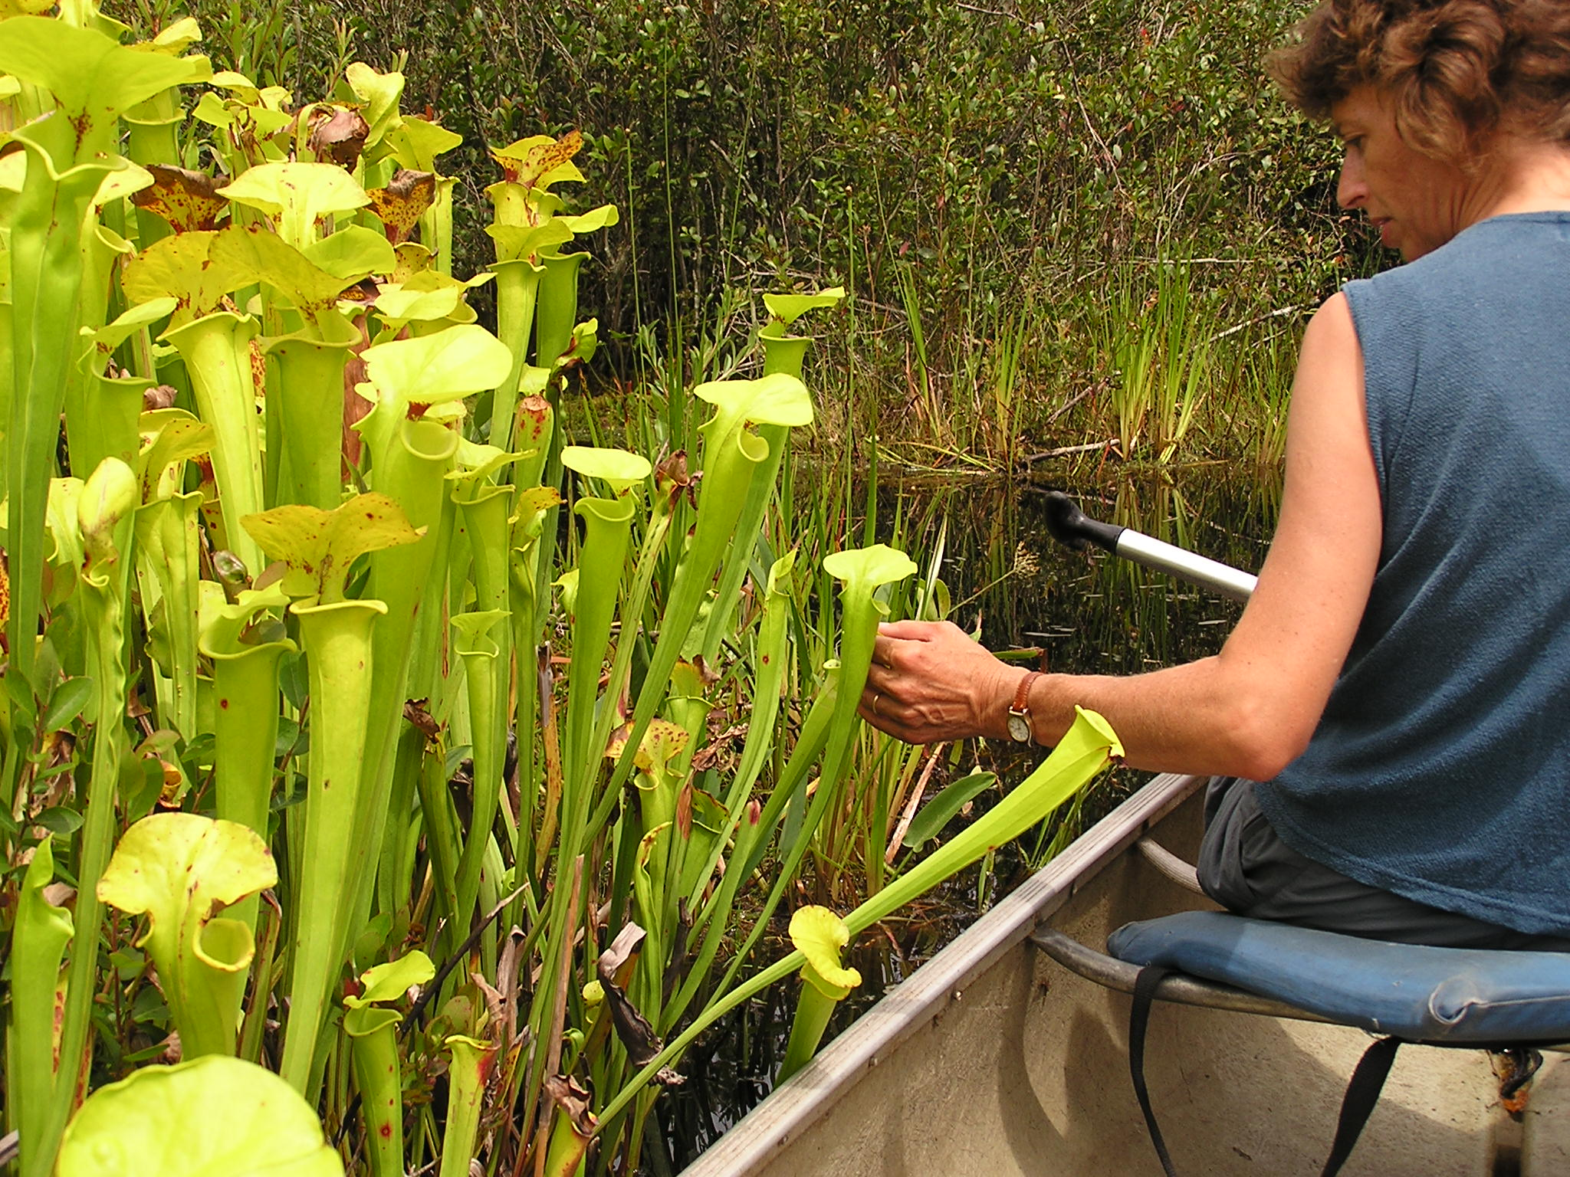
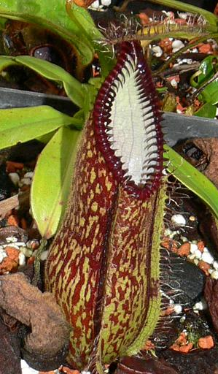
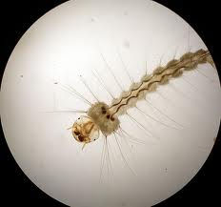
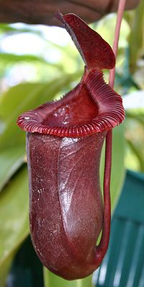
Pitcher plants
Darlingtonia californica
Sarracenia altata
Sarracenia
minor
Wyeomyia smithii
Metriocnemius knabi
Nepenthes

Slide 12
Predation and Parasitism [Ch. 13]
Predators
Catches kills and eats many victims (prey) during its life
Parasitoids
Juveniles placed in/on victims (host) by female; consumes and eventually kills one victim (often from the inside) during its (juvenile) live
Parasites
Lives on / in intimate association with victim (host); draws nutrition from it, and harms it, but does not necessarily kill it

Slide 13
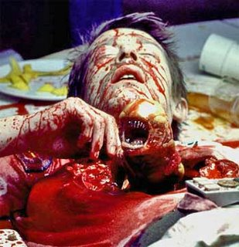
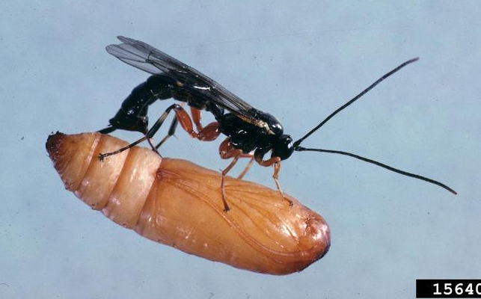
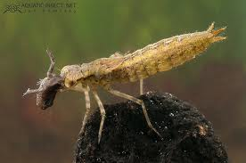
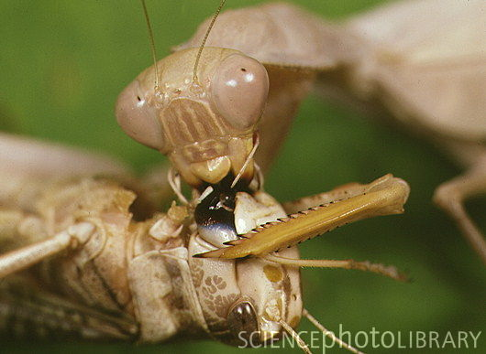
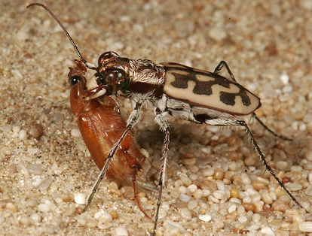
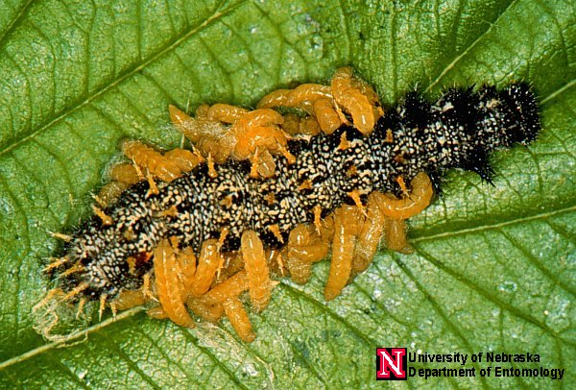
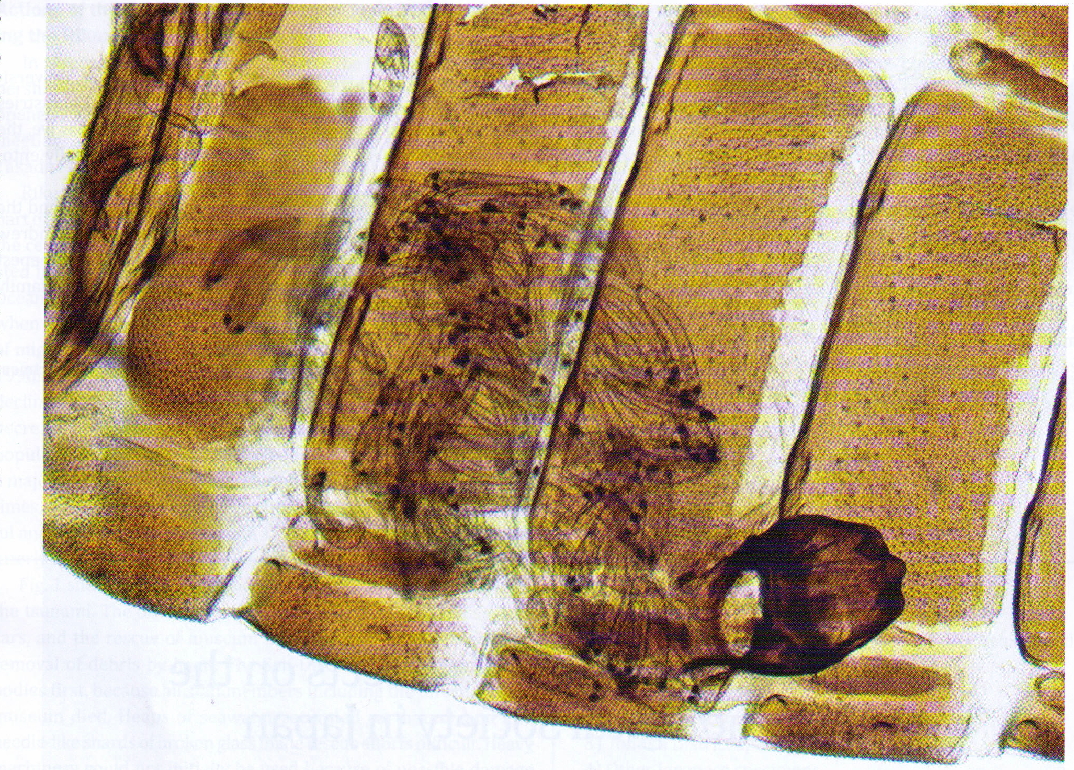
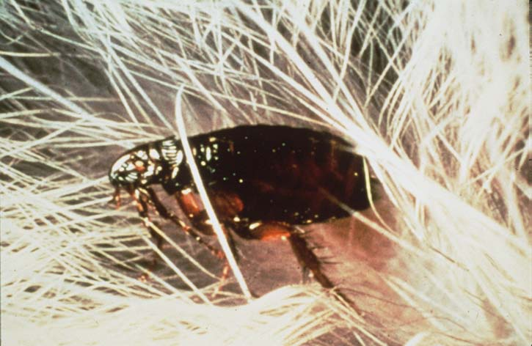

Slide 14
Predatory insects
Odonata, Mantodea (all)
Hemiptera (all aquatic groups; Reduviidae; Phymatidae; Nabidae; Anthocoridae)
Orthoptera (some Tettigoniidae)
Coleoptera (Carabidae; Cleridae; Dytiscidae; Hydrophilidae larvae)
Megaloptera, Neuroptera, Raphidioptera (all)
Diptera (Chaoboridae, Syrphidae, Sciomyzidae, larvae; Asilidae adults)
Trichoptera (Hydropsychidae; Rhyacophilidae)
Hymenoptera (Vespidae; some Formicidae; Sphecidae; Pompilidae)

Slide 15
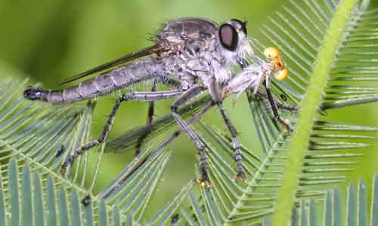
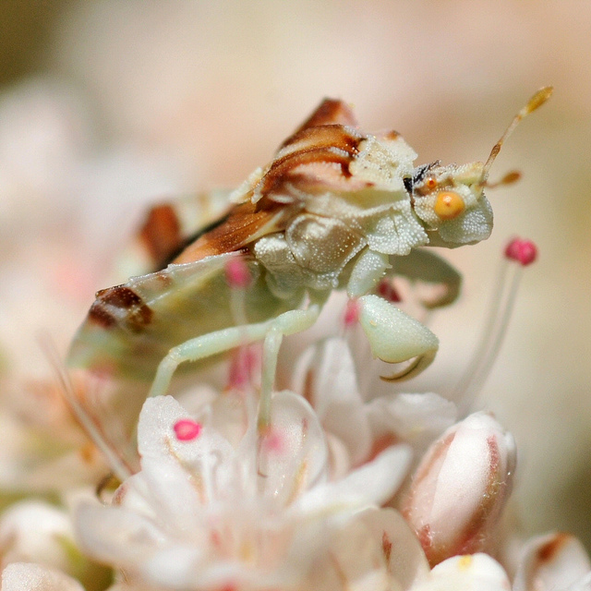
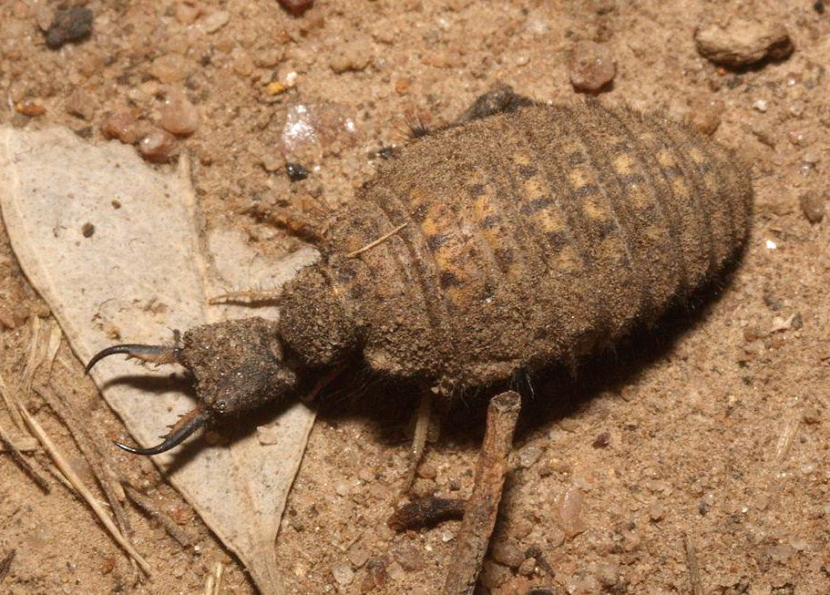
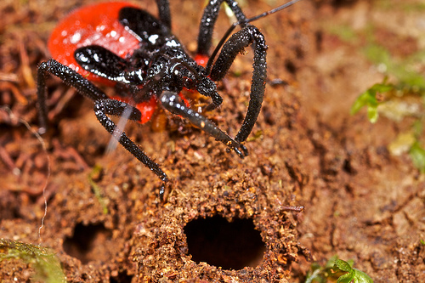
Predation strategies
Active foraging
Carabidae, Odonata adults, Asilidae, Coccinellidae
Ambush/sit-and-wait
Cicindelinae larvae, Odonata naiads, Phymatidae
Traps
Myrmeleontidae larvae, Hydropsychidae larvae
Other
Reduviidae hunting termites

Slide 16
Predation
Generally, most predators:
are polyphagous
are selective based on size, movement, odor, hardness
Predation based on physical characteristics rather than taxonomy
May endure periods of food shortage
Metabolic adjustments to endure starvation
Ability to eat a lot when opportunity presents itself
Search with what appears to be a strategy

Slide 17
Predator searching and movement
Kinesis: change in speed of movement in response to stimulus
Predator success = reduced speed [orthokinesis]
Predator success = increased turning frequency [klinokinesis]
Taxis: orientation toward a stimulus
Increased speed toward a stimulus [orthotaxis]
Increased turning toward stimulus [klinotaxis]
Combined these simple behaviors lead to area restricted search
Concentrates search effort where there is success
Moves predator out of areas where there is no success

Slide 18
Hierarchy of prey location cues
Prey habitat finding
Chemical, visual, tactile cues to host plant or other environmental condition
Prey finding
Chemical, visual, tactile cues to prey itself or its residue
Feces, silk, damage to plant

Slide 19
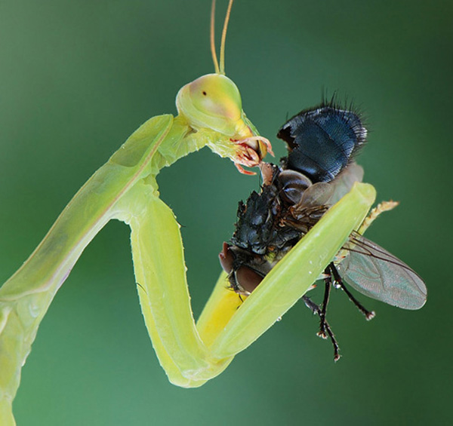
Responses to prey density
Functional responses (individuals)
Types I (linear)
Type II (asymptotic)
Type III (sigmoid)
Numerical responses (populations)
More prey = more reproduction
More prey attracts more individual hunters
N_{e} (number eaten)
N (number of prey)

Slide 20
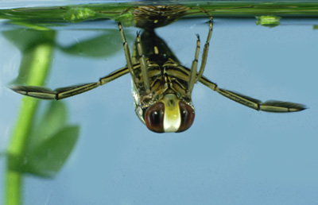
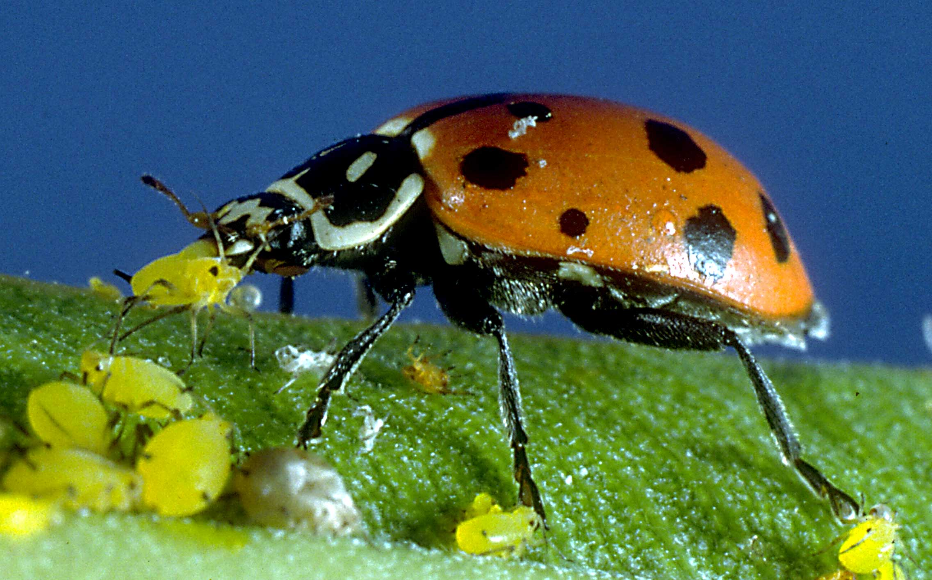
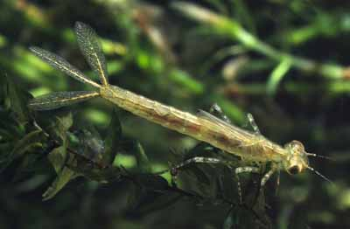
Responses to prey density
Wasteful killing
Incomplete consumption
Eat only the most valuable parts
Switching
Hunting what is common

Slide 21
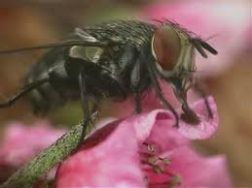
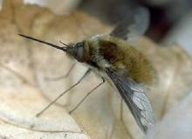
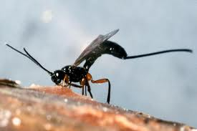
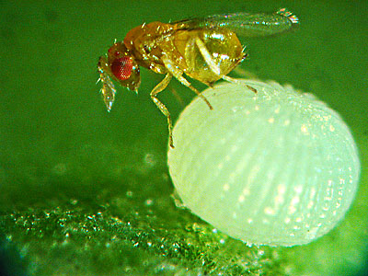
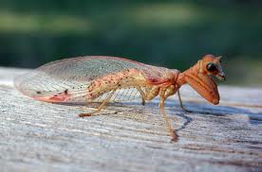
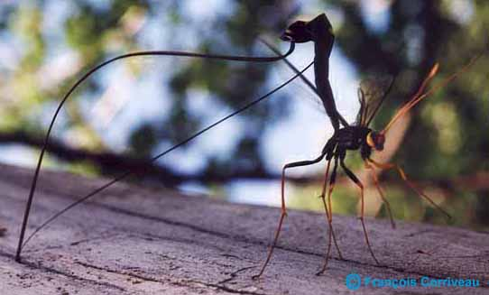
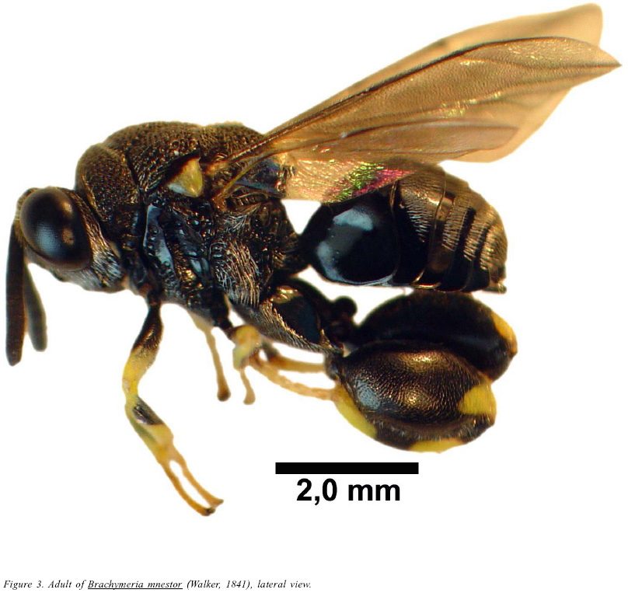
Parasitoids
Hymenoptera (many families)
Diptera (Tachinidae, Bombyliidae, others)
Coleoptera (a few Carabidae; Meloidae)
Neuroptera (Mantispidae)
Strepsiptera ??

Slide 22
Diversity of entomophagous parasitoids
One major component of insect diversity
10% of all insect species are parasitoids
Estimates are that 75% of Hymenoptera species are parasitoids
But, they are rather poorly known taxonomically
Estimates are the 16% of Diptera are parasitoids
Characteristically more likely to be monophagous or oligophagous than predators
http://www.entsoc.org/buzz/hornworm-meets-alien

Slide 23
Hunting stage for parasitoids
Adult female (ovipositor for piercing)
All hymenoptera
Some Diptera
1st instar Larva (hypermetamorphosis)
Coleoptera (Triungulin)
Mantispidae (Planidia)
Some Diptera (Planidia)
Victims
Invertebrates, mainly arthropods, mainly insects
Eggs, Larvae, Nymphs, Pupae, Adults
External or internal; solitary or gregarious

Slide 24
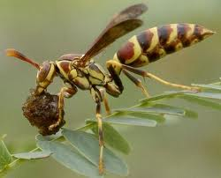
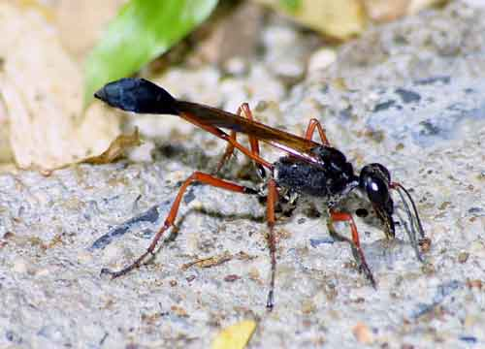
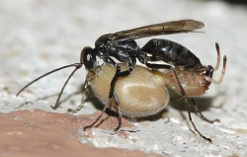
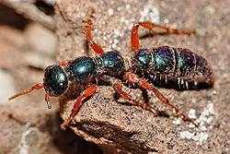
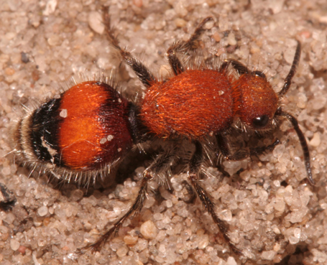
Continuum among predators vs. parasitoids
Hymenoptera
Hunting Wasps (Vespidae, others)
Females capture caterpillars, sting and paralyze them, and cut them to pieces to bring to nest to feed brood
Solitary wasps (Sphecidae)
Sting prey, bring them back whole to then nest, and feed to brood
Spider wasps (Pompilidae)
Female stings a spider, paralyzing it, takes it to the nest where she lays a single egg on it. One offspring/spider
Velvet ants, Tiphiids (Mutilidae, Tiphiidae)
Female stings beetle larva, leaves it in place and lays one egg on it.

Slide 25
Parasitoid life cycle / style
Polyembryony: Multiple embryos cloned from a single egg
Multiparasitism: Host parasitized by multiple species of parasitoid
Interspecific competition, murder, etc.
Superparasitism: Host parasitized by more larvae of one species than it can support
Intraspecific competition, murder etc.
Hyperparasitism: Parasitoids that attack parasitoid larvae and pupae, usually by ovipositing in the host
Intermediate hosts: Parasitoid requires one host to be eaten by another

Slide 26
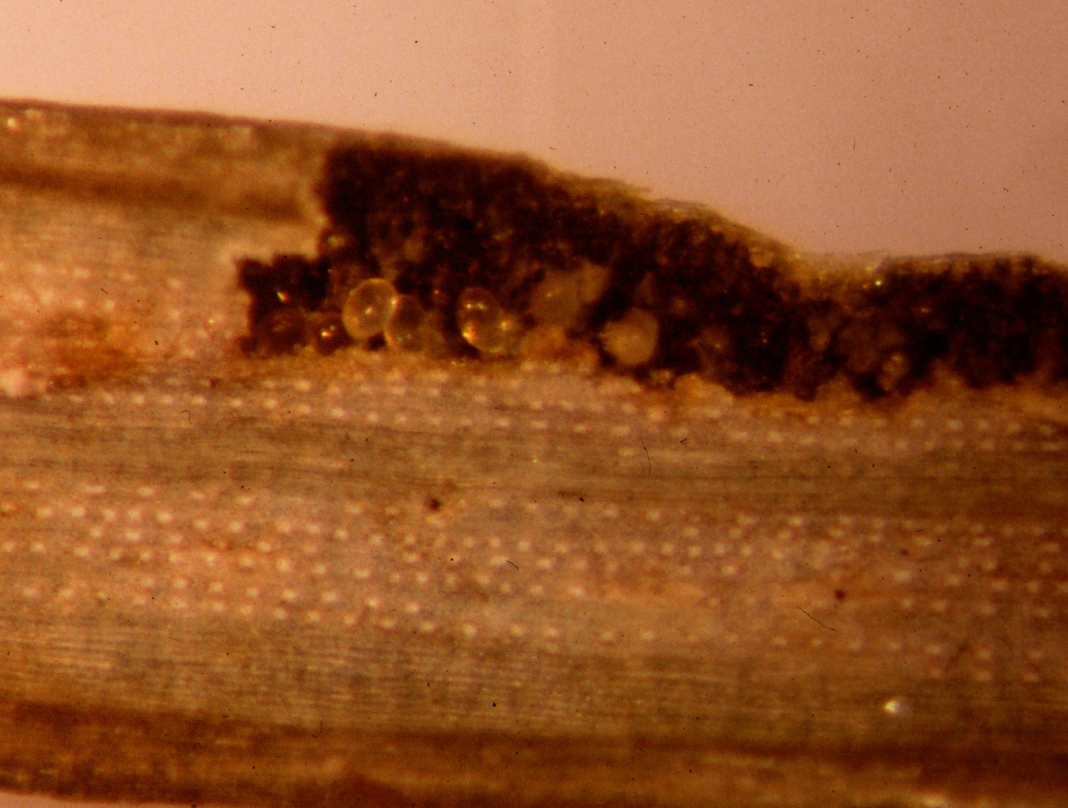
Trigonalidae
Parasitoids of vespid larvae
Hyperparasitoids of parasitoids in caterpillars
Female lays 1000s of tiny hard shelled eggs on leaves
Eggs eaten by caterpillars
Hyperparasitoids
Hatching larva finds parsitoid larva (Ichneumonidae, Tachinidae, others) inside caterpillar
Waits for 1º parasitoid to consume caterpillar and pupate, then consumes parasitoid pupa
Parasitoids of vespids
Caterpillar caught by vespid, brought to nest to feed larvae
Trigonalid larva hatches, eats vespid larva

Slide 28
http://www.carabidae.ru/foto/thumbnails.php?album=83

Slide 29
Host manipulation by parasitoids
Ectoparasitoids
Feed quickly, externally to the host
Pupae, killed or paralyzed hosts
Endoparasitoids
Feed from inside host eggs, larvae, pupae, adults
Host may continue to feed, and may increase feeding
Respond to or manipulate host endocrine system
Idiobionts: consume immobile or dead host quickly
Koinobiont: enters early stage, allows host to develop, consumes later stage

Slide 30
Host defenses
Encapsulation: Surrounding parasitoid larvae with hemocytes
Melanization: deposition of dark pigment melanin in the capsule
Parasitoid evasion of host immune defenses
Stage of attack: eggs don’t melanize; no immune response
External feeding
Avoid hemolymph; occupy specific tissue until consumption begins
Chemical mimicry; prevents recognition of non-self
Destroy or suppress (viruses, box 13.1) host immune system

Slide 31
Host discrimination
Parasitoid Hymenoptera act like they are smart
Select hosts for parasitism based on species, size, location
Preference changes depending on availability
Foraging theory: ignore poor quality hosts when high quality hosts are abundant
Leave host patches (plant) when rate of host finding falls
Choose numbers of eggs to lay on host based on size or quality
More eggs in larger hosts

Slide 32
Host discrimination (continued)
Detect chemically and avoid previously parasitized hosts
Marking pheromones
Choose offspring sex and sex ratio based on host size and quality
Smaller males in lower quality/size hosts
May vary sex ratio in response to local mate competition
Learn to associate novel chemical cues with hosts (and other stimuli)

Slide 33
Parasitoids
Very sensitive to chemical cues to hosts
Capable of learning to associate hosts with novel cues
Application – sniffer wasps
Microplitis croceipes [Braconidae]
http://www.sciencedaily.com/videos/2006/0702-wasps_mans_new_best_friend.htm

