Slide 2
DNA Sequencing
Sanger’s dideoxy-sequencing method
Dideoxyribonucleoside triphosphate (ddNTP) lacks a 3′-oh group, which terminates DNA synthesis.

Slide 3
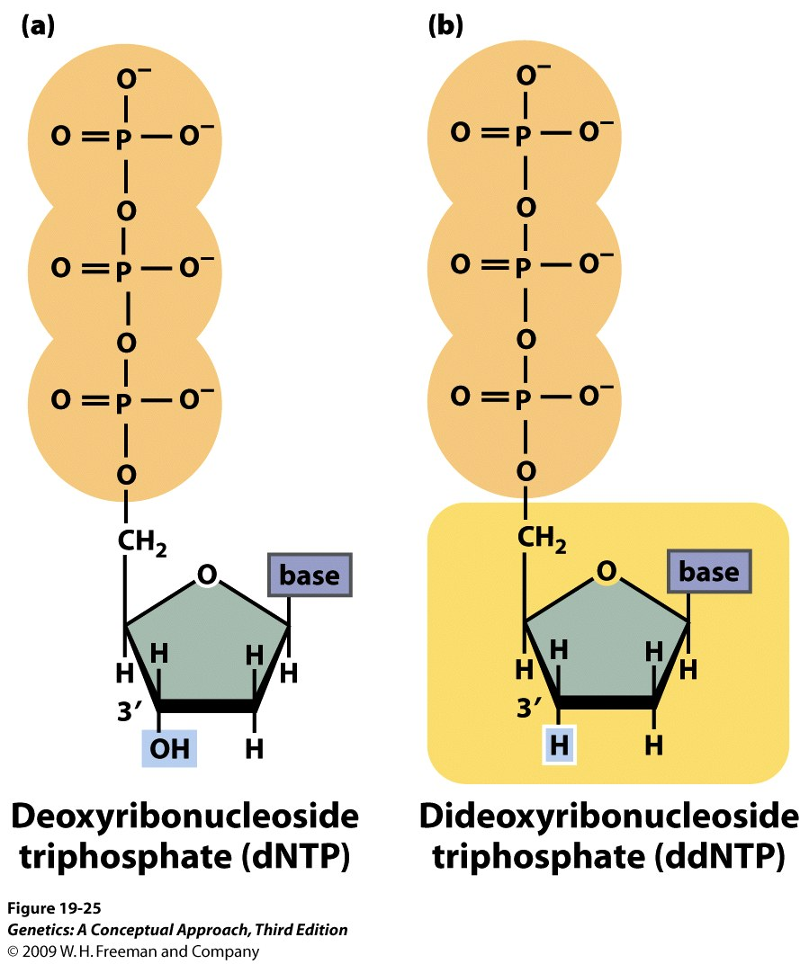

Slide 4
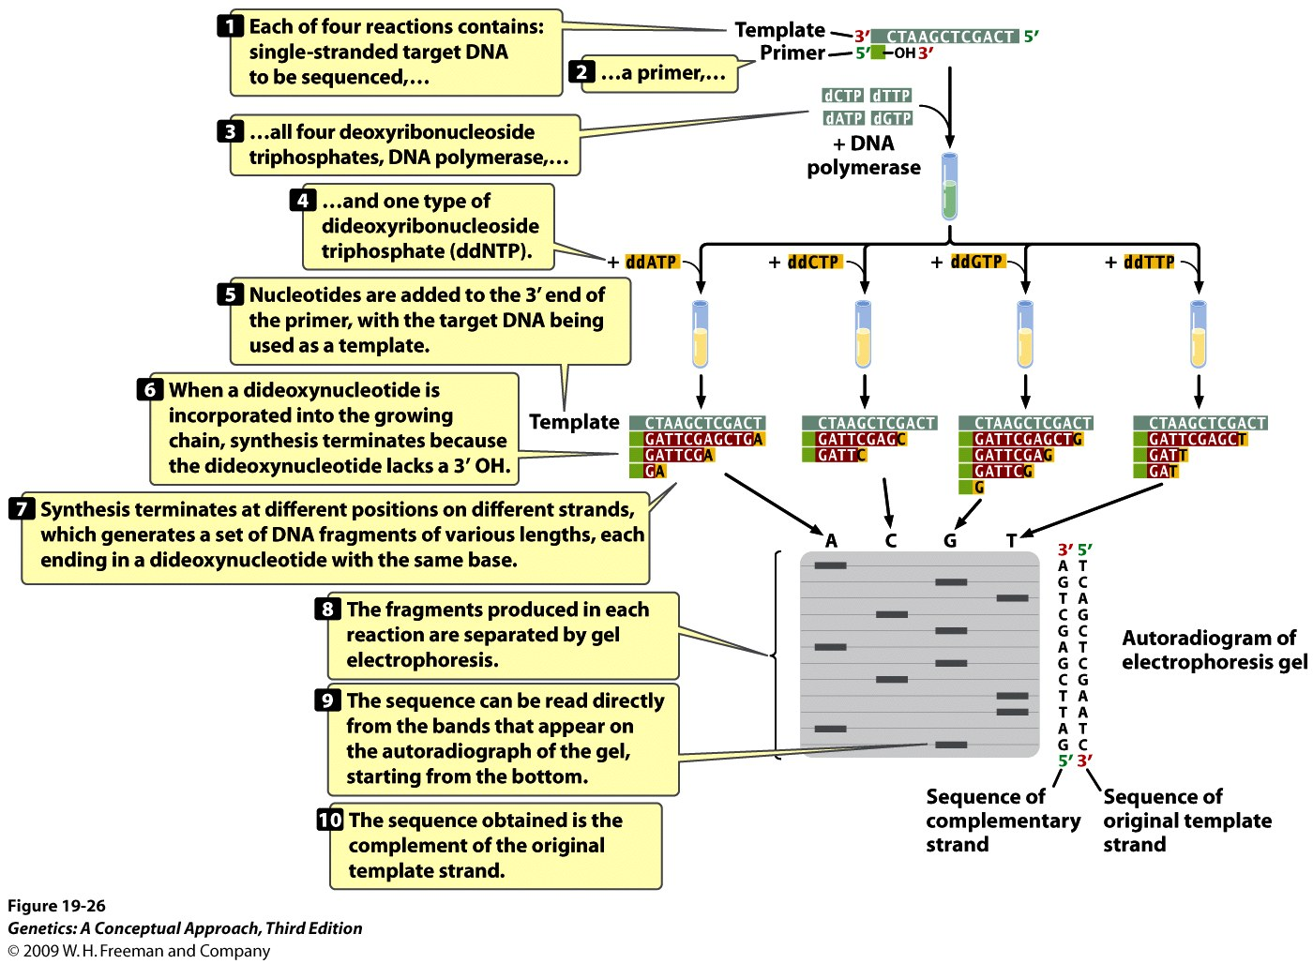
Notes:
19.26 The dideoxy method of DNA sequencing is based on the termination of DNA synthesis.

Slide 5
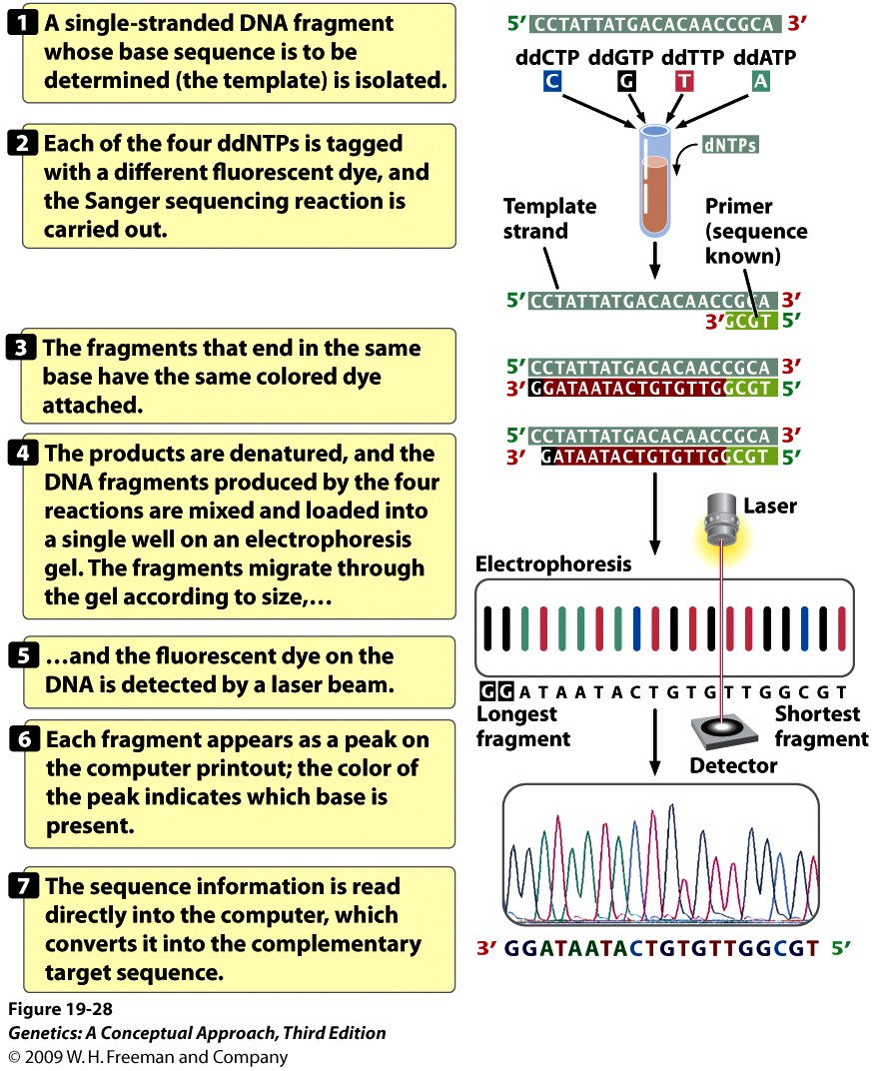

Slide 6
